Slide 1
KIN 284
Physical Growth
and Motor Development
VI. Early Movement Behaviour:
Reflexes and Stereotypies

Slide 2
The following powerpoint slides are designed for educational purposes only and are intended solely to be used for knowledge acquisition and examination preparation by students currently registered in KIN 284.
This content is not to be photocopied, distributed, and/or used in any manner other than for its intended use.
*All copyrighted material (e.g., pictures, slides, graphs) has been removed from these lecture slides for posting in accordance with UBC copyright guidelines.
Copyright © Bredin, 2014

Slide 3
Overview of Lecture Topic
VI. Early Movement: Reflexive Behaviour and Stereotypies
Concept 6.1:
The Reflexive Phase of Motor Development
Concept 6.2:
What are Infantile Reflexes?
Concept 6.3:
What are Primitive Reflexes?
Concept 6.4:
What are Postural Reflexes?

Slide 4
Overview of Lecture Topic
VI. Early Movement: Reflexive Behaviour and Stereotypies
Concept 6.5:
What are Locomotor Reflexes?
Concept 6.6:
Spontaneous Movements (Rhythmical Stereotypies) and their Importance
Concept 6.7:
What about Exercising Reflexes?

Slide 5
Lecture Objectives
VI. Early Movement Behaviour: Reflexes and Stereotypies
Upon completion of this topic you should be able to:
  Define what an infant reflex is.
  Explain the difference between primitive, postural, and locomotor infant reflexes.
  Discuss how each of the following reflexes are stimulated, the infant’s response to the stimulation, and where applicable, the importance of the reflex: Rooting Reflex, Sucking Reflex, Withdrawal Reflex, Palmar and Plantar Grasp Reflexes, Babinski Reflex, Babkin Reflex (Palmar-mandibular Reflex), Moro Reflex, Asymmetric Tonic Neck Reflex, Symmetric Tonic Neck Reflex, Labyrinthine Righting Reflex, Pull-Up Reflex, Parachute (Propping) Reflex, Crawling Reflex, Primary Stepping Reflex (vs. Placing Reflex), and Swimming Reflex.

Slide 6
Lecture Objectives
VI. Early Movement Behaviour: Reflexives and Stereotypies
Upon completion of this topic you should be able to:
  Explain what false crawling is.
  Explain the significance of the appearance, disappearance, persistence, or re-emergence of reflexes as it relates to the motor system. You should be able to use a variety of examples to illustrate your explanation.
  Define and discuss the difference between spontaneous movements and reflexive behaviour in infancy.
  Discuss the importance and implications of examining infant reflexes and spontaneous movements.
  Identify and discuss common infant stereotypies.

Slide 7
Lecture Objectives
VI. Early Movement Behaviour: Reflexives and Stereotypies
Upon completion of this topic you should be able to:
  Explain the Apgar scoring system and why it is still used today.
  Explain the term, ‘Frontal Release Sign’.
  Explain the difference between the structural, functional, and applied views of reflexive theory
  Discuss the research findings that investigate the effect of exercising the walking reflex.
  Explain Esther Thelan’s work on the stepping reflex and whether or not the stepping reflex disappears. This includes discussing what individual constraints must be taken into consideration and how these constraints influence the stepping reflex.

Slide 8
Concept 6.1
The Reflexive Phase of Motor Development

Slide 9
A Developmental Continuum
SPECIALIZED
MOVEMENT PHASE
FUNDAMENTAL
MOVEMENT PHASE
RUDIMENTARY
MOVEMENT PHASE
REFLEXIVE MOVEMENT PHASE
Topic 6

Slide 10
Reflexive Movement Phase
Reflexes are the first forms of human movement.
e.g., Definition: Involuntary, sub-cortically controlled movements that are a relatively stereotypical response to a specific sensory stimulus
Grounded in the idea that they are maturationally determined.
REFLEXIVE MOVEMENT PHASE

Slide 11
Reflexive Movement Phase
Reflexes are the first forms of human movement.
Maturation:
refers to qualitative changes that enables one to progress towards higher levels of functioning and a mature biological state.
A genetically determined fixed order of progression.
REFLEXIVE MOVEMENT PHASE

Slide 12
Concept 6.2:
What are infantile reflexes?

Slide 13
Reflexes: Involuntary movement reactions elicited by such forms of sensory stimuli as sound, light, touch, or body position.
Origins: Prenatal period
  Reflexes:
    can be elicited in the fetus as early as the 2nd or 3rd mo;
    most are present by birth;
    form the basis for all phases of motor development

Slide 14
Continuous progress of neuromuscular functional maturation
  initial movement responses:
    controlled subcortically by the spinal cord
  as CNS matures:
    response is under the command of the brain stem and midbrain.
  as cerebral cortex matures:
    become inhibited (suppressed, integrated)
    voluntary movement takes over

Slide 15
From Textbook: Table 8.1

Slide 16
Infantile Reflexes
  ~ 27 major infant reflexes
  most suppressed by 6 mo
    e.g.’s, of persisting reflexes:
      coughing
      blinking
      sneezing
    Some reflexes can re-emerge due to neurological trauma or insult
    Practitioner emphasis: abnormal reflexes, assessment of, and intervention

Slide 17
Apgar Scoring
Function
  0 = impaired; 1 = reduced; 2 = normal
Example, a neonate displays at 1-min:
  Skin colour: body blue
  Pulse: 100 bts/min
  Muscle Tone: Limbs partly flexed, poor tone
  Respiration: Slow
  Grimace: None
What is the neonate’s Apgar score?

Slide 18
Apgar Scoring
Function
  0 = impaired; 1 = reduced; 2 = normal
Example, a neonate displays at 1-min:
  Skin colour: body pink, limbs blue
  Pulse: more than 100 beats/min
  Muscle Tone: active movement
  Respiration: strong cry
  Grimace: Facial grimace, body movement
What is the neonate’s Apgar score?

Slide 19
Apgar Score: Utility is immediately following birth
Limited long-term predictability
75% of children scoring low develop normally
From Textbook: Table 12.2

Slide 20
Concept 6.3:
What are Primitive Reflexes?

Slide 21
Primitive Reflexes
Many initial reflexes are essential to sustain life processes; most already functional in utero
  Examples:
    Nourishment (found in all mammalian animals)
      Search/Rooting Reflex
      Sucking Reflex
    Avoidance
      Withdrawal Reflex
  Called primitive b/c:
    mediated by lower brain
    centre (e.g., spinal cord)

Slide 22
Rooting
(Search Reflex)
Stimulated by: touching the area around the baby’s mouth or cheek
Response: head turns towards the side touched, mouth opens and tongue extends
Function: facilitates the search of a nipple

Slide 23
Babkin Reflex
(Palmar-Mandibular Reflex)
Stimulated by: simultaneous pressure to both palms
Response: (one of or all of) opening of mouth, closing of eyes, flexion of neck, and tilt of head forward

Slide 24
Sucking Reflex
Step 1:
  Stimulated by: the nipple touching the back of the palate
  Response: jaw movements needed to express milk
Step 2
  Sucking triggered by: touching lips above or below

Slide 25
Withdrawal Reflex
Stimulated by:
gently scratching the sole of the infant’s foot with a sharp object
Result: produces a simultaneous flexion of the hip, knee, and foot.
Often followed by a similar response by the non-stimulated leg.
Function: avoidance of injury.
In cases of a breech birth, this reflex may be weak or even absent.

Slide 26
Palmar Grasp Reflex
One of the first reflexes to emerge.
Begins prenatally, normally endures first four months.
Stimulated by: tactile stimulation to the palm of the hand.
Response: four fingers flex and close (thumb does not respond).
Negative palmar grasp (one that fails to appear) may be indicative of neurological abnormality (e.g., spasticity).
Watch for asymmetry in the reflex and persistence after 1 yr.

Slide 27
Proposed Function:
Preparation for voluntary grasping

Slide 28
Evolutionary Purpose?

Slide 29
Palmar Grasp Reflex:
Is Retention Problematic?

Slide 30
Palmar/Planter Grasp Reflex
Plantar Grasp Reflex: application of pressure (or stroking) the ball of the foot
Must be suppressed before a child can stand erect, stand alone, or walk.
e.g., parents will have difficulty putting on shoes if a child still exhibits the reflex.

Slide 31
Asymmetric Tonic Neck Reflex
aka: ‘bow and arrow’ or ‘fencer’s position’
Stimulated by: the head being turned to one side or the other
Response: the limbs on the face side extend while the limbs on the other side flex.
Supine or prone.
Begins prenatally, elicited up to four months. Watch for persistence after 6 mo. Proposed Function: assists in birthing process, facilitates body awareness, development of eye-hand coordination (object/distance perception)

Slide 32
Asymmetric Tonic Neck Reflex
Supine Position
Full Reflex
Partial Reflex

Slide 33
Emergence as an adult?

Slide 34
Asymmetric Tonic Neck Reflex
Is Excessive Retention Problematic?
Interferes with:
If retained:
*There are children who retain traces of flexion on skull side and extension on the face side until 8 yrs.

Slide 35
Symmetric Tonic Neck Reflex
Transitional Reflex (initiated 6-7 mo, integrated 12-13 mo)
Tipping Back
Symmetric Response
Arms Extend
Legs Flex
Tipping Forward
Symmetric Response
Arms Flex
Legs Extend

Slide 36
Symmetric Tonic Neck Reflex
Reflex serves four-legged animals functionally; therefore, there is a reason for the reflex to remain permanently.

Slide 37
Symmetric Tonic Neck Reflex
Stimulated by: placing the baby in a supported sitting position.
Response: if the infant is tipped forward, the neck is flexed, which triggers the arms to flex and the legs to extend.
Response: if the infant is tipped far enough backwards, the neck extends, which triggers the arms to extend and the legs to flex.
Limbs move symmetrically.
Commonly found in young-for-date infants.
Very pronounced presence of reflex has been linked to motor impairments in children.
Forward tilt

Slide 38
Emergence as an adult?

Slide 39
Symmetric Tonic Neck Reflex: Excessive Retention
Excessive retention:
E.g., if a child is thrown a ball to one side, he will not be able to catch it unless he moves over and uses both hands.
E.g., severely affects writing ability.
E.g., severely affects oppositional movements such as twisting a lid off, cutting with a knife or fork.

Slide 40
Symmetric Tonic Neck Reflex
Reflex interfering with forward roll.

Slide 41
Babinski Reflex
Stimulated by: stroking the bottom or lateral portion of the foot.
Response: big toe extends upwards, toes splay outwards
Presence after 2 yrs: sign of damage to the nerve paths connecting the spinal cord and the brain (the corticospinal tract). This tract runs down both sides of the spinal cord, therefore a Babinski's reflex can occur on one side or on both sides.

Slide 42
Re-appearance in Adulthood?

Slide 43
Concept 6.4:
What are Postural Reflexes?

Slide 44
Postural Reflexes
(may also be known as) Gravity reflexes:
  facilitate the maintenance of posture in a dynamic environment
  Ability to react to gravitational forces and changes in equilibrium
  Some Examples include:
    Labyrinthine Righting Reflex
    Pull-Up Reflex
    Parachute (Propping) Reflexes

Slide 45
Labyrinthine Reflex
Stimulated by: tilting the body
Response: head tilts in the opposite direction.
Occurs when: tilted forward, backward, and to the side.
Critical for: attainment of upright posture. Involves both righting and gravity reactions.
Generally appears at 2 to 3 months and lasts throughout the first year of life.
Function: contributes to the ability to move in a forward direction.
Detects functioning of the otolith organs housed in the labyrinth of the inner ear.

Slide 46
Pull-Up Reflex
Stimulated by: tilting the infant while in a supported standing position in any one direction
Response: the supporting arm(s) flex or extend in an effort to maintain an upright position.
Normally evident from 3 to 12 mo.
Function: related to the attainment of voluntary upright posture.

Slide 47
Parachute (Propping) Reflex
Stimulated by: tipping infant off balance in any direction (lowered, tilted sideways, forwards or backwards).
Response: if tilted forward, the arms make a propping movement, extending toward the front as the fingers extend and separate.
Critical for: attainment of upright posture (it is an attempt to break a fall).
When:
-lowered rapidly, legs extend (from 4 mo)
-tilted forward, arms extend (from 7 mo)
-tilted sideways, arms extend (from 6 mo)
-tilted backwards, arms extend, may also elicit the body to rotate to avoid falling backward (from 9 mo)

Slide 48
Parachute (Propping) Reflex

Slide 49
Concept 6.5:
What are
Locomotor Reflexes?

Slide 50
Locomotor Reflexes
Reflexes that appear similar to and are related to particular voluntary movement behaviours
  Three locomotor reflexes have been identified:
    Swimming Reflex
    Crawling Reflex
    Stepping Reflex

Slide 51
Swimming Reflex
When held horizontally over a solid surface (e.g., floor, water), or in the water in a prone position, the arms and legs move in a well coordinated swimming like action.
Typically occurs from 11 days to 5 mo. Does not mean an infant can swim….

Slide 53
Crawling Reflex
Stimulated by: alternatively stroking the soles of the feet when placed in the prone position.
Response: the legs and arms move in a crawling like action.
Typically occurs from birth to 4 mo.
Proposed Function: essential for the development of future voluntary creeping (i.e., related to the development of sufficient muscle tone).

Slide 54
False Crawling Reflex
When placing a newborn on the stomach, (s)he will assume what appears to be a crawling reflex. After approx one week infant will lie flat (i.e., false crawling position disappears).
Why?

Slide 55
Primary Stepping Reflex
Stimulated by: placing infant in an upright position with the soles of the feet touching a supporting surface.
Response: pressure on the bottom of the feet causes the legs to lift and then descend.
Often occurs alternatively resembling a crude form of walking.
Can be elicited from birth to 5 mo.

Slide 56
Primary Stepping Reflex

Slide 57
Summary Ideas
Same stimulus will elicit a specific reflex over and over
Practitioners use the pattern of reflex appearance and disappearance to assess functioning of CNS
  Deviation may indicate a problem
  Neurological dysfunction may be considered if a particular reflex is:
    absent when it should be there
    irregular (too strong or too weak)
    uneven in strength
    prolonged* when it should not be there
  Serves as a basis for intervention
In the case of brain trauma or insult:
  Primitive reflexes are primarily tested to assess functioning of the frontal lobe

Slide 58
Frontal Release Signs
Frontal release signs:
  refers to the “release” of a group of primitive reflexes, which are normally suppressed or inhibited following the early postnatal period (e.g., rooting reflex)
  ‘released’ from inhibition in the event of cerebral (usually frontal damage)
BUT, can be found in the general population
  (e.g., 25% young healthy adults, prevalence increase with age)
Single sign: limited clinical significance
Multiple signs: correlate with brain pathology
  e.g., increased frequency, schizophrenia
  (implicates a cortical origin for the clinical signs and evidence of frontal lobe dysfunction in this disorder).

Slide 59
Concept 6.6:
Spontaneous Movements (Rhythmical Stereotypes) and their Importance

Slide 60
Spontaneous Movements
(or Rhythmical Stereotypies)
Not a reflex!
stereotypic repetitive motions that appear in the absence of any known stimuli;
  nonspecific, generalized
aka: ‘transitional behaviours’
  some level of control over body parts, but voluntary, goal-directed action is not yet possible;
  underlying temporal structure to the movement

Slide 61
Spontaneous Movements
(or Rhythmical Stereotypies)
Increase with frequency between 6 & 10 months of age
47 distinct stereotypic movements
  Most common?

Slide 62
Spontaneous Movements
(or Rhythmical Stereotypies)
Rhythmical Leg Kicking
    Alternative Leg
    Single Leg
    2 Legs Together
  Greatest frequency of movement in the supine vs. prone
    posture, not age, is a determining factor
Notes:
Posture is a rate-limiter
More movements allowed on supine position
Age is not a limiting factor, rhythmical kicking on supine does not necessarily emerge at a certain time period

Slide 63
Random Infant Kicks: Precursor to walking?
Notes:
Why does it emerge?
These are within the system, emerge in a spontaneous matter
Readying system for later voluntary actions
Rhythmical kicking most common in infants -> precursor to walking

Slide 64
Illustration of Common Stereotypies
A, single leg kick
B, Both legs
C, Arm wave
D, Hands and knees rock
E, Sit rock
F, Stand bounce
Notes:
Before child attempts to move, there will be precursor movements A->F
When a child is standing and holding themselves to other things, may bounce up and down to rhythmical stereotypes

Slide 65
Illustration of Common Stereotypies
F, arm banging against surface
G, finger flex
Notes:
Finger flex: wake up of system, only theorized
Trying to trigger and initiate certain movements
Tendency to rock and slow system down in adults under high stress situations -> rhythmical sterotypes, e.g. in exams

Slide 66
Spontaneous Movements
(or Rhythmical Stereotypies)
SUMMARY:
Suggestion: link between stereotypies and later voluntary movements
  appearance is predictable and orderly
    Stereotypic kicking…voluntary control of legs
    Rocking on hands/knees…creeping
  Coordination patterns resemble the patterns seen in later voluntary movement
    e.g., coordination of supine kicking resembles the positioning and timing of the adult walking step; occurs even in young-for-date children

Slide 67
Spontaneous Movements
(or Rhythmical Stereotypies)
Other considerations:
  Increasing number and persistence of rhythmical movements have been found in children with particular disabilities
    e.g., Downs Syndrome, Tourette’s syndrome, blindness, deafness, schizophrenia
    e.g., currently examining children with autism

Slide 68
Concept 6.7:
What about Exercising Reflexes?

Slide 69
Theories of Reflexes
Structural (Neuro-Maturational) Views
Reflexes:
  Reflect human wiring
  Reflect maturation of a system
  Disappear ~3-4 months
  Interfere with voluntary movements
  Must be inhibited by the CNS before voluntary movements can occur; called motor interference (McGraw, 1943)
Notes:
Exercise reflex does not fall under structural (neuro-maturational) views
Structural reflexes must be inhibited to allow voluntary movement to occur

Slide 70
Seven Phases of Erect Locomotion
Newborn Reflex Stepping
Inhibition or Static Phase
Transition
Deliberate Stepping
Independent Stepping
Heel-toe Progression
Integration, Maturation of Erect Locomotion
McGraw (1942/1969)
Notes:
Evidence may suggest the contrary, that these don’t need to be inhibited

Slide 71
Theories of Reflexes
Functional Views
Reflexes:
  Are needed for survival purposes
  E.g.,
    eating
    breathing
    grasping
    birth process
  Not concerned for later purposes
Notes:
Most motor behaviorists do not follow this view, they think those reflexes are needed for a good reason
- Not just for basic survival needs

Slide 72
Theories of Reflexes
Applied (Dynamical/Environmental) Views
Reflexes:
  play a role in future volitional movements – ‘building blocks’.
  stimulate development
  do not need to disappear
  other systems are highly influential for their presence/absence or strength (e.g., muscular)
  IS THERE EMPIRICAL SUPPORT?
Notes:
- these reflexes are allowing for the emergence for behavior later on
Building blocks for future volitional movements because the system isn’t ready yet
Depends on the slowest maturing system, takes a long time
Therefore cannot walk when being neonates -> reflexes serve as building blocks
Some think these locomotor reflexes do not need to disappear (not the reflexes learned previously)

Slide 73

Exercising the Walking Reflex
(Zelazo et al. 1972)
What happens if you ‘exercise’ the walking reflex?
Groups:
  ACTIVE exercise group:
  (4, 3-min sessions/day from 2nd-8th wk of life, walking reflex is exercised)
  PASSIVE exercise group:
  (legs & arms exercised, with gentle pumping action)
  NO exercise group
  (no exercise)
  NO exercise ‘control’ group:
  (tested only once, prevents contamination of weekly testing)
Dependent variable: # of walking responses

Slide 74
baseline
30
Active exercise
15
# of walking responses
Passive exercise
No exercise
Control
0
1
2
3
4
5
6
7
8
WEEKS
Notes:
With exercise of the ‘exercise reflex’, stepping frequency inceases
Exercise strengthens the frequency of active exercise
Passive exercise were slightly influenced
No exercise = no change
Simple stimulation of locomotor reflex enhance the voluntary locomotion actions
Stepping reflex does not have to be inhibited for the behavior to emerge, contrary to some of the earlier ideas

Slide 75
Exercising the ‘Walking Reflex’
Zelazo et al. (1972)
  Daily practice:
    increased stepping reflex
    resulted in earlier onset of voluntary walking
  Systematic stimulation of a locomotor reflex can enhance acquisition of voluntary locomotion
  Disappearance of reflex = one of disuse
  Reflex inhibition before onset of voluntary walking is unnecessary
Notes:
Why does the reflex disappear then?

Slide 76
Theories of reflexes
Thelan
  Noticed Infants have a dramatic increase in leg weight (primarily via leg fat) in first 2 mo
  A corresponding increase in muscle strength does not occur
  Perhaps stepping reflex disappears because infant has insufficient strength to lift heavier legs?
Notes:
Focused on rate limiters to try and explain this
Biggest rate limiter at this point may be gained weight\ increased leg weight
Much heavier than a neonate, maybe reflex disappears due to other changes in the system that’s inhibiting it
Does not have a corresponding increase in strength to increase in mass

Slide 77
The case of the ‘Disappearing Reflex’
Normally developing infants:
# of steps versus body wt
20
5000
4500
Wt (g)
15
Number of steps
4000
10
3500
2wk
4wk
6wk
Thelen et al., 1984
Notes:
Blue line shows number of steps (actual reflex)
Yellow line shows the addition of weight onto the system, as weight is added, there is a decreased number of steps
Inversely related
Earlier decrease in stepping reflex in heavier babies compared to lighter infants
Lighter child may be exercising the ‘exercise reflex’ more than heavier child due to longer remnants of the reflex

Slide 78
Theories of reflexes
Thelan
  added ankle weights equal to the amt of wt gain in 4-6 wk olds who were still reflex kicking
    reflex stepping decreases

Slide 79
Theories of reflexes
Thelan
  placed older infants (no longer reflex stepping) and submerged them into chest deep water
    stepping frequency increases
    Why?
    - water acts a buoy for the legs
    - stimulated an increase in strength
Notes:
Product of rate limiter and actual environment?

Slide 80
Theories of reflexes
Thelan
  held infants who do not reflexively step at 7 mo over a treadmill
    What occurred?
      Infants step when treadmill is moving
Notes:
By exercising reflex = overcoming rate limiter of the system
Use reflex to gain strength, turn into voluntary movement very quickly
As soon as a child can stand independently, placed on a treadmill, can gain enough strength to walk within three weeks period

Slide 81
Theories of reflexes
Thelan
  Taken together: several individual factors play a role in the integration of reflexes and the onset of voluntary movement; it is not simply a matter of genetic maturation of the CNS

Slide 82
Summary Question
What is the Importance of Reflexes for Human Motor Development?
Notes:
Survival purposes
In terms of postural reflex and locomotor reflex, critical for voluntary movement
Interventions that can come about from that

Slide 83
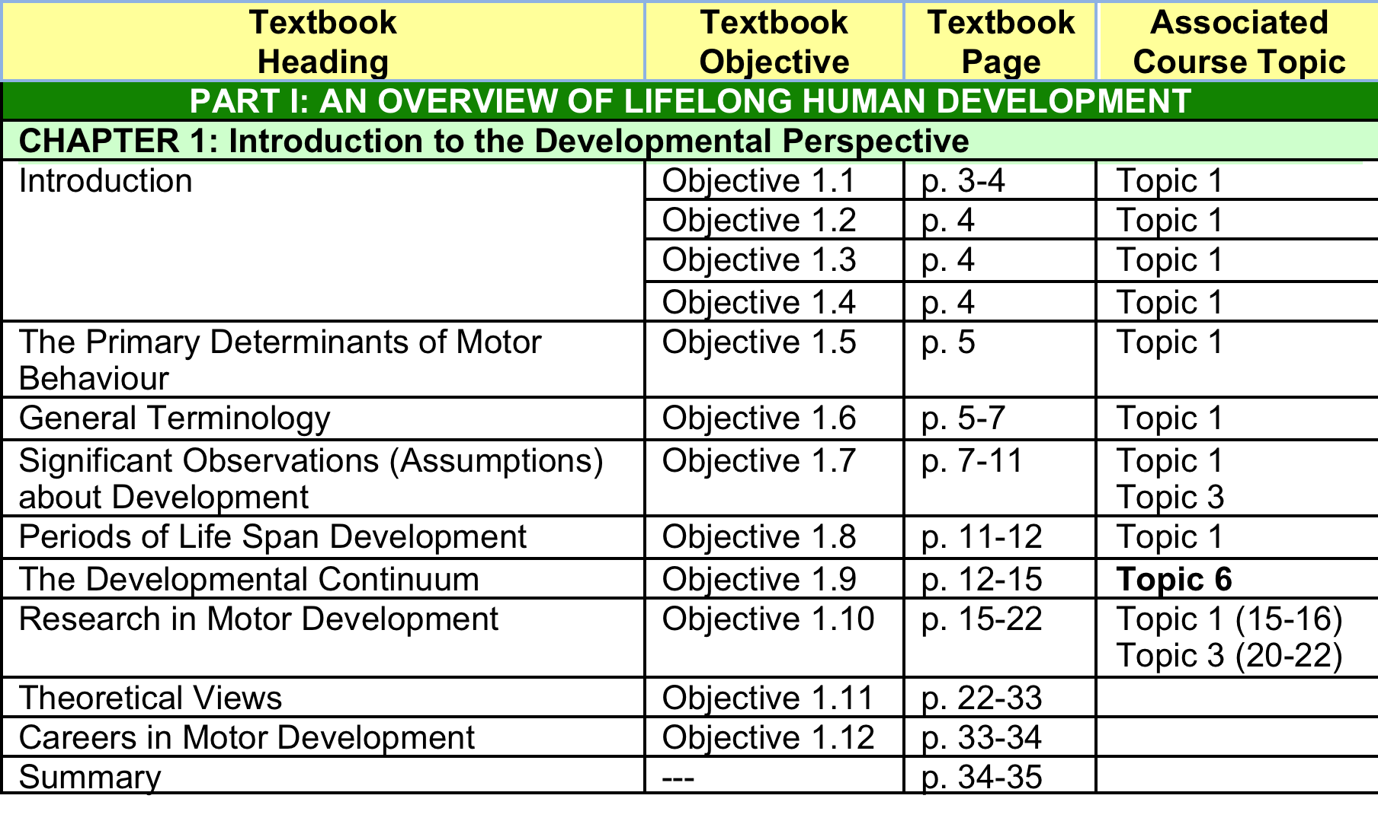
Associated Topic Readings

Slide 84
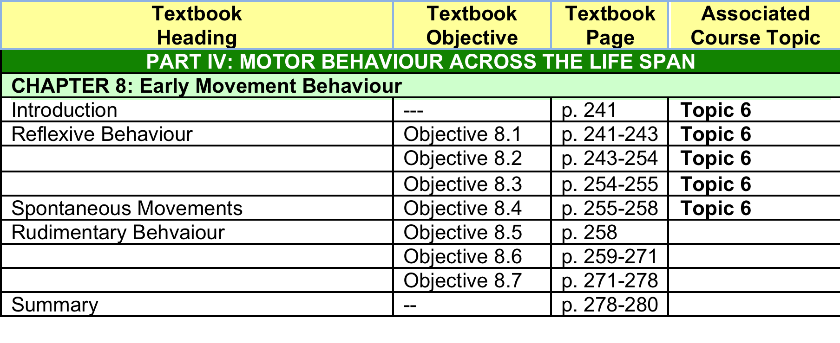
Associated Topic Readings

Slide 85

Associated Topic Readings

