Slide 1
Georg Simmel
Thursday 2nd October

Slide 2
Georg Simmel (1858–1918)
Born in Berlin, he studied history and philosophy at the University of Berlin
The Stranger (1908)
The Metropolis and Mental Life (1903)
The Philosophy of Money (1907)
Sociology (1908)

Slide 3
Metropolis and Mental (or Spiritual or Inner Life) – ‘Geist’
Simmel begins with a problem
“The deepest problems of modern life flow from the attempt of the individual to maintain the independence and individuality of his existence against the sovereign powers of society. Against the weight of historical heritage and the external culture and technique of life”

Slide 4
The resistance of the individual to being leveled, swallowed up in the social-technological mechanism – becoming a cog in the machine – losing their individuality and autonomy
Simmel locates the metropolis as the site where this struggle is most intensely played out

Slide 5
Echoing Durkheim he connects the division of labor and increased dependency on others with the growth of individualism
Simmel is more concerned about the negative effects on individual culture than on society as a whole
“the atrophy (or wasting away) of individual culture through the hypertrophy (or disproportionate growth) of objective culture” (338).

Slide 6
In the metropolis he can investigate “the relationship which such a social structure promotes between the individual aspects of life and those which transcend the existence of single individuals” (325).
Simmel’s essay is an exploration of the relationship of the elements between objective culture and their subjective corollary in the mental life of the metropolitan type.

Slide 7
Simmel makes numerous comparisons with life in the small town, in order to highlight these distinctions
Life in the small town is slow paced, more emotional, more personal
The mental life of the metropolitan type is distinguished by its primarily intellectual and rational character which develops as protection against the intense emotional stimulation of city life
tokyo
The metropolitan type –ideal type

Slide 8
“The reaction of the metropolitan person to those events is moved to a sphere of mental activity which is least sensitive and furthest removed from the depths of the personality.”
Think about driving in a city
Road rage is an example of when these protective barriers fail.
City people are typically considered as cold and distant

Slide 9


Slide 10
The Money Economy
The money economy and the intellectualized existence in the city go hand in hand.
Both display a ‘matter of factness’ (327) in relation to people and things, reducing all that is personal and qualitative to the quantitative
Marx – Capital – commodity exchange and how money acts as a special type of commodity- it expresses all qualitative difference in commodities through quantitive means – price
How much for a human life, sex, friendship,anything – you can buy anything in the city

Slide 11
The money economy also introduces a level of precision and calculability into relations which ensures the successful hourly coordination of multiple agendas by manifold agents.
In the city there is a premium on time
All the clocks in Berlin- think if all the clocks in Ottawa went haywire
So the subjective element is necessarily squeezed out of things as rational co ordination is impossible otherwise- bus drivers not stopping for people

Slide 12
Punctuality, exactness and calculability which are part of the money economy and intellectual life also color and exclude the more instinctive sovereign human traits –love
social relations become clear cut, to the point and highly individualized –
speed dating is a good example of this or professional dating services

Slide 13
Executive Search Dating's Vancouver matchmakers, search all of Greater Vancouver for single professionals who could be potential matches. All of these matches are pre-screened through interviews and reference checks to ensure suitability and security. (predictability) This headhunting and screening process not only helps to ensure positive dating experiences, it also greatly enhances the chances of finding the perfect match(calculability)
All of the scheduling and other date arrangements will be taken care of for you so all you have to do is show up and enjoy yourself (punctuality and exactness)

Slide 14
We know how time-consuming and frustrating traditional dating methods such as the bar scene and online dating can be, and that's why we strive to make the process as stress-free and as successful as we can by handling all of the details on your behalf and by ensuring more suitable matches.
In addition, the time and energy you spend meeting poor matches and people who are not as they represent themselves to be will decrease significantly. The ultimate result will be that you will experience far less frustration and far more positive dating experiences.

Slide 15
Simmel identifies the ‘blasé attitude’ as a uniquely urban phenomenon, ‘caused’ initially by the physiological nature of city life but also by the money economy.
He defines it as “an indifference to the distinction between things” (329)
-the value and meaning between things is perceived as subjectively meaningless.
He sees the blasé attitude as the ‘correct subjective reflection of a complete money economy’ (330) as the money economy too flattens out the meaning of things into the inevitable question of cost, a quantitative rather than a qualitative evaluation “how much?” everything has a price

Slide 16
The quantifying effect of the city causes individuals to want to stand out more – in the city you get the weirdest eccentricities- standing out from the crowd – pets, clothes, anything
Exaggerated/heightened individualism in the city

Slide 17

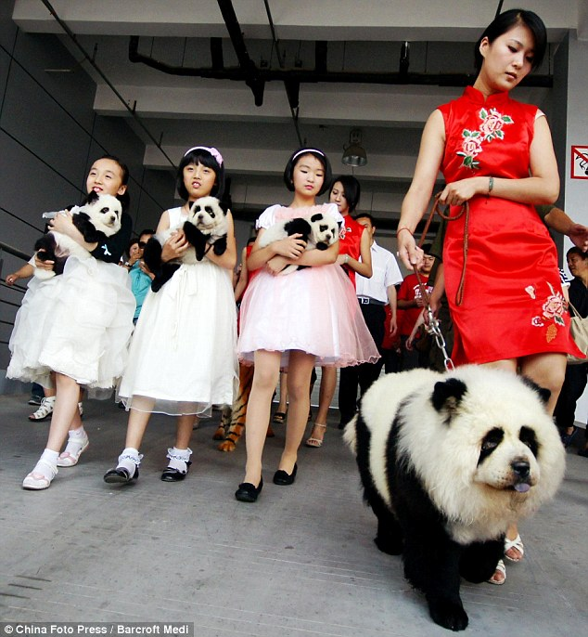


Slide 18
Simmel sees the attitude of reserve as characterizing relations between people in the city. Again there is an element of self preservation involved as well as “a mutual strangeness and revulsion” (331).
Personal space in the city- so there is a room created for individuals
subway
Reservation allows more room for the growth of the individual in the city, a freedom that Simmel (like Durkheim) sees as contemporaneously evolving with the numerical and spatial expansion
as well as the division of labour which all combine to weaken the grip of the small group on the individual.
You can do your own thing in a city and people will not stare at you

Slide 19
So the city offers both individual freedom as well as alienation
“one never feels as lonely and as deserted as in the metropolitan crush of persons”
An inverse relationship between psychic and physical distance
The city is a cite of struggle between individuals as well as merchants
Ads must increasingly catch our attention- how many panhandlers signs “SEX’ now that I have your attention can you spare some change?”

Slide 20
In the city everyone is a stranger – everyday you pass hundreds if not thousands of people none of whom you know.
Overall Simmel doesn’t want to condemn of praise the city but merely to understand it

Slide 21
The Stranger
The Stranger is defined by being both close and far. Physically close but socially distant.
The stranger is a potential wanderer, while his position is fixed within a certain spatial circle
his position within it is fundamentally affected by the fact that he does not belong in it initially and that he brings qualities into it that are not, and cannot be, indigenous to it

Slide 22
The stranger is "an element of the group itself" while not being fully part of it.
He therefore is assigned a role that no other members of the group can play.
Stand up comedians and sociologists sometimes function as strangers – they estrange us from our everyday world and make us look at it from a different perspective
russell peters

Slide 23
Strangers are mobile and connected to multiple social worlds.
Objectivity. Because he is not bound by roots to the particular constituents and partisan disputes of the group, he confronts all of these with a distinctly objective attitude
Confidences & secrets are thus more likely passed to Strangers.
Freedom follows from the position of objectivity ability to see ones position from a birds eye view

Slide 24
Think about the role of psychologists/therapists
Generality. Relations with others are based on more general qualities that people have in common. We relate socially not based on the specific & unique organic elements.
Note he’s making a case here for the value of attributes to building solidarity. For people to look beyond the particular and specific and towards the more universal or general.

Slide 25
Midterm next Thursday
No lecture Monday – exam review instead- it’s up to you to bring any questions you have- I will be there to answer questions/go over/clarify past material covered
Midterm – 5-7 short answer questions on the readings
Sample Question (from another course)
Q: Why is the ‘division of labor’ such an important concept for Durkheim?
Short Answer = no more than 1 page of lined A4 paper

