Slide 1
Welcome to ANP 1105A!
Course Coordinator: John Copeland, PhD
john.copeland@uottawa.ca
Roger Guindon Hall, Rm 3155
Lecturers: John Copeland, Ph.D.
Anthony Krantis, PhD.
Textbook: E.N. Marieb & K. Hoehn: Human Anatomy & Physiology
(9th edition, 2013) Benjamin Cummings.
Mastering A&P Course ID: MAPCOPELAND51850
Lecture times: Monday 14:30-16:00 in MNT 202
Thursday 16:00-17:30 in MNT 202

Slide 2
ANP 1105A Course Structure
Two in class mid-terms – October 6 and November 10, worth 25% each.
Cumulative Final Exam – TBA , worth 40%, 25% of material from midterms
Mastering A & P assignments – Due throughout the semester (10%)
Missed exams -medical excuse requires doctor’s note.
-make-up exams will be on my schedule
-no second chances on make-up exams
-do NOT book Xmas travel before final exam schedule is up
No late assignments will be accepted.
See Syllabus for additional details.

Slide 3
ANP1105A web-site
Syllabus
Detailed learning objectives
Course notes
Link to Mastering A&P
Course notes will generally be posted at least 24 hours before the lecture.
Go to university home page and under quick picks, choose Virtual Campus
At bottom of screen enter your user ID and password – these are the same as are used for InfoWeb
Click “Login” and this will bring you to a list of courses for which you have online access.
Select ANP1105A.

Slide 4
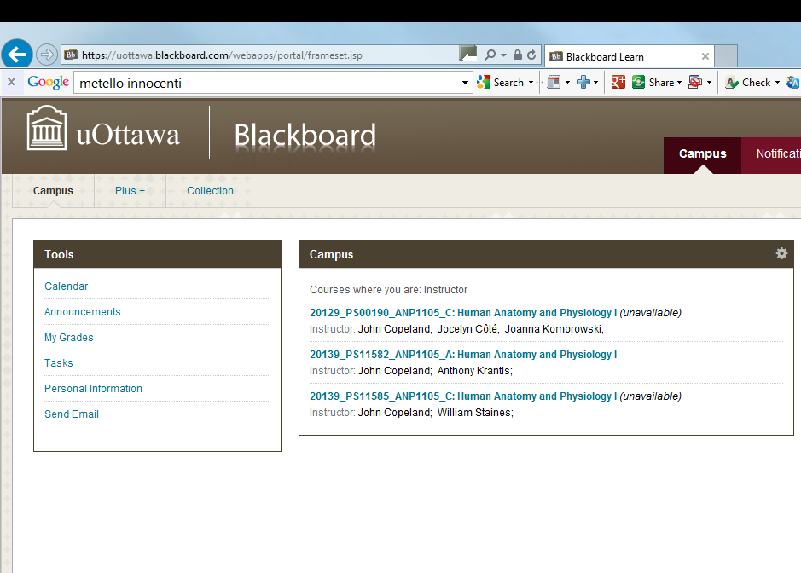

Slide 5


Slide 6

Not all learners are the same
Visual
Aural
Read/write
Kinesthetic
(© 2006, N. Fleming & C. Bonwell)
Multimodal

Slide 7

http://www.vark-learn.com

Slide 8

Get Started
with Pearson MasteringA&P
Notes:
Note to presenter: This entire Getting Started presentation is designed to be delivered in under 15 minutes.
Script:
Thank you for the opportunity to tell you more about the Pearson digital solution that your Educator has selected for this course.

Slide 9
Mastering A & P Assignments
1 practice assignment to introduce you to the system
8 assignments worth 10% of your mark
Assignments become available as we work through the material
See syllabus for due dates
http://www.pearsonmylabandmastering.com/northamerica/masteringaandp/
Mastering Course ID for ANP1105A: MAPCOPELAND51850
You will need the course access code that comes with your textbook.
An access code can also be purchased separately from the bookstore
Once you have the access code you can create an ID and register for the course assignments.

Slide 10
Section 1. Structural Organization of the Human Body
1.1 Levels of Organization (Chapter 1, pages 3-4)
1.2 Cells (Chapter 3, pages 83-96)
1.3 Tissues (Chapter 4, pages 116-136).

Slide 11
Section 1.1 Levels of Structural Organization
Chemical
  Atoms and molecules (chapter 2); and organelles (chapter 3)
Cellular
  Cells (chapter 3)
Tissue
  Groups of similar cells (chapter 4)
Organ
  Contains two or more types of tissues
Organ System
  Organs that work closely together
Organismal
  All organ systems

Slide 12
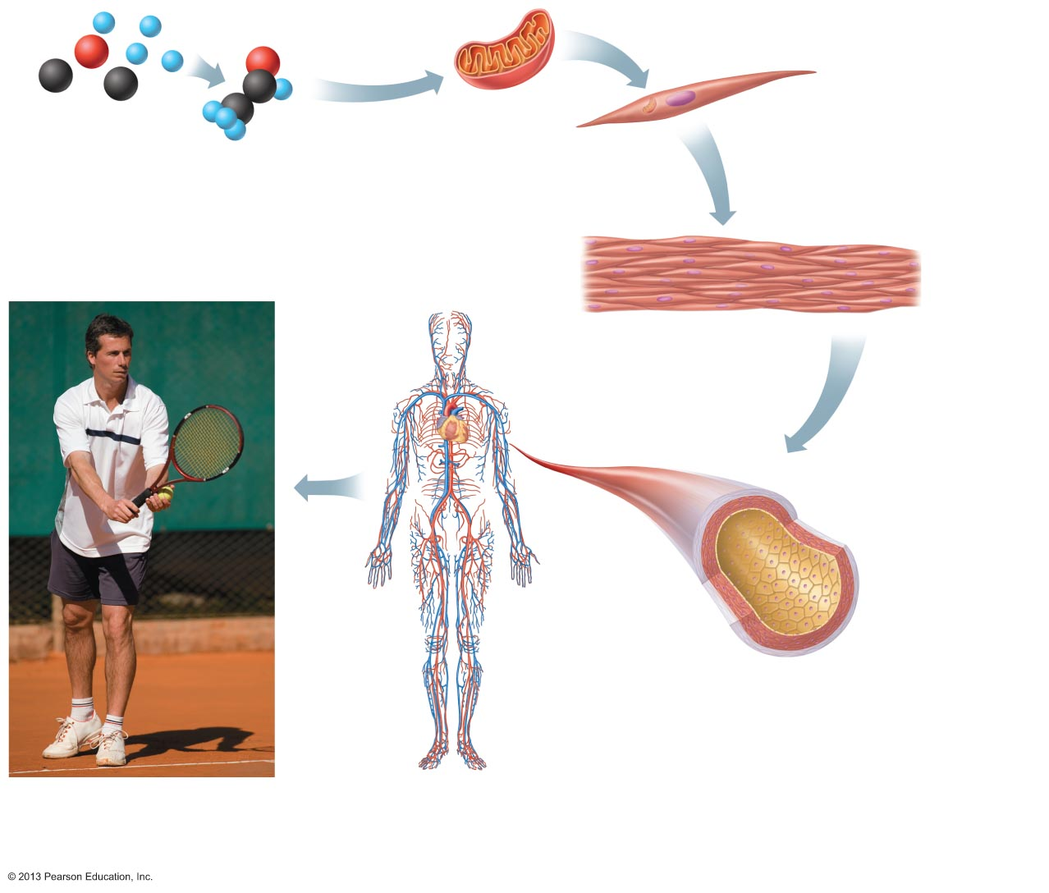
Figure 1.1 Levels of structural organization.
Slide 1
Atoms
Molecule
Organelle
Smooth muscle cell
Chemical level
Atoms combine to
form molecules.
Cellular level
Cells are made up
of molecules.
Smooth muscle tissue
Cardiovascular
system
Heart
Tissue level
Tissues consist of
similar types of cells.
Blood
vessels
Blood vessel (organ)
Smooth muscle tissue
Connective tissue
Epithelial
tissue
Organ level
Organs are made up of different types
of tissues.
Organismal level
The human organism is made
up of many organ systems.
Organ system level
Organ systems consist of different
organs that work together closely.

Slide 13
Section 1.2 Cells/cell theory
Cell - structural and functional unit of life
Organismal functions depend on individual and collective cell functions
Biochemical activities of cells dictated by their shapes or forms, and specific subcellular structures
Continuity of life has cellular basis

Slide 14
Cell Diversity
Over 200 different types of human cells
Types differ in size, shape, subcellular components, and functions

Slide 15
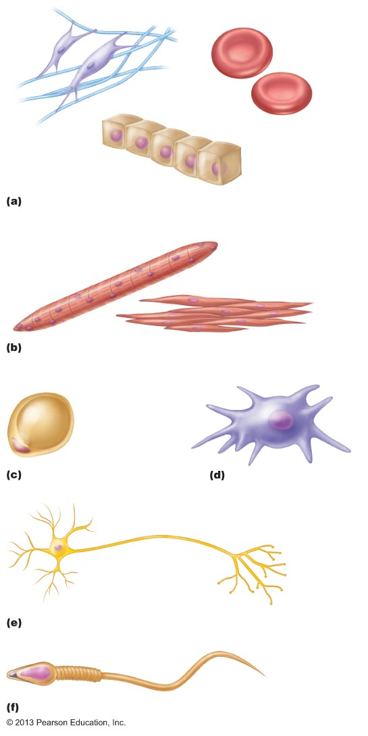
Figure 3.1 Cell diversity.
Erythrocytes
Fibroblasts
Epithelial cells
Cells that connect body parts, form linings, or transport
gases
Skeletal
muscle
cell
Smooth
muscle cells
Cells that move organs and body parts
Macrophage
Fat cell
Cell that stores nutrients
Cell that fights disease
Nerve cell
Cell that gathers information and controls body functions
Sperm
Cell of reproduction

Slide 16
Generalized Cell
All cells have some common structures and functions
Human cells have three basic parts:
  Plasma membrane—flexible outer boundary
  Cytoplasm—intracellular fluid containing organelles
  Nucleus—control center

Slide 17
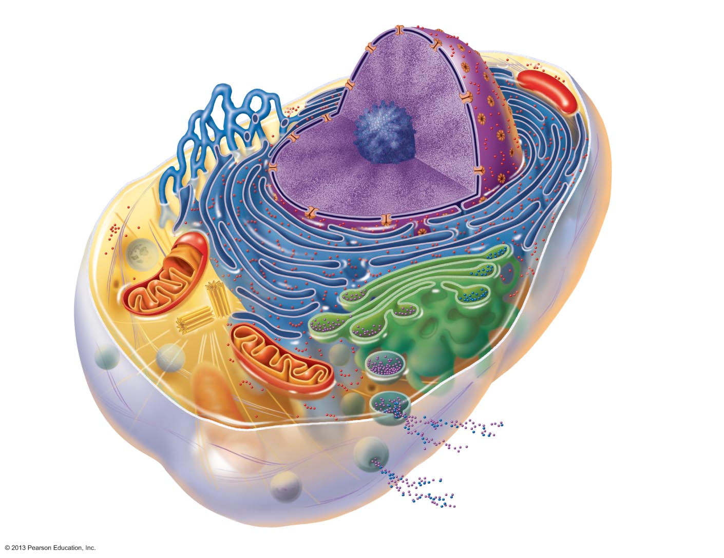
Figure 3.2 Structure of the generalized cell.
Chromatin
Nuclear envelope
Nucleolus
Nucleus
Smooth endoplasmic
reticulum
Plasma
membrane
Cytosol
Mitochon-
drion
Lysosome
Centrioles
Centro-
some
matrix
Rough
endoplasmic
reticulum
Ribosomes
Golgi apparatus
Secretion being released
from cell by exocytosis
Cytoskeletal
elements
• Microtubule
• Intermediate
filaments
Peroxisome

Slide 18
The cell is dynamic
Mitosis
http://www.youtube.com/watch?v=P7m3WfzgZdI
Golgi Transport
http://www.youtube.com/watch?v=souBkm-R5yU
http://www.youtube.com/watch?v=T3xGlmiqIUk
Mitochondrial movement
http://www.youtube.com/watch?v=HpgRGbwu6CM

Slide 19
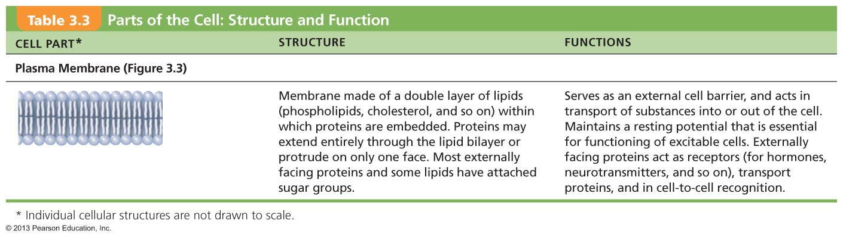
Table 3.3 Parts of the Cell: Structure and Function (1 of 4)

Slide 20
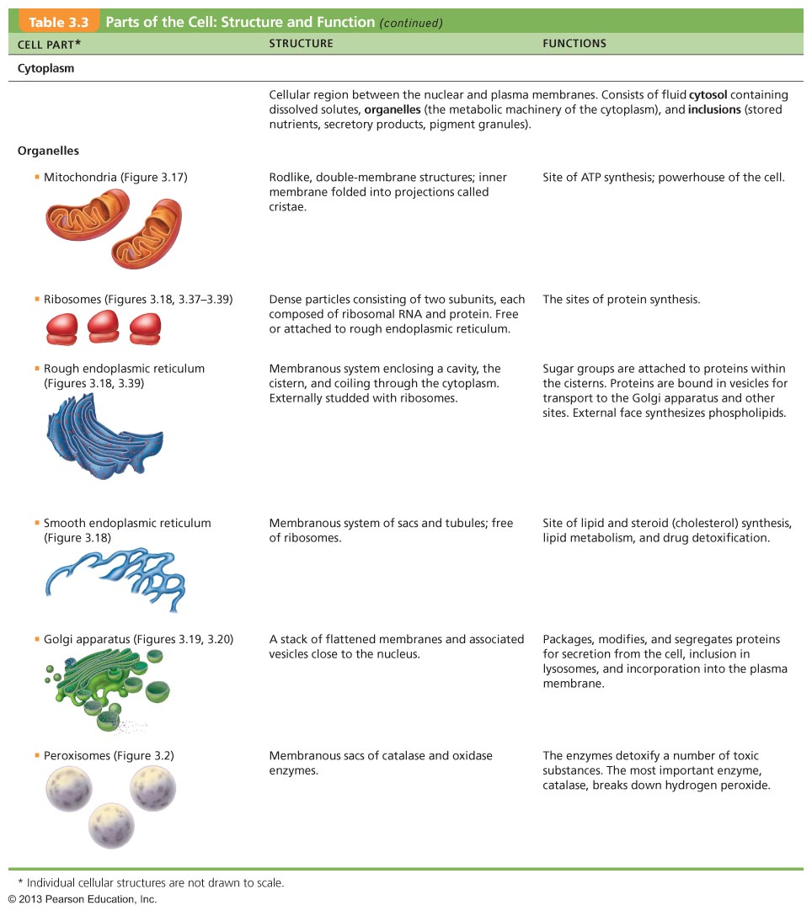
Table 3.3 Parts of the Cell: Structure and Function (2 of 4)

Slide 21
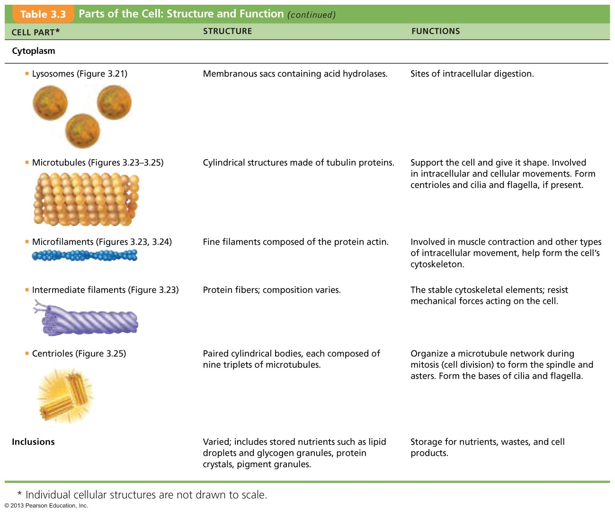
Table 3.3 Parts of the Cell: Structure and Function (3 of 4)

Slide 22
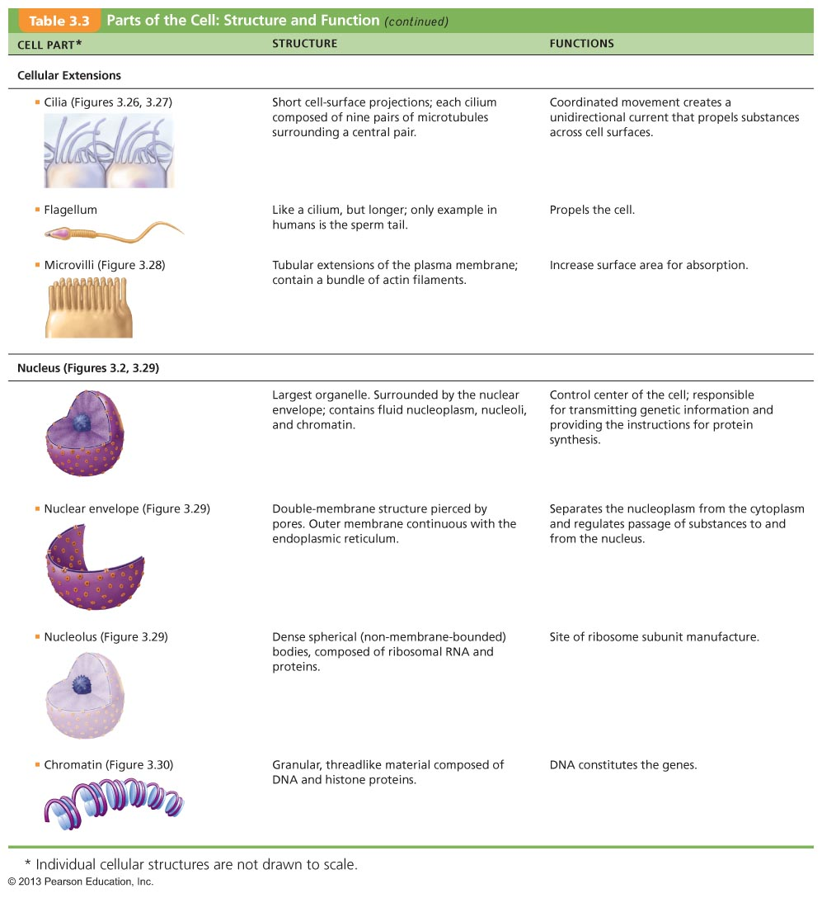
Table 3.3 Parts of the Cell: Structure and Function (4 of 4)

Slide 23
1.3 Describe the different tissues of the human body
Individual body cells are specialized
  Each type performs specific functions that maintain homeostasis (division of labour)
Tissues
  Groups of cells similar in structure that perform common or related function (1.3.1)
Histology
  Study of tissues

Slide 24
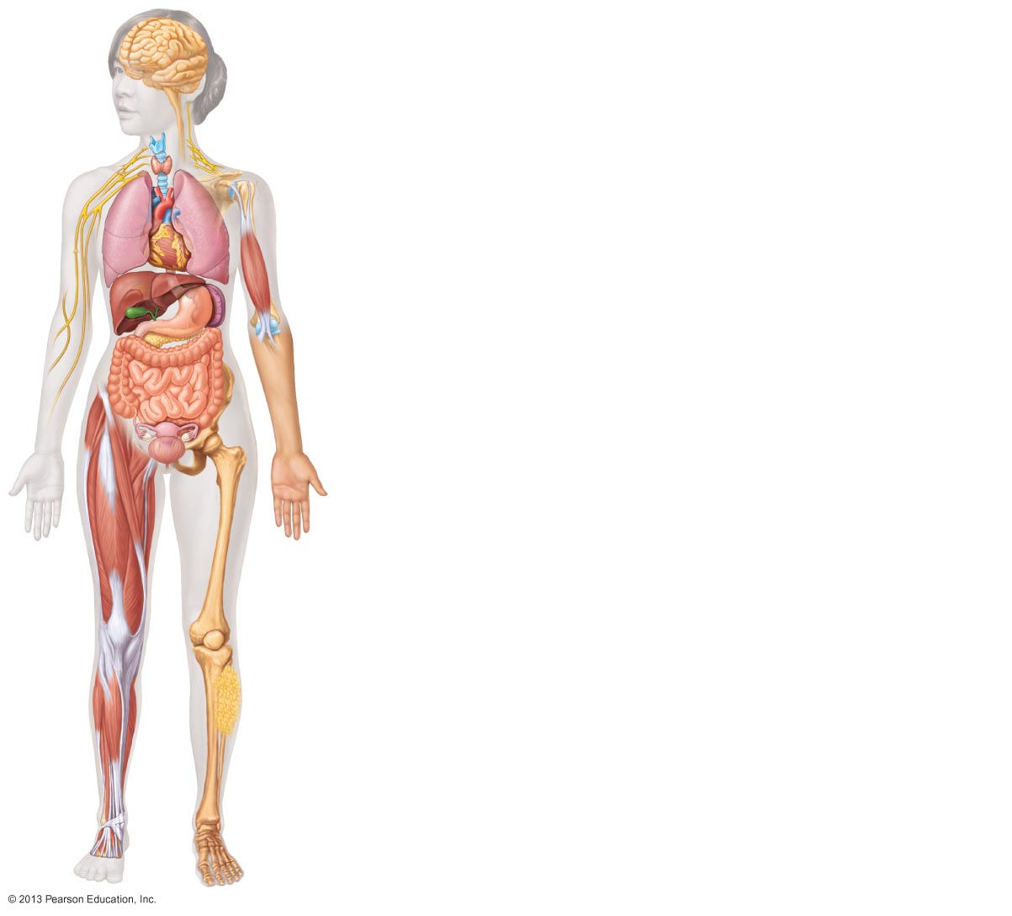
Nervous tissue: control, regulation (Internal communication)
• Brain
• Spinal cord
• Nerves
Muscle tissue: Contracts to cause movement
• Muscles attached to bones (skeletal)
• Muscles of heart (cardiac)
• Muscles of walls of hollow organs (smooth)
Epithelial tissue: Forms boundaries between different environments, protects, secretes, absorbs, filters
• Lining of digestive tract organs and other hollow organs
• Skin surface (epidermis)
Connective tissue: Supports, protects, binds other tissues together
• Bones
• Tendons
• Fat and other soft padding tissue
1.3.2 Four basic tissue types: epithelial, connective, muscle, and nervous tissues.

Slide 25
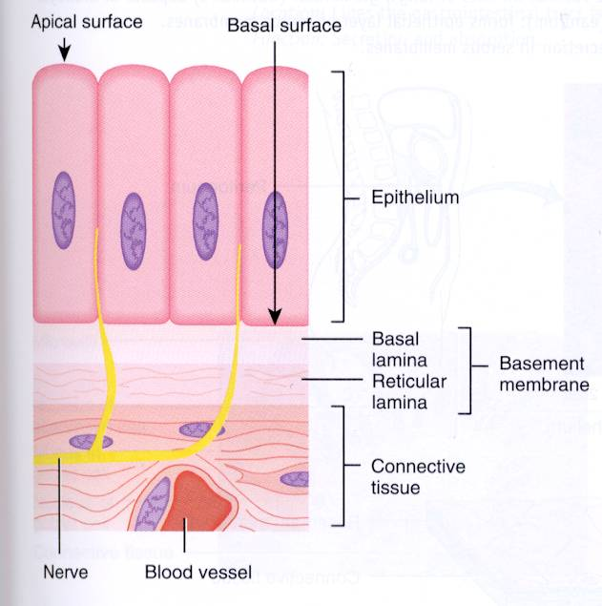
1.3.3 Define Epithelial Tissue and its functions
A sheet of cells that covers a body surface or lines a body cavity
1) covering and lining epithelium
-creates boundaries
2) glandular epithelium
-secretion
Six Epithelial Functions
protection (mechanical, chemical, infection) - e.g. skin,
Absorption - e.g.GI tract,
Filtration - e.g.kidney,
excretion – e.g.kidney,
secretion – e.g. glands,
sensory reception – e.g. taste buds, olfactory membranes . . .
T&G

Slide 26

1.3.4 Seven special structural characteristics of epithelial tissue
Cellularity
Specialized contacts: tight junctions & desmosomes – why? (polarity, barrier)
Polarity: apical and basal surfaces; apical surface often specialized such as having microvilli or cilia
Basal lamina: noncellular, underlying supportive sheet of primarily glycoproteins - What are two functions of a basal lamina?? (filter & scaffold)
Supported by connective tissue: basement membrane = basal lamina + underlying reticular CT (Collagen fibers from connective tissue)
Innervated but avascular: how nourished? (diffusion from CT)
Regeneration: high regenerative capacity - Reflects nature of their job – rubbed off, damaged.
* An important feature of cancerous epithelial cells is failure to respect the boundary imposed by the basement membrane
J. Carnegie, Uof O

Slide 27
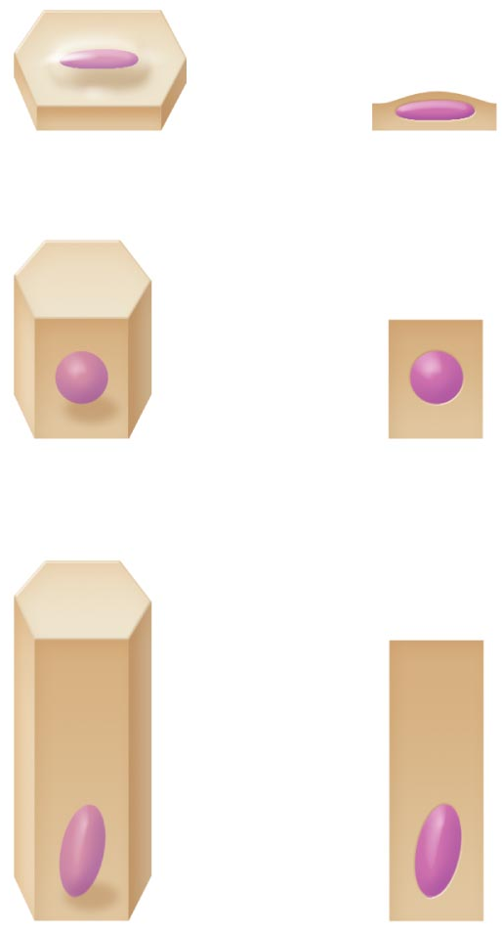
1.3.5 Indicate the 2 criteria used to classify epithelial cells
1. Cell Shape
Squamous cells
  Flattened and scalelike
  Nucleus flattened
Cuboidal cells
  Boxlike
  Nucleus round
Columnar cells
  Tall; column shaped
  Nucleus elongated

Slide 28
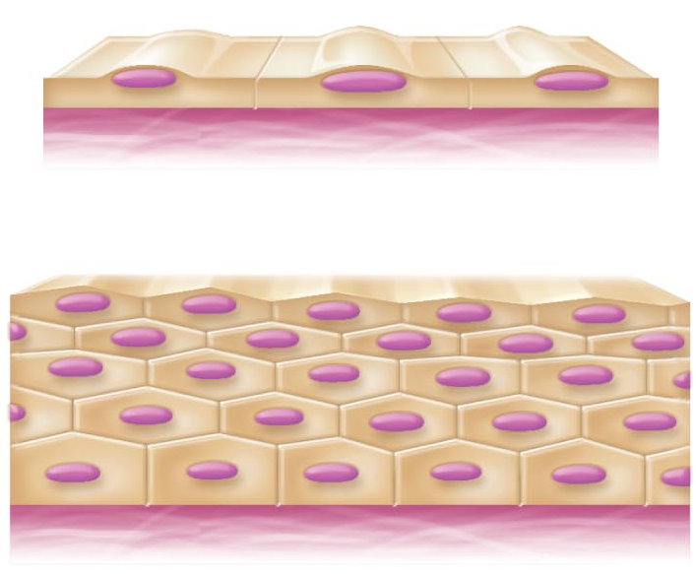
1.3.5 Indicate the 2 criteria used to classify epithelial cells
2. Cell Layers
Simple epithelia = single layer of cells
Stratified epithelia = two or more layers of cells
Shape can change in different layers
In stratified epithelia, epithelia classified by cell shape in apical layer
Notes:
First picture is squamous. Second image is stratified squamous layer. Classify for exams!

Slide 29
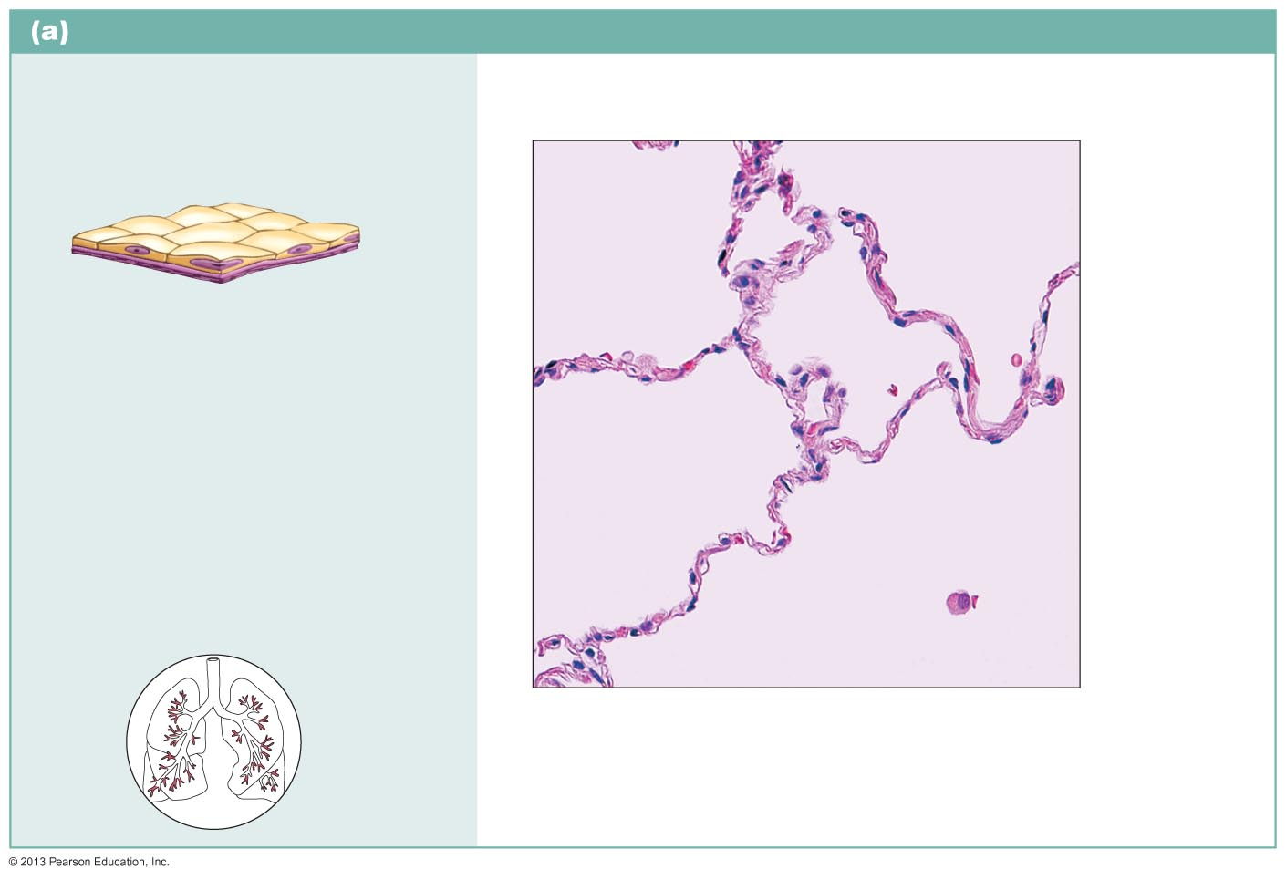
1.3.6 List the 4 types of simple epithelia: 1. Simple squamous epithelium
Description: Single layer of flattened cells with disc-shaped central nuclei and sparse cytoplasm; the simplest of the epithelia.
Air sacs of lung tissue
Nuclei of squamous epithelial cells
Function: Allows materials to pass by diffusion and filtration in sites where protection is not important; secretes lubricating substances in serosae.
Location: Kidney glomeruli; air sacs of lungs; lining of heart, blood vessels, and lymphatic vessels; lining of ventral body cavity (serosae).
Photomicrograph: Simple squamous epithelium forming part of the alveolar (air sac) walls (140x).
2 other locations: Endothelium - lining of blood vessels, and heart
  Mesothelium - epithelium of serous membranes in the ventral body cavity
Notes:
Where do we want thin layered cells? Not somewhere where there is wear and tear. Allows the passage of solutes across a membrane. Found where simple absorption is needed and protection.

Slide 30
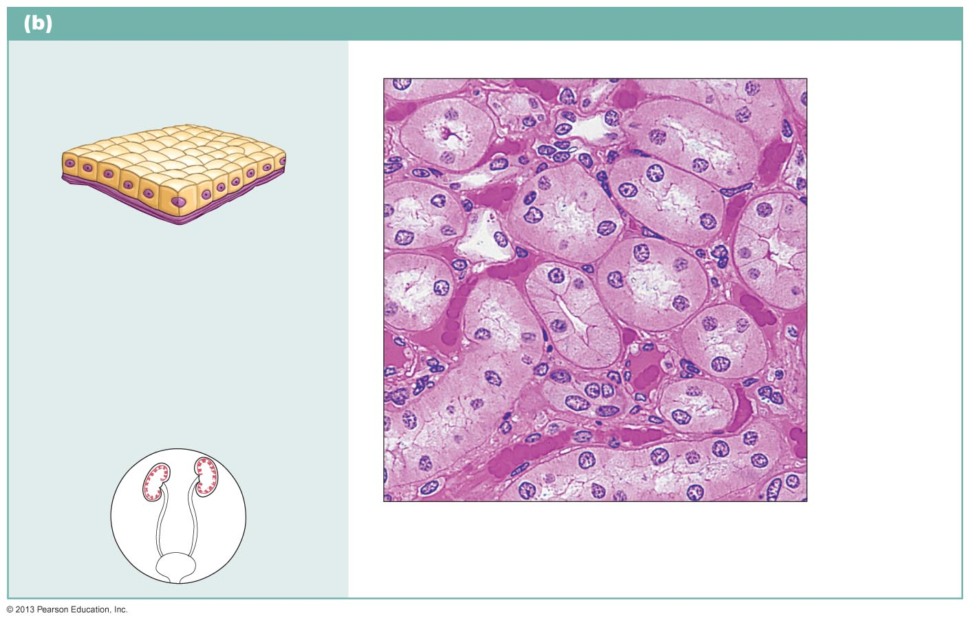
1.3.6 List the 4 types of simple epithelia (cont’d)
2. Simple cuboidal epithelium
Description: Single layer of
cube-like cells with large, spherical central nuclei.
Simple cuboidal epithelial cells
Nucleus
Function: Secretion and absorption.
Basement membrane
Location: Kidney tubules; ducts and secretory portions of small glands; ovary surface.
Connective tissue
Photomicrograph: Simple cuboidal epithelium in kidney tubules (430x).
Notes:
Secretion and absorption; a little more stress then before.

Slide 31
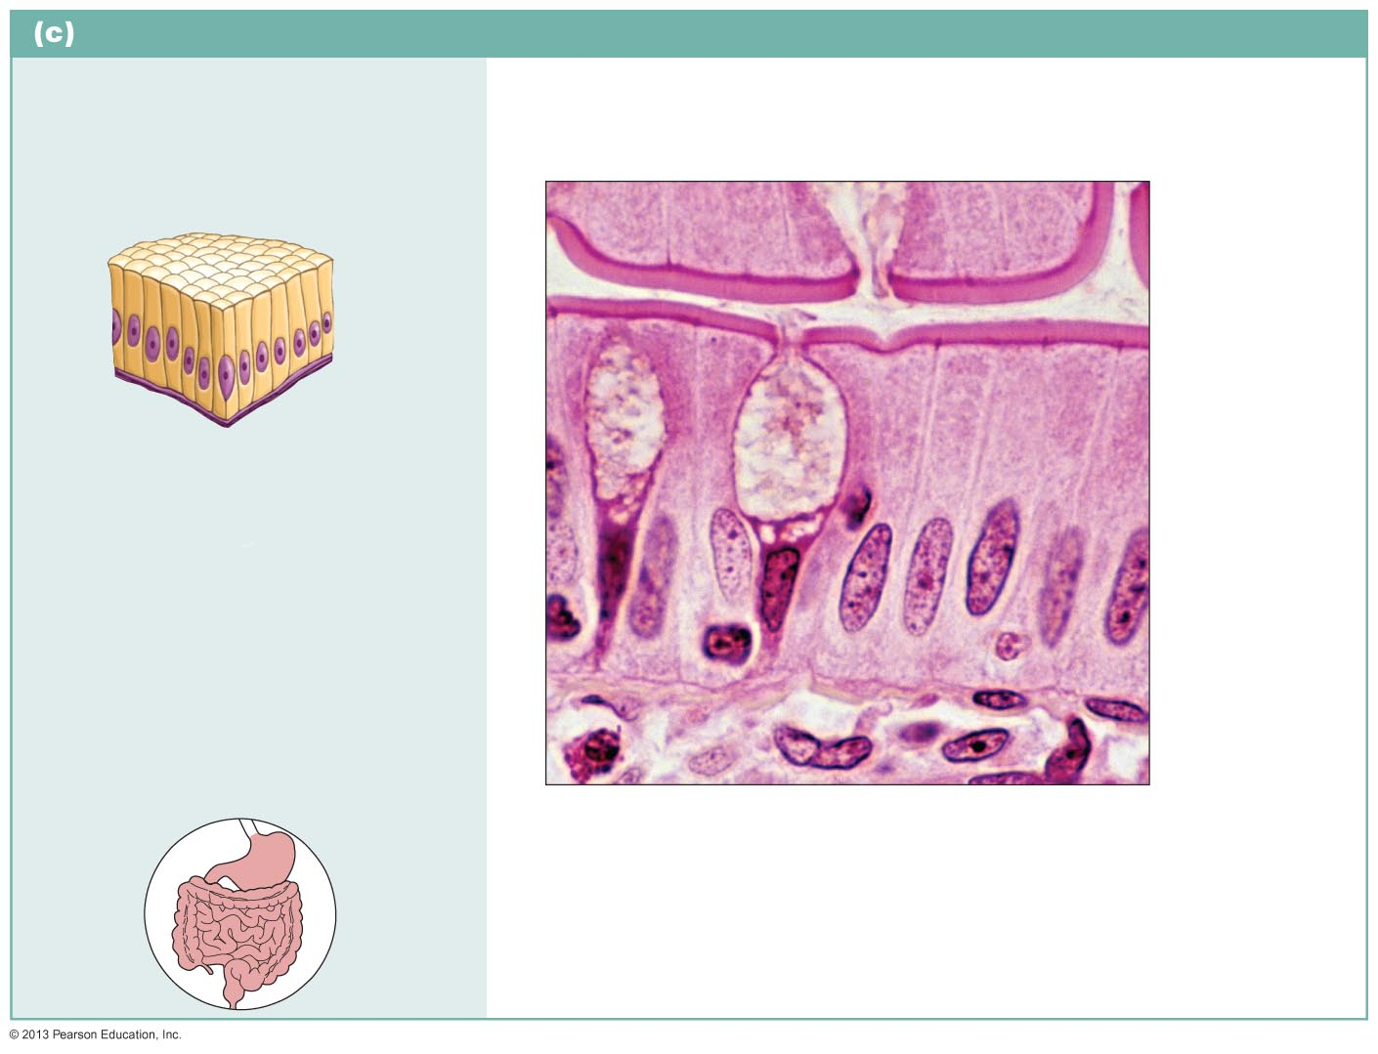
1.3.6 (Cont’d): 3. Simple columnar epithelium
Description: Single layer of tall cells with round to oval nuclei; some cells bear cilia; layer may contain mucus-secreting unicellular glands (goblet cells).
Microvilli
Simple columnar epithelial cell
Function: Absorption; secretion of mucus, enzymes, and other substances; ciliated type propels mucus (or reproductive cells) by ciliary action.
Mucus of goblet cell
Location: Nonciliated type lines most of the digestive tract (stomach to rectum), gallbladder, and excretory ducts of some glands; ciliated variety lines small bronchi, uterine tubes, and some regions of the uterus.
Basement membrane
Photomicrograph: Simple columnar
epithelium of the small intestine mucosa (660x).
Notes:
Also roles like secretion and absorption but also something a little tougher. Absorbing but also physical stress like stomach acid and food. May need specialized structures to help with the environment such as cilia.

Slide 32
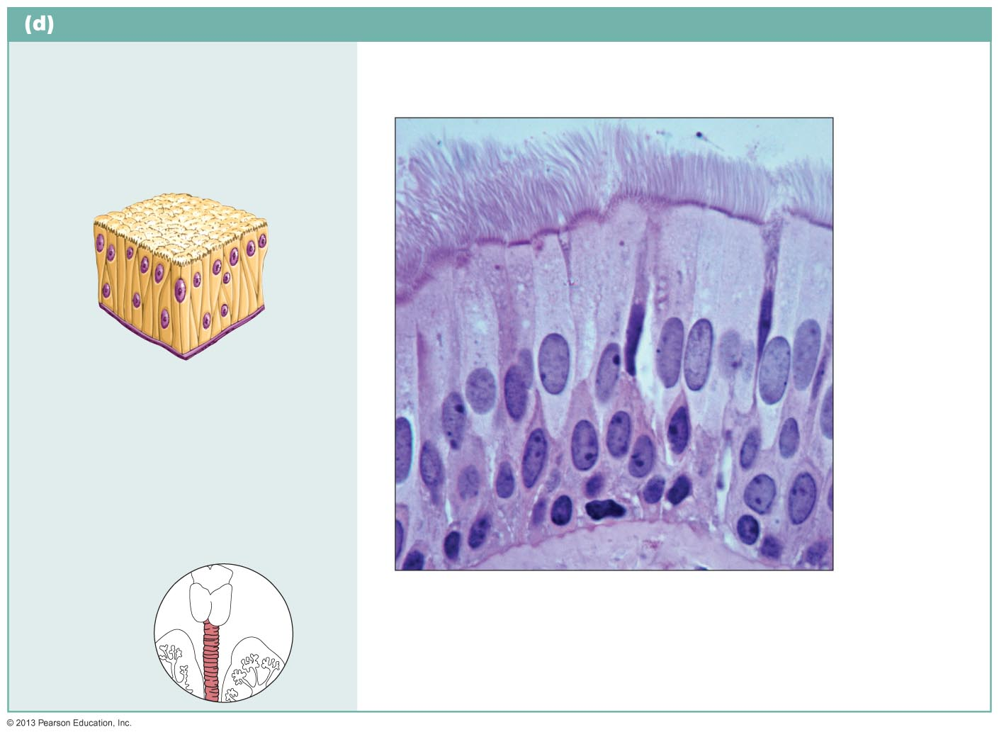
1.3.6 (cont’d): 4. Pseudostratified columnar epithelium
Description: Single layer of cells of differing heights, some not reaching the free surface; nuclei seen at different levels; may contain mucus-secreting cells
and bear cilia.
Cilia
Pseudo-stratified epithelial layer
Function: Secrete substances, particularly mucus; propulsion of mucus by ciliary action.
Location: Nonciliated type in male’s sperm-carrying ducts and ducts of large glands; ciliated variety lines the trachea, most of the upper respiratory tract.
Basement membrane
Photomicrograph: Pseudostratified ciliated columnar epithelium lining the human trachea (800x).
Trachea
Note: the position of the nuclei give the appearance of a stratified epithelia
Notes:
Cells jammed together but altogether they are a single long layer. Cilia is moving mucus to move debris and stuff out of the body.

Slide 33
Stratified Epithelial Tissues
Two or more cell layers
Regenerate from below
  Basal cells divide, cells migrate to surface
More durable than simple epithelia
Protection is major role
1.3.7 Stratified Squamous Epithelium
Most widespread of stratified epithelia
Free surface squamous; deeper layers cuboidal or columnar
Located for wear and tear
Those farthest from basal layer (and therefore nutrients) less viable
Notes:
Best example of this is our skin. Actively dividing by the basal level, therefore they are less viable at the apical point.

Slide 34
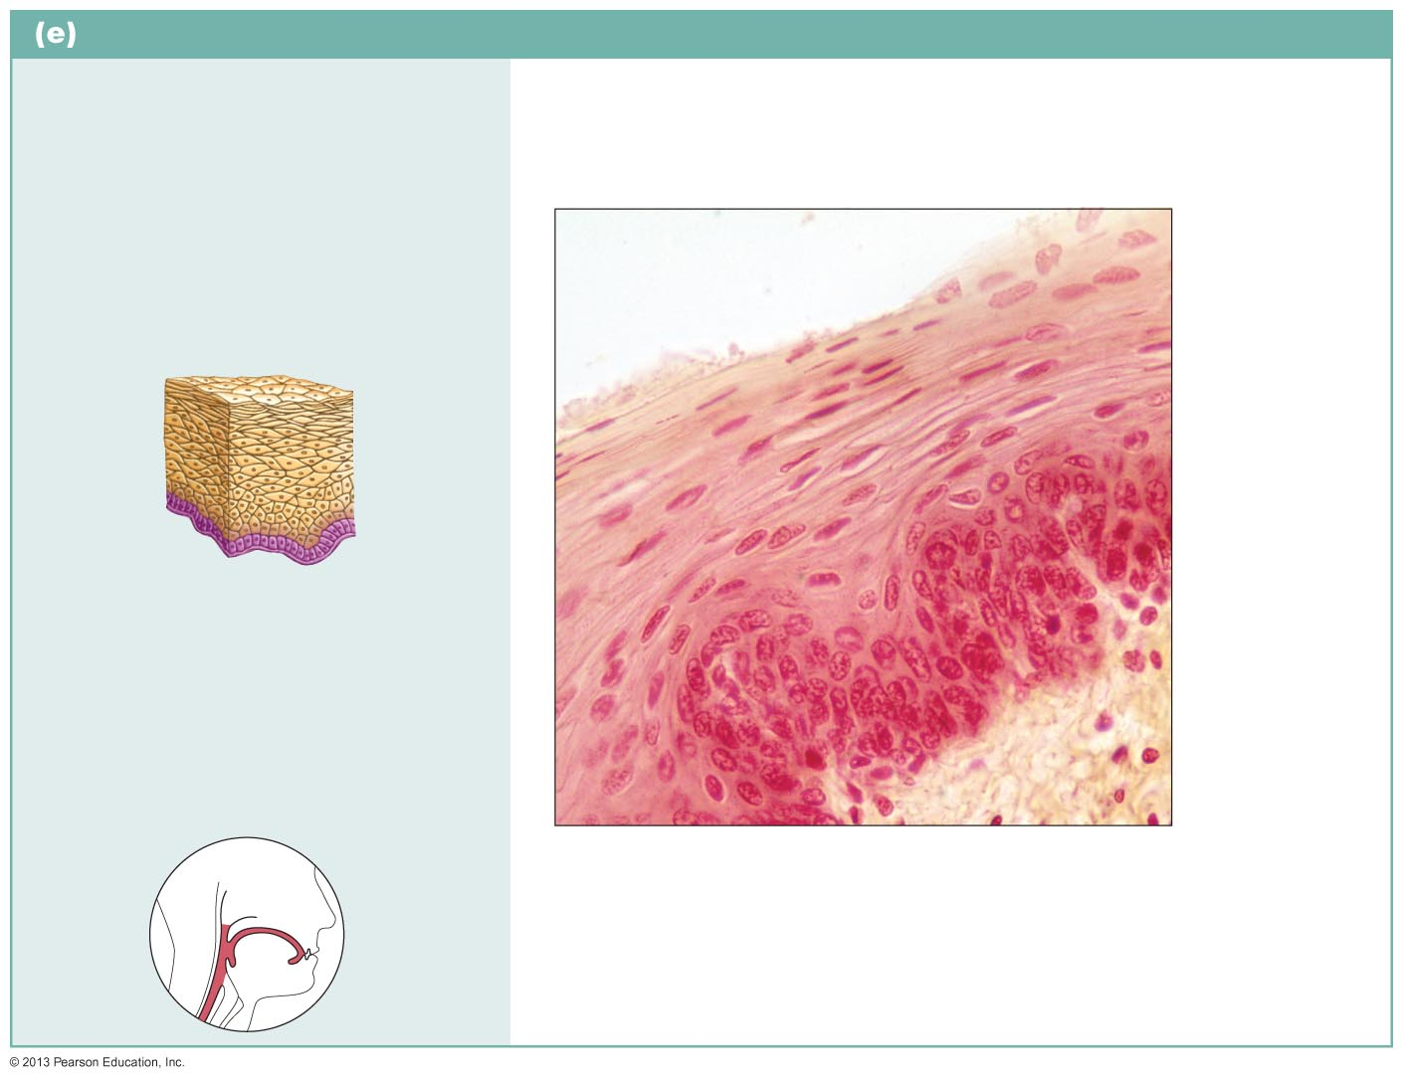
1.3.7. Stratified squamous epithelium
Description: Thick membrane composed of several cell layers; basal cells are cuboidal or columnar and metabolically active; surface cells are flattened (squamous); in the keratinized type, the surface cells are full of keratin and dead; basal cells are active in mitosis and produce the cells of the more superficial layers.
Stratified squamous epithelium
Function: Protects underlying tissues in areas subjected to abrasion.
Nuclei
Location: Nonkeratinized type forms the moist linings of the esophagus, mouth, and vagina; keratinized variety forms the epidermis of the skin, a dry membrane.
Basement membrane
Connective tissue
Photomicrograph: Stratified squamous epithelium lining the esophagus (285x).
What is the most widespread example of stratified squamous epithelium?
What happens to the apical layers of cells?

Slide 35
1.3.8 Glandular Epithelia
Gland
  One or more cells that makes and secretes an aqueous fluid called a secretion
Classified by: -Site of product release: endocrine or exocrine
  -Relative number of cells forming the gland
    unicellular (e.g., goblet cells) or multicellular
Endocrine Glands: release product (hormones) directly into blood
covered elsewhere; just know that they are ductless
Exocrine Glands: release products into ducts
mucous, sweat, oil/salivary glands, liver, pancreas, etc.
a) Unicellular exocrine glands:
• no ducts because only one cell!
• really just the goblet cells (digestive & respiratory tracts)
b) Multicellular exocrine glands:
• epithelium-derived duct & secretory cells; surrounded by supportive CT which brings blood vessels & nerves
Notes:
Secrete things like hormones and sweat.

Slide 36
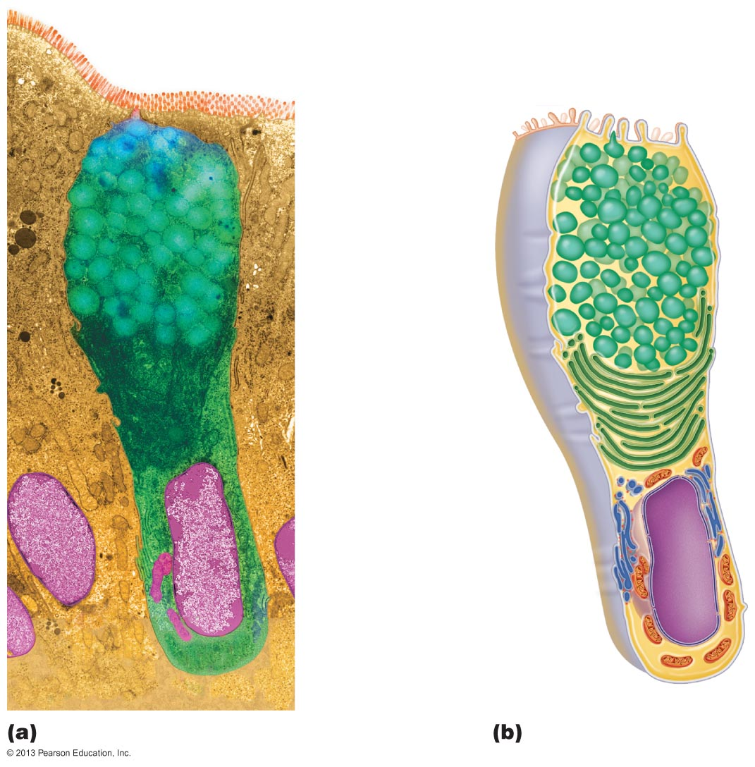
Goblet cells:
A unicellular
exocrine gland
Microvilli
Secretory vesicles containing mucin
Golgi apparatus
Rough ER
Nucleus
Notes:
Mucus protects from acids and removes debris

Slide 37
Classification of Multicellular Glands
By structure and type of secretion
  i) Structure
    Simple glands (unbranced duct) or compound glands (branched duct)
  ii) Type of secretion
    Merocrine
    Holocrine
    Apocrine

Slide 38
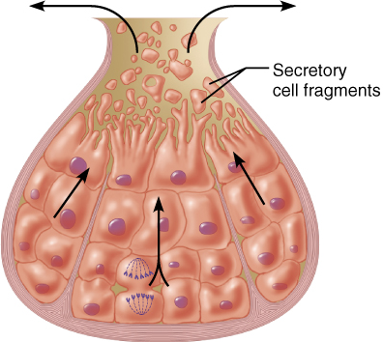
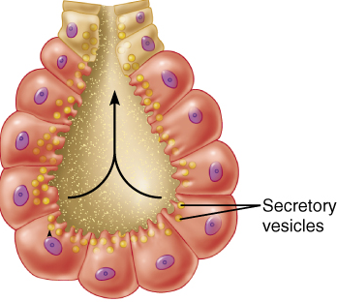
(ii) Secretory method:
    Merocrine – most common, secrete products by exocytosis as produced
e.g. pancreas, salivary glands, most sweat glands
    Holocrine – accumulate products within then rupture
e.g. only sebaceous glands
    Apocrine – accumulates products within then apex pinches off -- controversy if exist in humans
Is mammary gland apocrine or merocrine?
Merocrine
Holocrine
Fig. 4.6
Notes:
Merocrine – merely secrets its products through exocytosis.

Slide 39
1.3.9 list the 5 types of CT; list the 4 main functions associated with CTs
5 major types: mesenchyme, CT proper, cartilage, bone & blood
• main functions: (1) binding or support
(2) protection
(3) insulation
(4) transportation

Slide 40
1.3.10 describe the structural organization of CT in general;
1. Three Structural Elements of CT:
a) ground substance: interstitial fluid + cell adhesion proteins & proteoglycans: molecular sieve
• fibronectin, laminin - help cells attach to CT elements
• proteoglycans - What are these? What do they do? (trap water)
b) fibers: 1) collagen fibers: high tensile strength
2) elastic fibers: elastin has coiled structure to allow stretch + recoil
3) reticular fibers: thin collagenous protein; fine network to support blood vessels, soft tissues
cells: immature (“blast”) forms vs mature (“cyte”) forms
“blasts” are actively dividing/synthesizing cells during growth & repair
“cytes” primarily provide a level of maintenance
Others – fat cells, immune cells (WBC, mast cells, macrophages)
**NB: CT is living cells surrounded by matrix; details vary by tissue type
Notes:
Ground is a gel like substance, fibers give CT its strength.

Slide 41
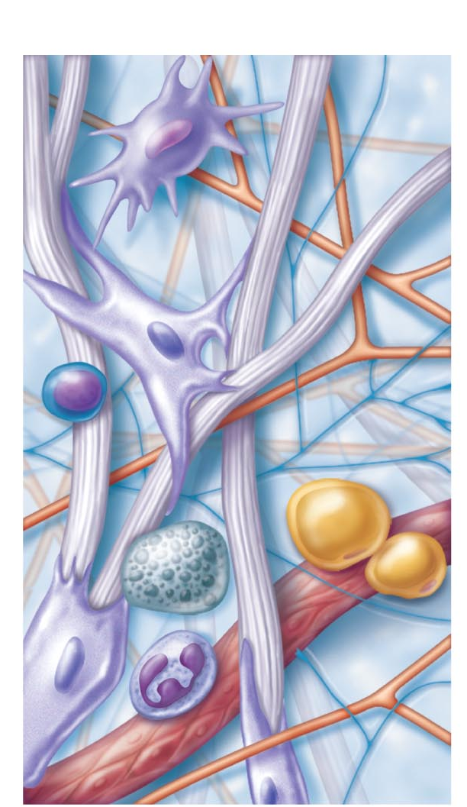
Cell types
Extracellular matrix
Ground substance
Macrophage
Fibers
• Collagen fiber
• Elastic fiber
• Reticular fiber
Fibroblast
Lymphocyte
Figure 4.7 Areolar connective tissue: A prototype (model) connective tissue
Fat cell
Mast cell
Neutrophil
Capillary
Notes:
EXAM QUESTION! LOOK AND LABEL
Reticular aid that gel like substance.
Macro, Mase and neutro are apart of the immune system (function not impt to this course)

Slide 42
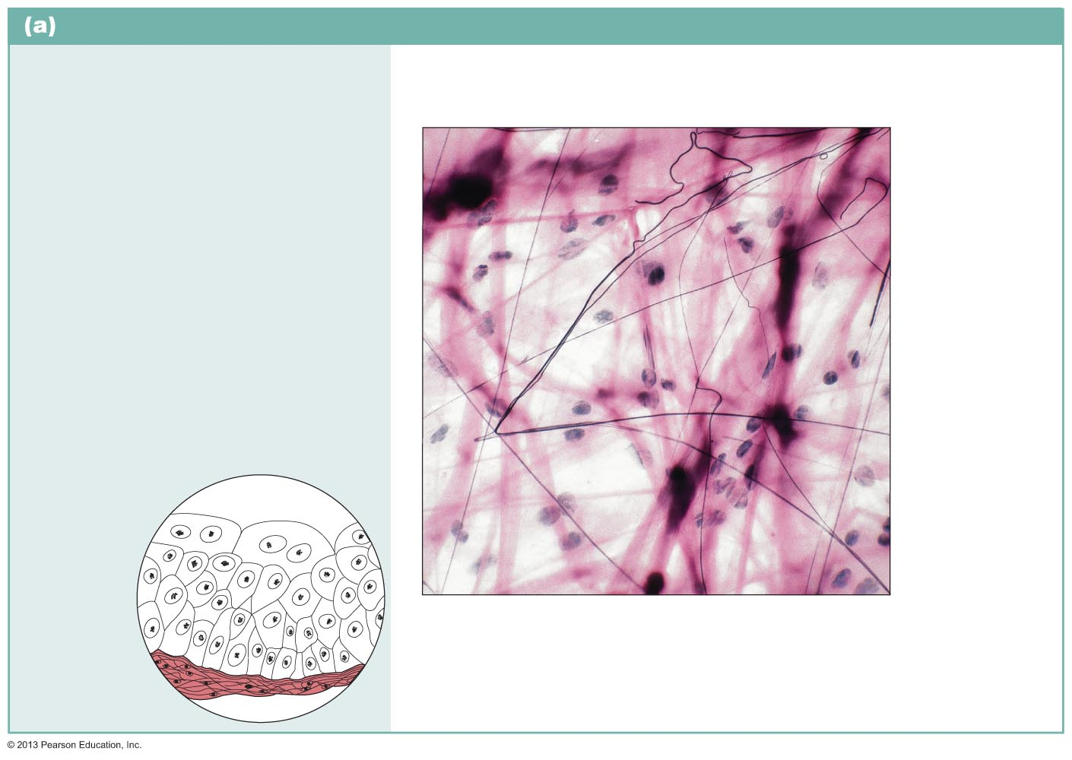
1.3.11 List and describe the 3 kinds of loose CT, its location and function
Connective tissue proper: loose connective tissue, areolar
Description: Gel-like matrix with all three fiber types; cells: fibroblasts, macrophages, mast cells, and some white blood cells.
Function: Wraps and cushions organs; its macrophages phagocytize bacteria; plays important role in inflammation; holds and conveys tissue fluid.
Elastic fibers
Ground substance
Location: Widely distributed under epithelia of body, e.g., forms lamina propria of mucous membranes; packages organs; surrounds capillaries.
Fibroblast nuclei
Collagen fibers
Epithelium
Photomicrograph: Areolar connective
tissue, a soft packaging tissue of the body (340x).
Lamina propria

Slide 43
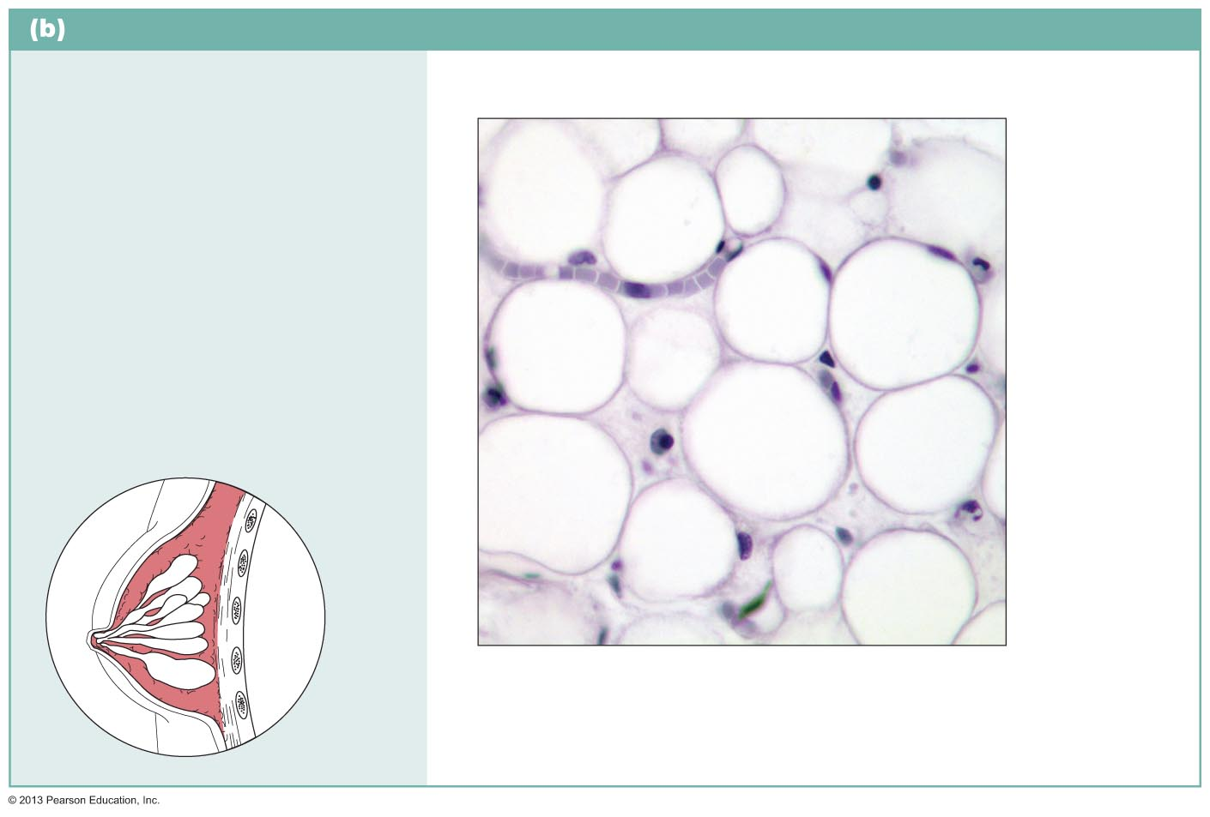
1.3.11 List and describe the 3 kinds of loose CT, its location and function
Connective tissue proper: loose connective tissue, adipose
Description: Matrix as in areolar, but very sparse; closely packed adipocytes, or fat cells, have nucleus pushed to the side by large fat droplet.
Function: Provides reserve food fuel; insulates against heat loss; supports and protects organs.
Nucleus of adipose
(fat) cell
Location: Under skin in subcutaneous tissue; around kidneys and eyeballs; within abdomen; in breasts.
Fat droplet
Adipose tissue
Photomicrograph: Adipose tissue from
the subcutaneous layer under the skin (350x).
Mammary glands
Notes:
The sizes of the fat droplets either shrink or grow! They don’t divide or go away. No fibers that’s why its squishy. This provides and preserves fuel.

Slide 44
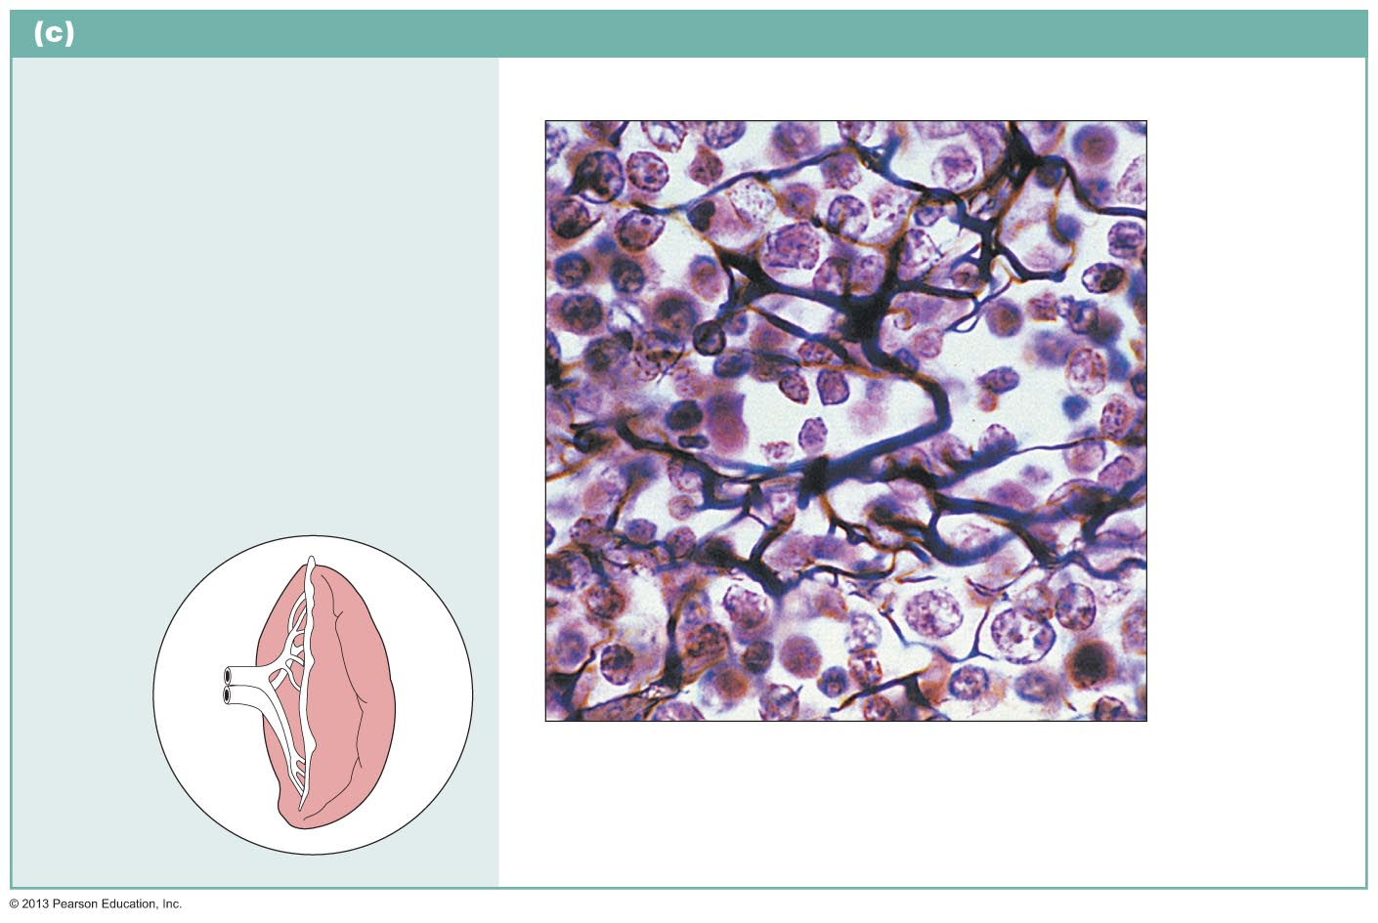
1.3.11 List and describe the 3 kinds of loose CT, its location and function
Connective tissue proper: loose connective tissue, reticular
Description: Network of reticular fibers in a typical loose ground substance; reticular cells lie on the network.
Function: Fibers form a soft internal skeleton (stroma) that supports other cell types including white blood cells, mast cells, and macrophages.
White blood cell
(lymphocyte)
Location: Lymphoid organs (lymph nodes, bone marrow, and spleen).
Reticular fibers
Spleen
Photomicrograph: Dark-staining network of reticular connective tissue fibers forming the internal skeleton of the spleen (350x).
Notes:
Abundance of reticular fibers, giving it a much softer consistency.

Slide 45
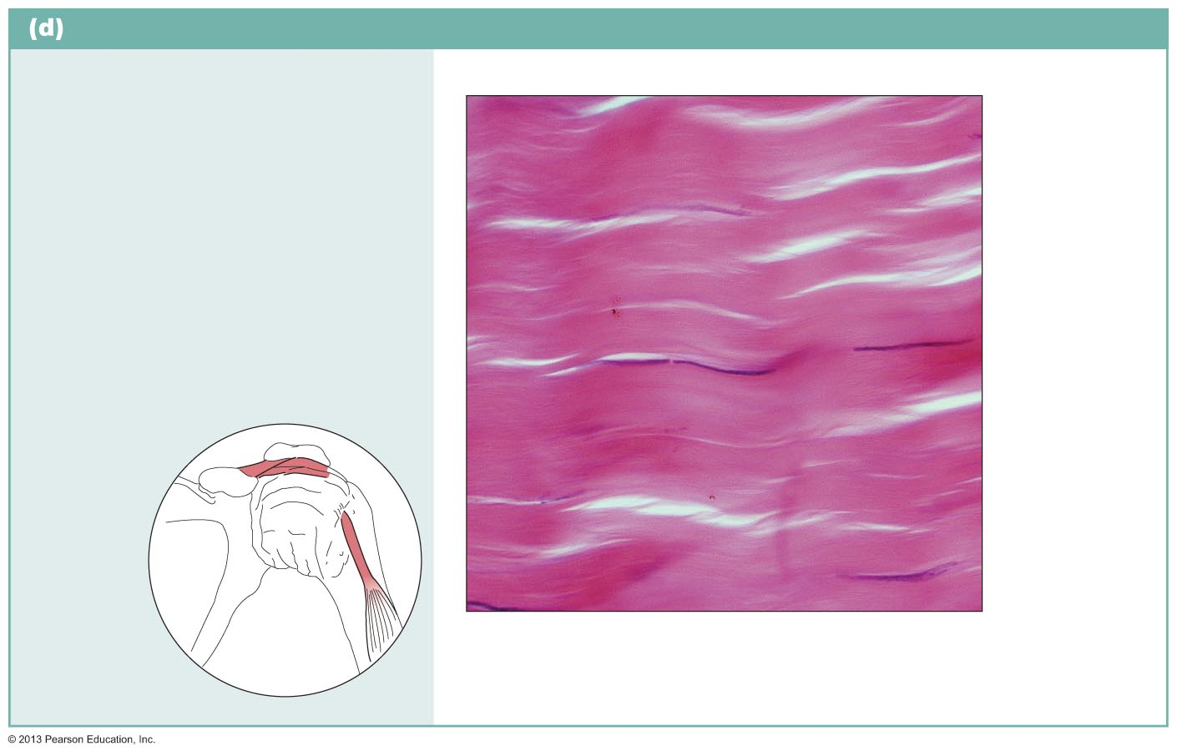
1.3.12 List and describe the 3 kinds of Dense CT
Connective tissue proper: dense connective tissue, dense regular
Description: Primarily parallel
collagen fibers; a few elastic fibers;
major cell type is the fibroblast.
Function: Attaches muscles to
bones or to muscles; attaches
bones to bones; withstands great
tensile stress when pulling force is
applied in one direction.
Collagen
fibers
Location: Tendons (m to b), most ligaments (b to b), aponeuroses (m to m).
Nuclei of
fibroblasts
Shoulder
joint
Ligament
Photomicrograph: Dense regular connective
tissue from a tendon (430x).
Tendon
Notes:
Collagen fibers are packed in a denser regular array. Very few cells to allow for repair by regeneration once the tissue has been torn.

Slide 46
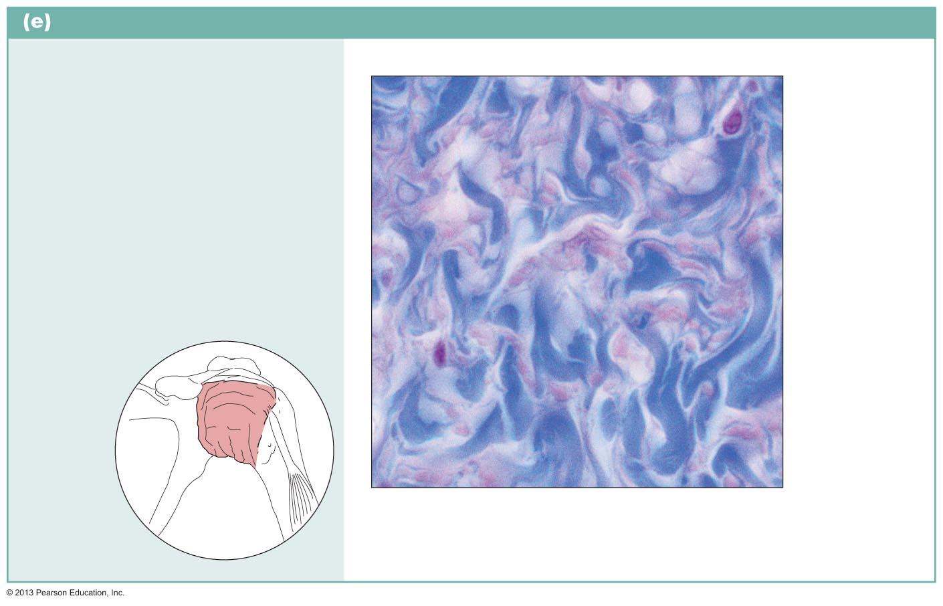
1.3.12 List and describe the 3 kinds of Dense CT
Connective tissue proper: dense connective tissue, dense irregular
Description: Primarily irregularly
arranged collagen fibers; some
elastic fibers; fibroblast is the
major cell type.
Nuclei of
fibroblasts
Function: Withstands tension
exerted in many directions;
provides structural strength.
Location: Fibrous capsules of
organs and of joints; dermis of the
skin; submucosa of digestive tract.
Collagen
fibers
Shoulder
joint
Fibrous
joint
capsule
Photomicrograph: Dense irregular connective
tissue from the fibrous capsule of a joint (430x).
Notes:
We need things to be strong but were unsure in which way the could be pushed or pulled. Dense with limited cells.

Slide 47
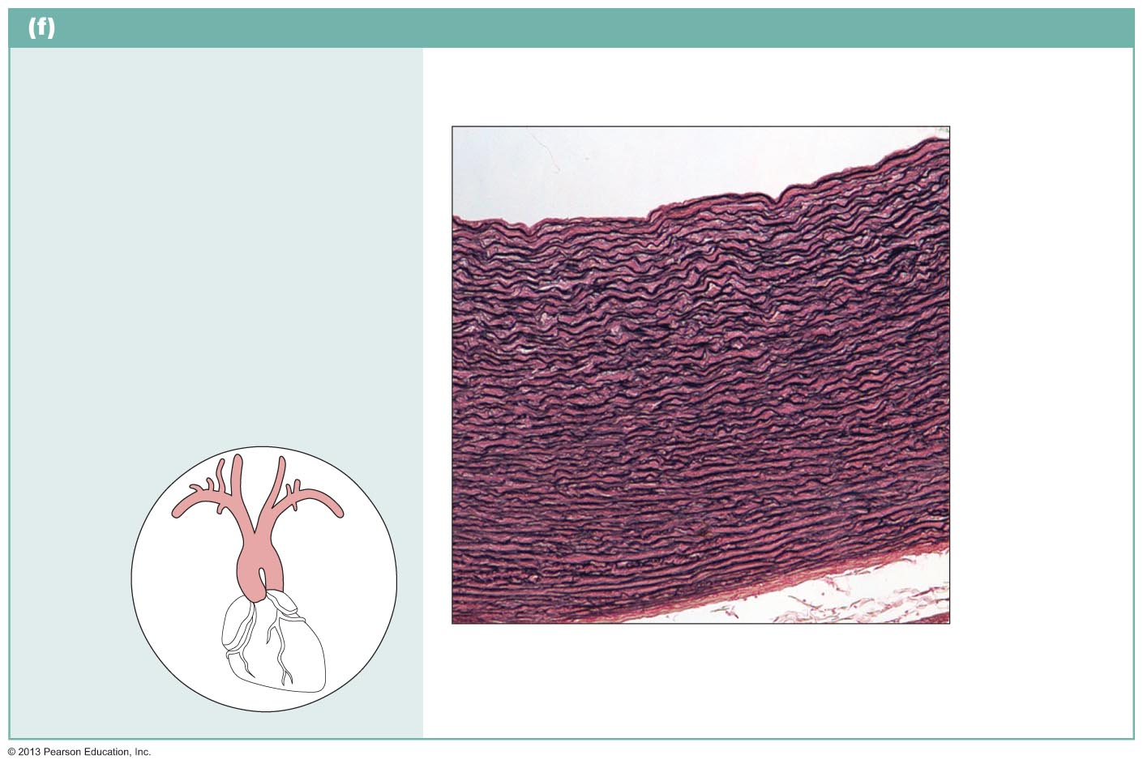
1.3.12 List and describe the 3 kinds of Dense CT
Connective tissue proper: dense connective tissue, elastic
Description: Dense regular
connective tissue containing a
high proportion of elastic fibers.
Function: Allows tissue to recoil
after stretching; maintains pulsatile
flow of blood through arteries; aids
passive recoil of lungs following
inspiration.
Location: Walls of large arteries;
within certain ligaments associated
with the vertebral column; within
the walls of the bronchial tubes.
Elastic
fibers
Aorta
Heart
Photomicrograph: Elastic connective tissue
in the wall of the aorta (250x).
Notes:
A large array of elastic fibers. When the heart contracts there is a huge pressure from the blood in the aorta and this tissue can absorb that energy and spring back which can allow for blood flow (e.g). Also lungs are a good example when we breath in and out.

Slide 48
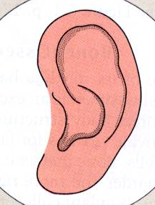
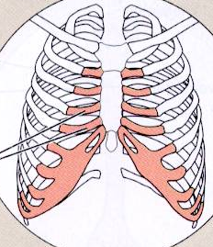
1.3.13 List the other remaining types of connective tissue
3. CARTILAGE features between dense CT & bone: tough, but flexible
(i) avascular, devoid of nerve fibers
(ii) ground substance contains lots of the GAGs chondroitin sulfate & hyaluronic acid
also chondronectin, (adhesive protein)
(iii) collagen fibers (can have some elastic fibers)
(iv) up to 80% H₂O
Notes:
Has very few blood vessels and nerves which makes for white and painless features. A lot of ground substance (gel) that allow it to hold a lot of water. Shape is held by collagen fibers. Different specializes cells (cytes and bytes) for different tissues

Slide 49
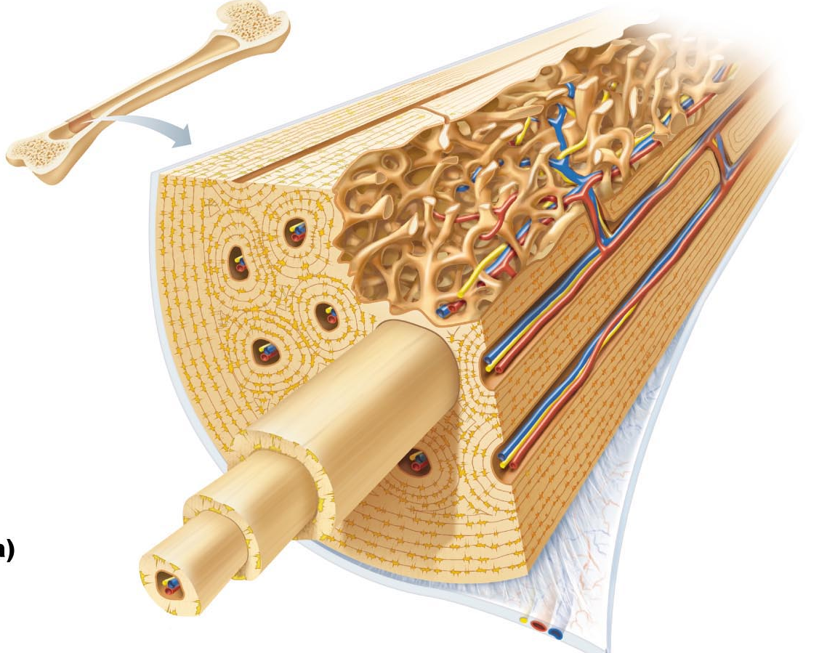
4. BONE calcium salts give hardness & strength for support/protection of softer tissues; cavities for fat storage & synthesis of blood cells
Osteoblasts: bone producing cell, mature into osteocytes
Osteocytes: mature bone cell, reside in lacunae (spaces in bone matrix)
Osteoclasts: “bone-breakers”
*cartilage and bone dealt
with in detail in ANP1106
Notes:
Very porous for good blood supply.

Slide 50
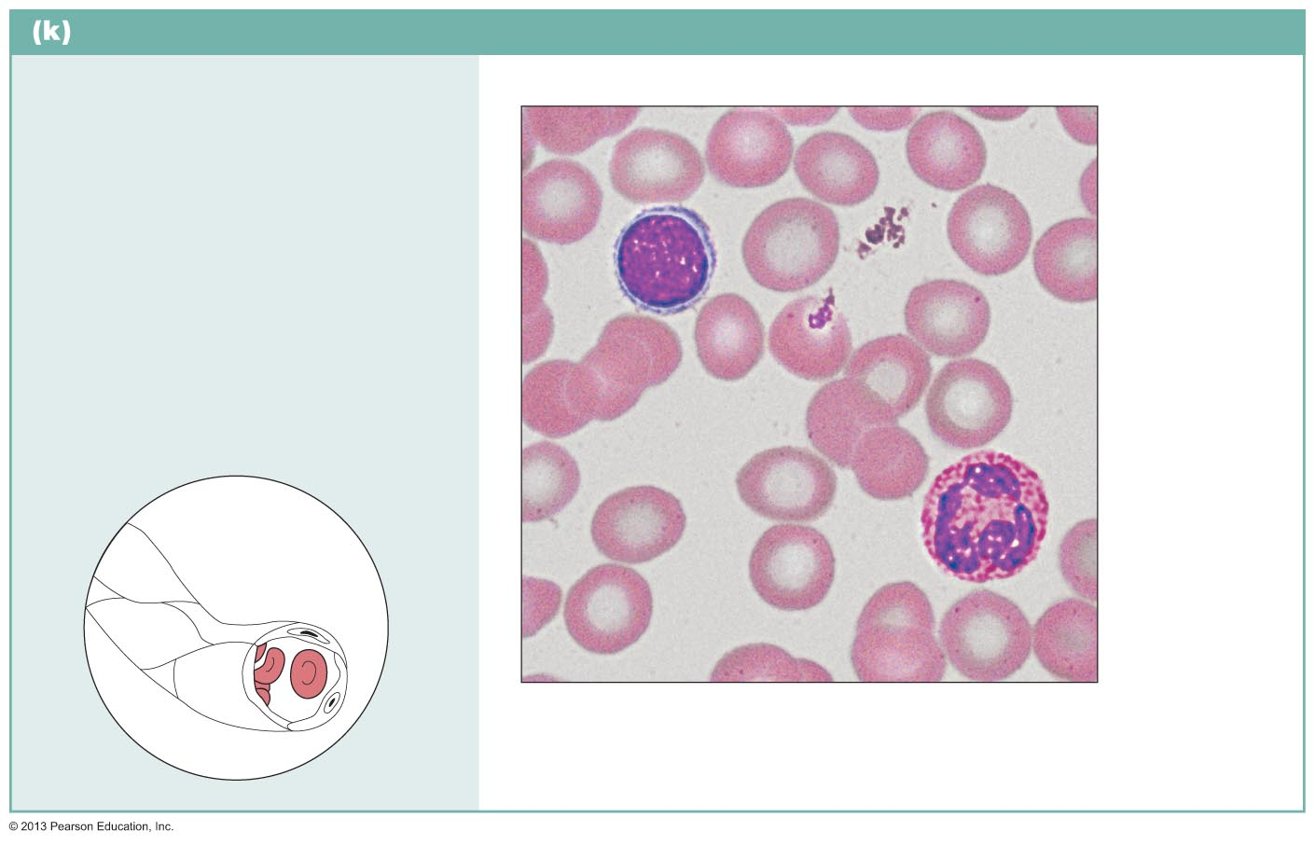
5. BLOOD
Connective tissue: blood
Description: Red and white blood
cells in a fluid matrix (plasma).
Red blood
cells
(erythrocytes)
Function: Transport respiratory
gases, nutrients, wastes, and other
substances.
White blood
cells:
• Lymphocyte
• Neutrophil
Location: Contained within blood
vessels.
Plasma
Photomicrograph: Smear of human blood
(1670x); shows two white blood cells
surrounded by red blood cells.
classified as CT because it consists of cells surrounded by a nonliving fluid matrix, blood plasma
“fiber” components are soluble protein molecules - only visible during clotting
Notes:
Only fluid tissue. Its CT because it meets the criteria.

Slide 51
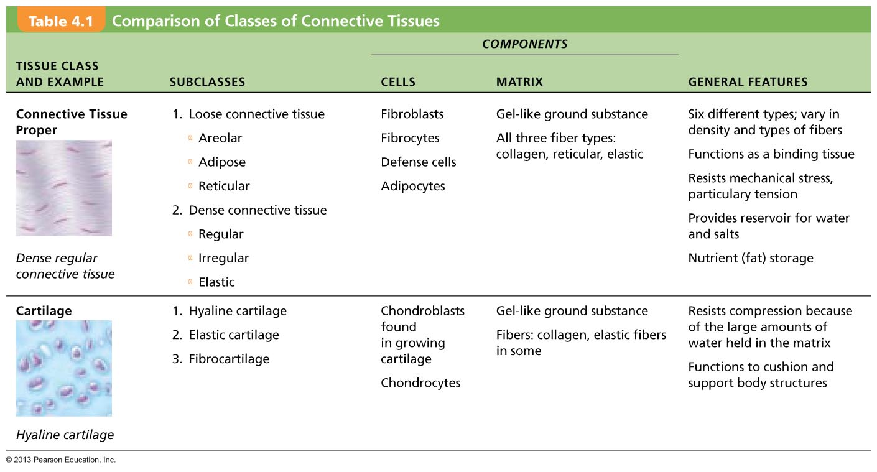

Slide 52
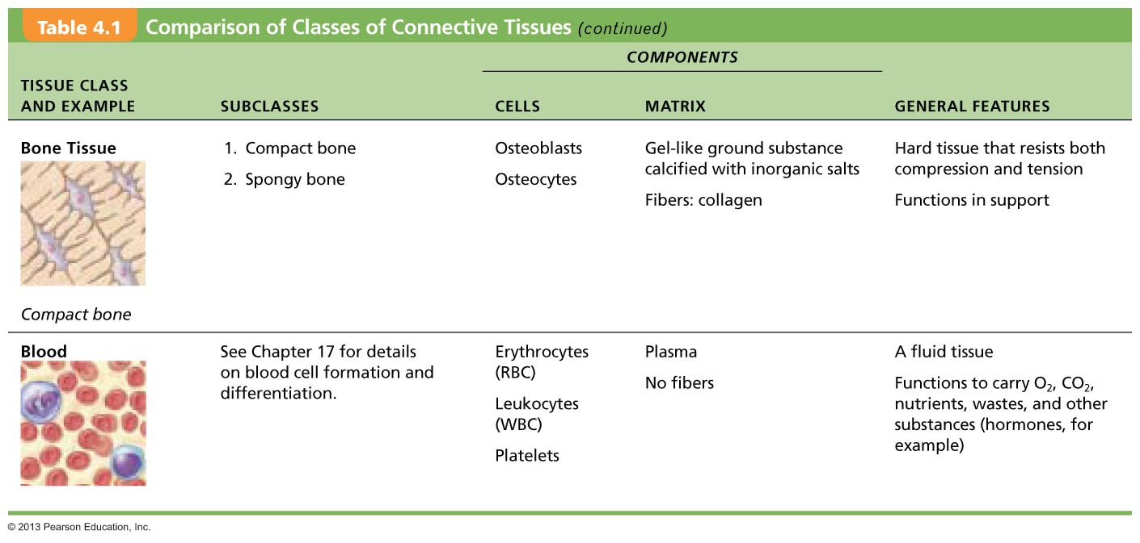

Slide 53
1. Which of the following fibrous elements give a CT high tensile strength?
a) reticular fibers c) collagen fibers
b) elastic fibers d) myofilaments
2. The cell that forms bone is the:
a) fibroblast d) osteoblast
b) chondroblast e) reticular cell
c) hemocytoblast
3. Which kind of CT acts as a sponge, soaking up fluid when edema occurs?
a) areolar CT d) reticular CT
b) adipose CT e) vascular tissue
c) dense irregular CT

