Slide 1
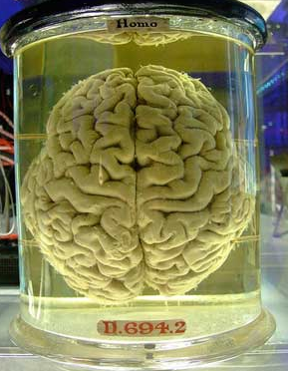
PSY 1101F Chapter 2: The Biology of the Mind
Part 2: The Brain
September 22nd 2014

Slide 2
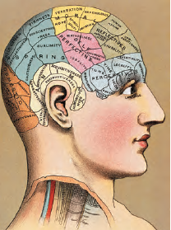
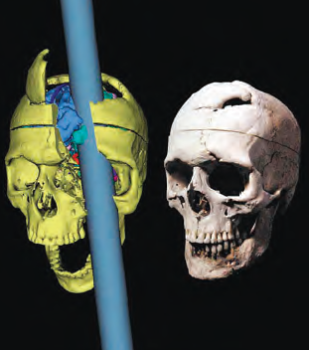
How can we study the brain and the mind? – Historical Perspective
The first attempt was undertaken by Franz Gall in the early 1800s who founded phrenology:
  Phrenology: Skull morphology can predict character and mental abilities ;
  Incorrect theory but lead to the idea of a localization of functions.
Studying the effects of brain lesions:
  Theory: What is different about the mind when one part of the brain is absent can reveal its role;
  Famous examples: Henry Molaison (memory), Phineas Gage (personality).
Notes:
Jean- first to determine that the mind is in the brain. *
By removing different parts of the brain he could find out what they controlled/functions.
Now we can chemically/magnetically remove parts of the brain
Wilder- would put electrical probes in the brain and then observe their responses. Could create maps of the functions of portable reigions on the brain. Found out where language took place in the brain.
Brain lesions – similarily to florence the theory is that by investigating what part of the brain is missing we can determine what that part controls.
Gage- his frontal lobes were destroyed, he survived but with a different personality. He went from mild mannered to being mean spirited.

Slide 3
How can we study the brain and the mind? – Brain Imaging Tools
Look at the structure and/or activity of the brain to localize functions and explain psychological disorders.
Underlying principles:
  Localization of functions: Compare the brain’s baseline activity (i.e. oxygen or energy consumption) to what is observed when the participant is conducting a task;
  Psychological Disorders: Compare the brains of healthy patients with those of patients with psychological disorders to determine if they are different.
Notes:
Brain imagining ct scans, etc.. Have been developed and let us look at the structure and impacts on the brain. They show a strong link between biological activity and psychological events. 10% of the brain is false, mostly all parts of the brain are being used at all times. The brain uses 20% of the bodys oxygen and 25% of its energy. Brain imagining helps locate things in the brain (functions), help determine differences between a healthy and not healthy brain (one with psychological issues)

Slide 4
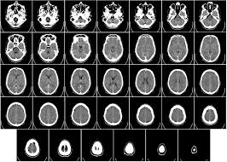

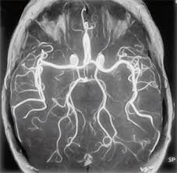
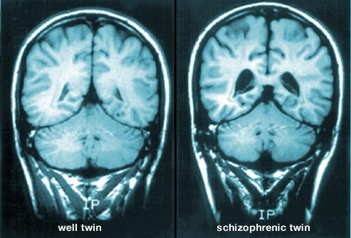
How can we study the brain and the mind? – Structural Brain Imaging Tools
Structural Brain Imaging Tools:
  CT scans: Series of x-rays of the head.
  MRI: Uses magnetic fields and radio waves to produce high quality images of the brain;
Notes:
Typically used to see brain injuries and tumors.

Slide 5
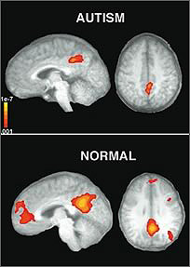
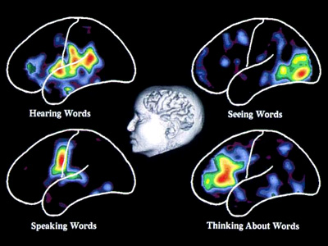

How can we study the brain and the mind? – Functional Brain Imaging Tools
Functional Brain Imaging Tools look at the activity of the brain:
  EEG: Measures the electrical activity along the scalp.
  PET scan: Traces the consumption of radioactive glucose by neurons.
  fMRI: Measures brain activity by detecting associated changes in oxygen-laden blood flow.
EEG
PET scan
fMRI
Notes:
Used to look at the activity of the brain between brains during rest or during activity.
EEG – uses electrodes, measures ions coming in and out of the axon during depolarization. Has excellent temporal resolution (real time) however its spatial time is not that good. Cannot pin point the exact location of events, and cannot see deep into the brain. Simple studies.
PET Scan and fMRI’s go deeper but are expensive.
PET-
fMRI- shows changes in the level of oxygen in the bloodflow as it travels the brain. Can automatically give structural imaging of the brain.
Seeing where these increased consumptions take place during certain activities.

Slide 6
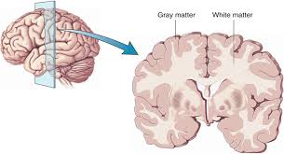
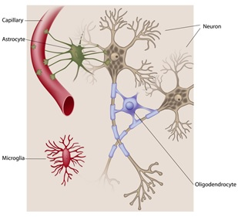
The Brain: Glial Cells
Glial cells: Support cells of the nervous system. There are a few different types:
  Oligodendrocytes: Form the myelin sheath which increases the speed of neural transmission:
    Correspond to the white matter of the brain;
    Absence = lack of judgement that we see in children;
    Damage = multiple sclerosis.
  Astrocytes: Form the blood-brain barrier, supply neurons with nutrients, play a supportive role at the synapse, and participate in the repair and scarring process following injury.
  Microglia: Immune cells that eliminate potentially harmful pathogens.

Slide 7
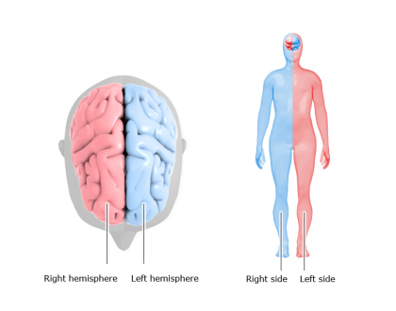
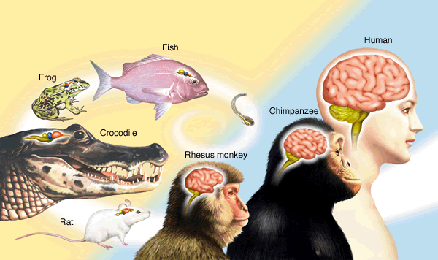
The Brain: General Organization
The brain is made up of two symmetrical hemispheres:
  Left hemisphere: Responsible for the right side of the body;
  Right hemisphere: Responsible for the left side of the body.
Brain evolution: Newer regions have been added on top of the older ones:
  Older regions: In yellow, are mostly related to survival;
  Newer regions: In pink, related to thinking and more complex behavioural programs.
Notes:
Each hemisphere is responsible for processing information from the oppisite side of the body. This involves senosry and motor control. Crossing of the nerve fibers in the brain.
Older region is common to all species.

Slide 8
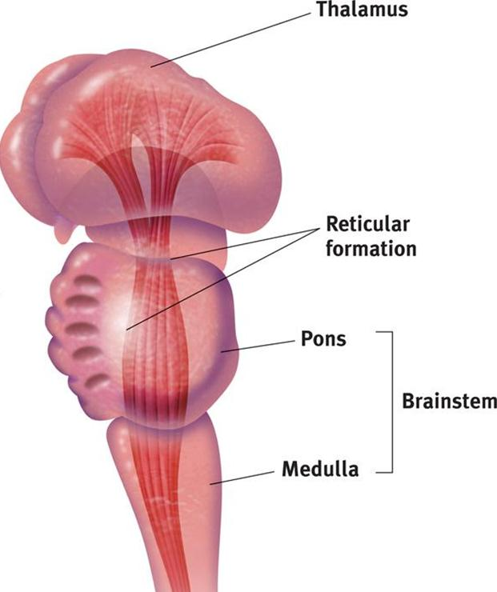
The Brainstem
Brainstem: Oldest and inner most region of the brain. Contains:
  The medulla: Autonomic survival functions;
  The pons: Automatic and unconscious movements and crossover point for nerve fibers;
  The reticular formation: Alertness and filtering of incoming sensory information, including pain perception.
Notes:
Do not require concious effort.
Medulla – very basic survival functions (breathing and beating of the heart) Can still breath if you damage anywhere above the medulla but if you damage it you will need assitance in breathing. When damaged = parapalegic.
Pons – swalloing, posture, eye movements, etc… The nerve fibers cross here.
Reticular formation – arousal (not sexual, alertness) If severed acoma will take place. It is also responsible for selective awareness, selects which incoming stimuli will be sent to the brain for further processing. I.e. the feeling of your clothes on your body is not important as its constantly there. It allows or inhibits pain stimuli from entering the brain, and responds to it.

Slide 9
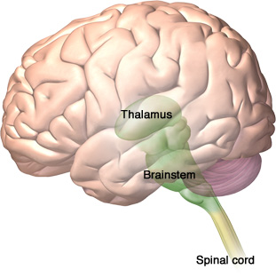
The Thalamus and the Cerebellum
Thalamus: Sensory switchboard of the brain where all sensory messages except smell are routed on the way to the cortex.
Cerebellum: Coordinates voluntary movements, balance, and nonverbal learning and memory.
Cerebellum
Source: Zygote Media
Notes:
Damage to the thalamus can lead to blindness or loss of other senses. Even if the organs are still intact you can lose that sense. The thalamus is the router of where things go.
Cerebellum – relays information between the body and cortex. If damaged an individual can forget that they know how to do something(hippocampus) but can still do it, i.e. playing an instrument. Very vulenrable to effects of alcohol.

Slide 10
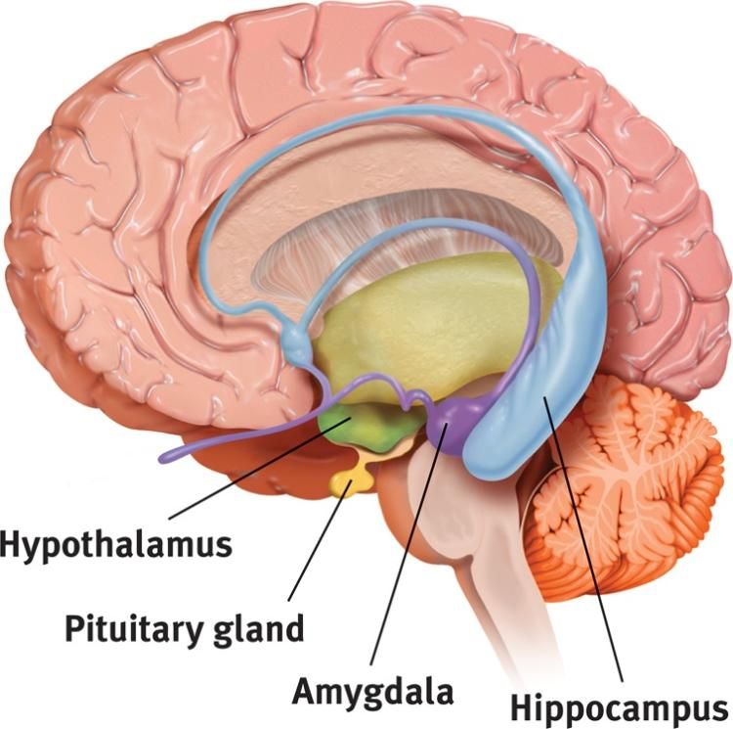

The Limbic System
Hippocampus: Processes conscious memories;
Amygdala: Helps process emotions, especially fear and aggression.
Hypothalamus: Is involved in homeostasis, sex drive, and reward. Directs the endocrine system via messages to the pituitary gland.
Notes:
Located in the center of the brain, between the brain stem and very specialized parts of the brain.
Hippocampus – learning.
Amygdala – emotional center of the brain. Stimulating different parts you get different reactions. Generally related to fear and aggression.
Hypothalamus – regulates body temperature, sarcadium rhytms (internal clock), food and water intake. Maintains homeostaysis. Role in pleasure, contains reward center.

Slide 11
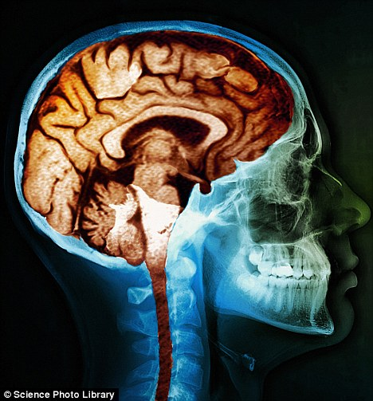
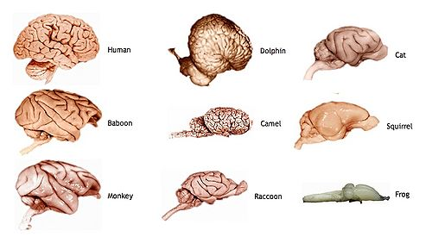
The Cerebral Cortex
The brain’s outer layer;
Larger in humans than in other mammals;
A large cerebral cortex enables behavioural adaptation.
Notes:
Makes up 85% of your brains total weight.

Slide 12
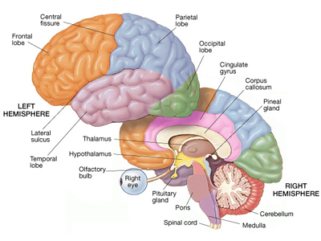
The Structure of the Cerebral Cortex: Hemispheres and Lobes
The brain has two symmetrical hemispheres that communicate through the corpus callosum;
Each hemisphere is divided into four lobes:
  Frontal lobes: Primary motor cortex, speaking, planning, judging, abstract thinking, personality.
  Parietal lobes: Primary sensory cortex and spatial processing.
  Occipital lobes: Visual cortex.
  Temporal lobes: Auditory cortex.
Notes:
Fishers are the bigger folds of the brain.

Slide 13
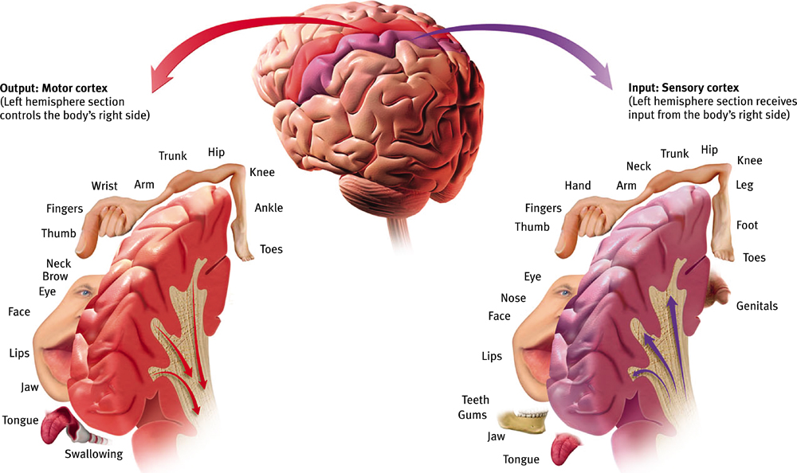
Functions of the Cerebral Cortex: The Motor and Sensory Strips and the Homunculus
Output: Motor cortex (Left hemisphere section controls the body’s right side)
Input: Sensory cortex (Left hemisphere section receives input from the body’s right side)
← Axons receiving motor signals FROM the cortex
←Axons sending sensory information TO the cortex
Notes:
Sensory (in parietal lobe but borderline on temporal)

Slide 14
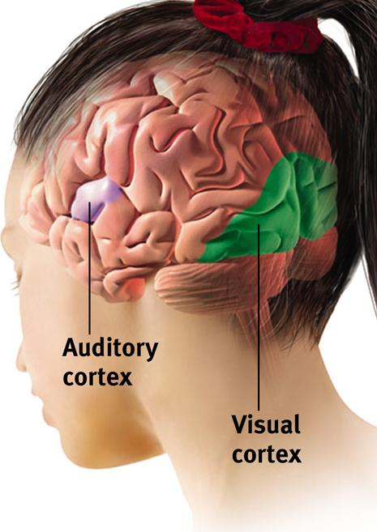
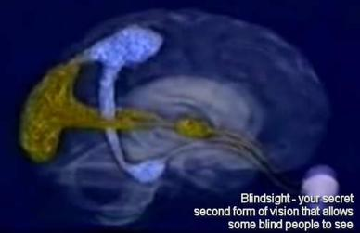
Functions of the Cerebral Cortex: Sensation
The sensory cortex only processes information related to touch stimuli;
The occipital lobe processes visual information:
  When the occipital lobes are damaged, patients experience blindsight.
The temporal lobes process auditory information.
Notes:
Visual info is not only processed in occipital lobe but also other areas. You are legally blind if that occipital lobe is damaged, however; they still have some sense of a visual field.
Words are formed into thoughts in the paretal lobe

Slide 15
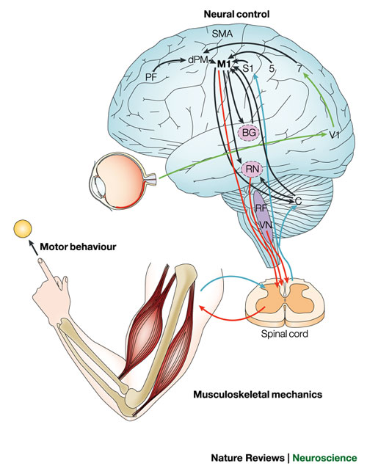
Functions of the Cerebral Cortex:
Motor Control
The carry out goal-directed movements, the motor cortex, must receive information from:
  Other regions of the cerebral cortex: Body’s position in space, location of objects, passed similar experiences, appropriate strategy, etc.
  Cerebellum: Regulates the sequence and duration of the elementary movements.
It also sends information back to these regions and to the motor neurons of the spinal cord which are attached to the muscles.
Notes:
Basic function of the brain is to generate behaviours (i.e. movements) To carry out these behaviours the motor cortex doesn’t work alone it receives information from other parts of the brain!

Slide 16
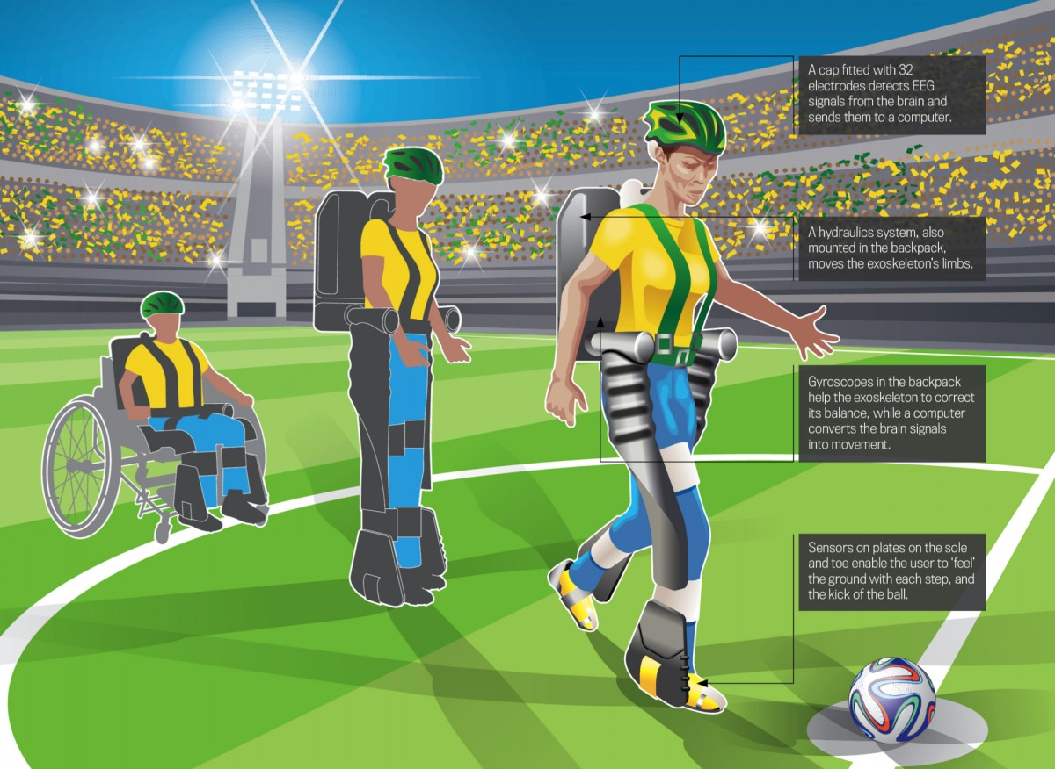
Functions of the Cerebral Cortex: Motor Control and Brain-Computer Interfaces
Brain-computer interfaces can translate motor programs formulated in paraplegic patients into movements:
Notes:
Scientists have the ability to transfer information in the brain to a computer chip which decodes the message and can send it to mechanics. The computer makes his limb move which makes the exoskeleton move, its a visual thing he cannot sense any of this.

Slide 17
Functions of the Cerebral Cortex: Association Areas
Associations areas integrate/associate information and are located in multiple regions of the brain:
  Frontal lobes: Implicated in working memory and processing of new memories; responsible for executive functions such as judgement, planning, and inhibition of impulses.
  Parietal lobes: Manage input from multiple senses, perform mathematical and spatial reasoning, monitor the sensation of movement;
  Temporal lobes: Facial recognition, understanding of spoken words;
  Whole-brain association activity: Contributes to memory, language, attention, spirituality, and consciousness.
Notes:
Everything we talked about in the cortex = primary areas
If you touch an association areas you don’t necessarily get a sensation. It’s not straightforward it involves more complex tasks like thinking.
Frontal lobes are what makes us who we are.
They are responsible for creating some of the psychological phenomena that define us as humans spirituality, and language

Slide 18
Functions of the Cerebral Cortex: Association Areas and Language
There are two major language centers in the brain:
  Broca’s area: Located in the frontal cortex, specialized in speech production.
  Wernicke’s area: Located in the temporal lobe, involved in the understanding of writthave trouble en and spoken language.
Notes:
Broca – studied a person who could understand language but could only repeditively say one thing. He examined the patient and noticed that one part of the brain was partically damaged.Trying to speak but cannot form words, usually the result of a stroke or trauma.
Wenickes – (KNOW NAMES not dates) they can speak but their speech is incoherent, they also might not have an understanding the meaning of words. They try to answer it just doesnt make sense.
When one of these centers isnt working a aphasia can occur. Reading and writing is also effected.

Slide 19
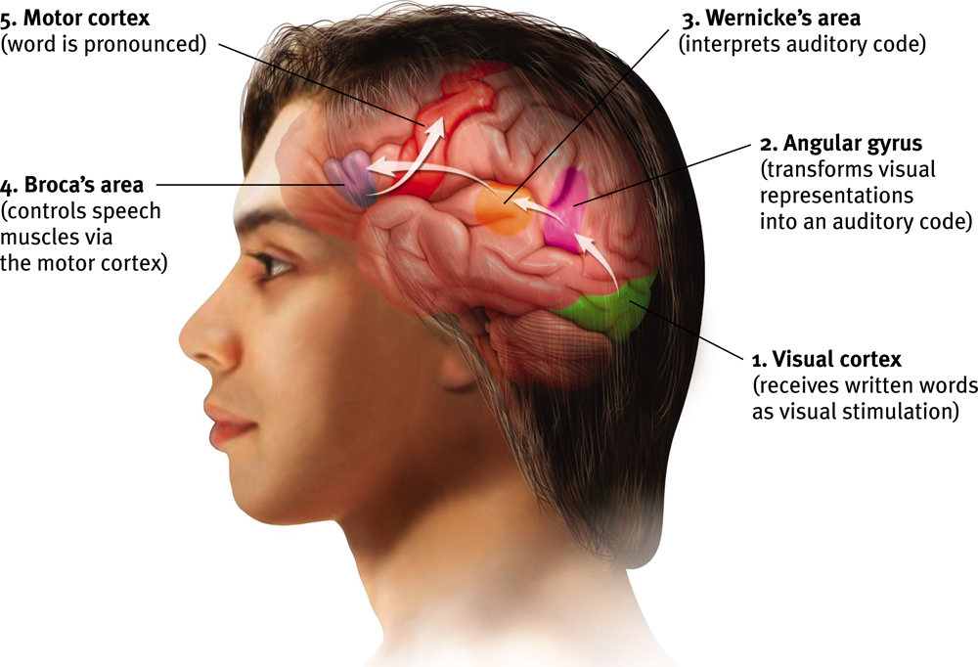
Functions of the Cerebral Cortex:
Five Steps in Reading a Word Aloud
Notes:
Occipital lobe
Paretial lobe
4. Frontal lobe
5. Motor cortex

Slide 20
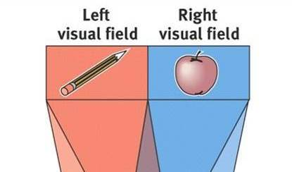
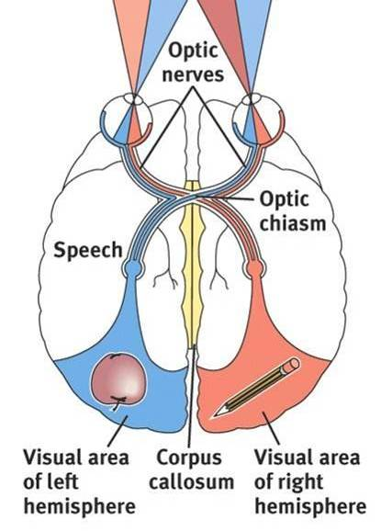
Lateralization of Functions
Brain lateralization: One side of the brain exerts more control over a function than the other:
  Motor control and handedness.
Split-brain surgeries and injuries to only one of the two hemispheres suggest a lateralization of functions:
  Split-brain surgery: The corpus callosum is sectioned to end whole-brain seizures:
    Left hemisphere: Language;
    Right hemisphere: Spatial relations.
  Prosopagnosia: Happens when the right temporal lobe is injured:
    Right Hemisphere: Facial recognition, seeing things as a whole.
  Hemispatial neglect and anosognosia: Happen when a stroke damages the right parietal lobe:
    Left hemisphere: Sense of self, preservation of belief systems.
    Right hemisphere: Correction of belief systems in the face of experience.
Notes:
When a function is lateralized one side of the brain has more control then the other of a function.
Motor control is dominant in the opposite side of the brain of your dominant hand (Right hand/left brain)
Prosopagnosia: can no longer recognize faces. Recognizing someone's face is spatial
There is no relationship between personality and handedness', and there's no truth behind you being left or right brained.

Slide 21
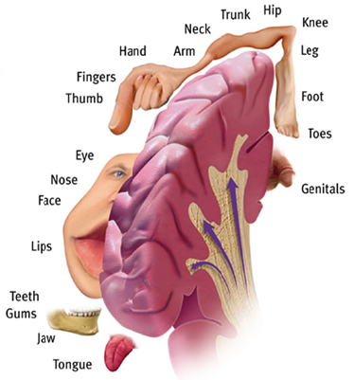
Brain Plasticity
Two major forms:
  Neurogenesis;
  New connections between pre-existing networks;
    Explains phantom limb syndrome.
Notes:
The brain does not repair damaged neurons.
Neurognesis – the brain can form new neurons and add them to exisisting networks but only in two different regions of the brain (subvantricular and hypocampus)

