Slide 1
Planning and Forecasting
Chapter 4
Mechanical Engineering 496
Engineering Management

Slide 2
In Chapter 4, we will:
Explain the importance of planning.
Identify missions.
Explain the roles of goals and objectives.
Identify strategies.
Define the different types of forecasting.
Describe the Delphi Method.
Define different approaches to forecasts.
Discuss some strategies for managing technology.

Slide 3
Planning
Planning provides a method of identifying objectives and designing a sequence of programs and activities to achieve these objectives.
The planning/decision-making process is shown in the figure on the next page.
  The process is rarely as linear or sequential as it appears.
  There is not always one best alternative; often alternatives must be modified or combined to form the best alternative.
  The solution must be audited or monitored to ensure that the original problem has been solved.
  Problem-solving is more often an iterative process.

Slide 4
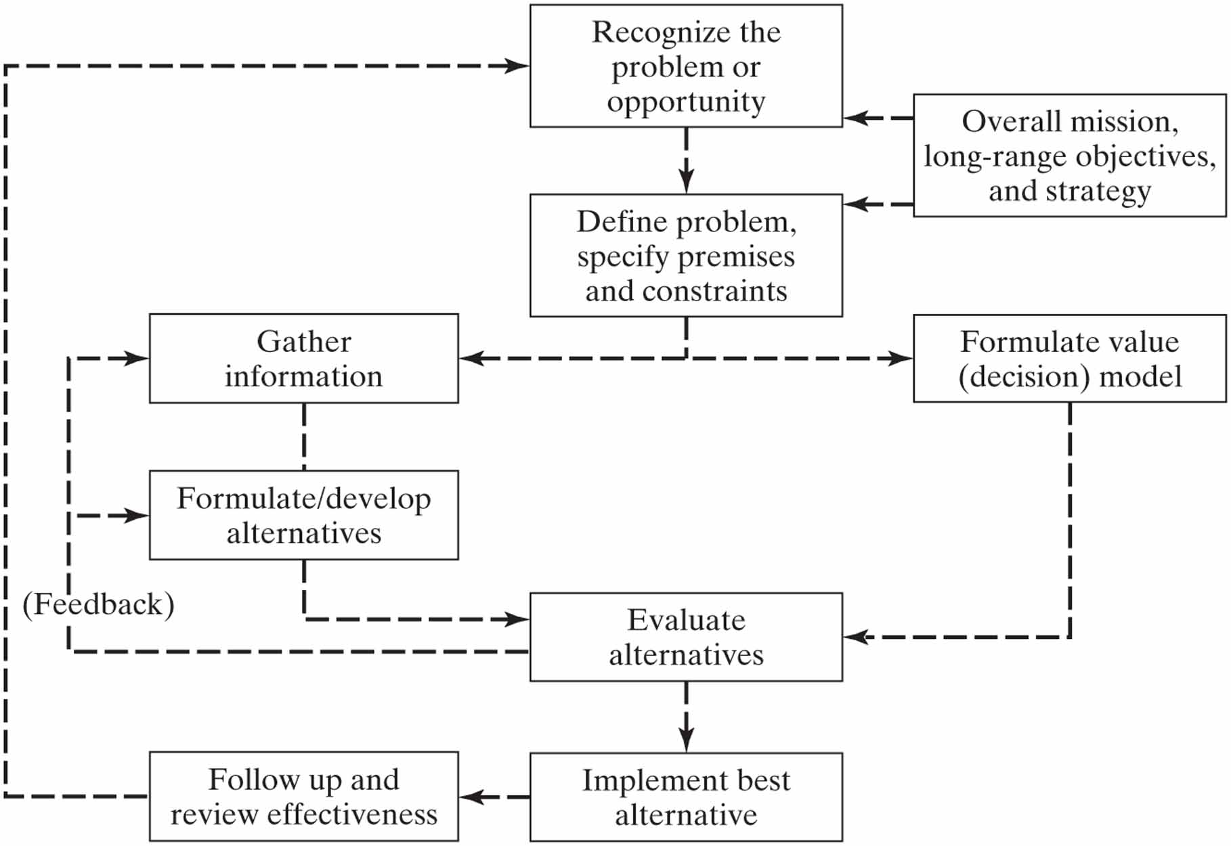
Planning/decision-making process

Slide 5
Strategic planning
Strategic planning is an organization’s process of defining how it will succeed, how it will be competitive.
To determine its future direction, an organization must
  understand its current position and the possible avenues through which it can pursue particular courses of action;
  answer at least one of three key questions:
    What do we do?
    For whom do we do it?
    How do we excel?
The strategic planning process is shown on the next page.

Slide 6
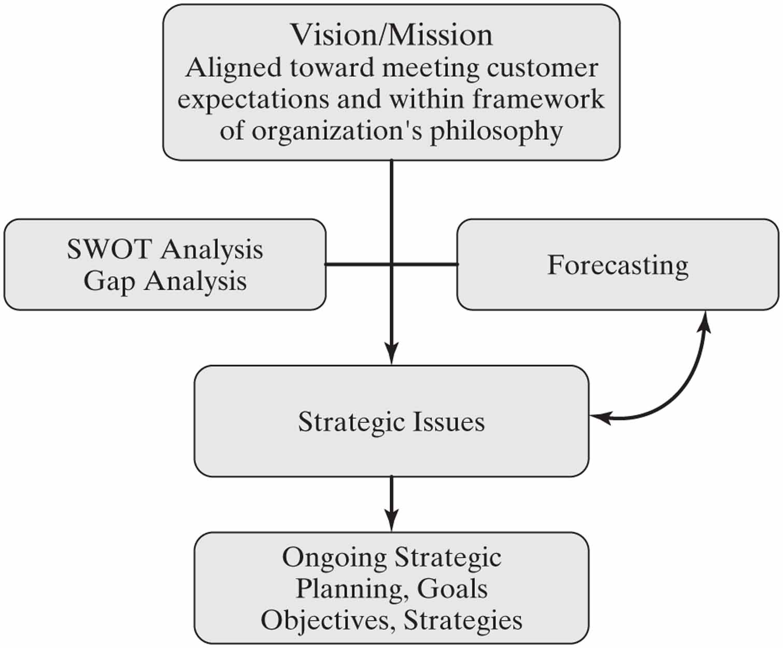
Strategic planning …

Slide 7
Strategic planning …
Key components of strategic planning: understanding of
  Vision— what the organization wants to be; long-term view
    A vision statement describes where the goal setters of an organization want to position themselves and the organization in the future.
  Mission— fundamental purpose of an organization; what it does to achieve its vision
    A mission statement has an immediate business focus with a time horizon; it states publicly what the company is attempting to do.
  Values— beliefs shared among an organization’s stakeholders
  Strategy— ends (goals) toward which the firm is striving and the means (policies) by which it is seeking to get there

Slide 8
Strategic planning …
SWOT (Strengths, Weaknesses, Opportunities, Threats) analysis is used to determine the current situation before formulating a strategy.
Mission
Internal strengths
External opportunities
Analysis
Internal weaknesses
External threats
Strategy

Slide 9
Strategic planning …
Internally, a firm’s strategy should enhance strengths and diminish weaknesses in management, marketing, finances, production, personnel, systems, innovation, etc.
A firm’s strategy should exploit opportunities and protect against threats in its external environment, e.g. customers, competition, government regulation, etc.
A SWOT analysis works with a gap analysis, a technique used to analyze/assess where you are currently with respect to where you would like to be in the future.

Slide 10
Strategic planning …
From the mission statement and the results of the SWOT analysis, the organization must set
  goals that give purpose and direction, and
  objectives that clarify goals and say how they will be met.
Strategies state how to achieve objectives.

Slide 11
Strategic planning …
Objectives must address the organization’s key result areas:
  Market share
  Innovation
  Productivity and quality
  Physical and financial resources
  Manager performance and development
  Worker performance and attitude
  Profitability
  Social responsibility

Slide 12
Management by objectives
Management by objectives (MBO) is a management model that aims to improve performance of an organization by clearly defining objectives that are agreed to by both management and employees.
  According to the theory, having a say in goal setting and action plans should ensure better participation and commitment among employees, as well as alignment of objectives across the organization.
The term was first outlined by Peter Drucker in 1954 in his book “The Practice of Management”.

Slide 13
Planning concepts
A more senior manager is more responsible for planning, but all managers have a continuing responsibility to plan.
The premises of planning are the anticipated environ-ment in which plans are expected to operate:
  assumptions, forecasts, known conditions
The planning horizon is the future time toward which the organization is planning.

Slide 14
Planning concepts …
Policies are guides for decision-making that allow room for interpretation and discretion.
  Rules do not allow discretion.
  Policies have a hierarchy, like plans do.
Procedures are prescribed sequences of activities designed to accomplish desired purposes.

Slide 15
Forecasting
Forecasting: foreseeing what the future will be;
  estimating the results, given the plan or alternatives and the possible environment in which they will be implemented.
  Methods can be qualitative or quantitative.
Qualitative methods:
  Jury of executive opinion— educated guesses of future outcomes by executives of the organization
  Sales force composite— members of the sales force estimate sales outcomes in their own territories
  Users’ expectation— customers project their future needs; market surveys are expensive and can be unreliable.

Slide 16
Forecasting …
Quantitative methods:
  Simple moving average— the forecast F_{n+1} for the next period is a simple average of the n most recent actual values A_{t}:
  Weighted moving average— similar to the above; allows the user to apply differing emphasis on the actual results of past periods:

Slide 17
Forecasting …
  Exponential smoothing— similar to weighted moving average; reduces the weight of a value as it becomes older (α < 1):
  Simple regression model— estimates a linear relationship with intercept, a, and slope, b, between variable D, the dependent variable, and I, the independent variable (see the next page):
  Multiple regression model— dependent variable D is estimated to be a function of more than one independent variable with direct, inverse, exponential, or power proportionality, e.g.

Slide 18
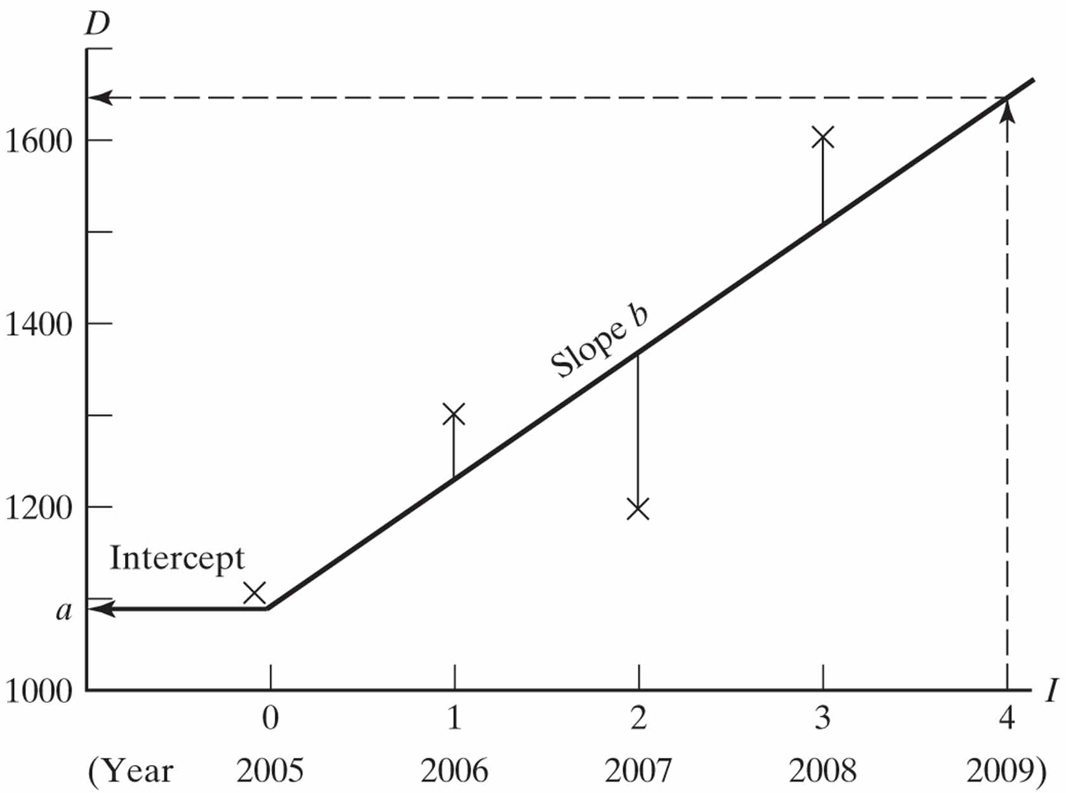
Forecasting …

Slide 19
Forecasting …
Technological forecasting; three premises:
  technological events and capabilities grow in an organized way
  technology responds to needs, opportunities, and the provision of resources
  new technology can be anticipated by understanding the process of innovation
Normative technological forecasting— a desired future goal is selected; a process is developed that is designed to achieve this goal by working backward from the future to the present.
Notes:
new tehnology
an e antiipated y understanding the proess of innovation

Slide 20
Forecasting …
Exploratory technological forecasting— often performed using a panel of experts (the Delphi method):
  Each expert is invited to offer a view of the future.
  The views are summarized and communicated to the experts.
  The experts are invited to contribute their opinions in additional rounds until some consensus is achieved.
Technology S-curve— performance gains from a new technology develop slowly, then accelerate for a time, finally leveling off as the technology matures (see the next page).

Slide 21
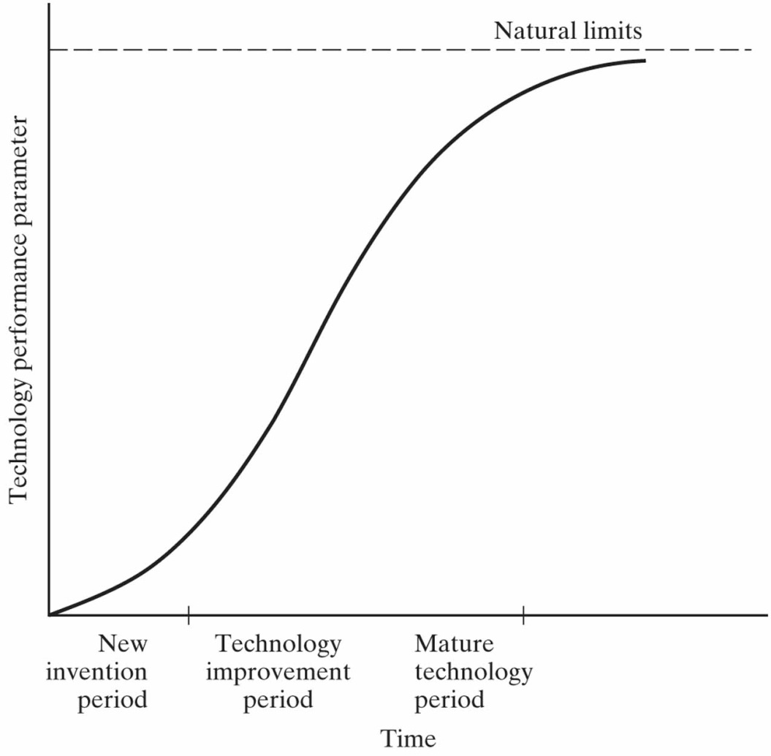
Forecasting …

Slide 22
Managing technology
Invention and innovation
Technological innovation is the introduction to the market of new products, processes, or services based on new technology.
Product innovation and improvement must be continuing parts of a strategy that relies on technology.
The competitiveness of an enterprise depends on:
  doing new and better things (invention and innovation)
  doing things in new and better ways (quality and productivity)

Slide 23
Managing technology …
Managing technological change
Top management in technological enterprises must constantly monitor the technologies underlying their businesses and recognize the potential for change.
Companies can prosper when they focus on integrating technology strategy with business strategy.
The best modern example of this is the use of the internet as a tool for marketing and for providing service to customers.

