Slide 1
Leading People
Chapter 3
Mechanical Engineering 496
Engineering Management

Slide 2
In Chapter 3, we will:
Explain the differences between leaders and managers.
Describe the nature of leadership and its significance to an organization.
Address the application of servant leadership in current organizations.
Recognize the different views of motivation.
Explain why communication skills are important to an engineer.

Slide 3
Leadership and management
In Chapter 1, we introduced four management functions: planning, organizing, leading, and controlling.
  Leading: using social influence to enlist the aid and support of others in the accomplishment of a common task
  Managing: action, including design, that facilitates the production of useful outcomes from a system
People can become leaders either through
  appointment— formal (titular) leaders who have the opportunity to prove themselves effective at leadership
  emergence— informal leaders evolve from their expertise or referent power as it is expressed in the process of group activity

Slide 4
Leadership and management …
The differences between managers and leaders are sometimes stark and sometimes subtle.
Managers | Leaders
Administer | Innovate
Ask how and when | Ask what and why
Focus on systems | Focus on people
Do things right | Do the right things
Maintain | Develop
Short-term perspective | Longer-term perspective
Imitate | Originate
Can be imitated | Are original

Slide 5
Characteristics of leaders
Research produced this list of traits of effective leaders:
  Physical: health, vitality, and endurance
  Personal: magnetism, cooperativeness, enthusiasm, ability to inspire, persuasiveness, forcefulness, and tact
  Character: humanism, self-discipline, stability, and industry
  Intellectual: mental capacity, ability to teach others, and a scientific approach to problems
The leadership traits that were most valued by engineers:
  Starting— ability to inspire, persuasiveness, mental capacity
  Mid career— enthusiasm, stability, self-discipline
  Experienced— integrity, ability to inspire, tact

Slide 6
Myers-Briggs preferences
The Myers–Briggs Type Indicator (MBTI) measures personal preferences on four scales of opposites:
  Extraversion E focuses externally on people and things; Introversion I focuses internally on ideas and impressions.
  Intuition N focuses on the future with a view toward patterns and possibilities; Sensing S focuses on the present and on concrete information gained from the senses.
  Thinking T bases decisions on logic and on objective analysis of cause and effect); Feeling F bases decisions on values and on subjective evaluation of person-centred concerns.

Slide 7
Myers-Briggs preferences …
    Judging J prefers a planned and organized approach to life; Perceiving P prefers a flexible and spontaneous approach.
Engineers are generally ENTJ or INTJ.
  Successful engineering managers are mainly ENTJ.
  Researchers are mainly INTJ.
  Only about two percent of the total population are in these categories.

Slide 8
People/task matrix approaches
The leadership grid— management style is characterized by its placement on two scales: concern for people and concern for production (or results). See the figure on the following page.
  9, 9 Team management is considered the ultimate in effective management.
  Other grid positions lead to problems:
    1, 9 Country club— enjoyable, but not productive
    9, 1 Authority-compliance— nonresponsive, Theory X workforce
    5, 5 Middle of the road— adequate performance and morale; mediocrity
    1, 1 Impoverished— minimal effort; destined to fail or be replaced

Slide 9
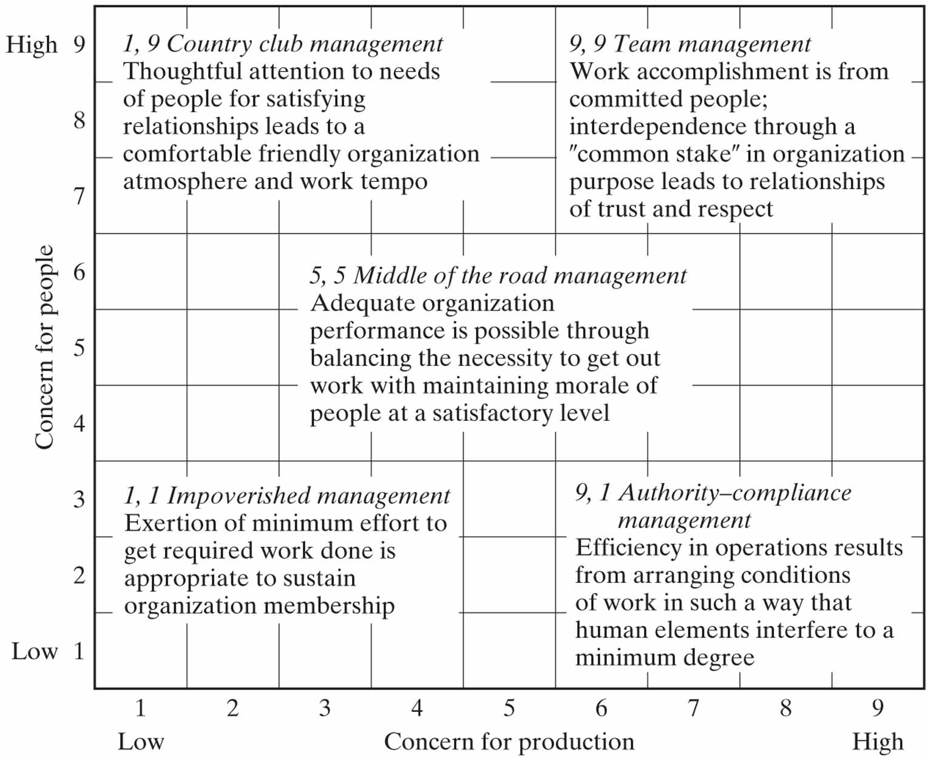
People/task matrix approaches …

Slide 10
People/task matrix approaches …
Michigan and Ohio State studies— compared job-centred (initiating structure) to employee-centred (consideration) supervision.
  The best style depends mainly on the nature of the work.
  Hersey and Blanchard Life-Cycle Theory— proposed that the most effective leadership progresses through the quadrants counter-clockwise from high IS + low C to low IS + low C.
Initiating structure (IS) | Consideration
 | Low | High
High | High IS + Low C | High IS + High C
Low | Low IS + Low C | Low IS + High C

Slide 11
Situational approaches
Contingency theory says that there is no single best way to manage.
There is a leadership continuum:
  Autocratic (telling); manager makes decisions essentially alone with little or no involvement of nonmanagers
  Diplomatic (selling); manager attempts to persuade nonmana-gers to accept decisions that were made without consultation
  Consultative (consulting); manager uses ideas from nonmana-gers in own decisions
  Participative (joining); manager involve nonmanagers heavily in decisions and may delegate decisions to nonmanagers

Slide 12
Situational approaches …
Servant leadership— people serve first, then lead as a way of expanding service to individuals and institutions.
  Based on collaboration, trust, empathy, and ethical use of power
Types of leaders who are effective:
Executive | Motto
Entrepreneur | We do it my way. Only risk-taking achievers need apply.
Corporateur | I call the shots, and we all work together on my team.
Developer | People are our most important resource.
Craftsman | We do important work as perfectly as we can.
Integrator | We build consensus and commitment.
Gamesman | We win together, but I must win more than you.

Slide 13
Situational approaches …
Other types of leaders who are merely successful:
Executive | Motto
Bureaucrat | We go by the book.
Zealot | We do things my way, in spite of the organization.
Machiavellian | We depersonalize and use you.
Missionary | We love one another.
Climber | I vault over anyone I can.
Exploiter | When I bark, they jump.
Temporizer | We bend to the strongest pressure.
Glad-Hander | We sell the sizzle, not the steak.

Slide 14
Motivation
Motivation is a psychological feature that arouses a person to act towards a desired goal and elicits, controls, and sustains certain goal-directed behaviours.
In an organizational sense, motivation is the willingness to exert the levels of effort needed to reach organization-al goals, conditioned by the effort’s ability to satisfy some individual need.

Slide 15
Motivation theories
McGregor’s Theory X and Theory Y:
  Theory X: Management must direct the efforts of people, motivate and control them using behaviour modification because they would otherwise be passive or resistant to the organization’s needs. Methods include: persuasion, reward, punishment, and control.
  Theory Y: Management must make it possible for people to achieve their goals best by directing their own efforts toward organizational objectives and to make it possible for people to develop themselves since they are naturally motivated, have the potential to develop, and the capacity to assume responsibility.

Slide 16
Motivation: content theories
Maslow’s Hierarchy of Needs: human needs are arranged in hierarchies of pre-potency; the appearance of one need rests on the prior satisfaction of another.
  See the figure on the following page.
Maslow considered his hierarchy to be approximately appropriate in terms of needs satisfaction for most of us.
Others, notably Geert Hofstede, have criticized it as being ethnocentric, i.e. appropriate for individualistic societies, but not for collectivist societies.

Slide 17
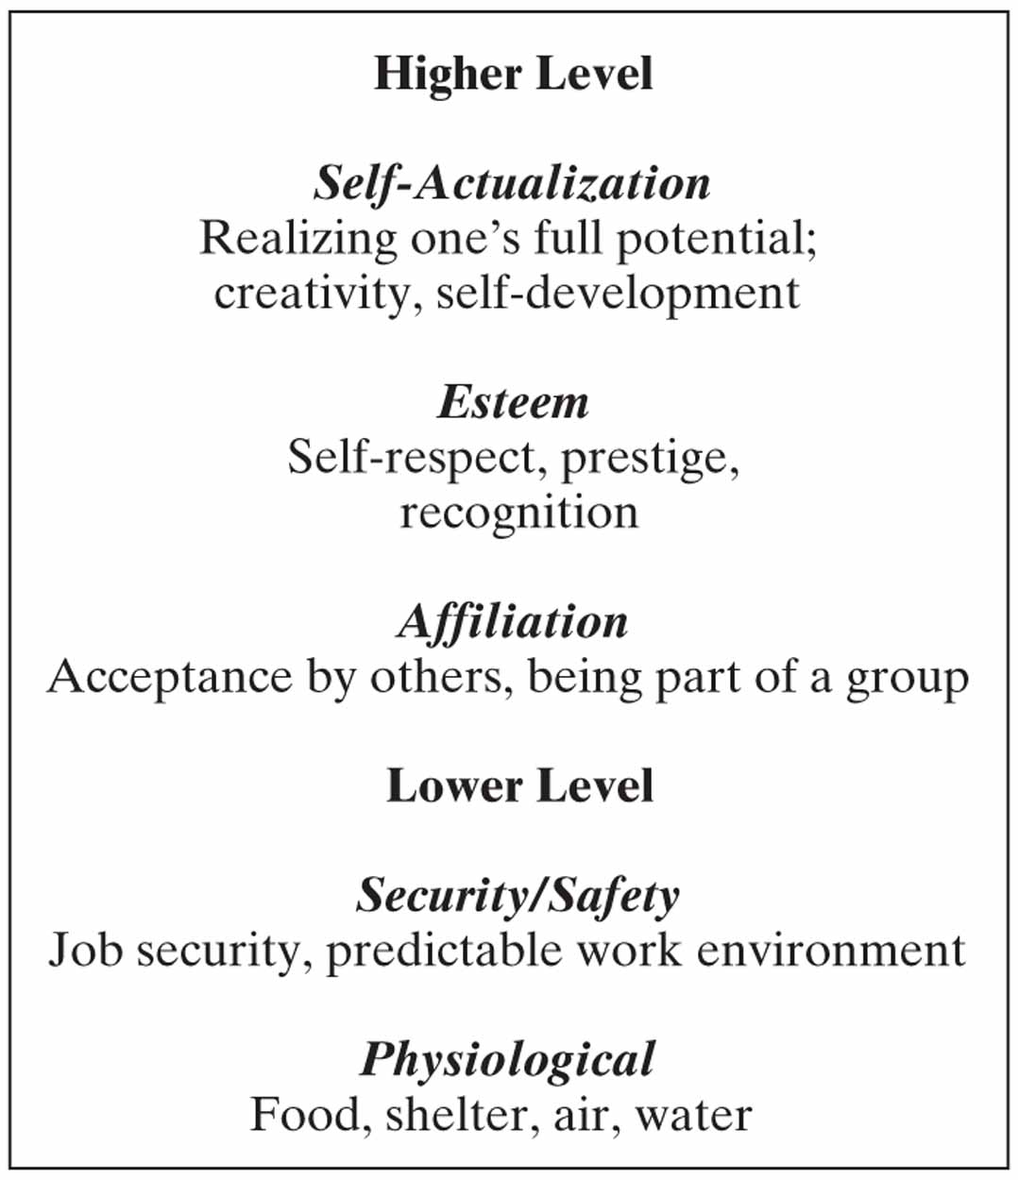
Motivation: content theories …

Slide 18
Motivation: content theories …
Herzberg’s Two-Factor (Motivation-Hygiene) Theory: certain factors in the workplace cause job satis-faction; a separate set of factors cause dissatisfaction.
  Individuals are not content with the satisfaction of lower-order (hygiene) needs at work, for example, those associated with minimum salary levels or safe and pleasant working conditions.
  Individuals look for the gratification of higher-level psychologi-cal (motivator) needs having to do with achievement, recogni-tion, responsibility, advancement, and the nature of the work.
See the table of factors on the following page.

Slide 19
Motivation: content theories …
Herzberg proposed job enrichment: reduce control, give feedback on performance, provide challenging work, etc.
Hygiene Factors | Motivator Factors
Salary | Recognition
Working conditions | Work itself
Company policies | Responsibility
Relationship with boss | Advancement
Relationship with peers | Achievement

Slide 20
Motivation: content theories …
McClelland’s Trio of Needs:
  Need for achievement. People who typically prefer to master a task or situation, prefer working on tasks of moderate difficulty, prefer work in which the results are based on their effort rather than on luck, and prefer to receive feedback on their work.
  Need for power. Stems from a person’s desire to influence, teach or encourage others; people who enjoy work and place a high value on discipline.
  Need for affiliation. People who prefer to spend time creating and maintaining social relationships, enjoy being part of groups, and have a desire to feel loved and accepted.

Slide 21
Motivation: process theories
Equity Theory: attempts to explain relational satisfac-tion in terms of perceptions of fair/unfair distributions of resources within interpersonal relationships.
John Stacey Adams stated in 1963 that employees seek to maintain equity between the inputs that they bring to a job and the outcomes that they receive from it against the perceived inputs and outcomes of others.

Slide 22
Motivation: process theories …
Expectancy Theory: individuals behave in certain ways because they are motivated to select a specific behaviour over other behaviours based on what they expect the result of that selected behaviour will be.
  Victor H. Vroom stated in 1964 that organizations need to relate rewards directly to performance and ensure that the rewards provided are the ones deserved and wanted by the recipients.
Key elements of the theory (see the figure overleaf):
  Expectancy: effort-to-performance (E→P)— belief that one’s effort will result in attainment of desired performance goals

Slide 23
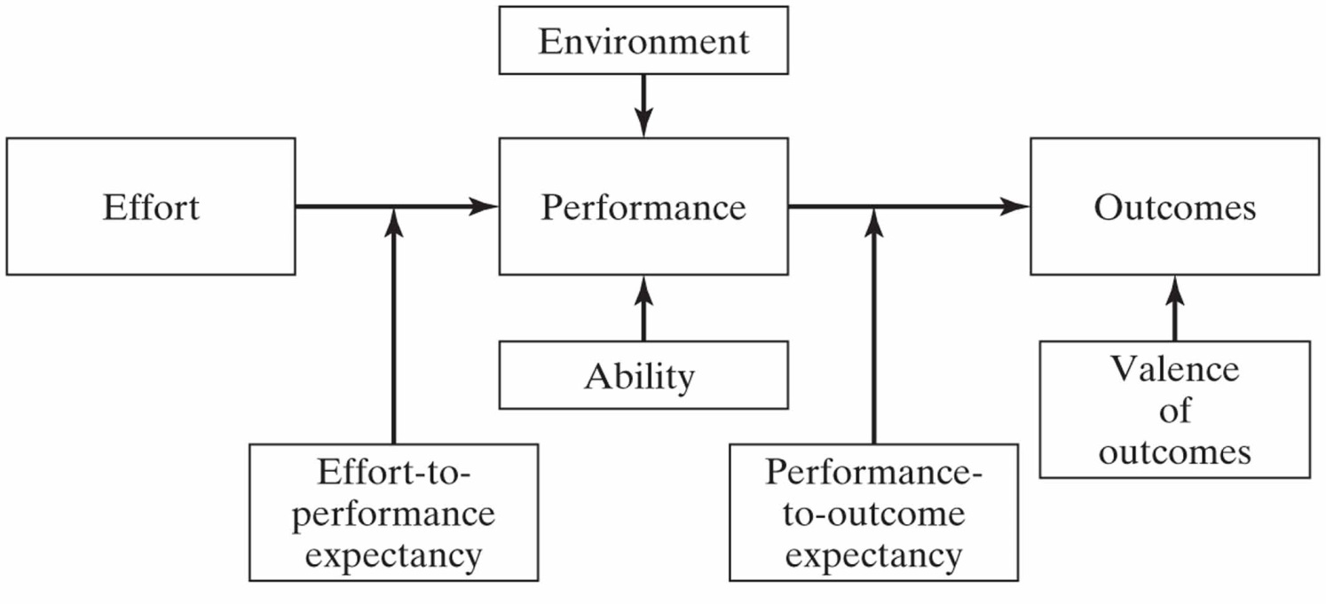
Motivation: process theories …
  Instrumentality: performance-to-outcome (P→O)— belief that a person will be rewarded if the performance expectation is met
  Valence: the value an individual places on rewards based on their needs, goals, values and sources of motivation

Slide 24
Motivation: process theories …
Behaviour Modification: behaviour is followed by an event (reinforcement) that affects the probability the behaviour is repeated; see also “operant conditioning”
  Introduced by B. F. Skinner in “The Behaviour of Organisms”
There are five recognized procedures.
  Reinforcement and punishment, the core tools of operant condi-tioning, are either positive (delivered following a response), or negative (withdrawn following a response). This creates four basic procedures. The fifth procedure is known as extinction, i.e. no change in consequences following a response.

Slide 25
Motivation: process theories …
  Positive reinforcement— a behaviour is followed by a stimulus that is rewarding, thereby increasing that behaviour’s frequency.
  Negative reinforcement— a behaviour is followed by removing an adverse stimulus, thus increasing that behaviour’s frequency.
  Positive punishment— a behaviour is followed by a stimulus, such as introducing a shock or loud noise, resulting in a decrease in that behaviour.
  Negative punishment— a behaviour is followed by the removal of a stimulus, such as taking away a child’s toy following an undesired behaviour, resulting in a decrease in that behaviour.
  Extinction— absence of reinforcements; may unintentionally lower desirable behaviour that has previously been reinforced.

Slide 26
Motivating & leading technical professionals
General characteristics of technical professionals:
  Have a high need for achievement; derive motivation from their work, especially when they can achieve their professional goals
  Desire autonomy; need to participate in goal setting and decision making as it affects their work
  Tend to identify with their profession first, with their company second; look to their peers for recognition, ethical standards, and collegial support
  Seek to maintain their expertise and avoid obsolescence through professional development, continuing education, reading, and working at the state of the art

Slide 27
Motivating & leading technical professionals
Scientists and engineers are both technical professionals, but are motivated by different conditions. For instance:
  A scientist values autonomy and publication of results; an engineer is a team worker who places little value on publication.
  A scientist depends on reputation with peers outside the company; the engineer’s advancement is tied more to activities within the company.

Slide 28
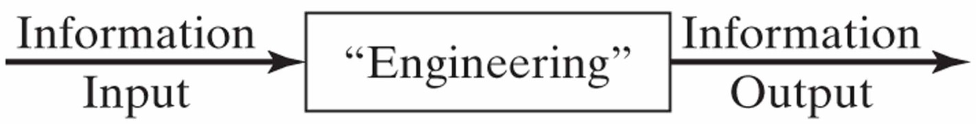
Communication
Communication: a way to make information productive
  the transfer of information from the sender to the receiver, with the information being understood by the receiver
Engineering is a transformation process in which information is received, transformed in some way, and the results transmitted to others, as shown above.
  The information output must be effectively communicated so that the meticulous engineering performed will have full value.

Slide 29
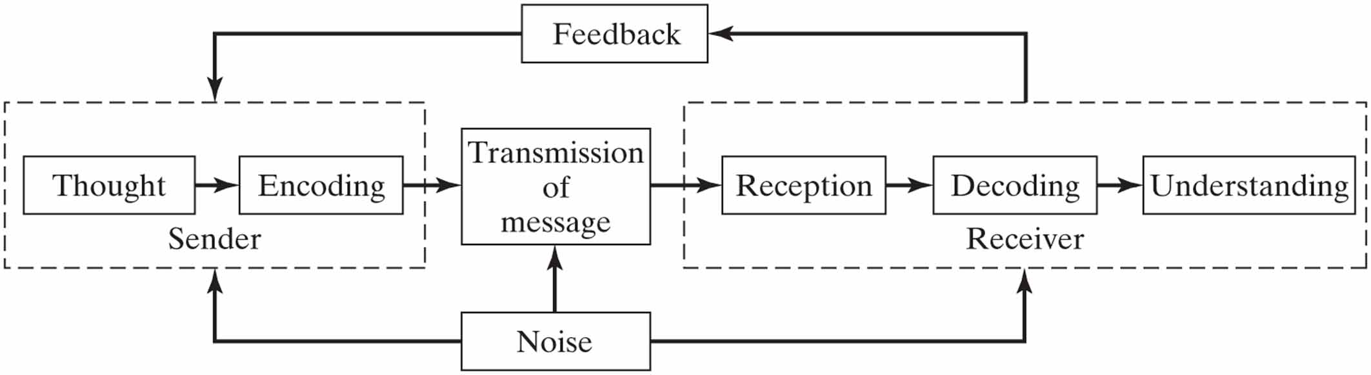
Communication …
Communication (writing, reading, meetings, phone con-versations) takes about 90 percent of a manager’s time.
  Good communication skills are essential to a manager.
The communication process, shown below, applies to all forms of communication.

Slide 30
Communication …
Communication methods differ in terms of their speed, complexity, cost, formality, feedback, and recording.
  Depending on the occasion and the need or purpose, the best communication method (medium) may come from this list:
    Informal conversation, phone conversation— fast, simple, low-medium cost, informal, medium-high feedback, no record
    Formal presentation — medium speed, medium complexity, medium cost, formal, high feedback, record available
    Informal note, memo— medium speed, simple-to-low complexity, low-medium cost, informal, low feedback, record available
    Letter, formal report— slow, complex, high cost, formal, low feedback, record kept

Slide 31
Communication …
The effectiveness of media, in decreasing order, is:
  Oral plus written presentation
  Oral only
  Written only
  The grapevine
Other factors for effective communication:
  Active listening— listen positively and attentively; analyze the speaker’s attitude, frame of mind; try to understand the meaning
  Nonverbal communication—pitch, stress, tone, pauses, expression, eye contact, posture, gestures, and body movement

Slide 32
Communication …
Important management tools for communication:
  The written report
    Begin with an executive summary; a busy reader may look at this only.
    Carefully structure the report and write an outline first.
    Review thoroughly for clarity, grammar, word usage, spelling, etc.
  The oral briefing
    Presentation of analyzed, synthesized information to inform a group
    Often involves mixed media visual aids: slides, charts, video, etc.
  Visual aids
    PowerPoint® slides are often used; they are aids, not the presentation.
    Prepare well, avoid pitfalls, and rehearse thoroughly before presenting.

