Slide 1
History and Development of Engineering Management
Chapter 2
Mechanical Engineering 496
Engineering Management

Slide 2
In Chapter 2, we will:
Describe the origins of engineering management.
Identify the different basic management philosophies.
Discuss the future issues that will affect the continuing development of engineering management.

Slide 3
Early history
Civilizations performed engineering feats that required management skills to serve the needs of people who shared a common purpose.
  Jericho— walled city of 1000 people; 6000 B.C.
  River Gangir— canals; 4500 B.C.
  Babylon, Mesopotamia— temples; administration, plans, records, division of labour; 3000 B.C.
  Nile Valley, Egypt— pyramids; 2500 B.C.
  Babylon— Code of Hammurabi; 2100 B.C.
  Imperial Rome— military, roads, water management, civil government; 27 B.C. – 476 A.D.

Slide 4
Medieval period (Dark Ages) to the Renaissance
After the Western Roman Empire collapsed, the Dark Ages, a period of intellectual darkness and economic repression, lasted from the 5th to the 15th century A.D.
Established in 1104, the Venetian Arsenal had developed many engineering and management practices by 1450:
  manufacture of ships (galleys), arms, and equipment
  storage of equipment and materials until needed
  assembly of ships and refitting of ships on reserve
  industrial management: warehousing, inventory control, personnel policies, standardization, accounting, cost control

Slide 5
The industrial revolution
The industrial revolution (about 1760 to 1840) was characterized by phenomenal gains in productivity driven by several main technological innovations:
  Textiles— mechanized cotton spinning, the power loom, the cotton gin; spinning and weaving of wool and linen
  Steam power— steam engines, stationary engines producing rotary motion, transportation
  Iron making— coke, cast iron blowing cylinder, puddling process, rolling mill, hot blast
  Chemicals— sulphuric acid, synthetic soda ash and potash, bleaching agents, portland cement, dyestuffs, to name a few

Slide 6
The industrial revolution …
While the industrial revolution created many benefits and improvements, it also brought tremendous social and economic upheaval:
  mass migration from rural locales to urban centres with mines, mills, and factories
  malnutrition; disease; substandard, crowded housing
  population explosion; creation of a middle class
  deterioration of working conditions; child labour
  resistance to progress: Luddites
  organization of labour; formation of guilds and societies

Slide 7
Management philosophies — scientific management
Scientific management:
  analyzes and synthesizes work-flows to improve economic efficiency, especially labour productivity.
  Themes: analysis, synthesis, logic, rationality, empiricism, work ethic, efficiency, elimination of waste, standardization, best practices, transformation of craft production into mass production, knowledge transfer
Scientific management has been attributed to:
  Charles Babbage (1791–1871)— difference engine (computer)
  Henry Towne (1844–1924)— first to see the importance of management techniques to the engineering profession

Slide 8
Management philosophies — scientific management …
Scientific management has been attributed to …:
  Frederick W. Taylor (1856–1915)— break a job into elementary motions, discard those that are unnecessary, devise the most efficient method, teach the resulting methods to workers.
    Replace rule-of-thumb work methods with methods based on a scientific study of the tasks.
    Scientifically select, train, and develop each employee rather than passively leaving them to train themselves.
    Provide detailed instruction and supervision of each worker in the performance of that worker’s discrete task.
    Divide work nearly equally between managers and workers, so that the managers apply scientific management principles to planning the work and the workers actually perform the tasks.

Slide 9
Management philosophies — scientific management …
Scientific management has been attributed to …:
  The Gilbreths, Frank B. (1868–1924) and Lillian M. (1878–1972)— analyzed a job to eliminate unnecessary motions and devised a system of classifying hand motions into seventeen basic units, called “therbligs”. Together, they developed the study of workplace psychology.
  Henry L. Gantt (1861–1919)— devised a chart for planning and controlling work; task and bonus system; social responsibility

Slide 10
Management philosophies — administrative management
Administrative management refers to:
  how a business organizes
  the practices a successful manager should follow
  the way order and structure are used to accomplish tasks
Administrative management has been attributed to:
  Henri Fayol (1841–1925)— divided administration into:
    Planning/forecasting
    Organization
    Command
    Coordination
    Control

Slide 11
Management philosophies — administrative management …
Administrative management has been attributed to …:
  Max Weber (1864–1920)— developed a model for a rational and efficient large organization, a bureaucracy, in which:
    The basic organizational unit is the office or position.
    Members of the organization owe loyalty to the office, not the individual.
    Candidates for offices are selected/appointed on their technical capability.
    Offices are organized in a clearly defined hierarchy.
    Office holders are subject to strict, systematic discipline and control in the conduct of the offices and subordinates have the right of appeal.
    Administrative acts, decisions, and rules must be reduced to writing.
    The office is the primary occupation of the incumbent on a fixed salary.
    Promotion is based on the judgment of superiors.
    Office holders are separate from the owners of the organization.

Slide 12
Management philosophies — behavioural management
Behavioural management investigates the impact that individuals, groups and structures have on behaviour within an organization for the purpose of using such knowledge to improve an organization’s effectiveness.
Behavioural management has been attributed to:
  Elton Mayo— headed the Hawthorne Studies at Harvard. In “Human Problems of an Industrial Civilization”, (1931) he advised managers to deal with emotional needs of employees.
  Mary Parker Follett— provided analyses on workers as having complex combinations of attitudes, beliefs, and needs; told man-agers to motivate employees based on their job performance.

Slide 13
Management philosophies — behavioural management …
Behavioural management has been attributed to …:
  Douglas McGregor— two theories about human nature:
    Theory X which is pessimistic and negative; according to McGregor it is how managers traditionally perceive their workers.
    Theory Y which takes a more modern and positive approach; he believed that managers would achieve more if they perceived employees as self-energized, committed, responsible and creative beings.
  Abraham Maslow— created a hierarchy of needs, a theory of psychological health predicated on fulfilling innate human needs in priority, culminating in self-actualization.
  Frederick Herzberg— introduced job enrichment and the Motivator-Hygiene theory.

Slide 14
Management philosophies — behavioural management …
Behavioural management has been attributed to …:
  David McClelland— worked on Need Theory; developed new scoring systems for the Thematic Apperception Test; developed the Achievement Motivation Theory commonly referred to as need achievement or n-achievement theory.
  Chester Barnard— wrote “The Functions of the Executive” which sets out a theory of organization and of the functions of executives in organizations.
  Victor Vroom—researched the expectancy theory of motiva-tion: why individuals choose to follow certain courses of action in organizations, particularly in decision-making and leadership.

Slide 15
Contemporary management issues and challenges
Quality management
  ensures that an organization or product is consistent by practicing quality planning, quality control, quality assurance and quality improvement;
  is focused not only on product/service quality, but also the means to achieve it;
  uses quality assurance and control of processes as well as products to achieve more consistent quality.

Slide 16
Contemporary management issues and challenges …
Customer focus
  the orientation of an organization to serve its clients’ needs;
  a strong contributor to the overall success of a business;
  involves ensuring that all aspects of the company put its customers’ satisfaction first;
  maintaining an effective customer relations and service program.
  See the CASA/SME CIM (Computer Integrated Manufacturing) model on the next page.

Slide 17
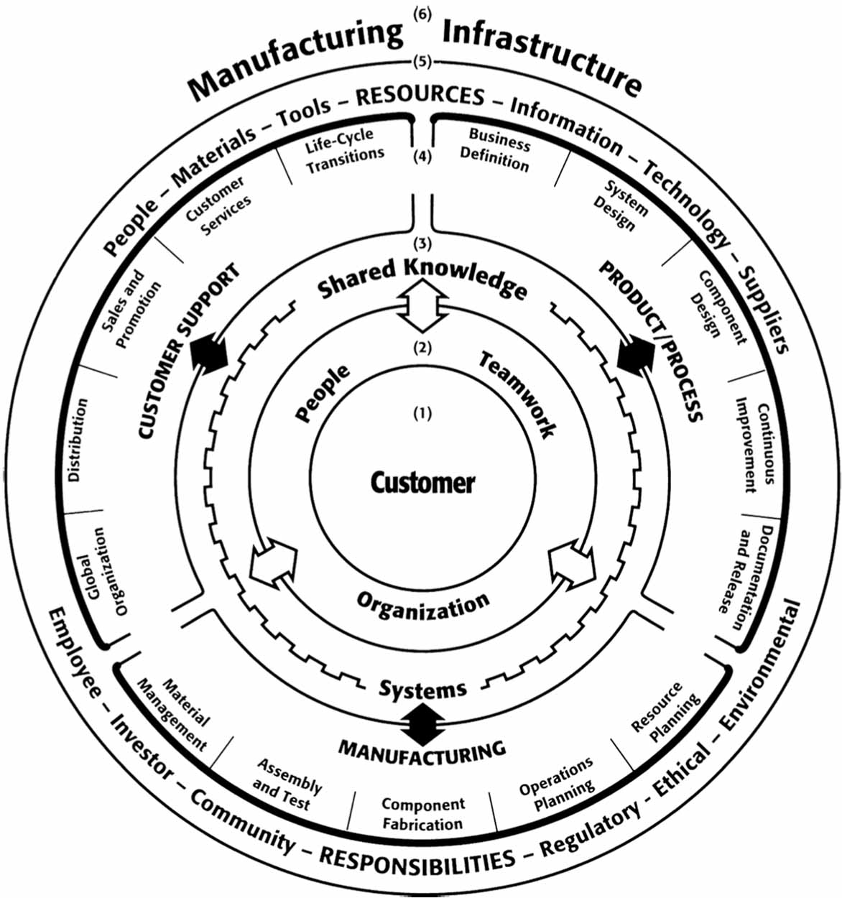
Contemporary management issues and challenges …

Slide 18
Contemporary management issues and challenges …
Information technology:
  the application of computers and telecommunications equipment to store, retrieve, transmit and manipulate data;
  computers and computer networks, other information distribution technologies such as television and telephones;
  associated industries include computer hardware, software, electronics, semiconductors, internet, telecom equipment, e-commerce and computer services.
  in a business context, it is defined as “the study, design, development, application, implementation, support or management of computer-based information systems.”

Slide 19
Contemporary management issues and challenges …
Project management
  the discipline of planning, organizing, motivating, and controlling resources to achieve specific goals;
  the primary challenge is to achieve all of the project goals and objectives while honouring the preconceived constraints:
    the primary constraints are scope, time, quality and budget;
    the secondary and more ambitious challenge is to optimize the allocation of necessary inputs and integrate them to meet pre-defined objectives.
  Visit the Project Management Institute.

Slide 20
Contemporary management issues and challenges …
Globalization
  has increased the flow of goods, services, money, people, knowledge and jobs across geographic and political boundaries;
  today, all business is global, competition comes from everywhere, and jobs are borderless.
  Career building is a continuous activity that requires awareness, and adjustments to take advantage of changes in local, national and international conditions.
  You must manoeuver, which requires focus and strategy.

Slide 21
Contemporary management issues and challenges …
Management theory and leadership
  The world of management has been covered by practitioners who espouse pet theories like “management by walking around” and catchphrases like “do the right thing and do the thing right”.
  Authors on strategy, management, and leadership include:
    Peter Drucker— leader in the development of management education; invented the concept known as management by objectives
    Michael Porter— leading authority on company strategy and the competitiveness of nations and regions
    Philip Kotler— describes strategic marketing as serving as “the link between society’s needs and its pattern of industrial response”

