Slide 1
Introduction — Engineering and Management
Chapter 1
Mechanical Engineering 496
Engineering Management

Slide 2
In Chapter 1, we will:
Describe the origins of engineering practice.
Identify the functions of management.
Explain what Engineering Management is.
Explain why engineers are needed in management.

Slide 3
Engineering and engineers
What is engineering?
  the art of directing the great sources of power in nature, for the use and convenience of man
  the profession in which a knowledge of the mathematical and natural sciences gained by study, experience, and practice is applied with judgement to develop ways to utilize economical-ly the materials and forces of nature for the benefit of mankind
  the application of science and mathematics by which the properties of matter and the sources of energy in nature are made useful to man in structures, machines, products, systems, and processes.

Slide 4
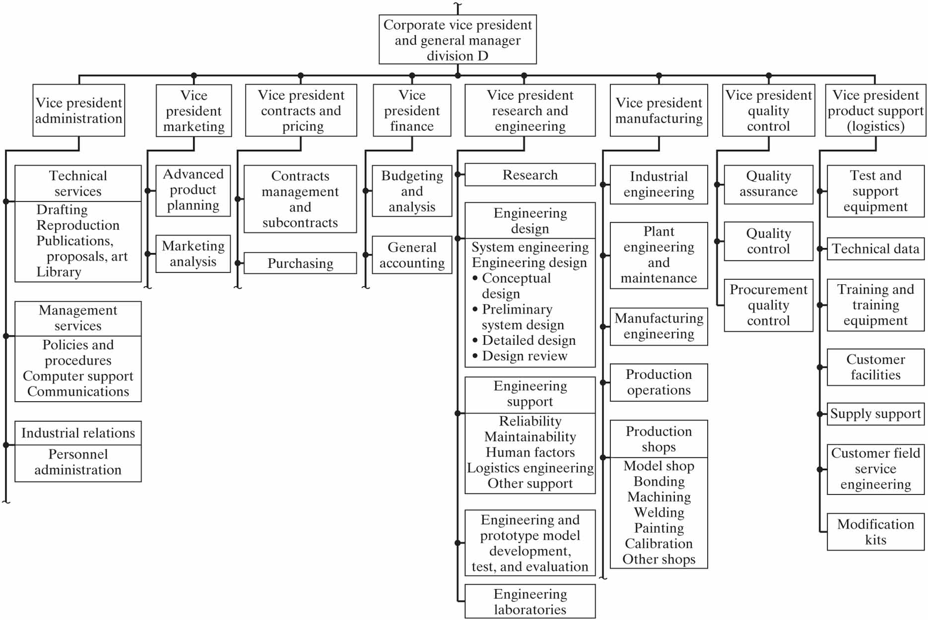
Engineering and engineers …
What engineers do …

Slide 5
Management
“Management” can be used in four distinct ways:
  an organizational or administrative process
  a science, discipline, or art
  the group of people running an organization
  an occupational career
Management is a set of activities (planning and decision making, organizing, leading, and controlling) directed at an organization’s resources (human, financial, physical, and information) with the aim of achieving organization-al goals in an efficient and effective manner.

Slide 6
Management levels and managerial skills
Management is performed generally on three levels:
  First-line: direct supervision of nonmanagers
  Middle: manage through other managers
  Top: board chairman, president, vice president, chief officer
Managers must possess skills in three areas:
  Technical: the skills that are practiced by the supervised group; e.g. engineering, accounting, machining, etc.
  Interpersonal: skills and abilities used to achieve results through the efforts of other people
  Conceptual: ability to discern the critical factors and determine what the organization must do to succeed

Slide 7
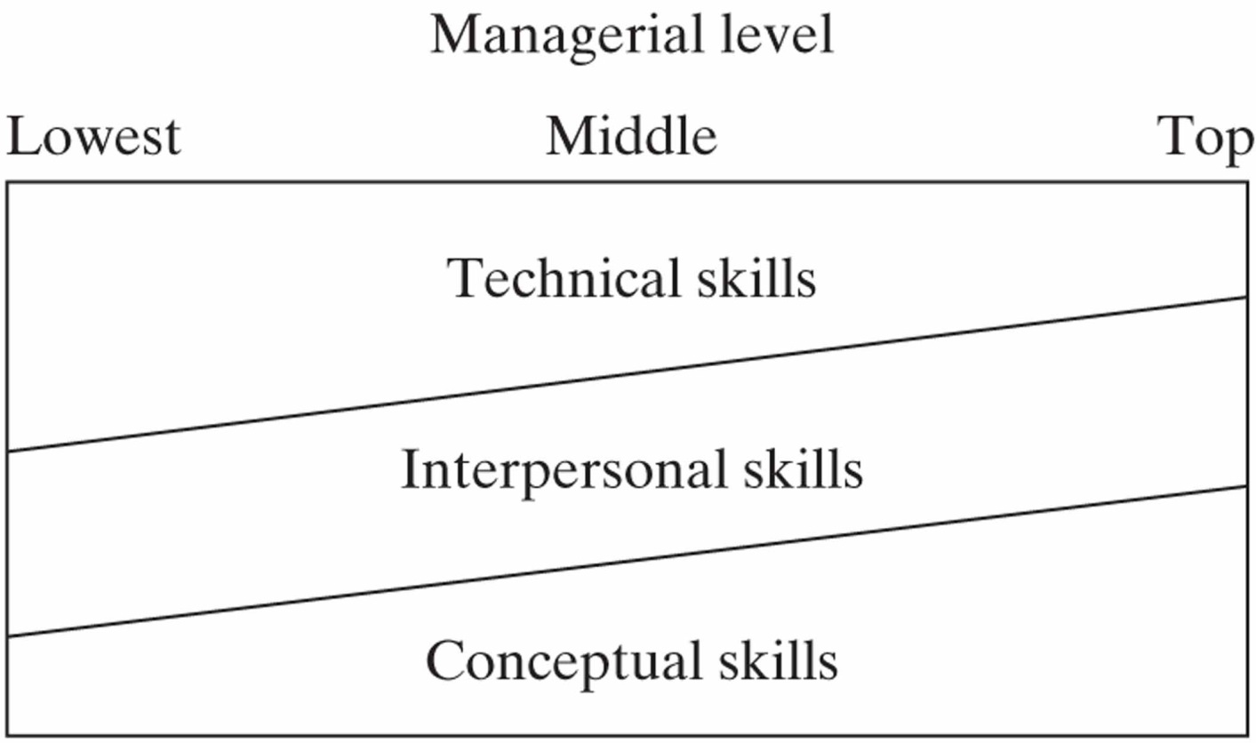
Management levels and managerial skills…
Depending on the level of management, a manager will generally possess and practice a mix of managerial skills.

Slide 8
Managerial roles (Mintzberg)
Henry Mintzberg says a manager has three types of role: interpersonal, informational, and decisional.
Depending on the direction of the relationship, interpersonal roles have three types:
  Figurehead— actions of the symbolic head of an organization (outward)
  Leader— selecting, guiding, and motivating subordinates (downward)
  Liaison— sometimes called networking; used to effect mutual assistance (horizontal)

Slide 9
Managerial roles (Mintzberg) …
Depending on the direction of the flow of information, informational roles have three types:
  Monitor— collects information that the organization needs
  Disseminator— transmits information to those who need it
  Spokesperson— interprets and conveys the messages
There are four types of decisional role:
  Entrepreneurial— initiate change, assume risk, transform ideas
  Disturbance handler— handle unforeseen problems or crises
  Resource allocator— distribute (scarce) resources, e.g. funds
  Negotiator— bargain to obtain favourable agreements

Slide 10
Functions of managers (Fayol and Koontz)
First Henri Fayol, then later Harold Koontz, defined the functions of managers under these headings:
  Planning— selecting the mission and objectives of the organization, then the tactical actions required to achieve them
  Organizing and staffing— designing the structure of the organization and the roles, then filling the positions and keeping them filled
  Leading— influencing people to work willingly and enthusiastically to achieve organizational and group goals
  Controlling— measure and correct activities to ensure that events conform to the goals of the organization

Slide 11
Engineering Management
What is Engineering Management?
  direct supervision of engineers or of engineering functions
  application of quantitative methods and techniques to the practice of management, often called management science
The engineering manager:
  possesses both an ability to apply engineering principles and a skill in organizing and directing people and projects
  is uniquely qualified for two jobs: managing technical functions (such as design or production) in almost any enterprise, and managing broader functions (such as marketing or top management) in a technology-based enterprise

Slide 12
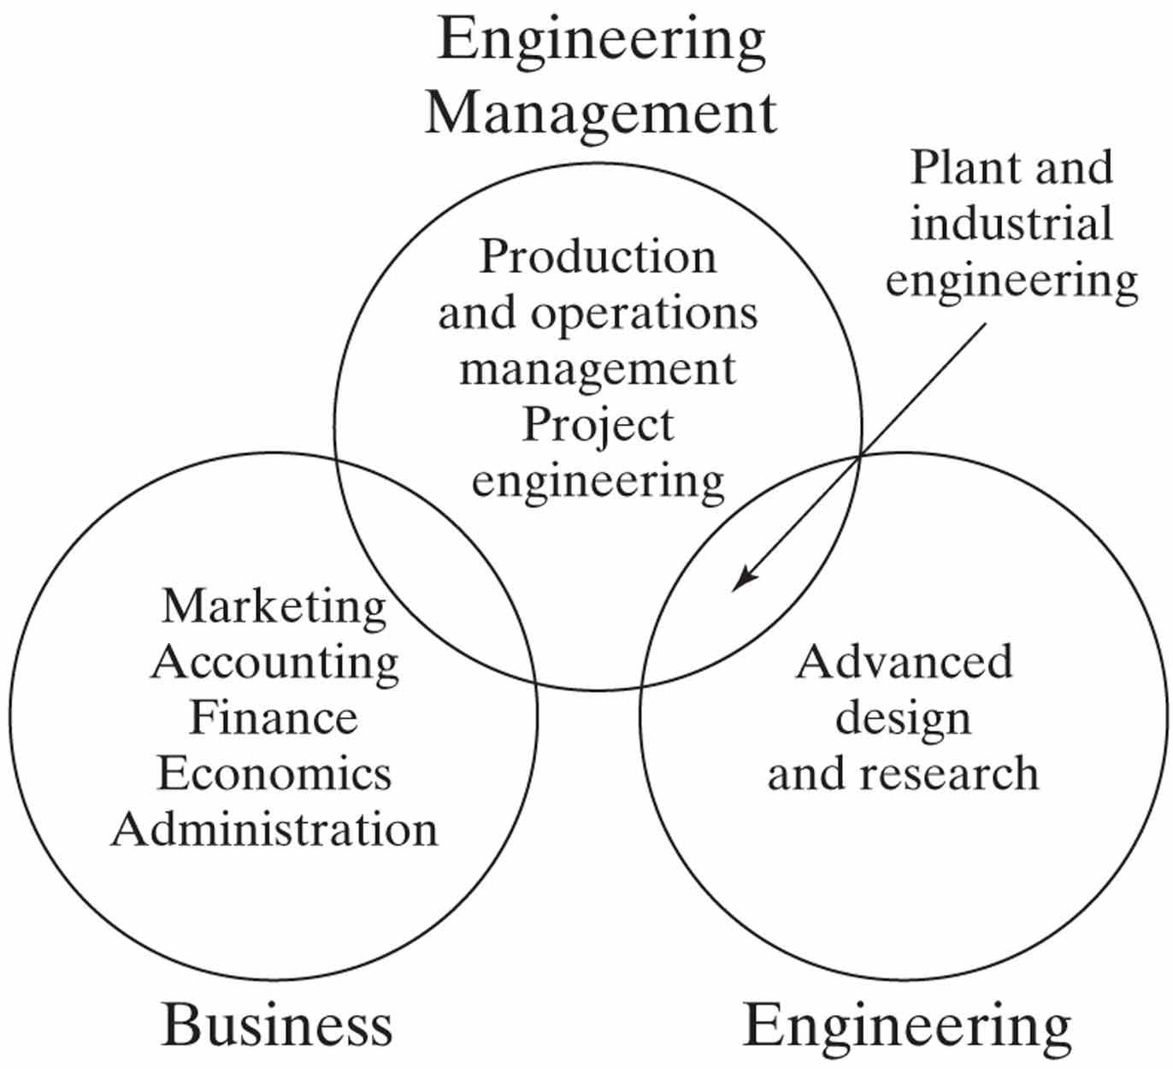
Engineering Management …
Corporate leaders must:
  understand the business
  understand the technology that drives the business today and in the future
  treat research and develop-ment as an investment to be nurtured, rather than as an expense to be controlled

Slide 13
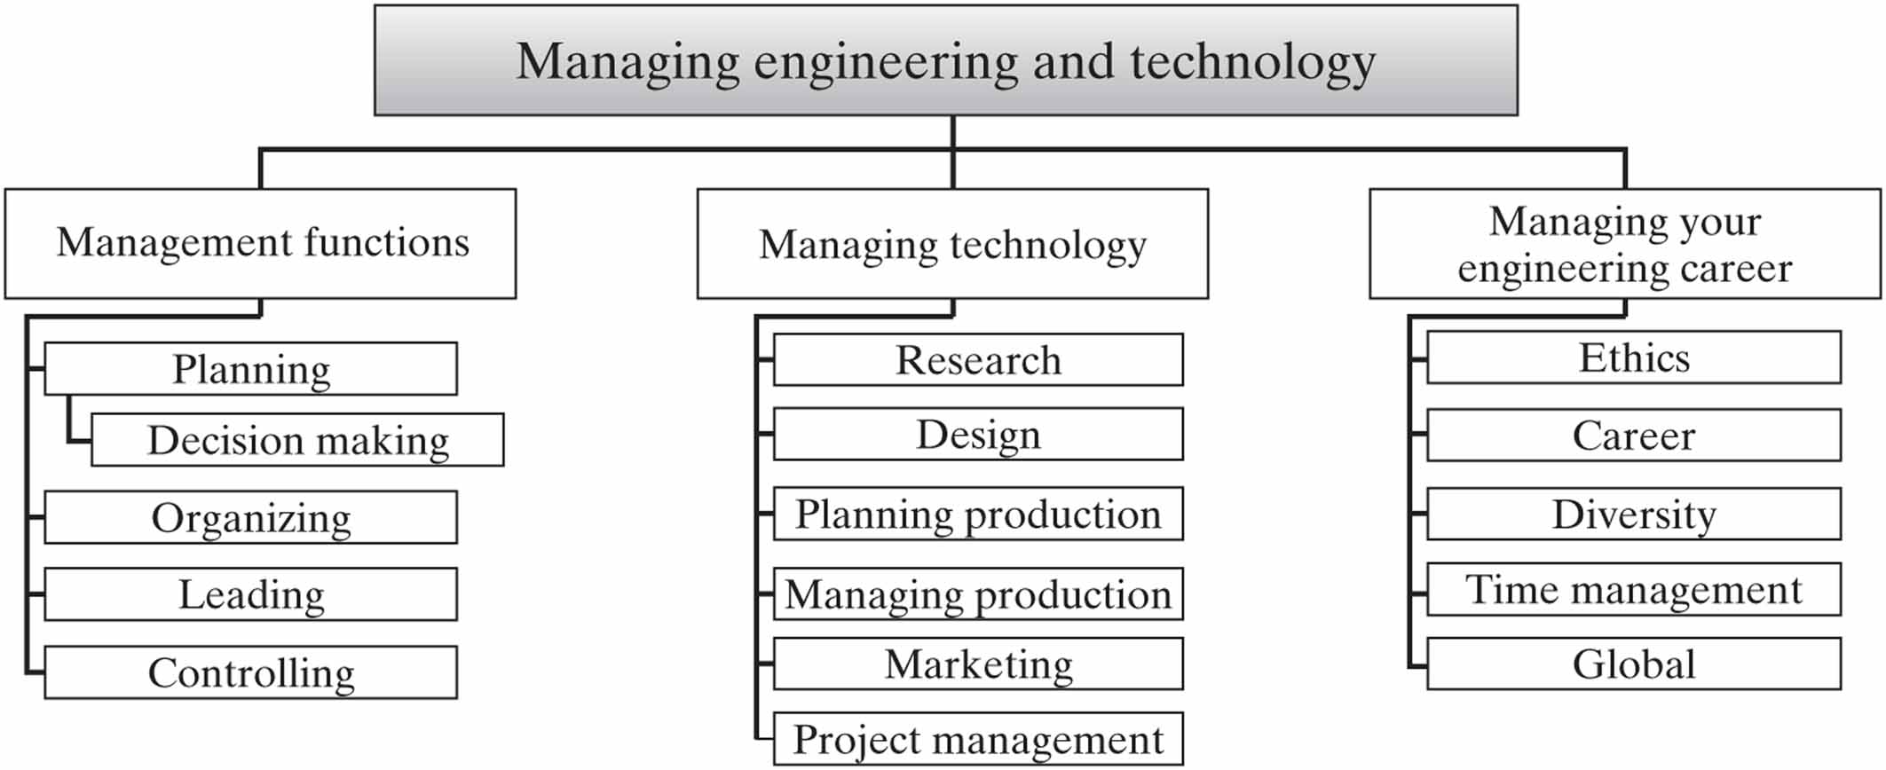
Study of Engineering Management
We will gain insight into Engineering Management and an engineer’s need to understand management as his/her career progresses through the process illustrated below.

