Slide 1
PS 268
Drugs and Behaviour

Slide 2
Contact Information
Instructor: Bruce McKay, Ph.D.
Office: N2074A
Office hours: Mondays 3:30-4:30 pm
Fridays 9-10 am
or by appointment
E-mail: bmckay@wlu.ca
Office phone: (519) 884-0710 x 3033

Slide 3
Prerequisites: PS100 or PS101/102 – Introduction to Psychology
Textbook: Custom course notes posted to MyLS after each lecture
Lectures: Wednesdays
7-7:50; 8-8:50; 9-9:50

Slide 4
Final Grade Determination
Test #1
Test #2
Test #3
Multiple choice question building assignment
Final Exam
21.67%
21.67%
21.67%
5%
30%
Tests and exams will be about 90% based on material covered in class or on the posted lecture slides, and about 10% from the course notes (e.g., material in the course notes that was not covered in lectures)

Slide 5
All tests in this course will be conducted ONLINE, with questions delivered via MyLS, with webcam proctoring.
Test #1: (Oct 1, 7-7:50)
Surnames Aa-Ki: ONLINE, on your laptop, in this room
Surnames Kj-Zz: ONLINE, wherever you want
Test #2: (Oct 29, 7-7:50)
Surnames Aa-Ki: ONLINE, wherever you want
Surnames Kj-Zz: ONLINE, on your laptop, in this room
Test #3: (Nov 19, 7-7:50)
Details to be announced later
** If you do not have a laptop, and cannot borrow one, contact me.
More details, webcam guidelines, helpful tips, etc., on MyLS
Why this new test format?

Slide 6
Multiple choice question building assignment
Create 5 multiple choice questions, on a topic determined by your surname (see the Table in the instructions, including due dates) according to detailed instructions posted on MyLS
Rationale:
Learning about how multiple choice questions are designed, and the different depths of learning they can assess, can improve how effectively you study across all courses.

Slide 7
“I bombed a midterm OR
I’m not very good at multiple choice…
What can I do to get more marks?”
Complete a “Special Topics Project”
This will replace your lowest midterm mark
totally optional - See guidelines on MyLearningSpace (coming soon)

Slide 8
2% Course Bonus
“Psychoactive Drug Use Prevalence and Perceptions Survey”
Overview of Informed Consent Statement
Purpose:
To collect information on the drugs that may be most commonly encountered, and thus the drugs that you might benefit the most by learning about. This survey was a recommended addition to the course by students in previous classes
Information:
The survey should take no more than approximately 1 hour to complete.
Confidentiality:
The survey is being administered online through the program SNAP. Part I “Consent” asks you to consent to participate in the survey, and to provide your name. Part II “Survey” contains the survey questions, but is completely separate from Part I – and as such it is anonymous. Your name is not associated with your answers.
Participation:
Your participation is voluntary.
If you choose not to complete the survey you may submit an article review for 2% Bonus.
See MyLearningSpace (syllabus or BONUS survey instructions) for weblinks
(must be completed by September 16th)

Slide 9
Bonus Marks – 1%
Behavioural experiences with psychoactive drugs
Write a 1-page summary of an experience a “friend” had while using a recreational psychoactive drug
NOT alcohol, unless its truly unusual, memorable, etc
Must be well written
About 400 words long
Stories can be about positive OR negative experiences.
Must conclude with some “bulleted” discussion points
If its not suitable I will return it and you can try again
These stories are often read in class – WHY?

Slide 10
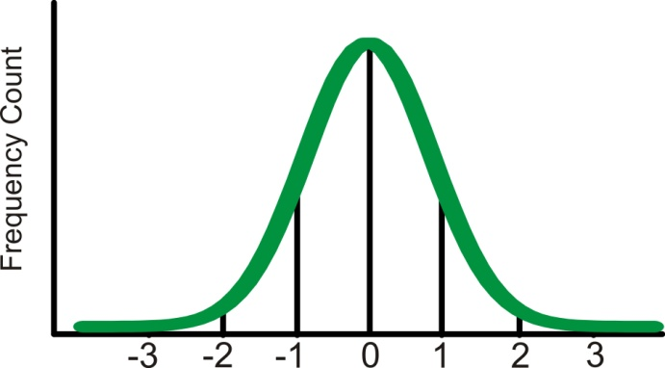
BIG challenges in this course: pre-existing “knowledge” about drugs…
Some things to always keep in mind:
Drug use and effects are distributed in the population – what is your
reference point?
Or here?
How much, how often?
Your personal experience with drugs
Threshold amounts for dependence / abuse
How toxic is a given drug?
Or here?
Are you here?
2. Dealing with the “knowledge” that is mostly “mythology” – the
importance of SCIENTIFIC DATA
“Drugs kill brain cells…”
“Smoking causes cancer”

Slide 11
My approach to the lectures:
I take a “just the facts” approach to the lectures
  NOT for…
  NOT against
  just the facts (with a couple of opinions here and there)
The Reason:
I want you to take the facts and form your own opinions, and make evidence-based decisions about psychoactive drugs

Slide 12
BIG challenges in this course: making a personal judgement about what is said
(and possibly telling your friends / parents)
As an example:
“the withdrawal symptoms of heroin are often exaggerated by the media”
  some think (that others are thinking): “Hmmm… maybe I should try heroin”
  others think: “The media emphasizes the extreme withdrawal symptoms characteristic of high dose withdrawals, withdrawal from smaller doses is less pronounced”
  and still others think: “OMG, he’s encouraging “them” to use heroin!”

Slide 13
BIG challenges in this course: taking things out of context
(and possibly telling your friends / parents)
Or another example, let’s say I:
Show a video depicting how to make cocaine
  some keep in mind the context: “the war on drugs – the feasibility of decreasing the supply of cocaine”
  others omit the context: “Awesome! He showed us how to make cocaine!”

Slide 14
BIG challenges in this course: misinterpretations / misunderstandings
(and possibly telling your friends / parents)
A good example: the principle of harm reduction
Needle exchange programs
Demonstration of safe injection techniques
Single drug use vs. drugs-in-combination (e.g., cocaine + alcohol)
If I say something that sounds grossly negligent (etc) … come talk to me and make sure that’s what I said, or what I meant to say!

Slide 15
How much “Biology” is there in Drugs and Behaviour?
    Biology (e.g., the brain) is what links drugs to behaviours
    “Biology” is not a pre-requisite, therefore we will only discuss what is absolutely necessary

Slide 16

A slide convention
If you see this symbol at the top left corner of a slide, the information on that slide is just to establish context or provide a fun (or disturbing) fact – it will not be tested.
If you see this symbol next to a bulleted point, or on a figure, then that point or figure will not be tested; however the significant point made by the slide is fair game

Slide 17

Overview of Drug Use
(Lesson 1)
Outline:
What is a drug?
Who is using drugs, how much, and why?

Slide 18
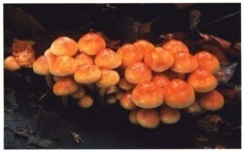
What is a drug?

Slide 19
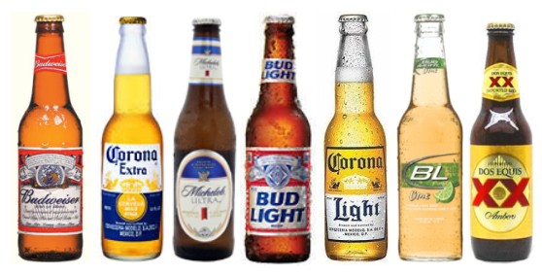
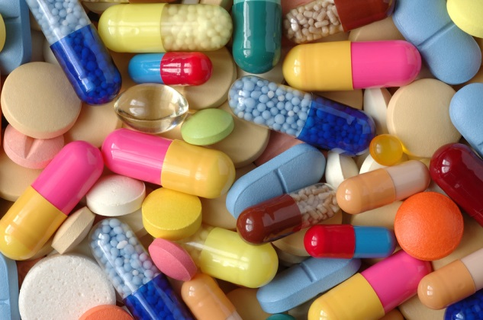
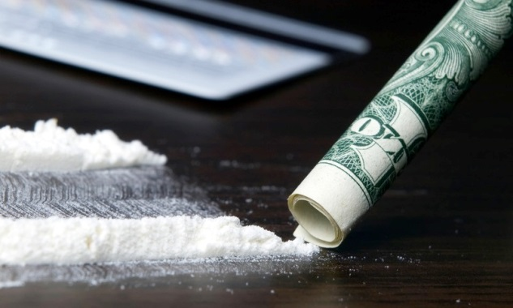
What is a drug?
What is a psychoactive drug?
Drug
Food is not a drug
Psychoactive drug

Slide 20
What are the different types of drugs?
Class of drug | Effects | Examples of drugs
Psychostimulants (aka “uppers” | Increases in brain activity, energy levels, and wakefulness; increases in heart rate and blood pressure; euphoria | Cocaine, methamphetamine, Ritalin, Adderall, caffeine, nicotine, MDMA
Depressants (aka “downers”) | Decreases in brain activity, energy levels, and wakefulness; sedation and possibly unconsciousness; decreases in heart rate and blood pressure; euphoria | Alcohol, barbiturates, benzodiazepines
Hallucinogens | Marked changes in sensation or perception; marked changes in emotions / spirituality; euphoria | Magic mushrooms (psilocybin), Peyote (mescaline), LSD, ayahuasca (DMT), Salvia, MDMA
Opiates | Pain reduction (analgesia); at higher doses depressant-like effects; euphoria | Morphine, heroin, codeine, Oxycontin, Vicodin
Marijuana | Very complicated effects with similarities to stimulants, depressants and hallucinogens; changes in appetite; euphoria | Marijuana
** euphoria means different things depending on the drug class

Slide 21
Types of drugs: Licit vs. Illicit
Licit drugs
Drugs whose manufacture, sale or possession is legal (e.g., alcohol, nicotine, caffeine, etc; age-requirements may be important)
Illicit drugs
Drugs whose manufacture, sale or possession is illegal (e.g., heroin cocaine, amphetamines, marijuana, MDMA, LSD, GHB, etc)
Stated Alternatively:
Legal; Legal so long as…; Illegal

Slide 22
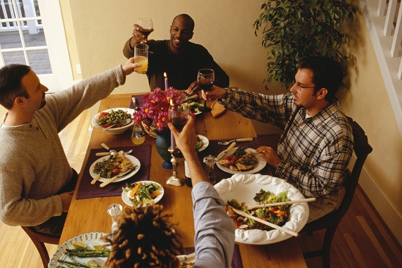
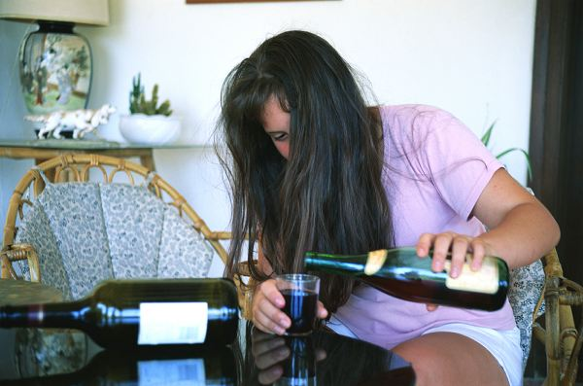
What do we really mean by “drug use” or a “drug problem”?
It’s imperative to always collect DATA
Avoid meaningless statements like “(s)he uses drugs”
Who?
What?
When?
Where?
Why?
How?
How much?

Slide 23
Who is using drugs, how much, and why?

Slide 24
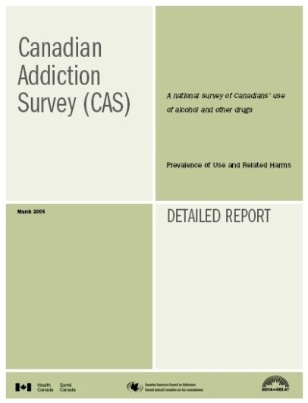


Who is using drugs, how much, and why?
Survey questionnaires
  Door-to-door
  Phone surveys
  Classroom surveys
Easy to use
Drawbacks
Psychoactive Drug Use
And
Perceptions Survey
Laurier

Slide 25
Who is using drugs, how much, and why?
Who?
  Questions about age, gender, socio-economic status, etc
How much?
In the LAST 12 MONTHS, how often have you smoked a cigarette?
A. Once per month or less
B. 2 or 3 times per month
C. Once per week
D. 2 or 3 times per week
E. 4 or 5 times per week
F. 6 or 7 times per week (e.g., almost every day)
G. I have never taken more than a few ‘puffs’ of a cigarette at any time in my life
H. I have never smoked a cigarette at any time in my life
I. I do not know what a cigarette is
Why?
  Correlations with risk factors, protective factors, attitudes, etc.

Slide 26

Survey Findings:
How many people have tried a drug?
And of those who have tried, what percent developed a dependency?
Drug Percent who’ve Of those who’ve tried it,
tried it percent that are dependent
Tobacco 76% 32%
Alcohol 92% 15%
Cannabis 46% 9%
Cocaine 16% 16%
Hallucinogens 11% 5%
Heroin 2% 23%

Slide 27
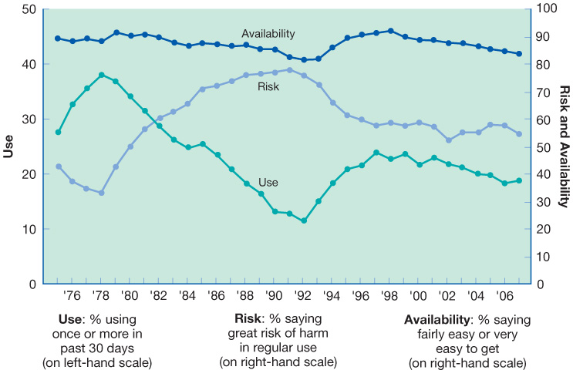
War on availability?
Hart et al. 2009 Chapter 1

Slide 28
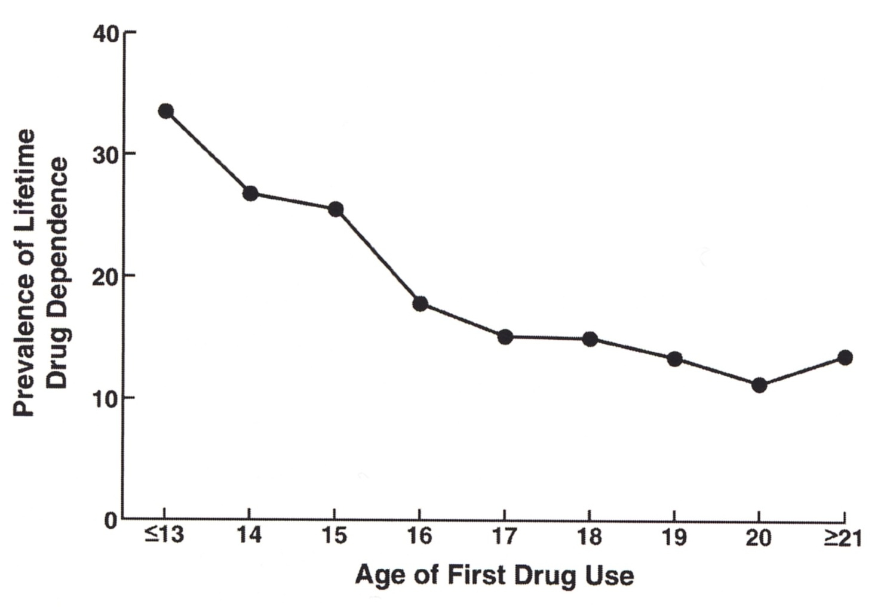
Survey Findings:
Relationship between onset age and likelihood of adulthood dependence
All drugs pooled
All drugs pooled together

Slide 29
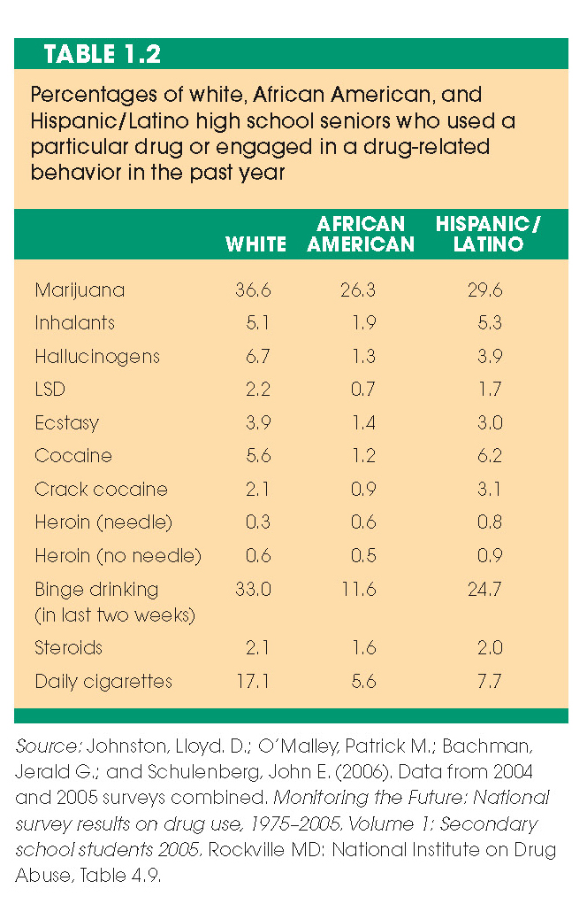

Survey Findings:
Who is using drugs? Ethnic profiles
What are the potential confounds in a high school survey?

Slide 30
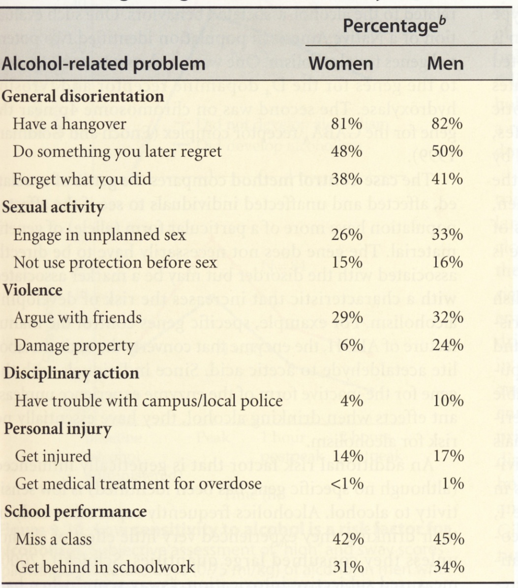

Survey Findings:
Who is using drugs? Male vs. female
binge drinking outcomes
What are the obvious trends from these data?

Slide 31
Survey Findings:
Correlates of drug use: risk factors and protective factors
All drugs pooled
Risk factors include:
Protective factors include:

Slide 32
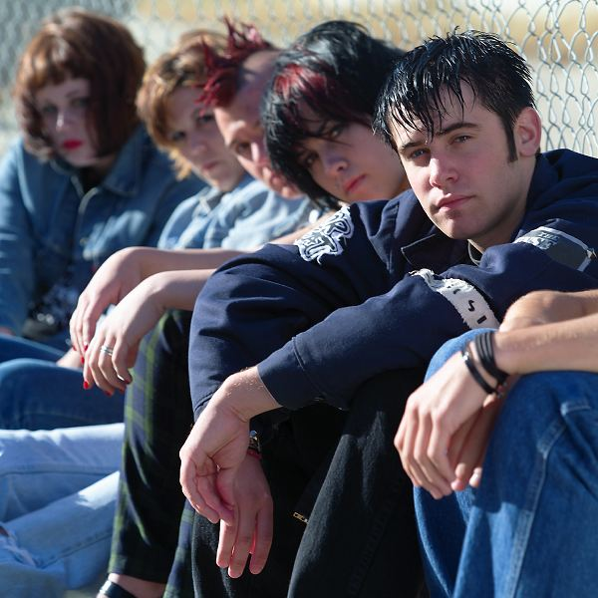
Survey data: it’s only correlational
Survey finding: marijuana smoking is correlated to low grades in high school
Possible “causes”:

Slide 33

Survey Findings: Antecedents of Drug Use
Antecedent
Examples of antecedents

Slide 34
Antecedents: Gateway Substances?
A gateway substance is:

Slide 35
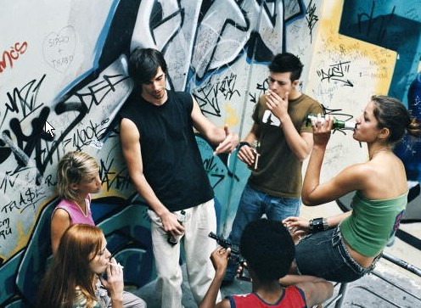
Survey Findings: Why take drugs?

Slide 36
Why take drugs?
Instrumental Use
Recreational Use

Slide 37
Four categories of drug-taking behaviours, derived from the combination of goal and legal status
Licit
Illicit
Taking Valium with a prescription to relieve anxiety
Drinking Red Bull to stay awake while driving
Smoking marijuana to relieve anxiety
Taking Provigil, Ritalin, etc without a prescription to stay awake while driving
Instrumental
Use
Having an alcoholic drink to facilitate social interactions at a party
Smoking salvia to experience an hallucination
Taking MDMA/Ecstasy to facilitate social interactions at a party
Taking LSD to experience a hallucination
Recreational
Use

Slide 38
Why take drugs? / Types of drug use
Deviant drug use
Drug misuse

Slide 39
Why take drugs? / Types of drug use
Drug abuse
Drug dependence

Slide 40
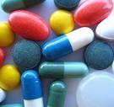
Drugs, Society, and the Law
(Lesson 2)
Outline:
Changing views in society about psychoactive drug use
What is drug toxicity?
What does it mean to have a drug dependency?
What are the “causes” of dependency?
Somebody snitched on me…

Slide 41
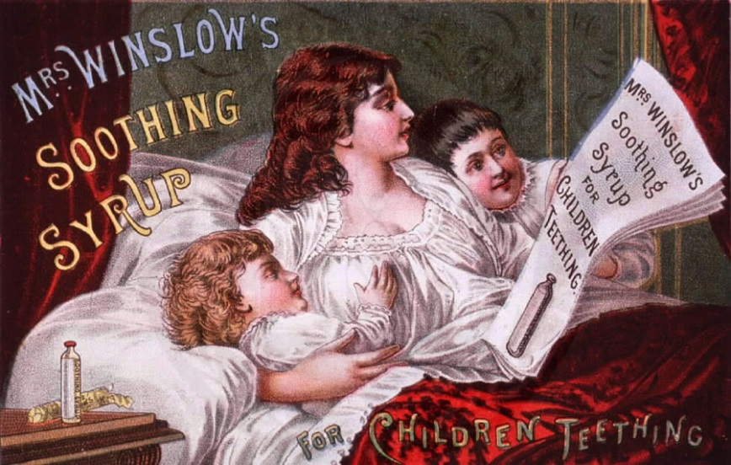
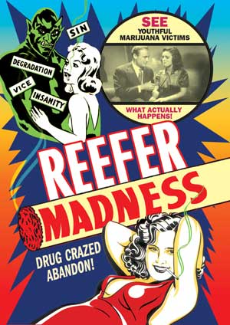
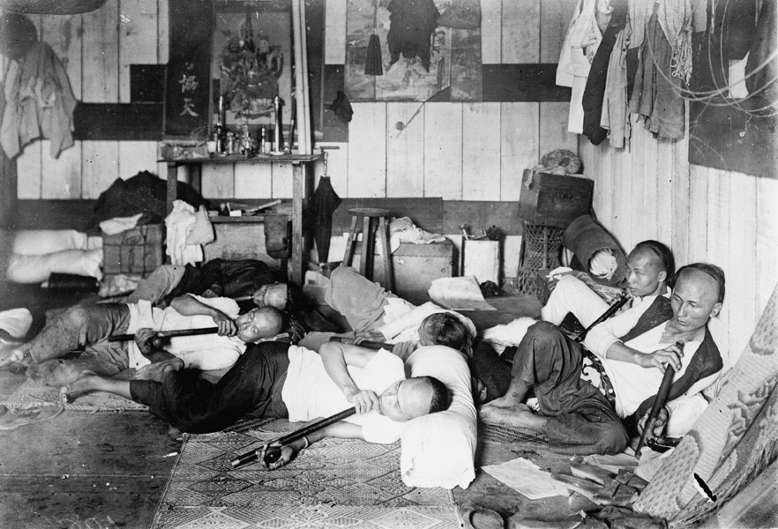
Changing views in society about psychoactive drug use

Slide 42
Changing attitudes towards drugs results in changes in the law
Early government approach (1800s)
  Laissez-faire
Subsequent approach (1900s and onwards)
  Control

Slide 43
Effects of Drug Use to Society

Slide 44
Changing attitudes towards drugs results in changes in the law
What caused this shift in approach?
  Costs to Society:
  Toxicity
  Dependence
  Crime

Slide 45
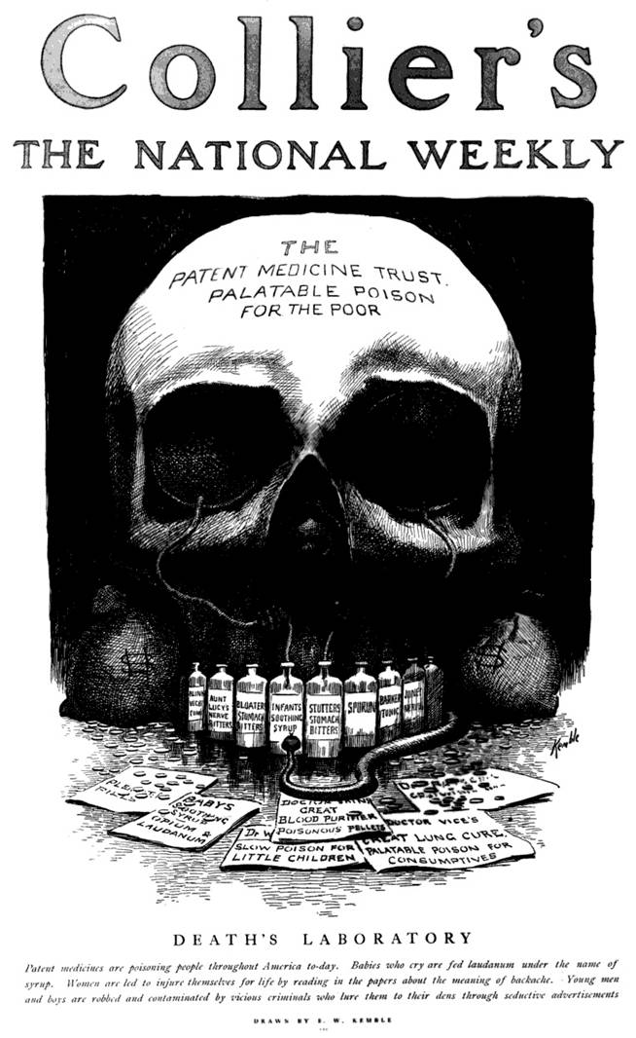
What is “drug toxicity”?

Slide 46
Some definitions
Toxicity:
What makes a drug toxic?

Slide 47
Drug-related toxicity
Acute toxicity
Behavioural:
Physiological:

Slide 48
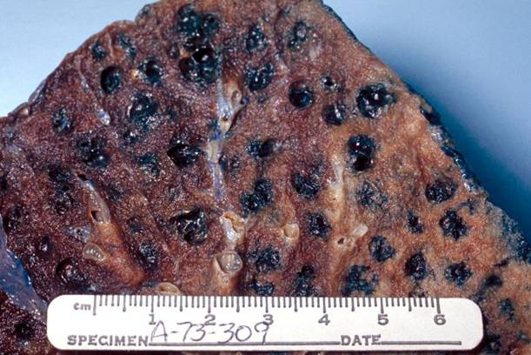
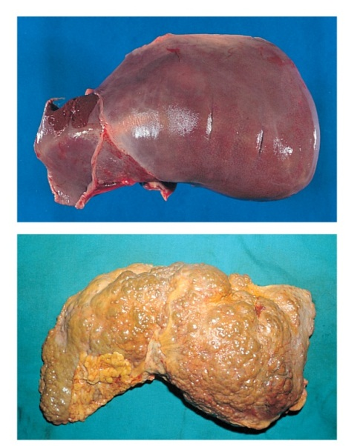
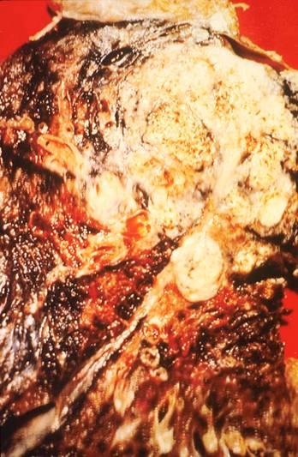
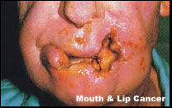
Drug-related toxicity
Tobacco
Alcohol
Chronic toxicity
Behavioural
Physiological
Normal
Chronic obstructive pulmonary disease
Cirrhotic
Mouth and lip cancer
Lung cancer

Slide 49
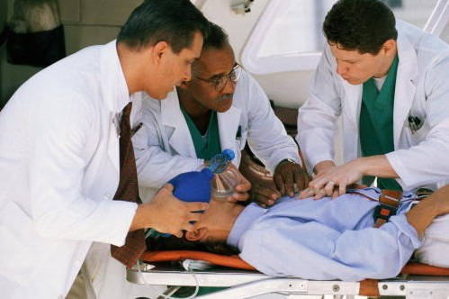
DAWN
The Drug Abuse Warning Network (DAWN) program reports the number of drug-related emergency room visits in major metropolitan hospitals in the United States.

Slide 50
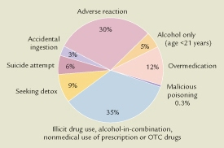

Drug-related emergency room visits by type of circumstance

Slide 51
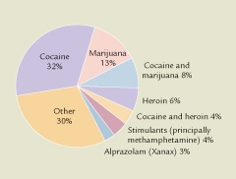
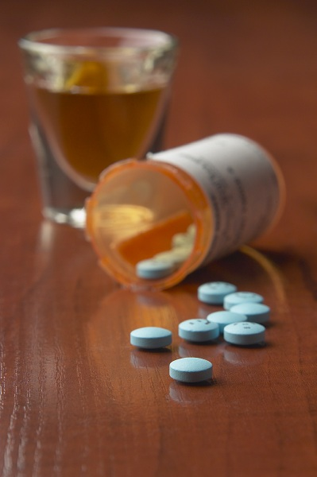
Frequency of drugs involved in alcohol-in-combination emergency room visits

Slide 52
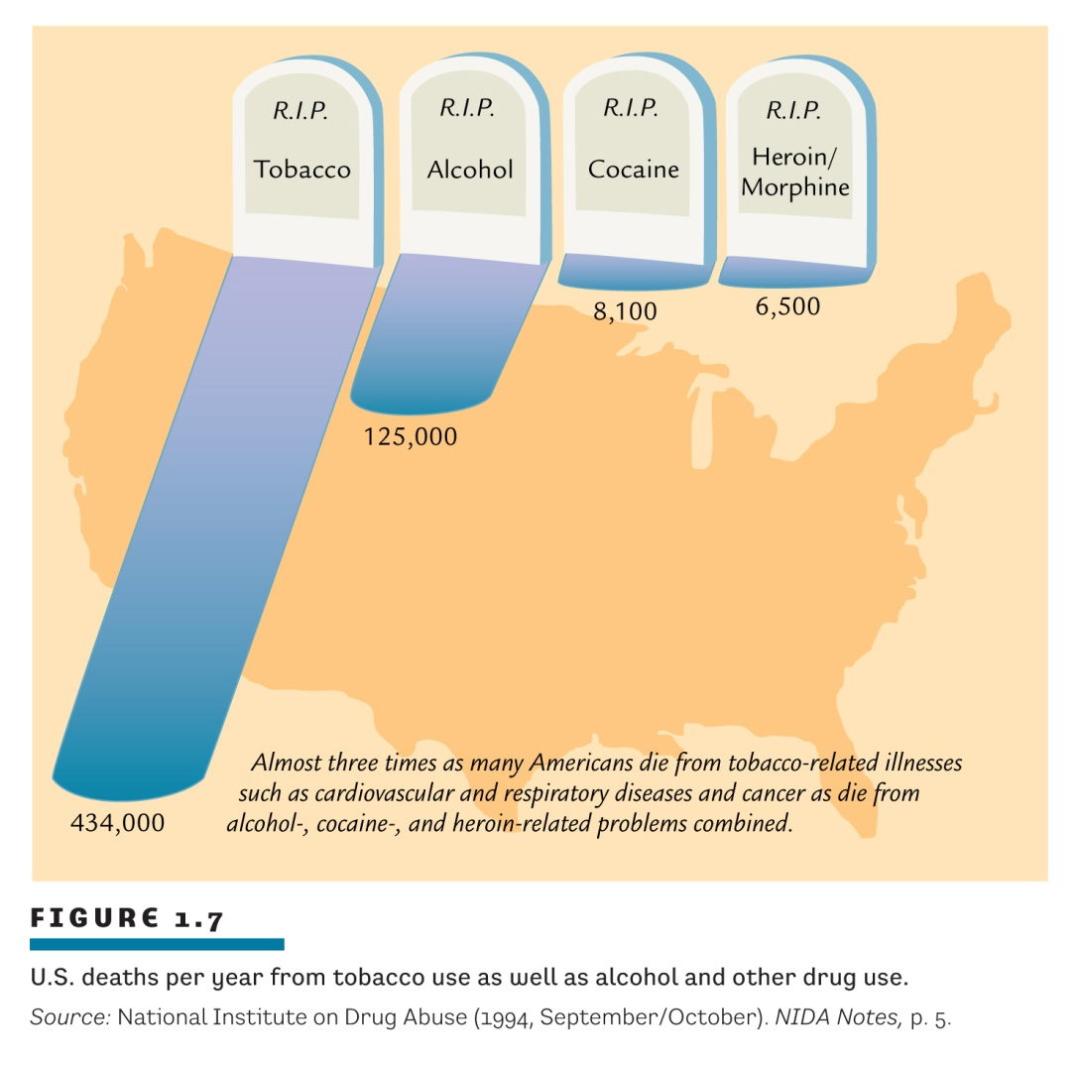
Deaths (per year) from legal and illegal drug use
What message is clear from this figure?

Slide 53
Total number of drug-related deaths per year, worldwide
Report released Jan 2012:
250,000 people die each year from illegal drugs (3%)
2.3 million per year from alcohol (30%)
5.1 million per year from tobacco (67%)

Slide 54
Comparing chronic toxicity levels with respect to illicit and licit drugs normalized against usage rates
Alcohol: assume even 70% consume alcohol in some amount each year
N.A. population = 300 million; therefore 210 million drinkers
125,000 deaths per 210 million users = 1 death per 1680 users / annum
Cocaine: about 3 million users in N.A.
8100 deaths per 3 million users = 1 death per 370 users / annum
Tobacco: assume roughly 20% of the N.A. population smokes chronically
N.A. population = 300 million; therefore 60 million smokers
434,000 deaths per 60 million smokers = 1 death per 138 users / annum
Heroin: about 180,000 users in N.A.
6500 deaths per 180,000 users = 1 death per 28 users / annum

Slide 55
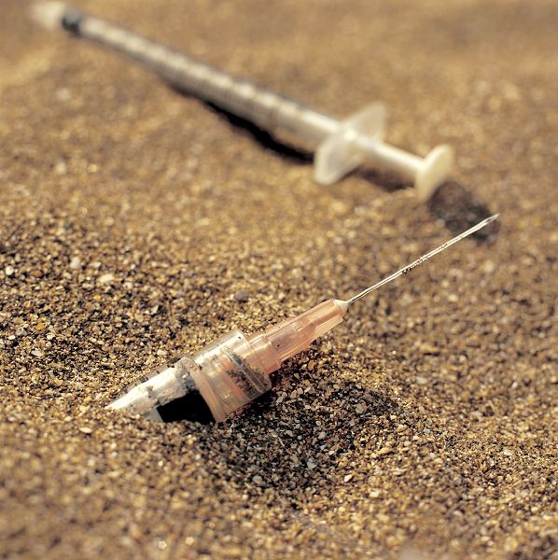
Blood-borne toxicity

Slide 56
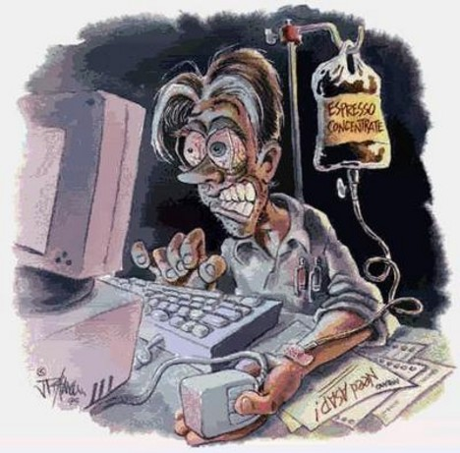
What does it mean to have a drug dependency?

Slide 57
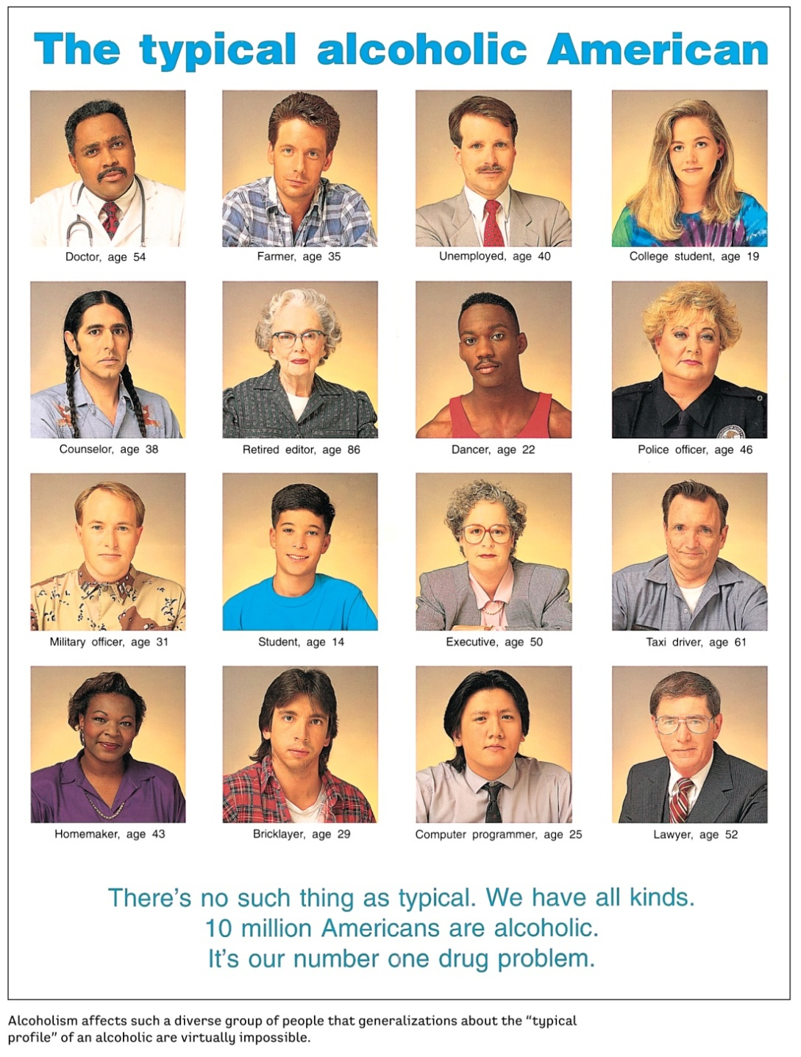
Dependence
What is it and how do we define it?
What do “addicts” look like?

Slide 58
Substance Dependence
Three basic processes
  Tolerance
  Physical dependence
  Psychological dependence

Slide 59
Drug tolerance
Dose of drug to get
“equivalent high”
High resulting from
original dose of drug
New user
User with
Tolerance
New user
User with
Tolerance

Slide 60
Drug dependence: physical vs. psychological
Psychological dependence

Slide 61
Drug dependence: physical vs. psychological
Physical dependence
  Alcohol
    tremors, nausea, weakness, tachycardia, seizures
  Hallucinogens, marijuana
    none

Slide 62

Substance Use Disorder – DSM-V
  Taking the substance in larger amounts or for longer than you meant to
  Wanting to cut down or stop using the substance but not managing to
  Spending a lot of time getting, using, or recovering from use of the substance
  Cravings and urges to use the substance
  Not managing to do what you should at work, home or school, because of substance use
  Continuing to use, even when it causes problems in relationships
  Giving up important social, occupational or recreational activities because of substance use
  Using substances again and again, even when it puts you in danger
  Continuing to use, even when you know you have a physical or psychological problem that could have been caused or made worse by the substance
  Needing more of the substance to get the effect you want (tolerance)
  Development of withdrawal symptoms, which can be relieved by taking more of the substance
2 or 3 symptoms: mild substance use disorder
4 or 5 symptoms: moderate substance use disorder
6+ symptoms: severe substance use disorder

Slide 63
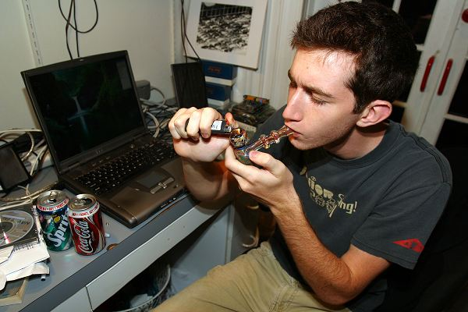
What are the “causes” of dependence?

Slide 64
What causes substance dependence?
Is it biological?
Does it depend on the drug?
Most addictive: heroin, cocaine, tobacco
Intermediate: alcohol
Least addictive: caffeine, marijuana, hallucinogens
Does it depend on the route of administration?
Most addictive: injecting, smoking
Least addictive: swallowing

Slide 65
What causes substance dependence?
Is it a personality or family problem?
“Addictive Personality”?
Family?

Slide 66
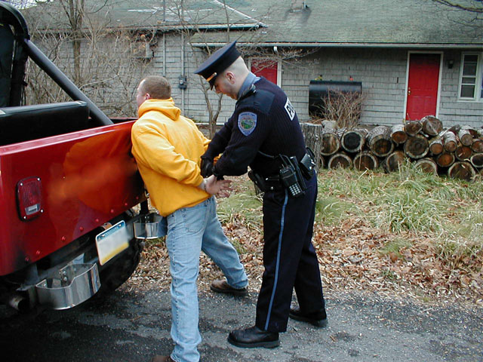
Drugs and the Law
Somebody snitched on me…

Slide 67
Drugs and crime
Two general scenarios:
Use Drugs
Commit crime
Commit crime
To use Drugs

Slide 68
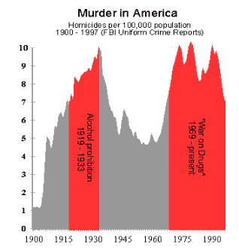
Drugs and crime: correlation or causation?
Do drugs induce criminal behaviour (causation)?
OR
Are drugs consumed by individuals with socioeconomic backgrounds (low education, broken family, no social supervision, low social status) more likely to be involved in crime and drugs (correlation)

Slide 69
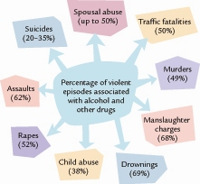
Association of violence with alcohol and other drugs

Slide 70
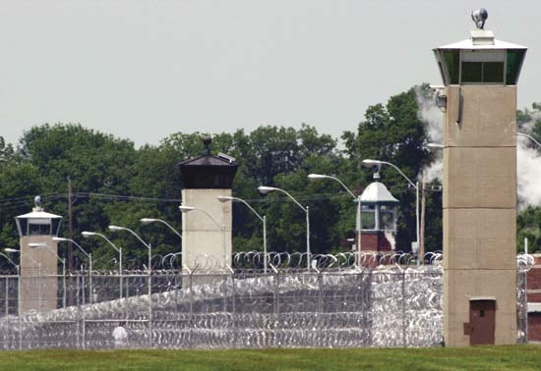
Dealing with drug offenses: an overview of punishment of drug crimes

Slide 71
Drug Schedules - Canada
Controlled Drugs and Substances Act (1996)
Definitions related to the legal outcomes of drug production, possession or distribution
Organized into Schedules I thru VIII

Slide 72
A brief primer on offences in Canada
Summary conviction offence
Less serious crimes
Police must see you do it
Maximum 6 months in prison
Maximum $5000 fine
Indictable offence
More serious crimes
Police do not need to see you do it; must have warrants for arrests
> 6 months in prison; > $5000 fines
Hybrid offence

Slide 73
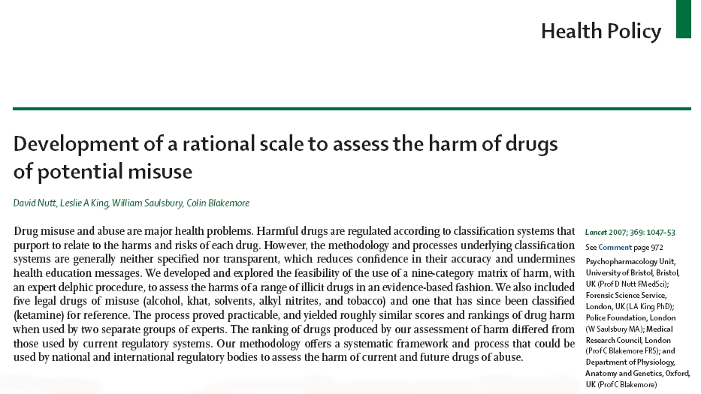

Slide 74
Categories of Harm
Physical Harm
How physically dangerous is the drug to the user?
Dependence
How likely is the drug to cause dependence?
Social Harm
What is the effect of the drug on families, communities, society, etc?

Slide 75
Objectively assessing the harm of drugs
Parameter #
Physical harm 1 Acute
2 Chronic
3 Intravenous harm
Dependence 4 Intensity of pleasure
5 Psychological dependence
6 Physical dependence
Social harms 7 Intoxication
8 Other social harms
9 Health-care costs
Each parameter assessed on a 4 point scale:
0 = no risk 1 = some risk 2 = moderate risk 3 = extreme risk

Slide 76
Ranking the most harmful drugs
Rank | Drug | Risk Score
1 | Heroin | 9.3
2 | Cocaine | 7.7
3 | Barbiturates | 7.0
4 | Street methadone | 6.3
5 | Alcohol | 6.3
6 | Ketamine | 5.7
7 | Benzodiazepines | 5.7
8 | Amphetamines | 5.7
9 | Tobacco | 5.3
10 | Cannabis | 4.3
11 | Solvents | 4.3
12 | LSD | 4.0
13 | Steroids | 4.0
14 | GHB | 3.7
15 | Ecstasy / MDMA | 3.7

Slide 77
Schedule I
“hard drugs”
Opium poppy derivatives (opium, heroin, codeine, morphine, oxycodone, etc.)
Coca and derivatives (coca leaves, cocaine)
PCP, Ketamine, Fentanyls
Methamphetamine
Amphetamines, MDA
  MDMA, MDEA, MDBD
Flunitrazepam (Rohypnol)
GHB
others
NEW with C-10

Slide 78
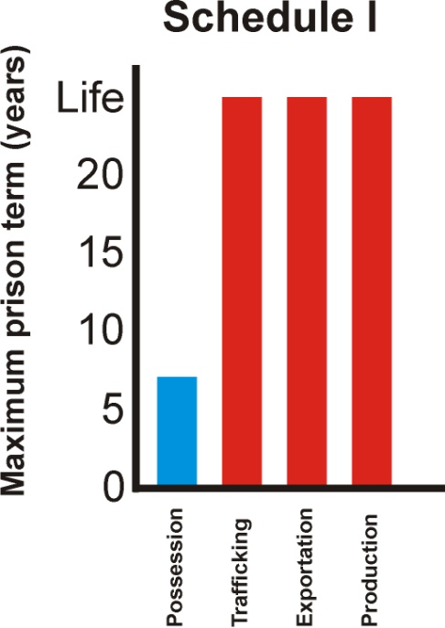
Schedule I - Laws
Possession
indictable offense – maximum 7 years in prison
summary conviction offense
  maximum $1000 fine for first offence and/or max 6 months prison
  maximum $2000 fine for subsequent offence and/or max 1 year prison
Trafficking
maximum life imprisonment
Exportation
maximum life imprisonment
Production
maximum life imprisonment

Slide 79
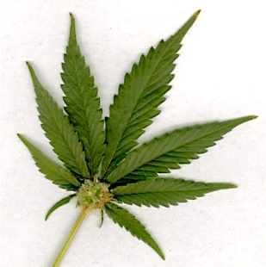
Schedule II
“cannabis”
Cannabis and derivatives
  Marijuana, cannabis resin, THC, hash, hashish, etc
  Excludes fibres derived from cannabis stalks (Hemp)
Schedule VII and VIII
Schedule VII Schedule VIII
3kg hashish 1 g hashish
3kg marijuana 30 g marijuana

Slide 80
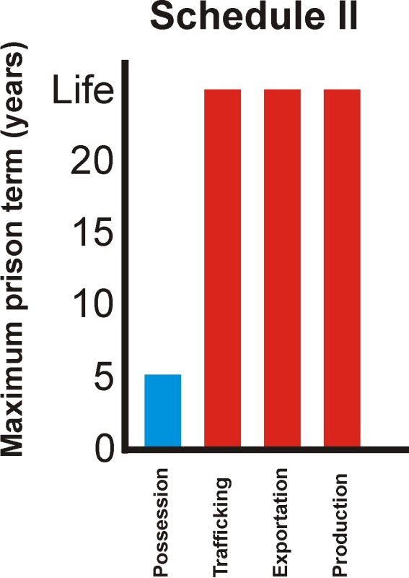
Schedule II - Laws
Possession
> Amounts in Schedule VIII:
indictable offense: Maximum 5 years imprisonment
summary conviction offense
  maximum $1000 fine for first offence and/or maximum 6 months prison
  maximum $2000 fine for subsequent offence and/or max 1 year prison
< amounts in Schedule VIII:
for amounts not exceeding those set in Schedule VIII, maximum fine of $1000 and/or maximum 6 months imprisonment is the only punishment.
Trafficking
> amounts in Schedule VII: Maximum life imprisonment
< amounts in Schedule VII: Maximum 5 years imprisonment
Exportation
maximum life imprisonment
Production
maximum life imprisonment (excluding marijuana)
marijuana: maximum 7 years imprisonment
now 14 years with C-10

Slide 81
Schedule II – Laws
(new with Bill C-10)
Production – number of plants:
6-200 plants: MANDATORY minimum = 6 months
201-500 plants: MANDATORY minimum = 12 months
500+: MANDATORY minimum = 24 months
+ another MANDATORY year if grown near school yards, on someone else’s property, in a residential area, booby-traps were set, etc.

Slide 82
What about 5 plants or less?
“5 plants (AND under 1 pound total plant weight) personal use no effort to traffic, no prior record, no aggravating circumstances conditional discharge ie. Probation 12 months minimal terms and maybe a drug awareness program or assessment. If aggravating circumstances it gets tricky. Less than 30 grams police may not even charge, if they did and no aggravating circumstances absolute discharge.
Prosecutors have been instructed not to minimize so if its 6 plants or 1 pound 1 ounce you are supposed to go to jail. Lots of speculation we will repeat American experience with overflowing jails full of non violent offenders who would otherwise be working and contributing members of society not to say anything about the devastating effects on certain youth populations.”

Slide 83
Schedule III
“medical sedatives, hallucinogens”
Some Barbiturates (pentobarbital, secobarbital, etc)
LSD, DMT
Mescaline, but not Peyote
Psilocybin
Harmaline

Slide 84
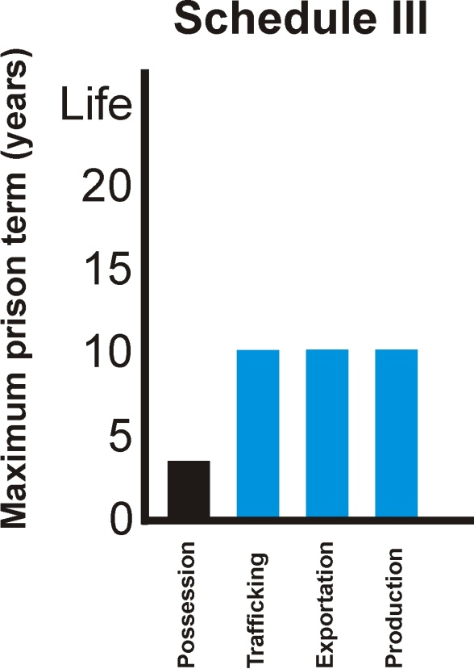
Schedule III - Laws
Possession
indictable offense: maximum 3 years imprisonment
summary conviction offense
  maximum $1000 fine for first offence and/or maximum 6 months prison
  maximum $2000 fine for subsequent offence and/or max 1 year prison
Trafficking
indictable offense: maximum 10 years imprisonment
summary conviction offense: maximum 18 months imprisonment
Exportation
indictable offense: maximum 10 years imprisonment
summary conviction offense: maximum 18 months imprisonment
Production
maximum 10 years imprisonment

Slide 85
Canada - Schedule IV
“prescriptions: steroids and sedatives”
Anabolic Steroids
Benzodiazepines (valium, xanax)
Most Barbiturates (phenobarbital, sodium thiopental, etc)

Slide 86
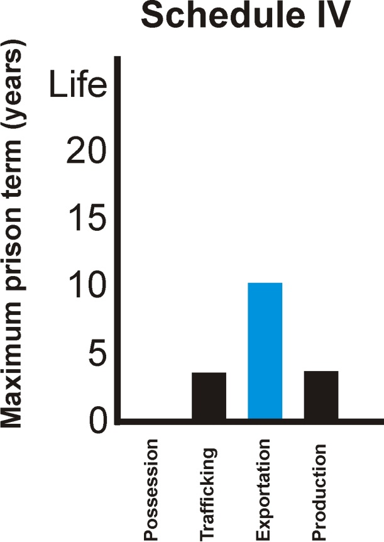
Schedule IV - Laws
Possession
It is not an offence to possess a Schedule IV substance for personal use; however, Subsection (2) of Section (4) of the CDSA states that "no person shall seek or obtain a substance or authorization from a practitioner to obtain a substance in schedules I through IV." Subsection (7) then states that it is an indictable offence to contravene subsection (2). Therefore, it is an indictable offence to attempt to acquire a Schedule IV substance but not an offence for possession.
Trafficking
indictable offense: maximum 3 years imprisonment
summary conviction offense: maximum 1 year imprisonment
Exportation
indictable offense: maximum 10 years imprisonment
summary conviction offense: maximum 18 months imprisonment
Production
maximum 3 years imprisonment

Slide 87
Canada - Schedule V
“cold medication”
Propylhexedrine (cold medication)

Slide 88
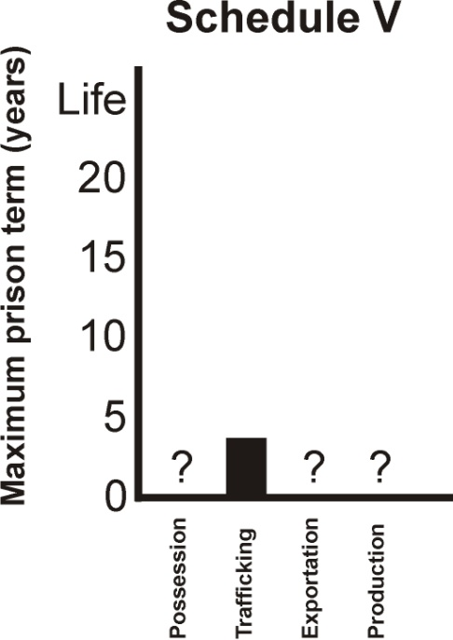
Schedule V - Laws
Possession
It is not an offence to possess a Schedule V substance (?)
Trafficking
?
Exportation
indictable offense: maximum 3 years imprisonment
summary conviction offense: maximum 1 year imprisonment
Production
?
?

Slide 89
Canada - Schedule VI
“Precursors”
Class A
Ephedrine (easily reduced into methamphetamine)
Isosafrole (used in making MDMA)
Lysergic acid (used in making LSD)
Pseudoephedrine (easily reduced into methamphetamine)
Class B
Acetone
Ethyl Ether
Hydrochloric acid
Methyl ethyl ketone
Sulfuric acid
Toluene

Slide 90
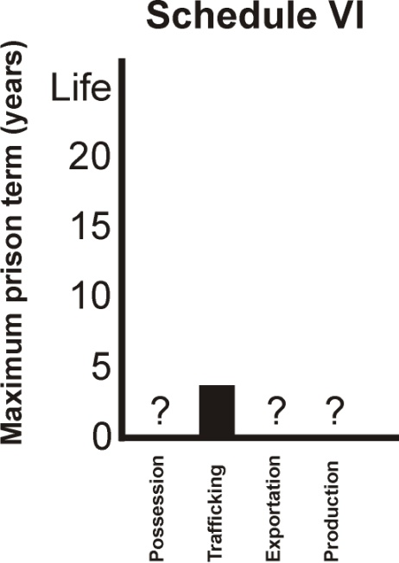
Schedule VI - Laws
Possession
It is not an offence to possess a Schedule VI substance (?)
Trafficking
?
Exportation
indictable offense: maximum 3 years imprisonment
summary conviction offense: maximum 1 year imprisonment
Production
?
?

Slide 91

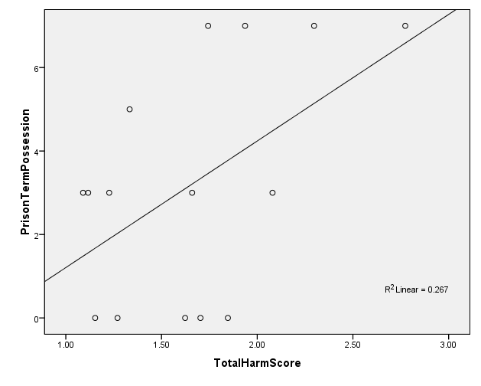
Objective Drug Harms vs.
Prison Terms for Possession
Ketamine
Methadone
Cocaine
Heroin
Cannabis
Maximum Prison Term for Possession
GHB
Ecstasy
LSD
Amph
Barb
Steroids
Solvents
Benzodiazepines
r = 0.52; p<0.05
Tobacco
Alcohol
3.3
5.0
6.6
8.3
10
Total Harm Score (out of 10)

Slide 92
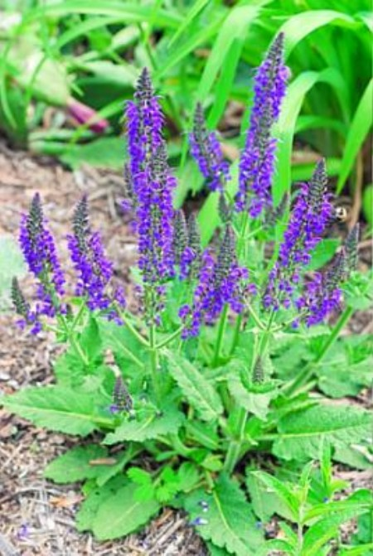
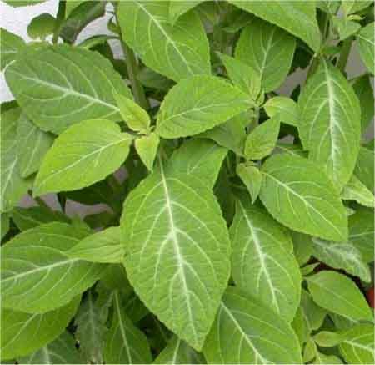
Important:
There is a clause in the Controlled Drugs and Substances Act which essentially states that any drug not currently listed, but which has chemical properties or behavioural effects similar to a drug which is listed, can be inserted into the Act without Parliamentary approval or notice

