Slide 1



Visual Organization
Sensation
  Detection of environmental energies (electromagnetic radiation) by photoreceptors
  Transduction
Perception
  Feature Detection
    E.g., lines, angles, colour
  Depth
  Organization of features into meaningful objects or scenes
    Organization in to a gestalt
    An organized whole
  Gestalt psychologists identify principles of organization
    Principles of image construction

Slide 2
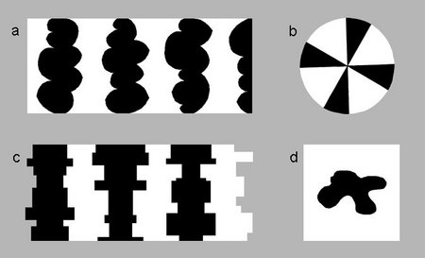
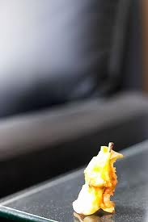

Form Perception
Figure and Ground
  Figures constitute the objects we perceive and with which we interact
  Ground is the background
Edge/boundary detection
  The boundary or edge belongs to the figure
Cues for boundary/edge perception(NOT IN TEXT)
  Convex, symmetric, smaller in area, enclosed, or surrounded are more likely to be seen as the figure than are regions that are concave, asymmetric, larger in area, or surrounding
  Depth cues
  Experience (Top-down processing)

Slide 3
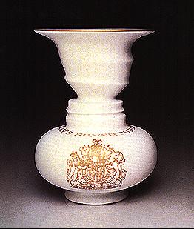

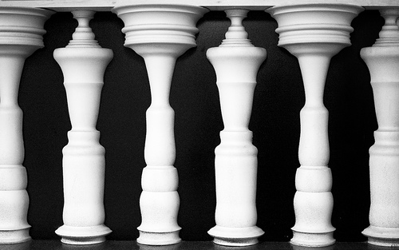

Ambiguous Figure-Ground
Cues are ambiguous
  Both “figures” have convex components
  Both are symmetric
  Areas are roughly equal
  In the bottom image, both figures are enclosed
  We have experience with both faces and vases (or people and columns)

Slide 4
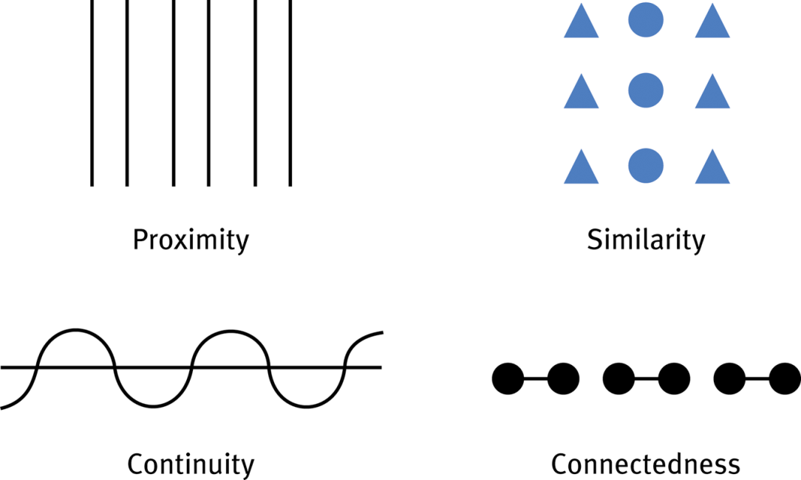



Grouping: Proximity
Proximity
  We perceive things that are nearby as belonging together

Slide 5
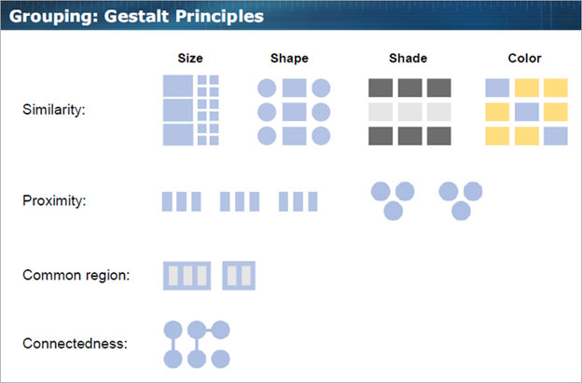
Grouping: Similarity
Similarity
  We perceive similar figures as belonging together

Slide 6
Grouping: Continuity
Continuity
  We perceive smooth, continuous patterns, rather than discontinuous ones
  Thus, elements that are arranged on a line or a curve are perceived to be more related

Slide 7

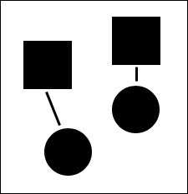

Grouping: Connectedness
Connectedness
  Things that are linked are perceived as belonging together

Slide 8


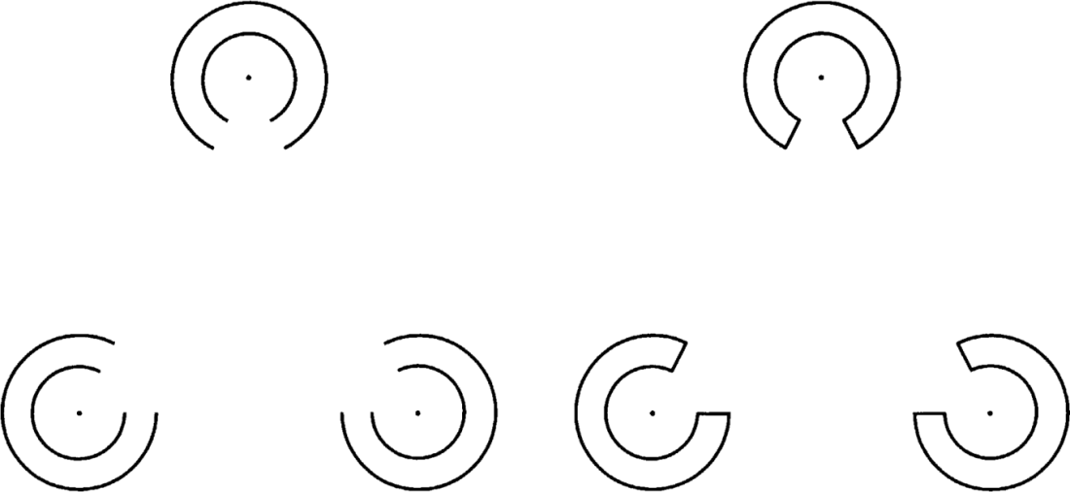


Grouping: Closure
Closure
  We tend to fill in gaps to create a complete, whole object

Slide 9
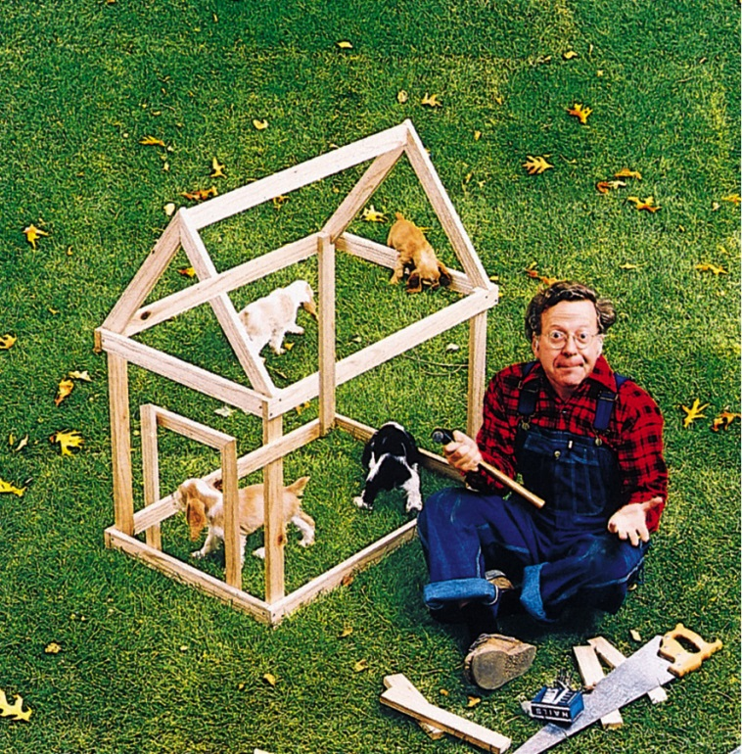
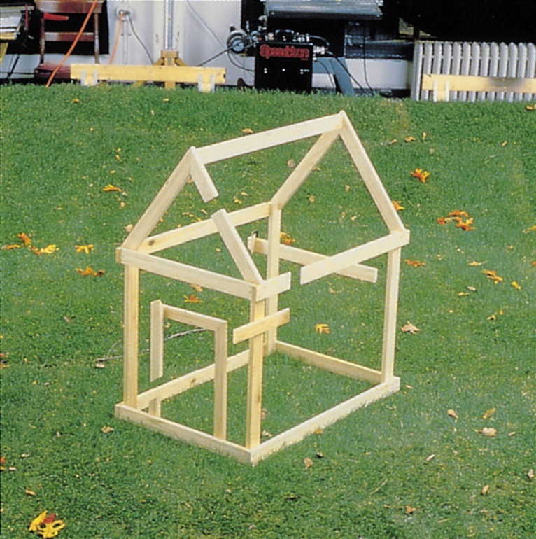
Impossible Doghouse
Principles of continuity and closure cause this illusion

Slide 10
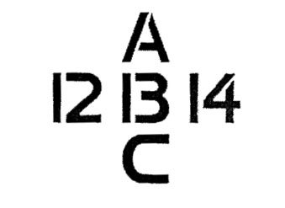
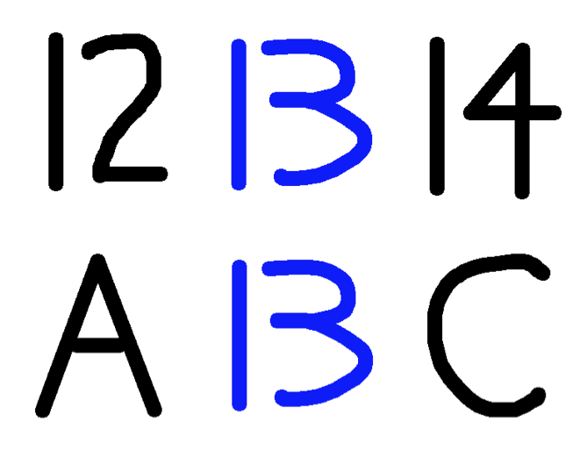
Bottom-Up Vs. Top-Down Processing
Bottom-Up Processing
  Stimulus energy detection
  Feature detection
  Organization into perception
  Most of what we perceive is the result of this processing
Top-Down Processing
  Context, experience, expectation impact perception
    Context effects
    Perceptual set
  Phonemic restoration effect
“Mary had a
a little lamb whose
fleece was white
as snow.”
“The state governors
met with their respective legislatures convening in the capital city.”
“It was found that
the wheel was
on the axle.”

Slide 11
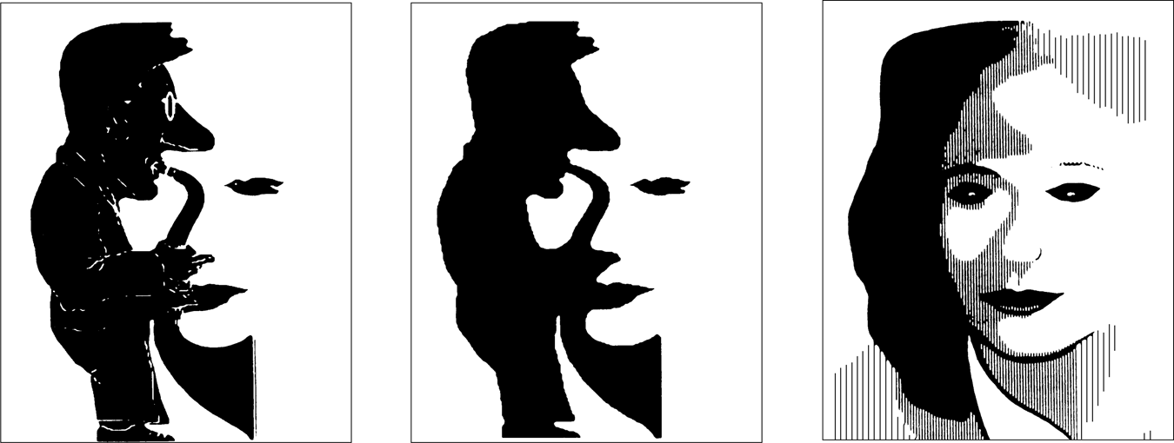
Bottom-Up VS Top-Down Processing

Slide 12

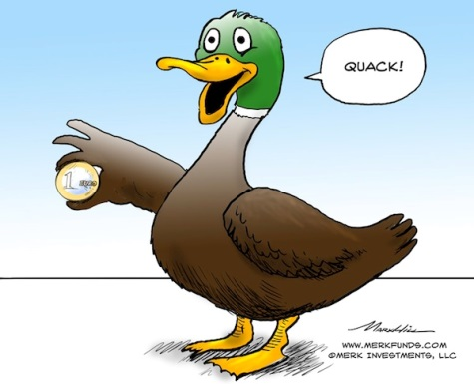
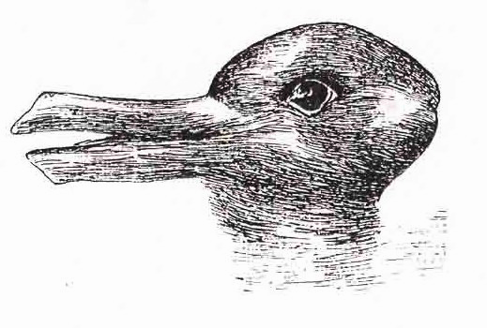

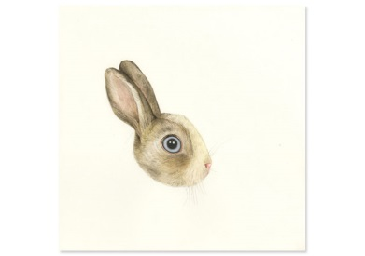
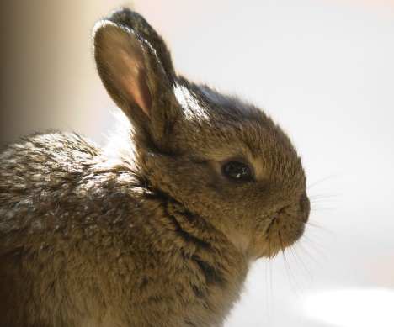
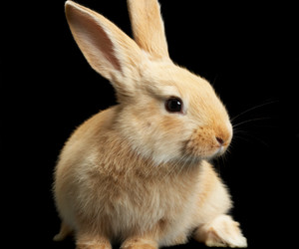
Bottom-Up VS Top-Down Processing

Slide 13
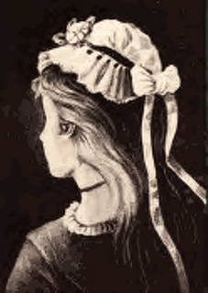
Power of Top-Down Processing
http://www.youtube.com/watch?v=QbKw0_v2clo
  Charlie Chaplin face
http://www.youtube.com/watch?v=Z71LzCJPCyU&feature=fvwrel
  Einstein face

Slide 14
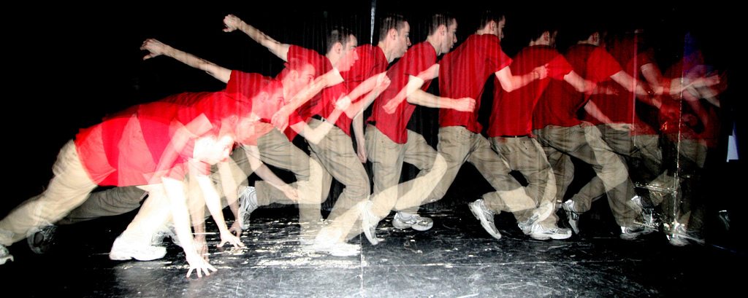
Motion Perception
Brain infers motion by the change in images on your retina
1) Same image taking up progressively more retinal space
  Approaching object
2) Same image taking up progressively less retinal space
  Retreating object
3) Same image displaced on the retina to the left, right, up, or down from one moment to the next
  Movement, right, left, down, or up

Slide 15
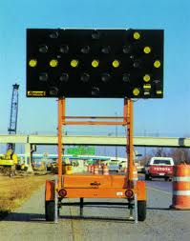

Illusory Motion
Phi Phenomenon
  Adjacent stationary lights blink off and on in quick succession
  Perceive light as moving from one spot to the next
  E.g., moving arrow, Marquee lights
Stroboscopic Movement
  Brain perceives continuous movement in a rapid series of slightly changing images
  E.g., flip books, movies
http://www.youtube.com/watch?v=SE70zzs75tE
http://www1.psych.purdue.edu/Magniphi/index.html

Slide 16
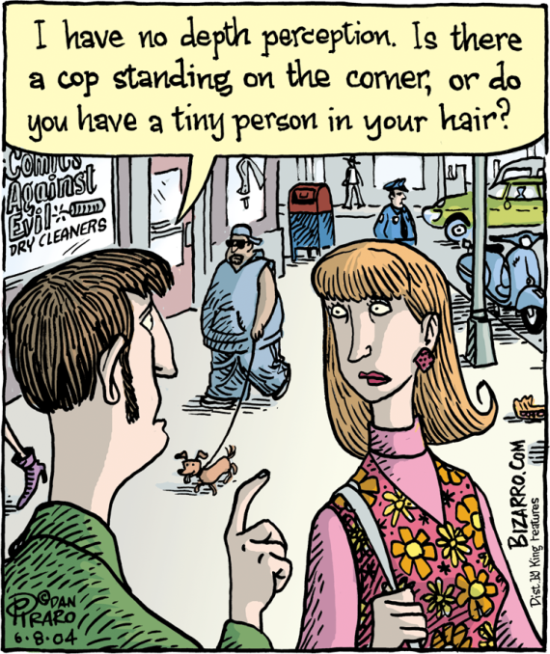
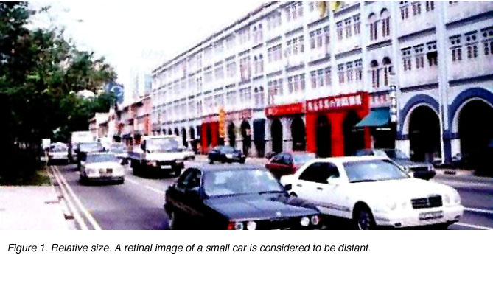
Perceptual Constancy
Perceptual Constancy
  Perceiving objects as unchanging, even as retinal image or illumination changes
  Size, lightness, colour, shape
Relative Size
  If we assume that two objects are similar in size (2 cars, 2 people), then the one that takes up the least amount of retinal space will be perceived as farther away
“Assumption” that familiar objects are roughly the same size (cars, people) is learned through experience
This is perceptual constancy
  Specifically, this is called size constancy

Slide 17
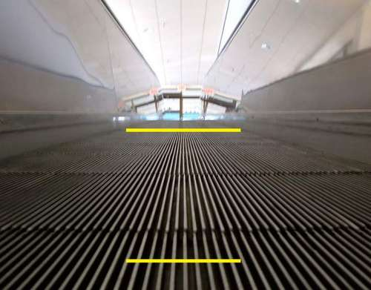
Illusions of Size Constancy
Which yellow line is bigger?
They are the same size
They are casting the same sized image on the retina
  But one is perceived as bigger than the other

Slide 18
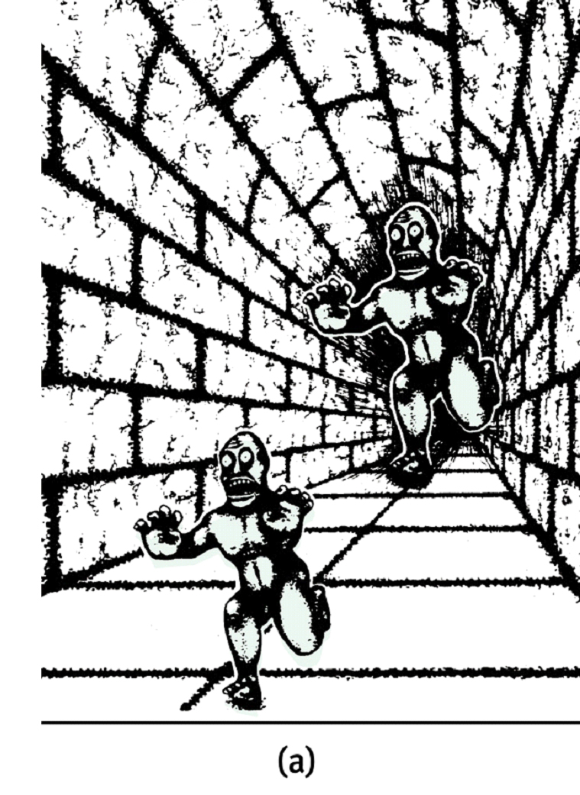
Illusions of Size Constancy
Which monster is bigger?
http://www.sapdesignguild.org/goodies/optical_illusions/perspective.html
Relative height & linear perspective are depth cues
Retinal image is the same size
Depth + same retinal size = bigger

Slide 19
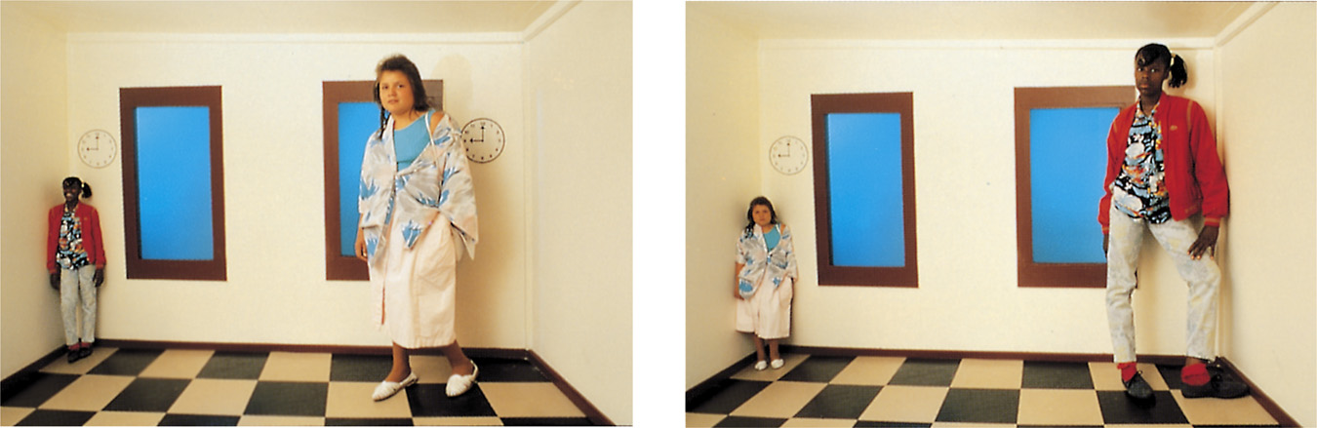
Illusions of Size Constancy: Ames Room
Two girls are actually about the same size

Slide 20
Illusions of Size Constancy: Ames Room
Videos
http://www.youtube.com/watch?v=Q45diWsVbHY
http://www.youtube.com/watch?v=hCV2Ba5wrcs
http://www.youtube.com/watch?v=Ttd0YjXF0no

Slide 21
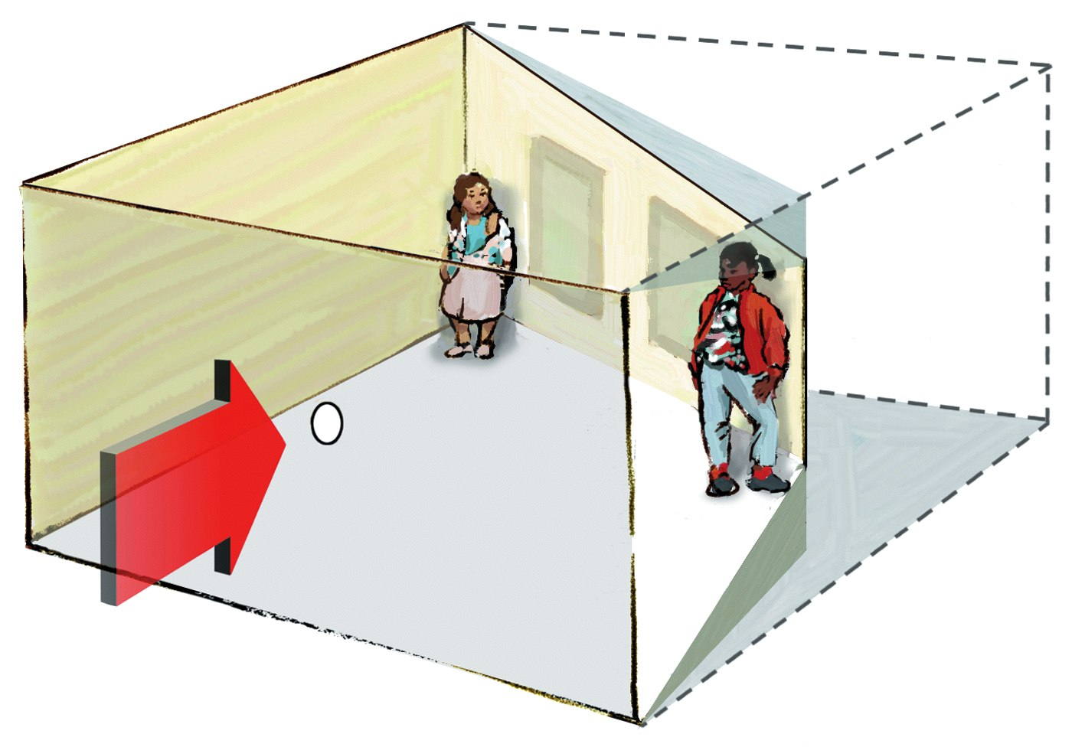
Illusions of Size Constancy: Ames Room
Room Shape
  Peep-hole eliminates binocular depth cues
  Linear cues altered
  Experience with rooms (Top-down)
Size Distortion
  Since room seems cubed, two corners seem about the same distance
  Two people same distance, but one takes up more space on retina
  Thus, must be bigger
  Illusion overrides size constancy assumption (top down)

Slide 22

Lightness Constancy
Amount of light reflected influences lightness (brightness) perception
Black paper in sunlight reflects more light than white paper indoors
  But the paper still appears black
  Called lightness constancy
Relative luminance (lightness)

Slide 23
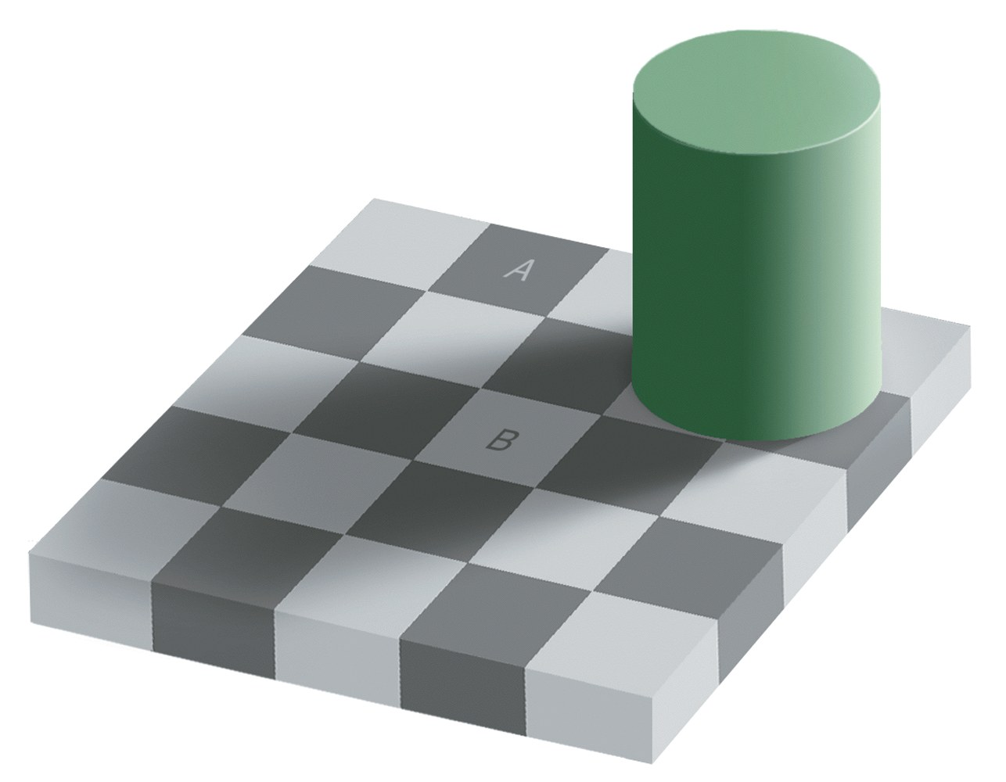
Lightness Constancy

Slide 24
http://www.youtube.com/watch?v=z9Sen1HTu5o

Slide 25
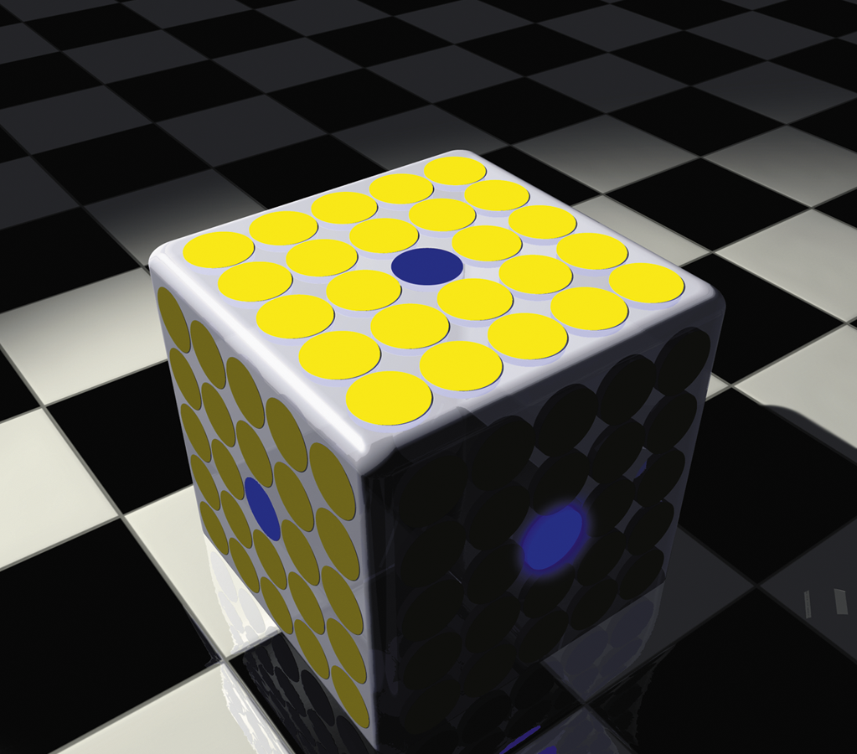
Colour Constancy
Amount of light reflected influences lightness (brightness) perception
But dull blue does not become bright blue in sunlight
Relative luminance
  Everything is brighter

Slide 26
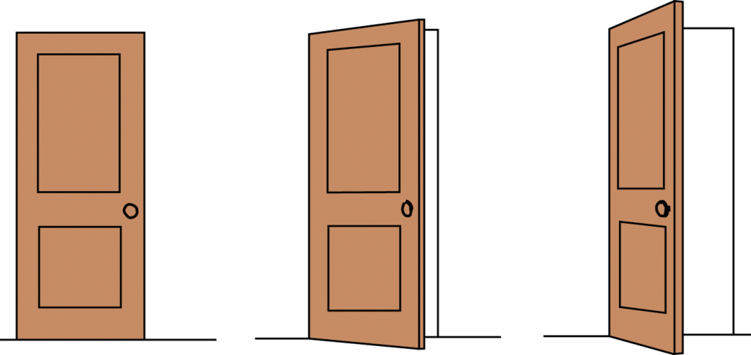
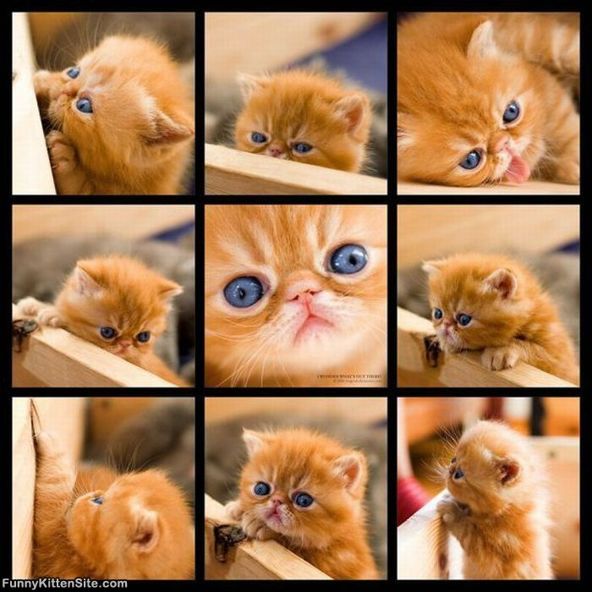
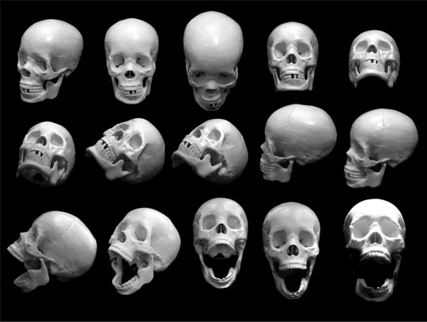
Shape Constancy
Perceive the shape of familiar objects as unchanging, even though the image on the retina changes

Slide 27
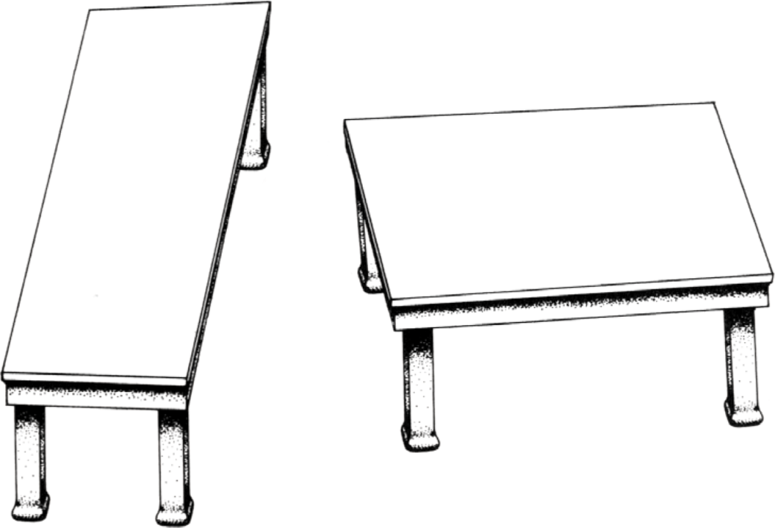

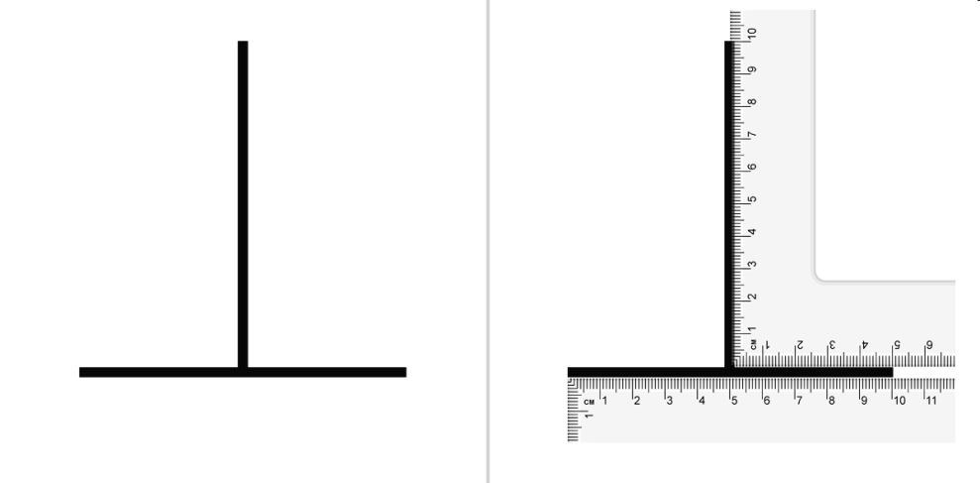
Illusion of Shape Constancy
http://library.thinkquest.org/05aug/01744/shepard_tabletop_illusion.htm
Horizontal-vertical illusion

Slide 28
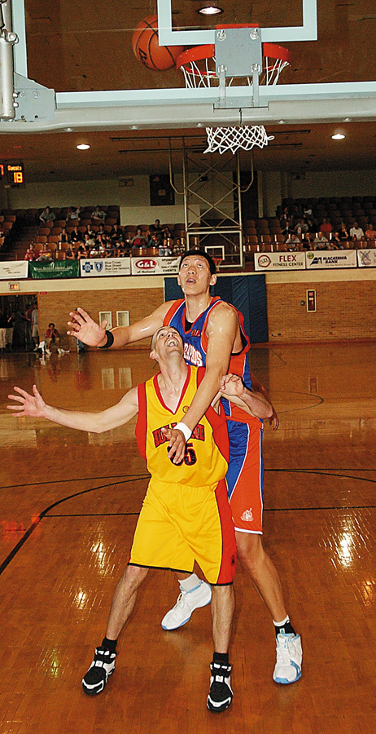
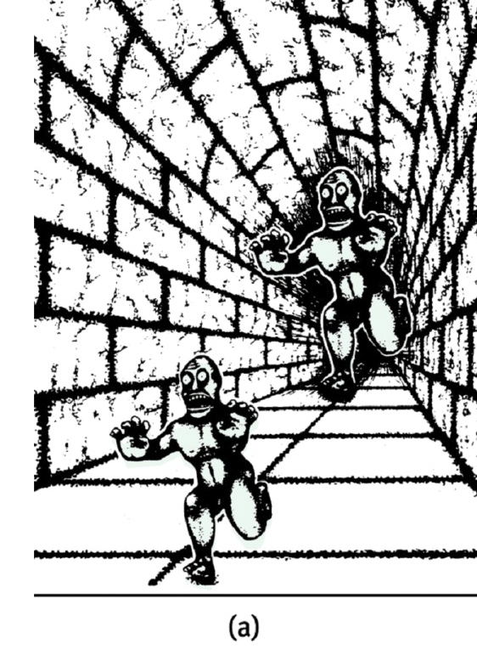
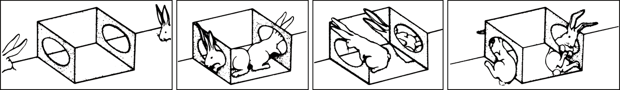
More Context Effects
1) How tall is the basketball player in yellow?
2) Is the basket on the ground or hanging from the ceiling?
3) Which face appears aggressive and which face appears frightened?
4) What is the meaning of the following words?
  Happy music vs. sad music
  Mourning/morning, die/dye, pain/pane

