Slide 1
Understanding and Interpreting Medical Terminology
EXCI233
Lecture 3

Slide 2
Summary Slide
Locational Terminology
Medical Terminology

Slide 3
Introduction
Medical terminology can be confusing to patients
Understanding some of the terminology used by doctors and other healthcare personnel will help a patient better understand what is being discussed about care
Is your mouth superior or inferior to your nose?
I have a posterior medial meniscus tear? What’s that?
Where’s the anterior cruciate found?

Slide 4
Introduction
Locational terminology gives an idea of location of an injury or problem
Medical terms may indicate organs of the body and tests or procedures to be done

Slide 5

Locational Terminology
The body is mostly symmetrical, bilaterally
The left half is essentially equal to the right half
The center line is the median or midline
  Fun Fact: What are the important exceptions to the rule of symmetry of the two sides of the human body?

Slide 6
Locational Terminology
Locations of the body are made with the body assumed to be in the anatomical position, as standard reference
The subject is assumed to be standing erect facing the observer, arms at the side, palms facing forward, feet on the floor
Using the anatomical position for reference avoids confusion

Slide 7
Locational Terminology
Is this subject in the anatomical position?
If she were lying down, would she be in the anatomical position?
Standing up, what small change would put her out of the anatomical position?

Slide 8
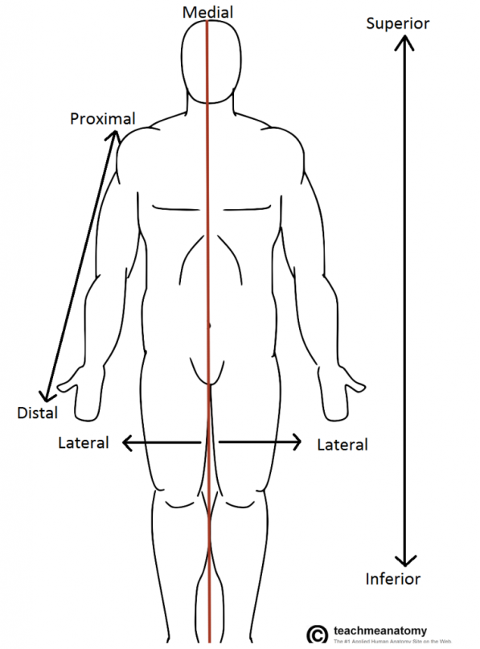
Locational Terminology
Most commonly used Anatomical Position Terms
Anterior | In front of, front
Posterior | After, behind, following, toward the rear
Distal | Away from, farther from the origin
Proximal | Near, closer to the origin
Dorsal | Toward the back
Ventral | Toward the belly
Superior | Above, over
Inferior | Below, under
Lateral | Toward the side, away from the mid-line
Medial | Toward the mid-line, middle, away from the side

Slide 9
Locational Terminology-Practice
The digestive tract contains the mouth, esophagus, stomach, small intestine, large intestine or colon, rectum and anus. Most water is absorbed in the distal part of the digestive tract rather than in the proximal part. What does this tell you?
  That the absorption occurs further from the beginning of the digestive tract, meaning closer to the end (colon) than in the mouth, stomach or small intestine. (No absorption happens in the rectum or anus.)
You have control mostly over only the extreme proximal and extreme distal parts of the of the digestive tract. Can you give the name of the sections that you voluntarily control?
A cyclist has to discontinue the activity due to an injury to the anterior cruciate ligament (found in the knee). Is this ligament on same side as the heel, or on the same side as the toes?

Slide 10
Locational Terminology-Practice, continued
The patient complained of a pain in the superior portion of the body, mostly towards the anterior. The pain has been persisting for a few hours. What do you think the patient has?
A gunshot victim has a stomach wound on the dorsal surface of the body. Is this correct or incorrect?
Football and hockey players can sometimes have either a medial or a lateral meniscus injury (The meniscus is a type of tissue found in the knee). Which type of meniscus would be towards the midline of the body, and which would be towards the outer side of the body?

Slide 11
Medical Terminology Explained-What do the highlighted terms mean?
Arthroscopy brings injury to its knees: The procedure has revolutionized sports medicine, saving pro athletes and weekend warriors alike. Dave Stubbs. The Ottawa Citizen. Ottawa, Ont.: Feb 7, 1999.
Rx 'Watchful waiting'; Why more doctors are choosing patience over antibiotics when treating ….. OTITIS MEDIA; Lila Sarick, The Canadian Press. Edmonton Journal. Mar 3, 1999.
…… encephalopathy first diagnosed in 1986; National Post. May 21, 2003.

Slide 12
Medical Terminology-Root Term
Medical terms always have what is called a “root term” which can be seen as the foundation of the term
The root is most often based on Greek or Latin words
Its medical meaning is based on the original meaning of the word in the original language
Cardi(o)- heart
Gastr- stomach
Oste(o)- bone
Could you make up a word using any of these terms?

Slide 13
Medical Terminology-Prefixes
Sometimes there will also be a “prefix” placed before the root term
Prefixes are small parts added to the front of the root word to add precision or more meaning
Sub - underneath
Pre- before
Hyper- over, above
Mono- one
Are there any words in which you could use these prefixes right away, not just medical words?

Slide 14
Medical Terminology-Suffixes
There will always be another section called a “suffix” placed after the root term
Suffixes are added to the end of the root word also to add meaning
In some cases, a combining vowel (usually –o) will be placed between the separate parts to join them all together

Slide 15
Medical Terminology-Suffixes
Here’s where you have to think a little harder.
Recall any words you might have heard using these suffixes
-itis inflammation
-oma tumour
-pathy disease, disorder

Slide 16
Medical Terminology
Consult the tables on pages 5, 6 and 7 for the relevant terms
Bring a copy of these tables to class

Slide 17
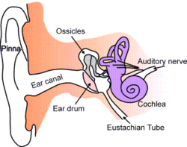
Medical Terminology
Ear infections are frequently called otitis media, meaning the infection is in the middle ear, as opposed to the outer ear or inner ear
  Ot = ear
  -itis = infection
  media = towards the midline

Slide 18
Medical Terminology Applied
  What is the prefix for beneath?
  What is the full term for “beneath the skin”? (there are 2 possibilities)

Slide 19
Medical Terminology-Practice
Suffixes (added to the end of the root word)
  What is the suffix for viewing?
  What is the full term for “viewing the stomach”?
  What is the term for joints?
  How would you write the term for viewing the joints? (Used most often for the procedure that looks inside the knee joint to determine ligament injury—many football and hockey players know this, unfortunately)

Slide 20
Medical Terminology Applied
Work with a partner
Form a medical term denoting:
  An infection in some part of the body
  An infection of the liver, specifically
  A flow of blood, as from a cut or injury
  A procedure to look inside a specific part of the body, for example, the colon (large intestine)
  A surgical procedure where some part of the body is removed
  The re-forming or moulding of the blood vessels (around the heart)

Slide 21
Medical Terminology
Form the medical term that describes:
  Removal of the gallbladder
  The recording (writing) of muscle activity
  The recording of the heart’s electrical activity

Slide 22
Summary
Medical terminology is based on Latin or Greek words providing the main meaning with small parts added (suffixes or prefixes) for greater precision
Understanding the root word and many of the prefixes makes it easier to understand the terminology used by medical personnel

