Slide 1
An Invitation to Health for the 21st Century
Pages 5-24
http://www4.hrsdc.gc.ca/.3ndic.1t.4r@-eng.jsp?iid=3 (life expectancy)
http://www4.hrsdc.gc.ca/.3ndic.1t.4r@-eng.jsp?iid=2#M_4 (Infant mortality rate)
http://www4.hrsdc.gc.ca/.3ndic.1t.4r@-eng.jsp?iid=5 (Mortality, all causes)
http://www4.hrsdc.gc.ca/.3ndic.1t.4r@-eng.jsp?iid=23 (Financial Security)
http://proquest.umi.com/pqdweb?did=2218002671&sid=5&Fmt=3&clientId=10306&RQT=309&VName=PQD
ProQuest document ID: 2218002671

Slide 2
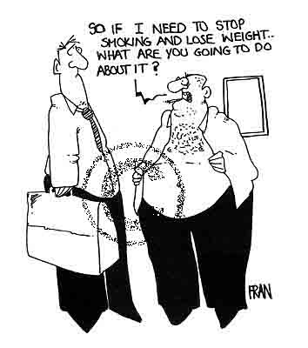
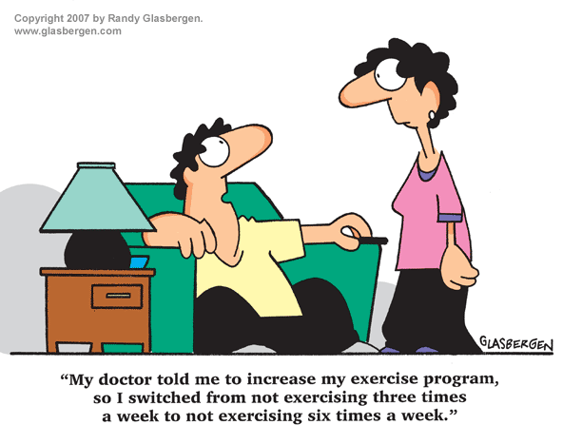
Current Issues in Health-a simple and as similar as the older issues in health

Slide 3
Summary
Health and Wellness
Aspects of Health
Health in Canada
Health Education

Slide 4
What’s the difference between health and wellness, or is there any difference?

Slide 5
Health and Wellness
Health means being sound in body, mind and spirit
Wellness is defined as purposeful, enjoyable living
  What’s the difference?

Slide 6
What do we know about icebergs?
90% of the volume of an iceberg is under water
The shape of the underwater section of an iceberg is difficult to guess at

Slide 7
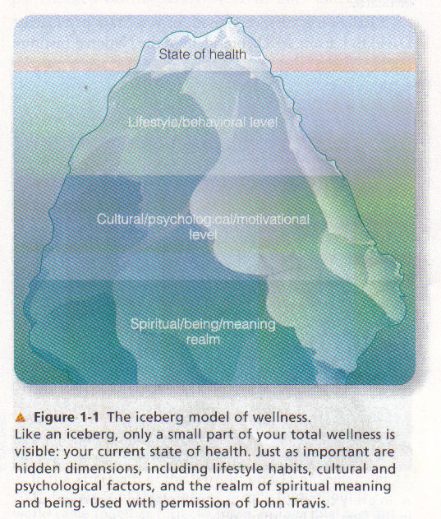
Health and Wellness-Like an Iceberg
What lifestyle habits, cultural or psychological factors have an effect on our health?
What about spiritual aspects?
Can you describe a situation where these factors interact with each other?

Slide 8
Think about it…..
Can someone be healthy but not well?
Can you be well but not healthy?
Under what conditions could either of these circumstances occur, if at all?

Slide 9
Health and Wellness
Iceberg Theory of Wellness
  Current state of health is comparable to the tip of the iceberg

Slide 10
What are the six different aspects of health?

Slide 11
Six Different Aspects of Health

Slide 12
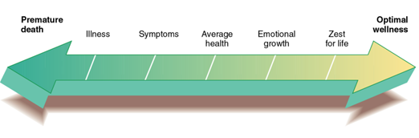
Physical Health-a continuum
©2003 Wadsworth, a division of Thomson Learning, Inc. Thomson Learning™ is a trademark used herein under license.

Slide 13
Physical Health
States of physical health can be seen as points on a continuum
Physical health
  Positive factors, also avoiding harm

Slide 14
Psychological Health
The awareness of feelings in oneself and in others
One’s ability to cope with stresses and to function independently

Slide 15
Spiritual Health
Being fulfilled, being at peace with oneself and with others
Able to experience love and joy in oneself and in others
Not necessarily religion-based

Slide 16
Social Health
Ability to interact with others and the social environment

Slide 17
Intellectual Health
Ability to learn from life experiences, be open to new ideas
Being able to use critical thinking skills also contributes

Slide 18
Environmental Health
The impact that dangers in the water, air, soil have on our well-being
Knowing the dangers of products we use and what to do to protect the environment

Slide 19
What would you suggest?
Ryan is in his first year of university. As an out-of-town student away for his first semester, he is living in residence. He has always been relatively shy, and hasn’t made many friends so far.
His usual routine now involves attending class, studying, watching TV and communicating with friends at home online. At home, he was very involved in cycling and outdoor activities, but since coming to university, he has not found much time to do any of these activities at all.
In the past few months, his clothes seem to be getting a bit tighter. He finds he feels tired all the time, and is not so sure if he made the right decision about when and what to study.
Do you know people similar to Ryan? What aspects of his health are good? Which aspects need improvement? What would you suggest to Ryan to improve his overall health/wellness situation?
What aspects of health were not mentioned in this scenario? What should he be doing to maintain optimum health in these other aspects of his life?
What resources are available here at Concordia that would help someone like Ryan in a similar situation?

Slide 20
Health in Canada

Slide 21
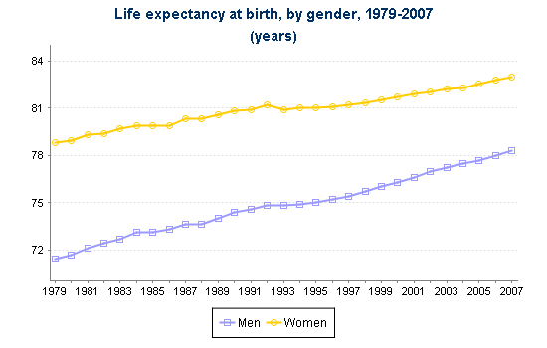
Life Expectancy in Canada
How has life expectancy of Canadians overall changed over the last 35 years?
How does life expectancy for women compare to that of men over the same period?

Slide 22
Life Expectancy
Life expectancy in Canada is 80.7 years for those born in 2007
The figure is 83 years for women, 78.3 for men
Canada had the second highest life expectancy of G7 countries

Slide 23
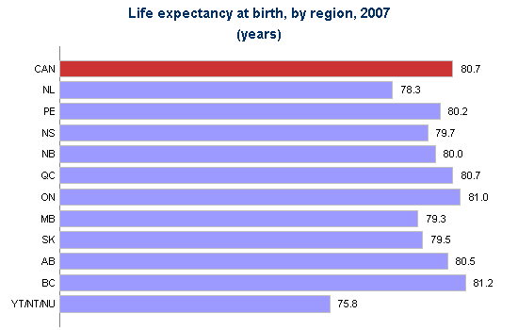
Life Expectancy in Canada
  A regional perspective
Which areas have the greatest life expectancy? Which areas have the lowest life expectancy? What could explain the difference?

Slide 24
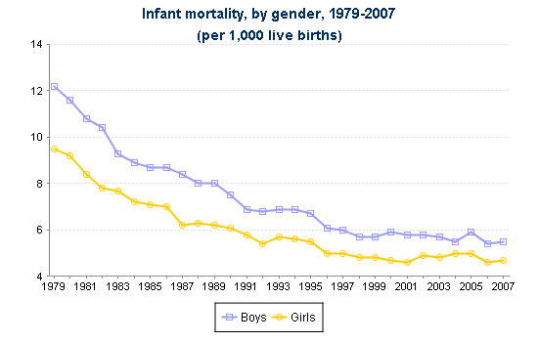
Infant Mortality
Infant mortality is expressed as the # of deaths of a live-born child below 1 year of age per 1000 live births
What does this graph show about infant mortality rates (IMR) in Canada?

Slide 25
Canada’s Health
Infant mortality (death of a live-born infant before the age of one) has declined dramatically in the last century
In Canada in 2007, the infant mortality rate (IMR) is 5.1/1000 live births; (in 1901, the rate was 130/1000 live births)
Canada’s IMR ranks second highest in rank order/ second lowest of G7 countries
http://data.worldbank.org/indicator/SP.DYN.IMRT.IN

Slide 26
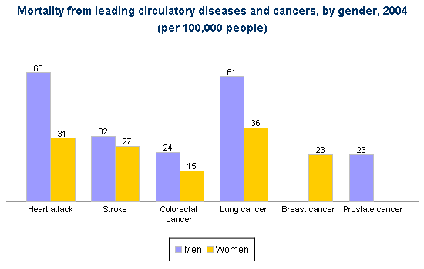
Canada’s Health

Slide 27
Canada’s Health
Are there challenges to the health of Canadians, despite these good indexes?

Slide 28
Canada’s Health
Heart disease and cancer become important causes of death in mid-age and up
Males have higher mortality from heart disease, stroke, colorectal and lung cancers

Slide 29
Canada’s Health
Single parents, recent immigrants, disabled persons and Aboriginal people were at greater risk of low income compared to Canadians in general
Someone at a low income has greater challenges in providing food, shelter and basic necessities

Slide 30
Quite close to home….
The following is an excerpt from an article that appeared in the Montreal Gazette in December 2010. Interestingly, it presents some information about research done at Concordia, as well as profiling a Concordia student.
As you read it, think of what aspects of health are mentioned in this excerpt, what are some of the determinants oh health that are mentioned, and what factors are cited as negatively affecting health.

Slide 31
Poverty: ending the cycle
DONNA NEBENZAHL. The Gazette. Montreal, Que.: Dec 18, 2010
Christmas was a trip to the Salvation Army for Sarah Cote and her siblings - if she was lucky. "My father is a heroin addict. We had a single mom who worked as much as she could, raising three kids and working at a minimum wage job," says Cote, now 30.
She recalls taking just one family trip during her entire childhood, and that was because her mom's boyfriend at the time paid for it. "If we wanted things, we had to buy them ourselves," she says. "I've been working since age 13."
Everybody knows that poverty is tough, that it is often at the root of lack of education, drug abuse, even violent crime.
But everybody doesn't know why. Peeling back the layers of poverty has been a career's work for psychologist Lisa Serbin and her colleagues, the drivers behind Concordia University's 34-year Longitudinal Risk Project.
Since 1976, at the university's Centre for Research in Human Development, a group of academics have been surveying and studying three generations of Montrealers. The project started with 4,000 children in 22 inner-city Montreal schools in lower socio-economic areas, looking for predictors of health and development, and the transfer of risk from one generation to the next.
The researchers followed the children and their parents, and when the children became parents, they followed the third generation as well -studying mental health, childhood aggression, emotional stability, parenting skills, and more.
One thing they know for sure.
"Poverty causes trouble," Serbin says. "It limits education because if your parents don't finish school, then it's less likely you will."
These researchers talk about the concept of "unpacking poverty," she says. "We ask, 'Why does it have a bad impact?' "
For starters, people who live in poverty don't have material resources, she points out. "They're without proper housing and quality of food, and there is an effect on nutrition and on brain development."
In addition, poverty affects social resources, especially if the community in which you live is crowded and sometimes dangerous. "Often people work long hours," she says. "We know that social support is important for child rearing -well, your needs are even greater when you're poor."

Slide 32
The Health of College Students
Incidence of life-threatening illness is lowest in this age group
Gender differences are apparent in this age group
  College-aged men are more likely to engage in risk-taking behaviours than women of this age, and men are more likely to be hospitalized

Slide 33
The Health of College Students
Women more than men report significantly elevated stress levels
Higher levels of education are related to lower levels of certain diseases

Slide 34
Questions to discuss
Which of the 6 kinds of health is the most important, in your opinion?
Does this remain constant over the lifespan?
Are there any aspects of health one can ignore and still remain healthy?

Slide 35
Summary
Health and Wellness
Aspects of Health
Health in Canada
Health Education

Slide 36
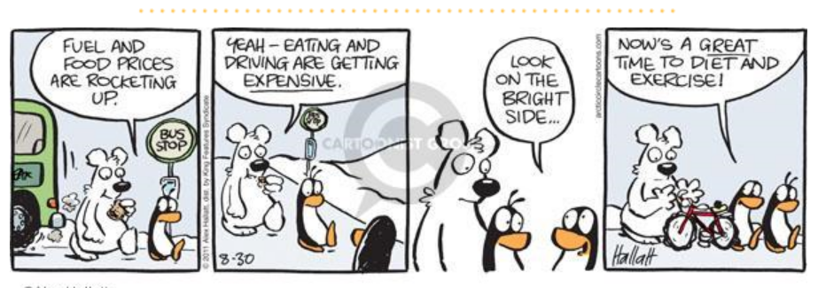
Motivation to Improve Our Health…

Slide 37

And every New Year, I resolve to…..

Slide 38
Can you think of any campaigns, either from government or health-related organizations, that aim to have us improve our health or change negative habits?

Slide 39
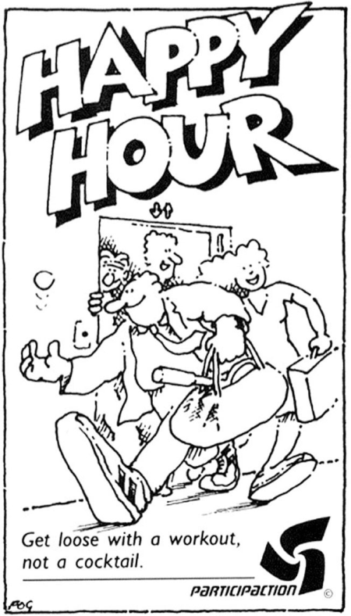
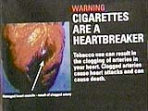




Prevention, Protection or Promotion?

Slide 40
Prevention
Prevention can take many forms
  Primary prevention seeks to stop problems before they start
  Prevention can also target individuals with certain risk factors and help them with information and support to avoid potential problems

Slide 41

Protection
Protection goes hand-in-hand with prevention
Protection is a way to decrease the risks of our actions
What is the DIFFERENCE between prevention and protection?

Slide 42
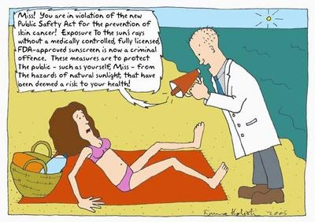
Protection….…gone too far?

Slide 43
Assessing Risks
Are there possible benefits of taking this risk?
  Is risk voluntary? Is it fair? Are there alternatives?
  How the risk is presented-positive or negative light

Slide 44

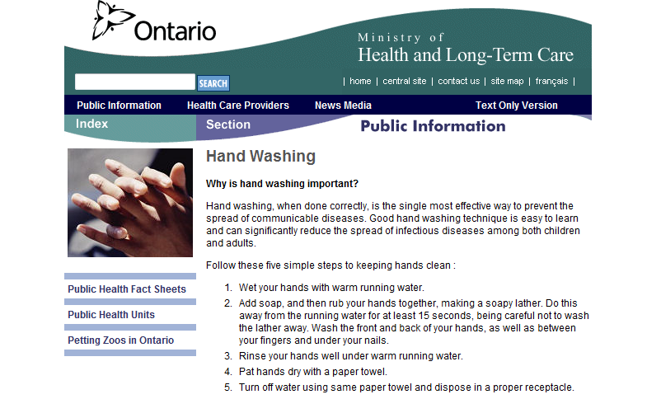

Health Promotion

Slide 45
Health Promotion
Health promotion combines prevention and protection
WHO defines health promotion as “the process of enabling people to improve and increase control over their health”

Slide 46
Health Promotion
Health promotion programs combine different aspects:
  Educational-mass media, use of community leaders
  Peer counseling-one-to-one counseling
  Environmental-decreasing availability of poor choice items
  Encouraging volunteerism so young people look beyond themselves to the wider community

Slide 47
Summary
Health and Wellness
Aspects of Health
Health in Canada
Health Education

