Slide 1
ENV1101:
Global Environmental Challenges
Fall 2014
Instructor: Sasha Kebo

Slide 2
Today’s agenda (~30 min)
Defining environmental studies
  What is this course about?
Syllabus overview
Introductions(s)

Slide 3


What are environmental studies?
What is this course about?
Relationships between humans and nature

Slide 4
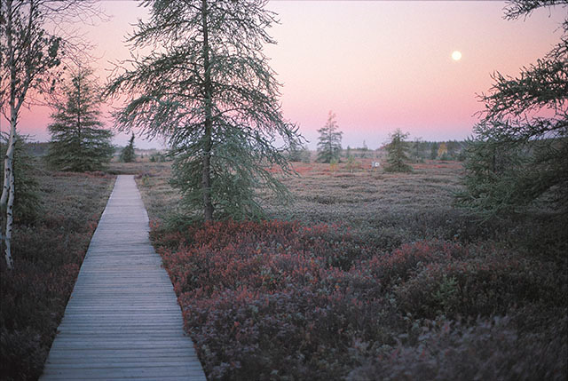

Slide 5
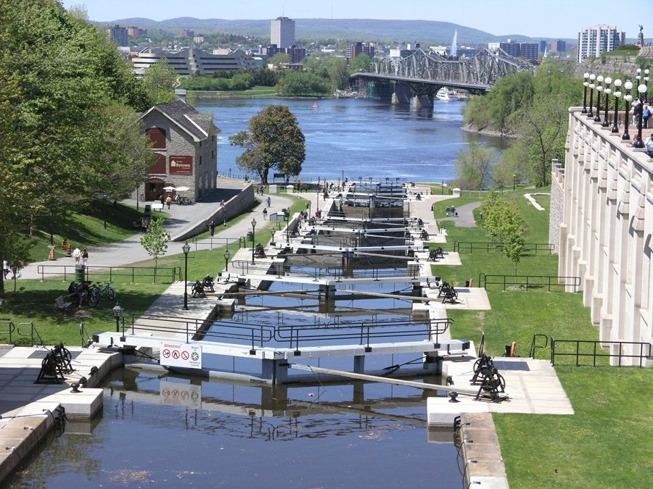

Slide 6
The interdisciplinary approach of environmental studies
Ecology
Geography
Sustainability
Resource Mngmt
Sociology
… and more!

Slide 7
My slides are minimalistic and text-poor
So, you must come to class to take notes.
So, you must come to class to take notes.
So, you must come to class to take notes.
So, you must come to class to take notes.
So, you must come to class to take notes.
So, you must come to class to take notes.
So, you must come to class to take notes.

Slide 8
Syllabus overview
Our “contract”

Slide 9
E-mail that will not receive a response
From:slugsley@hotmail.com
Subject: very unhapy
Hey
I just got back my test and my mark is like totally unacceptable and I am very unhapy and I want something done about it :(

Slide 10
E-mail that will receive a response
From: mike@tubular.net
Subject: ENV1101 midterm exam – request for appointment
Hello,
My name is Mike Oldfield and I am in your ENV1101 class. I just got back my midterm exam and I was hoping my grade would be better. I checked the rubric, and I am not sure what was meant by the phrase “explain the discrepancies” in question 4. Can I come show you my paper? I have a class that conflicts with your office hours. Is it possible to see you on Friday morning? I have no classes then. Also, I would like to ask you for advice on how to improve my score on the final exam.
Thanks, Mike

Slide 11
Introduction(s)
Myself
You

Slide 12
Next class…
Complete assigned readings
  Tip
Full lecture
Slides will be made available shortly before class.

