Slide 1

Hypnosis:
Facts and Fiction
Psyc 200 – January 30th 2014
Shelagh Freedman, Ph.D. Candidate
Hypnosis and Memory Lab, Concordia University

Slide 2
What is hypnosis?
One person (the subject) is guided by another (the hypnotist) to respond to suggestions for changes in subjective experience, alterations in perception, sensation, emotion, thought or behaviour.

Slide 3
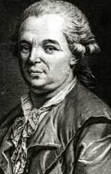
The Origins of Hypnosis
Franz Anton Mesmer
  The father of hypnosis
Late 1700s – Paris
Animal magnetism

Slide 4
Types of Hypnosis
Stage hypnosis
Research hypnosis
Clinical hypnosis
Forensic hypnosis

Slide 5
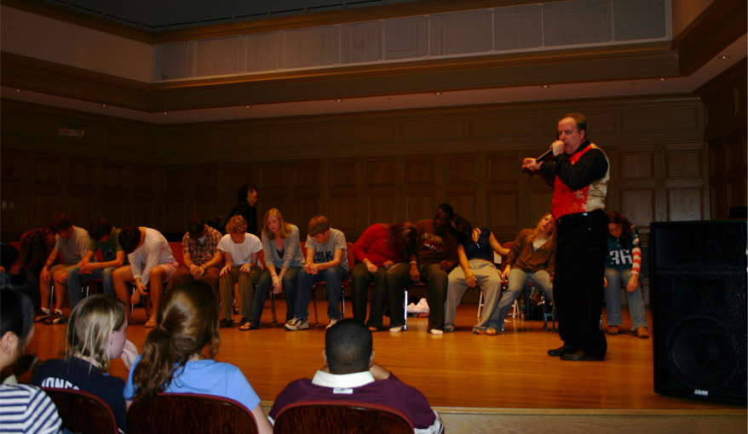
STAGE HYPNOSIS
Theatrical performance

Slide 6
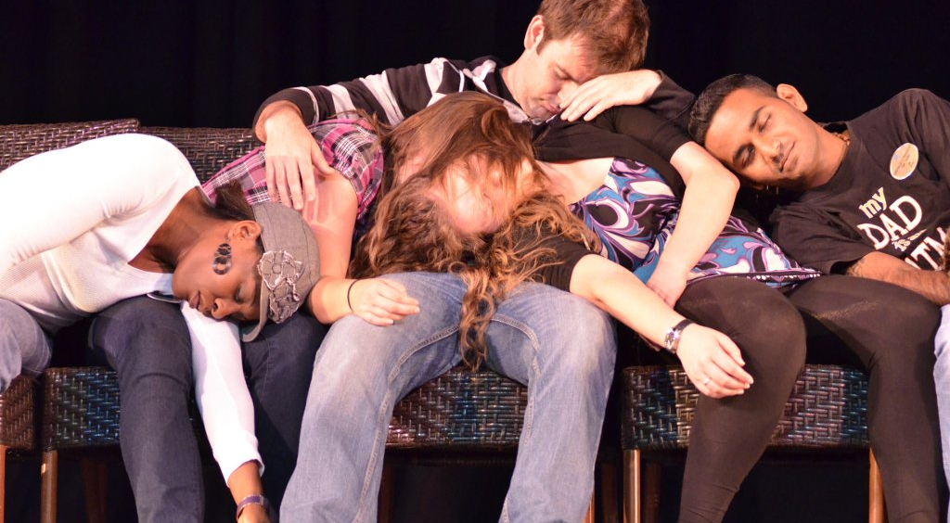

Slide 7
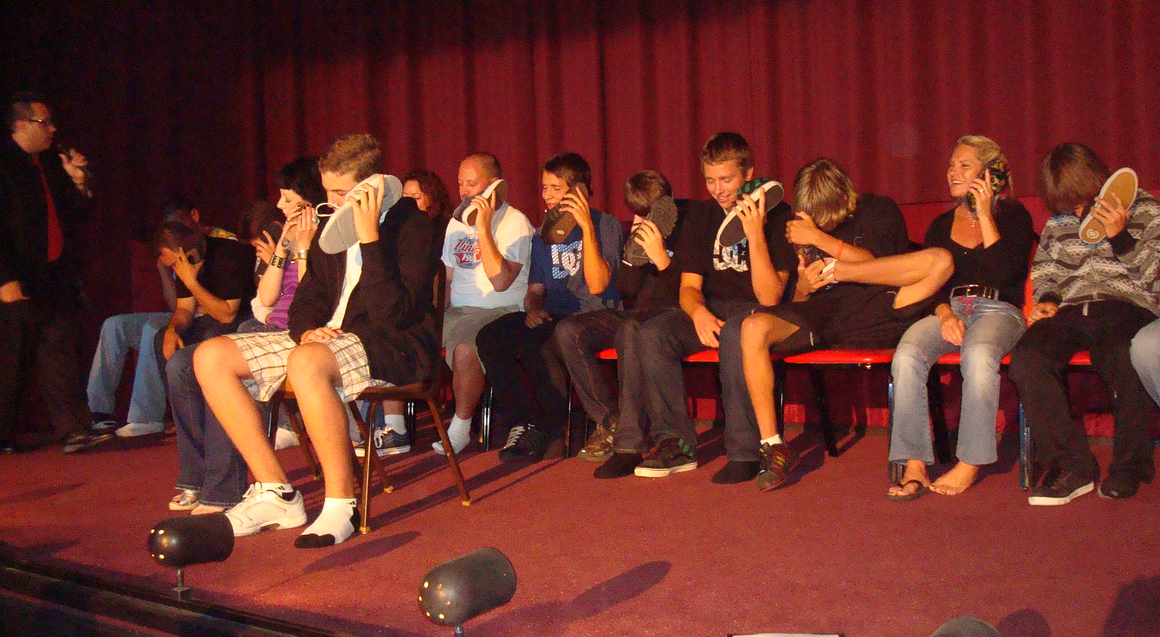

Slide 8
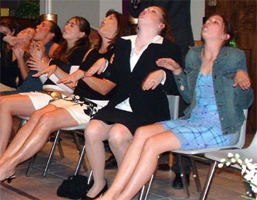

Slide 9
Are people faking hypnosis?
Participants asked to fake hypnosis (Simulators) are compared to participants genuinely hypnotized (Reals)
  The Real-Simulator Design
Differences reported in:
  Behaviours
  Subjective experiences
  Neural correlates

Slide 10
Can everyone be hypnotized?
Most people can experience some degree of hypnosis (Mediums)
10-15% are very responsive (Highs)
10-15% are not very responsive (Lows)

Slide 11
Do people lose control when they are hypnotized?
People remain in control of their actions during hypnosis
You can only be hypnotized if you are willing
Cannot be made to do anything against your will

Slide 12
Can people get stuck in hypnosis?
People will naturally come out of hypnosis
Some people report feeling a little groggy after hypnosis
Some people report feeling rested and very alert

Slide 13
RESEARCH HYPNOSIS
Intrinsic research
  Research that focuses on the phenomena and nature of hypnosis itself
    i.e. Is hypnosis an altered state of consciousness
Instrumental research
  Research that uses hypnosis as a tool to investigate phenomena outside its immediate domain
    i.e. Inducing hallucinations hypnotically to study hallucinations

Slide 14
Measuring Hypnotizability
Hypnotizability: One’s ability to respond to standardized hypnotic suggestions
Standardized scales:
  Harvard Group Scale of Hypnotic Susceptibility (HGSHS:A)
  Stanford Hypnotic Susceptibility Scale (SHSS:C)

Slide 15
Typical Hypnotic Procedure
Induction (progressive muscle relaxation)
Deepening
Hypnotic suggestions
  Focus on overt, behavioural responses
Dehypnotization

Slide 16
Harvard Scale vs. Stanford Scale
HGSHS:A
SHSS:C
Standardized
12 suggestions
Group administration
Screening procedure
More easy suggestions
Self scored
Standardized
12 suggestions
Individual administration
Gold standard
More difficult suggestions
Experimenter scored

Slide 17
Types of Suggestions
Suggestions vary in difficulty
  i.e. number of participants passing
Three main types of suggestions:
Ideomotor (easy)
Challenge (medium)
Cognitive (difficult)

Slide 18
Harvard vs. Stanford Suggestions
* You don’t need to know all of these specific examples, just the three general types – ideomotor, challenge, cognitive *
HGSHS:A
SHSS:C
Head falling
Eye closure
Hand lowering (left)
Arm immobilization (right)
Finger lock
Arm rigidity (left)
Hands moving together
Communication inhibition
Fly hallucination
Eye catalepsy
Posthypnotic suggestion
Posthypnotic amnesia
Hand lowering (right)
Moving hands apart
Mosquito hallucination
Taste hallucination
Arm rigidity (right)
Dream
Age regression
Arm immobilization (left)
Anosmia to ammonia
Hallucinated voice
Negative visual hallucination
Posthypnotic amnesia
Notes:
* for your interest

Slide 19
Ideomotor Suggestions
Thinking of a movement can cause the movement
Arm Lowering (easy ideomotor)
Arm Levitation (hard ideomotor)

Slide 20
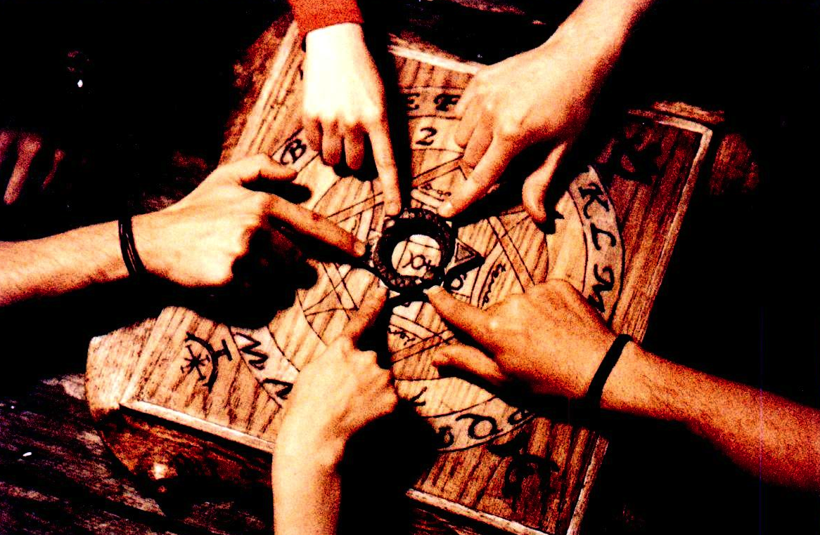

Slide 21
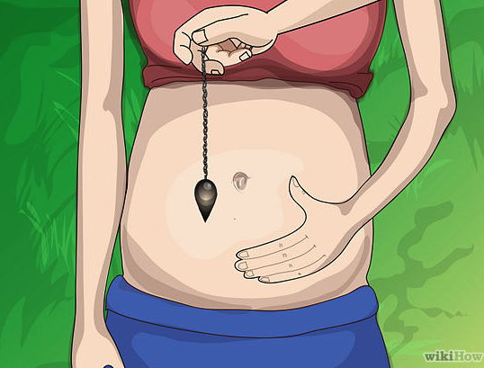

Slide 22
Challenge Suggestions
Starts with an ideomotor suggestion and then challenges the participant to go against it
Arm Rigidity: Imagine your arm is stiff and rigid like an iron bar and now try to bend your arm

Slide 23
Cognitive Suggestions
Suggestions for changes in perception, emotion, memory, etc.
The most difficult suggestions to pass
What people normally think of when they think of hypnotic suggestions

Slide 24
Harvard vs. Stanford Suggestions
Red = examples of cognitive suggestions
HGSHS:A
SHSS:C
Head falling
Eye closure
Hand lowering (left)
Arm immobilization (right)
Finger lock
Arm rigidity (left)
Hands moving together
Communication inhibition
Fly hallucination
Eye catalepsy
Posthypnotic suggestion
Posthypnotic amnesia
Hand lowering (right)
Moving hands apart
Mosquito hallucination
Taste hallucination
Arm rigidity (right)
Dream
Age regression
Arm immobilization (left)
Anosmia to ammonia
Hallucinated voice
Negative visual hallucination
Posthypnotic amnesia

Slide 25
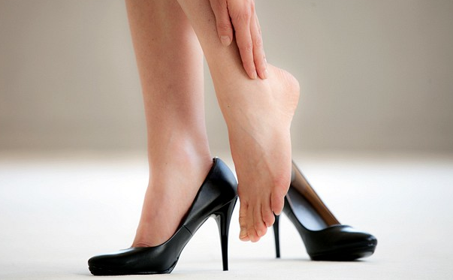
Posthypnotic Suggestion
A suggestion given during hypnosis that takes place after hypnosis
  Usually with a cue
  eg. Touch your left ankle when you hear a tapping noise

Slide 26
Posthypnotic Amnesia
A temporary difficulty remembering what occurred during the hypnotic session
  Suggested: occurs in response to suggestion
  Reversible: upon a pre-arranged cue, the participant remembers

Slide 27
Calculating Hypnotizability Scores
All suggestions are passed if the participant makes the predetermined overt movement
  One point for each item passed
  Total scores range from 0-12
0-3: low hypnotizable
4-7: medium hypnotizable
9-12: high hypnotizable

Slide 28
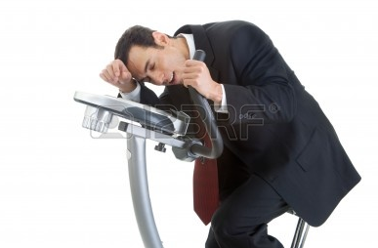
Is a relaxation induction necessary?
Any type of induction is possible if the person believes it to be “hypnotic”

Slide 29
CLINICAL HYPNOSIS
Using hypnosis in a therapeutic context
Not all about hypnotizability
  Context
  Beliefs
  Guided imagery
Make use of person’s beliefs and abilities

Slide 30
How is hypnosis best used?
BAD: voluntary and pleasurable
  Smoking
  Overeating
  Drinking/drugs
GOOD: Non-voluntary, non-pleasurable
  Pain
  Allergies
  Psoriasis
Notes:
* for your interest

Slide 31
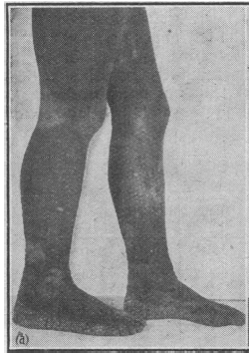
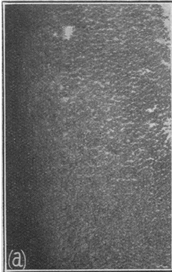
Case Study: Congenital Ichthyosiform Erythrodermia of Brocq
Mason, 1952
Notes:
16 year old boy
Untreatable condition since birth
Black horny layer of skin
Progressive thickening of the skin – cracks and gets infected
Even light coloured areas thickened
Shy and lonely – he smelled bad, looked weird
2 skin grafting attempts – didn’t work
A doctor tried hypnosis on him, but intelligently only gave suggestions for the skin to clear on his left arm
About five days later skin healed on left arm
Since the improvement occurred only on left arm, the effect is not considered a coincidence
Then gave suggestions for right arm, and legs, etc.
Improved his overall life and attitude
Quick improvement to begin with and then slowed after months
Still fine a year later

Slide 32
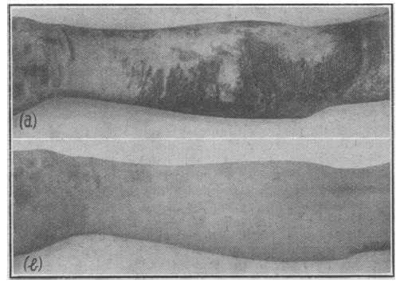
Notes:
8 days

Slide 33
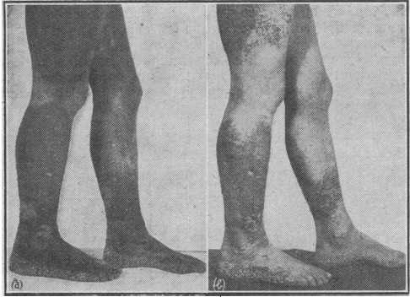
Notes:
4 weeks after treatment

Slide 34
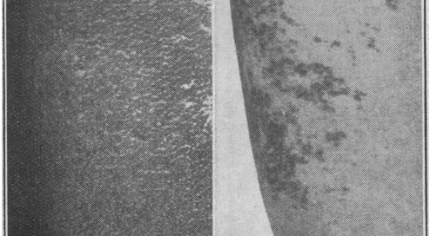
Notes:
One month later

Slide 35
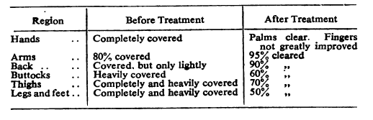
Before and After Hypnosis

Slide 36
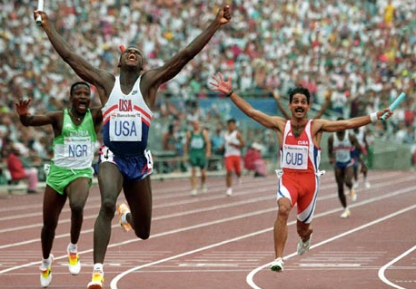
Athletic Performance
Notes:
*hypnosis can be helpful for athletes (focus, anxiety, mental rehearsal)

Slide 37
FORENSIC HYPNOSIS
The use of hypnosis in the legal arena
Eyewitness testimony
Repressed memories
Free will

Slide 38
Can you recall lost memories with hypnosis?
Highs report more “new found” memories
For every correct memory, 4-5 false memories
False Memory:
Memories are malleable
Not everything we remember is correct!

Slide 39
Hypnosis and Memory
Hypnosis can cause false memories
Hypnosis increases confidence in memories
  Both true and false
Increased effect if people believe hypnosis can help with the retrieval of memories

