Slide 1
Evolutionary and Genetic foundations
PSYC 200
Winter 2014
Chapter 3
Tues/Thurs Jan 14/16

Slide 2
Lecture Plan
Natural selection
Evolutionary psychology
Heritability
Gene environment interactions

Slide 3
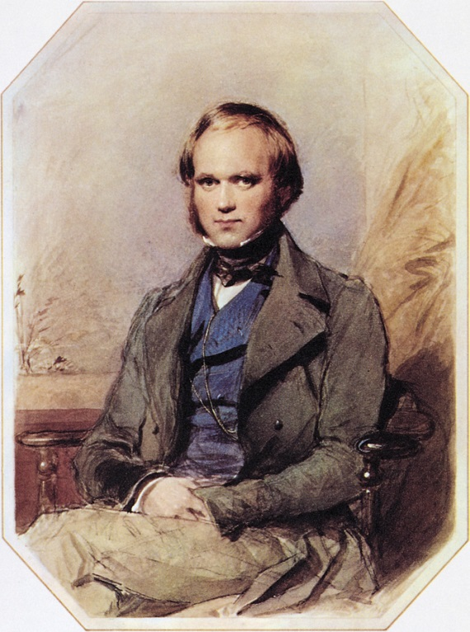
Evolution by Natural Selection:
Charles Darwin
Naturalist on the HMS Beagle to South Africa and the Galapagos Islands
1859 Origin of Species
3 main observations
  Individuals of a given species are not identical
  Some variation can be inherited
  Not all offspring survive
Major organizing principle for life sciences
“Psychology will be based on a new foundation, that of the necessary acquirement of each mental power and capacity by gradation” (1859, p.113)
http://www.imdb.com/title/tt0974014/?ref_=fn_al_tt_1

Slide 4
Natural Selection
Obstacles to reproduction imposed by natural environment
If obstacles can be overcome, reproduction is possible
Any variety of an inherited trait that causes individuals to fair better than individuals with another variety of that trait is “selected” for

Slide 5
Evolution by Selection
Dark blue variation = selected for
Light blue variation = selected against
Time

Slide 6
Variability of a particular trait in a given population

Slide 7
Normal Distribution: Stabilizing Selection
Frequency in the population
Less to more of a trait

Slide 8
Skewed Distribution: Directional Selection
Frequency in the population
Less to more of a trait

Slide 9
Population Variation
At any given point of time and space there will be an optimum value of a trait from the point of view of reproductive fitness

Slide 10
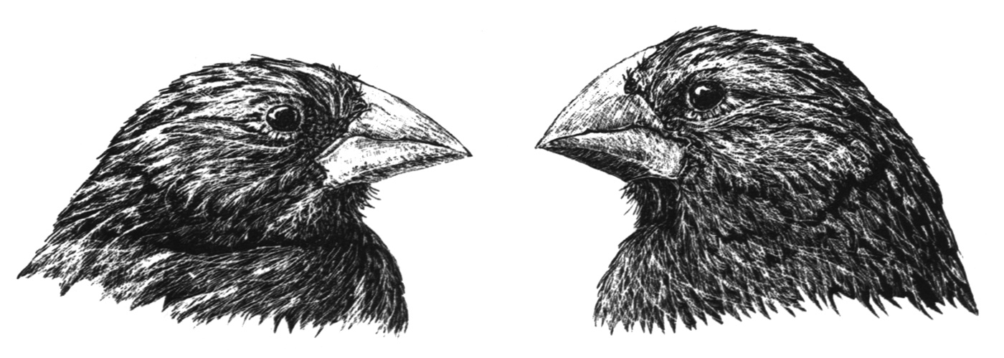
Sharper, longer, deeper beak, easier to break open hard seeds
Less sharp, shorter beak, more difficult to break open hard seeds
Increase frequency
in times of drought
Decrease frequency
in times of drought

Slide 11
Environmental pressure
Drought leaves only hard seeds for bird food
Competition btw individuals w/ different phenotypic traits
Sharp-beaked birds vs. blunt-beaked birds
Trait differences lead some to outcompete others
Sharp-beaks cause birds that have them to get more food
Some survive and/or reproduce better
Sharp-beaked survive and reproduce better
Genotype Selection
Increase proportion of sharp-beak genes in pop.

Slide 12
Important Notes about Natural Selection
Not progressing toward anything in particular
Has no moral value
  http://eugenicsarchive.ca/

Slide 13
Important Notes about Natural Selection
Not all characteristics passed on/“selected” for because necessarily adaptive

Slide 14
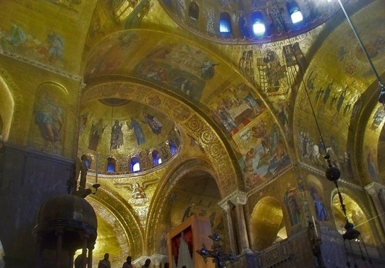
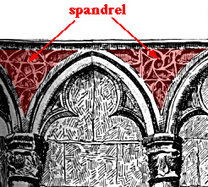
Spandrels of San Marco
Gould, S.J. and Lewontin, R.C. (1979). The Spandrels of San Marco and the Panglossian Paradigm: A Critique of the Adaptationist Programme. Proceedings of the Royal Society of London, Series B. 205(1161), 581-598
Image from: http://shimmanen.wordpress.com/2012/03/31/the-better-spandrels/
Image from: http://art1arquitectura.blogspot.ca/2011/06/las-enjutas-de-san-marcos-y-el.html

Slide 15
Selecting for SIZE, not color

Slide 16
What does this have to do with psychology?
Human beings – as a species – have the biologically/genetically based instincts, tendencies, traits, characteristics, cognitive mechanisms, emotions, behaviors of the people from 10,000 years ago
  not inherently stronger, more intelligent, less aggressive
We have the genes that underlie the variations of those traits that were selected for – or that came along with characteristics that were selected for – through Darwinian natural selection process
  survival and reproductive advantage/fitness

Slide 17
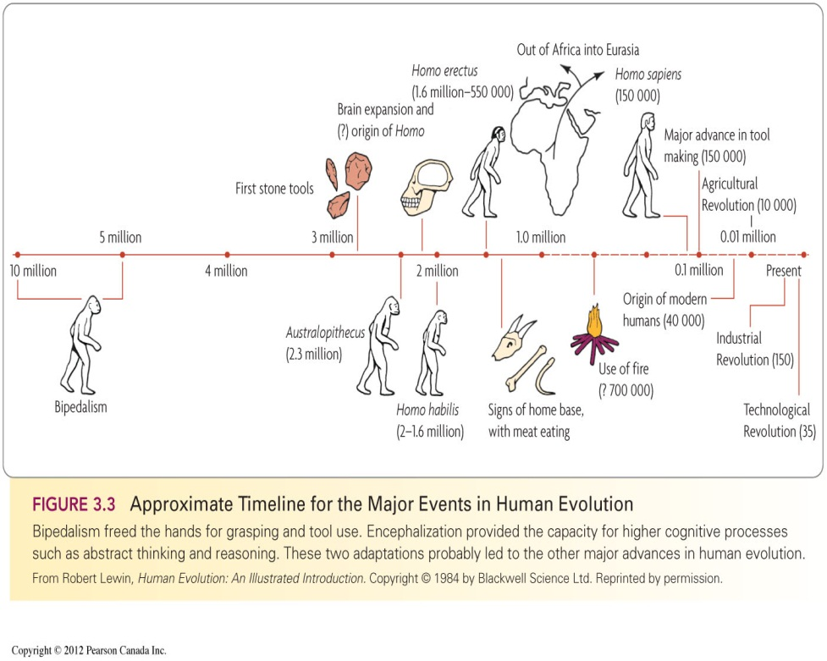
Human Time Scale

Slide 18
Evolutionary Psychology
What is the survival/fitness-enhancing function of a particular mental or behavioral trait?
Distal explanations for psychological phenomena
  In contrast to traditional, proximal, mechanistic explanations
Use animal models to test mechanisms
  many other animal species also share our traits based on our common ancestry
  can manipulate gene pools and environment in ways we can’t in humans

Slide 19
Artificial Selection
Breeding
Manipulating gene pools
Demonstrates that traits are inherited
Mate individuals at the extremes
Common with domesticated plants and animals
“dull” vs. “bright” rats

Slide 20
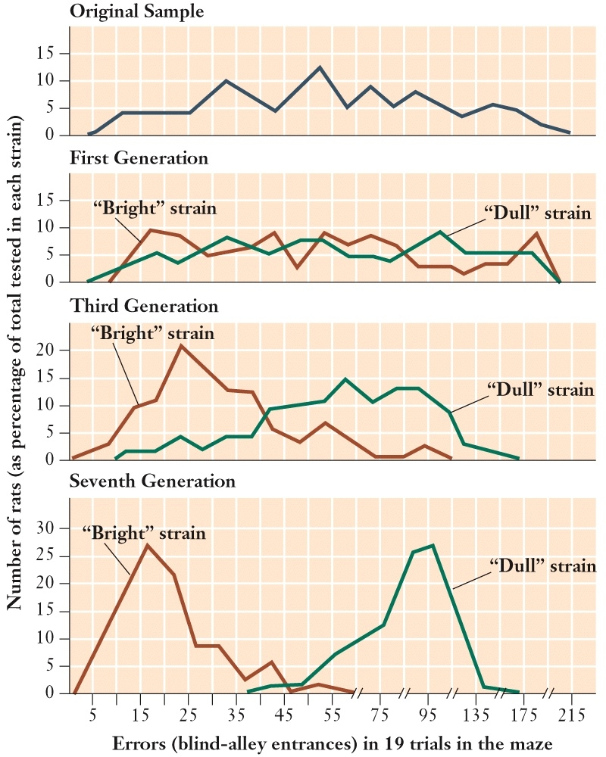

Slide 21
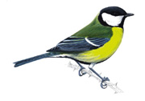
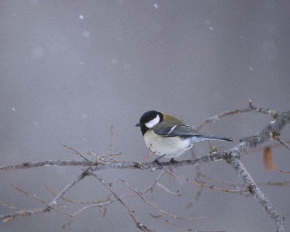
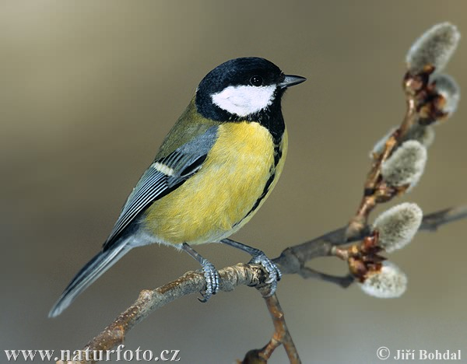
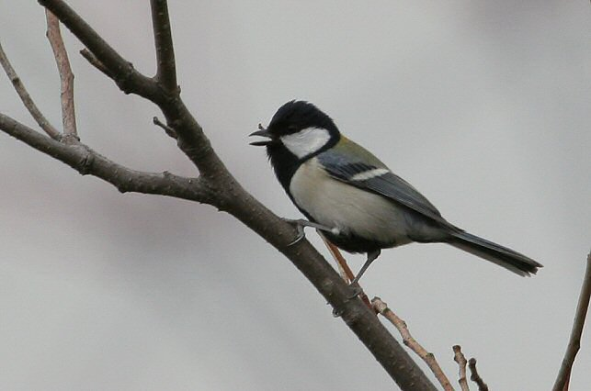
Chickadee Parus major

Slide 22
Chickadee Aggressive Behavior
Differ on a dimensional behavior: exploration
  Greater exploration = more aggressive and bold
  Less exploration = less aggressive and bold

Slide 23
Who has the advantage?
Environmental condition:
  Food is scarce:
  Food is plentiful:

Slide 24
Evolutionary Psychology of Personality
Personality:
  A person’s general style of interacting with the world
  Distinguishable from habits, attitudes, and interests
  Underlying basic tendencies

Slide 25
Extraversion: positive emotions, exploratory activity
Benefits
Costs

Slide 26
Neuroticism: negative emotions, fear, sadness, anxiety, guilt
Benefits
Costs

Slide 27
Who is advantaged today?
More/less neurotic?
More/less extraverted?

Slide 28
Other Examples in the Text
Language
Music
Emotion
Addiction

Slide 29
Modern Evolutionary Theory
Combines natural selection and genetics
  “Modern Synthesis”
Genetics: study of the mechanisms of inheritance

Slide 30
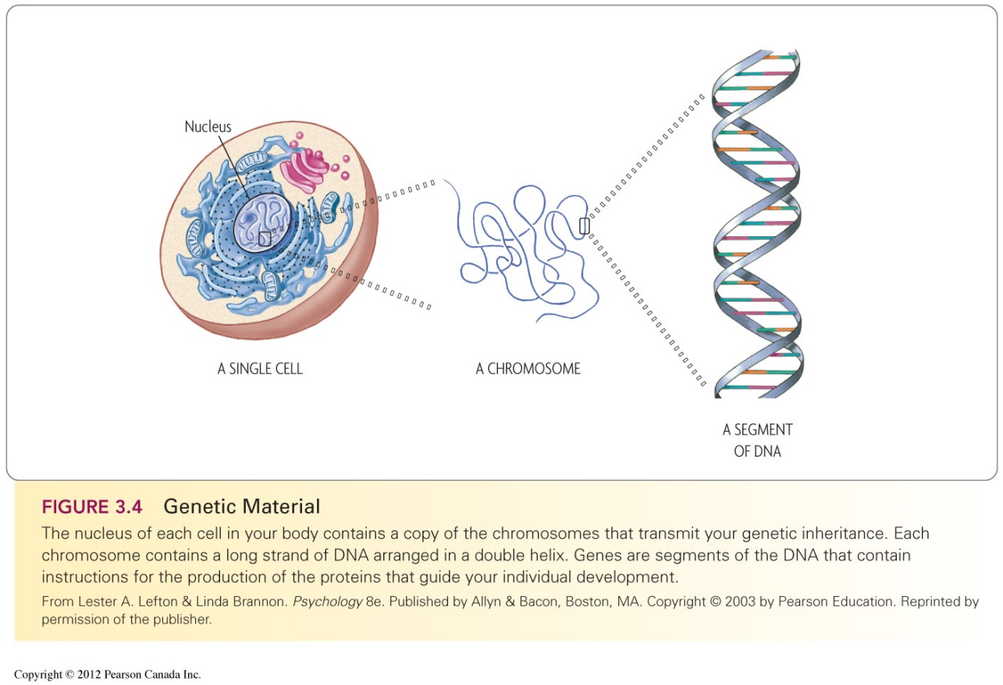
Genes
Biological units of heredity
Segment of a DNA molecule that contains the code for making a specific protein molecule
www.genome.gov

Slide 31
Heredity
How is genetic information passed on from parents to offspring?
Meiosis: form of cell division
  new sperm & ova are formed

Slide 32
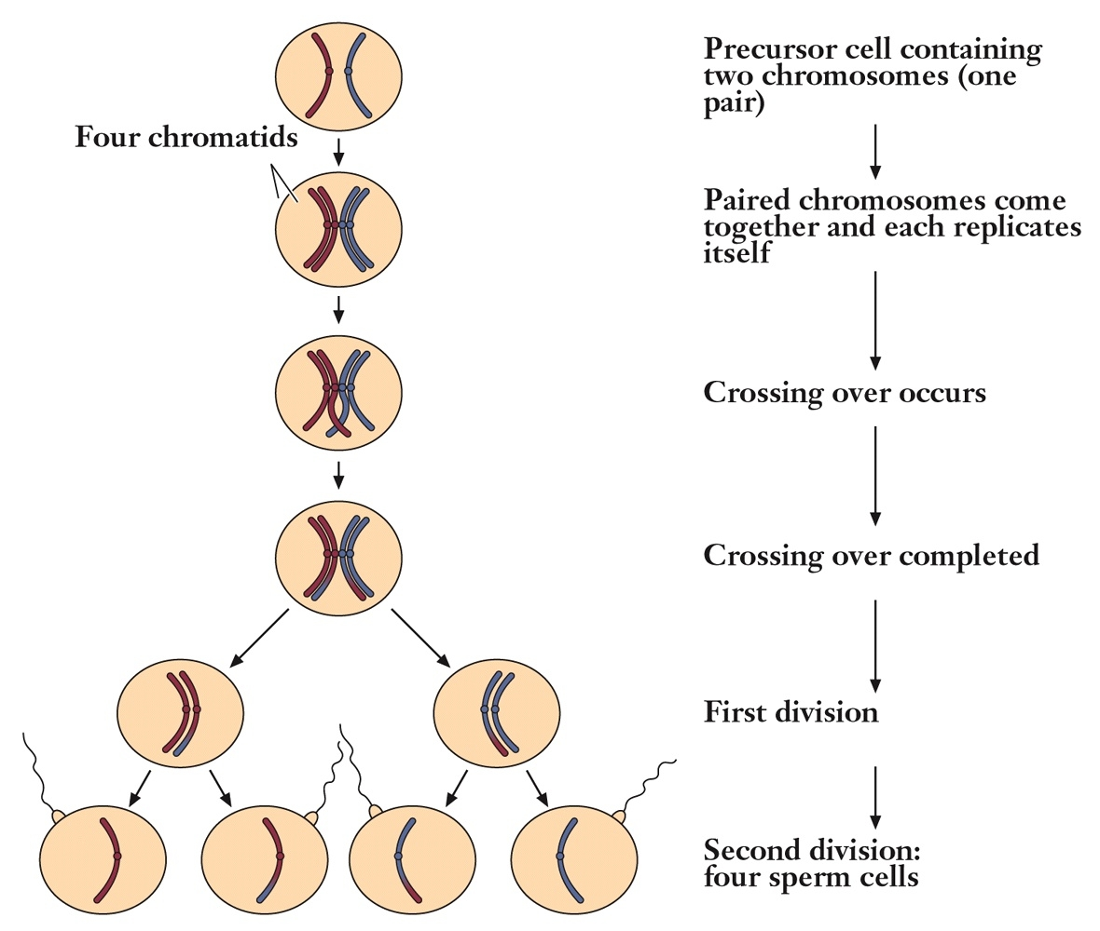
**Results in
random variation
in the population

Slide 33
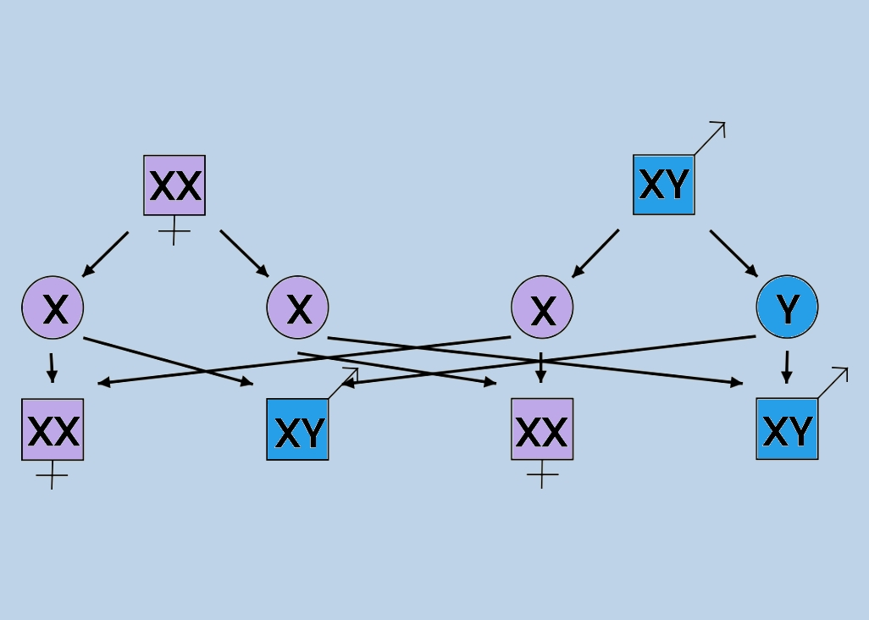
Sex Genetics

Slide 34
Fragile X Syndrome
 |  | Father
Mother |  | Y | X fragile
 | X | Boy XY | Girl XX fragile
 | X | Boy XY | Girl XX fragile
 |  | Father
Mother |  | Y | X
 | X fragile | Boy X fragile Y | Girl XX fragile
 | X | Boy XY | Girl XX

Slide 35
Genotype and Phenotype
Phenotype = expression
Hair Colour
Eye Colour
IQ score
Personality
Genotype

Slide 36
Behavioral Genetics: Heritability
How much of the total phenotypic variation of a trait in a population is accounted for by variation among individual genotypes (compared to the variation in the environment)?
variation = differences

Slide 37
Variability of a particular trait in a given population

Slide 38
Proportion of variation/differences accounted for by environment
Proportion of variation/differences accounted for by genes

Slide 39
Heritability Quotient
Proportion that ranges from 0.00 to 1.00
  .40 = 40% of variance due to genes
h² = Variance due to genes ÷ total variance
How is h² determined/calculated?

Slide 40
Twin Studies
Monozygotic
Dizygotic
100% identical
50% identical

Slide 41
Calculate concordance (correlation) for monozygotic twin pairs r = .977
Calculate concordance (correlation) for dizogotic twin pairs r = .536
Identical Twins Monzygotic r = .977
Twin 1 Score Extraversion | Twin 1 Rank-Order | Twin 2 Rank-Order | Twin 2 Score Extraversion
5.0 | 1 | 1 | 4.9
4.9 | 2 | 3 | 4.7
4.2 | 3 | 2 | 4.4
4.0 | 4 | 5 | 3.9
3.7 | 5 | 4 | 4.1
3.5 | 6 | 6 | 3.1
2.8 | 7 | 7 | 2.5
2.3 | 8 | 8 | 2.0
1.9 | 9 | 10 | 1.6
1.1 | 10 | 9 | 1.4
Non-identical (fraternal) Dizygotic r = .536
Twin 1 Score Extraversion | Twin 1 Rank-Order | Twin 2 Rank-Order | Twin 2 Score Extraversion
5.0 | 1 | 3 | 3.8
4.9 | 2 | 2 | 4.0
4.2 | 3 | 6 | 3.2
4.0 | 4 | 8 | 2.9
3.7 | 5 | 5 | 3.3
3.5 | 6 | 1 | 4.6
2.8 | 7 | 4 | 3.7
2.3 | 8 | 10 | 1.9
1.9 | 9 | 9 | 2.5
1.1 | 10 | 7 | 3.0

Slide 42
Geometric Analogy
Area = Length X Width
Trait expression = genes X environment
Length = genes, identical
Pairs of Monozygotic (identical) Twins r = .977
Width = assume environment
almost identical
Length = genes, 50% shared
Pairs of Dizygotic (non-identical) Twins r = .536
Width = assume environment
almost identical

Slide 43
Variations: Twin Studies
MZ twins raised together
MZ twins raised apart

Slide 44
Nature vs. Nurture Debate?
Genes and environmental features interact to produce phenotypes
  Neither is the sole cause
  Area = length X width
Length = genes
Width = environment

Slide 45
Epigenetics
Genes affect behavior through the building and modifying of physical structures and mechanisms of the body
Gene expression depends on the environment (from conception)

Slide 46
Epigenetics
Development is the result of an ongoing, bidirectional interchange between heredity and environment

Slide 47
Example: Maternal stress
Objective and subjective stress

Slide 48
Gene-Environment Interactions
Conceptual ways to think about interactions:
Passive
  biological parents provide an environment that matches their own and the child’s genetic tendencies
  musical parents have musical children provide a stimulating musical environment
Evocative
  child’s genotype produces a phenotype that elicits certain types of physical and social responses
  happy outgoing children elicit positive reactions
Active/niche-picking
  child seeks out environments that are compatible and stimulating
  sports, music, reading

Slide 49
H² Increases with Age
Genes account for more variation in traits in adulthood than they do in childhood
  Environmental factors play a stronger role in phenotypic variation in children compared with adults
Why?

Slide 50
How this relates to the rest of the course…
Section II: Similarities among individuals
  Evolutionary/genetic foundations
  Nervous system
  Sensation and perception
  Consciousness
  Learning, memory, problem solving
Section III: Individual differences
  Intelligence
  Motivation
  Personality

Slide 51
How this relates to the rest of the course…
Section IV: The Individual in Context
  “Environmental” impact on individual differences
  Developmental psychology
  Social psychology
Section V: Individual Challenges
  When and under what circumstances are the variations we’ve discussed unhealthy, negative, abnormal, problematic, etc.
  Emotions, stress, health
  Abnormal psychology

