Slide 1
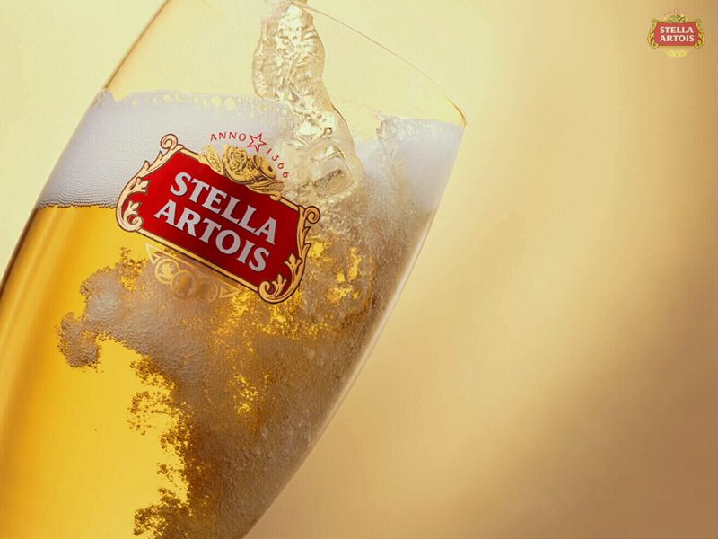
The Global Branding of Stella Artois

Slide 2
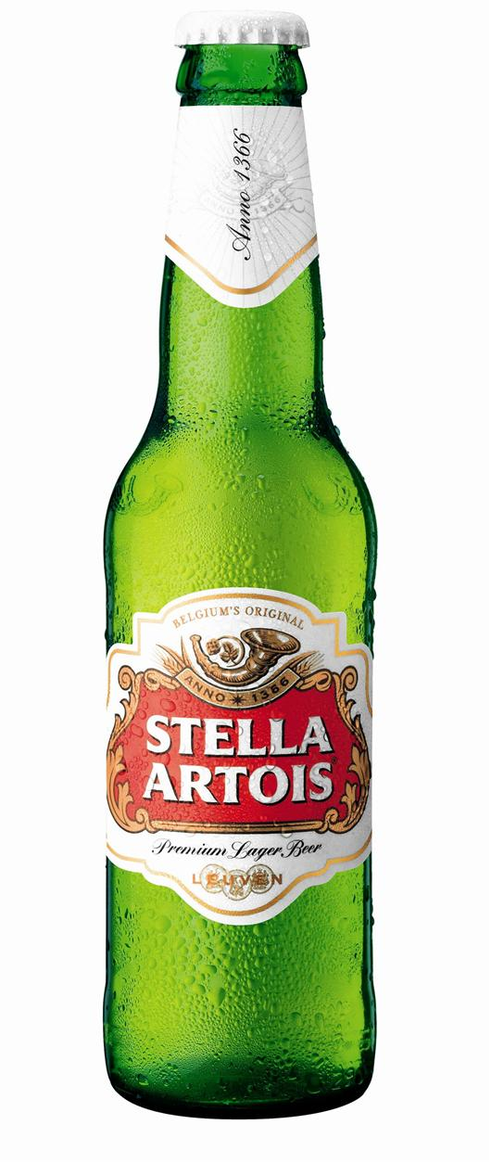
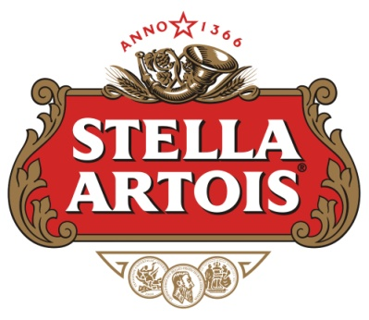
Table of Contents
Brief Summary of Case
The Core Problems
Recommendation
Benefits: Global Brand
Benefits: Regional Marketing
Global Awareness

Slide 3
Timeline
Founded in 1717 by Sebastian Artois
Merged in 1987 and became Interbrew
Subsidiaries and Joint Ventures in 23 countries
Beer sales in 80 countries
Producers of Dos Equis, Labatt, Rolling Rock

Slide 4
Primary Issue Facing Interbrew
Turning Stella Artois into a global brand
Devising a proper marketing strategy
Increase its presence in growing markets

Slide 5
Recommendation
Continue development of Stella Artois as a global brand with local touch
  In growth markets: target key urban centers
  In mature markets: improve production, distribution and marketing efficiencies
  Capitalize on brand awareness with global branding
  Use adaptable regional marketing/advertising

Slide 6
Discussion: Why Stella Artois?
Interbrews most recognized brand: super-premium lager
Take advantage of globalization of the industry
Demand for premium and specialty beers is increasing
“ A Cut Above The Rest, She is a Thing of Beauty”

Slide 7
Benefits of a Global Brand
Synergies is global advertising and sponsoring
Centralized coordination and control
Global advertising framework
P/E leverage
Socioeconomic trend increasing demand for premium beers

Slide 8
Global Sales/Production
Stella Artois 1999 sales profile:
  Belgium: 13%
  UK: 50%
  France: 18%
  Other: 19%
Stella Artois Total Production 1999 (000 Hectolitre):
  Belgium: 902
  France: 1,074
  UK: 3,377
  Overall Total: 6,691
Heineken 1998 Sales Profile
  Netherlands: 19.5%
  USA: 18.8%
  UK: 12.8%
  Other: 48.9%
Foster’s 1998 Sales Profile
  UK: 62.8%
  Australia: 20.2%
  USA: 9.5%
  Other: 7.5%
Carlsberg 1998 Sales Profile
  UK: 37%
  Denmark: 12.9%
  Other: 50.1%

Slide 9
Benefits of Regional Advertising
Make the brand more relevant
ex: Super Bowl
Allow Stella to target certain markets
ex: Young adults
Help to capture the focused attention of the consumers
ex: Movies
Increased awareness of brand in local markets
ex: Belgian Beer Cafés

Slide 10
Benefits of Regional Advertising
Help Interbrew to better understand their individual markets
Equip the company to better serve their clients
Create opportunities for local community involvement
Overall increase in awareness locally and globally

Slide 11
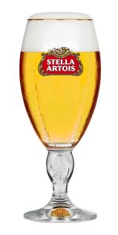
Need for Global Awareness
Build brand awareness
Maintain premium beer image
Attract customer loyalty
Prevent loss of sales

Slide 12



Global Awareness Opportunities

Slide 13


