Slide 1
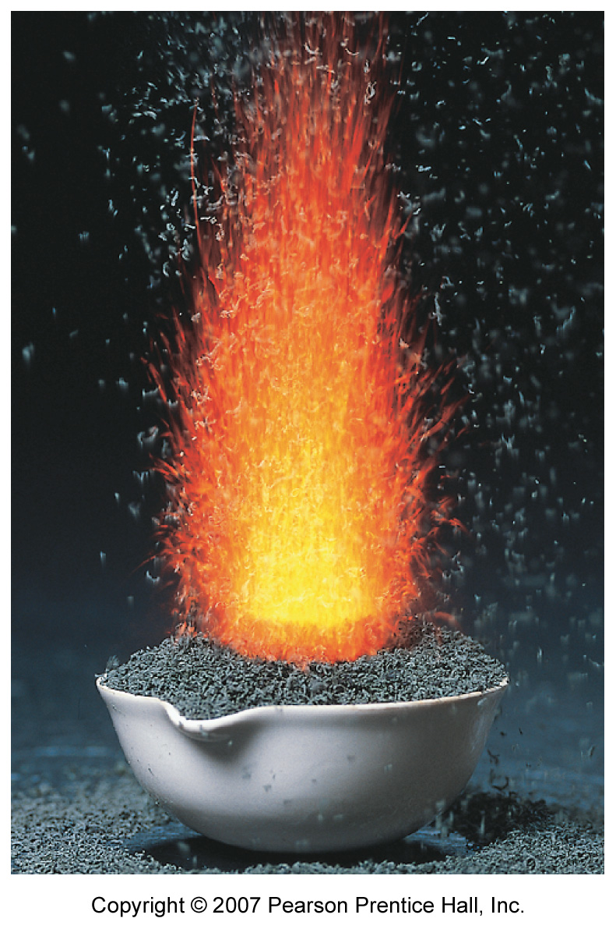
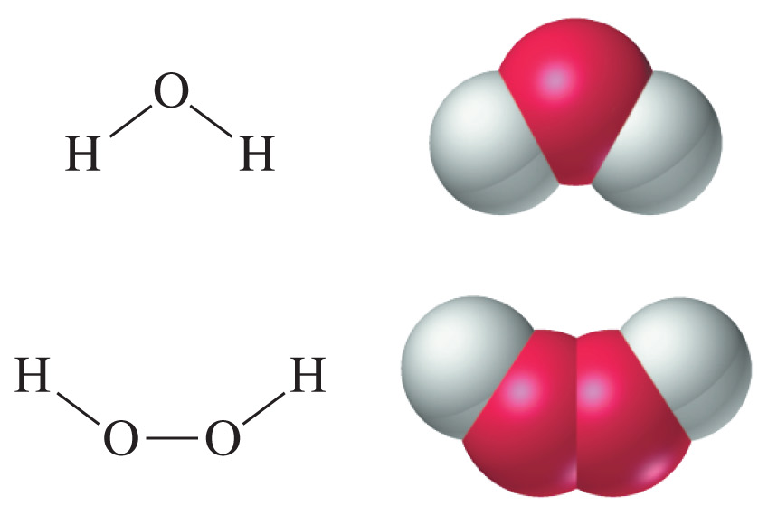
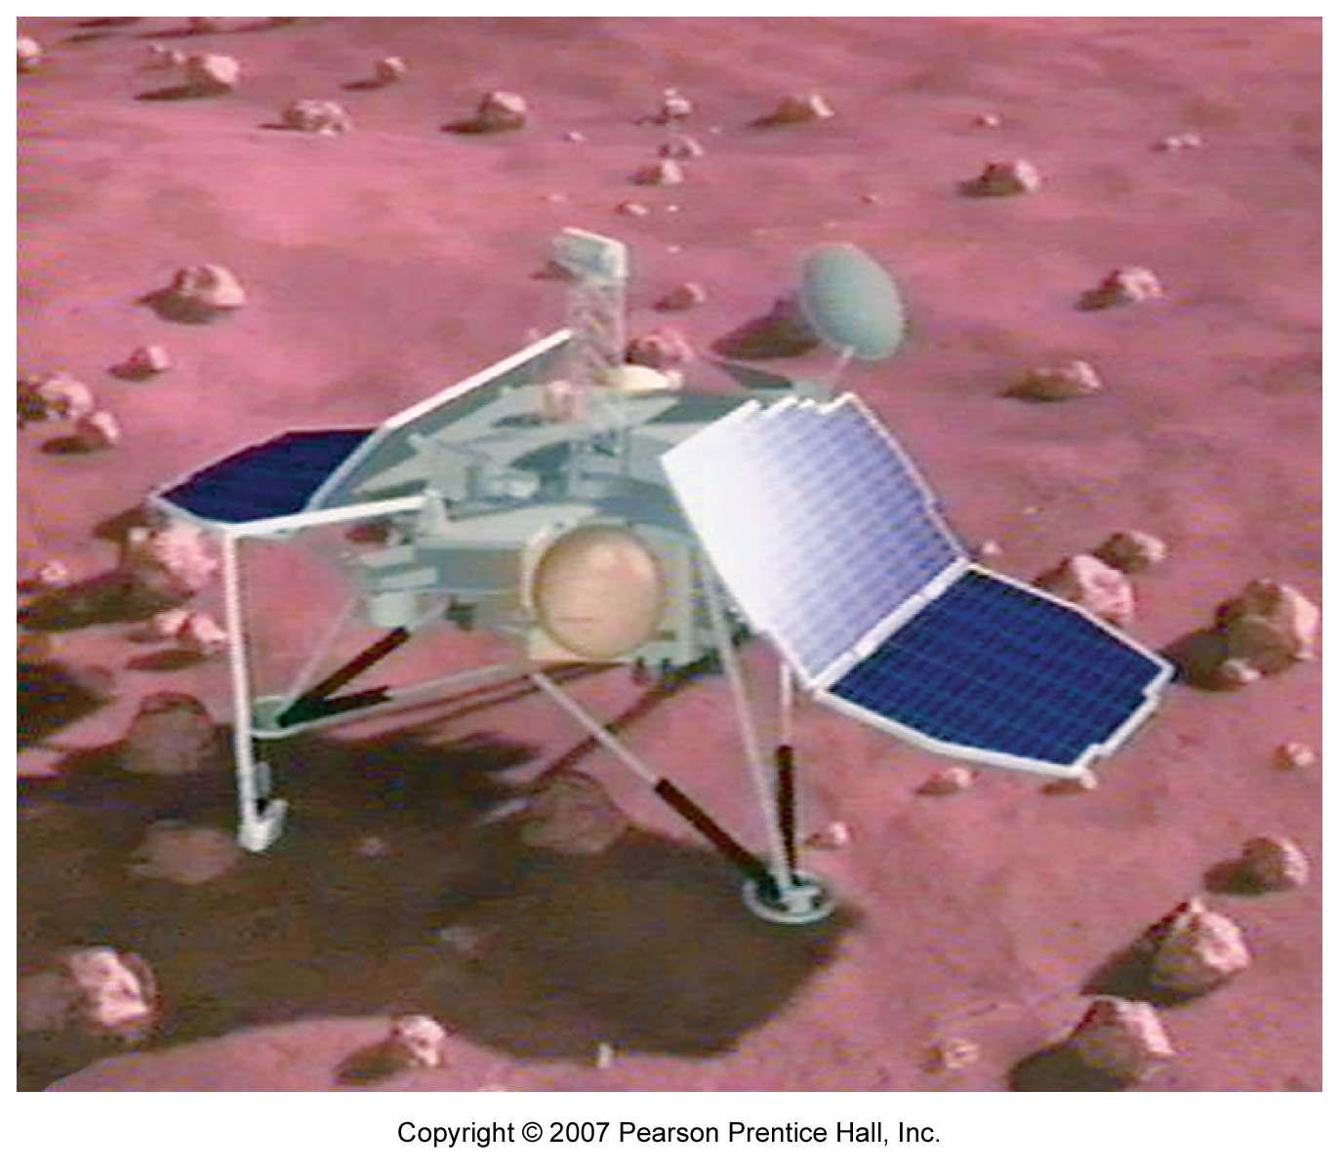
Chapter 1:
Keys to the Study of Chemistry

Slide 2
Properties of Matter
Matter: occupies space and displays mass and inertia
Composition: relative proportions of the components of a sample of matter
    ex. water is 11.19% H and 88.81% O by mass

Slide 3
Properties of Matter
Physical property:
  a property that can be measured or observed without changing the matter’s composition
Chemical property:
  a property that comes with observing a change in chemical composition
Extensive property:
  depends on the quantity of matter present
Intensive property:
  does NOT depend on the quantity of matter present

Slide 4
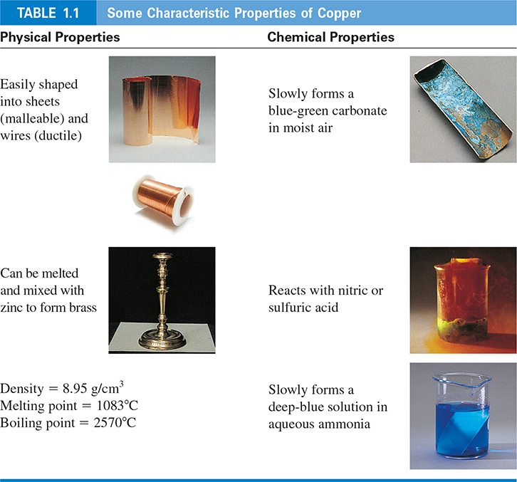
An example: Copper

Slide 5
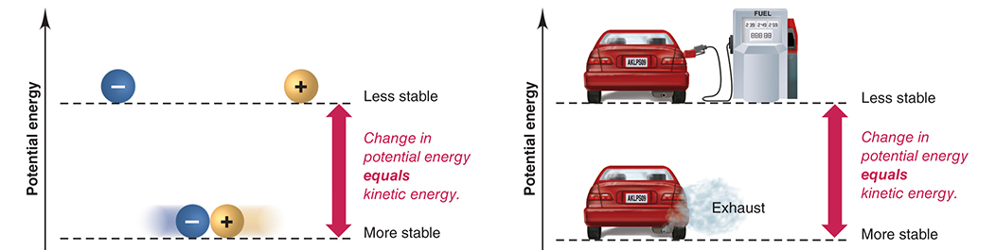
Energy and Chemistry
potential energy
kinetic energy

Slide 6
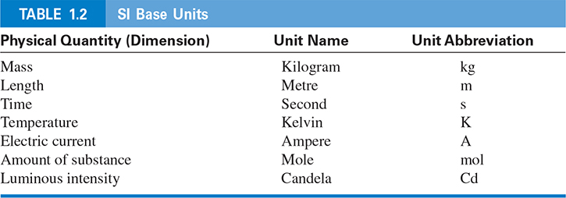
Measuring Matter
an observed measurement not followed by a unit is meaningless!

Slide 7
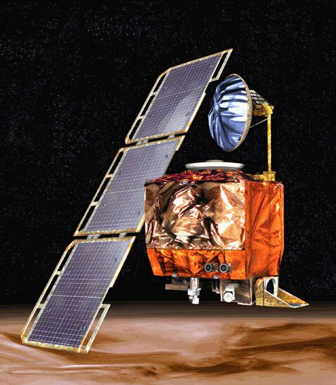
Who cares about units anyway?
Mars Climate Orbiter
probe sent by NASA to Mars to study its weather
the $168 million probe was destroyed in 1999 after entering the Martian atmosphere
desired altitude: 140-150 km
altitude attained: 57 km
investigation revealed that the on board computer used SI units, while the computers on Earth were using BE units

Slide 8
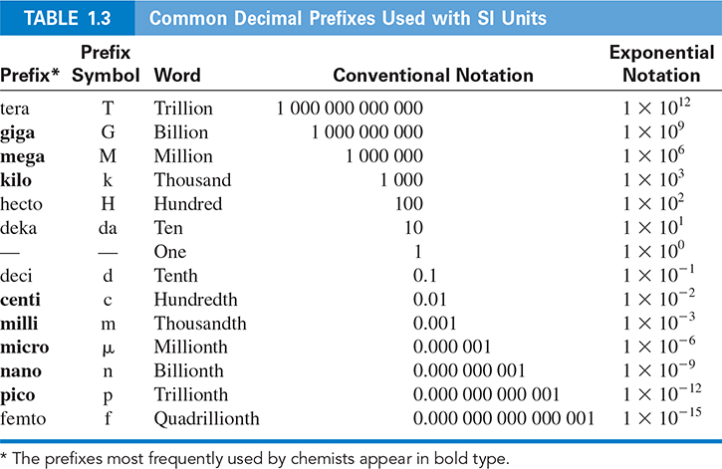
SI Prefixes

Slide 9
Dimensional Analysis
use conversion factors to convert a quantity from one unit to another
Quantity with desired unit
=
Quantity with given unit
X
Conversion factor

Slide 10
Length
typical macroscopic units:
1 cm = 10 mm 100 cm = 1 m
typical microscopic units:
1 nm = 1 x 10^{–9} m 10 Å = 1 nm

Slide 11
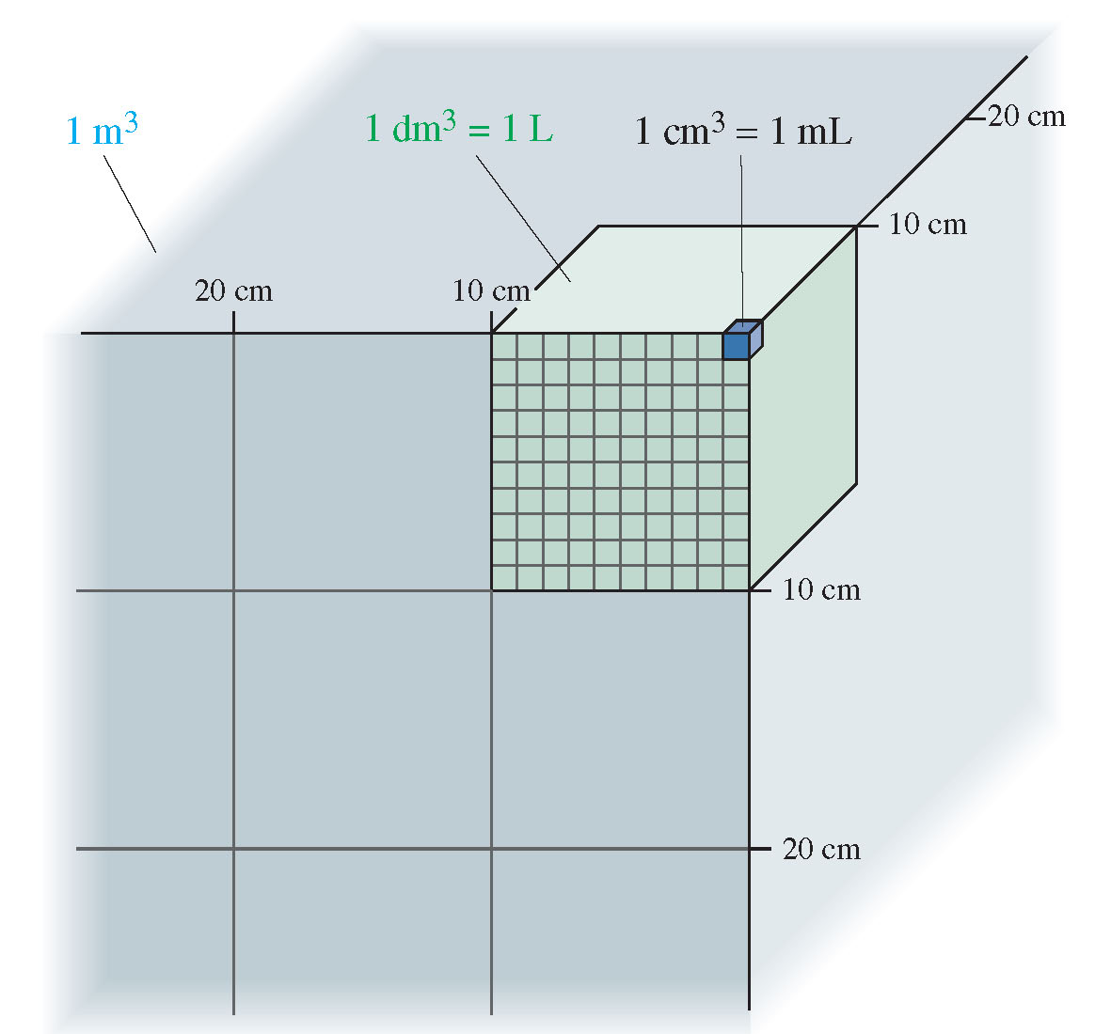
Volume
volume: the size of a cube (ex. m³)
we will most often use the litre (L) for measuring volumes
1000 mL = 1 L
1000 L = 1 m³

Slide 12
Mass
mass:
  measures the quantity of matter in an object
weight:
  the force of gravity on an object
The kilogram (kg) is the official SI unit, but we will most often use the gram (g):
1 kg = 1000 g

Slide 13
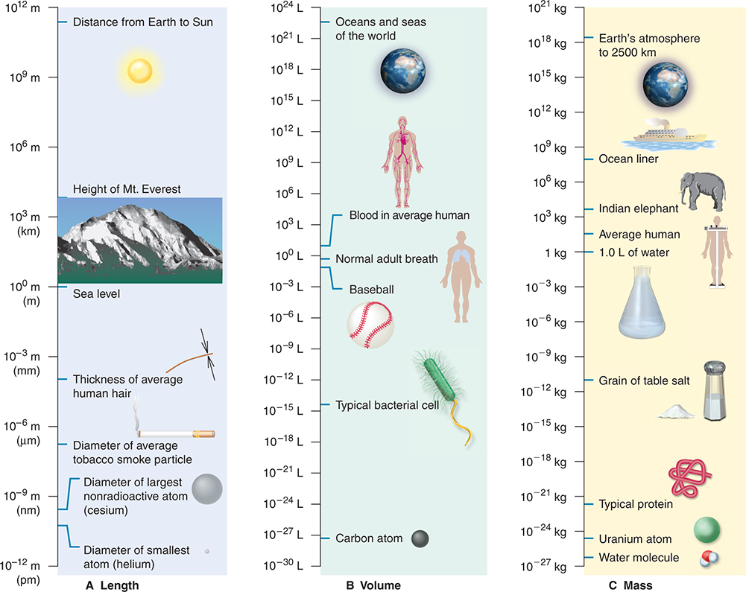
Fig. 1.9: A Useful Reference…

Slide 14
Temperature
the SI unit is the kelvin (K)
absolute zero temperature is 0 K or -273.15ºC
the freezing point of water is 273.15 K or 0ºC
the boiling point of water is 373.15 K or 100ºC
Always use the temperature in K in your calculations!

Slide 15
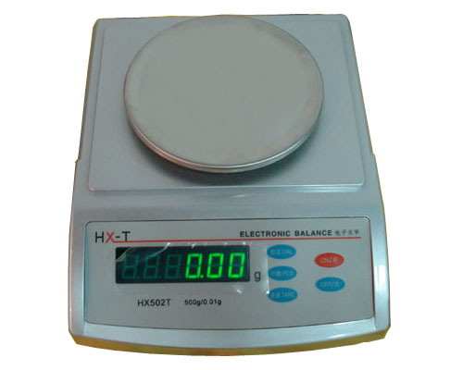
Scientific measurements
Scientific notation: N x 10^{n}
6.022 x 10²³ instead of 602 204 500 000 000 000 000 000
Significant figures
  digits considered to be significant in the calculation or measurement of a quantity
this balance is precise to ±0.01 kg
an object that has a mass of 6.732 kg
will give a measurement of __________ kg
6.73 ± 0.01

Slide 16
Rules for sig figs…
all non zero digits are significant
zeros between two sig figs are also significant
zeros to the left of a sig fig are not significant
6.732 kg has __ significant figures
4
6.0061 kg has __ significant figures
5
0.0502 kg has __ significant figures
3

Slide 17
Rules for sig figs…
if the value is greater than 1, all zeros to the right of the decimal point are significant
when converting to scientific notation, it may sometimes be ambiguous whether “hanging zeros” are significant or not
6.000 kg has __ significant figures
4
4500 kg could be 4.5 x 10³, 4.50 x 10³, or 4.500 x 10³ kg
therefore 4500 kg could have 2, 3, or 4 sig figs!
Notes:
In the same way that 5.999 kg would also have 4 significant figures

Slide 18
Rules for sig figs
a whole number with perfect precision has an infinite number of significant figures
this works for most conversion factors as well
if we determine the average of 3 trials,
we can assume it’s 3.000 000 000… trials
1 m = 100.000 000 000… cm

Slide 19
Rules for sig figs…
addition/subtraction:
  the answer must have the same number of sig figs after the decimal as the element of the calculation with the least number of sig figs after the decimal point
rounded to ______
rounded to ______
3.27
1.0

Slide 20
Rules for sig figs…
multiplication/division:
  the answer must have the same number of sig figs as the element of the calculation with the least number of sig figs
2.2 x 3.7845 = 8.32590
3.76 ÷ 4.236 = 0.8876298
(2.27 x 7.324) ÷ 3.3 = 5.0380
rounded to ______
8.3
rounded to ______
0.888
rounded to ______
5.0

Slide 21
Rules for sig figs…
Logarithms
  the answer must have the same number of sig figs as the log element
log(957) = 2.980911...
= log(9.57 x 10²)
= log(9.57) + log(10²)
= 0.980911... + 2.00000...
= 2.98 ??
= 2.981

Slide 22
In summary…
on tests and the final exam,
on online assignments,
DON’T BE RIDICULOUS!
BE PRECISE!

Slide 23
Chapter 1: Key Concepts
the properties of matter
SI units and prefixes
conversion factors
scientific notation
significant figures

Slide 24
Chapter 1: Suggested Problems
1.6, 1.21, 1.36, 1.44,
1.46, 1.58, 1.66, 1.71,
1.72, 1.76, 1.82, 1.86

