Slide 1
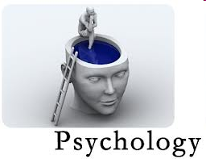
Chapter 1: Thinking Critically With Psychological Science
The Scientific Method
  Theories and hypotheses
Observational Methods
Correlations
Experimentation
Statistical Reasoning

Slide 2

Psychological Science
Scientific Method
  Theory
  Hypothesis
  Observations (Data Collection)
  Statistical Analysis

Slide 3
Theory
1) Theories explain a variety of observations
2) They explain through an organized set of principles (or principle)
3) They offer testable predictions which are implied by the theory
  Hypotheses

Slide 4
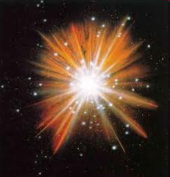
Celestial Observations
1) Galaxies are rushing away from each other at remarkable speeds
2) The universe exhibits a background radiation suggestive of the remnants of a tremendous explosion
3) The oldest galaxies originated about 14 billion years ago
THE BIG BANG
THEORY

Slide 5
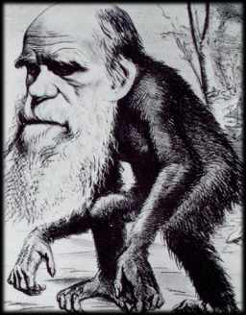
Natural Observations
1) There is a large variety of living organisms in the world
2) Each organism is equipped with traits that are ideal for surviving in their natural habitats
3) Some organisms seems related to others in terms of appearance and/or behavior
The Theory of
Evolution

Slide 6
Theory
1) Theories explain a variety of observations

Slide 7
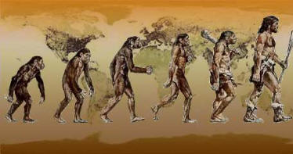
Theory of Evolution Through Natural Selection
Principles of Natural Selection
There is variation within any population of organisms
There is competition for finite resources
Certain variations are better than others for acquiring resources, which increases the chances of survival and reproduction
Thus, the next and successive generations will have proportionally more offspring from those with the more advantageous variations

Slide 8
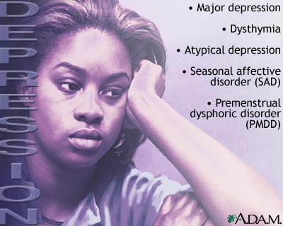
Major Depressive Disorder: A Cognitive Theory
Observations
People who are depressed display:
  Frequent thoughts of worthlessness
  Inappropriate feelings of guilt
  Feelings of helplessness
Cognitive Theory Principle
People with depression display low self-esteem
  They think poorly of themselves
Thinking colours our feelings
  Negative thoughts = negative emotions
Theory: Low self-esteem underlies depression

Slide 9
Theory
1) Theories explain a variety of observations
2) They explain through an organized set of principles (or principle)

Slide 10
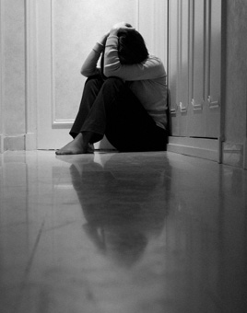
Major Depressive Disorder: A Neurobiological Theory
Neurochemical activity underlies all of our experiences, including our feelings
Serotonin (a neurotransmitter) is associated with positive mood
Theory: Neurochemical imbalance (low serotonin) underlies depression

Slide 11
Hypotheses
Testable predictions that logically flow from the principles of the theory
Cognitive Theory of Depression
  Low self-esteem underlies depression
  Thus, improving one’s self-esteem should alleviate depression
Neurobiological Theory of Depression
  Neurochemical imbalance (low serotonin) underlies depression
  Thus, drugs that increase serotonin should alleviate depression

Slide 12
How Does One Measure Self-Esteem?
A researcher must define the operations they went through to measure the attribute or behavior in question
Self-Esteem
  Measured by an individual’s responses to statements
  On a scale of 1 to 7, to what extent do you agree with the following statements:
    “I have good ideas”
    “I am fun to be with”
Operational Definitions

Slide 13
Operational Definitions
Function 1
  Protects against experimenter bias
Function 2
  Allows for replication
    Repeating the same study with identical procedure but different participants
    Repeating the study with slight modification of the procedure to see if the original findings can be extended to other circumstances

Slide 14
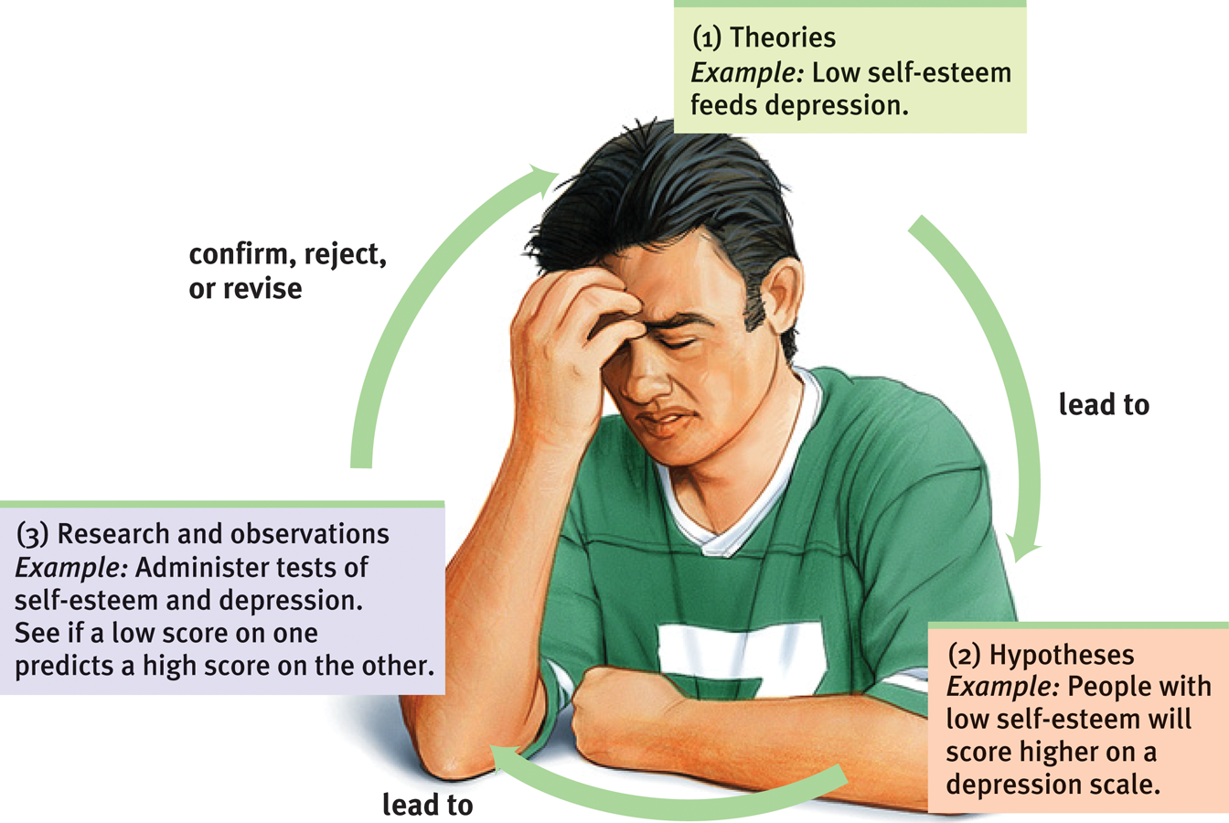
The Scientific Method

Slide 15
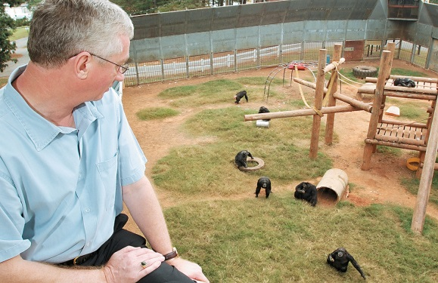
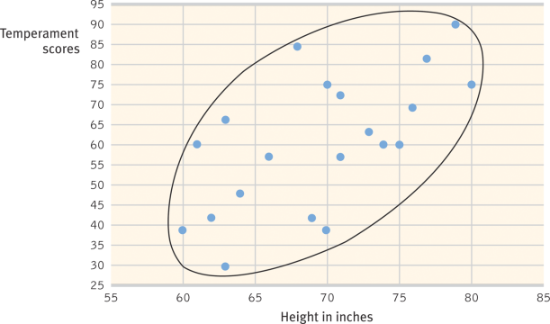
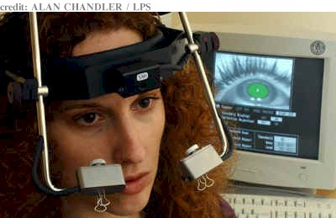
Observations
Descriptive
  The Case Study
  Surveys
  Naturalistic Observation
Correlational
Experimental

Slide 16
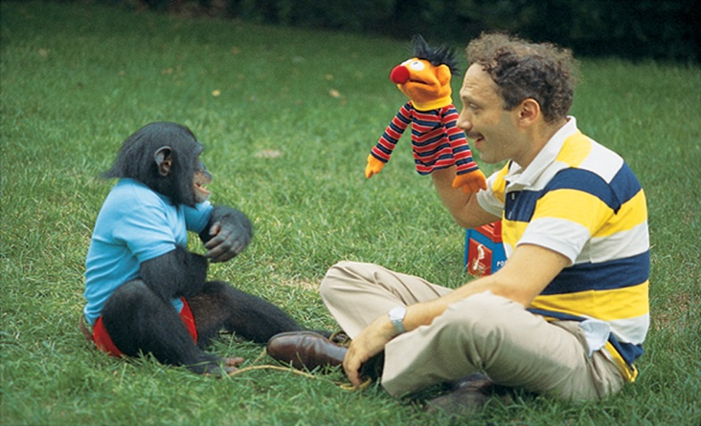
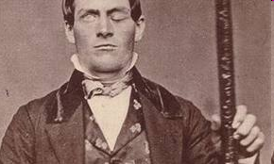
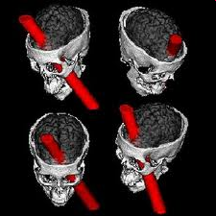
Descriptive: The Case Study
Examine a single individual in depth, usually over an extended period of time
  Exploratory in nature
    Purpose is detailed description of behaviour
  Observation, interviews, psychological testing
  Uncommon disorders, brain injuries
Drawbacks
  Individual may not be representative of the majority of people
    i.e., unknown if observations are generalizable
  Can’t conclude what caused the behaviour

Slide 17


Descriptive: The Survey
Many cases in less depth
  Questionnaires or interviews
Ask people to report their behaviors, attitudes, experiences
  Incidence of drug use
  Sexual behaviour of youth
  Attitudes towards violence or gay marriage
Sampling
  Sample = subset of the population that is selected and studied
    Population = the group of interest
  Representative Sample
    A sample that is representative of the population of interest
    Subgroups should be proportionately represented
Drawbacks
  Wording effects
  Inaccurate information

Slide 18
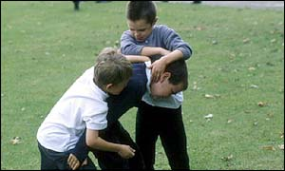

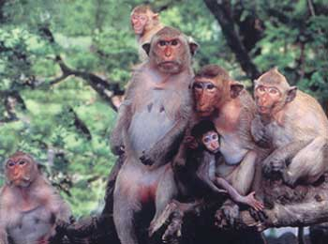
Descriptive: Naturalistic Observation
Unobtrusively observe and record behavior in natural environments
Benefit: Observe natural, spontaneous behaviour
  Measured behaviour is changed behaviour
  Hawthorne Effect
Drawback: No control

Slide 19
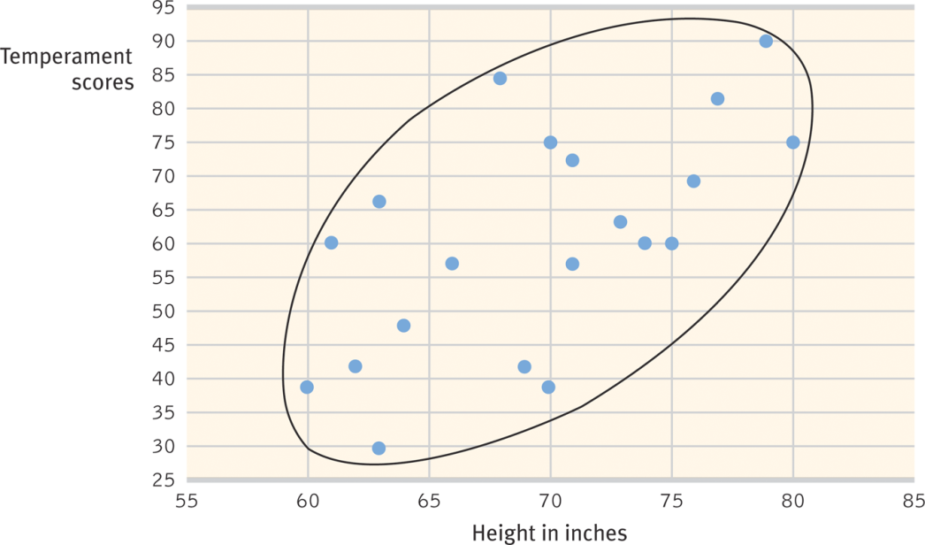
Correlations
Measure the relationship between two attributes or behaviors
Examples:
  1) The more young children watch TV, the less they read
  2) The more sexual content teens see on TV, the more likely they are to have sex.
  3) The longer children are breast-fed, the greater their later academic achievement.
  4) The more often adolescent eat breakfast, the lower their body mass.

Slide 20
Correlation: Scatterplot
10
 | Communication Level | Marriage Satisfaction
Couple 1 | 2 | 3
Couple 2 | 3 | 5
Couple 3 | 5 | 4
Couple 4 | 5 | 6
Couple 5 | 6 | 7
Couple 6 | 6 | 9
Couple 7 | 7 | 6
Couple 8 | 8 | 6
Couple 9 | 8 | 8
Couple 10 | 8 | 9
9
8
M.S.
7
6
5
4
3
2
1
1
2
3
4
5
6
7
8
9
10
Communication Level

Slide 21
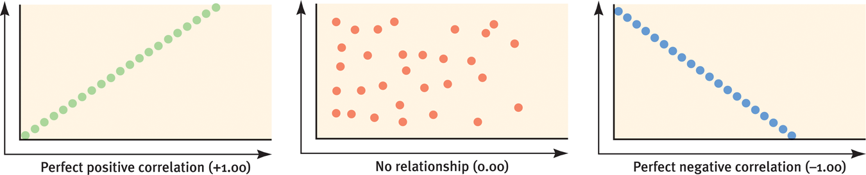
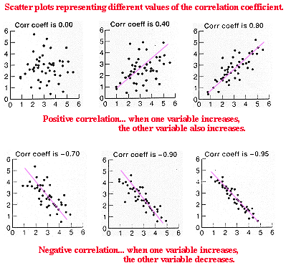
Correlation: Direction of Relationship
Positive Correlation
  as one attribute increases, the other attribute also increases
Negative Correlation
  as one attribute increases, the other attribute decreases

Slide 22
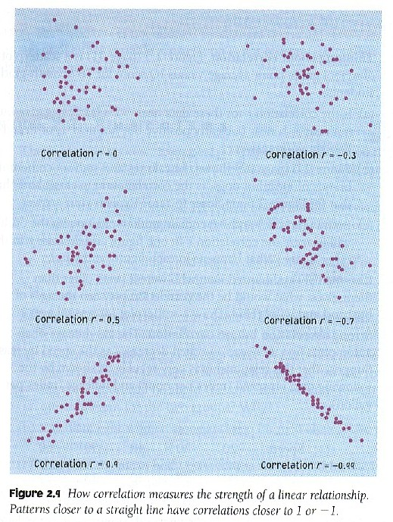
Correlation: Strength of Relationship
Correlation Coefficient
  Value ranges between -1 and +1
Positive Correlation
  Range between 0 and +1
  +1 is a perfect positive correlation
0 means no correlation at all
Negative Correlation
  Range between 0 and -1
  -1 is a perfect negative correlation

Slide 23
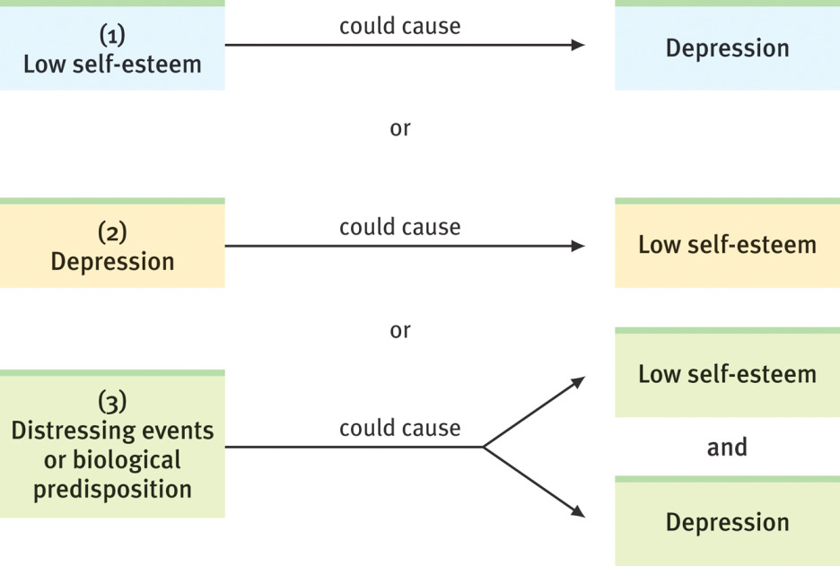
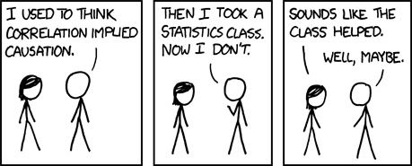
Correlation and Causation
If low self-esteem causes depression
  Should see a negative correlation
If depression causes low self-esteem
  Should see a negative correlation
If some third attribute (e.g., biological disposition) causes both low self-esteem and depression
  Should see a negative correlation

Slide 24
Chapter 1 Links
http://www.learner.org/series/discoveringpsychology/history/history_flash.html
  Interactive history of psychology timeline
http://www.learner.org/series/discoveringpsychology/methods/index.html
  Principles of research methods
http://www.nizkor.org/features/fallacies/confusing-cause-and-effect.html
  The fallacy of confusing correlation with causation
http://istics.net/stat/correlations/
  Interactive: Guessing correlations (sometimes blocked by security settings)
http://psych.utoronto.ca/museum/
  Classic psychophysics equipment
http://psychology.about.com/od/researchmethods/u/psychology-experiments.htm#s1
  Principles of research methods
http://www.uakron.edu/gage/
  Phineas Gage information page
http://psych.hanover.edu/Research/exponnet.html
  Psychological research on the net
http://allpsych.com/
  Virtual psychology classroom
  Lots of resources, including stats and research methods

