Slide 1
Midterm Review
Questions From DGD Classes

Slide 2
Session 2 - 23 Jan
Question 17 - Homework
55. The probabilities that an adult man has high blood pressure and/or high cholesterol are shown in the table.
What is the probability that a man has both conditions?
What is the probability that he has high blood pressure?
What is the probability that a man with high blood pressure has high cholesterol?
What is the probability that a man has high blood pressure if it’s known that he has high cholesterol?
Cholesterol | Blood Pressure
 |  | High | OK
 | High | 0.11 | 0.21
 | OK | 0.16 | 0.52

Slide 3
Session 3 - 30 Jan
The prior probability for event A₁, A₂ and A₃ are P(A₁)= 0.20, P(A₂)= 0.50 and P(A₁)= .30. The conitional probability of even B given A_{1,} A₂ and A₃ are P(A₁|B)= 0.50, P(A₂|B)= 0.40 and P(A₃|B)= 0.30.
Compute P(B∩A₁), P(B∩A₂₎ and P(B∩A₃).
Apply Bayes’ theorem to compute posterior probability P(A₂|B).
Use the tabular approach to applying Bayes’ theorem to compute P(A₁|B), P(A₂|B) and P(A₃|B).

Slide 4
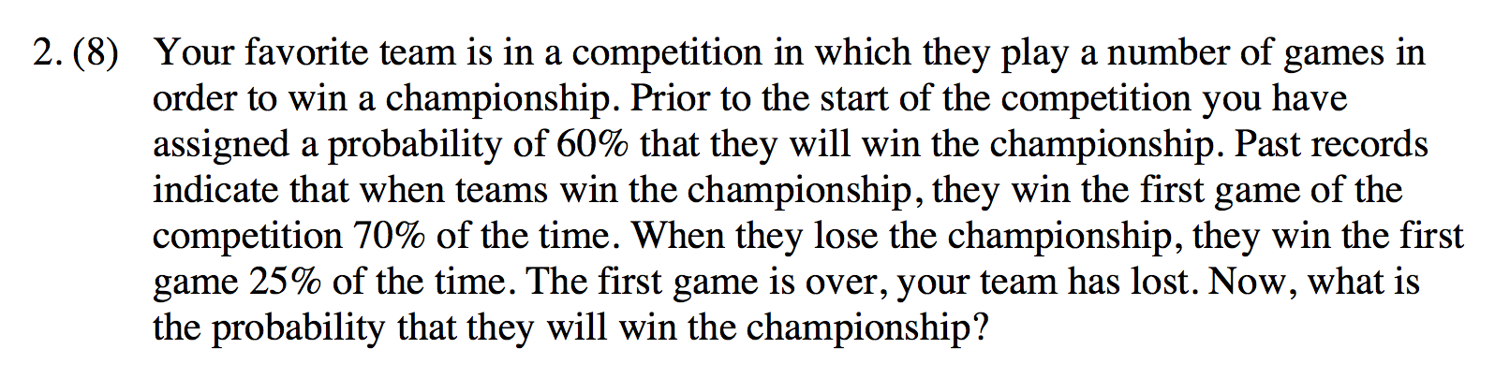
Session 3 - 30 Jan
Previous Final Exam: 02ffx.pdf

Slide 5
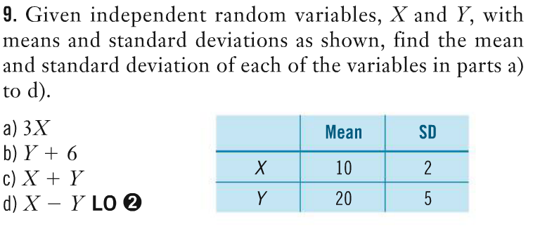
Session 4 - 06 Feb

Slide 6
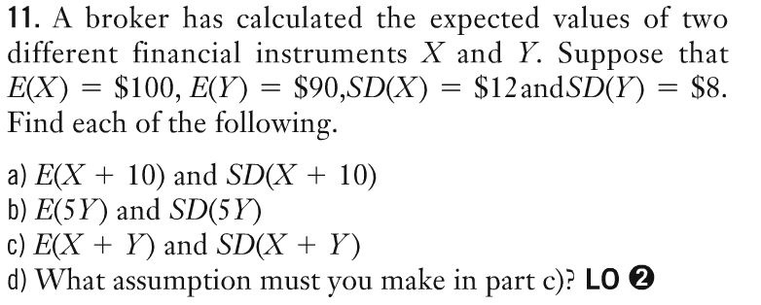
Session 4 - 06 Feb

Slide 7
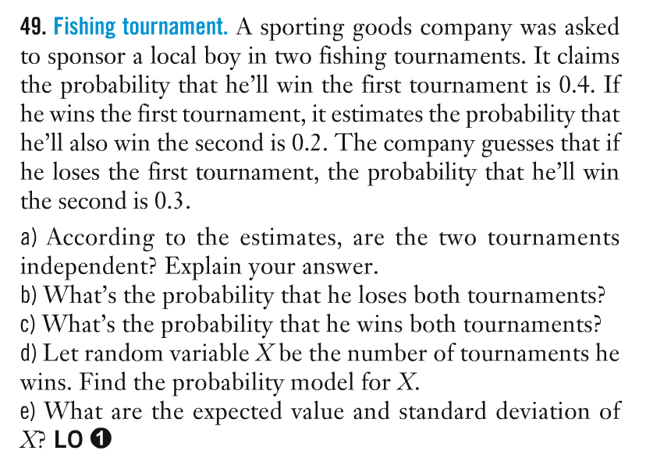
Session 4 - 06 Feb

Slide 8
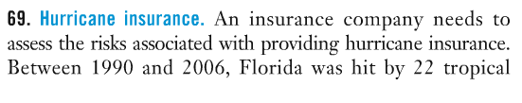
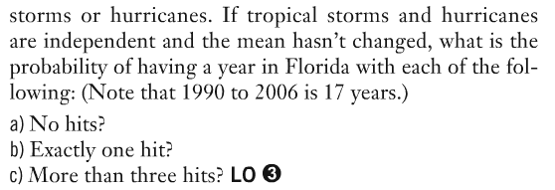
Session 5 - 13 Feb

Slide 9
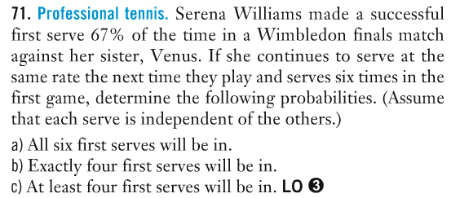
Session 5 - 13 Feb

Slide 10
Session 5 - 13 Feb
07ffx.doc
Question 1. A telecommunications equipment vendor produces two lines of products (i) private network equipment and (ii) public network equipment. It estimates the market size for these two product lines in one year’s time as shown in the table:
a) Assuming that the markets for the two lines of products are independent of each other, calculate the mean and standard deviation of the estimated total market size in one year’s time.
 | Estimated Market size: $bn
 | Mean | SD
Private | 7.6 | 1.2
Public | 4.3 | 0.5

Slide 11
Session 5 - 13 Feb
07ffx.doc
Question 2. A large survey of customers who called a customer service toll-free telephone number found that 46% of customers were satisfied with the service they received. Since the survey, the customer service agents have received additional training. After the training, interviews with 10 randomly selected customers found that 6 of them were satisfied with the service they received.
a) What is the probability that 6 out of 10 randomly selected customers would have said they were satisfied with the service they received, before the training.

Slide 12
Session 5 - 13 Feb
08ffx.doc
Question 1. An automobile dealership records the number of cars sold each day, and calculates the probability distribution as follows:
Number of cars sold daily_ Probability
0 0.1
1 0.11
2 0.2
3 0.23
4 0.3
5 0.06
Find the mean, variance, and standard deviation of the number of cars sold in one day.
) Find the mean, variance, and standard deviation of the number of cars sold in total during 2 days, assuming sales on the 2 days are independent of each other.

Slide 13
Session 5 - 13 Feb
08ffx.doc
Question 2. Statistics Canada provides data on the number of reportable transport accidents involving dangerous goods in their Table 4090002. In a recent year the average rate of occurrence of such accidents was 8.15 per week.
(a) During that year, what was the probability of getting less than 3 such accidents in a given week.

Slide 14
Session 5 - 13 Feb
08ffx.doc
Question 3. The regulations for young drivers getting a probationary motor vehicle drivers license will be severely tightened in the coming months. Here are some relevant data giving accident statistics based on driving frequency.
15% of drivers have a probationary license and 85% have a regular license. In a given year, 10% of drivers with a probationary license are involved in an accident, whereas 2.5% of drivers with a regular license are involved in an accident.
The occurrence of accidents for any driver, from year to year, can be assumed to be independent events. Use the following symbols to do the various calculations:
P: Probationary license driver: R: Regular license driver
A: Accident occurs A^{C}: No accident occurs
a) For a randomly selected driver, what is the probability that in a given year an accident will occur? Also, what is the probability that an accident will not occur?
b) Calculate the probability that if there is an accident, the driver is a probationary license holder .
c) Calculate the probability that if there is an accident, the driver is a regular license holder.

Slide 15
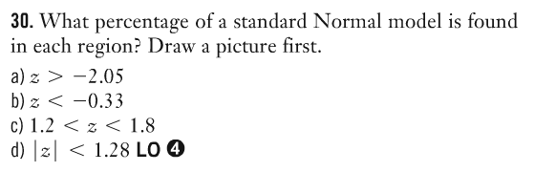
Session 6 - 27 Feb

Slide 16
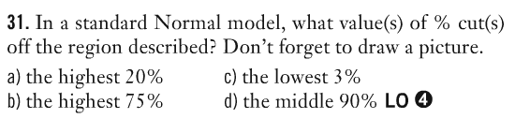
Session 6 - 27 Feb

Slide 17
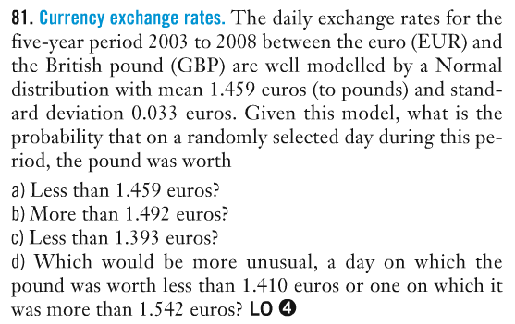
Session 6 - 27 Feb

Slide 18
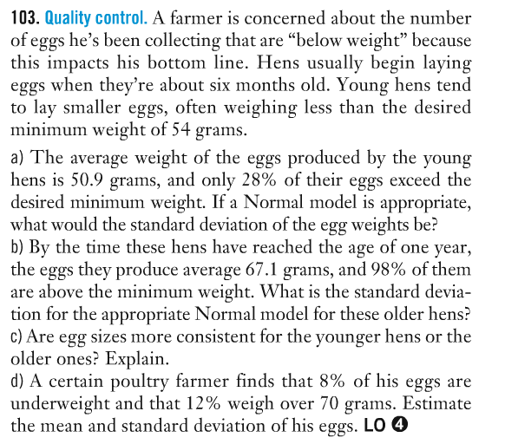
Session 6 - 27 Feb

