Slide 1
MODIFIED NODAL AMITTANCE FORMULATION
Webpage: http://www.doe.carleton.ca/courses/ELEC5508/
username: elec5508-2013f
password:cad-grad13fall

Slide 2
ELEC 2501 Problem
50Ω
1A
20Ω
20Ω

Slide 3
“Simple” Filter circuit
Number of transistors =162

Slide 4
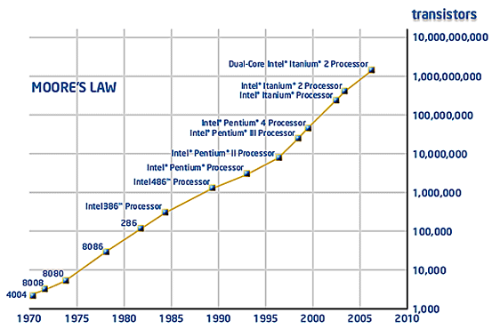
Why do we need CAD??
1965

Slide 5
Circuit Netlist
1
30Ω
50Ω
3
2
1A
20Ω
20Ω
R1 1 2 30
R2 2 0 20
R3 2 3 50
R4 3 0 20
Idc 0 1 1

Slide 6
Circuit Netlist
50Ω
1A
20Ω
20Ω
R1 1 2 30
R2 2 0 20
R3 2 3 50
R4 3 0 20
Idc 0 1 1

Slide 7
Nodal Analysis by Inspection
g
col i
col j
Node i
Node j
row i
g
-g
row j
-g
g
col i
g
Node i
row i
g

Slide 8
Nodal Analysis by Inspection
Node i
Right Hand Side vector
row i
Ι_{a}
Ι_{a}
row j
−Ι_{a}
Node j
Be careful about the signs.
If one of the terminals is connected to ground then there is no corresponding KCL equation and that node simply does not appear in the equations (we get only one entry in the RHS vector).

Slide 9
Nodal Analysis by Inspection: Example
g₁
v₁
Ι_{a}
1
2
3
4
5
1
g₁
+ g₂
-g₁
0
0
0
v₁
g₂
Ι_{b}
2
-g₁
g₁
0
-g₄
0
v₂
v₃
+ g₄
v₂
g₃
3
0
0
g₃
+ g₆
0
-g₆
v₃
g₄
g₅
g₆
4
0
-g₄
0
g₄
+ g₅
0
v₄
Ι_{c}
v₅
v₄
v₅
5
0
0
-g₆
0
g₆
Ι_{a}
1
−Ι_{b}
2
→ Check to see that each row represents the KCL equation at the corresponding node.
=
−Ι_{a}
3
−Ι_{c}
4
Ι_{c}
5

Slide 10
Nodal Analysis by Inspection
g₃
v₁
g₂
v₂
g₅
v₃
g₁
g₄
Ι_{a}
Ι_{b}

Slide 11
Nodal Analysis by Inspection
For circuits containing resistors and current sources only:
Designate a reference node.
Number the remaining nodes.
Size of the matrix (number of eqs) is equal to the number of nodes (not including the reference node).
Add the contribution of each element (or its “stamp”) to the matrix equations.
Resistors contribute to the LHS equations or to the matrix itself.
Current sources contribute to the right hand side (RHS) vector.

Slide 12
Capacitor Stamp
C
col i
col j
Node i
Node j
row i
sC
-sC
row j
-sC
sC
C
col i
Node i
row i
sC

Slide 13
Example: Using capacitor stamp
C₁
g₂
1
2
3
J
g₁
C₂
1
2
3
1
sC₁
-sC₁
0
v₁
J
2
-sC₁
g₁
+g₂
+sC₁
-g₂
v₂
=
0
3
0
-g₂
g₂
+sC₂
v₃
0

Slide 14
Question
What is the meaning of the “frequency-domain response?

Slide 15
Challenging Question (1)
Given an RC circuit with all positive components, prove that the circuit is stable (all poles are in the LHP)

Slide 16
Example: Voltage source
1
g₁
2
I_{E}
g₂
C₁
E
2 equations,
3 unknowns

Slide 17
Voltage Source Stamp
E
Node i
Node j
RHS
vector
New col
col i
col j
row i
+1
row j
-1
New row
+1
-1
E

Slide 18
Example: Inductors

Slide 19
Example: Inductors
L₁
2
1
J
g₁
g₂
C₁

Slide 20
MNA Formulation
L₁
2
1
I_{L}
J
g₁
g₂
C₁

Slide 21
Inductor Stamp
L
Node i
Node j
New col
col i
col j
row i
+1
row j
-1
New row
+1
-1
-sL

Slide 22
Inductor Example: Time domain

Slide 23
Inductor Example: Time domain

Slide 24
Challenging Question (2)
Given an RLC circuit with all positive components, prove that the circuit is stable (all poles are in the LHP)

Slide 25
Short Circuit
1
2
I_{s}
J
g₁
g₂

Slide 26
Short circuit Stamp
Node i
Node j
New col
col i
col j
row i
+1
row j
-1
New row
+1
-1

Slide 27
Modified Nodal Analysis
New variables are added for inductor and voltage source stamps.
Vector of unknowns contains node voltages, and some currents (we will add more later).
MNA matrices are typically very sparse.
MNA matrices are symmetric (in the absence of controlled sources).

Slide 28
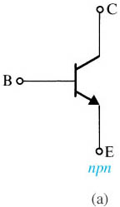
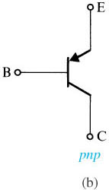
.

Slide 29
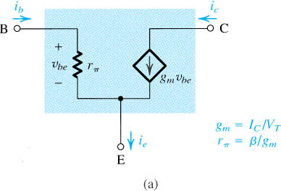
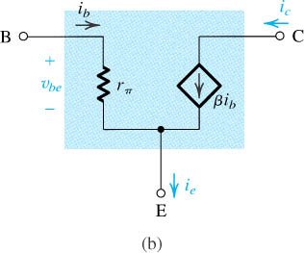

Slide 30
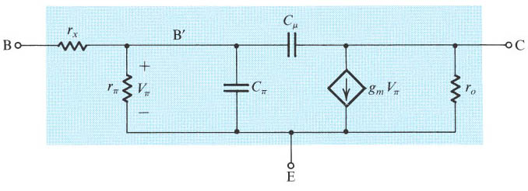

Slide 31
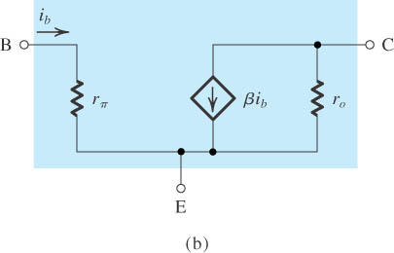
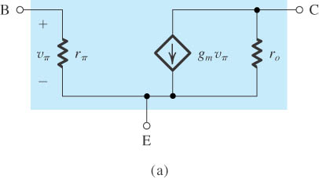
.

Slide 32
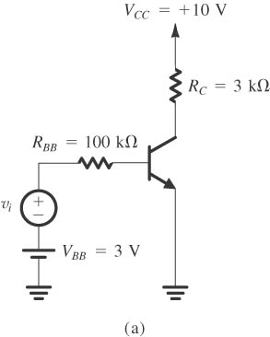
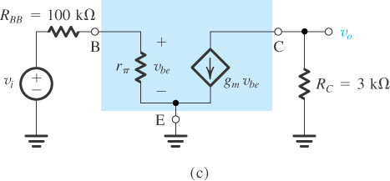

Slide 33
Voltage Controlled Current Source
VCCS
+
v_{o}
i=g_{m}v_{o}
-
A current source whose value is controlled by a voltage at another point in the circuit.
Example: Transistor small signal model.

Slide 34
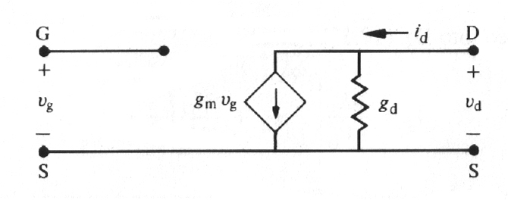
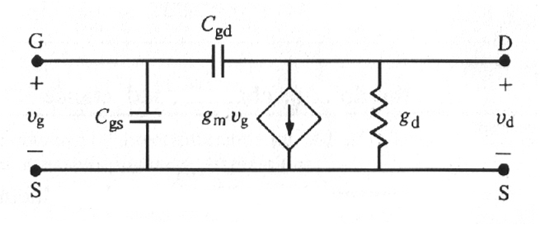
Application
G
D
input
MOSFET
output
S
S

Slide 35
Example
g₂
1
2
3
J
g₁
C₁
C₂

Slide 36
VCCS Stamp
VCCS
j
k
+
v_{o}
i=g_{m}v_{o}
-
col j
col j’
j’
k’
row k
g_{m}
-g_{m}
row k’
-g_{m}
g_{m}
Note: No longer symetric!
What happens when one of the nodes is ground?

Slide 37
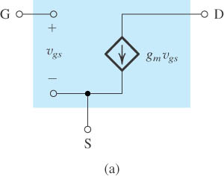
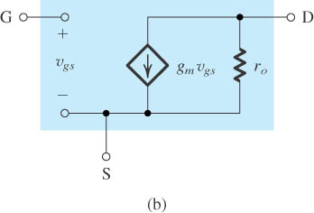
Small-signal models for the MOSFET:

Slide 39
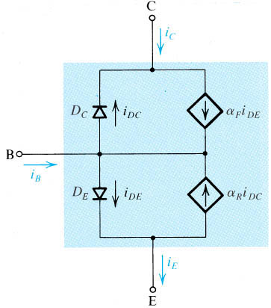
.

Slide 40
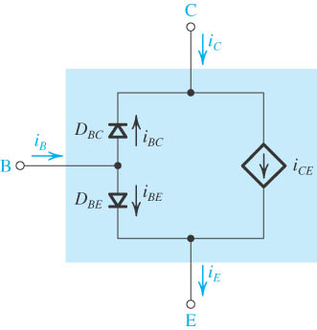
.

Slide 41
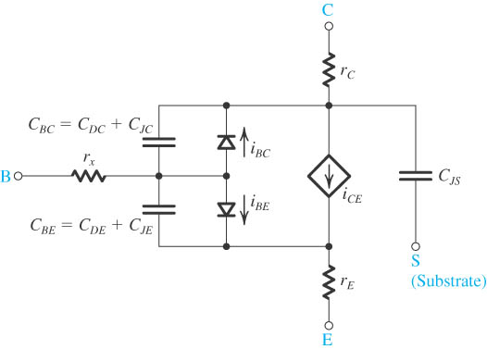
.

Slide 42
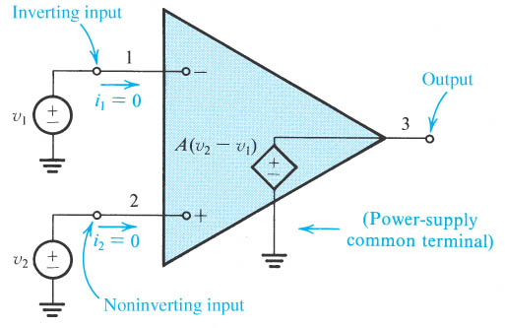

Slide 43
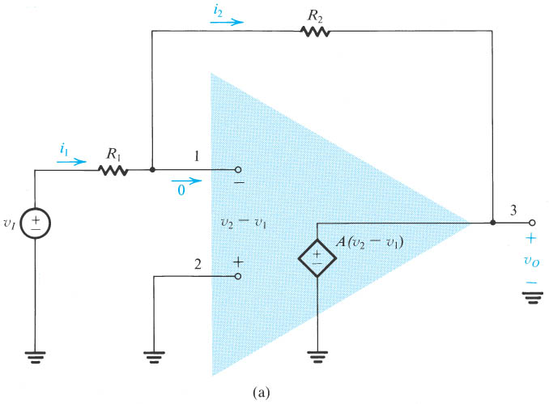

Slide 45
VCVS Stamp
VCVS
j
k
+
v_{o}
+
v=A v_{o}
I
-
-
New col
I
j’
k’
col j
col j’
col k
col k’
row k
+1
row k’
-1
New row
-A
A
1
-1
Note: No longer symmetric!

Slide 46
Example
g₂
1
2
3
+
-
I
J
g₁
C₁
C₂

