Slide 1
Solution of Ax=B (Review)
Let A be a square n by n matrix invertible matrix:
The following statements are equivalent:
A is nonsingular
det A ≠ 0
A has full rank; that is, rank A = n
The equation Ax = 0 has only the trivial solution x = 0
The equation Ax = b has a unique solution for each b
The columns of A are linearly independent
The rows of A are linearly independent
There is an n by n matrix B such that AB = I(nxn) = BA.
The transpose A is an invertible matrix
Zero is not an eigenvalue of A

Slide 2
Solution of Ax=B (Review)
  A singular matrix is a square matrix that does not have an inverse
  A matrix is singular iff its determinant is 0
  A is singular iff at least one of its eigenvalues is zero

Slide 3
Solution of Ax=B (Review)
  Some Properties of Invertible Matrices

Slide 4
Diagonally Dominant Matrices
g₁
v₁
Ι_{a}
1
2
3
4
5
1
g₁
+ g₂
-g₁
0
0
0
v₁
g₂
Ι_{b}
2
-g₁
g₁
0
-g₄
0
v₂
v₃
+ g₄
v₂
g₃
3
0
0
g₃
+ g₆
0
-g₆
v₃
g₄
g₅
g₆
4
0
-g₄
0
g₄
+ g₅
0
v₄
Ι_{c}
v₅
v₄
v₅
5
0
0
-g₆
0
g₆
Ι_{a}
1
−Ι_{b}
2
=
−Ι_{a}
3
−Ι_{c}
4
Ι_{c}
5

Slide 5
Diagonally Dominant Matrices
g₁
v₁
Ι_{a}
g₂
1
2
3
4
5
Ι_{b}
v₂
v₃
g₃
1
g₁
+ g₂
-g₁
0
0
0
g₄
g₅
g₆
2
-g₁
g₁
0
-g₄
0
+ g₄
Ι_{c}
v₅
v₄
3
0
0
g₃
+ g₆
0
-g₆
G=
4
0
-g₄
0
g₄
+ g₅
0
5
0
0
-g₆
0
g₆

Slide 6
Diagonally Dominant Matrices
g₃
v₁
g₂
v₂
g₅
v₃
g₁
g₄
Ι_{a}
Ι_{b}

Slide 7
Diagonally Dominant Matrices
g₃
v₁
g₂
v₂
g₅
v₃
g₁
g₄
Ι_{a}
Ι_{b}
Is G strictly diagonally dominant?

Slide 8
Diagonally Dominant Matrices
  The matrix A is strictly diagonally dominant iff
  The matrix A is diagonally dominant iff

Slide 9
Diagonally Dominant Matrices
  A strictly diagonally dominant matrix is non-singular
  A diagonally dominant matrix with at least one strictly diagonally dominant row is non singular
  Is the G matrix diagonally dominant ? Is it strictly diagonally dominant ?

Slide 10
DC Solution
  The G matrix of a resistive LINEAR circuit with a path from every node to every other node is strictly diagonally dominant or diagonally dominant with at least one strictly diagonally dominant row.
  Under these conditions, the circuit has a DC solution which is unique
Draw a linear resistive circuit that don’t have a unique DC solution
Draw a Linear circuit such that inverse (G) exists while (G+sC) is singular at w=1

Slide 11
Diagonally Dominant Matrices
L₁
2
1
I_{L}
J
g₁
g₂
C₁

Slide 12
Diagonally Dominant Matrices
L₁
2
1
I_{L}
J
g₁
g₂
C₁
Is G diagonally dominant?
Is G strictly diagonally dominant?
Is G invertible?
Every node has DC path to ground?
Does the circuit has DC solution?

Slide 13
Diagonally Dominant Matrices
C₂
C₃
1
3
2
g₂
J
g₁
C₁
Every node has DC path to ground?
Is G invertible?
Does the circuit has DC solution?

Slide 14
Inversion of a Random Matrix
CPU Time
N

Slide 15
MATRIX A

Slide 16
B=inv(A)

Slide 17
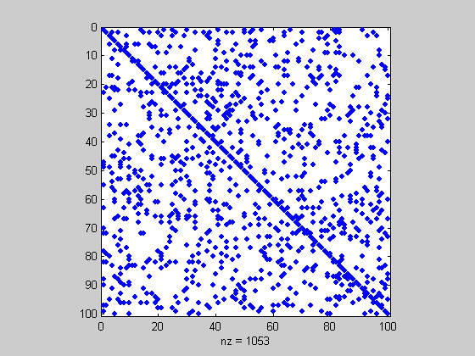
Matrix A
Sparsity=89.47%

Slide 18
Inverse (A)
Sparsity=0%

Slide 19
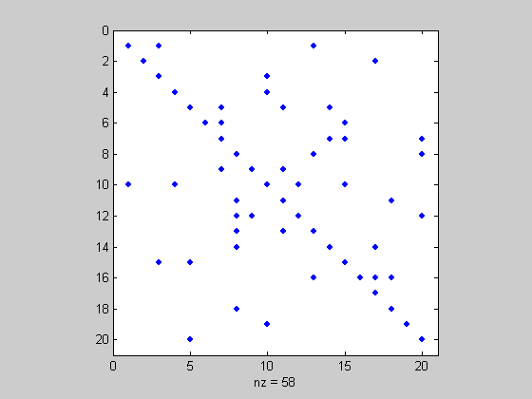
A
Sparsity: 85%

Slide 20
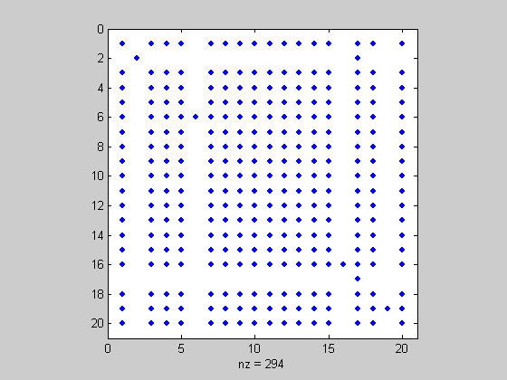
inv(A)
Sparsity: 27%

Slide 21
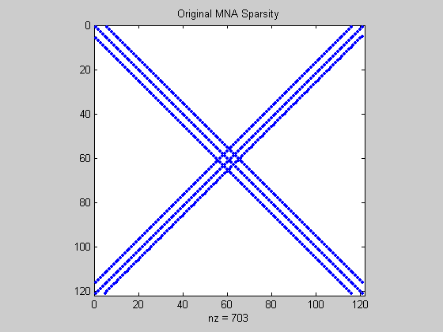
Sparsity= 95%

Slide 22
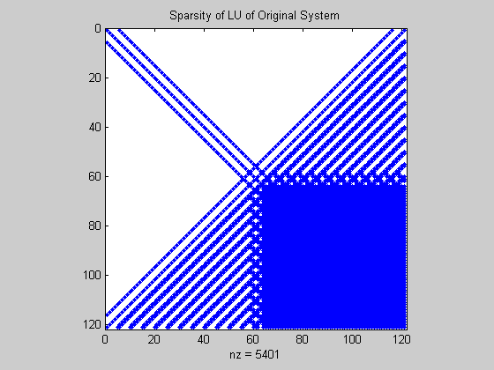
Sparsity= 62%

Slide 23
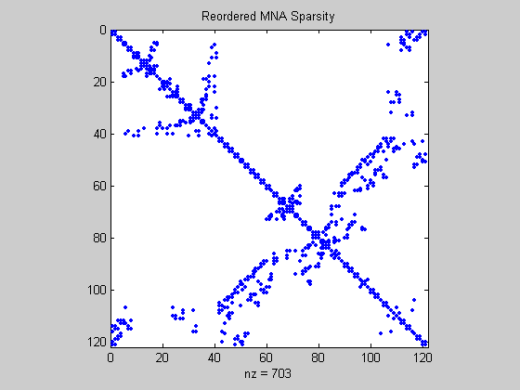
Sparsity= 95%

Slide 24
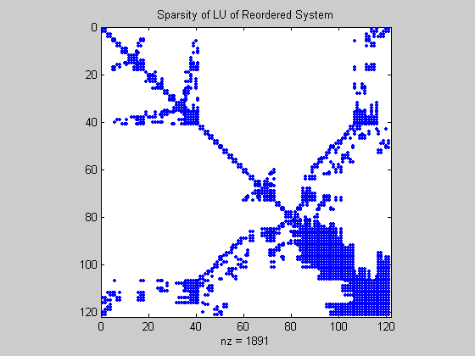
Sparsity= 86%

Slide 25
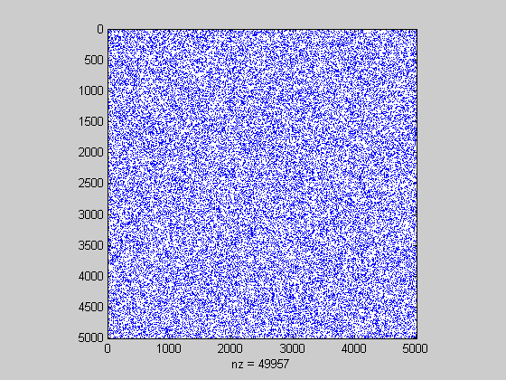
Sparsity= 99.8%
MATRIX A

Slide 26
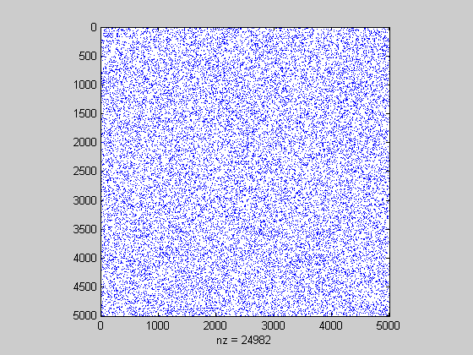
Sparsity= 99.8%
MATRIX B

Slide 27
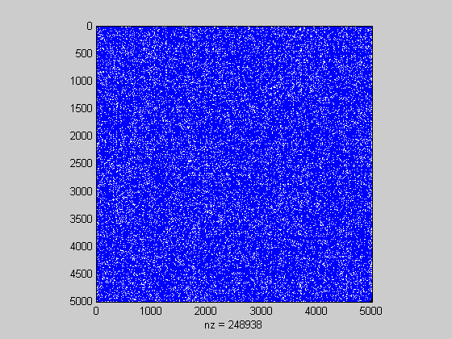
MATRIX C=A*B
CPU Time:
Full= 132.55 Second
Sparse= 0.046 Second
Speed-up= 2881:1

Slide 28
CPU Time for multiplying two matrices
5000x5000 Matrix
Full= 132.55 seconds
Sparse= 0.046 seconds
Speed-up= 2881:1
10,000x10,000 Matrix
Full= 17.7 minutes
Sparse= 0.1 seconds
Speed-up= 10,604:1

Slide 29
LU Decomposition
Forward Substitution FS
Backward Substitution BS

Slide 30
LU Algorithm: Example
Pivot
Pivot

Slide 31
LU Algorithm: Example

Slide 32
LU Algorithm: Example

Slide 33
Example
1Ω
1
1Ω
2
1
2
1Ω
3
1Ω
3
1Ω
4
1Ω
4
1A
1Ω
1Ω
1Ω
1A
1Ω
1Ω
1Ω

Slide 34
Example
1Ω
1
2
1Ω
3
1Ω
4
1A
1Ω
1Ω
1Ω
How many zeros remain after first step of LU
decomposition?

Slide 35
Example
1Ω
1
2
1Ω
3
1Ω
4
1A
1Ω
1Ω
1Ω
How many zeros doe we lose in the first step of LU decomposition?

Slide 36
Example
1Ω
1
1Ω
2
1
2
1Ω
3
1Ω
3
1Ω
4
1Ω
4
1A
1Ω
1Ω
1Ω
1A
1Ω
1Ω
1Ω

Slide 38
Sparse Matrix Ordering
k
j
A new nonzero is created in the location (i,j) iff:
K
i

Slide 39
Sparse Matrix Ordering
1Ω
B
A
A
B
1Ω
C
1Ω
D
C
D
1A
1Ω
1Ω
1Ω

Slide 40
Sparse Matrix Ordering
A
B
A
B
C
C
D
D
Node “A” as pivot in the first step of the LU decomposition
6 non-zeros

Slide 41
Sparse Matrix Ordering
A
B
C
D
Node “B” as pivot in the first step of the LU decomposition
zero non-zeros

Slide 42
Sparse Matrix Ordering
B
A
B
A
D
D
C
C
Node “A” as pivot in the first step of the LU decomposition
Two non-zeros location (B,C) and (C,B)

Slide 43
Sparse Matrix Ordering
Node “A” as pivot in the first step of the LU decomposition
A
B
B
D
C
D
C
Matrix after the 1st step

Slide 44
Minimum Fill-in Algorithm
D
E
F
H
A
J
G
C
B
I
What is the worst node to be number “1”?

Slide 45
D
E
F
H
A
J
G
C
B
I
F
“J” as pivot
D
E
H
A
G
C
B
I

Slide 46
D
E
F
J
I
H
A
G
C
B
I
F
“I” as pivot
D
E
H
A
G
C
B

Slide 47
D
E
F
J
I
A
H
A
G
C
B
“A” as pivot
D
E
F
H
G
C
B

Slide 48
D
E
F
J
I
A
H
H
G
C
B
“H” as pivot
D
E
F
G
C
B

Slide 49
D
E
F
J
I
A
H
G
G
C
B
D
E
F
“G” as pivot
C
B

Slide 50
D
E
F
J
I
A
H
G
F
C
B
D
E
“F” as pivot
C
B

Slide 51
D
E
J
I
A
H
G
F
B
C
B
D
E
“B” as pivot
2 nonzeros location (E,C) and (C,E)
C

Slide 52
J
I
A
H
G
F
B
C
D
E
D
E
C
D
E
“C” as pivot

Slide 53
D
E
F
J
I
A
H
G
F
B
C
D
E
1
2
3
4
5
6
7
8
9
10
H
A
J
G
C
B
I
9
10
6
4
3
1
5
8
7
2

Slide 54
Minimum Degree Algorithm
D
2
E
F
2
2
H
A
3
J
G
1
C
4
4
3
1
B
2
I

Slide 55
D
2
E
F
2
2
H
A
3
J
G
1
C
4
4
3
1
B
2
I
D
2
E
F
“J” as pivot
2
2
H
A
3
G
1
C
4
4
2
B
2
I

Slide 56
Permutation Matrices
row 3
row 1
row 2
row 3
row 1
row 2

Slide 57
Permutation Matrices
col 2
col 3
col 1
col 2
col 3
col 1
col 2
col 3
col 1
row 3
row 1
row 2

Slide 58
MATLAB
[L,U,P,Q] = lu(A, threshold);
z = L\(P*b);
y = U\z;
x = Q*y;
MATLAB

Slide 59
Permutation Matrices
Permutation matrices are Orthogonal (prove it !)

Slide 60
Permutation Matrices
Example:

Slide 61
3) Orthogonal Vectors
Two vectors are orthogonal if their inner product is equal to zero.
Examples:

Slide 62
4) Orthonormal set of Vectors:
An orthogonal set in which the norm-2 of each vector=1
Examples:

Slide 63
5) Orthogonal Matrices
A real matrix Q is said to be orthogonal if and only if its column vectors form an orthonormal set.
Examples:
If Q is square orthogonal matrix then

Slide 64
Example:

Slide 65
Accuracy
Computer precision
Floating point numbers are stored as a sign, a number and an exponent:
Exponent
Sign
Number (limited number of significant digits)

Slide 66
Accuracy
Computer precision
Assume we have only space for three numbers
➔ We loose 4 significant digits

Slide 67
Accuracy
Perform the addition (can only store three numbers):

Slide 68
Accuracy
Be careful adding or subtracting large and small numbers.
Be careful with large or small multipliers/divisors.

Slide 69
Accuracy
Example:
Exact solution:

Slide 70
Accuracy
Example:
Exact solution:

Slide 71
Accuracy
Example:
Finite precision solution:

Slide 72
Accuracy
Example:
Finite precision
solution:

Slide 73
Accuracy
Example:
Finite precision solution, with pivoting:

Slide 74
Accuracy
Example:
Finite precision
solution:

Slide 75
A(1,1) 1
A(1,3) 3
A(2,2) -1
A(2,4) 2
A(3,3) 5
A(4,3) 7

Slide 76
Matrix Norms

Slide 77
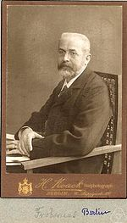
Ferdinand Georg Frobenius
(26 October 1849 – 3 August 1917)

Slide 78
Matrix Norms
MATLAB
norm(A,1)
norm(A,inf)
norm(A,’fro’)

Slide 79
Eigenvalues/Eigenvectors
Characteristic Polynomial
Prove it !

Slide 80
Matrix Norms-Norm2
A* is the conjugate transpose of A
norm 2 = maximum singular value of A
For symmetrical matrices

Slide 81
Matrix Norms-Norm2
Matlab:
s=svd(A)
(5.1167, 1.9544)
Or
smax=norm(A)
5.1167

Slide 82
Matrix Norms-Norm2
Matlab:
s=svd(A)
(5.3317, 2.1385)
Or
smax=norm(A)
5.3317

Slide 83
Matrix Norms- Properties

Slide 84
Condition Number

Slide 85
Condition Number
cond(A)= 2984

Slide 86
ILL- Conditioned Matrix- MATLAB Experiment
a =
1 2 3 4 5
2 3 4 5 6
3 4 5 6 7
4 5 6 7 8
5 6 7 8 9
>> b=inv(a)
Warning: Matrix is close to singular or badly scaled.
Results may be inaccurate. RCOND = 5.176174e-018
A is called Hankel matrix
cond(a)= 9.6864e+017
b = 1.0e+015 *
-0.4850 1.2010 -0.4850 -0.6929 0.4619
1.2010 -2.4019 1.2010 0.0000 -0.0000
-0.4850 1.2010 -1.6109 1.5589 -0.6640
-0.6929 0.0000 1.5589 -0.3464 -0.5196
0.4619 -0.0000 -0.6640 -0.5196 0.7217

Slide 87
ILL- Conditioned Matrix- MATLAB Experiment
a =
1 2 3 4 5
2 3 4 5 6
3 4 5 6 7
4 5 6 7 8
5 6 7 8 9
b = inv(a)=1.0e+015 *
-0.4850 1.2010 -0.4850 -0.6929 0.4619
1.2010 -2.4019 1.2010 0.0000 -0.0000
-0.4850 1.2010 -1.6109 1.5589 -0.6640
-0.6929 0.0000 1.5589 -0.3464 -0.5196
0.4619 -0.0000 -0.6640 -0.5196 0.7217

Slide 88
Can permutation changes the Condition Number
Given B=PAQ; where P and Q are permutation matrices;
Prove that A and B has the same condition number.

