Slide 1
ANP1105B
Anatomy & Physiology I
Basic Cellular Physiology & the Anatomy and
Physiology of the Cardiovascular, Lymphatic & Respiratory Systems

Slide 2
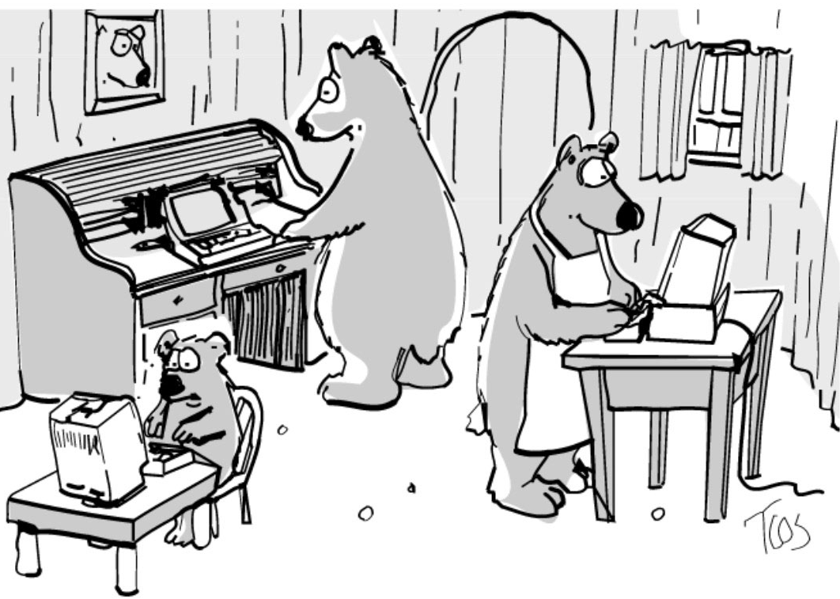
ANP 1105B COURSE WEB SITE
Go to university home page and under quick picks, choose Virtual Campus
Top left: choose login under Blackboard Learn
Scroll down & enter your username (student number) and your uoZone password
Click “Login” and this will bring you to a list of courses for which you have online access.
Select ANP1105B.

Slide 3
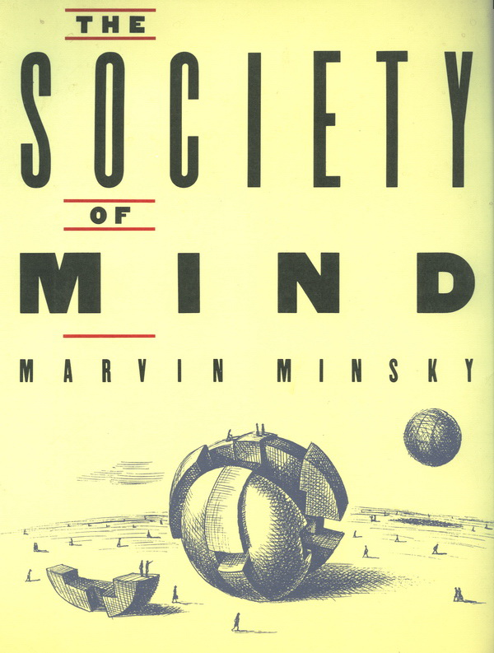
‘You don't understand anything until you learn it more than one way. ‘
-Marvin Minsky

Slide 4

Not all learners are the same
Visual
Aural
Read/write
Kinesthetic
(© 2006, N. Fleming & C. Bonwell)
Multimodal

Slide 5

http://www.vark-learn.com

Slide 6
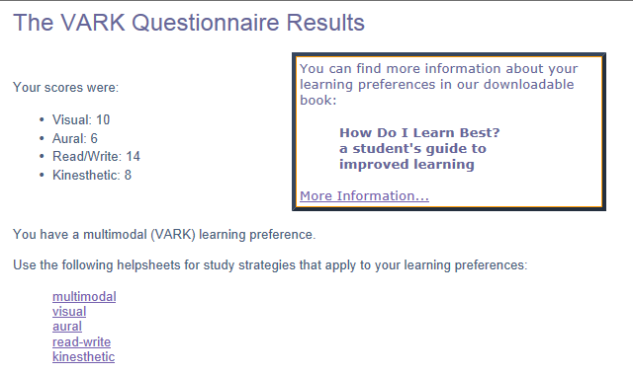

Slide 7
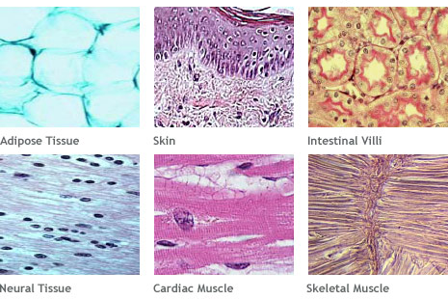

ANP 1105B
TOPIC #1: Structural Organization of the Human Body
1.1 Describe the levels of structural organization that make up the human body (pp. 3-4)
1.2 Cells: summarize the major organelles and structures found in cells (pp.83-96)
1.4 Describe the different tissues of the human body (Chapter 4)
J. Carnegie, Uof O
Figures from Human Anatomy & Physiology, 9th edition, by Elaine Marieb & Katja Hoehn © 2012 by Benjamin/Cummings Publishing Co. are reproduced by permission.
http://www.ptei.org/interior.php?pageID=42

Slide 8
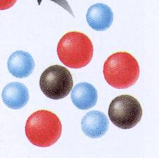
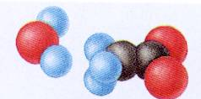
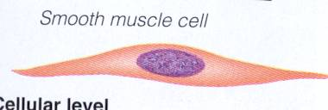
1.1.1 define: atom, molecule, organelle, cell, tissue, organ, organ system; give an example of each & localize each in the hierarchy of anatomical structure
The Structural Organization of the Human Body
atom: smallest particle of an element with all of the properties of that element - what are the different parts of an atom??
molecule: the smallest amount of a substance that can exist alone = a combination of atoms
organelle: molecules associate in specific ways to form organelles = basic components of living cells – give 5 examples of organelles
cell: fundamental structural & functional unit of a living thing; cells vary widely in size & shape, reflecting unique functions in the body
from Fig. 1.1
J. Carnegie, Uof O
Notes:
Atom: carbon, hydrogen, nitrogen... Parts of an atom are protons, electrons and neutrons
Molecule: carbon dioxide, water...
Organelle: mitochondria, nucleus, Golgi apparatus, ribosome, endoplasmic reticulum,
Cell: many organelles

Slide 9
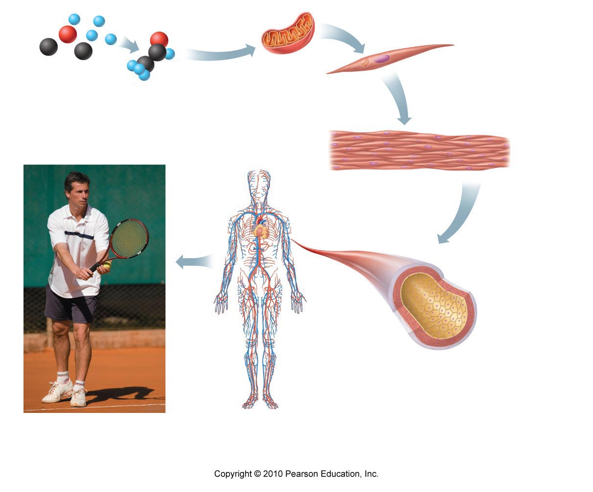
tissue: groups of similar cells that have a common function:
epithelium muscle connective tissue nervous tissue
Indicate the main function for each of these types of tissues
organ: structure composed of at least 2 (but usu 4) tissue types that performs a specific function for the body
Give an example of an organ and describe how each of its tissue types contributes to its overall role or function in the body
organ system: organs that work closely with one another to accomplish a common purpose; eg:
Name some organs associated with each of these systems.
1.
2.
3.
4.
J. Carnegie, Uof O
from Fig. 1.1
Notes:
Epithelium: inner or outer lining,
Muscle: movement, muscle tissue in the small intestine to move products
Connective tissue: many types of connective tissue. More of a filler tissue, also used as a pathway for blood vessels
Nervous tissue: communication, allows us to tell our body what to do, or allows us to speak and see
Organ: Liver, intestines, heart...
Organ system: cardiovascular, respiratory, digestive, endocrine

Slide 10
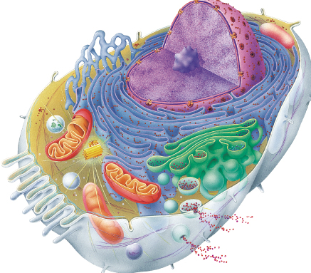
1.2 Summarize the organelles and structures found in body cells (Chapter 3: pp. 83-95)
We will review (you have already learned it in high school!) this content in class using a Jeopardy game. To fill in the gaps, read pp. 83-96 in your textbook.
Fig. 3.2
J. Carnegie, UofO

Slide 11
Complete the table shown on this slide & the next slide for a summary of what to remember about cellular components
Structure | Function
Plasma membrane
Mitochondria | Atp generation for cellular activities. Has a double membrane inner and outer. The inner membrane form shelf like structures called cristea.
Ribosomes | Where proteins are synthesized
Rough Endoplasmic Reticulum | Suface is covered with ribsomes. Where parts of the cell membrnne are manufactored. There enzymes help in protein synthesis
Smooth Endoplasmic Reticulum | Sythezize cholesterol, and lipid components. Also sythesize steriod based hormones such as sex hormones.
Golgi Apparatus | Package protein secretions for exports, packages enzymes into Lysosomes for cellular use, modifies proteins to become part of the cellular membrane
Lysosomes | Containing activated digestive enzymes. Helps dispose of invading bateria.
Peroxisomes | In cytoplasm containing powerful oxidase enzymes that use molecular oxygen to detoxify harmful or toxic substances
Microtubules | Made of spherical protein that determine the cell shape as well as the distribution of cellular organelles. They are hollow made of subunits known as tublin.
Notes:
Nonmebranous organnelles such as cytoskelton, centrioles and ribsomes

Slide 12
Structure | Function
Microfilaments | Involved in cell movement. Thinnest element of the cytoskeleton. Each cell has a different composition of microfilaments so no two cells are alike.
Intermediate Filaments | High tensile strength, and attach to desmosomes. They resist pulling forces exerted onto the cell.
Centriole | Consists of nine triplets of microtubeles.
Cilia | Loacted on the cells surface. They move substances in one direction across the cell surface. Made from centrioles.
Flagella | Also made from centrioles. Longer than cilia. Instead of propelling substances across the surface of the cell like cilia, flagella propels the cell it self using its special feature the tail.
Microvilli | Increase surface area for absorbtion. They are extensions of the plasma membrane and are located in the kidney and inestines.
Nucleus | Control center of a cell; contains genetic material
Nuclear Membrane | Double membrane. Outer membrane is covered with rough ER and ribsomes. Inner membrane is lined with nuclear lamina which allows the nucleus to retain its shape and allows for organiztion of the DNA.
Nucleoli | Involved with ribosomal RNA synthesis and ribosomal subunit assembly in the nucleus.
Chromatin | Structures in the nucleus that carry the hereditary factors (genes) 30% DNA, 60% histone protein which allow us to tightly pack our DNA, 10% RNA chains

Slide 13
1.3 Describe the different tissues of the human body
1.3.1 define tissue and demonstrate how the organization of cells into tissues contributes to overall homeostasis
1.3.2 list the 4 primary types of tissues
1.3.3 define epithelial tissue; list 6 functions associated with epithelia
• individual body cells specialized; division of labour
• at organ level, cooperation for organ to work as a whole
TISSUE: groups of structurally similar cells that perform common/related function
4 primary tissue types:
1) epithelial: covering usually all 4 to
2) connective: support make up
3) muscle: movement organ like a
4) nervous: control (regulation) kidney, heart
• histology: study of tissues & their cellular organization
J. Carnegie, UofO
Notes:
Many different types of tissues for different types of jobs

Slide 14
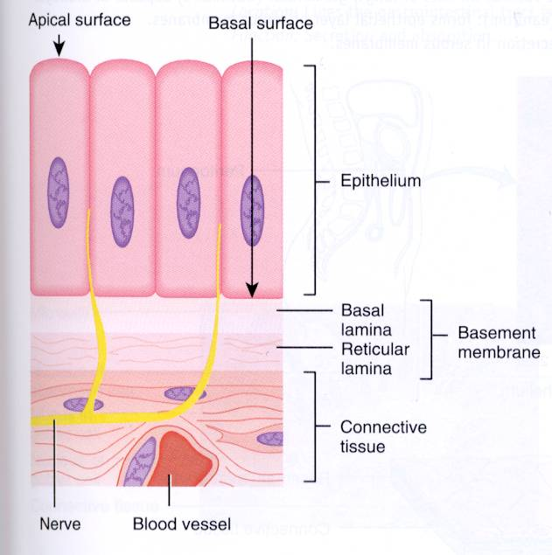
A. Epithelial Tissue
sheet of cells that covers a body surface or lines a body cavity
creates boundaries
1) covering and lining epithelium – e.g. ………………………………………
2) glandular epithelium
functions of various epithelia:
protection (mechanical, chemical, infectious) – skin,
absorption - GI tract,
filtration - kidney,
excretion - kidney,
secretion - glands,
sensory reception - taste buds, olfactory membranes . . .
T&G
J. Carnegie, Uof O
Notes:
Skin is epithial tissue, also inner lining is epithelial tissues such as oral cavity blood vessels, kidneys stomach
Glandular epithelium are sweat glands silvi glands
Protection: skin,
Absorption :GI tract ave eplitheil cells that absorb well
Filtration: Kidney
Apical surface: an upper free surface exposed to the body exterior or the cavity of an internal organ. Most of these surfaces face microvilli
Basal surface: lower part. Adjacent to this surface is the basal lamina.
Basal lamina: a sheet which consists of glycoproteins secreted by the epithial cells, and consists of some collagen fibers. Basal lamina acts as a selective filter which determines which molecules fiffusing friom the connective tissue are allowed to enter the epithelium.

Slide 15
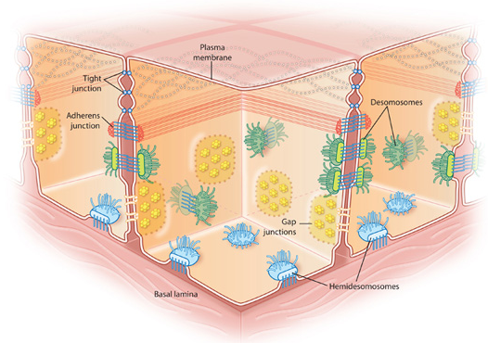
1.3.4 list and demonstrate your understanding of 7 special structural characteristics of epithelial tissue
cellularity:
specialized contacts: tight junctions & desmosomes - Why??
polarity: apical and basal surfaces; apical surface often specialized such as having ……………………… or …………………..
basal lamina: noncellular, underlying supportive sheet of primarily glycoproteins - What are two functions of a basal lamina??
J. Carnegie, Uof O
Notes:
Cellularity: cells are tightly packed
Specialz=ized contacts: must be able to communicate, tight junction firmly hold adjacent membranes. Tight junctions help keep proteins in the apical region of the plasma membrane from diffusing into the basal region which in turn helps keep polarity.
Polarity: cells tend to have certain shape, such as a apical surface or basal surface. Apical surfaces often specialized such as having Microvillia for more surface area or cilia which pushes mucus in different directions
Basal lamina: first function: to attach to things and move across, selective filter that determines which molecules diffusing from the underlting connective tissue are allowed o enter the epithelium. Also they can act as scaffolding along the epitheilal cellw can migrate to repair a wound
Second: cross linking fibers, which filter and control which molecules pass through the layer

Slide 16
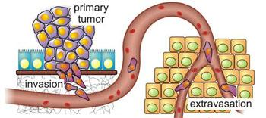
5. supported by connective tissue: basement membrane = basal lamina + underlying reticular CT (what is reticular CT??)
an important feature of cancerous epithelial cells is failure to respect the boundary imposed by the basement membrane
http://www.nccr-oncology.ch/scripts/index.aspx?idd=93
6. innervated but avascular: how nourished?
7. regeneration: high regenerative capacity - Why??
Notes:
Reticular CT: under the basal lamina. They work together which to form the basement membrane. Reticular CT is Fine mesh work of fibres, supports small cells
These to layers help resist stretching and tearing.
6) avascular: no blood vessels, no blood supply. Nourished by diffusion
7) Because they are constantly being damages so they are constantly being replaced.

Slide 17
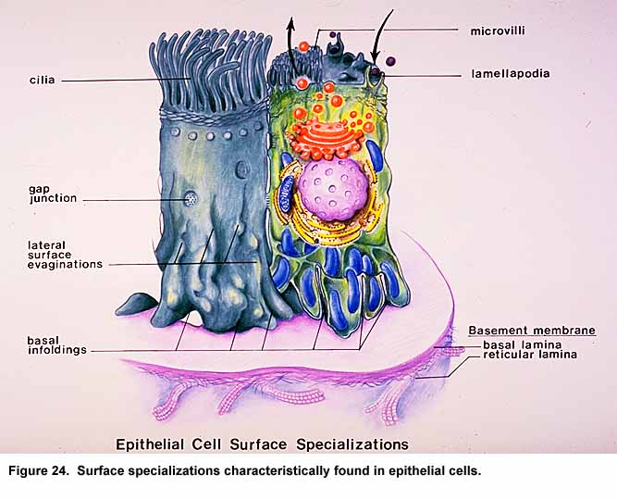
http://www.mednote.co.kr/images/epithsurf.jpg
Notes:
Apical is the surface or the lumina. Apical is on top basal is on the bottom.

Slide 18
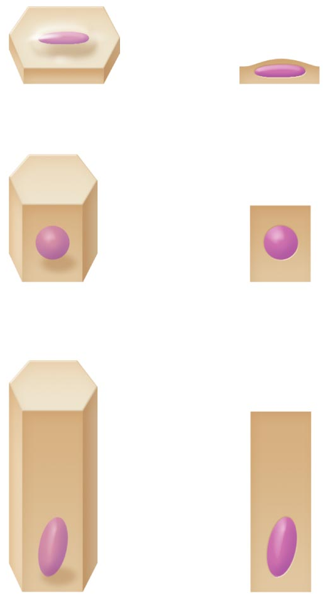
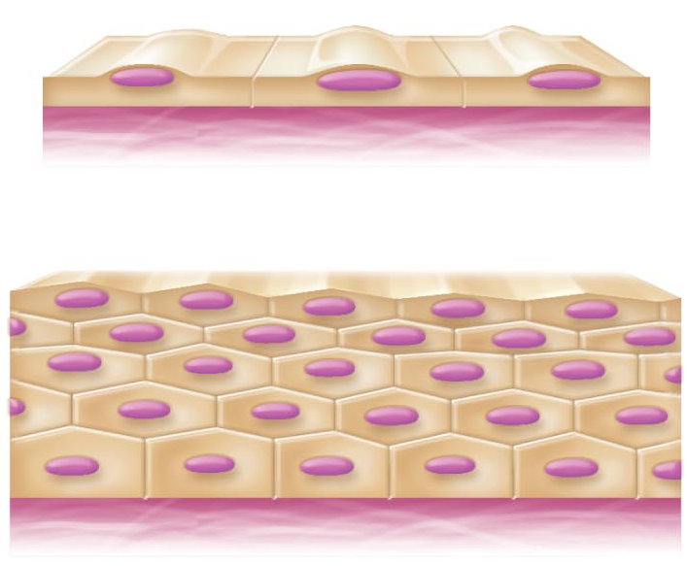
1.3.5 indicate the 2 criteria used to classify epithelial cells
CELL SHAPE LAYERS
squamous simple epithelia
cuboidal stratified epithelia
columnar
Fig. 4.2
Notes:
Stratified: greater than one
Simple: one layer
Squamous: flat, short
Cubuidal: cube shaped
Columnar: columnar shaped

Slide 19
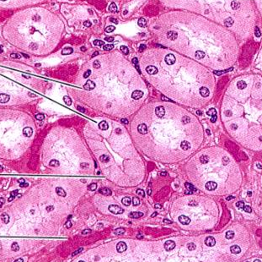
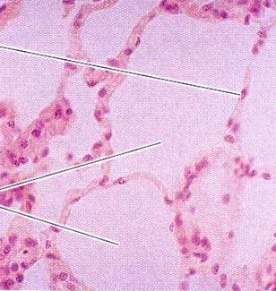
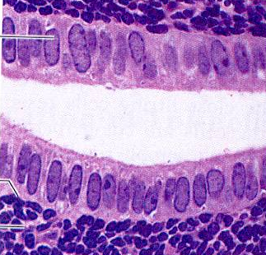
1.3.6 list the 4 types of simple epithelia; indicate primary functions associated with each & sample body locations
Examples of Simple Epithelia: (absorption, secretion, filtration)
simple squamous epithelium: thin & permeable - filtration, diffusion - eg: endothelium & in kidney, lungs
simple cuboidal epithelium: secretion & absorption - eg: kidney tubules, small glands
simple columnar epithelium: also digestion & secretion – eg. digestive tract
J. Carnegie, UofO
Notes:
Areas that are thin, so that things can move through easily: such as in blood vessels. Also in the lungs so that oxygen can leave the lungs and enter bloodstream
These cells are actually doing things such as directing things through and into the cell
These cells do a lot, they could be transporting objects or secreting. Found in the GI tract. Absorption; secretion of mucus, enzymes.

Slide 20
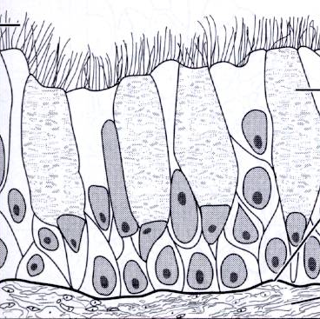
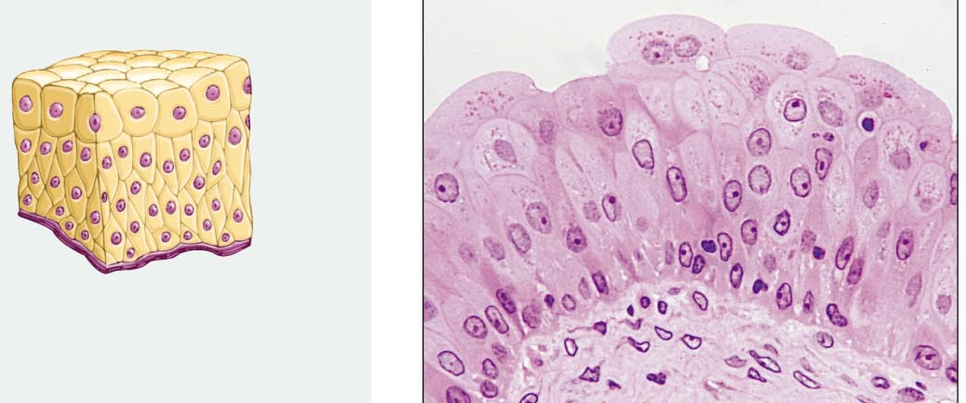
4. pseudostratified columnar epithelium: a single layer - eg: respiratory tract where cilia and mucus secretion are local specializations
Transitional epithelium (not simple!): lines the bladder, an organ that has to fill – the basal layers are columnar to cuboidal and the apical layers become increasingly flattened & squamous-like as filling occurs
Notes:
4) Pic is a single layer. Found in repiratory tract. Pseudo means false so it is not truly multe layered.
5) Found in the bladder. Consists of several layers and must be able to change its shape. It lines the bladder. Very flexible.

Slide 21
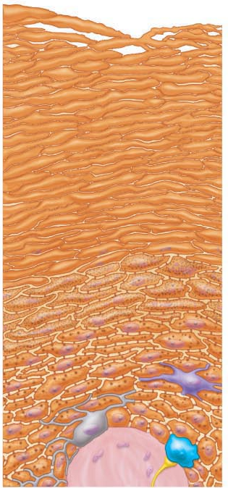
1.3.7. Describe the structure of stratified squamous epithelium and give a sample body location
protective role; basal cells cuboidal & undergo mitosis to keep regenerating the layer from below
1What is the most widespread example of stratified squamous epithelium?
2What happens to the apical layers of cells?
Fig. 5.2
J. Carnegie, UofO
Notes:
Stratifies squamous epithelium: will be found where cells are lost alot such as skin.
Stratifies means many layers
Squamous means flat
1) skin
2) They are stuffed up because they are constatley replaced

Slide 22
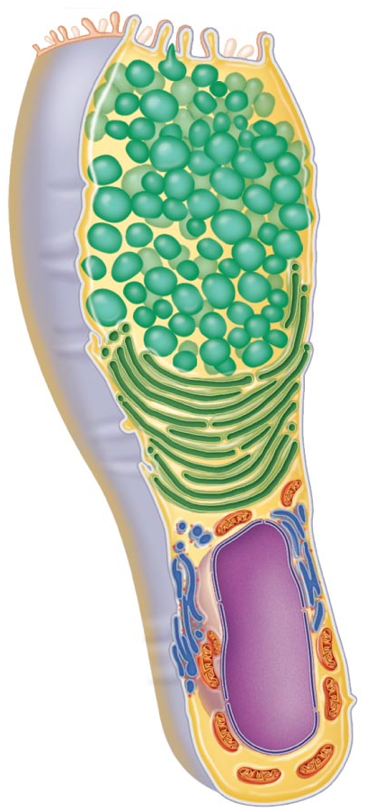
1.3.8 define: gland, endocrine gland, exocrine gland
Glandular Epithelia:
• gland: 1 or more cells that make & secrete a particular product
• glands are: endocrine: ………………………………………………………
exocrine: …………………………………………………………
unicellular or multicellular
Endocrine Glands:
• just know that they are ductless - products are called hormones
Exocrine Glands:
• mucous, sweat, oil/salivary glands, liver, pancreas, etc.
a) Unicellular exocrine glands:
• no ducts because only one cell!
• really just the goblet cells (digestive & respiratory tracts)
b) Multicellular exocrine glands:
• epithelium-derived duct & secretory cells; surrounded by supportive CT which brings blood vessels & nerves
Fig. 4.4
J. Carnegie, UofO
Notes:
Gland: one or more cells that make and secrete a product. Mucus glands
Endocrine gland: produce hormones and are released outside of the cell into the bloodstream to get from point a to point b. They are ductless
Exocrine gland: produce many things such as enzymes , mucus and oil. And they use ducts to transport their products to their destination.
Uni exocrine:
Goglet cells: create mucus.
Multicellular exocirne glands: made up of many producing cells that surround a cavity in which a duct is used to travel the secretions

Slide 23
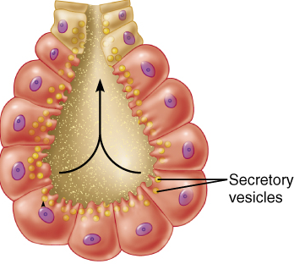
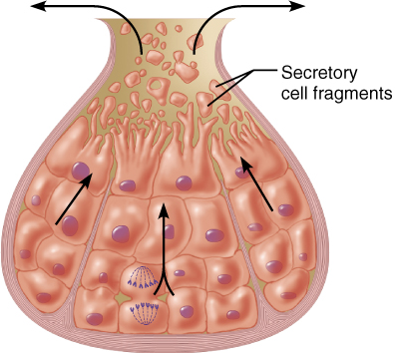
(iii) Secretory method:
merocrine/eccrine: exocytosis
most common type
pancreas, salivary glands, most sweat glands
holocrine: cell rupture; only sebaceous glands
apocrine: cell apex pinches off with secretory product
Is mammary gland apocrine or merocrine?
Fig. 4.6
Notes:
Merocrine: product is being released directly into the lumin of the gland. Exocytosis.
Holocrine: cell produces product and then the whole cell ruptures to release the product. Oil glands do this.
Apocrine:
Lipids use apocirne secretion while proteins use merocrine secretion.

Slide 24
Match the epithelial type (Column B) with the correct location (Column A)
Column A Column B
B 1. Lines stomach, most of intestines. A. Pseudostratified ciliated columnar
F 2. Lines the inside of the mouth. B. Simple columnar
A 3. Lines much of the respiratory tract. C. Simple cuboidal
D 4. Endothelium D. Simple squamous
D 5. Composes lung alveoli E. Stratified columnar
F. Stratified squamous
The gland type that secretes its product continuously, by exocytosis is:
a) merocrine
b) holocrine
c) endocrine
d) apocrine
J. Carnegie, UofO
Notes:
merocrine

Slide 25
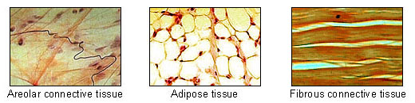
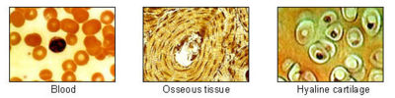
1.3.9 list the 5 types of CT; list the 4 main functions associated with CTs
• 5 major types: mesenchyme, CT proper, cartilage, bone & blood
• main functions: (1) binding or support - eg: …………………………………..
(2) protection - eg: ……………………………………………
(3) insulation - eg: ……………………………………………..
(4) transportation - eg: ………………………………………..
http://en.wikipedia.org/wiki/Connective_tissue
Notes:
cartilage, bone
Bone
Attox tissue (CT proper)
blood

Slide 26
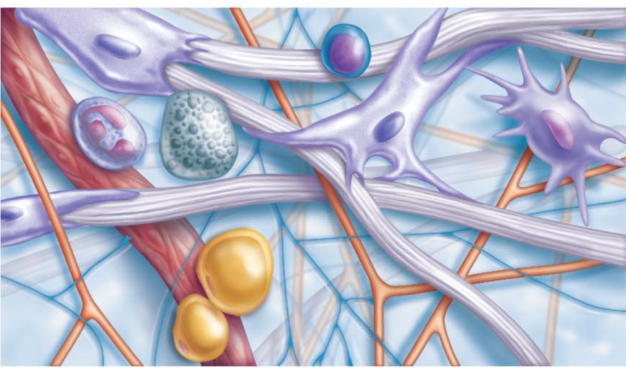
1.3.10 describe the structural organization of CT in general; distinguish between collagen, elastic & reticular fibers; distinguish between “blast” and “cyte” types of CT cells
Structural Elements of CT:
a) ground substance: interstitial fluid + cell adhesion proteins & proteoglycans: molecular sieve
• fibronectin, laminin - help cells attach to CT elements
• proteoglycans - What are these? What do they do?
b) fibers:
collagen fibers: high tensile strength
elastic fibers: elastin has coiled structure to allow stretch + recoil
reticular fibers: thin collagen protein; fine network to support blood vessels, soft tissues
Fig. 4.7: Areolar CT
Notes:
Ground substance: fibronectin combine to cells which help attach the cells
Collagen fibers are thick.
Elastic fibers: thin
Reticular fibers: the thinnest fibers, give mech work for the cells to attach to
protegylycans,, large molecules which
Blast as suffix: immature but is forming
Cyte as suffix: mature, less active they maintain the health of the matrix. If matrix is injured they return to blast to repair.

Slide 27
c) cells: immature (“blast”) forms vs mature (“cyte”) forms
• “blasts” are actively dividing/synthesizing cells during growth & repair
• “cytes” primarily provide a level of maintenance
Types of CT:
1) Mesenchyme: first tissue formed from mesoderm germ layer - mesenchymal cells + fluid ground substance & fine fibrils ➢ source of all other CTs
2) CT Proper: 2 subclasses ➢➢
  A. Loose CT (areolar, adipose, reticular)
  B. Dense CT (dense regular, dense irregular, elastic)
J. Carnegie, UofO
Notes:
Blasts: are less mature
Cyte: more mature more differeatible

Slide 28
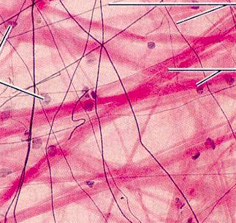
1.3.11 list and briefly describe the 3 types of loose CT; include key functions for each type as well as sample body locations
LOOSE CT
(i) AREOLAR CT: gel-like matrix with all 3 fiber types; cells = fibroblasts, macrophages, mast cells, & some WBCs
Description: loose arrangement of fibers; reservoir of water & salts but is also a prime site of edema during inflammatory reaction
Location: widely distributed under epithelia of body - eg:
Function: cushioning of organs, immunity (macrophages) & inflammation; fluid reservoir
Fig. 4.8
Notes:
Areolar Ct: resevoir for fluids and salts in the body. This is also where swelling(edema) occurs. Most common type of CT found in the body.

Slide 29
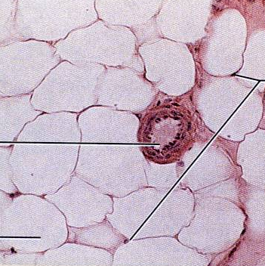
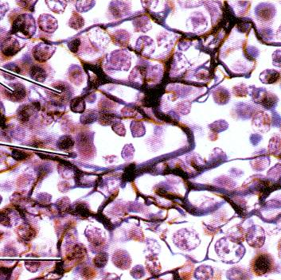
(ii) ADIPOSE TISSUE: areolar CT modified to store nutrients; adipocytes
Description: fat-filled adipocytes with displaced nuclei; do not reproduce; scanty matrix
Location: under skin, around kidneys & eyeballs, in bones & within abdomen, in breasts; 18% of average wt (15% ♂ & 22% ♀)
Function: fuel reservoir, insulation, supports & protects organs
(iii) RETICULAR CT: like areolar CT, but only reticular fibers
Loc: • lymphoid organs (lymph nodes, bone marrow, spleen)
Fcn: • fibers form soft internal skeleton that supports free blood cells
Notes:
Adipose tissue: cell dense area, and each is a fat filled cell. They store fats for energy deficiececie. Found under the skin. Around the kidneys to cushion.
Reticular Ct: only reticular fibers are founf in reticular CT. To make a mesh work of the fibers so that the blood cells have somehting to attach to .

Slide 30
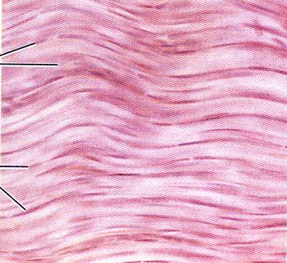
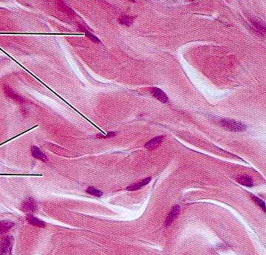
1.3.12 list and briefly describe the 3 types of dense CT
DENSE CT (fibers are the predominant element!!)
DENSE REGULAR CT: bundles of collagen fibers running parallel to direction of pull → white, flexible tissue with great resistance to tension
Location: tendons (??? to ??), ligaments (?? to ?? at joints), also aponeuroses
Function: attachment with strength
(ii) DENSE IRREGULAR CT: same as regular, but collagen bundles thicker & arranged irregularly
Location: dermis, submucosa of digestive tract, fibrous capsules of organs & joints
Function: withstand tension exerted in many directions; strength
(iii) ELASTIC CT: like dense regular CT, but a very high content of elastic fibers; found in some very elastic ligaments
J. Carnegie, UofO

Slide 31
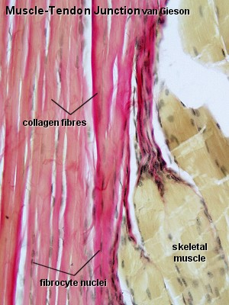
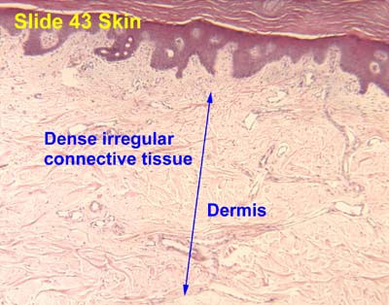
http://w3.ouhsc.edu/histology/Text%20Sections/Connective%20Tissue.html
http://www.lab.anhb.uwa.edu.au/mb140/CorePages/Connective/Images/skm40vg.jpg

Slide 32
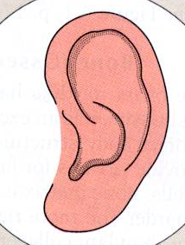
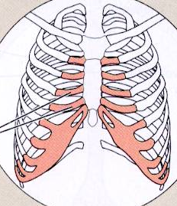
1.3.13 List the other remaining types of connective tissue
3. CARTILAGE features between dense CT & bone → tough, but flexible
(i) avascular, devoid of nerve fibers
(ii) ground substance contains lots of the GAGs chondroitin sulfate & hyaluronic acid - also chondronectin, (adhesive protein)
(iii) collagen fibers (can have some elastic fibers)
(iv) up to 80% H₂O
J. Carnegie, UofO

Slide 33
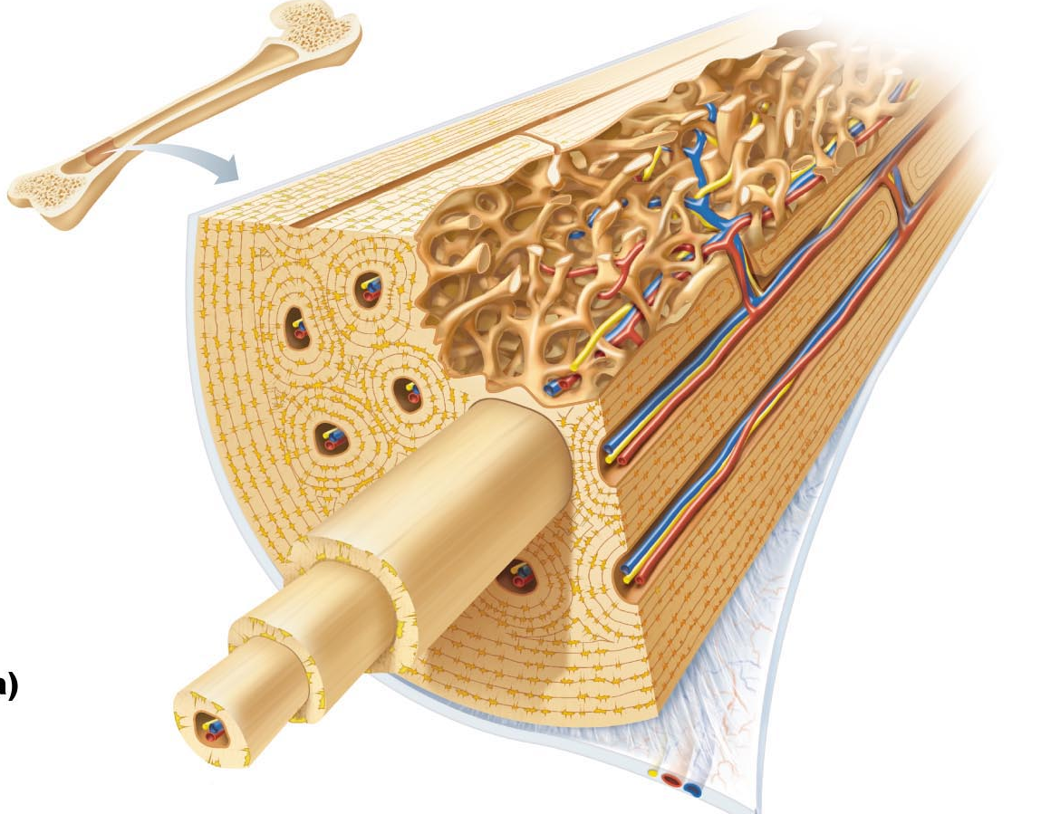
4. BONE calcium salts give hardness & strength for support/protection of softer tissues; cavities for fat storage & synthesis of blood cells
osteoblasts: ……………………………………………………………………
osteocytes: ……………………………………………………………………..
osteoclasts: ………………………………………………….…………………
J. Carnegie, UofO
Fig. 6.7: Structure of Bone

Slide 34
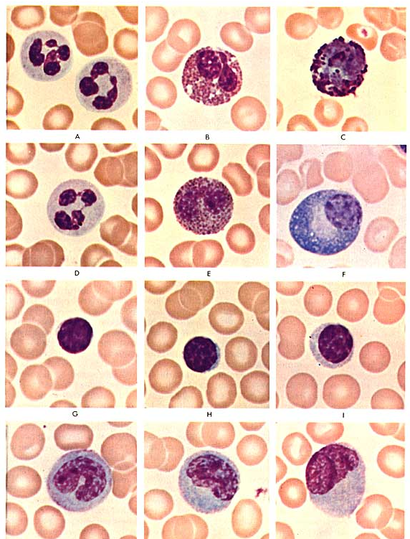
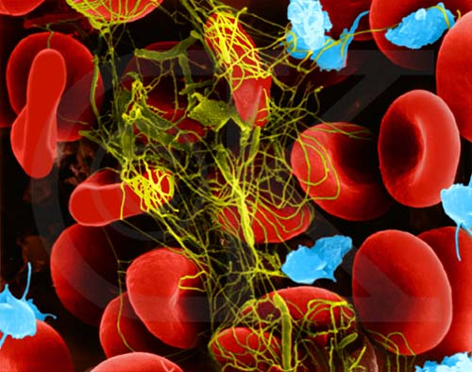
5. BLOOD classified as a CT because it consists of cells (RBCs, WBCs) surrounded by a nonliving fluid matrix, blood plasma
“fiber” components are soluble protein molecules - only visible during clotting
http://www.emc.maricopa.edu/faculty/farabee/biobk/BioBookcircSYS.html
http://faculty.une.edu/com/abell/histo/histolab3a.htm
J. Carnegie, Uof O

Slide 35

1. Which of the following fibrous elements give a CT high tensile strength?
a) reticular fibers c) collagen fibers
b) elastic fibers d) myofilaments
2. The cell that forms bone is the:
a) fibroblast d) osteoblast
b) chondroblast e) reticular cell
c) hemocytoblast
3. Which kind of CT acts as a sponge, soaking up fluid when edema occurs?
a) areolar CT d) reticular CT
b) adipose CT e) vascular tissue
c) dense irregular CT

