Slide 1
Class 3: Lifespan Development and Health?
GERON/HLTH 220
September 2013

Slide 2
Learning Goals
Today we will:
Briefly review the key health-relevant developmental theories
Discuss the relation between stress, development, and health
Complete a group exercise linking the theory and research methods.

Slide 3
Review: Definitions and Theories

Slide 4
Health Defined
“Health is a state of complete physical, mental and social well-being and not merely the absence of disease or infirmity.”
(WHO, 1948)
Strengths:
Multidimensional
Implies that health and disease are part of the same continuum and more complex than a health/disease dichotomy
Weaknesses:
Use of term “state” rather than “process”
Notes:
Basically, Health is multifactorial
State refers to your health at this time
It would be preferable to think of health as a process
We can think of health as being a state, or as something that’s building or developing over our lifetime
Health is very similar to the other kinds of development that we would focus on in this course… i.e: Cognitive development, etc

Slide 5
Development as a Dynamic System
Perpetually ongoing process
Conception to Death
Influences on development
  Biological
  Psychological
  Social
Notes:
System = not people/components.. it is the way in which the components are organized and interacting
Components in a system are mutually dependent.. When something happens with A/A does something, it will influence B (change) and the way B interacts with A will also change
Ex: blood vessels harden as you age, and heart has to pump harder against the vessel. The heart muscle gets bigger in order to pump harder, and eventually the heart gets weaker..
Systems maintain homeostasis – makes changes in order that things continue to function properly
Piaget – think about homeostasis
IF there is change in a system, a period of chaos occurs… none of the rules apply
Chaos → transition → reorganization

Slide 6
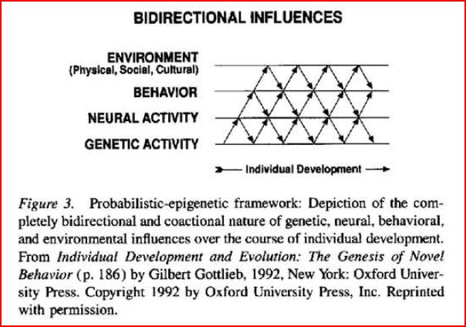
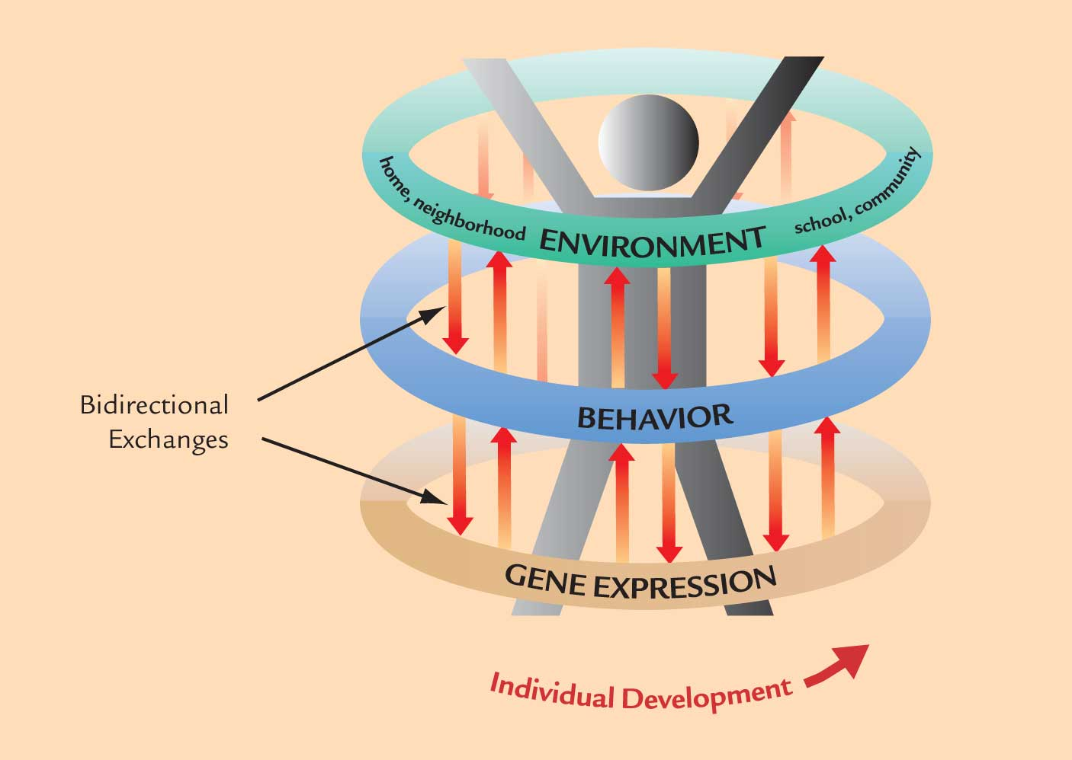
Current Theory: The Epigenetic Framework
“In truth, genes and environments are always interacting, and it would be impossible to consider one without the other” (Champagne, 2009, p 28)
Notes:
Transaction- the components are physically changed.

Slide 7
Advantages of Context-Based Theories (CBT)
CBT theories include Social Cognitive Theory (Bandura) and the developmental Systems theories
Comprehensive yet parsimonious
Highly adaptable to epidemiology and public health
  Cross-disciplinary, have overarching and lifelong perspectives, allow for empirical assessment and support research-based evidence for public health intervention
Focus on nature AND nurture
Provides a framework to address the social determinants of health and healthy (child) development
  Puts focus on role of social resources and family and community interactions as influences on wellness outcome
  Avan, B. I., and Kirkwood, B. R. (2010). Review of the theoretical frameworks for the study of child development within public health and epidemiology. Journal of Epidemiology and Community Health, 64, 388-393.
Notes:
Bandura, Ridovsky.
Persons health is strongly influenced by their environment
Focus on both nature and nurture.
Focus on SOCIAL resources and community interactions
Depend on bidirectional change where people are influencing each other and being changed themselves
Person will influence the environment, and the environment will influence them

Slide 8
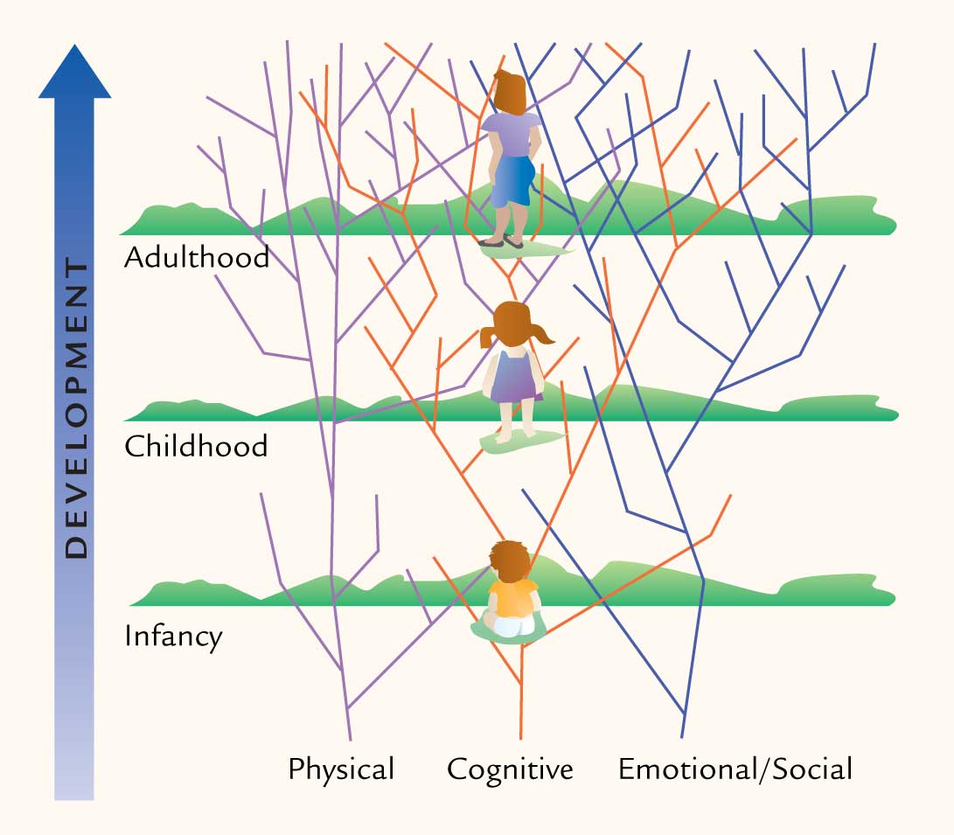
Lifespan View of Development
“The field of study that examines patterns of
growth, change, and
stability in behavior that
occur throughout the
entire life span.”
(Feldman, pg 5)

Slide 9
Successful Development
A Recent Lifespan Development Perspective
the individual who is successful experiences a state of functioning in which the relative gains for the individual are maximized and losses minimized (Baltes, 1997)
  Gains and losses characterize development throughout the lifespan
Growth, vitality and striving limit or overcome the physical, cognitive and social declines
Notes:
Maximizing gains, minimizing losses
Only possible if the environment enables maximizing gains
Ex: people create an environment, the environmnt influences them

Slide 10
Developmental Perspectives on Health:
Health is a lifelong process
Health is influenced by proximal and distal determinants
Health is pluralistic
Health is best understood in context
Health is variable
Propositions of the Lifespan Approach
Development is lifelong
Development is influenced by
  Evolution
  Sociohistory
  Ontogeny
Development is pluralistic
Development is located within a contextual worldview
Development is variable
Spiro (2007). The relevance of a lifespan developmental approach to health. In Handbook of Health Psychology and Aging

Slide 11
Developmental Transitions, Stress and Health

Slide 12
Developmental Transitions
Developmental transitions:
  “paths that connect us to transformed physical, mental, and social selves” (Schulenberg et al, 1999)
Assume some degree of discontinuity in development
Concurrently also requires connectedness
Involve all domains of development
  Physical
  Cognitive
  Psychosocial
Notes:
Discontinuity= period of chaos
Connectedness= tie back to what you were before… templates, ways of functioning that you carry with you
Developmental transitions involve all domains of development
You come out of the transition with a new way of functioning
Pathway through a system in change

Slide 13
Models of the Relation of Developmental Transitions & Health
Health risk is a consequence of experiencing developmental transition
Development alters the match between individual desires / needs and context
Health-risk and health-enhancing behaviours as components of negotiating developmental transition
Developmental transition exacerbates health risk status.
Schulenberg et al (1997)
Notes:
Transition = journey to a different way of functioning because of a change in the system
If a transition overwhelms the persons capacity to handle stress, their health will be impacted

Slide 14
Health risk is a consequence of experiencing developmental transition
Health Risk:
due to increased stress and is not inevitable
only if additional stress greater than current coping capacity
If the stress becomes overwhelming, health may be affected:
  wear and tear associated with an excessive allostatic load (Insel and Roth, 2006).
  individual may initiate health risk behaviours to cope.
  greatest risk if transition in multiple domains simultaneously.
Schulenberg et al (1997)

Slide 15
Health risk is a consequence of experiencing developmental transition
Interventions:
  increase coping capacity, increase coping supports, alter the timing of transitions.
Health Opportunity:
Increasing coping capacity assist in subsequent transitions
Schulenberg et al (1997)
Notes:
Health opportunity – teaching people how to cope better

Slide 16
Development alters the match between individual desires / needs and context
Change in system or in individual changes degree of ‘fit’ between the individual-in-transition and his or her context.
Health Risk:
A mismatch could result in frustration
Example
Toddler’s parents do not allow opportunities for safe exploration of the environment frustration /stress
Schulenberg et al (1997)

Slide 17
Development alters the match between individual desires / needs and context
Interventions
to increase match between needs and context
Health Opportunity:
An increase in fit may also result from the transition
Schulenberg et al (1997)

Slide 18
Health-risk & health-enhancing behaviours used to negotiate developmental transition
Health risk:
health risk behaviour may be both constructive & destructive
Constructive
  exploratory behaviours of the toddler may serve a positive identity function and ease journey through transition
Destructive
  the child encounters dangerous situations she is unable cognitively to navigate.
Health opportunity:
may result from negotiating a developmental transition.
Example: tendency of young adults who are making the transition to parenthood to reduce use of alcohol and other substances.
(Schulenberg et al, 1997);
Notes:
Use potentially destructive behaviours to get through the transition

Slide 19
Health-risk & health-enhancing behaviours used to negotiate developmental transition
Intervention goals:
1) encourage healthful activities to replace health-risk behaviour
2) reduce the risk associated with the health-risk behaviour.
(Schulenberg et al, 1997);
Notes:
Ex of reducing risk = seatbelts

Slide 20
Developmental transition exacerbates health risk status
transitions moderate the individual’s ongoing health risk status
like Erikson’s theory of psychosocial development
  the way we deal with current transitions is dependent upon, or connected with, outcome of previous transitions.
Example
Toddler fails to develop sufficient autonomy and identity struggles with transition to full-time schooling
Interventions:
1) provide support to the parenting dyad(s) to redirect the developmental path
2) provide alternate activities in the classroom that allow the child guided mastery experience
(Schulenberg et al, 1997).
Notes:
When someone isnt coping well, if they are placed into a transition, it will result in bad health

Slide 21
For Next Day / this Week:
Read Chapter 3
Sign in to MyVirtualLife and create your child and your ‘self’
  Be sure to link to the 220 course (view the video linked in the LEARN announcements for a how-to)
Become involved in the LEARN discussion for this week
  Check out any tips posted by your TA for discussion board participation

