Slide 1
Principles of LCA
LCA provides a way to assess the environmental impacts of a product in all stages of its life cycle: “from cradle to grave”
These stages can be: raw material extraction, materials processing, manufacture, distribution, use, repair and maintenance, and disposal or recycling
LCA can give us the pig picture regarding the environmental impacts about a new product to arrive at a more informed decision
Decisions such as: what materials and source of energy to use, How to dispose of waste, etc.

Slide 2
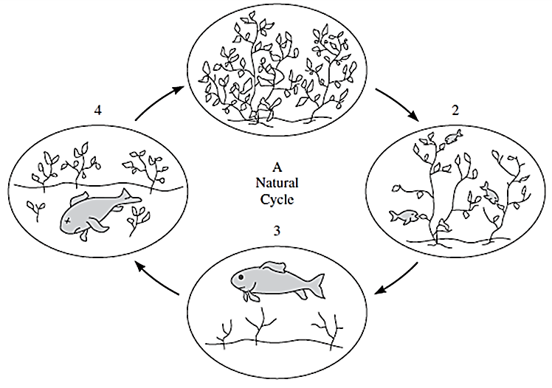
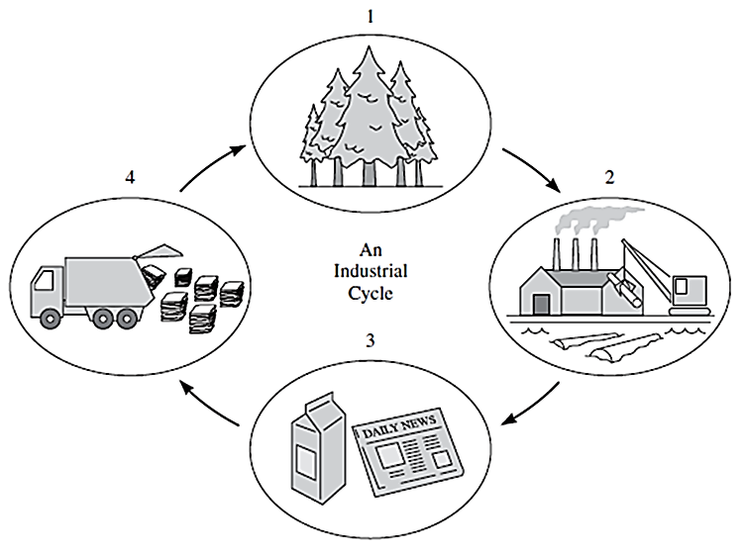
Benefits of designing a product to fit into a cycle:
waste minimization and
Reduction of use of raw materials

Slide 3
Overview of LCA
Materials
Energy
Service
Manufacturing
Environmental effects: emissions
wastes, etc.
Raw materials
Transporting
Use
Disposal

Slide 4
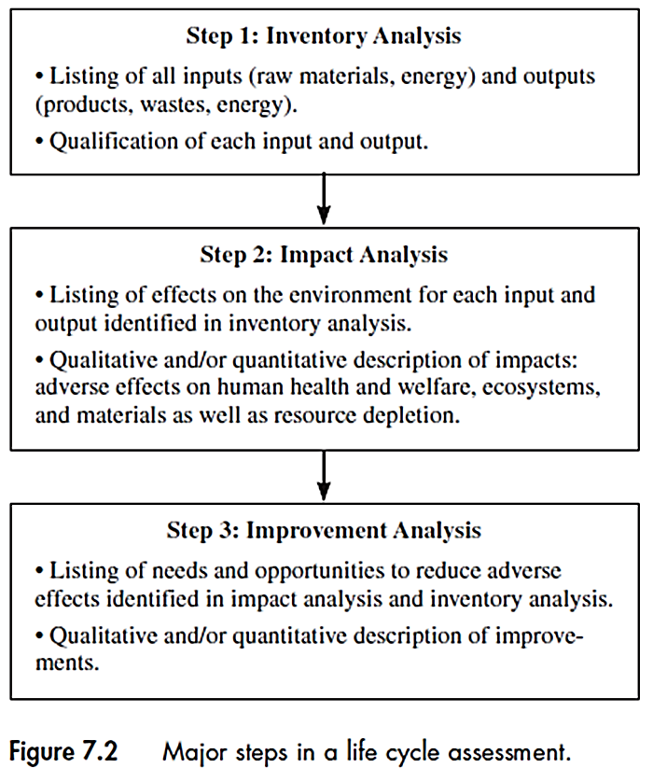
Major steps in LCA

Slide 5
Inventory analysis
Is based on the scope and possible uses of LCA
Listing and quantification of the inputs and outputs of
the processes.
It can identify which processes have the greatest environmental
burdens
Examples
Input: mass of steel used for a product
Output: flow rate of SO₂ emitted during manufacturing a product

Slide 6
Impact analysis
Determine Impacts of each input and output identified in
the inventory analysis.
It can identify where the most adverse effects can occur
Examples
land use for mining to obtain iron ore for steel production
Number of people become sick due to SO₂ emissions
Qualitative evaluation is based on importance of impacts such as globally affecting processes i.e. those releasing GHGs, or processes releasing toxic materials

Slide 7
Improvement analysis
Identify what can be done to reduce environmental impacts by
changes in product or process design
Examples
Using recycled scrap steel, reduces the land use for mining
Using alternative technologies to reduce SO₂ emissions

Slide 8
Scope of LCA
Need to define boundaries for LCA before doing in. Several issues to be considered when defining the scope:
Motivation for study
What is being pursued? Feasibility of a new technology? company meeting regulations or standards ? or establishing a baseline environmental data to show improvements over time?, etc.
Intended use of the results
To show if the new technology is meeting the expectations? Or to see which process in production line has more environmental impacts, etc.

Slide 9
Available resources to conduct the study
Has major effect on LCA scope. Need to make sure that the benefits of LCA study worth the results since LCA may require substantial financial resources.
Point of view of the analysis
The analysis is done with whose point of view? An engineer responsible for production of a product? A customer using that products? or a regulatory agent?
In this context, we consider an engineer’s point of view to discuss LCA.

Slide 10
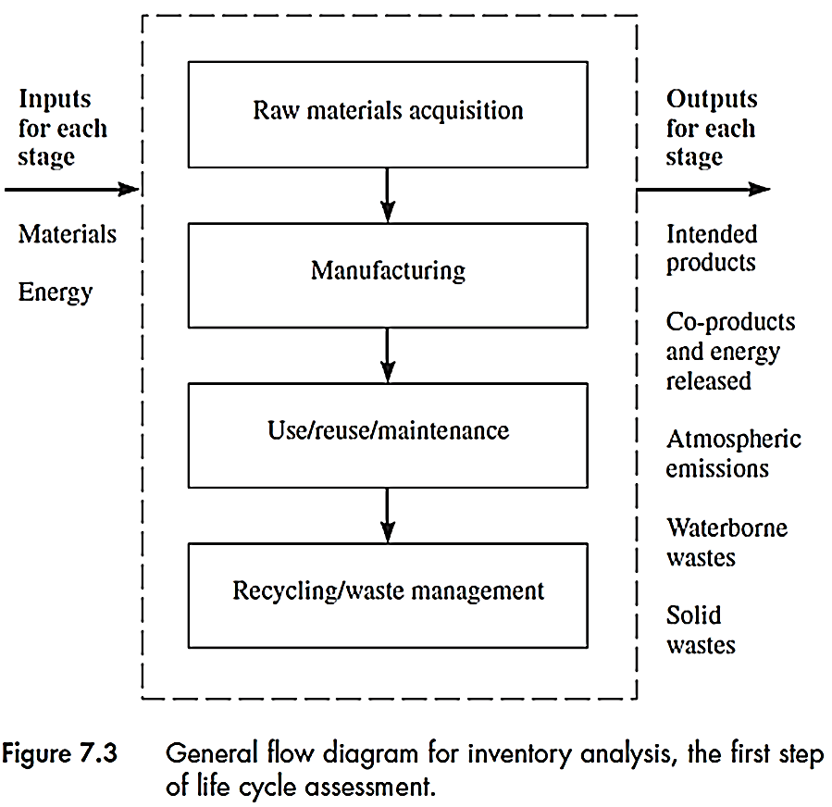
Inventory analysis
Example
Mining of iron ore
Processing iron ore to
generate iron
Using the product including
maintenance, repair, etc.
Disposal of the products. Could
include recycling

Slide 11
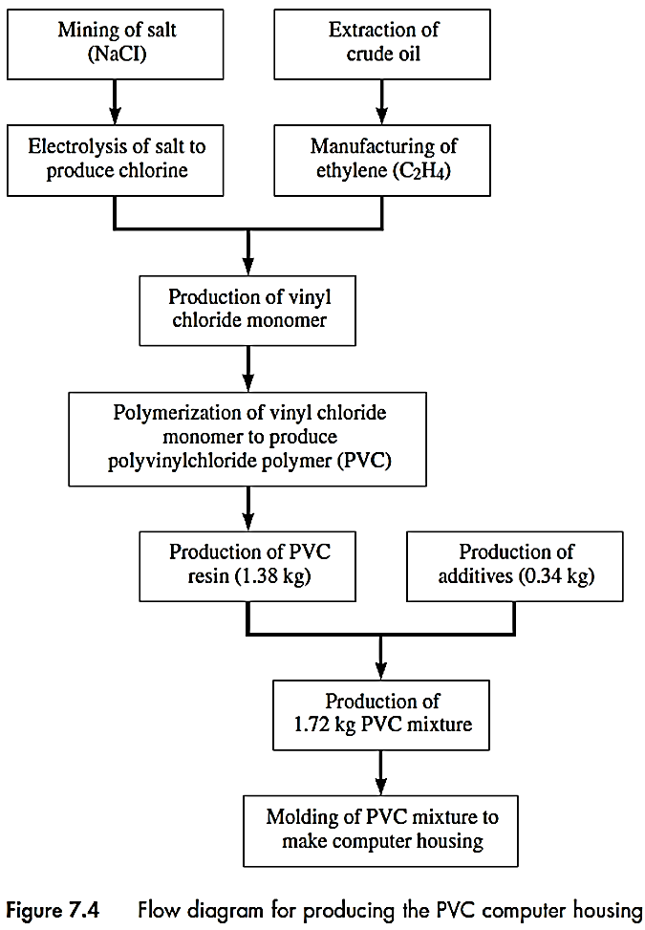
Example: Computer case made from PVC
Manufacturing the case
Where the materials come
From ?
How they are processed
to make the case?
How they are to be disposed of?
Production of VC (monomer)

Slide 12
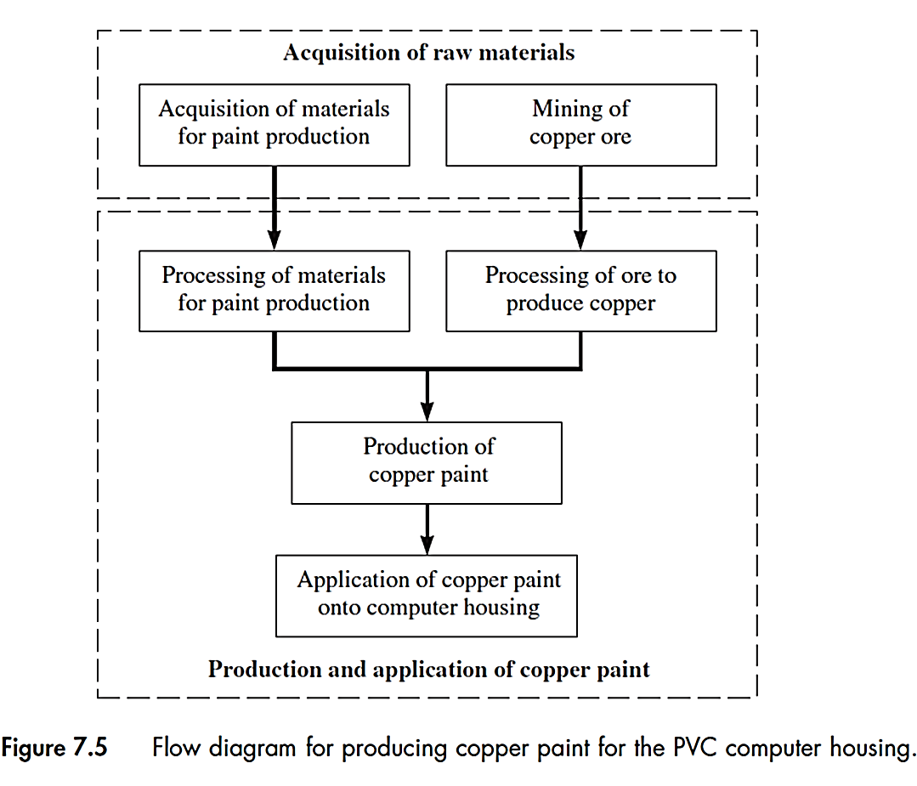
Painting the case

Slide 13
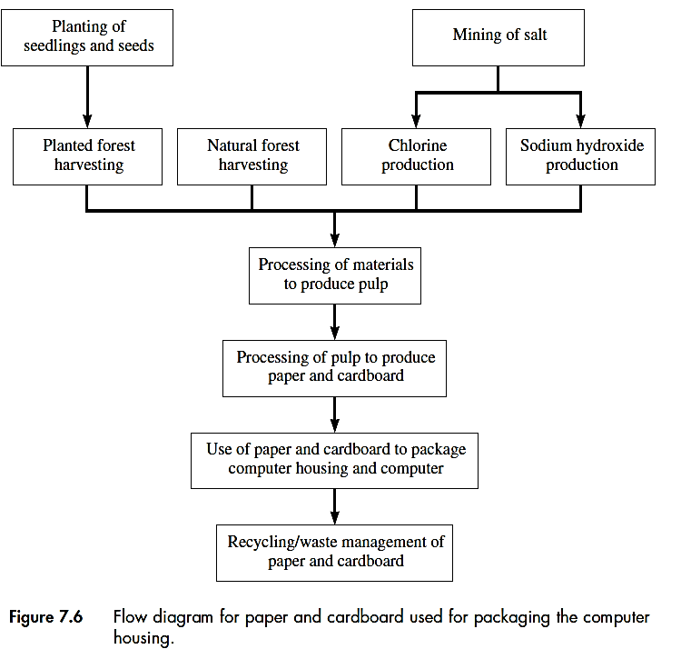
cardboard and paper used for packaging

Slide 14
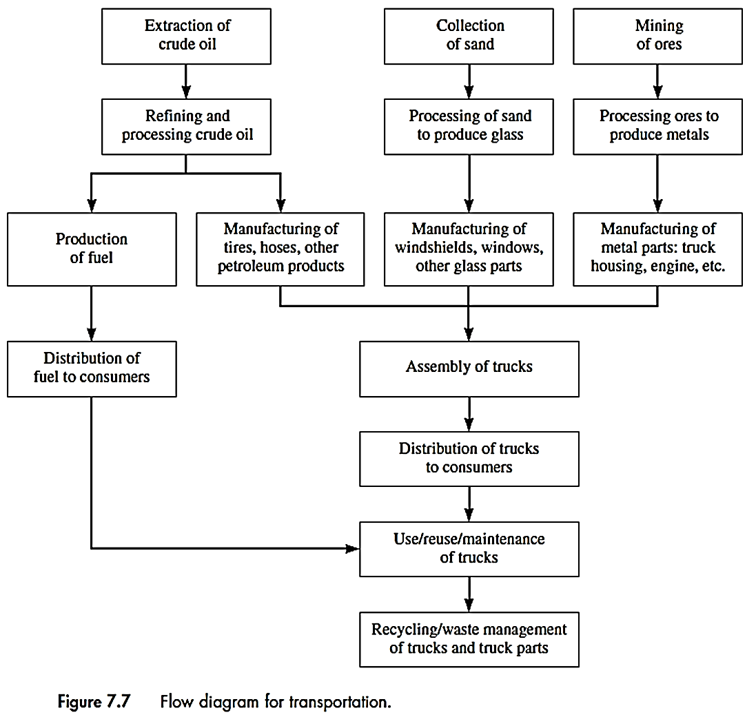
Transportation needed

Slide 15
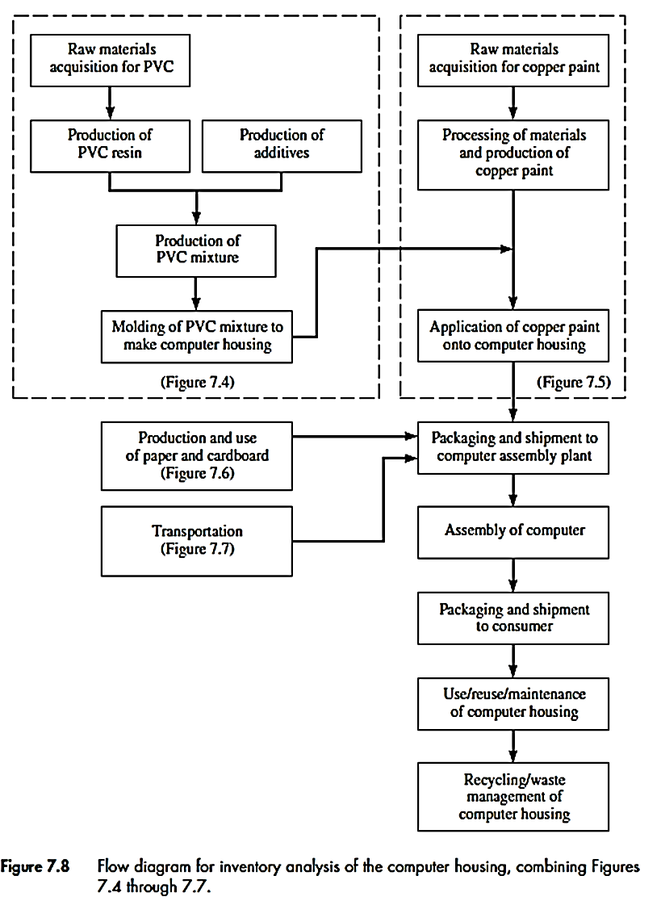
Overall Inventory analysis
Computer housing

Slide 16
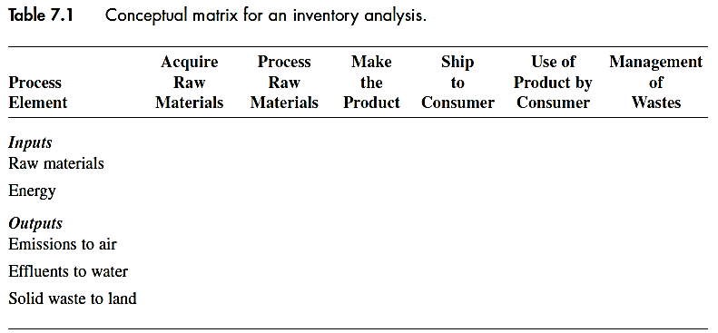
Quantitative analysis
Information related to stages of an inventory analysis can be tabulated in a matrix called conceptual matrix:
Also data related to the environmental burdens can be listed in a table such as Table 7-2.

Slide 17
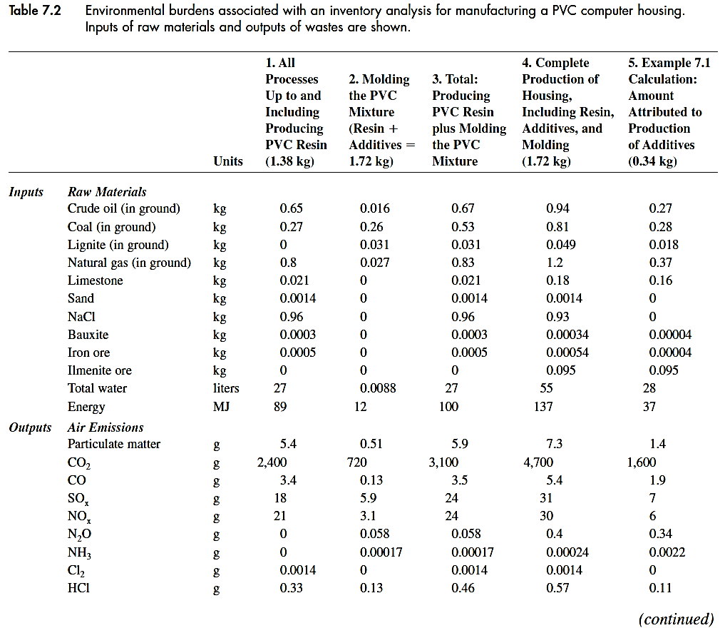

Slide 18
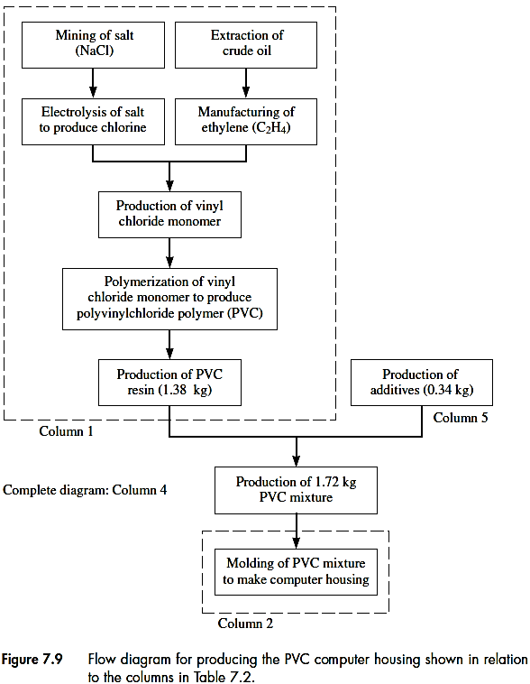
For box 5 (column 5) the data can
be obtained from:
Column 4 – (column 2+ column 1)

Slide 19
Other environmental burdens such as those from product transportation and related emissions, energy consumption, etc. can be calculated.
Impact analysis
Impacts from use of resources and environmental discharges
These impacts need to be identified and categorized in terms of their severity
Quantification of impacts for LCA analysis
Categories of impacts
Depletion of natural resources
Effects on human health
Effects on ecosystem
Impairment of human welfare

Slide 20
Depletion of natural resources
When energy and materials are needed as input to a process
Non-renewable resources are of more concern
The impacts may be described qualitatively
Processes using renewable resources and their products can be recycles or reused, have the potential of being sustainable
Effects on human health
Most important one
Process output to air, land and water can cause health problems
Industrial outputs with potential health effects and listed such as TRI or toxic release inventory
Interactive effects of toxic substances is hard to distinguish

Slide 21
Effects on ecosystem
Damage to all types of plants and animals, specially those in sensitive ecosystems such as lakes with poor buffering capacity
Effects on human welfare
Such as damage to recreation areas, climate changes, reduction of visibility due to air pollutants, etc.
These effects also affect ecosystems
Secondary compared to the effects on human health
Ranking of effects
EPA ranking

Slide 22
EPA criteria for rankings
The physical extent of the impacted area: can be measured such as affected population or the size of affected ecosystem
The level of danger posed by the environmental change: highly toxic materials ranked above less toxic ones
Extent of exposure: how highly toxic materials if attached to suspended particle may not be hazardous but trace toxic metals carried by fly ash can be very hazardous
Penalty of making the wrong decision: If a chemical is more toxic than it was assumed to be. A persistent chemical is more of concern than the one that disappears quickly

Slide 23
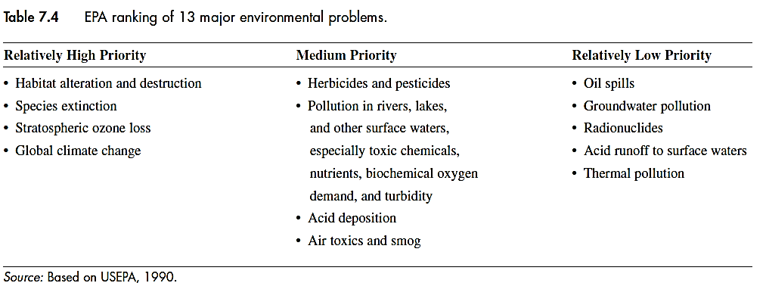
Ranking of 13 environmental problems

Slide 24
Accidental chemical releases, pollution of the oceans and metals and toxic chemicals in fresh water are of special concern in short and long terms
Quantification of impacts
In some cases, it is possible to quantify the impacts such as in case of greenhouse gases using global warming potential (GWP)
For estimating GWP, CO₂ is the basis with GWP = 1 and for other gases, it is calculated based on a 20-100- and 500-year time period: each gram of the gas is equivalent to how much CO₂
Gas GWP (100 year)
N₂O 310
CH₄ 21

Slide 25
Improvement analysis
Using the results of two previous steps to see where the improvement can be made: saving energy and/or raw material possible?
In the example of computer housing we can investigate the improvement analysis in two cases:
1- using the electrical shielding (steel plate) instead of applying copper paint.
2- waste disposal alternatives for the computer housing

Slide 26
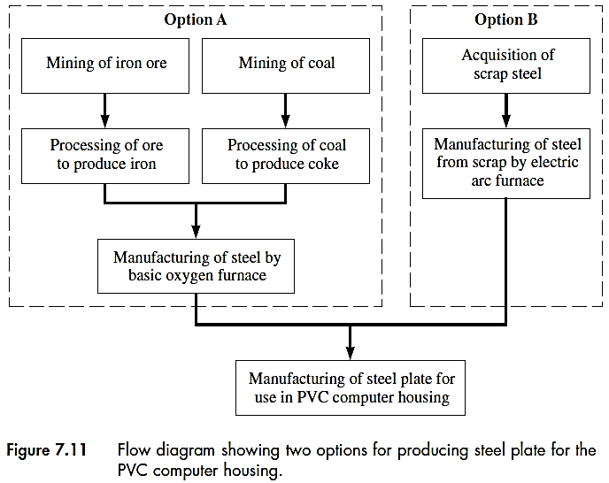
There is a choice for manufacturing of steel plate
Here, the option A is considered ( in Table 7.7)
Option A: Iron ore
Option B: scrap steel

Slide 27
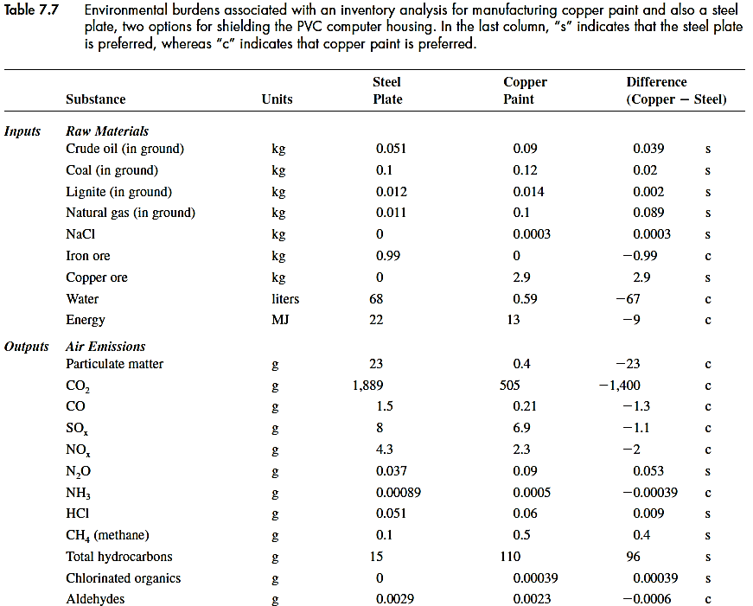
Considering option A, the environmental burdens can be compared to those for copper paint
Table continues

Slide 28
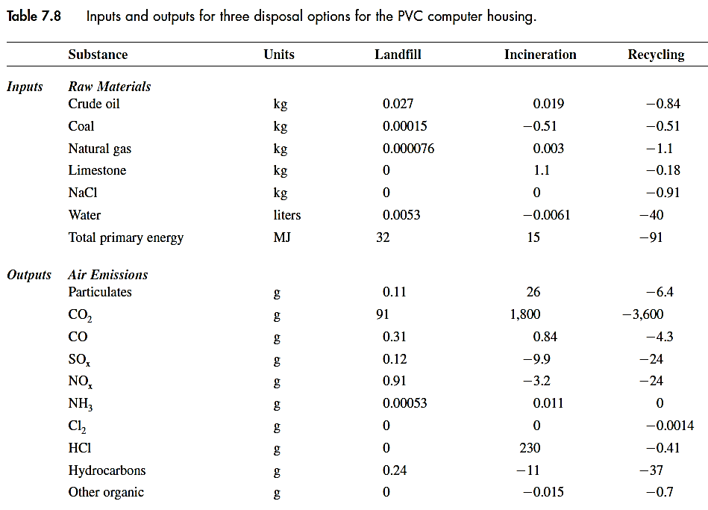
Based on the selected ranks for the environmental effect, the improvement analysis can be made: such as reducing energy consumption or solid waste generated, etc.
Improving waste management of the computer housing
Disposal options for all the wastes can be compared:
Table continues

Slide 29
Landfilling can contaminate surface or groundwater while incineration can pollute air (also water if ash disposal is required)
Assumptions made in the table:
Heat for incineration can be used to produce electricity.
Recycled PVC has the same quality as new PVC
Negative values represent savings in materials, energy, emissions, etc.
PVC can release energy when burns saving energy for transportation of PVC cases to the incinerator
Recycling of PVC can save raw materials (such as materials used to make carrying trucks) and emissions (such as emissions from recycling plants)

Slide 30
Various information given in Tables 7.2, 7.7 and 7.8 for manufacturing the computer case, shielding the case and disposal of the case can be combined in another Table 7.9
Total environmental impacts for each considered case now can be compared to other cases to see overall, which option is the best and where the advantages and disadvantages are.

Slide 31
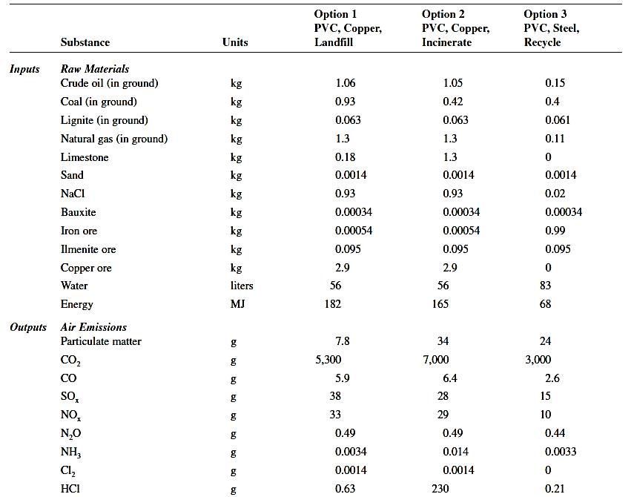
Table continues

