Slide 1
Overview of Environmental Issues
Environmental problems are associated with modern technology
Number of laws and regulations related to environmental protection has increased.
Engineering designs must take into account the environmental concerns

Slide 2
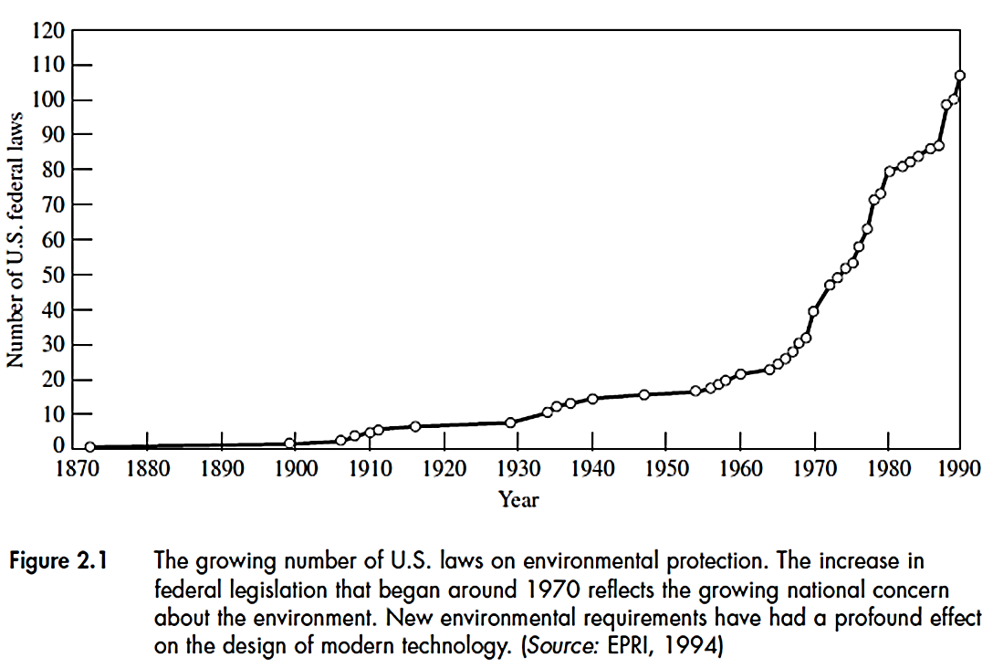

Slide 3
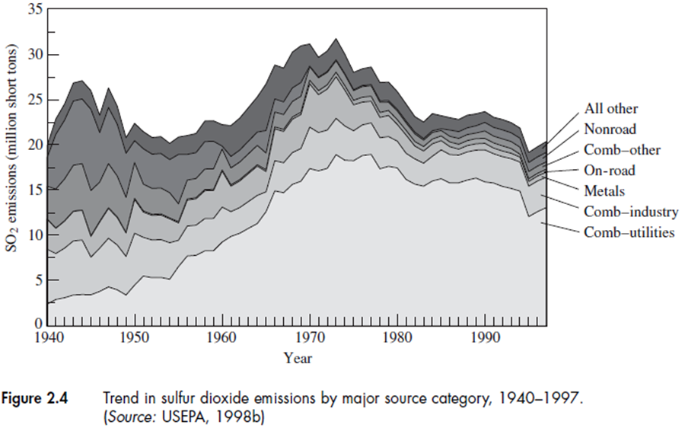
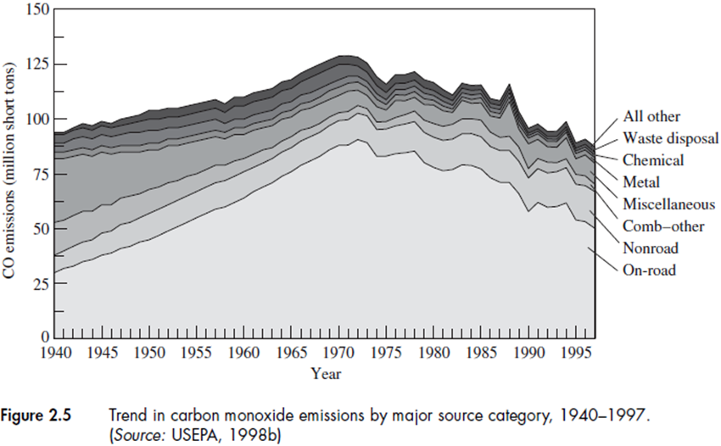
SO₂
CO

Slide 4
Environmental Concerns
Human health effects:
Acute: Pollutants cause immediate response to human body such as CO
Chronic: Long-term exposure to certain pollutants such as particulates in air cause asthma
Carcinogenic: change in cells causing irregular cell growth (cancer) – has become major concerns
Other concerns are related to impacts on biodiversity and ecosystems that can affect plants, animals and materials

Slide 5
Atmospheric Emissions
Criteria Air Pollutants: 6 major pollutants
Particulate matter (PM)
Sulfur dioxide (SO₂)
Carbon Monoxide (CO)
Nitrogen Dioxide (NO₂)
Ground-Level Ozone (O₃)
+
Lead (Pb)
The Clean Air Act (CAA) is the law that defines EPA's responsibilities for protecting and improving the nation's air quality and the stratospheric ozone layer
CAA 1963
CAA 1978

Slide 6
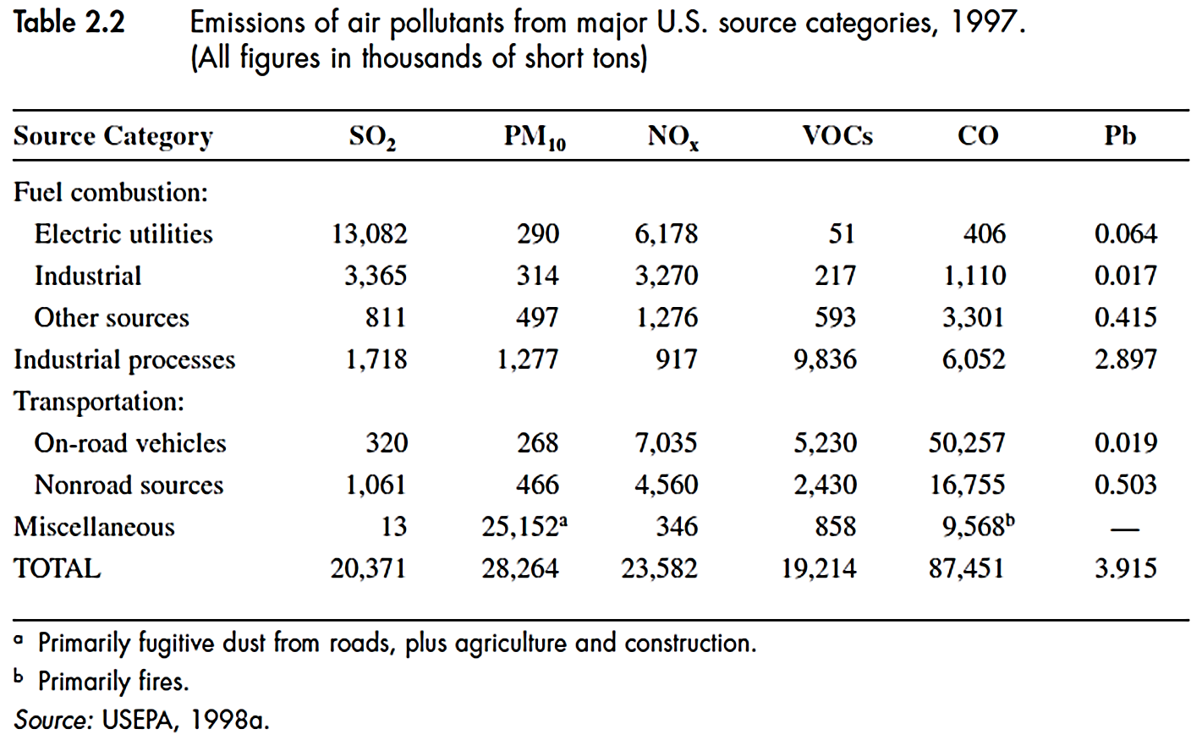

Slide 7
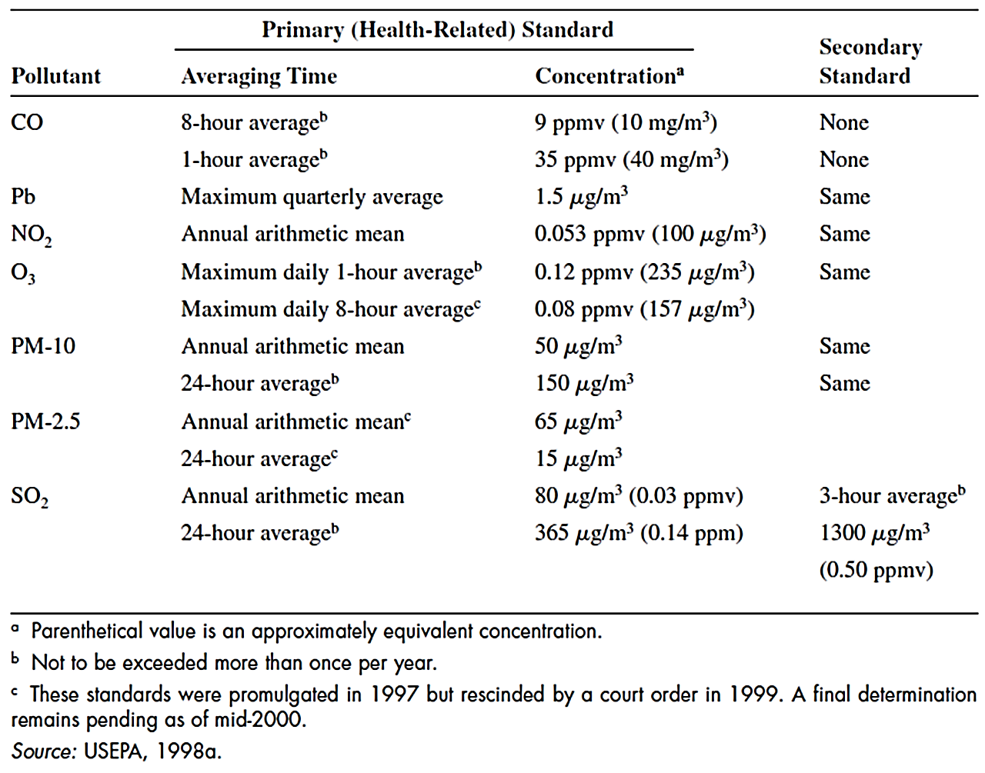

Slide 8
Particulate matter (PM)
A mixture of small solid or liquid particles suspended in air (also called total suspended particulates or TSP) . PM₁₀ or PM_{2.5}
Source: Fuel combustion (ash, soot by coal, oil, etc.). Mostly from fugitive dust [i.e. roads (mostly unpaved), tilling, heavy construction]
Health effects:
Respiratory and cardiovascular diseases, damage to lung tissue and potential carcinogenic effects.

Slide 9
PM also reduce visibility, causing soiling, dust creation
Some PMs are more dangerous such as those from heavy metals and pesticides

Slide 10
SO₂ (Sulfur Dioxide)
Source:
Combustion of sulfur-containing fossil fuels such as coal and oil, also metal smelting.
Health effects:
Adverse effects on the respiratory system, cardiovascular or chronic lung disease.
Asthmatics, bronchitis, children and elderly are most vulnerable to high SO₂ levels

Slide 11
SO₂ emitted from industry can be converted to sulfates
in atmosphere which leads to acid rain.
Carbon Monoxide (CO)
Source:
Incomplete combustion of fossil fuels of other C-containing materials. Transportation is the main source.
Health effects:
Blood prefers CO instead of O₂ and as a result, shortness of breath, dizziness happen.

Slide 12
Nitrogen dioxide (NO₂)
Generally referred to as No_{x} (NO₂ and NO= nitric oxide, a by product of combustion)
NO is converted to NO₂ in atmosphere
Source:
Fuel combustion , but less NO₂ is produced compared to CO and SO₂.
Health effects:
Respiratory illness such as bronchitis, specially in children.

Slide 13
Ozone (O₃)
The ozone at ground level or “bad ozone” as opposed to protective atmospheric “good ozone”
Source: (Transportation, power plants, factories, etc. that emit NO_{X} and VOCs)
Photochemical reaction of NO_{X} with hydrocarbon gases (or volatile organic compounds, VOCs) in the presence of sunlight creates smog.
Health effects:
Extremely reactive oxidant.
Attacks lung tissue
Damages paints and fabrics
Plants cannot produce and store food

Slide 14
Lead (Pb)
A Heavy metal poisonous to human beings at certain exposure levels
Source:
Automobiles using leaded gasoline
Lead smelting and manufacturing
Lead erosion from water pipes and lead in paints in old buildings are important sources of lead release
Health effects:
Damages the nervous system
Affects liver, kidney
Can accumulate in blood, bone and tissues.

Slide 15
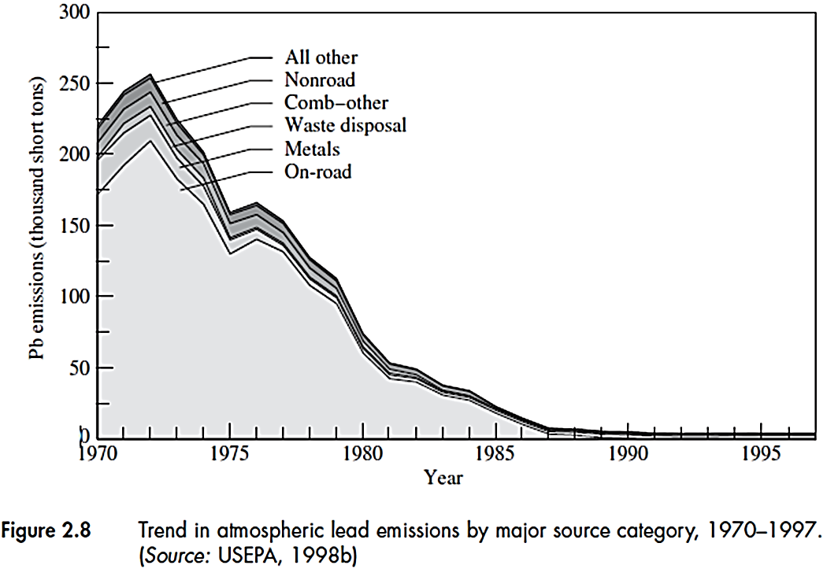

Slide 16
Air Toxics or Hazardous air pollutants (HAPs)
Their emitted quantities are less than criteria air pollutants, but can cause serious health effects even in small quantities
Carcinogenic substances such as benzene and asbestos
Heavy metals
Industries emitting HAPs are required to use MACT (maximum available control technique) to reduce them
189 HAPS listed by CAA (Table 2.3)
Communities must determine any treats from nearby industries to the people and environment

Slide 17
Acid Deposition or Acid Rain
Precipitation of any acidic particles in the form of rain, mist, fog or snow (more acidic than natural rainfall that has pH≥ 5.6)
The principal source of acidity was SO₂ from power plants located in far away. SO₂ converted to SO₄ and acidic species reached the earth.
Also NO₃ from NO_{X} emissions contribute to acid rain.
Environmental effects
Acidification of lakes and rivers affects fish and other aquatic species

Slide 18
Soil acidification that can alter soil chemistry and harm vegetation and trees. Also affecting animal habitat.
Deterioration of some building materials and structures
Provisions by CAA to put a cap on SO₂ emissions specially from coal-burning power plant
Depletion of Ozone Layer
Ozone layer:
10-40 km above the earth’s surface
Protects us from harmful ultraviolet-B (VU-B) radiation
UV-B can destroy biological tissues

Slide 19
Potential effects due to depletion of zone layer:
Risk of skin cancer, cataract, blindness
Harm marine ecosystem and food chain
Depletion of ozone layer caused by chlorofluorocarbons (CFCs) used mostly in refrigeration systems.
CFCs can release chlorine upon UV radiation which can destroy large amounts of O₃.
Greenhouse gases
Greenhouse gases not yet branded as pollutants but have indirect environmental impacts.
They trap heat in the same way as a greenhouse.

Slide 20
Sun
Solar radiation
CO₂
CH₄
N₂O
CFC
PFCs SF₆
Atmosphere
Infrared radiation
Earth Surface
Solar energy from the sun (UV radiation) is partially absorbed
by the earth’s surface
The earth’s surface radiates back to the atmosphere (IR radiation)
H₂O and CO₂ absorb the outgoing energy and warm the earth’s surface

Slide 21
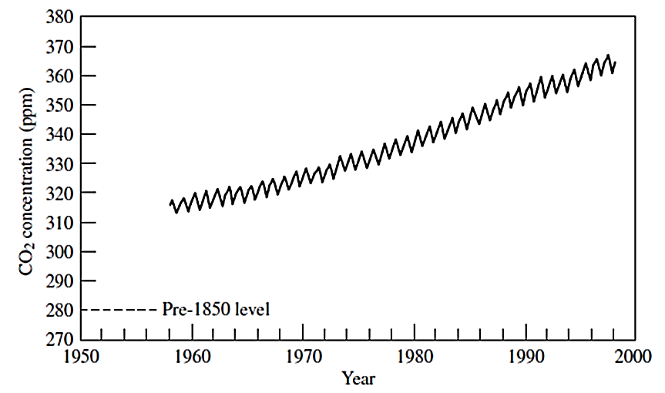
The great concern of global warming:
Rising sea levels, increased precipitation
flooding, increased droughts
Adverse effects on ecosystem
GHGs have long life in the atmosphere.

Slide 22
The great concern of global warming:
Rising sea levels, increased precipitation
flooding, increased droughts
Adverse effects on ecosystem
GHGs have long life in the atmosphere.
Intergovernmental Panel on Climate Change (IPCC) in 1966 stated the human influence on climate change
Table 2.4 shows the major GHGs.
Some gases even in small amount, are much more effective GHG than CO₂.
Global warming potential (GWP) is used to evaluate the GHG effect of different gases based on their heat absorbing capacity relative to CO₂ (GWP of CO₂ = 1).

Slide 23
Water Pollution
Surface water (lakes, streams and rivers, oceans) subject to evaporation and precipitation
Groundwater (Underground water: aquifers containing water percolating through earth surface). It is released naturally through springs or can be pumped to the surface
Surface water is used in agriculture and industry
Municipal water supplies water for domestic use
Point sources: From specific discharge points such as sewage treatment plants
Non-point sources: Runoffs from agriculture, erosion from mining and construction activities, rainfall

Slide 24
Pathogens
Disease-causing agents such as bacteria, viruses, protozoa and helminthes
Found in the intestines of infected people or animals
Can enter sewage and treatment systems and if not adequately treated, can cause serious illnesses such as typhoid, cholera, diarrhea and dysentery or respiratory and skin diseases
Organic waste
Main source of O₂ depletion in surface waters
Too low O₂ can threaten aquatic life: effect on fish reproduction and fish death

Slide 25
Biodegradable organic waste: human and animal excrement, food waste and organic waste from industry such as pulp and paper and food processing
Biological oxygen demand (BOD) is the demand of bacteria for O₂ and a common measure of water quality
Some O₂ is used up in chemical reactions by some substances. Chemical Oxygen demand (COD) is a greater measure of O₂ consumption
High BOD and COD levels indicate undesirable water quality

Slide 26
Nutrients
Nitrogen (N) and phosphorus (P) , two essential nutrients elements widely used in fertilizers and detergents
They bind to clay particles in soil and enter the surface waters through runoffs and erosion
They can enter surface waters through household sewage and wastewater treatment effluents
Increased level of N and P in surface waters cause eutrophication: excessive growth of algae making water unable to support fish or other aquatic species and unusable by human

Slide 27
High level of nutrients, deplete O₂ level through decomposition of algae by bacteria
Anaerobic conditions may prevail causing odors, smell, taste
Aesthetically unpleasant water bodies
High nitrate level in drinking water can cause “blue baby syndrome” : blood stream restriction in infants
Toxic Organics
These synthetic chemicals contain additional substances such as chlorine that are toxic to living organisms. Carcinogens and mutagens are other compounds.
Pesticides
Chlorine-containing pesticides such as DDT, DDE, Aldrin are persistence in the environment: they don’t degrade and accumulate in the tissue of organisms such as fish and birds

Slide 28
They can enter human body through food and cause cancer
Other alternative pesticides such as diazinon and parathion are toxic if inhaled or absorbed through skin.
Volatile organic compounds (VOCs)
Also contain chlorine such as vinyl chloride
Are used in industry or household solvents
Many VOCs contain carcinogens
Can enter surface waters by runoffs or through municipal stormwater and sewage systems. Can also enter groundwater through surface waters.
Higher concentrations in groundwater

Slide 29
Toxic metals
Chromium, Cobalt, Iron, Manganese, molybdenum Vanadium strontium and Zinc: required in trace levels but toxic at higher concentrations. Same for heavy metals such as mercury, lead and arsenic.
Sources
Industrial processes such as metal smelting
Runoffs from mining and construction
From pipes in old buildings to municipal sewage (such as lead)
Atmospheric deposition (such as mercury)
Some toxic metals such as mercury accumulate in fish tissue and can enter human body.

Slide 30
Sediments and suspended solids
Sediments: Soil particles entering a water body.
Siltation: suspension of small sediment particles in water
High level of total suspended solids (TSS) generates turbidity that can block sunlight required for aquatic vegetation
Can carry nutrients that cause eutrophication
Can harm organisms by blocking gills, suffocating eggs and therefore, destroying aquatic habitat.
Disturb recreational use and esthetic of water bodies
Source
Major source: Land erosion from construction, mining, logging and farming

Slide 31
Acidity
Acidity is due to high concentration of hydrogen ion (pH<7)
Low pH can impair biological processes and viability of fish
Source
Acidic wastewaters from industry such as from mining (such as coal mining releasing sulfur-containing minerals keading to formation of sulfuric acid)
Acid rain that can also release toxic metals from soil
Natural alkaline minerals such as calcium and magnesium in water bodies can neutralize acidity in water bodies

Slide 32
Salts
Compound of elements including calcium, magnesium, sodium and potassium, producing positively charged ions (cations)
Cations combine with anions (negative charge) such as chloride to form salts (such as NaCl)
Salts dissolve in water and measured by total dissolved solids (TDS)
Source
Natural dissolution of salts into runoffs
Manmade sources into industrial and municipal discharges and urban runoffs (i.e. deicing of roads)
Low TDS level is required in drinking water and water used in agriculture

Slide 33
Heat
Creates thermal pollution
Source
Heat wasted from electric power plant (about half the fuel energy used) into adjacent water bodies
Can be detrimental to fish and plant by temperature fluctuations
Warm water has less dissolved O₂ and increases the need for O₂ due to increase in biological activity

Slide 34
Drinking water quality
MCL = Maximum contaminant level for a series or organic and inorganic contaminants was established by Safe Water Drinking Act (SWDA) by US EPA.
Primary standards (enforceable): to protect public health (Table 2.5)
Secondary standards (Nonenforceable): public welfare criteria such as taste, color, odor and aesthetics (Table 2.6).
MCL has different units such as mg/L or ppm (part per million) or pCi/L (picocury/L) for radionuclides.
MCLG = Maximum contaminant level goal which is determined by EPA based on possible no health effect of contaminants.

Slide 35
Surface water quality
CWA of 1977 focused on “Best Available Control Technology” or BACT, to control wastewater effluents for any 126 priority toxic pollutants (Table 2.7).
Less stringent rules applied for BOD and TSS.
Standards and guideline determine the allowable discharge limits for pollution sources

Slide 36
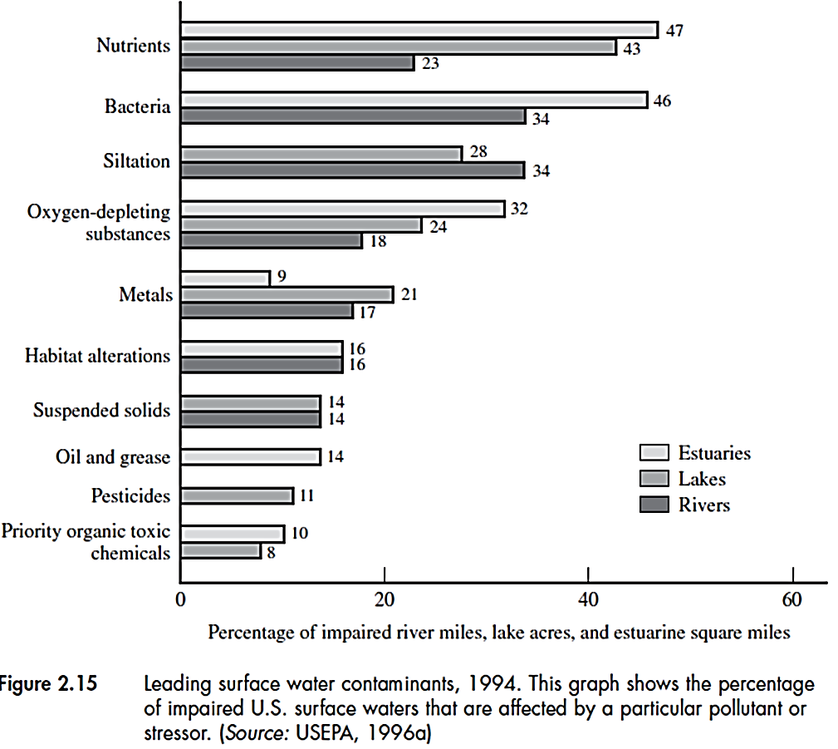
nutrients and bacteria are major pollutants of surface waters

Slide 37
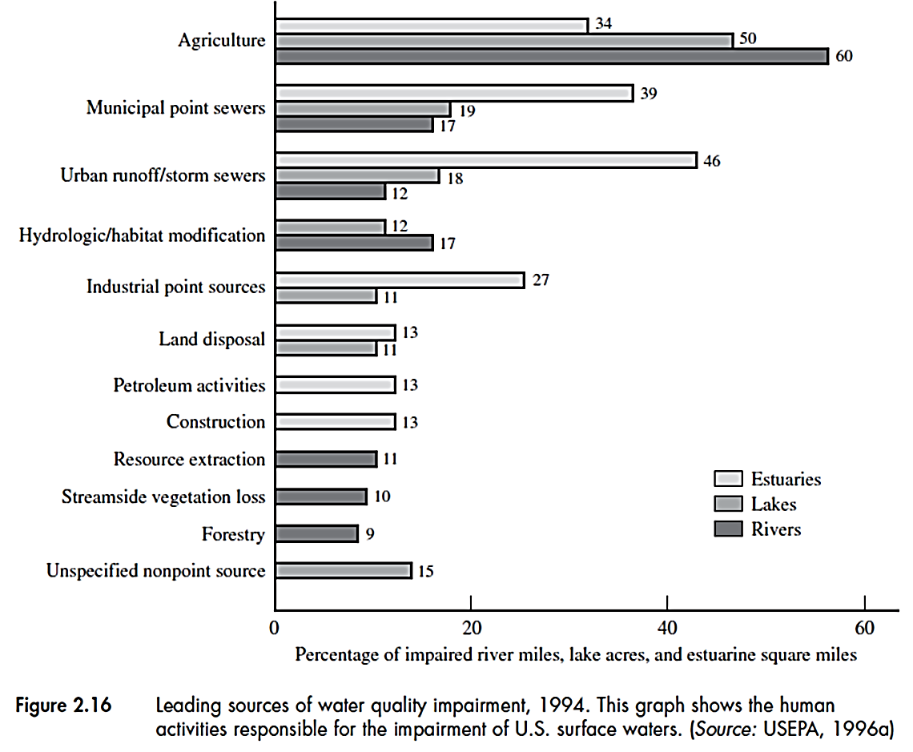
Agriculture industry and urban runoff the major sources of pollutants

Slide 38
Groundwater quality
More focus is on the groundwaters supplying drinking water
Highest priority pollutants
petroleum compounds from leaking underground tanks
nitrate from agricultural fertilizers
Also landfills leak toxic metals and organic compounds to the groundwater
Groundwaters can contaminate surface waters
Soils and ecosystems may remove or assimilate groundwater contamination

Slide 39
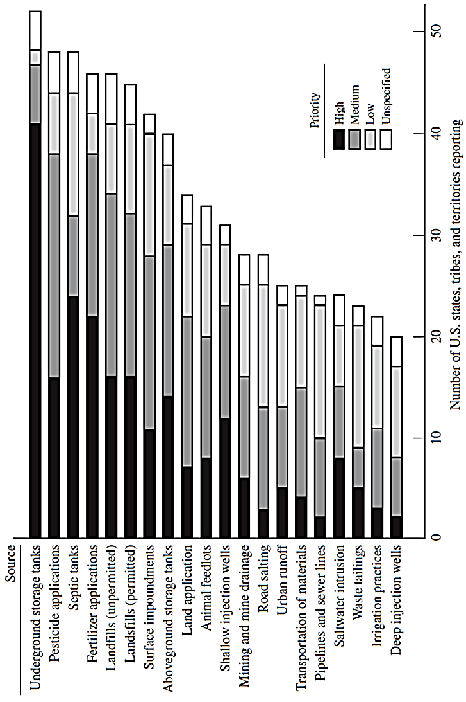
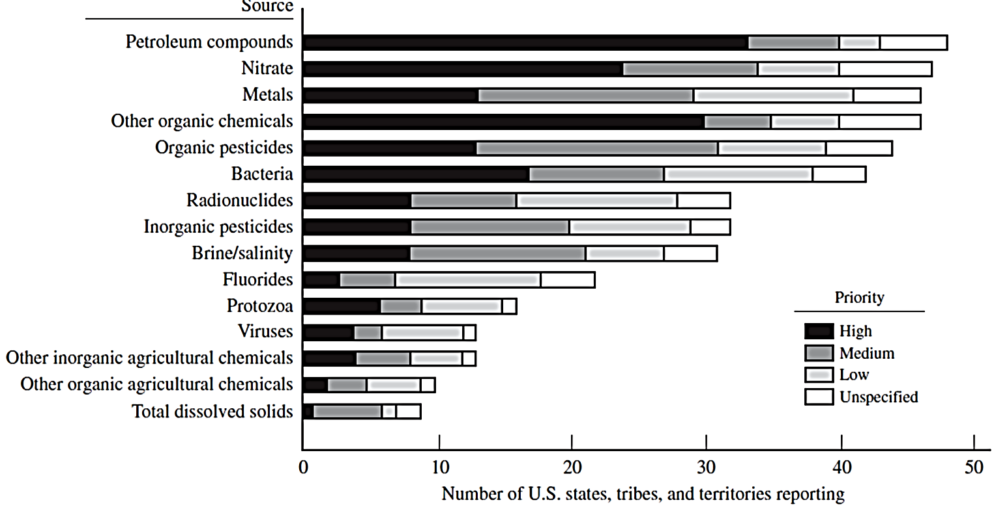

Slide 40
Solid and Hazardous Wastes
Solid waste in soil may migrate into and contaminate surface water or groundwater and enter the food chain
Hazardous Wastes
Resources Conservation and Recovery Act (RCRA) classified solid waste: Hazardous and nonhazardous
EPA definition of hazardous waste: A waste with any of the four characteristics:
Ignitability: ability to burn easily or cause or enhance fire
Corrosively: Strong acids and bases
Reactivity: React violently or cause explosions
Toxicity: threaten water supplied and health

Slide 41
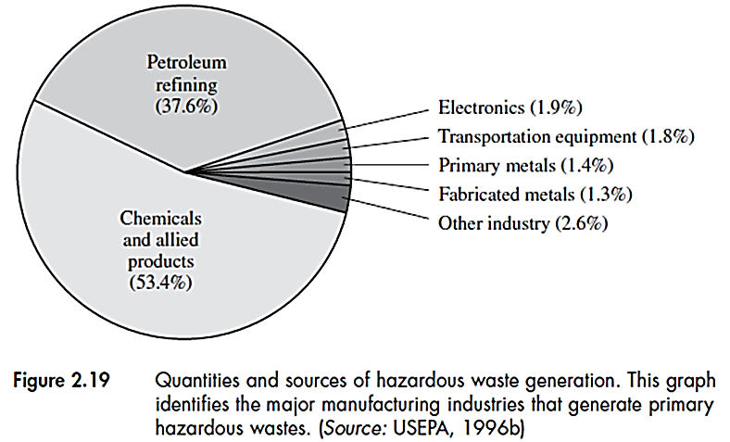
Most of these wastes are in liquid form such as solvents, organic chemicals, petroleum products, paints, strong acids and wastewaters carrying hazardous materials.
TCLP (Toxicity Characteristics Leaching Procedure) is a test developed by EPA to determine if a material is toxic: if the toxic substance in leachate is above threshold, it is toxic
Under RCRA, any hazardous waste is subject to “cradle-to-grave” (from generation of the waste to its disposal) management

Slide 42
Storage, treatment and disposal of hazardous waste must be under EPA permit.
Wastewater treatment (Physical, chemical and biological) is the most dominant disposal method of hazardous waste.
Sludge generated from wastewater treatment can be high in toxic materials and form a secondary hazardous waste.
Land disposal of hazardous waste is now only a small fraction (1%) of the total disposal (as opposed to the past)
Landfills must have impermeable barriers to leachate to prevent groundwater and soil pollution

Slide 43
The Love Canal catastrophe in 1978: leakage of toxic chemicals from abandoned chemical factory into residential area causing the relocation of people.
Comprehensive Environmental Response, Compensation and Liability Act (CERCLA) or Superfund: clean up of dangerous waste and force the “responsible parties” to pay for it.
Superfund: thrust fund to deal with emergency situations until responsible parties will be forced to pay.
About 1200 superfund sites listed by EPA as of 1996.
Legal proceedings and studies under CERCLA is said to have spent more money than actual site cleanup: determine who is responsible and how clean is clean.

Slide 44
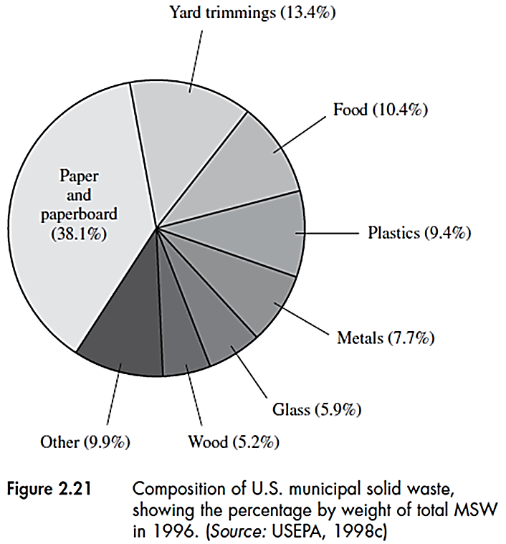
Problems with implementation of CERCLA has led to a more flexible approach: EPA’s Brownfield initiative which promotes the development of abandoned industrial areas.
Nonhazardous Wastes
Wastes that are not hazardous according to RCRA based on Solid Waste Recover Act and Resource Recovery Act
The most common is municipal solid waste (MSW)

Slide 45
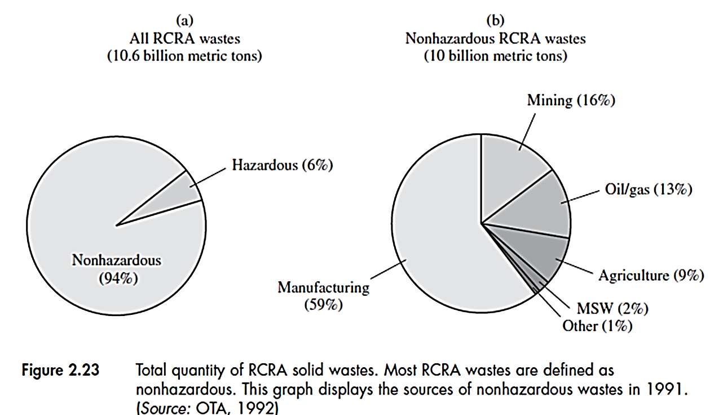
Hazardous and Nonhazardous Wastes quantities

Slide 46
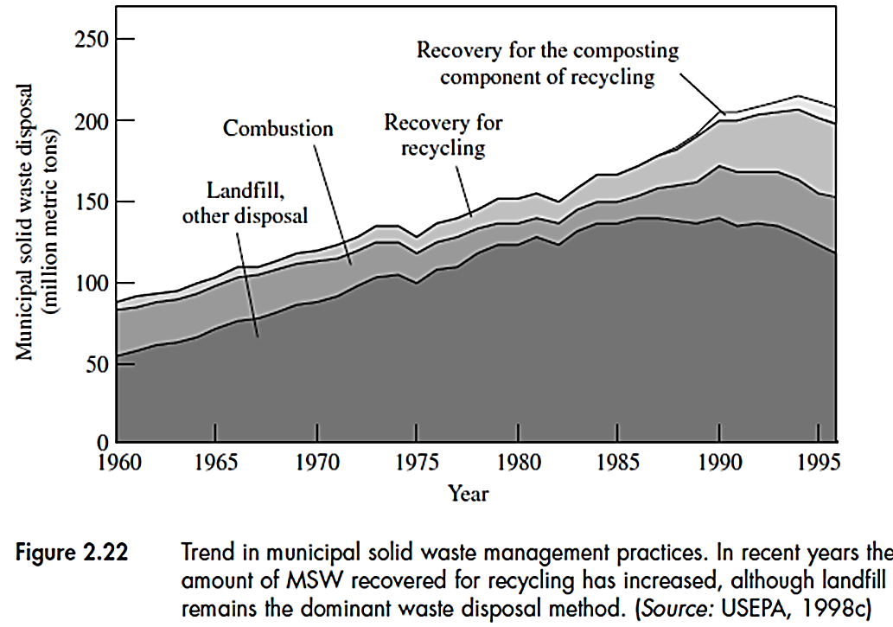
MSW is collected from households, commercial and institutional buildings except those from industries such as manufacturing processes, construction activities, agriculture which are called industrial wastes.
Management of MSW

Slide 47
In the US, each person produce more than 100 kg/d of combined solid waste.
Although classified as nonhazardous, they can contain hazardous waste such as batteries and paints and be harmful to humans
Land disposal of MSW is still dominant method (about 2/3 of total disposal). Landfills although safer than before, potential threat of groundwater contamination exist.
Degradation of landfill waste emit air toxics as well as GHGs such as CO₂ and CH₄.
Landfill gas can be used as energy source
When land is not available, other options such a incineration may be practical.

Slide 48
Incinerators can reduce the waste volume. But they can emit toxics such as dioxin and furans from incomplete combustion of chlorinated compound
Solid residues containing heavy metals can remain from incinerator’s operation
For industrial wastes, due to much larger volumes, landfilling is the preferred method of disposal
Using less raw materials and recycling and reuse are the major ways to reduce waste generation
Recycling of glass, papers, metal containers, etc. in communities are of such practices
Additional costs for above practices and the demand and price for recycled materials are other factors affecting the viability of such practices

Slide 49
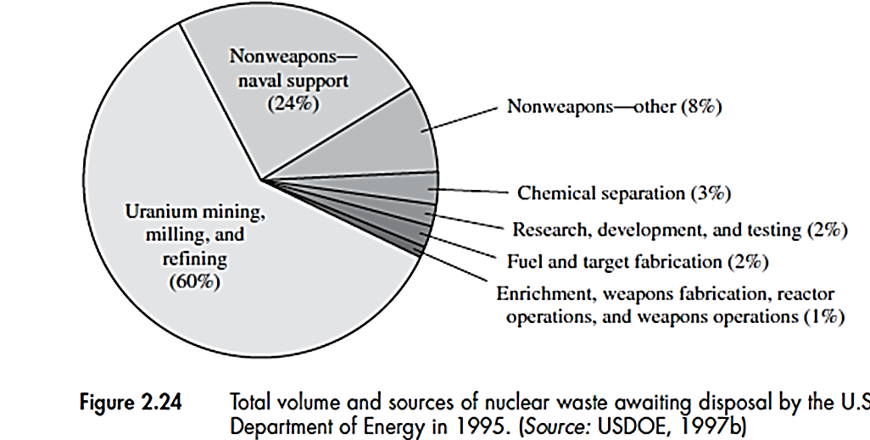
Radioactive Waste
These wastes are by-products of nuclear fuel generation.
Two distinguishing aspects of this waste:
Its harmful effect is by radiation rather than chemical action
They remain dangerous for hundreds of thousands of years

Slide 50
High-Level Waste
The most dangerous waste: spent fuel from nuclear reactors and highly radioactive liquids and solids from reprocessing of spent fuel
Require permanent isolation from humans because of possible “fission” and emission of alpha, beta and gamma particles that can destroy living tissue and cause cancer.
Exposure can be due inhalation, ingestion of contaminated food or liquid
Indications of this waste: Intensity and half-life (time required for a radioactive element to decay to its initial mass).
High-level waste may include elements with short half-life

Slide 51
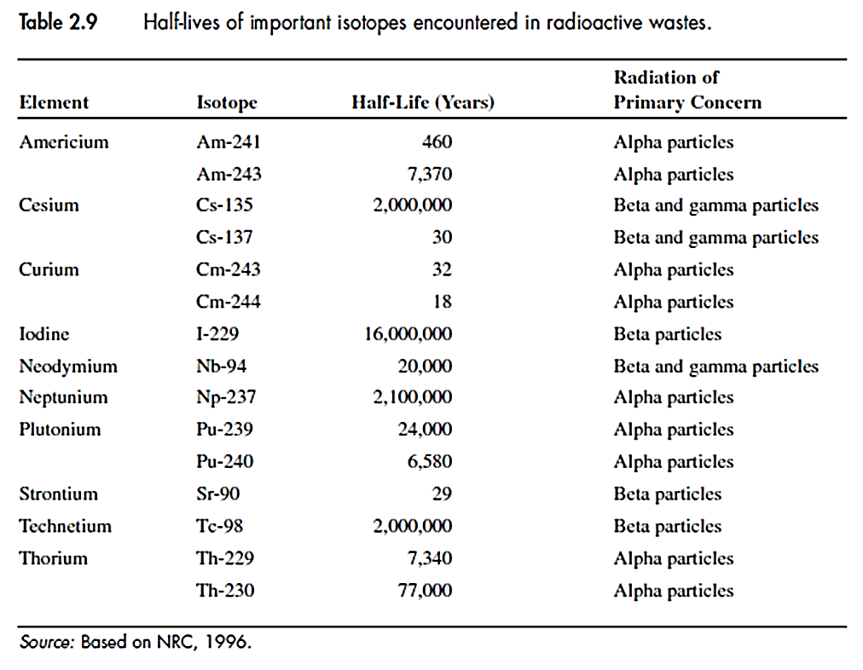
A repository needed for disposal of this waste, but it is under study since it is to be a deep geological formation not to be disturbed for thousands of years.

Slide 52
The high-level waste is temporarily stored in nuclear facilities such as dry storage of fuel rods in special metal casks or concrete module.
Most of the waste from government facilities (mainly from nuclear weapon process) are stored in huge underground tanks.
These liquid and solid wastes are planned to be chemically stabilized
Transuranic Waste (TRU)
Waste elements heavier than uranium (atomic weight >92) that are not radioactive as high-level waste.
Most TRUs are the result of weapon production
Many TRUs, like high-level waste have long life, but this waste has a wide range of waste materials, many with half-lives of tens to hundreds of years.

Slide 53
Most TRUs were disposed off in shallow burial trenches along with low-level waste. Recently, they are stored in a more isolated location (Waste Isolation Pilot Plant, WIPP).
Low-Level Waste (LLW)
A radioactive waste not classified as high-level waste, TRU waste or by-product waste from uranium mining. Mostly come from civilian sector such as:
Protective gloves or clothing worn by workers at the facilities such as nuclear power plants,
Contaminated pipes or equipment in these plants
Test tubes use in medical research
Nuclear Regulatory Commission (NRC) has classified LLW as A, B and C (based on radioactivity and half-life)

Slide 54
Unlike the high-level and TRU waste, disposal of this waste is the responsibility of state government.
Only special landfill disposal is approved for LLW
According to Nuclear Waste Disposal Act, LLW has to be disposed of near the borders of each state or in a designated regional facility.
Uranium Mill Tailing
Sand-like residue from the process of refining uranium ore.
It is generated at large scale and contains much of the ore’s radioactivity although at low levels
It can emit radon gas and contaminate groundwater through ponds
Stabilization methods can remediate milling sites to prevent spreading of mill tailings by wind.

Slide 55
Depletion of Natural Resources
Other environmental impacts arise from use of natural resources (energy and raw materials)
Technologies are to be more efficient to reduce utilization of raw materials and energy, but as population increase, demands increase
Demands are:
Source of food
Sources of energy
Sources of raw materials for devices, structure, etc.

Slide 56
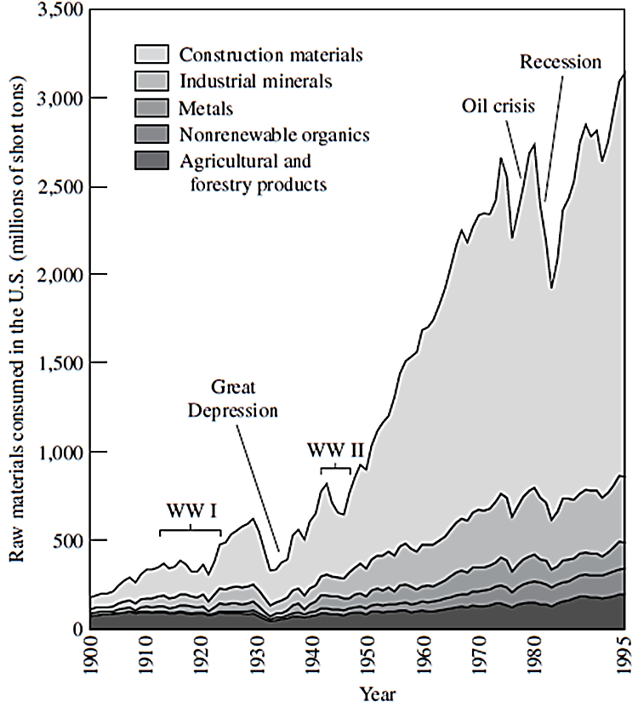
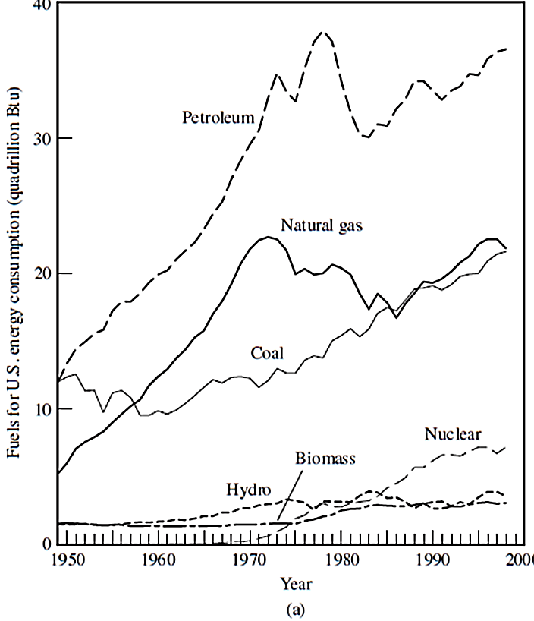

Slide 57
Natural resources
Renewable such as water, wind, solar energy
Nonrenewable: metals and minerals used in products and structures, coal, oil, natural gas, uranium to produce energy
Natural resources are needed by future generations
Increased consumption of nonrenewable resources not sustainable in long term
Increase of pollution (air, water) and waste production as a result of increase in consumption of natural resources
Increase of energy consumption increases the use of natural resources
Also use of renewable resources has impacts such as:
Loss of forests due to lumber production
Loss of land due to construction of dams

Slide 58
Consumption rate of materials is influenced by:
Growing demand and rising living standards
Reducing demands upon substitution by other materials
Technology development and consumption of natural resources have impacts on ecosystem, land and natural habitat.
Land Use and Ecological Impacts
Ecological impacts include effects of human activities on the environment
Ecosystem: biological community that functions as a cohesive unit within its physical environment, such as aquatic ecosystem
Components in an ecosystems are related to each other and affected accordingly.

Slide 59
Biodiversity
Variations in different living organisms such as animals and plants in an ecosystem required for a healthy ecosystem.
Loss of species affects function and balance of ecosystem as well as human population (most medicines are from plants)
500 species in the US are extinct: birds, fish, plants, etc.
Endangered Species Act (1973) in the US to save threatened species
UN and other organizations have programs to protect biodiversity
Loss of Habitat
Loss of biodiversity is directly linked to the degradation of aquatic and terrestrial habitat such as wetlands, estuaries, coral reefs, tropical forests.

Slide 60
Population growth and economic development threaten the loss of natural habitat.
Establishment of protected areas is a measure to prevent loss of habitat and biodiversity.
Marine ecosystem
Like terrestrial ecosystem, marine environment’s health is at risk
Overexploitation and contamination are major factors contributing to loss of aquatic species.
Oceans (over 70% of the earth’s surface) are polluted with toxic and radioactive materials. Oil spills also have great impact on the marine environment
Transferred species from one region to another through international shipping, act as “invaders” that can destroy local marine ecosystems.

Slide 61
Transferred species from one region to another through international shipping, act as “invaders” that can destroy local marine ecosystems.
Overexploitation of marine fisheries has depleted number of species and disturbed the balance of marine ecosystems.
Land Use Practices
Deploying any technology, even being very green, alter “land use” and therefore create environmental problems.
Laws and regulations control land use practices such as environmental impact statement (EIS) required by National Environmental Policy Act (NEPA) for major construction projects.
A big challenge is to establish new land use practices that are environmentally sustainable.

