Slide 1
Environment:
Physical environment surrounding us:
Air
Water: Fresh water, rivers, oceans, etc.
Soil: Lands, forests.
Broader definition includes urban infrastructure: building, highways, industrial facilities, etc.
The human activities affect the environment

Slide 2
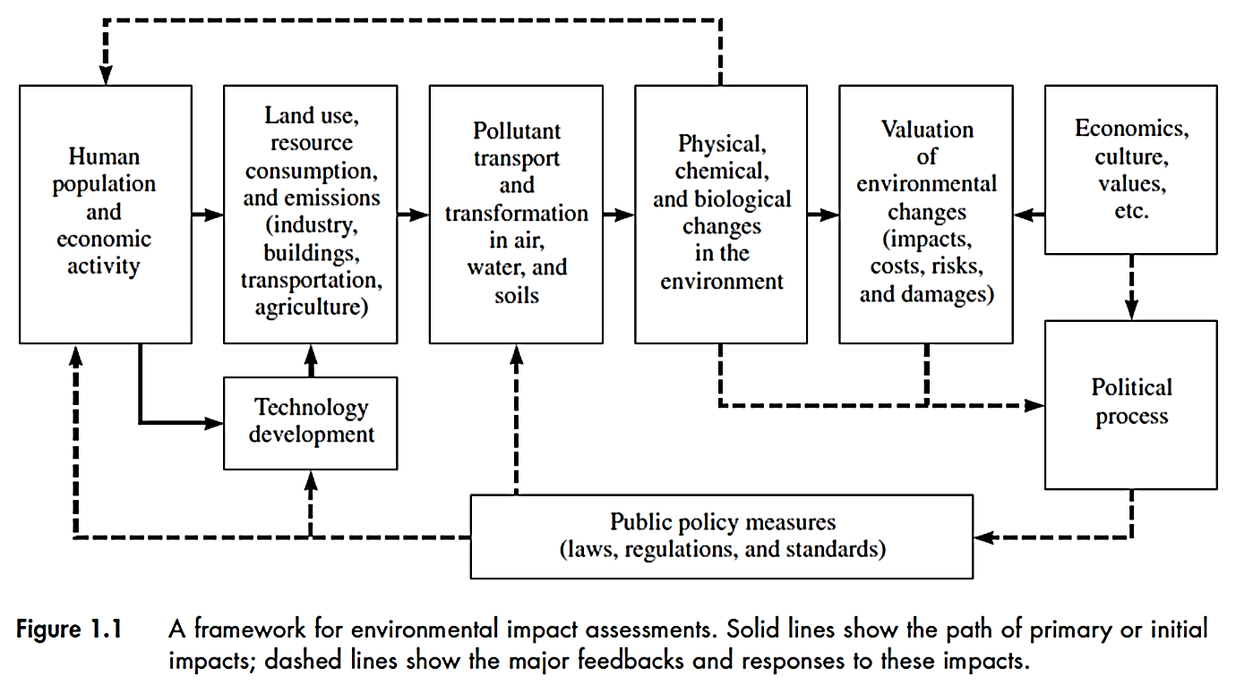
Human activities and changes in environment

Slide 3
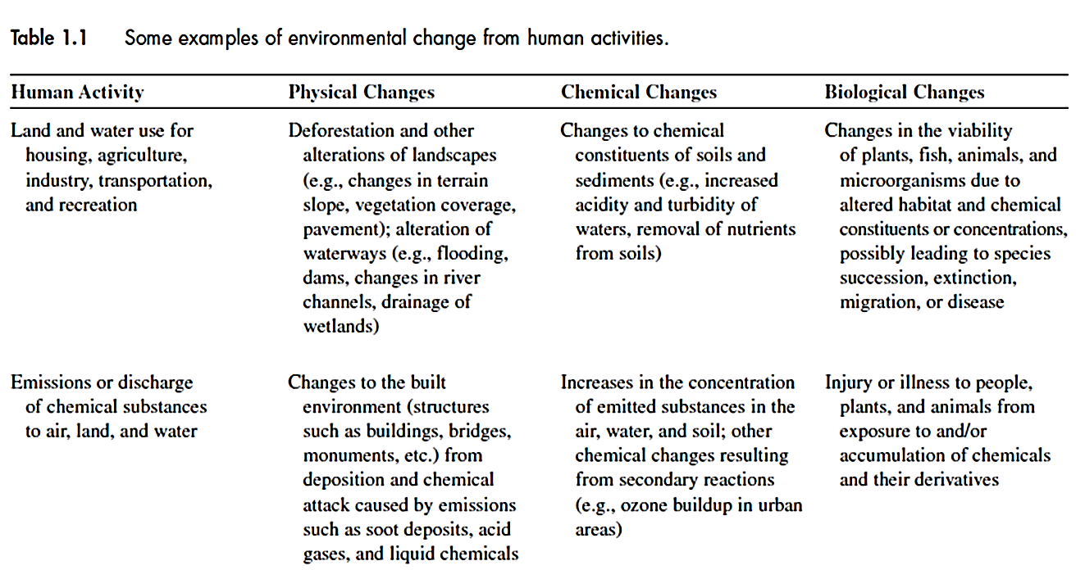

Slide 4
Impacts on the environment could be short-term and long-term
Impact/risk analysis should be done before a decision can be made
Local policies (laws, regulations), cultural and economic factors influence the decision
Environmental protection policies, regulate the technology development

Slide 5
Engineers to predict the possible impacts from:
Technology development
Manufacturing of products
Infrastructure development
Impacts:
land use (i.e. extinction of species, impacts on ecosystem )
emissions (dominant – i.e. air pollution)
Final decision to use land and deploy a technology involves other groups such as policy makers and regulatory agencies.

Slide 6
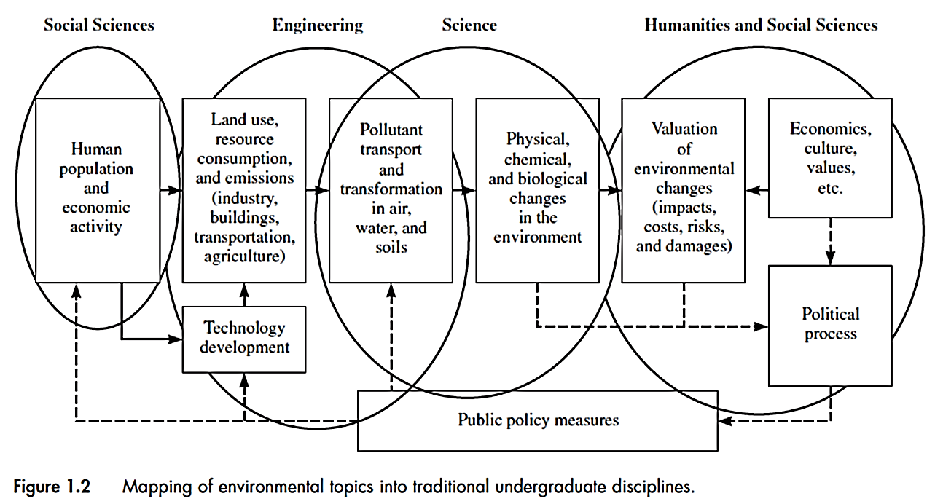
Role of engineers regarding the environmental issues

Slide 7
Green Engineering and Green Product :
Reduction in Impacts through Life Cycle Assessment (LCA)
Sources of environmental impacts:
Materials used : environmentally preferred materials? And using less materials?
Manufacturing processes: waste is generated during manufacturing of a product.
Energy use: Amount and type of energy use

Slide 8
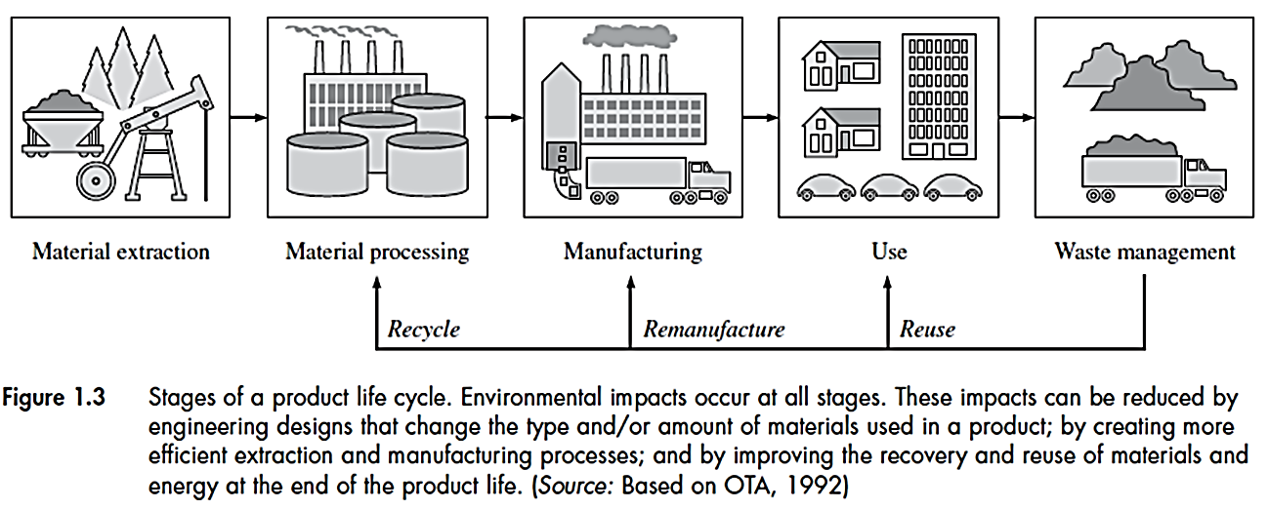
LCA (Life Cycle Assessment)
Impact assessment in all stages of a product’s life cycle (from raw materials extraction to manufacturing, use and disposal of the product).
A tool for green design, pollution prevention and waste minimization.

Slide 9
World Commission on Environment and Development (WCED-1987):
….Sustainable development is development which meets the needs of the present without compromising the ability of future generations to meet their own needs…
Sustainability
Environmental
Social
Economic

Slide 10
Economic: An economically sustainable system must be able to produce goods and services on a continuing basis, to maintain manageable levels of government and external debt, and to avoid extreme sectoral imbalances which damage agricultural or industrial production.
Environmental: An environmentally sustainable system must maintain a stable resource base, avoiding over-exploitation of renewable resource systems or environmental sink functions, and depleting non-renewable resources only to the extent that investment is made in adequate substitutes. This includes maintenance of biodiversity, atmospheric stability, and other ecosystem functions not ordinarily classed as economic resources.
Social: A socially sustainable system must achieve distributional equity, adequate provision of social services including health and education, gender equity, and political accountability and participation.

Slide 11
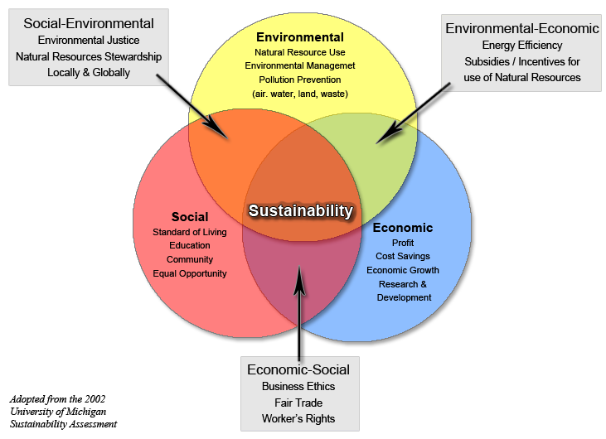

Slide 12
Basic Engineering Principles
Conservation of mass
Mass cannot be created nor destroyed: Rate of mass creation = 0
Mass in - Mass out = Mass accumulation
Example:
Rate of mass accumulation in the pond?
Mass in
System
Mass out
Evaporation = 2 kg/d
100 kg/d
= waste disposal
Disposal pond
Seepage = 1 kg/d

Slide 13
Mass in - Mass out = Mass accumulation
100 – (1+2) = 97 kg/d
Conservation of mass can determine the flow of contaminants in the environment: How much reacts, degrades, remains etc.
Energy conservation
Similar to the conservation of mass, energy cannot be created or destroyed, it transfers from one form to another:
Rate of energy creation = 0 (1st law of thermodynamics)
Energy flow in
Energy stored in the system
Energy flow out

Slide 14
In many types of environmental problems, energy and mass flows are coupled to each other since energy is stored in mass such as potential and kinetic energy.
Example:
Energy generation by a power plant in a year = 30 ×10⁶ kW-hr. Total energy input is 100 ×10⁶ kW-hr. How much energy is wasted to the environment? Assuming no energy is stored.
Energy Balance:
Energy in = Energy out = Energy generated + Energy wasted
Energy wasted = energy out - Energy generated
= (100-30) ×10⁶ = 70 ×10⁶ KW-hr

Slide 15
70% of energy is wasted ! The efficiency of the power plant can be improved to reduce the wasted energy
Mathematical models can predict the environmental impacts
These models are based on mass/energy principles or empirical
Their utilization may have limitations

