Slide 1
Chapter 1

Slide 2
organizational behaviour (OB) Field of study devoted to understanding, explaining, and ultimately improving the attitudes and behaviours of individuals and groups in organizations

Slide 3
human resources management Focuses on the applications of OB theories and principles in organizations
Takes the theories and principles studied in OB and explores the “nuts and bolts” applications of those principles in organizations.
An OB study might explore the relationship between learning and job performance, whereas a human resources management study might examine the best ways to structure training programs to promote employee learning.

Slide 4
strategic management Devoted to exploring the product choices and industry characteristics that affect an organization's profitability
Might examine the relationship between firm diversification (when a firm expands into a new product segment) and firm profitability.

Slide 5
THE ROLE OF MANAGEMENT THEORY
scientific management Using scientific methods to design optimal and efficient work processes and tasks
As an engineer, Taylor was focused on designing optimal and efficient work processes. Using scientific methods (e.g., careful observation, measurement, experimentation), Taylor and his colleagues would study how to optimize performance of any task (e.g., by reducing the number of hand movements exhibited by bricklayers, and thus reducing fatigue, more bricks could be laid in a given time period).

Slide 6
bureaucracy An organizational form that emphasizes the control and coordination of its members through a strict chain of command, formal rules and procedures, high specialization, and centralized decision making

Slide 7
human relations movement Field of study that recognizes that the psychological attributes of individual workers and the social forces within work groups have important effects on work behaviours

Slide 8
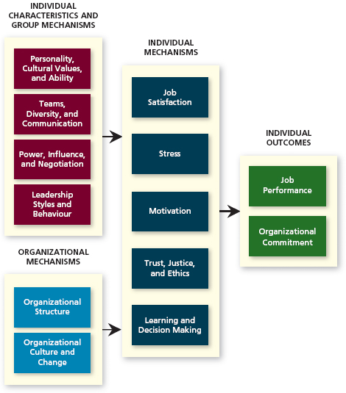
Integrative Model of Organizational Behaviour

Slide 9
INDIVIDUAL OUTCOMES
The two primary outcomes of interest to organizational behaviour researchers are:
job performance
organizational commitment.

Slide 10
INDIVIDUAL MECHANISMS
directly affect job performance and organizational commitment.
These include:
job satisfaction
Stress
Motivation
Trust, justice, and ethics
learning and decision making

Slide 11
INDIVIDUAL CHARACTERISTICS AND GROUP MECHANISMS
improve individual mechanisms.

Slide 12
ORGANIZATIONAL MECHANISMS

Slide 13
Does OB matter?
What we need is a logical conceptual argument that captures exactly why OB might affect the bottom line of an organization.
resource-based view A model that argues that rare and inimitable resources help firms maintain competitive advantage

Slide 14
What makes resources valuable?
rare In short supply

Slide 15
inimitable Incapable of being imitated or copied.
Includes:
History - People create a history—a collective pool of experience, wisdom, and knowledge that benefits the organization. History cannot be bought.

Slide 16
Numerous small decisions - Big decisions can be copied; they are visible to competitors and observable by industry experts and analysts.
To successfully mimic the practices of a competitor, it would be necessary to take into consideration all the little day-to-day decisions and trade-offs that employees make every day.

Slide 17
Socially complex resources - People are the source of socially complex resources, such as culture, teamwork, trust, and reputation. These resources are termed “socially complex,” because it is not always clear how they came about, though it is clear which organizations do (and do not) possess them.

Slide 18
Firms with very good OB practices also tend to be some of the most successful organizations, with good people who are rare and inimitable.
This creates a competitive advantage for them too.

