Slide 1
ADM1300~W4
.I.B.M.~.T.S.M.
JFA
Thanks to the much appreciate collaboration of
Prof. Matt Archibald and Prof. David Delcorde
F’2011

Slide 2
Today’s Agenda
Chapter 1:
  The Rational Decision-Making Process;
  The Importance of Strategic Management;
  Corporate Culture;
Chapter 2:
  What is management? ~Pages 50+51
  Managerial Roles by Mintzberg ~Pages 67 to 70
  Managerial dimensions by Stewart~Pages 70-73
Be well prepared for the W4 and W5
  Chapter 3: Entrepreneurship, Small business and New venture creation
  Chapter 4: Assessing external environments
  Chapters 5 and 6: Ethics, social responsibility and diversity.

Slide 3
Chapter 2
Managerial Roles by Mintzberg
The managerial roles are about How managers spend their time at work.
In other words, this typology was proposed by Henry Mintzberg and is based on the analysis of detailed accounts of the work done by real managers
It is a classification of behaviours according to the roles that managers should develop earlier in their career.
Three major categories:
  Interpersonal roles
  Informational roles
  Decisional roles
Each of which contains specific roles.

Slide 4
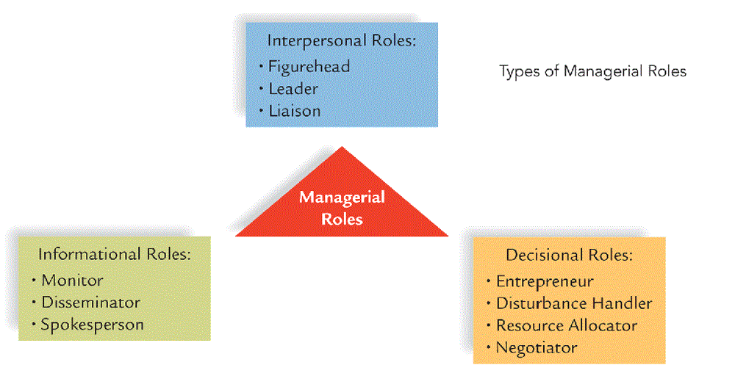
Chapter 2~ Managerial Roles by Mintzberg

Slide 5
Chapter 2
Managerial Roles by Mintzberg
  Interpersonal Roles: … are composed of three types of behaviour and, according to Mintzberg, are derived directly from the manager’s formal authority granted by the organization.
  Figurehead: involves taking part in ceremonial activities as a representative of the company.
  Leader: influencing and directing others
  Liaison: maintaining contacts outside the formal chain of command and even outside of the company.

Slide 6
Chapter 2
Managerial Roles by Mintzberg
  Informational Roles: This set of roles builds on the interpersonal relationships that a manager establishes and it underlines the importance of the network of contacts built up and maintained by a manager.
  Monitor: information seeking and gathering.
  Disseminator: seeing that information gets to those who need access to it.
  Spokesperson: representing the work product of a unit.
    Students frequently have difficulty differentiating this role from that of the figurehead. It may help to remind students that the figurehead is an interpersonal role and spokesperson is an informational role.
    Also, the figurehead usually represents the entire company in a ceremonial manner, whereas the spokesperson reports information from his/her workgroup.

Slide 7
Chapter 2
Managerial Roles by Mintzberg
  Decisional Roles: It’s a classification system who relates to the decision-making requirements of a managerial position.
  Entrpeneur: engaging in activities dealing with new projects, deciding which projects to adopt and which to close down.
  Disturbance Handler: settling conflicts among employees
  Resource Allocator: deciding how resources under one’s control will be distributed.
  Negotiator: representing the unit or organization in mediating agreements.
    Sometimes this role can be less formal and more individual. For example, a manager might be negotiating with a new hire for the terms of employment.

Slide 8
Chapter 2
Managerial jobs dimensions by Stewart
Stewart proposed this typology as a way of directly comparing different jobs even when they seem totally dissimilar.
  Demands: What a manager MUST do (activities or duties).
    Examples of demands can include travel, number of meetings each week, number of direct reports, etc.
  Constraints: Factors that limit a potential response by the manager to various demands (time, budgets, technology, attitudes, and regulations).
    Constraints can be their yearly budget, time to complete a project, any other scarce resources.
  Choices: The range and amount of discretion allowed to a manager in responding to demands. Despite demands, despite constraints, there is always room for some amount of discretionary behavior in any managerial job.
    Choices could be sales area, workgroup personnel, and scheduling of tasks.

Slide 9
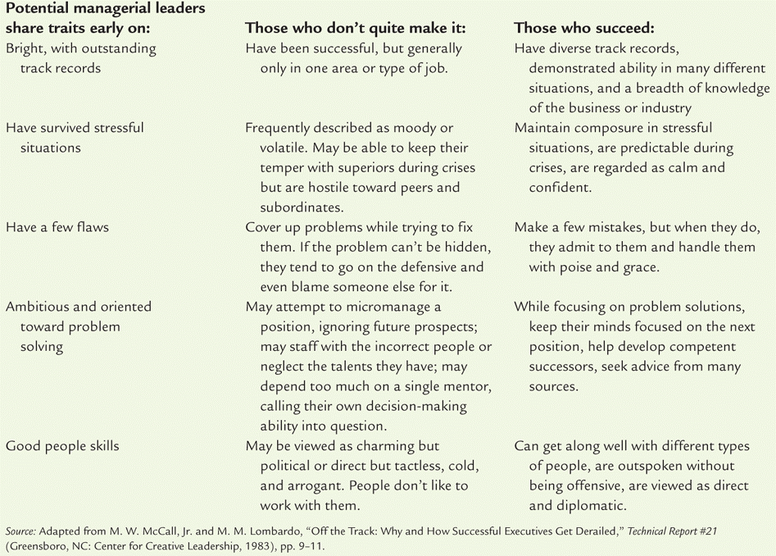
Who Succeeds? Who doesn’t?

Slide 10
The five key questions
Q1
Q4
Q6
Q15
Q17
Page 76 in textbook

Slide 11
Today’s Agenda
  Chapter 3: Entrepreneurship, Small business and New venture creation
  Small business, New venture creation and entrepreneurship;
  The Role of small and new businesses in the Canadian economy
  The entrepreneurial process
  Form of business ownership
  Success and failure in small business
Chapter 4: Assessing External Environments
  General external environment
  Task environment
  The internal environment
  Environmental scanning and response
Be well prepared for weeks to come:
  Chapter 5 and 6: Ethics, social responsibility and diversity
  Chapter 7: Individual and Group Decision making
  Chapters 8: Planning
  Review for Mid-Term examination
  Mid-Term Examination will takes place Oct. 21st at 7pm

Slide 12
Chapter 3
Entrepreneurship, Small business and New venture creation
The Objectives of the chapter 3 are:
  Be better prepared to identify the challenges and opportunities provided in new venture start-ups;
  Assess the risks and benefits of working in a new business;
  Evaluate the investment potential inherent in a new business.
  The terms Small Business, new venture and entrepreneurship are related terms, but each idea is distinct.

Slide 13
Small business, New venture creation and Entrepreneurship
Quick facts according to Industry Canada:
  A business must have at least one paid employee and annual sales revenues of $30000 or more, or be incorporated;
  A goods-producing business is considered small if it has fewer than 100 employees, while a service-producing business is considered small if it has fewer than 50 employees.
  There are 2.3 million “business establishment” in Canada and about 2.5 million people who are “self-employed”.

Slide 14
Small business, New venture creation and Entrepreneurship
  The majority of businesses in Canada have no employees (just the owner). 97.7% of all employer businesses in Canada are “small”.
Account for over 2/3 employment in four industries.
  Non-institutional health care = 90%
  Construction = 77%
  Accommodation and food = 69%
  Other services = 73%
Definition of a small business:
  An owner-managed business with fewer than 100 employees.

Slide 15
Small business, New venture creation and Entrepreneurship
  A business is considered to be new if it has become operational within the previous 12 months.
  If it adopts any of the main organizational forms such as proprietorship, partnership, corporation or co-operative…
  If it sells goods or services.
Definition of new venture (or new firm):
  A recently formed commercial organization that provides goods and/or services for sale.

Slide 16
Small business, New venture creation and Entrepreneurship
  A business person who accepts both the risks and the opportunities involved in creating and operating a new business venture is called an entrepreneur.
  Hours and creativity are the keys to success…
  How do you call the entrepreneurial characteristics that can create and maintain the innovation and flexibility of a small business environment within the confines of a large, bureaucratic structure?
Definition of entrepreneurship:
  : The process of identifying an opportunity in the marketplace and accessing the resources necessary to capitalize on that opportunity.

Slide 17
  The Role of small and new businesses in the Canadian economy
  Small business provide more jobs than large businesses;
  Small businesses lead the way when it comes to innovation and new technology;
  Ontario and Quebec together account for the largest proportion of business establishment in Canada = 56%;
Account for over 2/3 employment in four industries:
  Non-institutional health care = 90%
  Construction = 77%
  Accommodation and food= 69%
  Other services= 73%
  In another 5 industries, at least half of the workforce is employed by small businesses.

Slide 18
  The Role of small and new businesses in the Canadian economy
  New venture are important as a source of job creation and for the introduction of new products and services;
  In 2007, small business creates 100,000 jobs in Canada; this represented 40% of all jobs that were created.
  Between 2002 and 2006, approximately 130 000 new small businesses were started each year in Canada;
  According to Statistics Canada, there were about 877 000 women entrepreneurs in Canada in 2006; and 47% of small-and-medium-sized enterprises have some degree of female ownership;
  Women are playing a more prominent role than ever before in starting new venture; they now account for half of all new businesses that are formed;
  Young entrepreneurs –both men and women- are also involved in creating new venture in Canada.

Slide 19
  The entrepreneurial process
  The Process
Identify Opportunities
  Idea generation
  Screening:
    Idea creates or adds value
    Idea provides a sustainable competitive advantage
    Idea is marketable and financially viable
    Idea has low exit costs
  Develop the opportunity
Access the necessary resources

Slide 20
  The entrepreneurial process
  The Key Terms
Sales forecast: An estimate of how much a product or service will be purchased by the prospective customers for a specific period of time.
Exit costs: The costs in terms of time, money and reputation that are incurred when a business shuts down.
Franchise: A arrangement in which a buyer purchase the right to sell the product or service of the seller.
Bootstrapping: Financing techniques whereby entrepreneurs make do with as few resources as possible and use other peoples’ resources whenever they can.
  Can also refer to the acquisition of other types of resources, such as people, space, equipment or materials that are loaned or provided free by customers or suppliers.
Collateral: Items (assets) owned by the business (building and/or equipment) or by individual (house or/and car) that the borrower uses to secure a loan or other credit.

Slide 21
  The entrepreneurial process
  The Business Plan
Business Plan: A document that describes the entrepreneur's proposed business venture, explains why it is an opportunity, and outlines its marketing plan, its operational and financial details, and its manager’s skills and abilities. *See table 3.3, p.93
  The cover page
  Executive Summary
  Table of Contents
  Company description
  Product and Service description
  Marketing
  Operating Plan
  Management
  Financial Plan
  Supporting details/Appendix

Slide 22
  The entrepreneurial process
  Assessing the “Fit”
The Entrepreneur – Opportunity fit: The entrepreneur needs to decide whether the opportunity is something he or she can do and wants to do . This is an important realistic self-assessment. The success of the venture depends heavily upon the individual(s) involved.
The Opportunity – Resources fit: Accessing the opportunity-resources fir involves determining whether the resources needed to capitalize on the opportunity can be acquired.
The Entrepreneur – Resources fit: Once the resources requirements of the venture have been determined, the entrepreneur needs to assess whether he or she has the capacity to meet those requirements.

Slide 23
  The entrepreneurial process
  Sharing an ownership or not
Deciding whether to share ownership by forming a team involves considering whether having a team is desirable or necessary and whether the aim is to build a company with high growth potential.
Whether a TEAM IS NECESSARY depends upon certain conditions:
THE SIZE AND SCOPE OF THE VENTURE: How many people does the venture require? It is a one-person operation or does it need contributions from others?
PERSONAL COMPETENCIES: What are the talents, know-how, skills, track record, contacts and resources that the entrepreneur brings to the venture?
  If gaps are identified, the entrepreneur needs to decide what competencies are needed to complement his and when they are needed.

Slide 24
  Form of business ownership
Sole Proprietorship
Partnership
  General
  Limited
  Joint Venture
Incorporation
  Under Federal Laws
  Under Provincial Laws
    Public Corporation
    Private Corporation – (including most “Family Businesses”)
Alternative Business Forms
  Crown Corporations
  Cooperatives
  Non-Profit
  Family Business

Slide 25
  Form of business ownership
  (Source of Information: Robert Sexty: Canadian Business in the New Stakeholder Economy, Prentice Hall Canada, 1998)
Sole Proprietorship (SPs)
  The simplest form of business organization available to any individual who is legally able to enter into a binding contract
  SPs fall under provincial and municipal jurisdiction
  Filing a name declaration is not required provided the proprietorship operates under a person’s name
  Owned and operated by one person

Slide 26
Advantages and Disadvantages of the Sole Proprietorship
(Source of Information: Robert Sexty: Canadian Business in the New Stakeholder Economy, Prentice Hall Canada, 1998)
Ease and cost of starting and ending the business.
Secrecy
Flexibility and control.
Pride of ownership.
Distribution and use of profit.
No special taxes – profits are « personal income » and taxed at individual tax rates.
No government regulation.
Ulimited liability.
Limited financial resources.
Limited skills pool.
Overwhelming time commitment.
Few fringe benefits.
Limited growth.
Limited life span.

Slide 27
  Form of business ownership
  (Source of Information: Robert Sexty: Canadian Business in the New Stakeholder Economy, Prentice Hall Canada, 1998)
Partnership
  A form of organization established when two or more individuals (partners) agree to combine their financial, managerial and technical abilities for the purpose of operating a business for profit.
  Provincial laws require that a partnership must legally register its name and give information about the partners.

Slide 28
Partnership
(Source of Information: Robert Sexty: Canadian Business in the New Stakeholder Economy, Prentice Hall Canada, 1998)
  General Partnership – complete sharing in the management of the business
    Partners are not only liable in equal share for the debts of the partnership (jointly liable) but in addition, each partner is liable for the full amount (jointly and severally liable)
    Each member can bind the partnership without consent of the other partners
  Limited Partnership
    Composed of one or more general partners who conduct the business, and one or more persons who contribute an amount in actual cash (special or limited partners)
    The special partner’s liability is normally limited only to the amount of the cash s/he contributed to the partnership
  Joint Venture
    Partnership established for a specific project or a limited time.

Slide 29
Advantages and Disadvantages of Partnerships
Advantages
Disadvantages
Ease of organization
More financial resources (capital and credit)
Shared management
Combined knowledge and skills
Faster decision making
Few regulatory controls
Unlimited liability
Partners are responsible for business activities of all others.
Division of profits.
Disagreements among partners; can be difficult to get rid of a partner
Life of a partnership

Slide 30
to avoid trouble later, you need an agreement.
this agreement should answer several questions such as:
How will disagreements be resolved?
Who invested what sums of money in the partnership?
Who will receive what share of the partnership’s profits?
Who does what and who reports to whom?
How will the partnership be dissolved?
How will leftover assets be distributed among the partners?

Slide 31
The Corporation
(Source of Information: Robert Sexty: Canadian Business in the New Stakeholder Economy, Prentice Hall Canada, 1998)
A corporation is recognized as a separate legal entity that is liable for its own debts and whose owner’s liability is limited to their investment.
  The stockholders are the investors who buy shares or ownership in the form of stock.
A corporation incorporated under the laws of Canada (a federally incorporated business) can carry on business in all parts of Canada
  Federally incorporated businesses include 150 of the 200 largest corporations in Canada.
  A federal company cannot be prevented by a provincial government from exercising the powers that have been validly conferred on the company by federal authority (e.g., doing business in a province).
Ownership of a corporation is through stock or “shares” , typically the “voting” shares).
Governance of a corporation is the responsibility of a Board of Directors

Slide 32
The Board of Directors
The board of directors is the governing body of a corporation whose basic responsibility is to ensure that the corporation is run in a way that is in the best interests of the shareholders.

Slide 33
Types of Corporation
(Source of Information: Robert Sexty: Canadian Business in the New Stakeholder Economy, Prentice Hall Canada, 1998)
Private Corporation:
  The right to transfer shares is restricted
  Number of shareholders limited to 50
  May not sell shares or debentures (bonds or debt instruments) to the public
Public Corporation:
  Sells shares to the public on a stock exchange
  Is subject to stricter regulations for filing financial reports, must follow certain audit procedures
  Must file a prospectus if shares are being sold to the investing public

Slide 34
Advantages and Disadvantages of Corporations
Advantages
Disadvantages
More money for investment
Limited liability
Separation of ownership and management
Ease of ownership change
Perpetual life
Size
Initial cost
Paperwork
Two tax returns
Termination difficult
Double taxation

Slide 35

Other Types of Corporations
Non-profit - universities, hospitals, charities
Cooperative – The Farmers COOP
Crown Corporations – Export Development Corporation, VIA Rail

Slide 36
Other Types of Corporations – Non-Profit
Non-profit - universities, hospitals, charities
Focus more on providing a service than making a profit, but NOT owned by a government entity
Funded through private donations and grants from government

Slide 37
Other Types of Corporations – Cooperatives
A Cooperative or Co-op – an organization composed of individuals or small businesses that have banded together to reap the benefits of belonging to a larger organization.
  Gay Lea – a Co-op of Ontario Dairy Farmers
  Ocean Spray – a Co-op of cranberry farmers
A Co-op is expected to operate without profit
Pass savings on to members because the Co-op buys in bulk and advertising efforts are pooled.

Slide 38
Other Types of Corporations – Cooperatives
There’s six main areas of Co-op businesses:
Consumers co-operatives
Financial co-operatives
Insurance co-operatives
Marketing co-operatives
Service co-operatives
Housing co-operatives

Slide 39
Other Types of Corporations
The Crown Corporations
A Crown Corporation – a “for profit” corporation owned and operated by the federal, provincial or local government whose focus is providing a service.
Operate in areas where the private sector either could not or would not operate because of high infrastructure or other costs:
  Mail delivery in downtown and remote communities at the same cost
  Areas where return on investment occurs only in the long-term (Atomic Energy)
  Areas where the risk involved would make it necessary for a private sector organization to charge an unaffordable price (Export Development Corporation)
  Areas where a service is intended to make all businesses more profitable (Business Development Bank)

Slide 40
Other Types of Corporations
(Source of Information: Robert Sexty: Canadian Business in the New Stakeholder Economy, Prentice Hall Canada, 1998)
The Family Business
  About 2/3 of Canadian business enterprises are controlled by families (usually through private corporations.
  It is estimated there are 10,000 family businesses in Canada with two or more generations as owners or managers.
  Family businesses control about 1/3 of the 100 largest companies in Canada.
  Founder or family members are in executive positions
  Family members hold sufficient shares to make decisions and control operations.
  Approximately 25% of family businesses survive the founder’s demise; about 10% survive beyond two generations and 3% beyond the third generation.

Slide 41
The Canadian Private Sector
Over the last century the Canadian business sector has seen a shift from a system of enterprises more or less loosely connected by competition through the marketplace to a corporate system that now dominates the scene
The distribution of business organizations in Canadian manufacturing industries has changed dramatically (from Sexty, Prentice Hall 1998):
  % in 1950 % in 1980 % Today
  Sole proprietorships 45.6 11.5 2.4
  Partnerships 15.0 3.3 0.5
  Corporations 36.3 84.3 96.6
  Co-operatives 3.3 0.9 0.5

Slide 42
Success and failure in Small Business
Reasons for Success:
  Hard work, drive and dedication;
  Market demand for the product or service;
  Managerial competence;
  Luck…
Reasons for Failure (See p.107, table 3.7):
  Managerial incompetence or inexperience;
  Neglect;
  Weak control systems;
  Insufficient capital.

Slide 43
Just in case, just for you!
Question #3 on page 110
  Do you think that you would be a successful entrepreneur?

Slide 44
Today’s Agenda
  Chapter 3: Entrepreneurship, Small business and New venture creation
  Small business, New venture creation and entrepreneurship;
  The Role of small and new businesses in the Canadian economy
  The entrepreneurial process
  Form of business ownership
  Success and failure in small business
Chapter 4: Assessing External Environments
  General external environment
  Task environment
  The internal environment
  Environmental scanning and response
Be well prepared for weeks to come:
  Chapter 5 and 6: Ethics, social responsibility and diversity
  Chapter 7: Individual and Group Decision making
  Chapters 8: Planning
  Review for Mid-Term examination
  Mid-Term Examination will takes place Oct. 21st at 7pm

