Slide 1
ADM1300~W3
.I.B.M.~.T.S.M.
JFA
Thanks to the much appreciate collaboration of
Prof. Matt Archibald and Prof. David Delcorde
F’2011

Slide 2
Today’s Agenda
Chapter 1:
  The Rational Decision-Making Process;
  The Importance of Strategic Management;
  Corporate Culture;
Chapter 2:
  Three critical challenge ~Pages 48+49
  What is management? ~Pages 50+51
  Managerial Roles by Mintzberg ~Pages 67 to 70
  Tip of the week:
Be well prepared for the W4 and W5
  Chapter 3: Entrepreneurship, Small business and New venture creation
  Chapter 4: Assessing external environments
  Chapters 5 and 6: Ethics, social responsibility and diversity.

Slide 3
The Rational Decision Making Process
The sparkle : Recognizing that a solution is necessary.
  The stimulus for a decision maybe either a problem or an opportunity.
Problem decision: A decision that is necessary when actual results do not conform to those expected.
Opportunity decision: Taking new initiatives or doing a current activity more efficiently even no problem exists.

Slide 4
The Rational Decision Making Process
Step 1 : Recognizing and defining the decision situation.
Stimulus +/-
Step 2 : Identifying alternatives.
Obvious and creative
The more important the decision, the more alternatives should be generated.
Factors such as legal restrictions, moral and ethical norms and available technology can limit alternatives.

Slide 5
The Rational Decision Making Process
Step 3 : Evaluating alternatives
Feasibility, satisfactoriness and consequences
Step 4 : Selecting the best alternative
Choose the alternative that best fits the managers solution
It is the real crux of decision making
Decision makers should also remember that finding multiple acceptable alternatives maybe possible, so selecting just one alternative and rejecting all others might not be a good decision.

Slide 6
The Rational Decision Making Process
Step 5 : Implementing the chosen alternative
The chosen alternative is implemented into the organizational system
One of the key things that managers must deal with during implementation is employee resistance to change
The reason for such resistance include insecurity, inconvenience and fear of the unknown
Unanticipated consequences are still possible

Slide 7
The Rational Decision Making Process
Step 6 : Following up and evaluating the results
The decision making process requires managers to :
1- Evaluate the effectiveness of their decision
2- Make sure that the chosen alternative has served its original purpose
3- Adopt an alternative that had previously been discarded
4- Recognize that the situation was not correctly defined to begin with and start the process all over again.

Slide 8
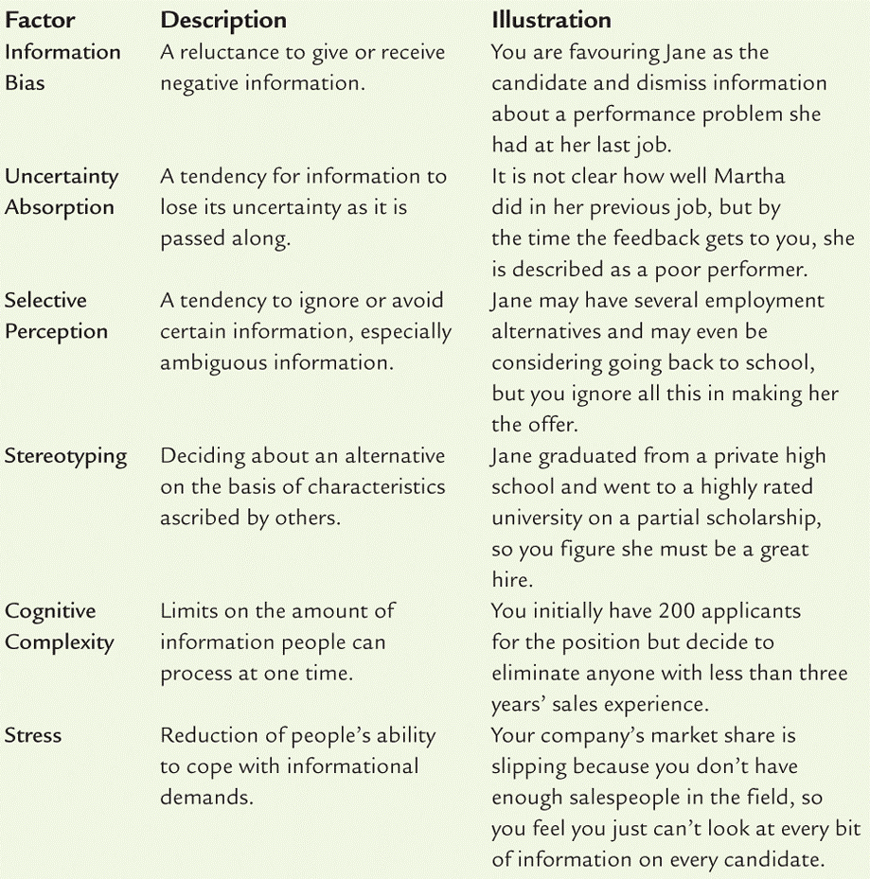
Factors that inhibit accurate problem identification and analysis

Slide 9
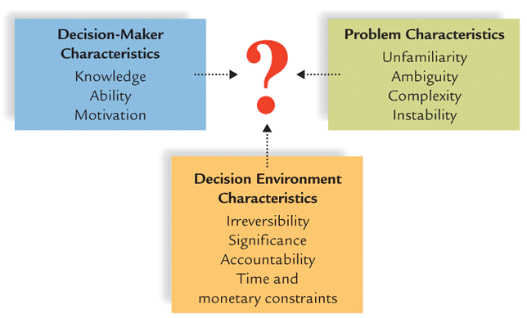
Influences on the
Decision-Making Process

Slide 10
The Behavioural Aspects of Decision Making
Non-logical and emotional factors often influence managerial decision making.
Organizational politics: The action that people take as they try to get what they want (Organizational power and personal power)
Intuition: An “inner sense” or “hunch” usually based on years of experience and practice in making decisions in similar situations

Slide 11
The Behavioural Aspects of Decision Making
3. Escalation of commitment: When a manager makes a decision and then remains committed to its implementation in spite of clear evidence that it was a bad decision.
4. Risk propensity: How much a manager is willing to gamble when making decisions. (Take risk?)

Slide 12
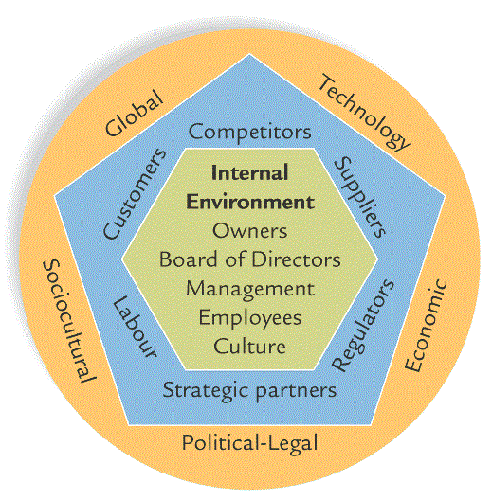
The Strategic Management
What is Strategic Management? The process of aligning the organization with its external environment.
External Environment :

Slide 13
The Strategic Goals
The starting point in effective management is setting strategic goals…
Strategic Management Goals are the overall objectives that a business wants to achieve.
  What it intends to do is the 1st step of an organization.
  Maybe the organization needs a strategy to achieve its goals…
Strategy: is the broad set of organizational plans for implementing the decisions made for achieving organizational goals.
  See “The purposes of goal setting” on page 29 (Textbook) and complete the next slide by briefly explaining each of those purposes.

Slide 14
The Strategic Management
The four main purposes in organizational goal setting
Provides direction, guidance and motivation for all managers.
Helps firms allocate resources.
Helps to define corporate culture.
Helps managers assess performance.

Slide 15
The Strategic Management
Kind of Goals
The Mission Statement: An organization’s statement of how it will achieve its purpose in the environment in which it conducts its business.
  Regardless of a company’s purpose and mission, every firm needs to set long-term (5y or more into the future), intermediate (1 to 5y) and short-term goals (less than one year).

Slide 16
The Strategic Management
The SMART Goals
Specific
Measurable
Achievable
Relevant
Time-framed

Slide 17
The Strategic Management
Steps 1, 2 and 3
The Strategy formulation involves three basic steps:
  Setting strategic (smart) goals:
    What are the kinds of goals?
  Analyzing the organization and its environment:
    See SWOT
  Matching the organization and its environment.
  SWOT analysis is the identification and analysis of organizational STRENGTHS AND WEAKNESSES and environmental OPPORTUNITIES AND THREATS as part of strategy formulation.

Slide 18
The Strategic Management
Steps 1, two and 3
The Strategy formulation involves three basic steps:
  Setting strategic (smart) goals:
    What are the kinds of goals?
  Analyzing the organization and its environment:
    See SWOT
  Matching the organization and its environment.
  This is the heart of strategy formulation;
  (...) Matching environmental THREATS and OPPORTUNITIES with corporate STRENGTHS and WEAKNESSES;
  This process may determine whether a firm typically takes risks or behaves more conservatively.

Slide 19
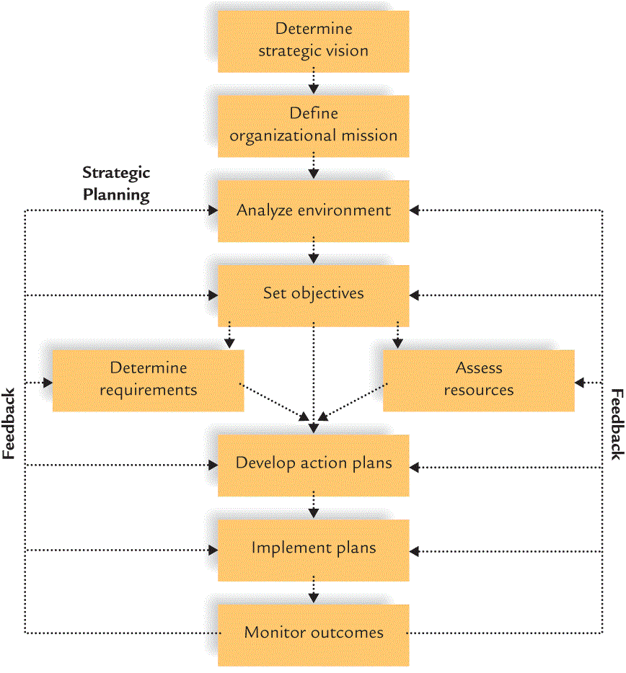
Strategic Management Process

Slide 20
Levels of Strategies
What is a corporate-level strategy:
  Identifies the various businesses that a company will be in and how these businesses will relate to each other.
What is a business-level strategy:
  Identifies the ways a business will complete in its chosen line of products and/or services.
What is a functional strategy:
  Identify the basic courses of action that each department in the firm will pursue so that it contributes to the attainment of the business’s overall goals.

Slide 21
Levels of Strategies
A Corporate-level strategy could be:
  A Concentration strategy which involves focusing the company on one product or product line.
  A Growth strategy. All or which focus on internal activities that will result in growth (Market penetration, product development and geographic expansion).
  A Integration strategy which focus on external activities that will result in growth (horizontal and vertical integration) or competitors vs. inputs and/or channels.

Slide 22
Levels of Strategies
A Corporate-level strategy could be:
  A Diversification strategy means expanding into related or unrelated products or market segments
    Related diversification … means adding new, but related, products or services to an existing business.
    Conglomerate diversification… means diversifying into products or markets that are not related to the firm’s present business.
  A investment reduction strategy means reducing the company’s investment in one or more of its lines of business.
    Retrenchment… which means the reduction of activity or operations.
    Divestment… involves selling or liquidating one or more of a firm’s business.

Slide 23
Levels of Strategies
Business-level (competitive) strategies are:
  Cost leadership strategy which means becoming the low-cost leader in an industry.
  Differentiation strategy occurs when a firm tries to be unique in its industry along some dimension that is valued by buyer.
  Focus strategy means selecting a market segment and serving the customers in that market niche better than competitors.

Slide 24
Levels of Strategies
Functional strategies are:
  When the Business-level Strategies are translated into supporting functional strategies (see Areas on management, chapter 1).
  A functional strategy is the basic course of action that each department (Areas) follows so that the business accomplishes its overall goals.

Slide 25
The Corporate Culture
A Corporate Culture is essential. This is the personality or the identity of a company:
  A corporate culture represents the shared experiences, stories, beliefs, norms and ethical stance that characterize an organization.
  A strong corporate culture guides everyone to work toward the same goals and helps newcomers learn accepted behaviours.
  The Corporate Culture is shaped by four forces which are fundamental:

Slide 26
The Corporate Culture
The Corporate Culture is shaped by four forces which are fundamental :
  The values held by top management help set the tone of the organization and influence its business goals and strategies;
  The firm’s history also helps shape its culture;
  Stories and legends are also important;
  A strong behavioural norms help define an sustain corporate cultures.

Slide 27
The Corporate Culture
Communicating the culture :
  Managers themselves must have a clear understanding of the culture;
  They must transmit the culture to others in the organization, specially to the newcomers.
  A clear and meaningful statement of the organization’s mission is also a valuable communication tool;
  Managers can maintain the culture by rewarding and promoting those who understand it and work toward maintaining it.

Slide 28
Today’s Agenda
Chapter 1:
  The Rational Decision-Making Process;
  The Importance of Strategic Management;
  Corporate Culture;
Chapter 2:
  Three critical challenge ~Pages 48+49
  What is management? ~Pages 50+51
  Managerial Roles by Mintzberg ~Pages 67 to 70
  Tip of the week:
Be well prepared for the W4 and W5
  Chapter 3: Entrepreneurship, Small business and New venture creation
  Chapter 4: Assessing external environments
  Chapters 5 and 6: Ethics, social responsibility and diversity.

