Slide 1
Midterm Review

Slide 2
What You Need to Do
UNDERSTAND the basic concepts of each chapter
PRACTICE:
  Recommended Exercises
  Capstone Questions
  Review Problems [at the end of each chapter]
  Additional problems I illustrated in the class
  Quiz Questions

Slide 3
Allocate Your Time Efficiently
B+: 75%
You are allowed to lose 25%!
My suggestion: Just for Your Reference
  M/C: conceptual
  Problems: easier calculations
  Problems: relatively challenging calculations
    They are worth more marks
    You may get partial marks
  M/C: computational
    Eliminate unlikely choices first

Slide 4
Review Problem: Chapter 9

Slide 5
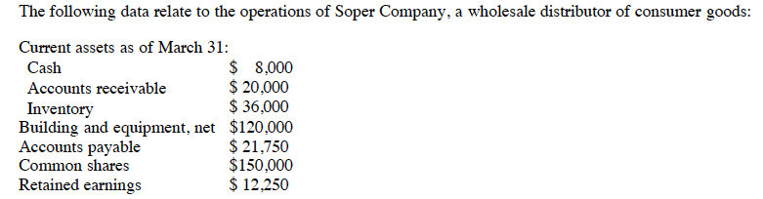

Slide 6
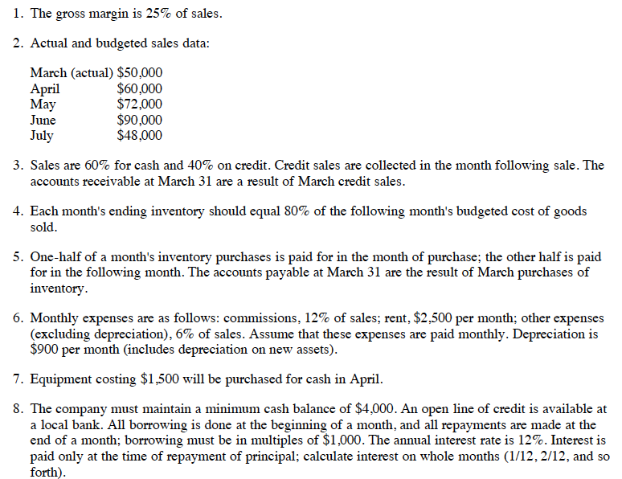

Slide 7
Cash Collections
 | April | May | June
Cash Sales | 60,000 × 60% | 72,000 × 60% | 90,000 × 60%
Credit Sales | 50,000 × 40% | 60,000 × 40% | 72,000 × 40%
Total: | 56k | 67.2k | 82.8k

Slide 8
Inventory Purchase Budget
 | April | May | June
COGS | 75% × 60,000 | 75% × 72,000 | 75% × 90,000
Ending Inv. | 80% × [75% × 72K] | 80% × [75% × 90K] | 80% × [75% × 48K]
Total Needs: | 88,200 | 108,000 | 96,300
Less: Beg. Inv. | 36,000
Purchase Req. | 52,200 | 64,800 | 42,300

Slide 9
Cash Disbursements: Inv. Purchase
 | April | May | June
March Purchase | 21,750
April Purchase | 50% × Apr. Pur. | 50% × Apr. Pur.
May Purchase |  | 50% × May Pur. | 50% × May Pur.
June Purchase |  |  | 50% × Jun. Pur.
Total:
YOU MUST USE THE PURCHASE NUMBERS FROM THE PREVIOUS CALCULATIONS

Slide 10
Cash Disbursements: Operating
 | April | May | June
Commissions | 12% × 60,000 | 12% × 72,000 | 12% × 90,000
Rent | 2,500 | 2,500 | 2,500
Other | 6% × 60,000 | 6% × 72,000 | 6% × 90,000
Total:

Slide 11
 | April | May | June
Cash, Beg. | Information given | From April Ending | From May Ending
Add: collections | From Previous Cal. | From Previous Cal. | From Previous Cal.
Total Cash: | Simple Calculations
Less disbursements
Inv. | From Previous Cal. | From Previous Cal. | From Previous Cal.
Exp. | From Previous Cal. | From Previous Cal. | From Previous Cal.
Equipment | Information given
Total Disbursements: | Simple Calculations
Excess (deficiency) of Cash | Simple Calculations
Financing
Borrowing | To keep cash req. | To keep cash req.
Repayments |  |  | Calculation
Interest |  |  | Calculation
Total Financing
Cash, End. | MUST BE GREATER THAN THE CASH REQUIREMENT
NEW CALCULATIONS!!

Slide 12
Review Problem: Chapter 7

Slide 13
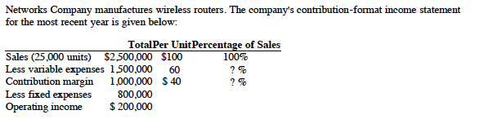
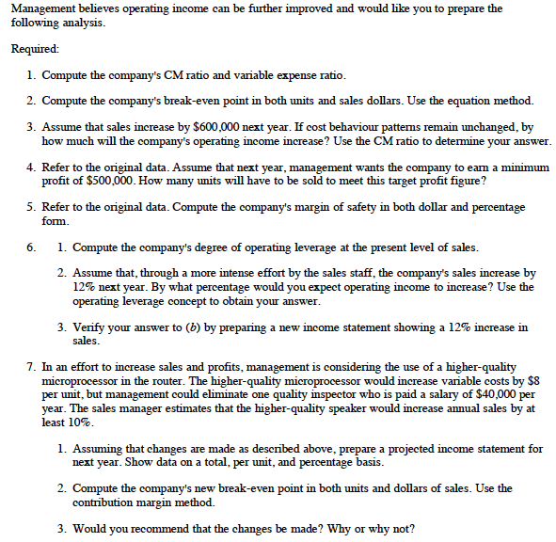

Slide 14
Req.1: CM% vs. VC%
CM%: CM resulting from $1 of sale
VC%: VC incurred for generating $1 of sale
CM% = Total CM ÷ Total Sales
Or = CM per unit ÷ Selling Price per unit
CM% = 1,000,000 ÷ 2,500,000 = 40%
VC% = Total VC ÷ Total Sales
Or = VC per unit ÷ Selling Price per unit
VC% = 60 ÷ 100 = 60%.
CM% + VC% = 1

Slide 15
Req. 2: BEP
Sales – VC – FC = Profit
CM – FC = Profit
At BEP, let Profit = 0, then:
CM = FC
CM = CM per unit × # of units
Or = CM% × Sales Revenues
BEP in units = FC ÷ CM per unit = 800,000 ÷ 40
BEP in dollars = FC ÷ CM% = 800,000 ÷ 40%
Double check: BEP in units × 100 (Price) = BEP in dollars

Slide 16
Req.3: Operating Income
CM%: 40%
Cost Behavior: unchanged.
Increase in operating income
= Increase in Sales × CM%
= 600,000 × 40%
= $240,000

Slide 17
Req. 4: Profit Objective
Sales – VC – FC = Profit
CM = FC + Profit
CM per unit × # of units = FC + Profit
# of units = [FC + Profit] ÷ CM per unit
= [800K + 500K] ÷ 40
            = 32,500 units

Slide 18
Req. 5: Margin of Safety
Margin of Safety:
  In units
  In dollars
  In percentage
In dollars: Actual Sales in dollars – BEP in dollars
In percentage: Margin of safety in dollars ÷ Actual sales in dollars

Slide 19
Req.6: Operating Leverage
Operating Leverage: % of change in income arising from 1% change of sales
Depending on sales levels
DOL = CM ÷ Operating Income
= CM ÷ [CM - FC]
= 1M ÷ 200K = 5
Increase in profit = 12% × 5 = 60%
Double Check: prepare an income statement

Slide 20
Req.7: CVP
Always a Cost-Benefit trade-off
Cost: VC per unit is increased by $8
Benefit:
  Sales increase: 10%
  FC decrease: $40,000

Slide 21
CVP-Continued: Method 1
VC % = new VC per unit ÷ original selling price
= [60+8] ÷ 100 = 68%
CM % = 1 – VC% = 32%
New CM in Total = 2.5M × (1+10%) × 32% = $880K
New FC in Total = 800K – 40K = $760K
New Operating Income = 880K – 760K = $120K
Incremental Operating Income = 120K – 200K = -80K

Slide 22
Method 2
# of units sold: 2.5M ÷ 100 = 25,000 units
Cost: 25,000 × 8 = $200,000
Benefit 1: FC savings of $40,000
Benefit 2: incremental CM
= Increased sales in units × CM per unit
= 25,000 × 10% × [100 – (60+8)]
= 80,000
Net Effect: 40,000 + 80,000 – 200,000 = -$80,000

Slide 23
Method 3
Prepare an income statement

Slide 24
Chapter 7: CVP
The Capstone Question
The Review Problem
The Quiz Question
The Indifference Analysis [Not Tested in the Midterm]

Slide 25
Chapter 6: High-Low Method

Slide 26
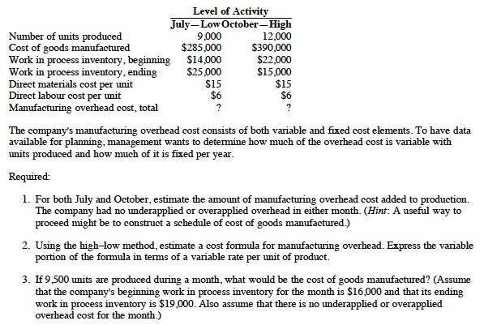

Slide 27
Req.1: MOH Added-July
WORK IN PROCESS
Beginning Inv. | COGM
DM
DL
MOH
Ending Inv.

Slide 28
Req.1: MOH Added-July
WORK IN PROCESS
Beginning Inv. | COGM
DM
DL
MOH
Ending Inv.
✔
✔
✔
✔
✔

Slide 29
MOH-July
Beg + DM + DL + MOH – COGM = End.
MOH = End + COGM – Beg – DM – DL
MOH = 25K + 285K – 14K – 15×9K – 6×9K
MOH = $107K

Slide 30
MOH-October
We follow the same method, and get MOH in October: $131K

Slide 31
Req. 2: Cost Function for MOH
High:
  Activity: 12K units
  Cost: 131K
Low:
  Activity: 9K
  Cost: 107K
So b = (131k-107k) ÷ (12K-9K) = $8 per unit
a = 131K – 12K × 8 = $35K
Y = 35K + 8X

Slide 32
Req. 3: COGM
# of units produced: 9.5K
So we calculate the following items:
DM = 9.5 K × 15
DL = 9.5 K × 6
MOH = 35K + 9.5K × 8
Total manufacturing cost = DM + DL + MOH = $310.5K
COGM = Beg + Total Costs – End = $307.5K

Slide 33
Chapter 6: Cost Behavior
Two Capstone Questions
Recommended Exercises
The Sample Midterm Question
Additional Questions We Covered in Class

Slide 34
Chapter 2: COGM and COGS
Problem 22

Slide 35
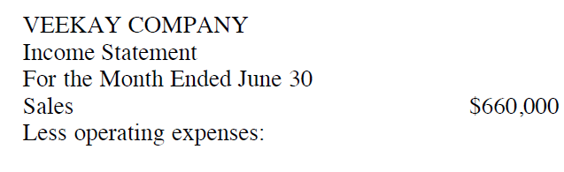
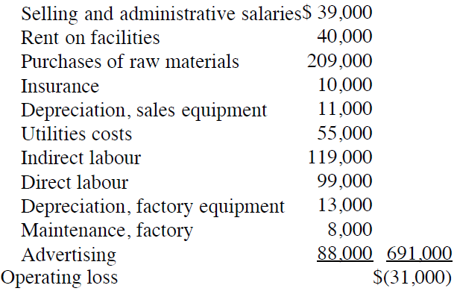
85% of the rent on facilities applies to factory operations; the remainder applies to selling and administrative activities.
90% of the insurance and 80% of the utilities cost apply to factory operation; the remaining amounts apply to selling and administrative activities.
Assuming all raw materials are used as DM
Inventory balances at the beginning and end of June were as follows:
 | June 1 | June 30
Raw Materials | $19,000 | $46,000
WIP | $77,000 | $94,000
FG | $22,000 | $66,000
Required:
Prepare a schedule of COGM for June
Prepare a NEW income statement for June [because the I/S provided is not properly prepared]

Slide 36
85% of the rent on facilities applies to factory operations; the remainder applies to selling and administrative activities.
90% of the insurance and 80% of the utilities cost apply to factory operation; the remaining amounts apply to selling and administrative activities.
Assuming all raw materials are used as DM
Inventory balances at the beginning and end of June were as follows:
 | June 1 | June 30
Raw Materials | $19,000 | $46,000
WIP | $77,000 | $94,000
FG | $22,000 | $66,000
DM:
Beginning and ending balances: Given
Purchase: Given
So DM usage = Beg. + Purchase – Ending = 182K

Slide 37
85% of the rent on facilities applies to factory operations; the remainder applies to selling and administrative activities.
90% of the insurance and 80% of the utilities cost apply to factory operation; the remaining amounts apply to selling and administrative activities.
Assuming all raw materials are used as DM
Inventory balances at the beginning and end of June were as follows:
 | June 1 | June 30
Raw Materials | $19,000 | $46,000
WIP | $77,000 | $94,000
FG | $22,000 | $66,000
DL: 99,000, information given

Slide 38
85% of the rent on facilities applies to factory operations; the remainder applies to selling and administrative activities.
90% of the insurance and 80% of the utilities cost apply to factory operation; the remaining amounts apply to selling and administrative activities.
Assuming all raw materials are used as DM
Inventory balances at the beginning and end of June were as follows:
 | June 1 | June 30
Raw Materials | $19,000 | $46,000
WIP | $77,000 | $94,000
FG | $22,000 | $66,000
MOH:
Rent related to production: 40K × 85%; Insurance related to production: 10K × 90%
Utilities related to production: 55K × 80% Indirect labor: 119K, given
Depreciation, factory equipment: 13K, given Maintenance, factory: 8K, given

Slide 39
85% of the rent on facilities applies to factory operations; the remainder applies to selling and administrative activities.
90% of the insurance and 80% of the utilities cost apply to factory operation; the remaining amounts apply to selling and administrative activities.
Assuming all raw materials are used as DM
Inventory balances at the beginning and end of June were as follows:
 | June 1 | June 30
Raw Materials | $19,000 | $46,000
WIP | $77,000 | $94,000
FG | $22,000 | $66,000
WIP:
Beginning and ending balances are given
DM, DL, and MOH in June are calculated before
So COGM = Beginning + DM + DL + MOH – Ending = $491,000

Slide 40
Veekay Company Schedule of Cost of Goods Manufactured For the Month Ended June 30
Direct materials:
Raw materials inventory, June 1 | $ 19,000
Add: Purchases of raw materials | 209,000
Raw materials available for use | 228,000
Deduct: Raw materials inventory, June 30 | 46,000
Raw materials used in production |  | $182,000
Direct labour |  | 99,000
Manufacturing overhead:
Rent on facilities (85% × $40,000) | 34,000
Insurance (90% × $10,000) | 9,000
Utilities (80% × $55,000) | 44,000
Indirect labour | 119,000
Maintenance, factory | 8,000
Depreciation, factory equipment | 13,000
Total overhead costs |  | 227,000
Total manufacturing costs |  | 508,000
Add: Work in process inventory, June 1 |  | 77,000
 |  | 585,000
Deduct: Work in process inventory, June 30 |  | 94,000
Cost of goods manufactured |  | $491,000

Slide 41
85% of the rent on facilities applies to factory operations; the remainder applies to selling and administrative activities.
90% of the insurance and 80% of the utilities cost apply to factory operation; the remaining amounts apply to selling and administrative activities.
Assuming all raw materials are used as DM
Inventory balances at the beginning and end of June were as follows:
 | June 1 | June 30
Raw Materials | $19,000 | $46,000
WIP | $77,000 | $94,000
FG | $22,000 | $66,000
To re-prepare the I/S, we need to determine COGS and Operating Expenses (i.e. period costs)
To determine COGS, we focus on FG
FG: Beginning and ending, given; COGM, calculated before
So COGS = Beginning + COGM – Ending = $447K

Slide 42
85% of the rent on facilities applies to factory operations; the remainder applies to selling and administrative activities.
90% of the insurance and 80% of the utilities cost apply to factory operation; the remaining amounts apply to selling and administrative activities.
Assuming all raw materials are used as DM
Inventory balances at the beginning and end of June were as follows:
 | June 1 | June 30
Raw Materials | $19,000 | $46,000
WIP | $77,000 | $94,000
FG | $22,000 | $66,000
Operating Expenses:
Selling and Administrative Salaries: 39K, given; Rent: 15% × 40k
Insurance: 10% × 10K; Depreciation, sales: 11K, given
Utilities: 20% × 55K; Advertising: 88k, given

Slide 43
Veekay Company Income Statement For the Month Ended June 30
Sales |  | $660,000
Cost of goods sold:
Finished goods inventory, June 1 | $ 22,000
Add: Cost of goods manufactured | 491,000
Goods available for sale | 513,000
Deduct: Finished goods inventory, June 30 | 66,000 | 447,000
Gross margin |  | 213,000
Selling and administrative expenses:
Selling and administrative salaries | 39,000
Rent on facilities (15% × $40,000) | 6,000
Depreciation, sales equipment | 11,000
Insurance (10% × $10,000) | 1,000
Utilities (20% × $55,000) | 11,000
Advertising | 88,000 | 156,000
Operating income |  | $ 57,000

Slide 44
Chapter 2
The Capstone Question
Recommended Exercises
Additional Questions We Covered in Class
Review Problem
Quiz 1
The Sample Midterm Question

