Slide 1
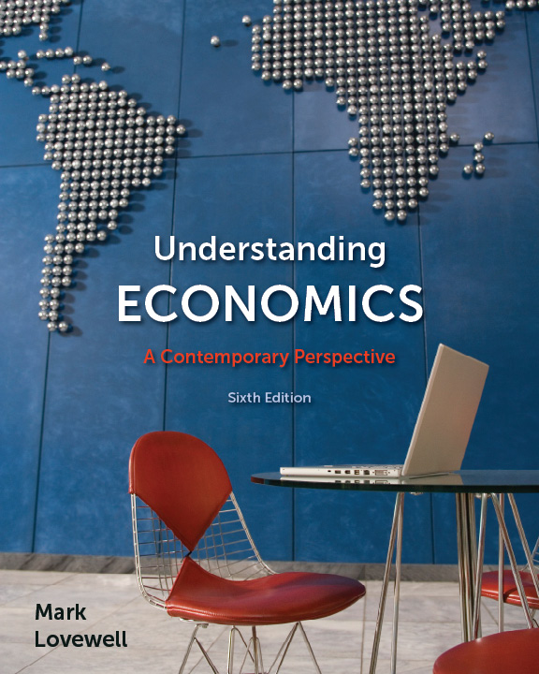
Understanding Economics
6th edition
by Mark Lovewell

Slide 2
Understanding Economics
6th edition by Mark Lovewell
Chapters 5 and 6: Market Structures
Copyright © 2012 by McGraw-Hill Ryerson Limited. All rights reserved.

Slide 3
Learning Objectives
In this chapter you will:
  Consider the four market structures, and the main differences among them.
  Examine the costs and benefits of those market structures.
  Study real-world examples.

Slide 4
Market Structures
There are four main market structures
  Perfect competition
  Monopoly
  Oligopoly
  Monopolistic competition

Slide 5
Perfect Competition
Perfectly competitive markets have three main features
  There are many buyers and many sellers
    Each produces only a very small portion of total output
  There is a standard product
    Each seller sells exactly the same product
  Easy entry and exit
    Anybody can become a supplier of the product
    Anybody can decide to bail out of the market

Slide 6
Perfect Competition
There is a large number of small firms
No one seller, and no one buyer, has any power to set the market price
  The price is set through the forces of demand and supply
  Firms are “price takers, who have to accept this market price
Example: soybeans

Slide 7
Monopoly
In a monopoly a single business (protected by “entry barriers”) provides a product with no close substitutes.
It is the ONLY firm providing the product in the marketplace, and no other firms can get into the market to compete with it.
Example: Cable TV firms

Slide 8
Monopoly
The defining characteristic of a monopoly is that one firm can set the price it charges.
It is a “price maker, not a“price taker (like a perfect competitor).
But a monopoly cant just set any price it wishes to set – why?

Slide 9
Monopoly
Remember: For a monopoly to survive as a monopoly, it must be virtually impossible for other firms to enter the industry

Slide 10
Oligopoly
In an oligopoly a few businesses (protected by “entry barriers) provide standard or similar products.
Example: Gasoline

Slide 11
Oligopoly
Unlike a perfect competitor, an oligopolist has some control over price
An oligopolist is very conscious of the actions of competing firms, and its behaviour is closely related to that of its competitors
  Those businesses co-operate so they can act as if they were one firm (a monopolist) – why?

Slide 12
How do oligopolists cooperate?
Price leadership: an understanding that one business will lead in pricing, and others will follow.
Collusion: a few firms acting together, as if they were a monopoly.
Cartel: a few firms acting together, with a formal market-sharing agreement (how much will be produced & how much each member of the cartel will produce).

Slide 13
Oligopolies “cheat”
All oligopolies are characterized by mutual interdependence.
They usually know what their rivals are up to.
They know if they do something, their competitors will probably find out.
It is in everybody’s best interest to co-operate, or “follow the rules”.
The reality: somebody in most oligopoly situations always lands up cheating, so profits aren’t as large as they could otherwise be.

Slide 14
Monopolistic Competition
Monopolistically competitive markets have three main features
  many buyers and sellers
  slightly different/differentiated products
  easy of entry and exit
Example: Beer, soft drinks

Slide 15
Monopolistic Competitor
A monopolistic competitor can charge more than a perfect competitor because its product isn’t the “same” as the product offered by its rivals.
  The differences may only be in your eyes – “perceived differences”.
  Advertising is used to make you think there are differences (one beer vs. another; Coke vs. Pepsi vs. PC Cola; etc.).

Slide 16
Monopolistic Competitor
A monopolistic competitor’s demand curve is elastic because of many substitutes for the business’s product.
  For example, there are lots of brands of beer. You can charge a premium for some kinds of beer, but you not too much of a premium, or beer drinkers will switch brands.
  You can charge more for a new CD released by a top artist, but not too much more, as there are other CDs that buyers will purchase instead.

Slide 17
Entry Barriers
There are six main entry barriers in oligopolies and monopolies
  increasing returns to scale
  market experience
  restricted ownership of resources
  legal obstacles (such as patents)
  market abuses (such as predatory pricing)
  advertising (which is most common in monopolistic competition)

Slide 18
Market Power
Entry barriers give firms ”market power.
Market power
  is a business’s ability to affect the price it charges
  varies with market structure, such that monopolists have the most and perfect competitors have the least

Slide 19
Attributes of Market Structures
Figure 5.1, Page 119
Perfect Competition
very many
standard
very easy
none
farming
Monopolistic
Competition
many
differentiated
fairly easy
some
restaurants
Oligopoly
few
standard or differentiated
difficult
some
automobile
manufacturing
Monopoly
one
not
applicable
very
difficult
great
public
utilities
Numbers of
Businesses
Type of
Product
Entry and Exit of
New Business
Market Power
Example

Slide 20
Anti-Combines Legislation (a)
Anti-combines legislation represents laws aimed at preventing industrial concentration and abuses of market power.
The Competition Act of 1986 was a major reform of Canada’s anti-combines legislation.

Slide 21
Anti-Combines Legislation (b)
Criminal offences under the Competition Act include:
  conspiracy
  bid-rigging
  predatory pricing
  abuse of dominant position

Slide 22
Anti-Combines Legislation (c)
Civil matters reviewed by the Competition Tribunal include:
  abuse of dominant position
  mergers
    horizontal merger
    vertical merger
    conglomerate merger

Slide 23
Nonprice Competition
Nonprice competition by monopolistic competitors and oligopolists includes:
  product differentiation
  advertising
Nonprice competition raises a business’s revenue and costs.
Nonprice competition may or may not be beneficial to businesses and consumers.

Slide 24
Industrial Concentration
Industrial concentration refers to market domination by a few large businesses.
  It can provide the consumer with benefits due to increasing returns to scale.
  It can impose costs on the consumer due to market power.
  It may or may not encourage technical innovation.

Slide 25
Concentration Ratios
Industrial concentration is measured using concentration ratios.
The four-firm concentration ratio shows the percentage of total sales revenue in a market earned by the four largest business firms.
Concentration ratios overestimate competition in localized markets and underestimate it in global markets.

Slide 26
Concentration Ratios in Selected Canadian Industries (1988)
Figure 6.13, Page 166
Share of Industry Sales
by Four Largest Businesses
98.9
74.5
68.5
59.2
58.9
38.9
32.1
25.7
19.6
16.4
11.3
9.7
6.6
2.2
Tobacco products
Petroleum and coal products
Transportation
Beverages
Metal mining
Paper and allied industries
Electrical products
Printing, publishing, and allied industries
Food
Finance
Machinery
Retail trade
Clothing industries
Construction

Slide 27
Pumping up Price (OLC)
The Role of OPEC
The Organization of Petroleum Exporting Countries is an example of a cartel that has had some success in the past in influencing the global price of oil.
During the 1970s, OPEC members used market-sharing agreements to significantly raise this price.

Slide 28
Pumping up Price (OLC)
OPEC in the 1980s
In the 1980s, the oil price fell and OPEC’s influence waned. This was due to:
  a reduction in quantity demanded – a delayed reaction to the high prices of the 1970s
  increases in quantity supplied by non-OPEC producers
  cheating by some OPEC members, who secretly raised output to counteract reduced prices, and thereby made the price reductions even greater

Slide 29
Pumping up Price (OLC)
OPEC in the 1990s and 2000s
During the 1990s and the early 2000s, despite continuing conflicts within OPEC, oil prices were driven much higher, due to a variety of factors, including political considerations:
  the Iraq War and its aftermath
  tensions between the West and Iran

