Slide 1
Viroids: unique type of plant infectious agent that does not
contain any protein associated with it (ssRNA with high
intramolecular complementarity)
viroids do not encode any protein
How are they pathogenic??
may act as a ribozyme or inhibit translation of normal
genes in plants
some are transcribed by RNA polII into rolling circle RNA
Examples: Potato spindle tuber viroid (PSTV)
Cadang cadang viroid (242 base ssRNA)
Notes:
Viroids : contain only RNA molecules
Becomes an organism once it comes in contact with host
Some pathogens dont have proteins> viroids > infect plants mostly
How are they pathogenic ? They are pathogenic b/c they interfere with normal cellular process, by taking control i essential enzymes for their own replication or by interfering with the production of necessary cellular RNA’s.
- They might also behave as abnormal regulatory molecules , with effects on the expression on genes
- sequence of that RNA molecule is directed towards certain genes > knocks out those genes= disease
Ribozymes : inhibits rna transcription
- The infectious particles usually enter the cell through breaks and cuts in the plants
Viroids are made by the plants rna
Potato
Cadang cadang viroid > palm tree , formed as a sinlge transcript . Mutate a couple of the nucleotides reduces the virulence of the viroids * sequence is IMPORTANT in this case

Slide 2
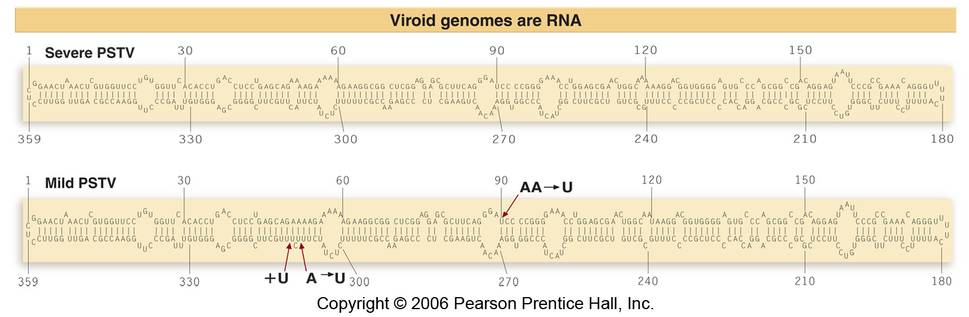
Fig 1.32

Slide 3
Prions:
infectious agents that do not contain DNA or RNA
28kDa hydrophobic glycoprotein (PrP) encoded by
normal gene in brain (in mammals)
Two forms:
PrP^{c}: normal and degraded by proteases in cell
PrP^{sc}: resistant to degradation
PrP^{c} is converted to PrP^{sc} to cause disease
Notes:
Ex : scrapie : a degenerative neurological disease in sheep and goats
This disease is similar to kuru and creutzfeldt-jakob disease which affects brain function
Infectious agents are PRIONS
Prions : no dna /rna , they do infect mammals
Glycoprotein made in the brain has a specific duty , maintains protein integrity
PrP
PrP^c : normal and degraded by proteases in the cell
PrP^sc : resistant to degradation
PrP^c > PrP^sc caused by conformational changes that makes it resistant to proteases
Caused in most cases by mutations >

Slide 4
Example of prion diseases
Human Prion Diseases
Creutzfeldt-Jakob Disease (CJD)
Variant Creutzfeldt-Jakob Disease (vCJD)
Gerstmann-Straussler-Scheinker Syndrome
Fatal Familial Insomnia
Kuru
Animal Prion Diseases
Bovine Spongiform Encephalopathy (BSE)
Chronic Wasting Disease (CWD)
Scrapie
Transmissible mink encephalopathy
Feline spongiform encephalopathy
Ungulate spongiform encephalopathy

Slide 5
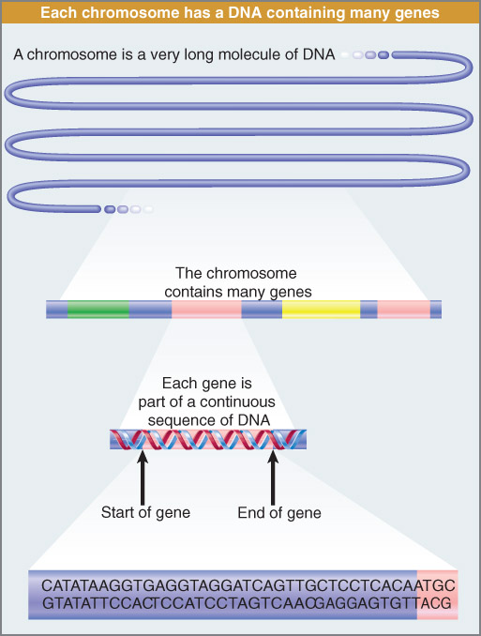
Chapter 2: Genes code for proteins
A chromosome
contains a very long
stretch of DNA
that contains many
genes
Fig 2.1
Notes:
Genes codes for proteins
A chromo contains
A very long stretch of dna that contain many genes
Clusters in certain spots , blank distance , cluster etc
Each gene processed = code four letter tell us where genes are n are not
What parts the chromosome went under changes ,

Slide 6
most genes in the genome code for proteins
Alleles: alternate forms of a gene (may be many for a
single gene)
Locus: region on the chromosome where a gene is located
genes on a specific chromosome are said to be linked
they do not assort independently during meiosis
as do genes that are on different chromosomes
recombination can occur between homologous
chromosomes during meiosis (crossing over)
causes genetic variation
Notes:
-genetic linkage the tendency for genes on the same chromosome to remain together in progeny instead of assorting

Slide 7
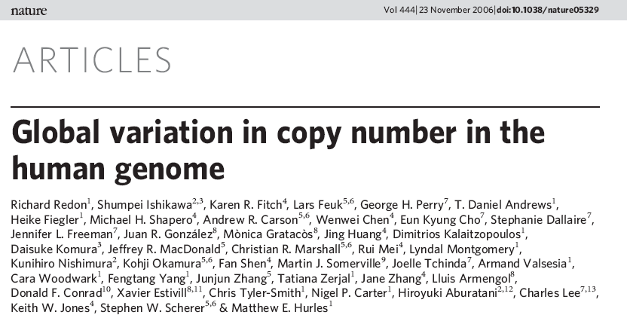
you get one maternal and one paternal copy for each gene
However in 2006- New discovery:
compared genome sequences from 270 people from
4 populations (descendants from Europe, Africa, Asia)

Slide 8
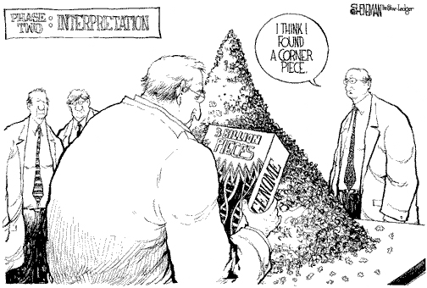

Slide 9
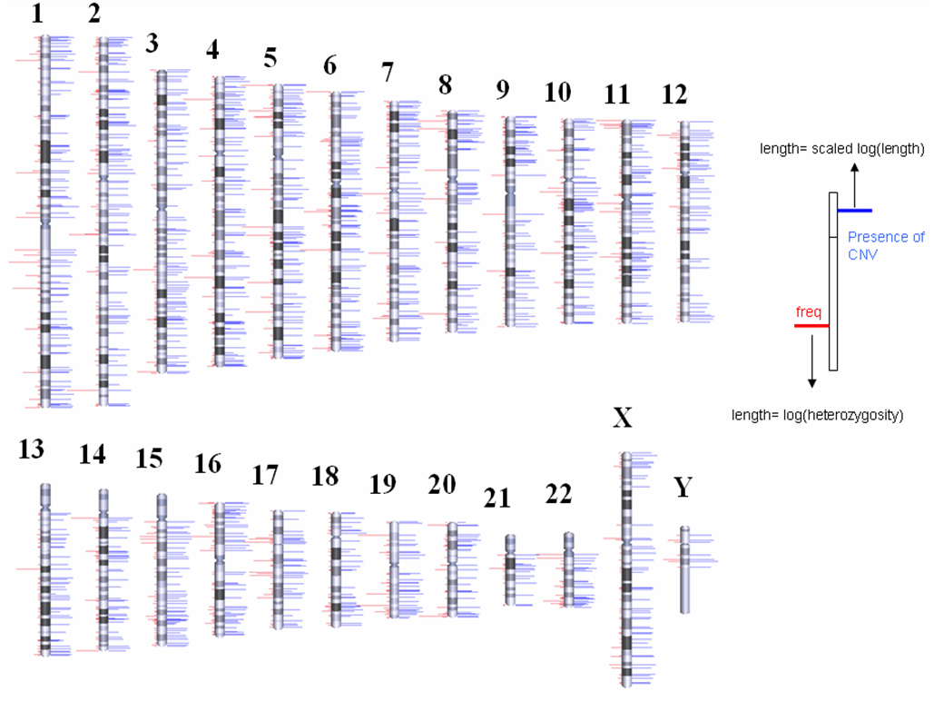
CNVs: copy number variations (>1000bp)
insertions, duplications and deletions
1447 CNVs account for ~ 12% of genome
(total of 360 megabases)
Notes:
Recombination /
Sometimes you dont get 1 copy from each parent ,
compared genomes sequences for ppl of diff populations ( europe. Africa, asia etc) 27 ppl
CNV s: copy number variations ( >1000bp)
Insertions, duplication, deletions // larger chunks // when you look at a populations of genome < 1447 CNV account for 12% of genome ( 360 megabases )

Slide 10
Chromosome #5
Different
possibilities
in population
OR
CNV
100,000bp
missing

Slide 11
What does this mean?
for some genes we may inherit more or less genes
from one parent (genomic copy number)
implications for disease traits (autism, heart disease,
Schizophrenia, Parkinson’s, Alzheimer’s) where increase
or decrease in gene expression may be a cause
http://www.sanger.ac.uk/humgen/cnv/
Notes:
What does this mean ?
Health/genome
For some genes we may inherit more or less genes from on parent ( genomic copy number )
Vary in the # of genes that we get from our parents

Slide 13
Charcot-Marie-Tooth (CMT) Disease
Most common nerve related disorders
Leads to myelin sheath damage in peripheral nerves
Diagnosed in mid-childhood and progressively
gets worse
Caused by mutation in PMP22 gene (Peripheral Myelin
Protein)
Another 43 genes involved in other CMT phenotypes
Notes:
PMP22 copy # impact on disease m hoe severe it is // higher risk of getting the disease
Doesn't happen often , if they did pop up would during meiosis
Some genes we have many copies ,
Different racial ancestry you have more genes of certain types and others you have less
why do we have extra copies
Focus on diet // you eat what is available // diet can select for high amylase gene ( AMY1) copy number
Selection affecting copy number
What is gene / what is a allele, what is CNV, what is an SNP
Does the cell have control to turn of the gene is an extra copy is obtained *Q
If its lethal they may get rid of it
Or turn down the expression of the gene
One gene - one enzyme hypothesis slide LAST
Carrier protection
Homozygote , het
Null mutant : nothing being made
Sometimes lethal = death of organism

Slide 14
PMP22 Gene
copy number and
impact on disease

Slide 15
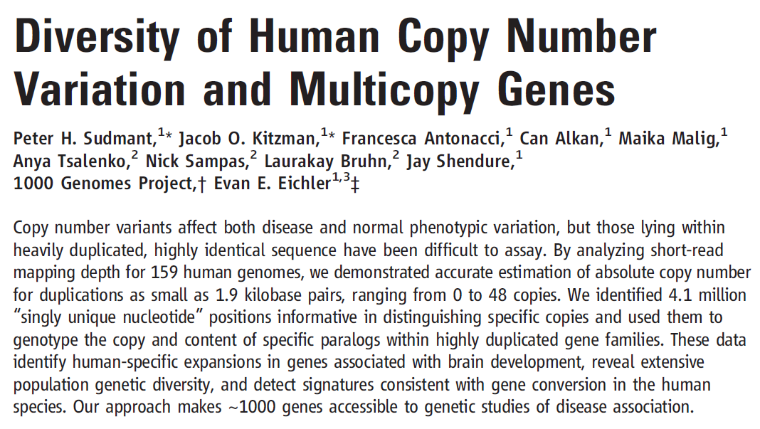
Notes:
Some genes we have many copies ,
Different racial ancestry you have more genes of certain types and others you have less
why do we have extra copies
Focus on diet // you eat what is available // diet can select for high amylase gene ( AMY1) copy number
Selection affecting copy number
What is gene / what is a allele, what is CNV, what is an SNP
Does the cell have control to turn of the gene is an extra copy is obtained *Q
If its lethal they may get rid of it
Or turn down the expression of the gene
One gene - one enzyme hypothesis slide LAST
Carrier protection
Homozygote , het
Null mutant : nothing being made
Sometimes lethal = death of organism

Slide 16
Copy number
variation for specific
genes vary between
populations

Slide 17
Human evolution and copy number variation:
Can copy number variation explain some human phenotypes?
Diet (high vs. low starch) can select for high amylase
gene (AMY1) copy number
High starch
Diets = high
amylase copy
number
Notes:
why do we have extra copies
Focus on diet // you eat what is available // diet can select for high amylase gene ( AMY1) copy number
Selection affecting copy number

Slide 18
What is a gene?
What is an allele?
What is a CNV?
What is an SNP?
AAGCTATGA
maternal
Gene X
Chromosome #15
Gene X
Gene X
Chromosome #15
paternal
AAACTCTGA
If sequences of gene X are different, they are
different alleles of gene X (also SNPs)
If gene X is duplicated, creates a CNV
Notes:
What is gene / what is a allele, what is CNV, what is an SNP
Gene : is functional unit of heredity
Allele:gene may exist in alterntive forms this is called an allele
Cnv : CNVs: copy number variations ( due to insertion deletions)
SNP:

Slide 19
One gene= one enzyme hypothesis (1909/1941)
Some enzymes are produced
by >1 gene
One gene= single polypeptide (1962)
Some genes only encode RNA
Gene is a sequence of DNA that encodes a
functional RNA molecule (2013)
most mutations that affect gene function are recessive
(get absence or reduction in protein function)
Notes:
One gene =one enyzme hyp: a mutatio in gene alters the activit of the protein enzyme it encodes
One gene =one polypeptide hyp: each subunit is encoded by different gene
Most mutation that affect the gene function are recessive : they result in an absence of function, b/c mutant gene does not produce its usual polypeptide
Does the cell have control to turn of the gene is an extra copy is obtained *Q
If its lethal they may get rid of it
Or turn down the expression of the gene
One gene - one enzyme hypothesis slide LAST
Carrier protection
Homozygote , het
Null mutant : nothing being made
Sometimes lethal = death of organism

Slide 20
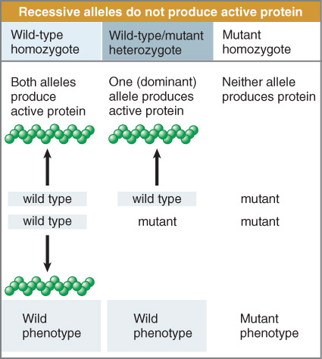
Fig 2.2
Notes:
- Genes encode proteins ; dominance explained by AA, Aa ,aa , a recessive allele does not contribute to phenotype because it produces no protein (or protein is nonfunctional)

Slide 21
Types of gene mutations:
Null mutant: eliminates function of a gene (no protein
produced)
sometimes these are lethal mutations (organism dies)
Silent mutation: usually point mutations that change the
DNA sequence but not the protein sequence
Neutral mutations: changes in DNA sequence resulting
in changed amino acid sequence that does not affect
protein activity
Leaky mutations: may affect protein function but not
enough to change phenotype
Notes:
Null mutant : if it fails to affect the phenotype we say that the gene function is not essential
Silent mutation : mutations without any apparent phenotypic affect
- base change in DNA that does not change amino acid
- base change in DNA that does change amino acid but the replacement does not affect the polypeptide ( neutral substitutions )
Carrier protection
Homozygote , het
Null mutant : nothing being made
Sometimes lethal = death of organism

Slide 22
Types of gene mutations:
Loss-of-function mutations: leads to loss in gene function
(but not usually complete loss)
Gain-of-function mutations: mutation that causes
new function for a protein (rare but usually dominant)
Notes:
Loss of function : recessive mutation
Loss of func: that affect the protein activity but they still retain sufficient activity so that the phenotype is not altered is called leaky mutation
Gain of function: dominant

Slide 23
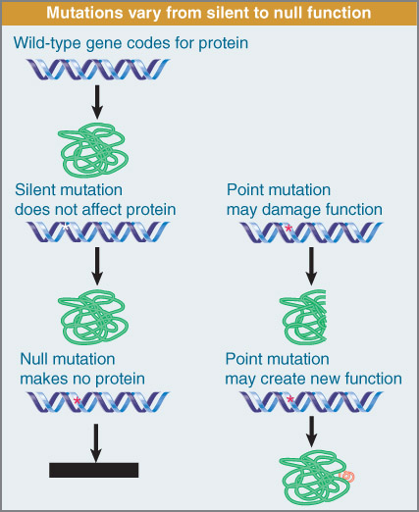
Fig 2.4
Notes:
Mutations that do not affect protein sequence or function are silent
Mutations that abolish all protein activity are null
Point mutations that cause loss of function are recessive
Those that cause gain of function are dominant

Slide 24
Multiple Alleles:
usually multiple mutations in a gene results in many
different alleles
can have a heterozygote that contains two mutant alleles
Eye color in Drosophila (fly)
W⁺ - wild type normal (red)
W^{i} - white eye (no pigment)
W⁺W^{i} – heterozygote is red (dominant)
W^{i}W^{i} –Homozygote is white (recessive)
Notes:
Multiple alleles
Changes that occur are passed down , mating within pop , mixing of alleles and they spread out in the pop
The one that has the highest % is the "normal" allele / usually one allele that stands out in most cases
-
- One allele may be dominat , partial dominance or codominance
Ex eye color in fruit fly
Wild type normal ( red) W+
White eye ( no pigment) Wi
Hetero is the red ( dominant) W+Wi
Homo is white ( recessive ) WiWi

Slide 25
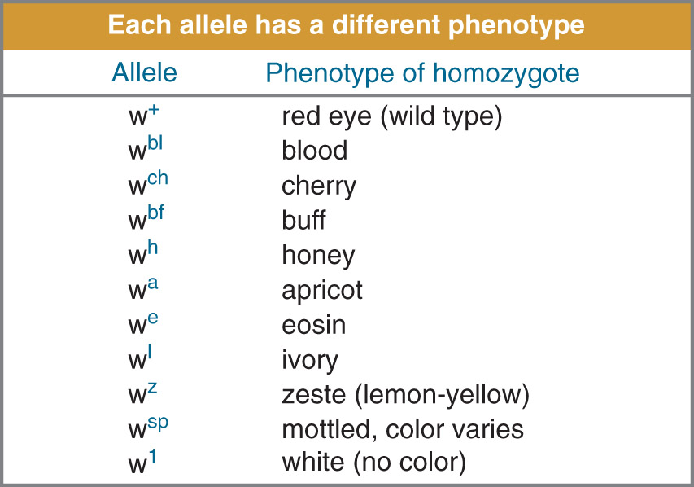
Fig 2.5

Slide 26
Some genes have more than one wild-type allele
Polymorphism: many alleles with no one allele being
considered as wild-type (usually >1% of population)
e.g.: ABO blood group locus on chromosome 9
A allele: produces glycosyltranferase that uses a cofactor
(UDP-N-acetylgalactose) which produces A antigen
B allele: produces glycosyltranferase that uses a cofactor
(UDP-galactose) which produces B antigen
O allele: mutation (deletion) in exon 6 which produces
no enzyme
Notes:
some genes have more than one type of wild type
Polymorphism : whole bunch of diff alleles at the locus but none are considered as the wild type ( <1%)
Ex ABO blood type group locus on chromo 9 , produces an antigen ,
A allele
B allele
o allele : if O is a mutation how did it become a common blood type
Can give your blood to everyone bc doesn't have antigens
Rh factor
AB uni acceptor , O is uni donator
AO and BO – both A and B are dominant , while in AB they are co-dominant producing both traferases , OO homozygote is null as neither acitvity and lacks both antigens
Neither A or B can be said as wild type b/c the represent alternative acvitites as opposed to loss of gain of funtion

Slide 27
Protein production :TRANSLATION
only one strand of DNA serves to produce RNA template
via transcription
genetic code is read in groups of three nucleotides (codon)
gene includes series of codons that are read sequentially
from starting point to a termination point in 5’-3’ direction
codons are non-overlapping
…. AUG CAU GGG AAG….
Met
His
Gly
Lys
Notes:
Protein production : translation
Only one strand of dna serves to produce Rna template via transcription
Genetic code as codons
Gene includes a series of codons and read starting >termination point 5' -3' direction
Codons as non-overlapping : implies that each codon consists of 3 nucleotides( each is only part of one codon )
Starts from a fixed starting point : making of polypeptide starts are one end and goes to the other, different parts of the coding seq cannot be reading independently

Slide 28
Translational mutations:
Insertions and deletions into the DNA can lead to amino
acid changes in the protein
Frameshift Mutations: changes the reading frame of
the codons, usually causes severe effects
Acridines: chemicals (dyes) that induce structural distortion
in DNA-leads to frameshift mutations
if insertions or deletions are in multiples of three
nucleotides, less severe consequences result
Notes:
Base substitutions and base insertions/deletions have different effects
Point mutation affects only one amino acid
However a mutation that inserts or deletes a single nucleotide will change the triplet sets for entire subsequent sequence >> FRAMESHIFT
Transitional Mutations
Insertions . Deletions into the dna can lead to amino acid changes in the protein
Frame shift mutation : severe effects, b/c the new seq of codons is completely different than the old one
> The entire amino acid sequence is altered > function of protein is likely to be lost
Frameshift mutations are induced by acridines which are compound that bind to dNA and distort structure of the double helix causing bases to be added or omitted during replication
If the insertions or deletions are in group of 3 occur , it as less severe impact

Slide 29
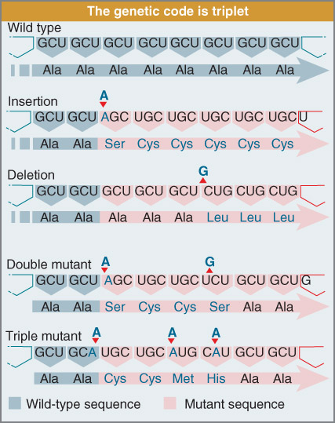
Ala codons:
GCU
GCC
GCA
GCG
Fig 2.10
Notes:
Insertion or deletion can cause the polypeptide seq to change
But if same number of nucleotides are inserted or deleted the polyp is only read incorrectly for btw the 2 sites of mutation

Slide 30
Gene reading frames:
three possible ways of reading an RNA sequence
ACGTTACGTCCCATGTTT
Frame 1
ACG TTA CGT CCC ATG TTT
Frame 2
CGT TAC GTC CCA TGT TT
Frame 3
GTT ACG TCC CAT GTT T

Slide 31
Open reading frame (ORF): reading frame used to
produce the protein from a particular gene
ORFs start with an AUG initiator codon and end
with a termination/STOP codon (UAA, UGA, UAG)
any mutations within the ORFs can alter accurate
protein translation (blocked reading frame)

Slide 32
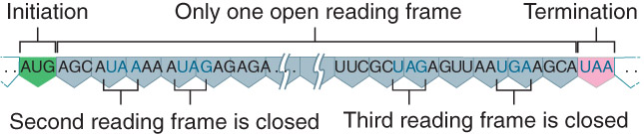
Fig 2.11
URF: unidentified reading frame
an ORF for which no protein has been identified
e.g. FLJ10560
http://www.ncbi.nlm.nih.gov/mapview/map_search.cgi?taxid=9606
Notes:
- Reading frame that cannot be read due to termination codons occuring frequently is said to be closed or blocked

Slide 33
Gene and protein sequences are colinear:
sequence of nucleotides is same as sequence of
amino acids
3N bp= N amino acids

Slide 34
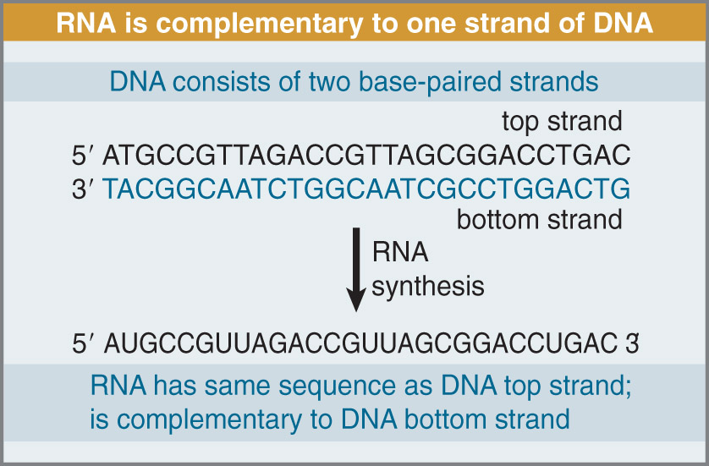
Transcription:
one strand of DNA serves as template for production
of messenger RNA (mRNA)
Coding strand
Template strand
Fig 2.13
Notes:
Rna has the same seq as the coding strand
Which strand does rna polymerase read to transcribe the rna the template strand the bottom strand > why?
RNA produced from 3'>5' / polarity has to line up as well /
Transcription : mRNA copy of coding strand of dna is produced
Translation : mRNA > polypeptide

Slide 35
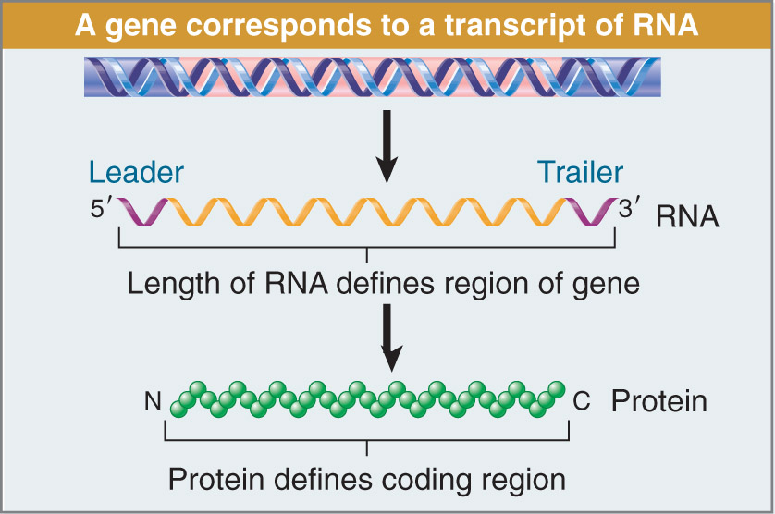
Transcription:
complete mRNA contains 5’ untranslated region (UTR)
called leader
mRNA also contains 3’UTR called trailer
Fig 2.14
Notes:
Complete mRNA contains 5' untranslated (UTR) called leader / shipped>translated > the sequence up stream doesnt go through that
mRNA also contains 3' UTR called trailer / stability of the RNA can be dependent on the how long it is
Other genes who's UTR's are very short ,d
UTR : UNTRANSLATED REGION

Slide 36
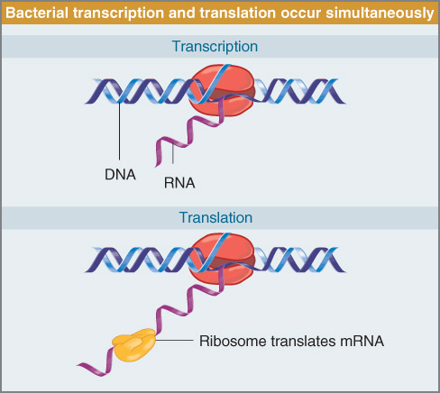
Transcription:
BACTERIA:
bacterial transcription and translation takes place
in the cell at the same time
WHY?
Fig 2.15
Notes:
Bacterial transcription /translation occurs at the same time Why ? No nucleus to separate the genetic material so it occurs in the cytoplasm

Slide 37
Transcription:
EUKARYOTES:
in eukaryotes, transcription takes place in the nucleus
and translation in the cytoplasm
mRNA is transported from nucleus to cytoplasm
Notes:
Euks transcription takes place in nucleus / the translation in cytoplasm
mrna transport from nucleus >cytoplasm for translation to occur
The most important stage in RNA processing is > SPLICING
b/c many genes contain introns that do not carry any coding information
Splicing removes the introns from pre-mRNA > mature RNA that is continous and has an open reading frame (ORF)
The expressed region are called exons
Translation : ribosome
- Recognizes amino acids that correspond to the nucleotide triplets (codons)
Can't screw up splicing bc you shift the frame BAD

Slide 38
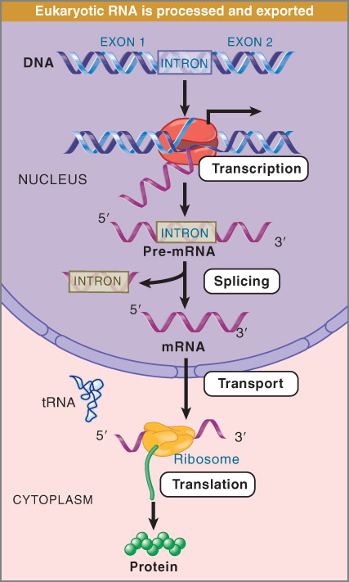
Fig 2.16

Slide 39
Cis vs. trans
Cis-acting: acts on its own molecule (usually DNA)
Trans-acting: can function on other molecules (protein
or RNA)
all gene products (protein and RNA) can act in trans
diffusible in the cell and can act on other molecules
binding sites on the same DNA molecule are cis-acting
Can also be used to describe complementation of mutations
Notes:
In genetics sites that are located on the same DNA are said to be cis
- Sites that are located on two different DNA molecules are trans
Two mutations may be in cis on the same DNA
Or they may in trans on different DNA molecules
CIS/ TRANS
Cis-acting : acts on its own molecule ( usually DNA) attached
Trans- acting : can function on other molecules ( protein or rna ) move
All gene products ( proteins and rna ) can act in trans
Diffusible in the cell and can act on other molecules
binding sites on the same dna molecule are cis -acting
Tata box , binds a protein that turns gene off
Can also be used to describe complementation of mutations

Slide 40
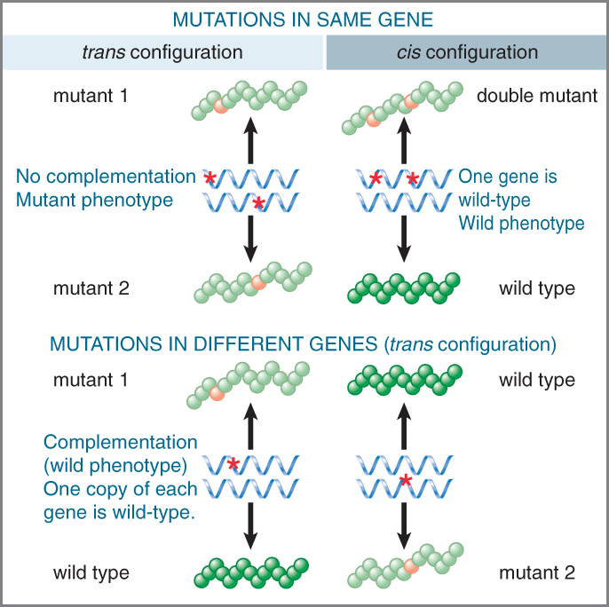
Fig. 2.3

Slide 41
promoter
Gene X
?
transcription
Gene X mRNA
Promoters require binding of proteins produced
from different genes to activate transcription of
gene X
Notes:
Affects on transcription
Promoter / gene x / > transcription = gene x RNA
Promoters require binding of proteins produced from different genes to be activated

Slide 42
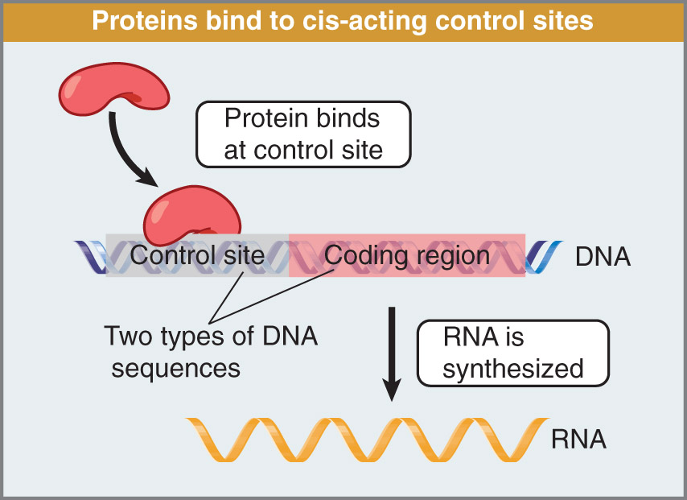
Produced from a
separate gene (in trans)
(acts in trans)
(acts in trans)
PROMOTER
Fig 2.17
Notes:
Promoters cis acting , bc they are linked to what they are acting one
In control
Red proteins are acting in trans b/c moving coming from somewhere else
Gene expression can become inactivated , by mutation in the control site or by a mutation in coding region to prevent binding
( lac operon, lacz MICro)
Gene can be inactivated by a mutation in the cis acting dna element that control the gene expression or in another gene that acts in trans to regulate the protein
Diagram : microbiology notes on lactose / glucose / lac operon and inhibitors

Slide 43
a gene can be inactivated by a mutation in a control
region or in the coding region of a gene
these mutations cannot be distinguished genetically
a gene can be inactivated by a mutation in a cis-acting
DNA element that controls gene expression or in
another gene (e.g. protein) that acts in trans to regulate
the gene

Slide 44
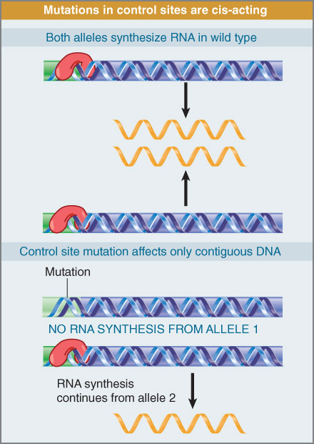
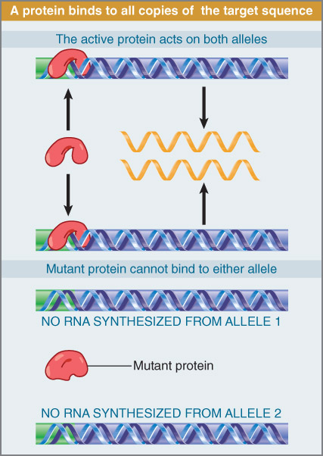
CIS
Fig 2.18
TRANS
Fig 2.19
Notes:
1st one : shows that a deficiency in the control site affects only the coding region to which it is connected ; does not affect the ability of homologous allele to be expressed >> cis acting
Show the absence of regulatory protein would prevent both alleles from begin expressed. A mutation of this sort is trans acting .
Promoters cis acting , bc they are linked to what they are acting one
In control
Red proteins are acting in trans b/c moving coming from somewhere else
Gene can become inactivated , you can have mutation to prevent binding , ( lac operon, lacz MICro)
Gene can be inactivated by a mutation in the cis acting dna element that control the gene expression or in another gene that acts in trans to regulate the protein
Diagram : microbiology notes on lactose / glucose / lac operon and inhibitors
Trans acting : effects must be exerted through some diffusible product ( protein or regulatory RNA) that acts on multiple targets
Cis –acting : must function by directly affecting the propertied of DNA , ( not protein or RNA)

