Slide 1
What is the definition of a gene???
sequence of DNA that encodes a functional RNA molecule;
In protein coding genes, the RNA in turn codes for
protein
some genes encode RNA that is not translated into
protein
e.g.??
Ribosomal RNA (rRNA)
Transfer RNA (tRNA)
Micro RNAs (miRNA- 26-31 nucl.)
much more numerous than
first thought- play roles in
regulating gene expression
PIWI RNAs (piRNA- 21-24 nucl.)
Small inhibitory RNAS (siRNA)

Slide 2
DNA is the genetic material and can transform cells
1928: Griffith experiment using Pneumococcus
Proved that virulence can be passed between cells
via DNA transformation
Fig. 1.3
avirulent (nonlethal) R type bacteria could be converted
to lethal S (smooth) bacteria when cells were mixed together
Notes:
Dna is the genetic material n can transform cells
Bacterial transformation provided the first support that dna is the genetic material of the bacteria
Genetic properties can be transferred from one bacterial strain to another
Dna was shown to be transmitted to progeny phages that were produced by bacteria

Slide 3
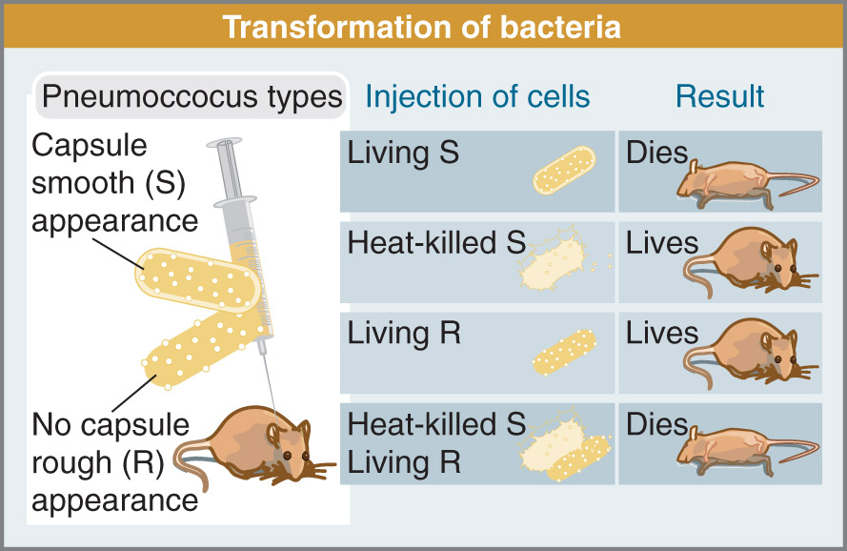
Fig. 1.3
Fig 1.3
Notes:
1928 griffith exp using pneumococcus : proved that virulence can be passed btw cells via dna transformation ( avirulent nonlethal) R type of bacteria could be converted to lethal S ( smooth) bac when cells are mixed FIGURE 1.3
S/R strains how it happens
Once the mice die they take the bacteria out extract it R> S bacteria , something in DNA that can convert R strain to S strain , toxin genes that are responsible for the toxicity
DNA genetic material of viruses /hersey , chase exp ( 1952) / radioactive compounds to tag DNA and protein of viruses ( p32 , s35, phage T2 ) , sulfur containing sistine and mythyine ,/ infected bacteria and recovered viral progeny , easured radioactivity amounts /
Let them replicate , infect bacteria w viruses , measure where their radioacivitiy will go after infection
New viruses had high levels of p32 not s35
Dna genetic material of viruses

Slide 4
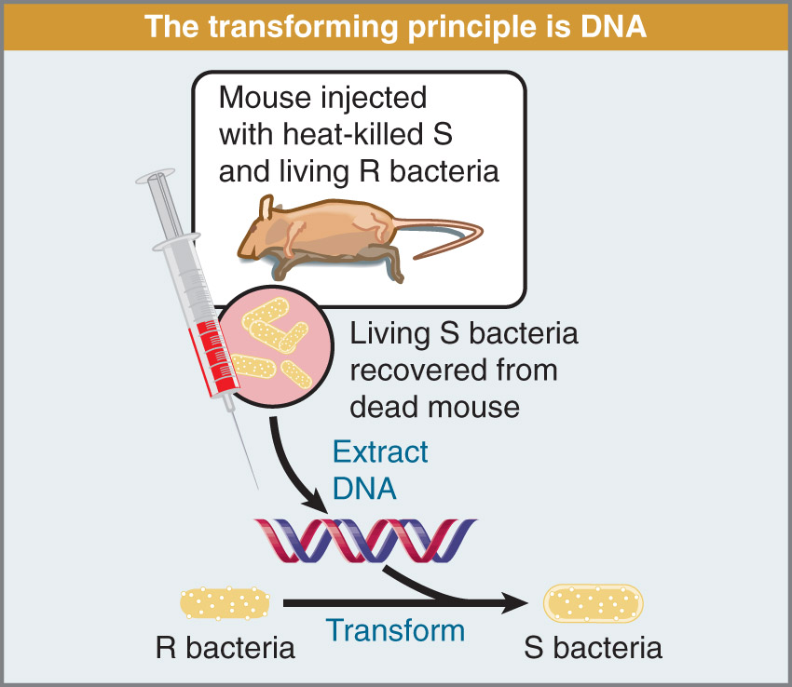
DNA is the
transforming principle
Fig 1.4
Notes:
Transforming principle : dna that is taken up by a bacterium and whose expression then changes the properties of the recipient cell

Slide 5
DNA is Genetic Material of Viruses
Hersey and Chase experiment (1952)
used radioactive compounds to tag DNA (³²P) and
protein (³⁵S) of viruses (Phage T2)
infected bacteria and recovered viral progeny and
measured radioactivity amounts
new viruses had high levels of ³²P and not ³⁵S
DNA is genetic material of viruses
Notes:
Experiment diretcly showed that only DNA of the parent phages enters the bacteria and becomes part of the progeny phages

Slide 6
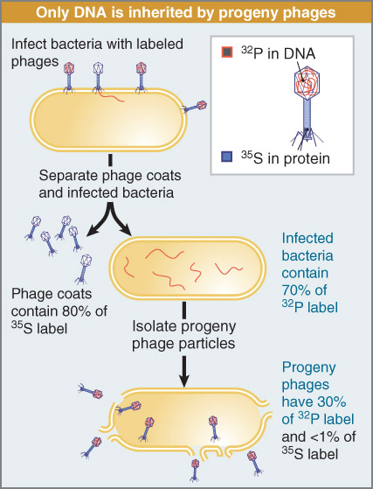
Fig 1.6

Slide 7
DNA can be introduced into all cells
when DNA is put into eukaryotic cells it is termed
transfection which is the same as transformation into
bacteria
DNA transforms at LOW efficiency
need a way to select for cells that have taken up DNA
Selectable markers
Antibiotic resistance in bacteria
Notes:
Dna can be introduced into all cells
When dna is put into euk cells it is termed transfection which is the same as transformation into bacteria
Dna transforms at low eff
Need a way to select for cell that have taken up dna ( what do you have to put ) SELECTABLE MARKERS (using in the lab ) antibiotic resistance in bacteria ( allows the bacteria to grow normally in the presence of ampicillin
Prevent the antibiotic from licing the cell
If you add an enzyme
Synthetic cells craig dent 60 mins

Slide 8
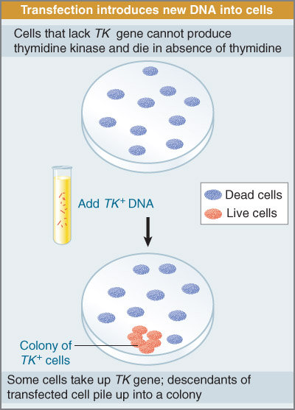
Fig 1.7
Notes:
Euk cells can acquire new phenotype are a result of transfection by added dna

Slide 9
DNA Structure
DNA is double helix with an average of 10 bp/turn
overwound DNA has more bp/turn and underwound
has less
the two strands of helix run antiparallel
H bonds
5’
3’
C
G
3’
5’
T
A
pyrimidines
purines
Notes:
DNA structure
Three main components :
N bases /sugars/phosphates
Nitrogen base is either purine or pyrimidie ring ( linked together by glycosidic bond )
A/T C/G bond together
A, G are present in both dna and rna
C ,T present in DNA
U present instead of T in rna
Has minor and major grooves
Know general structure A/T , G/C three bonds

Slide 10
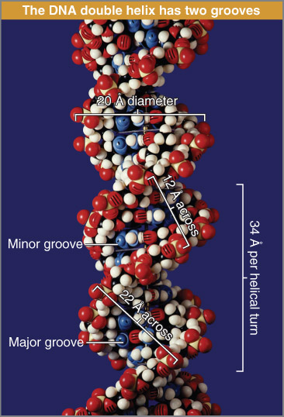
DNA has minor and
major grooves
Fig 1.13
Notes:
Dna structure has minor and major grooves
Minor grooves = 12 A (1.2nm) across
Major grooves =22A (2.2nm)

Slide 11
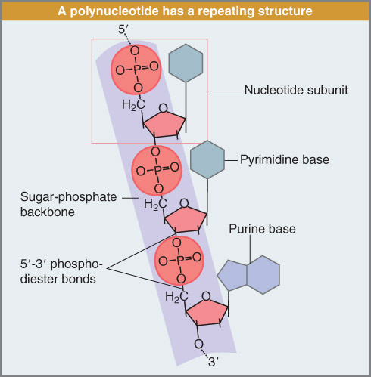
Figure 1.8: A polynucleotide has a repeating structure.

Slide 12
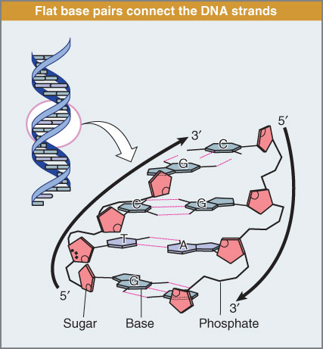
Figure 1.12: Flat base pairs connect the DNA strands.
Notes:
Flat base pairs lie perpendicular to the sugar phosphate backbone

Slide 13
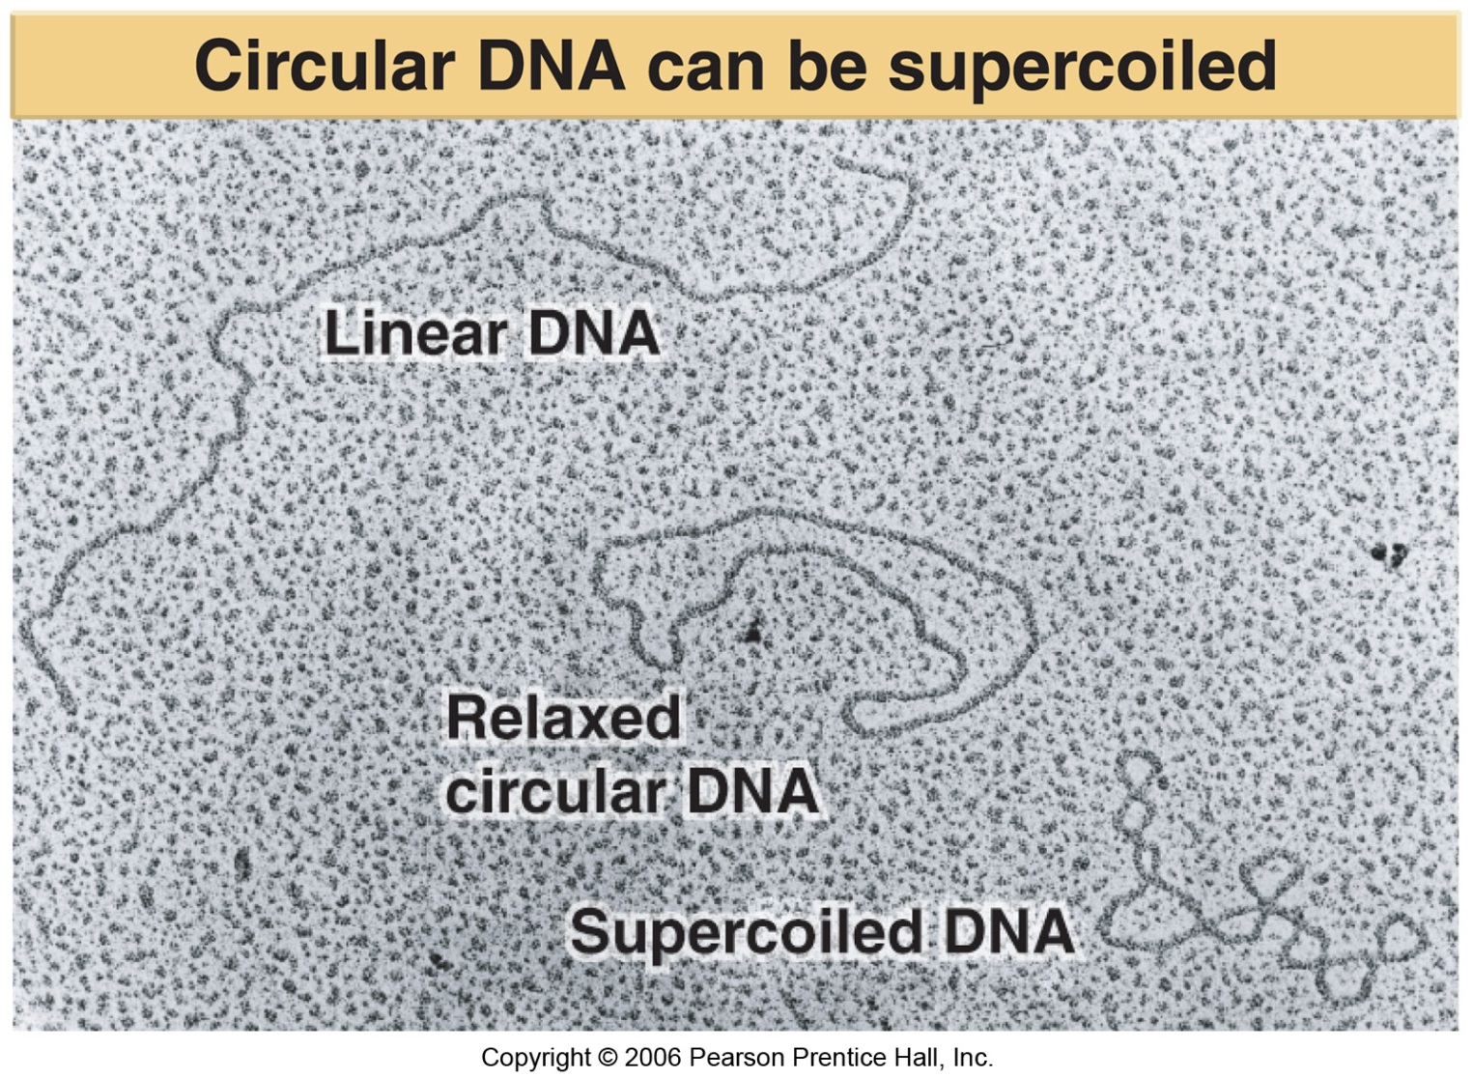
DNA supercoiling:
DNA can coil around its axis if it is closed with
no free ends (e.g. plasmid- closed circular DNA)
Notes:
DNA supercoiling
Dna has built in tension base on the conformation
can form diff shapes to relieve some of the stress
Linear, relaxed supercoiled , difference btw the two

Slide 14
Supercoiling Affects the Structure of DNA
A closed DNA can be a circular DNA molecule or a linear molecule where both ends are anchored in a protein structure.
Notes:
Denature when hydrogen bonds are broken , why is it important , cell evolves mechanism to counteract this
Replication , transcription when dna strands have to change configuration and separate
How does the cell do it ? : nick ( break is generate in order to relieve stress and after can be glued back together
Many enzymes participate , very fast rates // replication fork how it relieves stress

Slide 15
DNA has minor and
major grooves
Fig 1.13

Slide 16
Positive supercoiling:
twisting of the DNA helix in the same direction as
the two strands; causes increase in the number of
bases /turn
Negative supercoiling:
twisting of the DNA helix in the opposite direction as
the two strands; causes decrease in the number of
bases /turn
causes strand separation-denaturation
Why is this important??
Notes:
Positive superC you twist the Dna in the same direction makes the bases come in closer together , // negative unwinding it m fewer base in the same distance , if you do it too much you are at risk separating the two strands
The only way to relieve the tension is to cut , the problem , the supercoiling affects the # of bases and turn
Why do we have these enzymes, antiviral mechs , foreign dna detection , cut at a certain sequence , endonucleases, restriction enzymes isolated from bacteria
Used by bacteria primary antiviral mech
Dna ligase attach back ,

Slide 17
DNA strands have to separate during replication,
transcription and recombination
How does the torsional stress get relieved?
a nick (break) is generated in one of the strands which
allows it to rotate to relieve tension
nick is resealed (ligated) after it is rotated around
the intact strand
many proteins (enzymes) are involved in this process
Notes:
Enzymatically it’s not a simple task.
Not one enzyme does this – a bunch of enzymes do it at high rates.

Slide 18
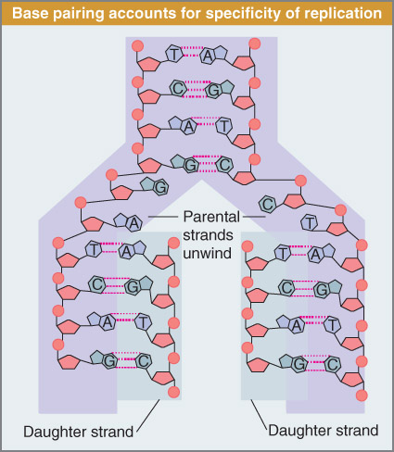
Transcription and Replication require DNA strand separation
and special enzymes
Fig 1.14
Notes:
Special enzymes are critical. Defect in enzymes can cause problems.

Slide 19
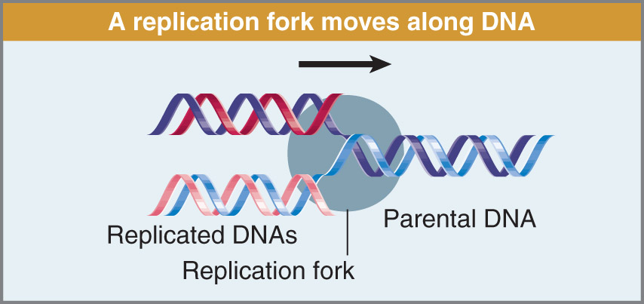
Fig. 1.16
Notes:
Replication machine – DNA polymerase and all other enzymes involved as it goes through the replication fork and DNA is being unwound it’s also being put under super pressure which has to keep on relieving that pressure as that whole unit goes down.

Slide 20
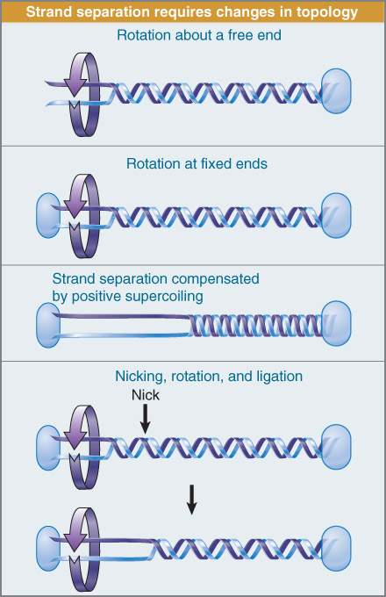
Fig 1.10
Notes:
Different format. Showing that you generate torsional forces on DNA molecule that have to be relieved. You can’t relive it unless you cut it and reseal it.
There has to be enzymes to nick one of the strands to allow the DNA to flip. And then that strand is re-sealed.

Slide 21
Topoisomerases
can relax OR create supercoils in DNA
Break bonds in DNA
Type I: single strand breaks
Type II: double strand breaks
Gyrases can also affect supercoiling
Notes:
Critical players: involved heavily in replication. Done at a high speed. Incredible fidelity. Mechanisms to repair DNA of individual nucleotides.

Slide 22
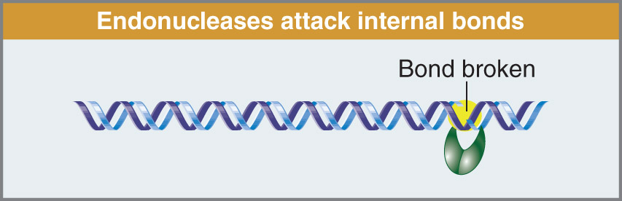
Enzymes involved in DNA degradation:
Deoxyribonucleases (DNases) degrade DNA
Ribonucleases (RNases) degrade RNA
Endonucleases: break bonds within nucleic acid
Fig 1.17
Which endonucleases are used in molecular biology?
Notes:
Enzymes that nick and cut DNA –as a cell don’t necessarily want a lot of enzymes that are cutting DNA.
Dnases – physically cut DNA. Rnases – degrade RNA
These enzymes evolved with eukaryotic cells to do jobs within the cell (get rid of unwanted RNA).
Why do we have these enzymes? Anti viral/anti bacterial mechanisms – so if DNA comes in – cell can recognize it as foreign then it can chop it up.
There are 2 types of endonucleases: RNA & DNA nucleases – restriction ends of nucleases that cut DNA w/in the nucleic acid at a specific targeted sequence: palandromic sequence
Restriction enzymes (nucleases) – we have 100s of them isolated (isolated from – bacteria) – and this was the beginning of molecular bio revolution – discovery of restriction enzymes
DNA ligase – attaches DNA back
DNA polymerase – to make DNA in a lab > All discoveries let to genetic engineering

Slide 23
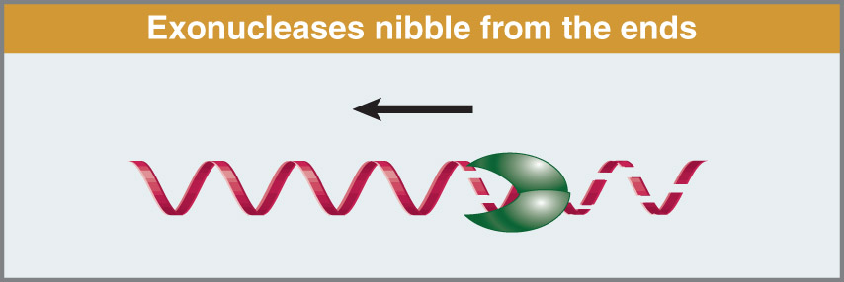
Exonucleases: break bonds at ends of nucleic acid-
(5’ OR 3’ ends)
Fig 1.18
Notes:
Exonucleases – attack free ends of DNA – don’t cut within the strand – cut the external parts

Slide 24
DNA replication is semi-conservative
Each original strand of the DNA duplex serves as a
template for the production of a new strand
Meselson-Stahl Expt (1958) labelled DNA with ‘heavy’
isotope of N (¹⁵N) and watched generation of new strands
measured the weight of DNA using density centrifugation
Notes:
Three theories of how DNA replicate
1 strand acts as a template for another strand – so if you have 2 original DNA molecules bound together – they pull apart and each act as templates for production of new daughter cells.
After the discovery of the structure of DNA – Meselson – proved how DNA is actually replicated. Used radioisotopes – used a heavy N – loaded up DNA with N15 and measured the weight of the molecule (bc it’s heavier than natural N) – then spun it

Slide 25
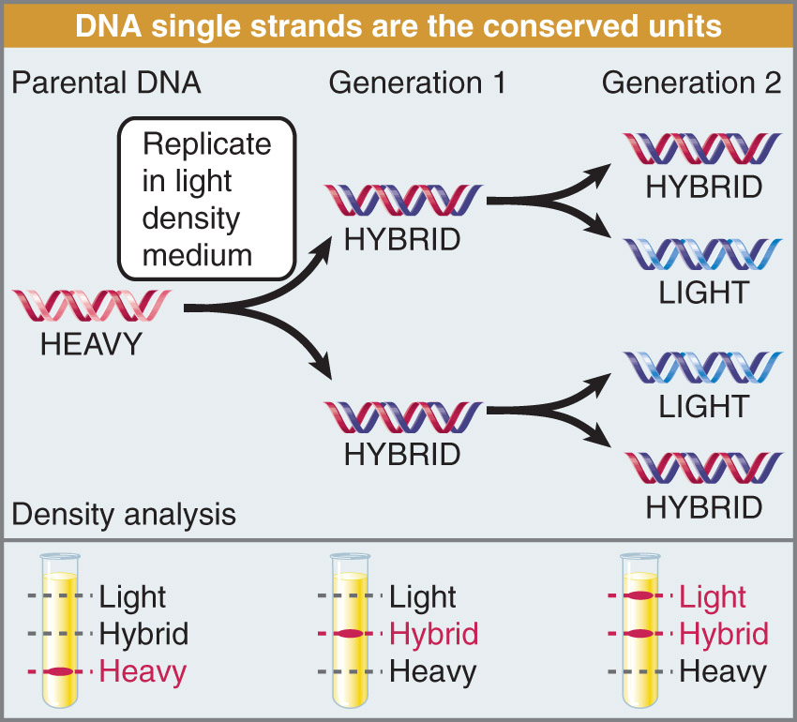
Meselson-Stahl
Fig 1.15
Notes:
Parental DNA – load it up with heavy N - take away the heavy N – and let the cells generate the next round of generation. Keep media same
Go another round – spin it
Found that – in the beginning all strand are heavy – first generation – all heavy went away – hybrids showing that each heavy acted as a template.

Slide 26
Nucleic Acid Hybridization
all nucleic acids can hybridize (form H bonds) with each
other using complementary sequences
DNA-DNA, RNA-DNA, RNA-RNA
intra- or intermolecular bonds
heating can lead to strand separation or denaturation of
DNA Duplex (‘melting’ of DNA)
melting point (T_{M}) is the midpoint of the range over
which DNA strands separate
T_{M} is dependent on the length of DNA and G-C content
typical 40% GC DNA has T_{M} of 87ºC
Notes:
Many molecular biology tech rely on hybridization C
Whole purpose is
You can take a nucleic acid from 1 organism and compare it to another organism
For it to work the probe used to hybridize they probe must but single stranded ,
DNA has to be separated to these transient states where its ss.
DNA has to come apart in order to transcribe – property of nucleic acids denatured and renature is very imp to the fact that DNA/RNA/any nucleic acid can hybridize w/ its complementary bases and be ripped apart as well. All use H bonds in bw complementary bases AU CG (RNA) and AT CG (DNA) to form secondary structures
Hybridization b/w ssDNA or ssRNA > anything can hybridize given the right sequence
Intermolecular – have DNA from plants and from humans if those bases are complementary – not if they’re ds
Intramolecular – can also form. Found primarily in RNA – most mRNA’s that can transcribe are ss and within that RNA molecule are stretches – can flip back and form bonds – lots of RNA is partially due to intramolecular bonds
DNA is a very stable molecule – if you heat it you can break those H bonds. Melting or denaturation of DNA
Melting point of DNA – heat up a liquid containing DNA – denaturation (strands start to come apart) – reach max at which all strands fall apart. That is the melting point.
If you have a piece of DNA that is a million bp long and one that is 20 bp – the million will have a higher melting point – a lot more to be broken.
Because CG have 3 H bonds - a string of CG vs a string of AT – CG will have a higher melting point. Length of DNA and CG content > effects the melting point

Slide 27
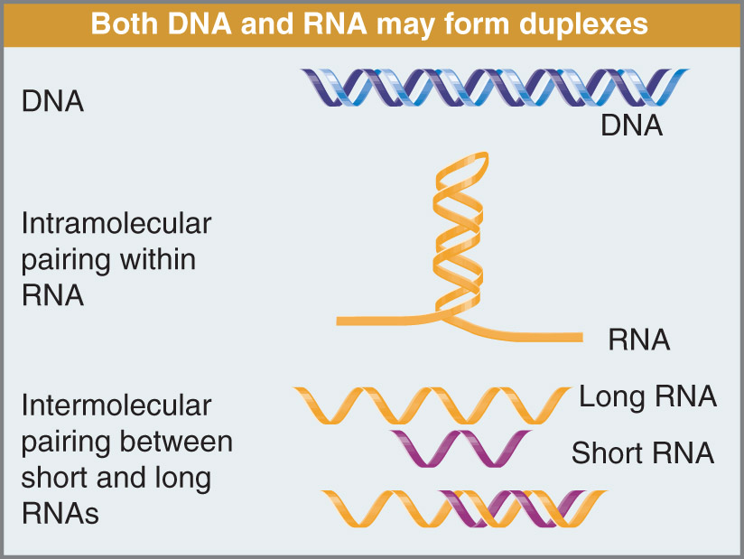
Inter
Fig 1.22
Notes:
Diff types of hybridization that can occur. Know what the various things are.
Second one – when there's a lot of intramolecular (b/w ss)
Third one – intermolecular b/w two diff RNA molecules – essentially how miRNA’s work > these are all targeted against a diff molecule - it is complementary to it’s target – very specific. Once it forms though – it forms a tight intermolecular ds bond

Slide 28
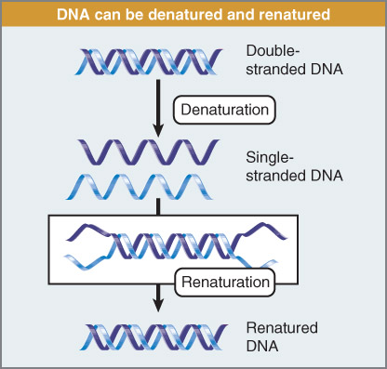
Fig 1.23
Notes:
Process of ripping apart DNA by heating it and then if you allow it to cool it will come back together – renaturation
Denature – splitting of H bonds. Cooling the temp brings those H bonds back together.

Slide 29
Renaturation of nucleic acid strands
any two strands with complementary sequences can anneal,
or renature (or hybridize)
ability of two strands to hybridize is directly related to
their complementarity
can still get hybridization with sequences that are not
100% homologous
CGTAATTGCTTT
GCATTGCCGAAA
Imperfect duplex
Notes:
Degree of comp determines how well they hybridize
You can manipulate parameters, high temp incr stringency , ( higher to temp higher degree of complentarity )
Have to visualize this
Label it w radio IS
Emitting beta particles , where the hybridization is occurring you can detect it
Now alot of the probes are light emitting probes
Can take DNA form diff organisms and based on how quickly they re-nature you can make predictions of how similar those DNA molecules are in terms of sequence.
Any two ss DNA molecule that are complementary can anneal (hybridize/renaturation) – same meaning – coming back together to form a ds molecule
Sequencing and complementarily of hybridization – to see if the molecules are similar in sequence or not.

Slide 30
Many molecular biology techniques rely on hybridization
allows for detection of specific DNA or RNA sequences
Southern blotting-
DNA detection
Northern blotting-
RNA detection
Notes:
Western – protein
Nucleic acid hybridization – imp for many diff things.

Slide 31
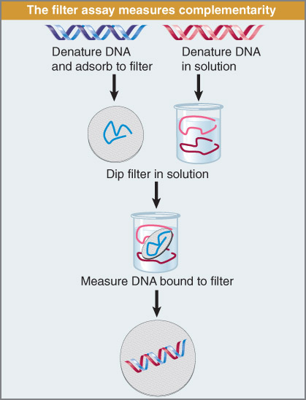
DNA is usually radioactively
labeled so detection can be
performed using X-ray film
(autoradiography)
Both probe and target have
to be single-stranded (DNA
and/or RNA)
Fig 1.24
Notes:
The whole purpose for this hybridization technique that are so imp – bc of the nature of nucleic acids to come together when ss – you can take a nucleic acid from one organism and use it to identify nucleic acid from another organism in a gene that shares some degree of base complementarity
Extremely imp for any hybridization to work – probe that you are using to hybridize and the target have to be ss – first step in the procedure is to denature the two strands – denature the ds – attach one onto a filter – mix them together as ss molecules and heat up the temp and then allow it to cool – as it cools it can renature and hybridize – degree of complemetnarity b/w the two strands determine how strongly the hybridization occurs - based on the requirements (CG content and length) – you can use this if you keep the temp high – that increases the strignency (degree which DNA molecules can hybridize) – higher temp need more complementarity – lower temp – lower degree of complementarity
Take one of those two samples – label it with radioisotopes – P32 incorporates into a probe – so one of the two strands is hot and emitting B particles – wherever hybridization occur you can identify that band on the gel by the emission of beta particles -through a process called …
If you don’t have any bands – need to denature it. A lot of the probes now are chemiluminescent (light emitting) – that can detected using high end photography

Slide 32
DNA Mutation:
change in the genomic DNA sequence
not all mutations are detrimental or affect phenotype
of organisms; some may be beneficial and lead to
evolution
Spontaneous mutation: result from random cellular
events; extremely rare
Mutagens: chemicals or compounds that increase
background level of mutation- induced mutations
normally act directly to change DNA base pairs
Notes:
DNA mutation
Change in genomic DNA sequence
Diff btw the population , 99.7% is the same
Change in gene that affects te function , if the gene cannot do its func may have condition due to this
Where a specific gene is affected but the change allows the organism to survive
Most inherited genetic disease express as homo recessive , have the gene you are carrier
Spont mut . Mutagens : induced
If it occurs in germ it is passed on to the next generation
We have 3 billion letters in our genome – 0.3% are different w/in our population of humans – if you sequence all the genomes in this room and compared the DNA – 99.7 is the same
Change in a gene that effects the gene function – that’s bad –
We know a specific change has effected gene function but allowed the organism to survive. Remember: two genes – one from each parent – heterozygosity. Remember: most inherited genetic disease are expressed phenotypically as a homo recessive. And if you’re hetero (wild type and mutant copy) – you are a carrier. If you don’t have any of the mutations – then you don’t have it. We’ll concentrate on heterozygosity
Spontaneous mutation – do arise but are rare – our bodies are pretty good at making the mechanisms work correctly. You’re not exposed to anything.
To increase the rate- expose yourself to mutagens - increase the rate – bad food, smoking – you can do things in your env that increases the chances of mutations.
Normally mutagens can change the letters - these mutations can accumulate over time

Slide 33
DNA Mutation and disease:
if mutations occur in germ line cells- passed on to
next generation
estimated over 1000 genetic diseases that result from
mutation in single genes
some mutations occur spontaneously in an individual-
did not inherit from parents
Is cystic fibrosis hereditary?
Yes, 28 different mutations in the CTFR gene are known to cause the disease
Is liver cancer hereditary?
In 95% of cases = NO
Mutations can happen in somatic cells- not passed on
Notes:
Cystic Fib: most common hereditary disease , ppl from Europe, 28 diff mutations in CFR gene
Depending on the mutation relation to severity
Liver cancer hereditary : in 95% of the cases = no , sometimes
Mutation that occur in somatic cells during our life times , they cannot be passed on
Most common hereditary disease in North America – from people who were originally from Europe.
Carriers of this disease
Depending on which mutation you have determines the severity of the disease

Slide 34
Mutations can be detected and repaired in cells
Mutation rate of genes is dependent on genome size
and selective pressure applied on organism
Genome sizes vary dramatically between species!!
has major impact on evolution of species
Notes:
Mutation s can be detected and repaired in cells
If a cell detects muts it commits that cell to suicide path or apoptosis
gets rid of the cells
How the mutation affect the cell ,
Modify the mutation , bacteria small genome size , not much room , the ability for the cell to handle mutations ,
Hit w enviro pressure mutation gives them a selective advantage \
That's why bacteria can adapt so well/ quickly , picking up mutations is used to their advantage , ( genome size is small mutations have a greater affect on them )
Mutation and genome size related
Humans lots of space
Hetero selective advantage , carrier , wild type selective disadvantage and if you have two copies of gene no good
If the cell detects there’s mutations – it generally commits apoptosis. Believed every single person has cancer all the time – our cells have mechanisms that initiate apoptosis.
Bacteria that have small genome size but packed of genes – no extra space (like our genome) – mutation lands in some spot – not too much of an effect. Genome size can play a big role in the ability of those cells to handle a mutation.
Hit by an envt pressure – mutation gives them a selective advantage – that’s why bacteria adapts so readily bc there’s no extra space in there genome – picking up mutations is a good thing – try to use it to their adv. Mutation and genome size are a major player in evolution
Beneficial mutation in a heterozygote state that causes disease in homozygote state?
-sickle cell anemia – one copy provides you selective advantage – bad is when you have two copies > you get the disease.
Hetero is a carrier – selective adv. Wild type – selective disadv.

Slide 35
Beneficial mutations:
some mutations provide benefit for survival
Example: CCR5 gene (CCR5Δ32 mutation)
Encodes chemokine receptor 5
Non functional
found that patients homozygous for CCR5Δ32 were
resistant to HIV infection (mostly of European origin)
HIV uses receptor to infect white blood cells
Why does this mutation exist in the population?
Bubonic plague (14th century Europe)- caused by bacteria
CCR5Δ32 leads to plague resistance
Notes:
Some mutation in the heterozygous state can be a good thing
CCR5( CCR 5 delta 32 mut) > chemokine receptor 5 > immune response >
Delta sign means something is missing
Non functional and bunch of amino acids are missing
HIV resistant , euro origin uses T receptor
Black plague , if you have this as a homo zygote no affect , same with heterozygote you are protect from HIV / plague / aIDS
If you dont have the mutation you are susceptible to both
CCR5 – gene encodes for chemokine receptor – evolved in immune response. We produce tons of immunological hormones. Some are pro/anti inflammatory. For chemokine to work – it needs to bind to smtg of a cell of the immune system – they bind chemokine receptor 5.
Mutation delta32 (delta – smtgs missing) – what’s gone is a bunch of amino acids that make the delta 32 non functional (so it doesn’t bind to chemokine)
Why do we know about this mutation? Having this mutation does not effect your overall immune function – doesn’t make you susceptible to diseases – how they found it (people who tested pos to HIV but were healthy – didn’t have aids) – had antibodies/were resistant to HIV – even though virus got in – it could not effect anything.
HIV uses this receptor to get into the cell – once in it integrates its DNA.
Why does this mutation exist? – too short of a time to develop this sort of selective pressure mutation
Where does it come from? You have this mutation – you are much more resistant. CCR5delta – mutation as homo – doesn’t appear to cause any lasting effects. As a hetero – same but you’re partially protected.

Slide 36
Beneficial mutations:
Disease causing genes with benefits depending on gene
allele copy number (homo vs. heterozygous)
Cystic fibrosis:
homozygous recessive alleles for CFTR mutation
causes mucus to form in lungs and intestines
Heterozygote advantage:
one copy of recessive allele provides resistance to
diarrhea (caused by cholera) and resistance to tuberculosis
tuberculosis responsible for 20% of European deaths
between 1600-1900
Notes:
Hetero selective advantage , carrier , wild type selective disadvantage and if you have two copies of gene no good
Some mutation in the heterozygous state can be a good thing
CFTR gene mutation inhibit lung cells to get rid of mucus, changes salt balance, allows bacteria to grow where it shouldn’t - there’s a hetero adv of it
Two ex of human diseases – presents selective adv to having those mutations – that’s why we still have diseases bc at some point -
Down side – over time – two individual carriers – 25 chance of having the diseases

Slide 37
Questions about mutations and populations:
What has to occur in the population for beneficial mutations
to be successful and become heritable?
Why are serious mutations not generally observed in the
population?
Notes:
Questions
What has to occur in the pop for bene muts to be successful and become hereditable ?
Has to give and advantage selective pressure, heritable, examples given *
What are serious muts not generally observed in the populations ?
The ones that we know about , came from ancestors , came from the development , they dont cause serious inflictions , and the serious ones get weeded out if there are some present
Selected against in most cases
The % of abortions 60 %
The ones that go to term are only 40%
Development has a genetic program and selected against
Interaction btw the mother and placenta does not agree
Normally mutations that are considered bad can also be good – are the drivers of evolution.
Some selective pressure/adv that gives the individuals ability to survive– that needs to be inherited by the children so they’re not killed off.
Mutations that come from ancestors aren't serious enough to effect development – anything serious gets weeded out during fetus dev and that’s why we never see too many serious mutations – bc they’re selected against during development
60% are spontaneous abortions

Slide 38
Types of Mutation:
Point mutation: change in single base pair
Transition: replaces pyrimidine with pyrimidine and
purine with purine
Transversion: purine replaced by pyrimidine and
vice versa
mutations can be induced by chemical modification of
bases or incorporation of base analogs into DNA

Slide 39
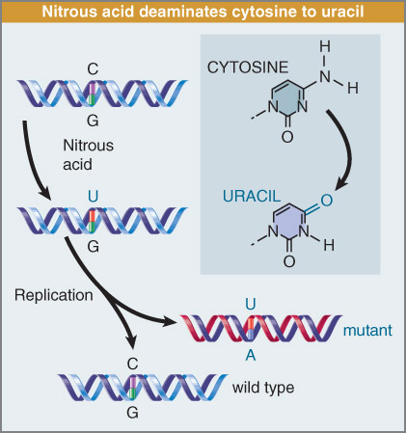
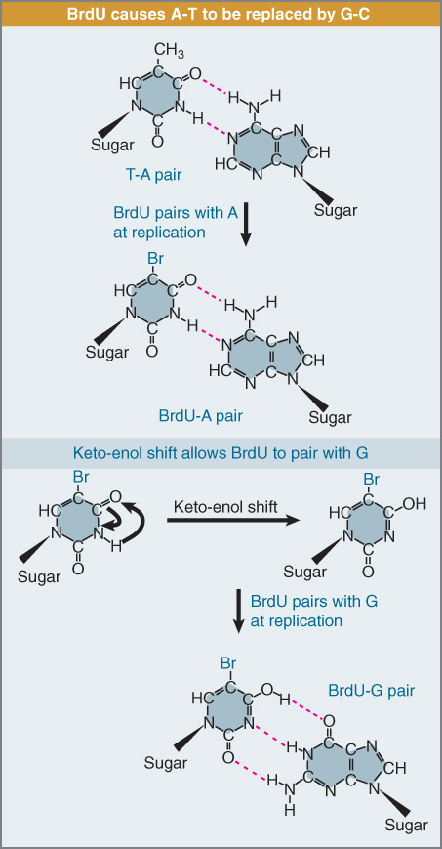
Fig 1.26
Analogs
Mutagens
Fig 1.27
Notes:
Examples
Nitrous acid – demaminates cytosine – physically changes the base from C to U – undergoes replication the G strand will put in a C – but the other cell that uses the U as the template will incorporate an A - in this case the cell that contains the DNA has a single point mutation in that spot.
BrdU – AT base pair it bind to A – BrdU has Br and base pairs with two H bonds to A – not modifying methonine – but acting like it. Base analog
Mutagen – actually changes the structure
Analog – Shifts the structure
So gone from AT – into UG base pair which will eventually become CG when it goes through replication.

Slide 40
Base Analogs: Uses
Chemotherapy (anti-metabolites): cancer cells take up
analogs and blocks division and DNA replication
Purine Analogs: Mercaptoguanine
Pyrimidine Analogs: Fluorouracil
eventually, cancer cells die but also normal cells can die too
causes side effects of chemotherapy
targets actively dividing normal cells
(e.g. hair, skin, epithelial)
Notes:
Most chemotherapy are base analogs
Tons of enzymes in our body break down toxins.
Flurouracil - one enzyme where if you have a single nucleotide change – can’t break it down.

Slide 41
Types of Mutation:
Insertion: addition of more than one bp into genome
Deletion: removal of base pairs from genome
Transposons: sequence of DNA that can duplicate and
insert into new location in genome
Notes:
Transponson – viral origin littered into our genome

Slide 42
Mutation Reversion:
Point mutations and insertions can be reverted back to
wild type sequence; deletions cannot
Forward mutations: inactivate a gene
Backward mutations: restores inactive gene to wild-type
Exact base reversal is true reversion
Base reversal somewhere else in gene compensates
for initial mutation: second site reversion
1
2
Gene
X
No function
Restores gene function
Notes:
mutation reversion: can turn certain things back to OG , insertion/delete, deletions can'ts be reverted
Some muts dont have an affect sometimes they do
Forward mut : inactivate the gene , stores the inactive gee : backward mutation
Exact base reversal TRUE REVERSION
Second site reversion : base reversal somewhere else in the gene compensates for the initial mutation , store the function of the gene product
Suppressor muts : diff btw supr and second site is that it occurs in a different gene
Occurs in bacteria, only way to restore the gene ,
Picture mutation hotspots , certain places more mutations /
Genome differences
Expression of genes if diff in diff organs
100-125 thousand proteins comprimise our proteome
Genomes vary greatly in size , plants have more genomes than we do
Why do plants have more genes and what is about plants that they d
Insertion – delete it out and you can go back. Deletion – odds of those being reverted back right into that place is 0
Sometimes mutations don’t have any effect on function of gene – sometimes they do.
Forward – there are way of having another mutation that restores that inactive gene back into wildtype.
Single point mutation – let’s say creates a stop codon – by reversing the mutation – can have a true reversion
Pick up a second mutation that restores the function of the gene product – doesn’t correct the first mutation but the second mutation restores the function of the gene product. This comes at a second site somewhere else on the same gene.

Slide 43
Suppressor mutation: second mutation in another gene
that compensates for or restores effects of primary
mutation
Example:
1
2
Gene
tRNA gene
Second mutation in a tRNA gene causes the tRNA to recognize the mutated codon
from first mutation
Notes:
Suppressor muts : diff btw supr and second site is that it occurs in a different gene
Occurs in bacteria, only way to restore the gene ,
Suppressor – difference bw this and second site reversion: Suppressor mutation occurs in a diff gene – not in the same gene like it does for second site reversion
Restored by secondary mutation on tRNA – puts back in the original amino acid– all reversions bc they’re restoring the function of the primary mutation

Slide 44
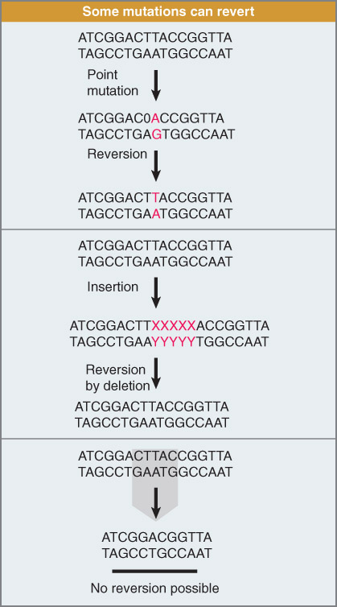
Deletion
Fig 1.28

Slide 45
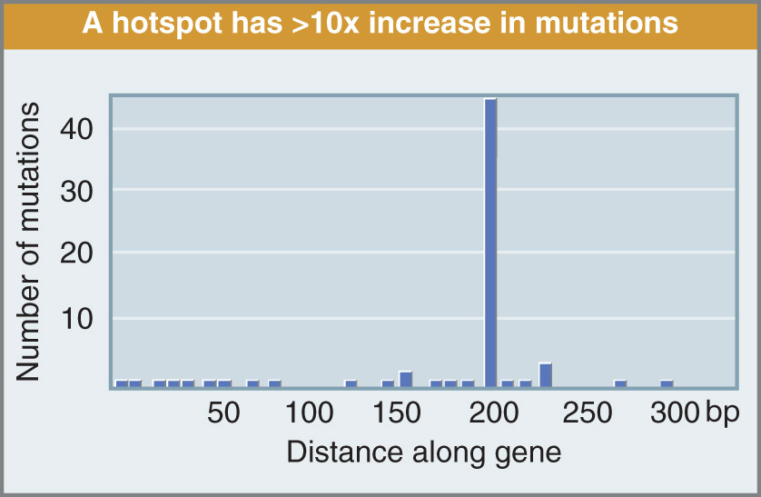
Mutation Hotspots:
regions in the genome have higher rates of mutation
than others
can be affected by particular mutagens or by specific
DNA sequences
Fig 1.29
Notes:
Picture mutation hotspots , certain places more mutations /
Genome differences
Expression of genes if diff in diff organs
100-125 thousand proteins comprimise our proteome
Genomes vary greatly in size , plants have more genomes than we do
Why do plants have more genes and what is about plants that they d
Why do plants have more Dna and more genes than mammals ?
Polyploidy
They need more genes , they can't move around (like humans ) so they need them to adapt to the environment
Some plants have smaller # of genes or larger number / genome size differs ( sunflowers. Poplar trees) cant move away from predators , immune system varies as compared to ours
Certain regions of the genome are sensitvie to picking up mutations than others

Slide 46
Genome Differences:
Genome: collection of all the DNA in an organism
All cells have dsDNA genomes, some viruses have
RNA genomes or DNA genomes
all genomes code for the production of all the protein
for a cell in an organism
the proteins (proteome) provides all the necessary
functions for survival of the organism
What is larger, genome or proteome?
Why?
Notes:
Not all cells in the body produce the same proteins. Liver cell proteins are diff from brain cell proteins even though both their genomes are the same – expression of them in diff tissue is very diff
If you take all the protein expressed in all of our cells that we need to survive – proteome – varies from cell type. Our genome doesn’t vary in cell type
20000 genes in our genome – how many proteins comprise our proteome? Over 100 000 - 125000
Proteome is larger – DUH In terms of number of genomes
Why? One gene – gives rise up to five proteins through differential splicing

Slide 47
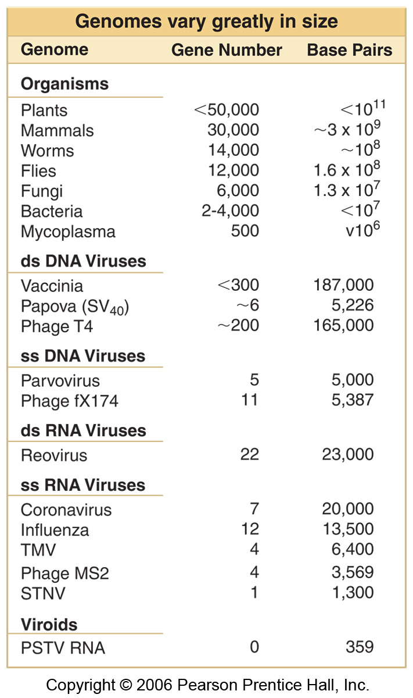
Fig 1.21
Notes:
Why do plants have more DNA/genes than mammals?
Plants are polyploidy – multiple sets of chromosomes thus increasing their genome size. We’re diploid – two sets > doesn’t necessarily come with extra genes – why do plants need more genes to survive than us? – more genes to adapt to their envt bc they can’t move around
Two examples
Suflower: 3.5 billion bp and 25 000 genes > their genome is larger than ours
Poplar Tree: 480 million bp >40 000 genes > smaller genome but more genes than us
Has to figure out mechanisms to deal with predators too – so immune system is very diff than ours

