Slide 1
Chapter 8: Globalization
“The broad-scale changes and transformations that have resulted from the impact of industrialization and the emergence of an interconnected global economy, with the spread of capital, labor (migration), and technology across national borders.”

Slide 2
Consequences of Globalization:
Increasing inter-cultural connections – impacts societies in two ways: 1) Economically; and 2) Culturally
First, we’ll explore the economic ramifications of globalization:
Economically – globalization leads to spread of capitalist, corporate culture and increasing “Westernization”
Western thinkers have sought to understand or justify these economic changes/incursions through the use of three theories

Slide 3
#1: Modernization Theory
In 1950’s became a model for understanding globalization
Idea that capitalism could produce cultural change

Slide 4
Theory #1: Modernization Theory
Popular 1940’s – 1960’s
Justifies Western economic imperialism by stating that “third world” societies are “not modern” because they have not embraced capitalism
Capitalism values individualism, hard work, and discipline – values espoused by Weber and the “Protestant ethic”
Therefore, the West must (ethnocentrically) modernize the rest of the world
Eg. Green Revolution

Slide 5
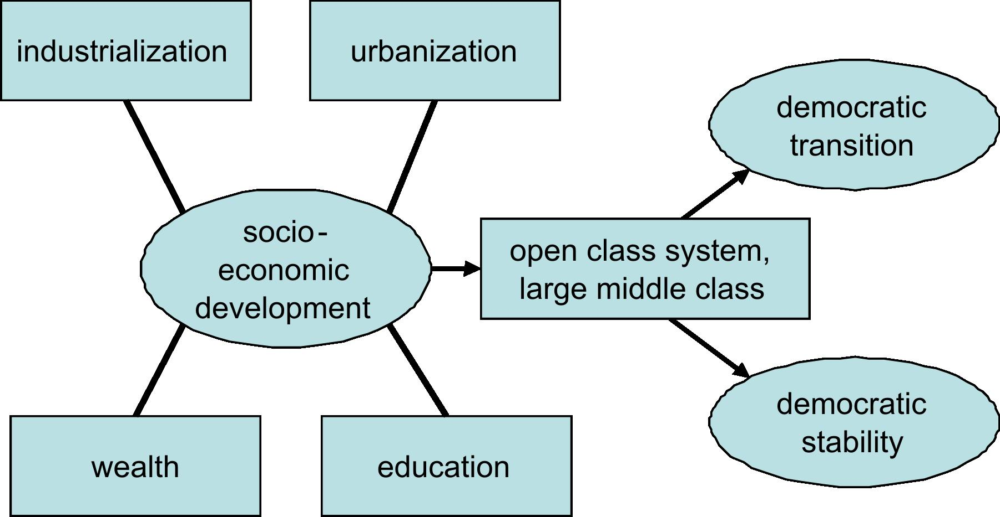
How Modernization Theory Works:

Slide 6
W. W. Rostow
The Stages of Economic Growth (1960)
Views cultural values and traditionalism as reasons for lack of economic development
This modernization model led to division of world into: First World, Second World, and Third World

Slide 7
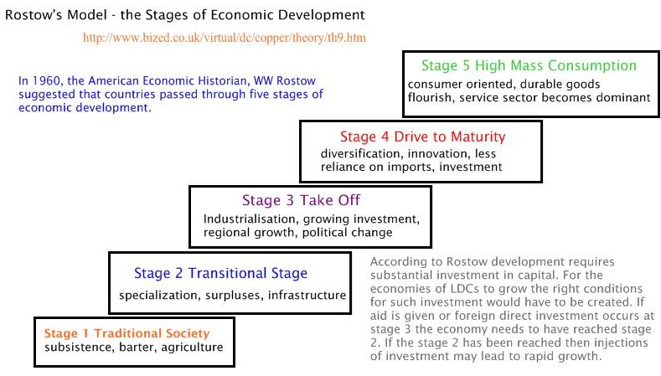

Slide 8
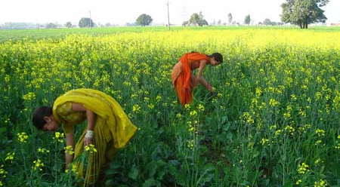
The Green Revolution: An example of Modernization theory

Slide 9
Green Revolution
1940’s-1960’s – attempts to increase agricultural output in developing nations
Eg. India and Mexico
Governments loaned money to help farmers buy fertilizer, high yield seeds, farming technologies (tractors, harvesters, etc).
But PROBLEMS…

Slide 10
Theory #2: Dependency THeory
Globalization and worldwide economic inequalities are rooted in COLONIALISM, IMPERIALISM and NEOIMPERIALISM
Influenced by writings of Karl Marx and his work on class struggles caused by capitalism/Industrialization in Europe – proletariat and bourgeoisie
For dependency theorists, the only way to overcome economic dependency is through radical change…eg. revolution

Slide 11
Theory #3: World Systems Theory
CORE, SEMI-PERIPHERY, PERIPHERY
Immanuel Wallerstein
Neoimperialism via

Slide 12
Critiques:
Did not produce economic or technological development
Ethnocentric and Westerncentric
Only helped wealthy in “third world” societies
Categories (First, third, etc. worlds) too simplistic

Slide 13
What can anthropologists offer re: these approaches?
Help us understand the process of “GLOCALIZATION” - how small, localized cultures interpret global cultural flows
Through fieldwork, cultural anthropologists can “test” the validity of these theories

Slide 14
Homogenization
Does globalization lead to increasing homogenization (sameness) throughout the world?
Homogenization = Americanization, Westernization, McDonaldization, Disneyification

Slide 15

Homogenization
Does globalization lead to increasing cultural homogenization (sameness) throughout the world?
Homogenization = Americanization, Westernization, McDonaldization, Disneyification
Critiques of homogenization argument – implies that societies lack agency.

Slide 16

Cultural appropriation refers to:
The borrowing and use of another culture’s symbols, images, or identity markers
For some -- it may be
perceived as the theft of
cultural traditions

Slide 17
Cultural Appropriation as “theft”?
Under what conditions might some regard appropriation as theft, or alternatively, as a misappropriation?
When original meanings and context are changed
Commodification
When dominant group appropriates from more marginalized group

Slide 18
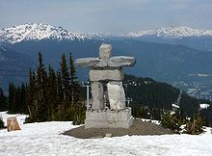
Inukshuk

Slide 19

Nunavut flag with Inukshuk

Slide 20


