Slide 1
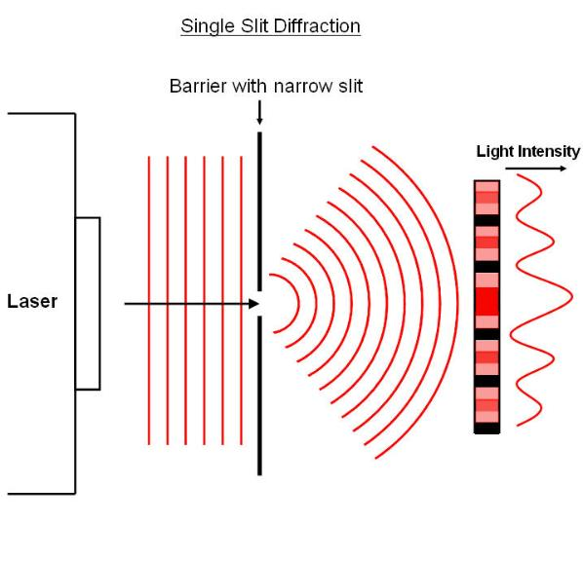
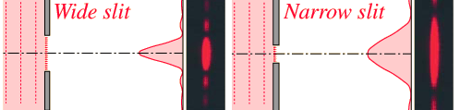
SINGLE SLIT DIFFRACTION
L2G
IVAN TAI
# 38272134

Slide 2
Question
A monochromatic source of light with a wavelength of 700 nm shoots through a narrow slit of 0.500 mm.
What is the distance between the slit and the screen that it is projected on, given the first minimum diffraction pattern (m=1) is 1.00 mm from the center of the screen?

Slide 3

Solution
$$a^{2}+b^{2}=c^{2}$$
0.500 mm
1.00 mm
λ = 700 nm
?
http://cronodon.com/Atomic/Photon.html

Slide 4
Solution
Formula for destructive interference
sin θ = mλ / w …where m is ±1, ±2, ±3 …
* for small θ, we can assume the approximation that
sin θ = tan θ = y / L holds true
y
θ
L

Slide 5
Solution
Hence, we get that…
y / L = mλ / w
Rearrange it to…
L = w y / m λ
= (5 x 10⁻⁴ m)(1.00 x 10⁻³ m) / (1)(700 x 10⁻⁹ m)
= 0.71 m

Slide 6
Test your understanding
A monochromatic source of light has a wavelength of 450 nm. What is the frequency of the light?

Slide 7
Solution
Remember that…
f = c / λ
= 3.00 x 10⁸ / 450 x 10⁻⁹ m
= 6.67 x 10¹⁴ Hz

Slide 8

THANK YOU FOR YOURE ATTENTION!
CONGRATULATIONS WE DID IT !

