Slide 1

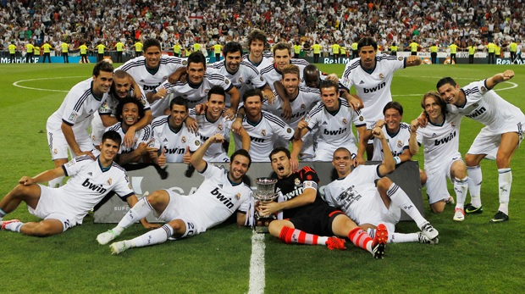
Soccer
Real Madrid C.F.
By: xxxx xxxx
Due : November 27,2013

Slide 2
Information
Real Madrid, is a professional football club based in Madrid, Spain
Founded in 1902 as Madrid Football Club, has traditionally worn a white home kit since.
The team has played its home matches in the 85,454-capacity Santiago Bernabéu Stadium in downtown Madrid since 1947.
Real Madrid's members (socios) have owned and operated the club since its inception.
Notes:
Cristiano Ronaldo, is a Portuguese footballer who plays as a forward for Spanish La Liga club Real Madrid. He is the second most expensive footballer in history worth $131.6 million.

Slide 3
Financial Information
The club is the world's richest football club in terms of revenue, with an annual turnover of €513 million and the most valuable, worth €3.3 billion.
Cristiano Ronaldo with total earning of $43.5 million is the second best paid soccer player.
Real madird is known for buying the world's most expensive players such as Zinédine Zidane, Luís Figo, Ronaldo and David Beckham.

Slide 4
Trophies
La Liga - 31
Copa del Rey - 18
League Cup - 1
Spanish Super Cup - 9
European Cup/Champions League - 9
UEFA Cup/Europa League - 2
UEFA Super Cup - 1
Intercontinental Cup – 3
Total of 74 Trophies

Slide 5
Team
Squad
1 Casillas Goalkeeper
13 Jesús Fdez Goalkeeper
25 Diego Lopez Goalkeeper
4 Ramos Defender
3 Pepe Defender
2 Varane Defender
17 Arbeloa Defender
15 Carvajal Right back
5 Coentrao Defender
12 Marcelo Defender
18 Nacho Centre back
14 Xabi Alonso Midfielder
6 Khedira Midfielder
24Illarra Midfielder
23 Isco Midfielder
16 Casemiro midfielder
11 Bale Midfielder
19 Modric Midfielder
22 Di María Midfielder
7 Cristiano Ronaldo Forward
9 Benzema Forward
21Morata Forward
20Jese Forward
Coach
Head coach: Carlo Ancelotti
Assistant coach: Zinedine Zidane
Assistant coach: Paul Clement
Head fitness coach: Giovanni Mauri
Goalkeeper coach: Villiam Vecchi
Delegate: Miguel Porlan "Chendo"

Slide 6
Supporters
During most home matches the majority of the seats in the stadium are occupied by socio or club members, of which there are average of 68,670. In addition to members, the club has more than 1,800 official, club-affiliated supporters' groups in Spain and around the world.
Real Madrid has the second highest average all-time attendance in Spanish football and regularly attracts over 74,000 fans.
Real Madrid's hardcore supporters are the so-called Ultras Sur supporters
They are known for their extreme right-wing politics

Slide 7
Links
Real Madrid C.F. - Official Website
Real Madrid - The Official Online Shop‎
Real Madrid C.F. – Facebook fan page

