Slide 1
Introduction to the Economics of Developing Countries
- ECO 2117 -
Fernanda Estevan
Department of Economics
Notes:
Today’s agenda:
- Introduction
- Course outline
- Class 1- Development defined

Slide 2
Today’s agenda
Introduction course
Topic 1: Development defined

Slide 3
Course objectives
To develop an intuitive and analytical understanding of the 'economist's toolbox' and its uses;
To be able to apply these tools on familiar and new development issues.

Slide 4
Assessment
weight
Assignments (4) 15%
Midterm exam 35%
Final exam 50%

Slide 5
Topics
Part 1: The nature and meaning of development
Development defined, Comparing development, Economic growth
Part 2: Problems and policies: domestic
Poverty and inequality, Population growth, Urbanization, Human capital
Part 3: Problems and policies: international
International trade, Macroeconomic stability, Inflow of financial resources

Slide 6
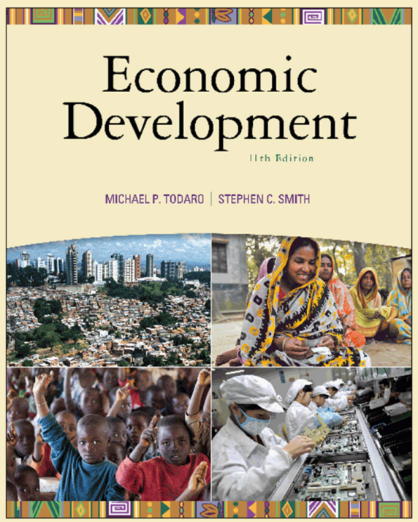
Readings
Todaro and Smith (2012), Economic Development, 11th edition
Other material will be provided on course website

Slide 7
More details …
Can be found in the course syllabus!
(handed out during first class and available on course website)

Slide 8
Questions?

Slide 9
Have you ever been in a developing country?

Slide 10
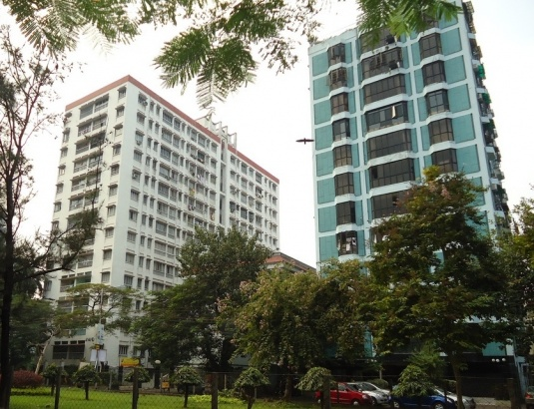
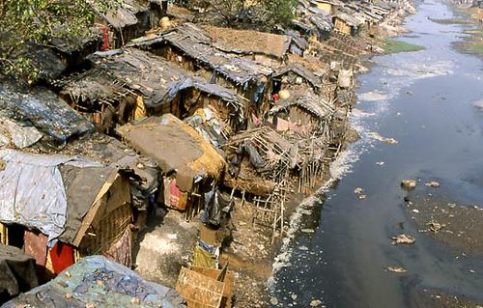
Inequality in developing countries
Calcutta, India

Slide 11
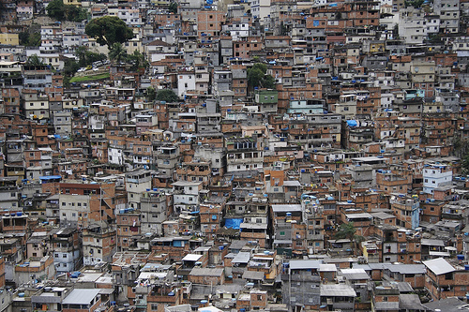
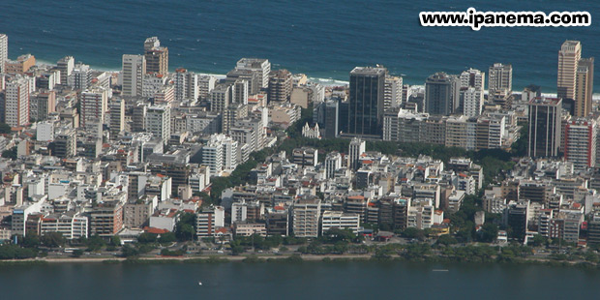
Inequality in developing countries
Rio de Janeiro, Brazil

Slide 12
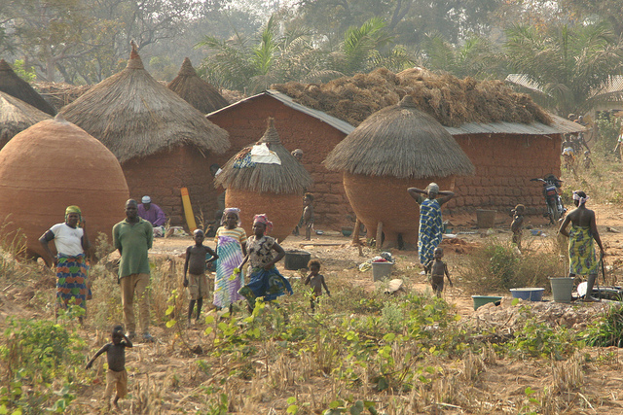
How the other half live
Remote village, Nigeria

Slide 13
Development economics
  Study of how economies are transformed from stagnation to growth, from low income to high income and overcome absolute poverty.
  In developing countries:
    Commodity and resource markets are highly imperfect
    Consumers and producers have limited information
    Multiple equilibria rather than a single equilibrium are common
    Disequilibrium situations often prevail (prices do not equate supply and demand)

Slide 14
The Important Role of Values
Value premises are an inherent component of both economic analysis and economic policy.
Example: Should child labour be banned?

Slide 15
The Important Role of Values
Development goals (e.g., ban child labour) do not arise out of an objective empirical or positive analysis of what is, but ultimately from a subjective or normative value judgement about what should be.
When there is agreement over subjective values, corresponding public policies (e.g., compulsory schooling) based on “objective” theoretical and quantitative analyses can be pursued.

Slide 16
Economics and Development Studies
Economies as Social Systems: The Need to Go Beyond Simple Economics
Social Systems
  Interdependent relationships between economic and non-economic factors
Success or failure of development policy
  Importance of taking account of institutional and structural variables along with more traditional economic variables
  ‘Non-quantifiable’ does not mean irrelevant

Slide 17
What is development? Changing views
Traditional economic measures
  Gross National Income (GNI)
  Income per capita
  => focus on industrialization
New economic view of development
  Development as a multidimensional process
  => focus on redistribution from economic growth
Capabilities approach (Amartya Sen)
  Development is the expansion of people’s capabilities (i.e. the freedoms to do the things they have reason to value)

Slide 18
What is a capability?
Resources have characteristics
A ‘functioning’ is what a person can do with the resources that she controls or possesses
A ‘capability’ is the freedom that a person has to do the things she values doing
The transformation of resources into capabilities depends on various factors:
  Differences between individuals, regions, institutions, relational perspectives & distribution within the family

Slide 19
What is a capability?
Example:
  Resource: bike
  Functioning: mobility
  Capability: ability to move around
  Utility: pleasure / happiness

Slide 20
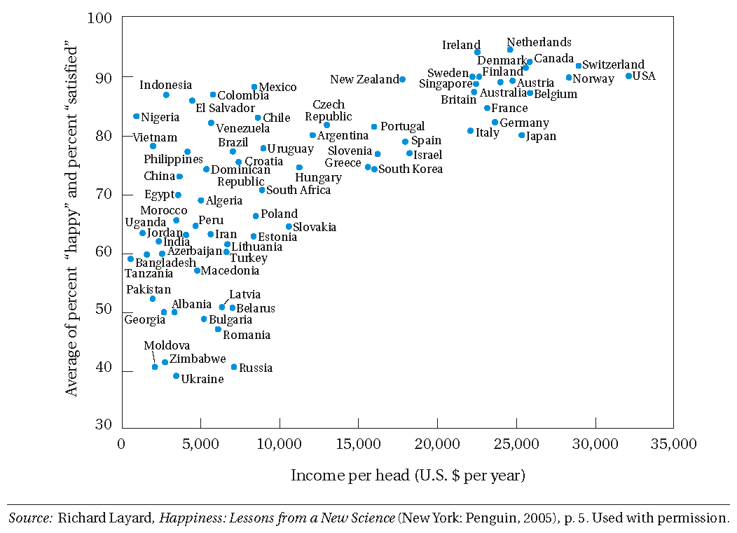
Figure 1.2 Income and Happiness

Slide 21
Three Core Values of Development
  Sustenance
    – the ability to meet basic needs
  Self-esteem
    – to be a person
  Freedom from servitude
    – to be able to choose

Slide 22
What we mean by development
The three objectives of development
  Increase availability of life sustaining goods
  Raise levels of living
  Expand range of economic and social choices
The central role of women
  To make the biggest impact on development, societies must empower and invest in women
The Millennium Development Goals
  Reflect international consensus

Slide 23
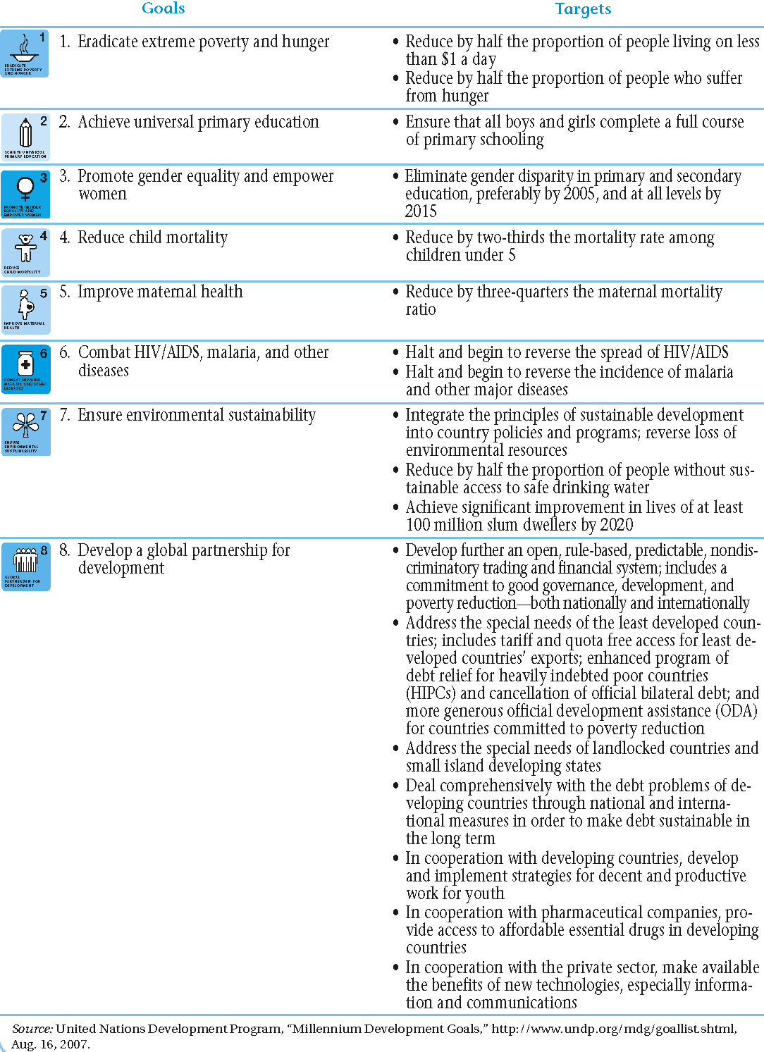
Table 1.1 Millennium Development Goals and Targets for 2015

Slide 24
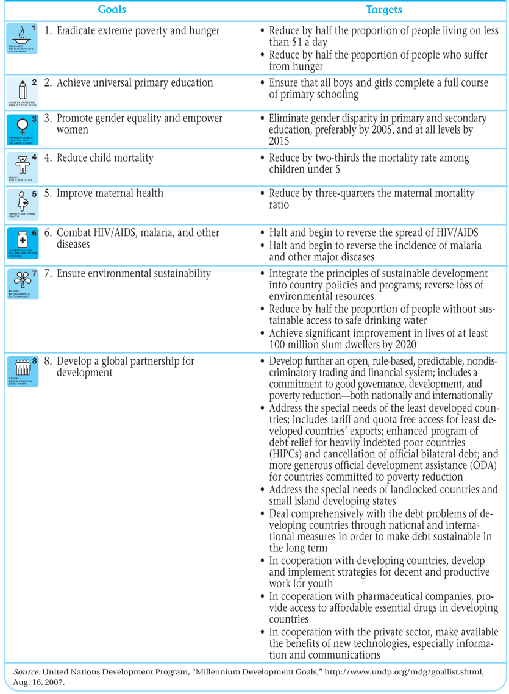
Table 1.1 Millennium Development Goals and Targets for 2015 (continued)

Slide 25
Conclusion
Development is multidimensional, complex and concepts cannot be defined without expressing normative judgements about what is desirable.
The economy reflects an important means to reach development objectives.
In this course we use the (development) economist’s toolbox to understand, analyze and influence development processes.

