Slide 1
Drugs 101
Allergy

Slide 2
Adverse reaction to harmless material

Slide 3
Allergy requires prior exposure
Immune system responds to something
  Epitopes of molecules from pathogens
Immune system “remembers” that material
  Memory cells
Subsequent exposure produces reaction
  Protection from pathogens
  Allergy to harmless material

Slide 4
Hay fever is a reaction to pollen
Notes:
Allergy to a particular plant

Slide 5
Cold-like symptoms
Notes:
Same sys involved w cold is also involved w allergic rxn

Slide 6
Some people get a geographic tongue
Notes:
Swelling of tongue

Slide 7
Atopic dermatitis from surface exposure
Notes:
Skin rash

Slide 8
Contact dermatitis from irritants
Hand washing makes it worse
Common w industrial powders (chemicals)
Notes:
There is an allergy form and non-allergy form
Irritates the skin
→ Washing hands too often make it worse

Slide 9
Exposure to large amounts of powder

Slide 10
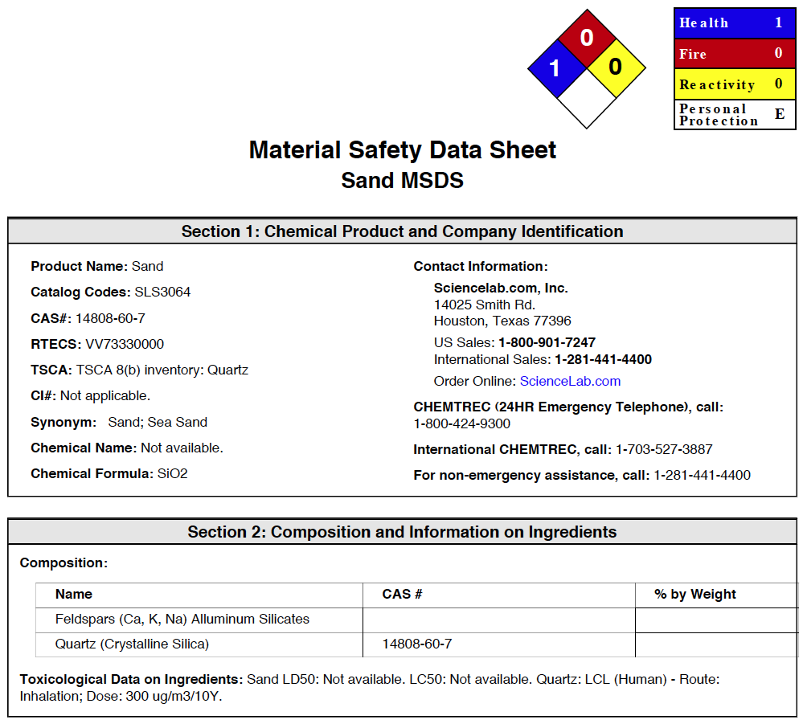
Dose makes the poison
Notes:
Sometimes chem never been tested → just use a computer algorithm to test
Eg: sand, concrete (sand powder)

Slide 11
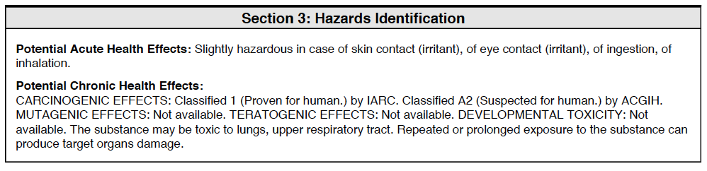
The amounts are what is important
Notes:
Sand
Human carcinogen
Amount makes the difference; typically powder

Slide 12
Contact dermatitis from immune reaction
Notes:
Eg: poison oak/ivy

Slide 13
Immune reactions at the site of contact
Notes:
Production of blisters

Slide 14
Urushiol produces the reaction
Notes:
These plants produce urushiol
Dissolves well in soap
- So need to be careful of washing → can spread it to other parts of body

Slide 15
Latex from rubber tree sap

Slide 16
Latex gloves and condoms
Notes:
See in ppl who work in health industry (bc of gloves)

Slide 17
Nickel is a common allergen
Notes:
Produces a rash in region of offending material

Slide 18
Nickel alloys are common
Notes:
Money, belt buckles, zippers, buttons
Can cover material w a varnish (eg. clear nail polish)
Very hard to avoid this allergy
- Extremely useful metal → toughens + hardens M in an alloy

Slide 19
Many piercings made of stainless steel
Notes:
Have created a stainless steel that doesn’t contain Ni

Slide 20
Allergies to henna tattos on skin
Notes:
Dye made from a plant juice
Causes blisters (in shape of tattoo)

Slide 21
Dust allergies are common
Notes:
Not the dust that you are allergic to but the ANIMALS (their feces) inside it
Dust = shed bits of human skin
Nutrient for dust mites
Eat it → produce feces (this is what you are allergic to)

Slide 22
Mattresses can contain large amounts of droppings

Slide 23
Allergies to pets
Most reactions are to pet saliva

Slide 24
Mold and fungi produce many allergies
Notes:
Many of the most powerful carcinogens are produced by fungi
Humans can get very strong rxns to mold

Slide 25
Food can give allergy or intolerance
Allergy
  Immune sys reacts to the food
Intolerance
  Substances in food produce adverse reaction
Food intolerance affects about 30 % of adults
Notes:
Allergy more dangerous
Intolerance – upset stomach, don’t feel well

Slide 26
Lactose intolerance is inability to digest lactose
Notes:
Milk contains a sugar that you don’t have the enzyme for → can’t digest it properly
So bacteria in intestine digests it → waste products → uncomfortable

Slide 27
Bacteria digest food instead

Slide 28
Lactase is available as a supplement
Notes:
Replaces enzyme that you are missing
- Breaksdown lactose → glucose

Slide 29
Headaches from food
Notes:
Rxn to something in the food
Some ppl are more tolerant than others
INTOLERANCE

Slide 30
Spices can irritate stomach
Notes:
Eg of INTOLERANCE

Slide 31
Food allergies affect about 4 % of adults
Notes:
Produce rashes, other stronger rxns
Less common than intolerance (30% vs. 4%)

Slide 32
Common food allergens
Notes:
Eg. milk, nuts (peanuts), eggs, seafood (fish)

Slide 33
Signs of food allergy
Bags under eyes
Dark under eyes

Slide 34
Peanut allergy common in North America
Rare outside North America
Peanut free schools common only in North America
Notes:
Mainly only in NA (no big problems in other countries)
Recent: Only in last 30 yrs

Slide 35
Spider and insect bites can give strong reactions

Slide 36
Rare allergies - allergy to sunlight
Notes:
If you go out into sun → get a rash
Bodies rxns to a chem that is light-activated
Eg. marigolds produce a toxic material that is only activated in the light (safe in the dark)
If handle marigolds and it gets into the blood → chem turns toxic when go out into sun → BODY REMEMBERS the rxn to the sun → even if no have chem, still have a rxn

Slide 37
Aquagenic allergy – allergy to water
Notes:
Hive-like rxn if contact w skin

Slide 38
20th Century disease – “allergy” to man-made substances
Notes:
Aka “total allergy syndrome”
Allergy to everything – especially man-made
Not really an allergy but more of a psychological condition
Triggered by a traumatic event
Unable to go out of house; live in house covered w tinfoil/plastic
DELIBILITATING
Won’t acknowledge the psych condition (believe that they have a phys condition)

Slide 39
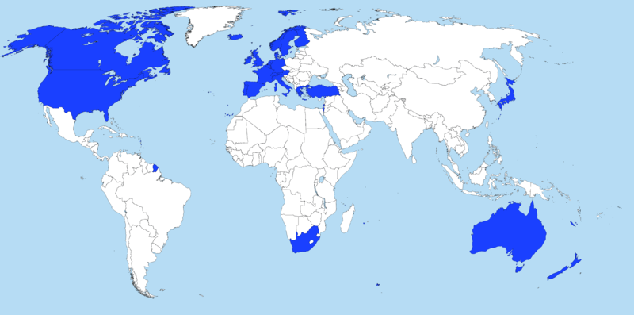
Allergy is a disease of the developed world
Rates have doubled since 1980
Notes:
Allergies are a new phenomenon (last 50 yrs)

Slide 40
Hay fever was a rare condition in 1900
Notes:
Most common type of allergy in NA

Slide 41
Peanut free schools only in last 30 years

Slide 42
Are we exposed to more substances?
NO
Industrial pollution more common in developing world
Most allergies involve natural substances
  We are exposed to less natural things

Slide 43
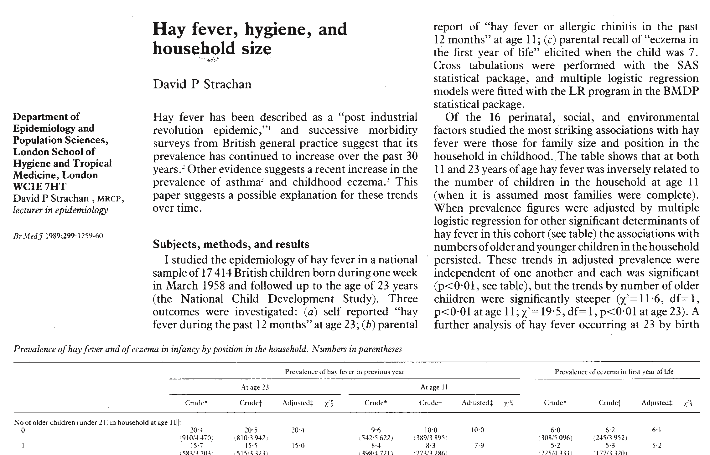
Hygene hypothesis for allergy
Notes:
We are too clean
Society is exposed to less and less things
Our immune sys has evolved
Doesn’t need to defend itself (we don’t get sick as often anymore) but sys needs to do something

Slide 44
Immunization and antibiotics reduce infection rates

Slide 45
Children in daycare less likely to be allergic
Notes:
More exposure to all kinds of diseases (sick more often)

Slide 46
Children in large families have less allergies
Notes:
Same reasoning as for daycare
The younger children have fewer allergies than older children

Slide 47
East vs. West Berlin
East Berlin had poor health care and pollution
West Berlin had good health care and was less polluted
More allergies in West Berlin
Notes:
East (communist) and west used to be separated by a wall
- In east, exposed to much more things

Slide 48
Some kids tend to have fewer allergies
Notes:
Fewer illnesses = more allergies
If parents let them have exposure to dirt

Slide 49
Some kids have more allergies
Notes:
If raised in a very clean env
Kind of like 2 immune sys that regulate each other – more of one = less of other

Slide 50
Allergy requires prior exposure
Involves immune sys memory
Hypersensitivity on “1st” exposure
  Unknown previous exposure

Slide 51
Mast cells display IgE antibodies
Notes:
Each antibody recognizes a specific

Slide 52
Allergin contacts the IgE molecules
Notes:
Epitope on allergen contacts IgE on mast cell
Binding changes shape on Antibody
Sends signal to inside of mast cell
Mast cell undergoes degranulation → explodes & releases histamine (active material, causes the allergy)

Slide 53
Mast cell degranulation releases histamine

Slide 54
Histamine produces allergy symptoms
Notes:
Get allergy → take ANTIhistamine
Can only deal w the symptoms

Slide 55
Managing allergy
Avoidance
Antihistamines
Decongestants
Immune modulators
Immunotherapy
Notes:
Can only reduce symptoms (not make it go away completely)
Going down = more heavy duty

Slide 56
Allergy tests look for reactions
Notes:
2 types of test
Injection test – inject small amount of allergen → look at pattern of rashes – unpleasant, many needles, rashes all over
Patches – not as effective as injection

Slide 57
Avoidance best for food allergy
Difficulty may be finding out what to avoid
Processed foods contain variable ingredients
Notes:
Variable – sometimes there are eggs sometimes there aren’t for the exact same product (they substitute materials sometimes)
Don’t really know what is in processed foods

Slide 58
Tracking down food allergy - logbook
Notes:
PROB: can take a long time (mnths, yrs)

Slide 59
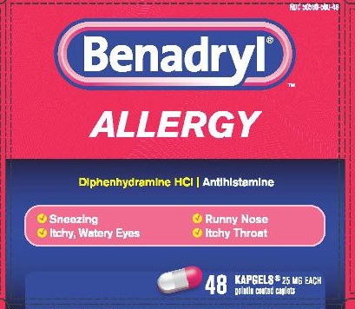
Antihistamines are often taken
Diphenhydramine
Notes:
Sedating type + Non-sedating type
1st generation: all sedating → eg. Benadryl (makes you drowsy)
2nd & 3rd gen: non-sedating
ANTIHISTAMINES
- Reduce nausea

Slide 60
Antihistamines are histamine antagonists
Notes:
Messenger = histamine
Binds to receptors in cells → response = allergy
Drug binds to exact same site → blocks histamine

Slide 61
Diphenhydramine is in Benadryl
Diphenhydramine

Slide 62
Generic versions are available
Notes:
Just search for “Diphenhydramine”

Slide 63
Diphenhydramine makes you sleepy
Notes:
Is in sleeping pills

Slide 64
Chlorpheniramine is in Chlor-Tripolon
Side effect is drowsiness
In cold medications
Notes:
Sold as an allergy medication
Only one that contains this particular antihistamine
Typically in cold medication
Both work the same way

Slide 65
Chlorpheniramine is in cold medications

Slide 66
First generation antihistamines can enter the brain
Notes:
Reason why they make you sleepy/give anti-nausea effect
Non-drowsy versions have been engineered so that they cannot enter the brain

Slide 67
Loratadine is a second generation antihistamine
Loratadine
Loratadine does not enter the brain
Chemically altered antihistamine
Notes:
Trapped in blood vessels by BBB
Eg. claratin

Slide 68
Body converts Loratadine to Desloratadine
PRO-DRUG
(inactive)
ACTIVE
metabolism
Loratidine
(Claritin)
Desloratidine
Notes:
Metabolised in liver

Slide 69
Desloratidine is in Aerius
Notes:
Since is converted (2 chem) → opportunity for companies to make more money
More expensive
Start out as diff chem but end up as same identical chem compound (claritin → desloratidine)
Will react diff in some ppl → bc of way it is metabolised

Slide 70
Seldane contained terfenadine

Slide 71
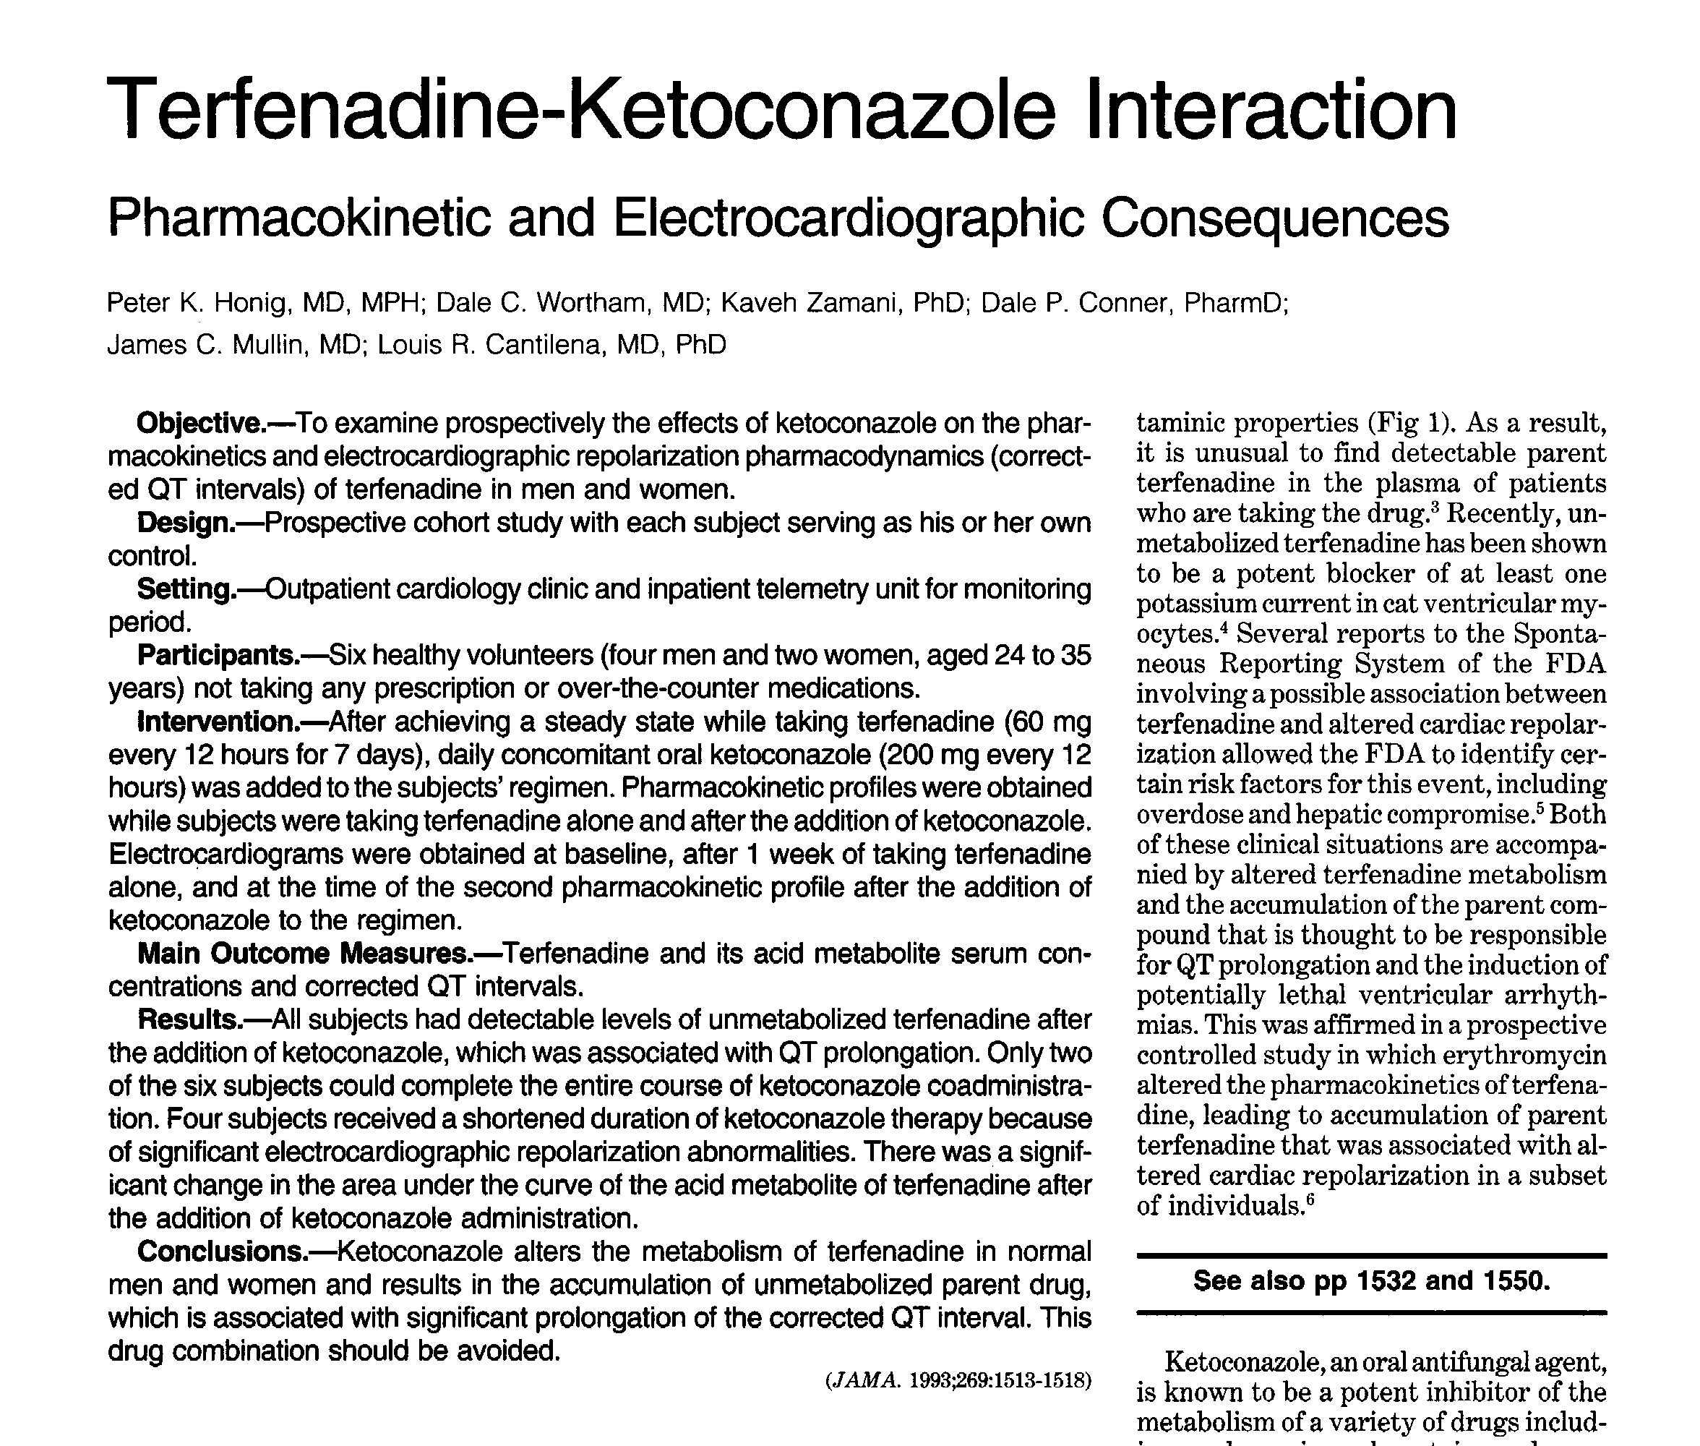
Drug-drug interactions with Ketoconazole
Notes:
Chem rxn → caused a toxic side effect
Rare side effect but severe enough for FDA investigation

Slide 72
Terfenadine is activated in the body
TOXIC
(Pro-drug)
ACTIVE
(non-toxic)
Fexofenadine

Slide 73
Allegra contains fexofenadine
Notes:
In this case, company + FDA worked together to solve the problem (unlike w VIOXX)
3rd gen histamine

Slide 74
Reactine contains cetirizine
Notes:
3rd gen histamine

Slide 75
Various generations of antihistamines
1st generation (drowsiness)
  Diphenhydramine (1940’s, Benadryl, generic available)
  Chlorpheniramine (1940’s, Chlor-Tripolon, generic available)
2nd generation (non-drowsy)
  Loratadine (1989, Claritin, generic available)
  Desloratadine (2002, Aerius, generic available)
3rd generation (non-drowsy)
  Fexofenadine (1996, Allegra, generic available)
  Cetirizine (1996, Reactine, generic available)
Notes:
Diphenhydramine – most commone
1st gen – very safe; have been around for awhile
2nd + 3rd essentially the same = NON-DROWSY

Slide 76
Buyer beware! Price for 100 tablets
Benadryl (Dipheniramine) | $32.45
Life-Brand Dipheniramine | $44.95
Claritin (Loratadine) | $63.32
Life-Brand Loratadine | $81.23
Kirkland Loratidine | $9.12 – COSTCO (bulk)
Aerius (Desloratidine) | $83.30
Life-Brand Desloratadine | $71.98
Allegra (Fexofenadine) | $68.95
Life-Brand Fexofenadine | $61.96
Reactine (Cetirizine) | $62.05
Life-Brand Cetirizine | $56.23
Notes:
Generic often manufactured by name brand
Was a huge diff in price 4-5 yrs ago
But change in situation 2-3 yrs ago (Benadryl, Claritin)
Fewer pills makes product look cheaper
Generic brand = less pills → looks cheaper but less pills
Name brand = more pills
EXPIRY DATES
Company regulated (not by FDA)
Will put expiry dates on things that will last for a very long time

Slide 77
Buying in bulk is best value

Slide 78
Pseudoephedrine for decongestion
Notes:
In cold medication
Hard to buy for just allergies
Will usually be bundled w ibuprofen (dont want to overdrug yourself though!)
Talk to pharmacist

Slide 79
Steroid decongestants
Rhinocort spray

Slide 80
Pulmicort is an anti-inflammatory steroid
Notes:
Steroid = 4 ring structure

Slide 81
Anaphylaxis is very serious
Notes:
Extreme condition/swelling → LIFE-THREATENING
Go to ER first, then go to doctors to get a prescription (epi-pen)

Slide 82
Epi-Pen for strong allergic reactions
Know how to use it
  Jab onto side of thigh
Notes:
Temporary release from anaphylaxis

Slide 83
Up to 50 % of allergies progress to asthma
Asthma = developed world only

Slide 84
Original drugs targeted nerve signals
Notes:
Allergy = bronchi airways collapse – caused by nerve signals

Slide 85
Salbutamol targets nerves to bronchii
Notes:
NT = norephedrine
Allergy med = amphetamine (mimics noradrenaline)

Slide 86
Salbutamol is a selective adrenaline agonist
Notes:
Mimics action of adrenaline → produces same shape change/response

Slide 87
Adrenaline agonists open airways in the lungs

Slide 88
High doses will stimulate the heart
Notes:
PROB → stimulates the heart
So need to make sure stays in lungs, out of the heart

Slide 89
Over use caused heart attacks
Notes:
When 1st came out
Prob of the user not the drug
Ppl were overdosing themselves

Slide 90
Flovent inhaler delivers measured doses
Notes:
Tried to affect dosing better (not by affecting the drug)

Slide 91
Leukotrienes associated with asthma

Slide 92
Singulair is a leukotriene antagonist
Notes:
These signaling molecules produce these effects

Slide 93
Singulair is very effective
Montelukast (active ing)
No heart attack/inhaler
Once a day pill
Much more convenient to take
Little bit more effective
Notes:
Made in canada (montreal)

Slide 94
Persistence pays off
Identify the allergen
  Avoid it when you can
Try antihistamines
  First, second or third generation
  Experiment and see which works best for you
Prescription steroids

Slide 95
Various generations of antihistamines
First generation (drowsiness)
  Diphenhydramine (1940’s, Benadryl, generic available)
  Chlorpheniramine (1940’s, Chlor-Tripolon, generic available)
Second generation (non-drowsy)
  Loratadine (1989, Claritin, generic available)
  Desloratadine (2002, Aerius, generic available)
Third generation (non-drowsy)
  Fexofenadine (1996, Allegra, generic available)
  Cetirizine (1996, Reactine, generic available)

