Slide 1
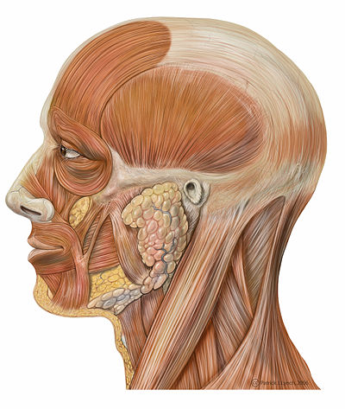
Topic 5: Anatomy of the
Muscular System
Chapter 10
http://en.wikibooks.org/wiki/Human_Physiology/The_Muscular_System

Slide 2
5.1 GROSS ANATOMY OF A SKELETAL MUSCLE
• recall that muscle fiber is the name of a single muscle tissue cell
• several different levels of CT wrapping
1) endomysium: fine layer of CT that surrounds each muscle fiber (cell)
perimysium: sheath around a fascicle
3) epimysium: dense, fibrous CT that surrounds & holds together a group of fascicles = outside layer of a single muscle
5) deep fascia: still coarser layer of dense CT that binds muscles into functional groups »» eg: hamstrings vs quadriceps

Slide 3
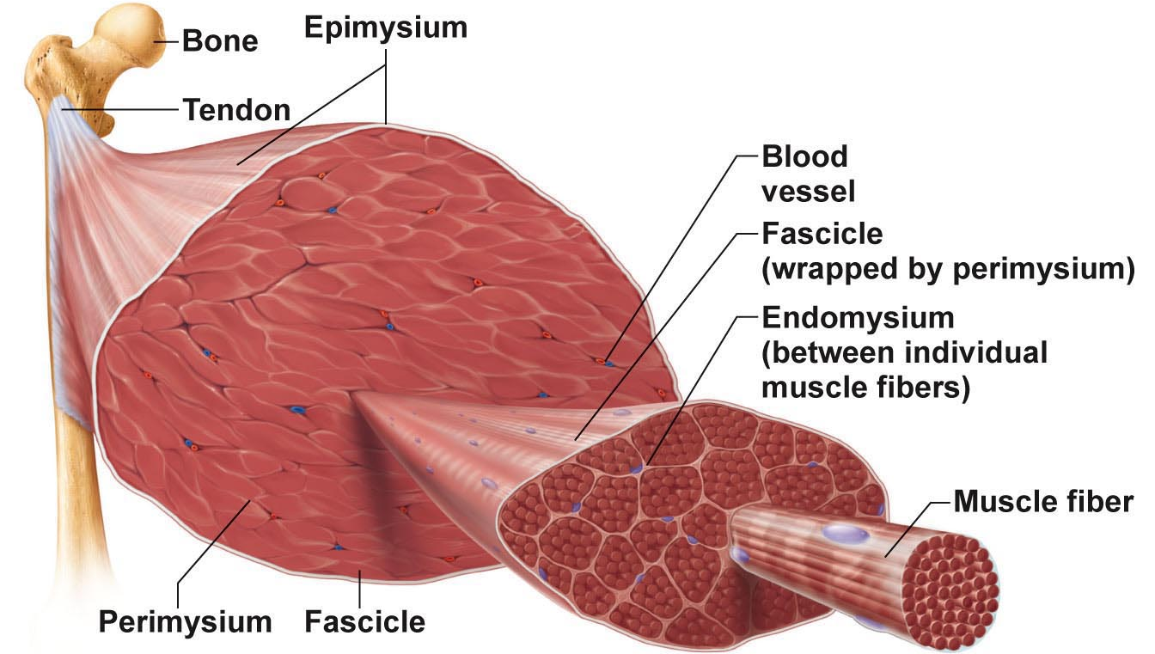
Fig. 9.1a
MUSCLE ATTACHMENTS
• most muscles span joints
• most muscles are attached to bones in at least 2 places
origin: ……………………..
insertion: ……………………..
Most attachments are indirect attachments involving either a tendon or an aponeurosis

Slide 4
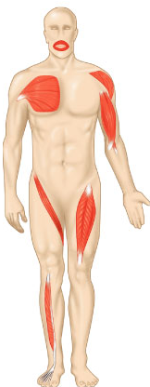
ARRANGEMENT OF FASCICLES
• all skeletal muscles have fascicles
• 4 basic patterns:
Parallel:
• can be straplike (sartorius) or fusiform (biceps brachii)
Pennate: unipennate (eg: extensor digitorum longus)
bipennate (eg: rectus femoris)
multipennate (eg: deltoid)
Convergent: muscle is triangular or fan-shaped (eg: pectoralis major)
Circular: concentric rings surround ext openings & contract to close opening (eg: obicularis oris)
Fig. 10.1

Slide 5
5.2 INTERACTIONS OF SKELETAL MUSCLES
• muscles can work together or in opposition
• 4 functional groups: prime movers, antagonists, synergists & fixators
1) Prime Mover:
• ……………………………………………………………………………………..
• eg: biceps brachii & elbow flexion
2) Antagonist:
• ……………………………………………………………………………………..
• can provide resistance to prevent overshoot or control rate of movement
• a single muscle can be a prime mover for one action & an antagonist for another action - eg: biceps brachii & triceps brachii
3) Synergists:
• muscles that help the prime mover by:
a) promoting the same movement
b) reducing undesirable movements (eg: finger flexor muscles cross both wrist & phalangeal joints)
4) Fixators:
• immobilize a bone - eg: muscles involved in posture

Slide 6
Naming Skeletal Muscles
Location of muscle: bone or body region – eg: temporalis, intercostal
Shape of muscle: eg: deltoid (triangular), right & left trapezius muscles form a trapezoid
Relative size of muscle: maximus, minimus, longus, brevis – eg: gluteus maximus & gluteus minimus
Direction of muscle fibers: eg: rectus = straight, parallel to midline (rectus femoris); also transversus abdominis, oblique
Number of origins: biceps, triceps, quadriceps – eg: biceps brachii
Location of muscle’s origin and/or insertion: if both indicated, origin always indicated first – eg: sternocleidomastoid (neck region – dual origin on sternum and clavicle & insertion on mastoid process of temporal bone)
Action of the muscle: flexor, extensor, adductor – eg: adductor longus for thigh adduction & suppinator muscle in forearm
What can we say about the extensor carpi radialis longus???

Slide 7
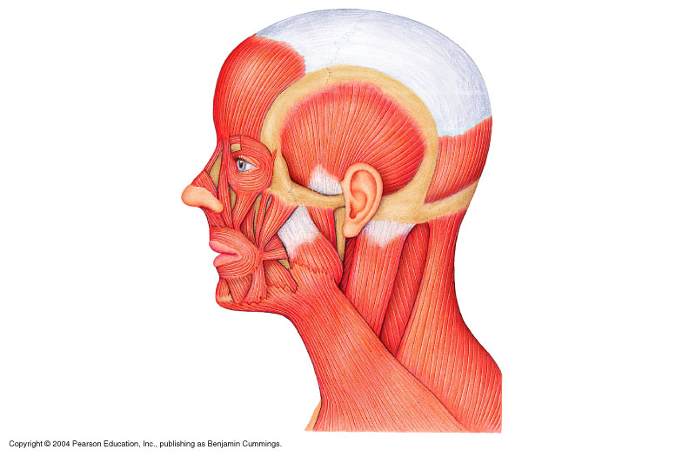
5.3 Muscles of the Head – Facial Expression
• insert into skin or other muscles, not bones; innervated by the facial nerve
epicranius = main muscle of scalp – consists of:
(i) frontalis: raises eyebrows, wrinkles forehead
(ii) occipitalis: pulls scalp posteriorly
orbicularis oculi: surrounds rim of orbit; protects eyes from light/injury – blinking, squinting, also draws eyebrows down
zygomaticus (cheek to corner of mouth):
smiling muscle
orbicularis oris:
lips; multi-layered; closes, purses, protrudes lips
mentalis (mandible to chin):
V-shaped pair – protrudes lower lip; wrinkles chin
ʘ buccinator (mandible/maxilla to orb.oris): deep to masseter – whistling, sucking; hold food in place when chewing; especially in nursing infants
platysma (fascia of chest to mandible):
helps depress mandible; tenses skin of neck
epcranial aponeurosis
galea aponeurotica
Fig. 10.7

Slide 8
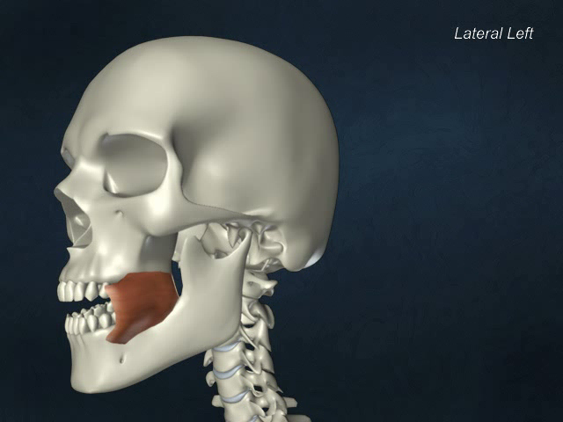
Buccinator

Slide 9
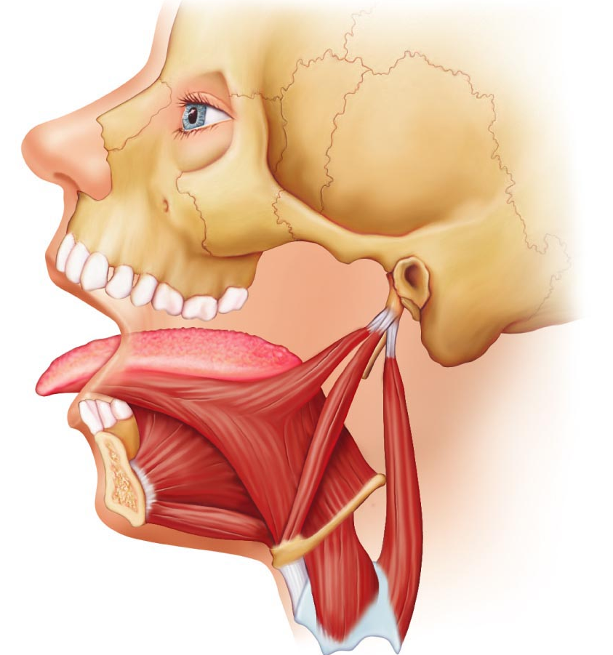
5.4 Muscles that move the tongue
genioglossus (mandible to inferior tongue & hyoid bone): prime mover of tongue protrusion; anchors tongue to prevent obstruction of respiration
hyoglossus (hyoid bone to inferolateral tongue): depresses tongue, especially lateral margins
styloglossus (styloid process of temporal bone to inferolateral tongue): retracts & elevates tongue
Fig. 10.8c

Slide 10
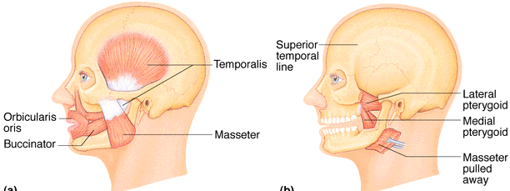
Muscles of the Head: Mastication, etc
• 4 pairs involved in chewing; all innervated by mandibular division of cranial nerve V
ʘ masseter (zygomatic to mandible): prime mover of jaw closure (powerfully)
ʘ temporalis (temporal to mandible): elevates and retracts mandible (closes jaw); maintains closed jaw at rest
medial and lateral pterygoid (sphenoid to mandible): both two-headed; additional jaw movements (eg: side-to-side grinding movments)
buccinator (mandible/maxilla to orbicularis oris): helps keep food between grinding surfaces of teeth during chewing
Fig. 10.8

Slide 11
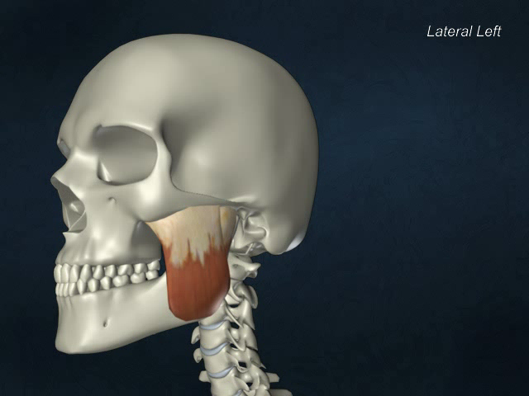
Masseter

Slide 12
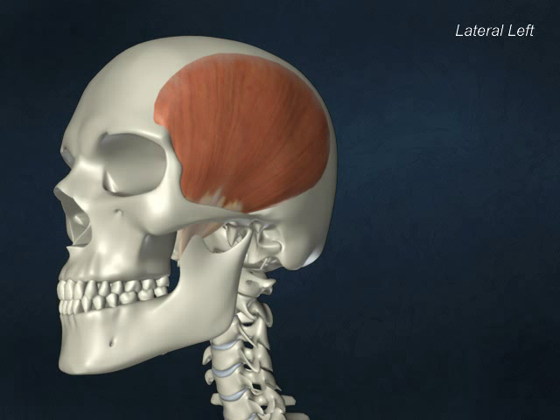
Temporalis

Slide 13
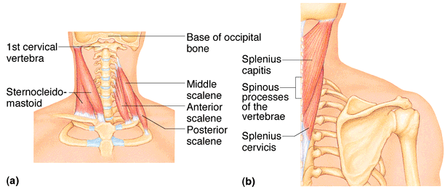
5.5 Muscles of the Neck & Vertebral Column: Head & Trunk Movements
• head moved by muscles originating from axial skeleton
sternocleidomastoid (manubrium/clavicle to mastoid process of temporal): 2-headed; deep to platysma; prime mover (both muscles) of head flexion; individual muscle action for head rotation to side, head tilts
scalenes (cervical vertebrae to 1st 2 ribs): more laterally and deep to platysma & sternocleidomastoid – elevate first 2 ribs, role in coughing, flex & rotate neck
ʘ splenius (vertebrae to mastoid process of temporal): superficial; “bandage muscle”; head extension (both sides) or rotation, tilts
Fig. 10.10a,b
posterior
anterior

Slide 14
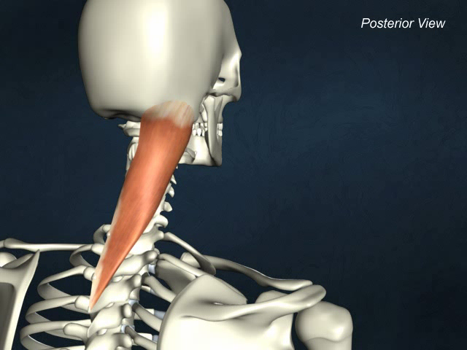
Splenius capitis

Slide 15
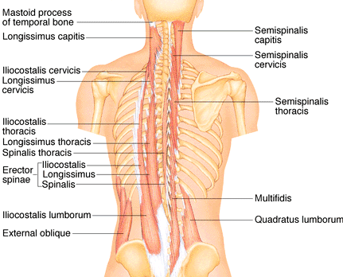
5.6 Muscles of the Neck & Vertebral Column: Head & Trunk Movements
erector spinae: prime mover of back extension; consists of 3 columns of muscles (iliocostalis, longissimus, spinalis); resistance to bending forward & extensors for return to erect position
ʘ semispinalis: deeper, composite muscle from thoracic region to head; extends vertebral column & head, rotation of head, synergistic with sternocleidomastoid muscles of opposite side
quadratus lumborum (iliac crest to lumbar vertebrae): individual muscles flex vertebral column laterally; jointly to extend lumbar spine & fix 12th rib; maintain upright posture
Fig. 10.10d

Slide 16
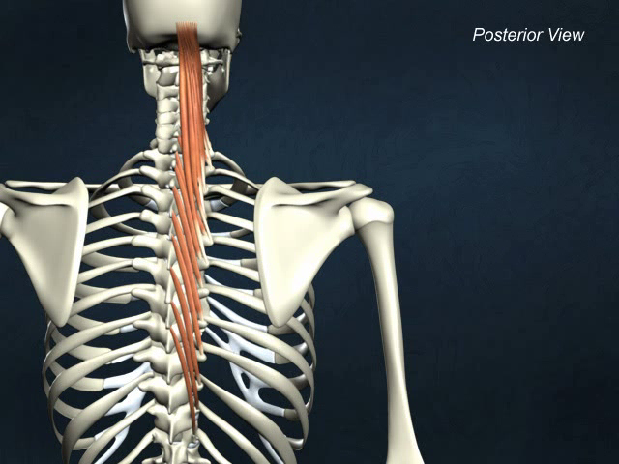
Semispinalis capitis

Slide 17
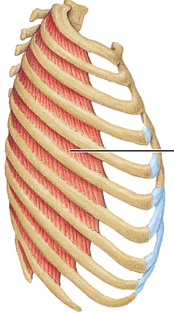
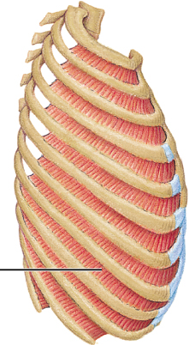
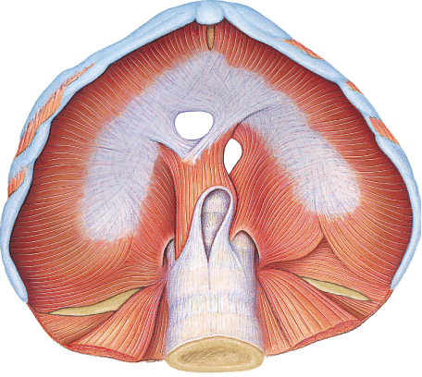
Fig. 10.11
External
Internal
5.7a Muscles of Respiration
ʘ external intercostals: 11 pairs, between ribs; oblique; pull ribs together to elevate rib cage (inspiration;1st ribs fixed by scalene muscles)
internal intercostals: 11 pairs, between ribs; ⊥ external intercostals; draw ribs together to depress rib cage (expiration; 12th ribs fixed by quadratus lumborum)
diaphragm: dome-shaped when relaxed; prime mover of inspiration

Slide 18
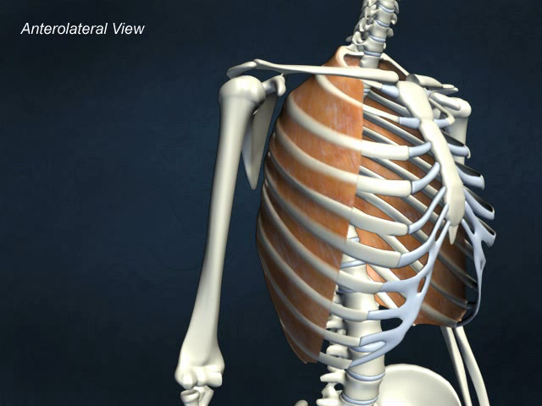
External intercostals

Slide 19
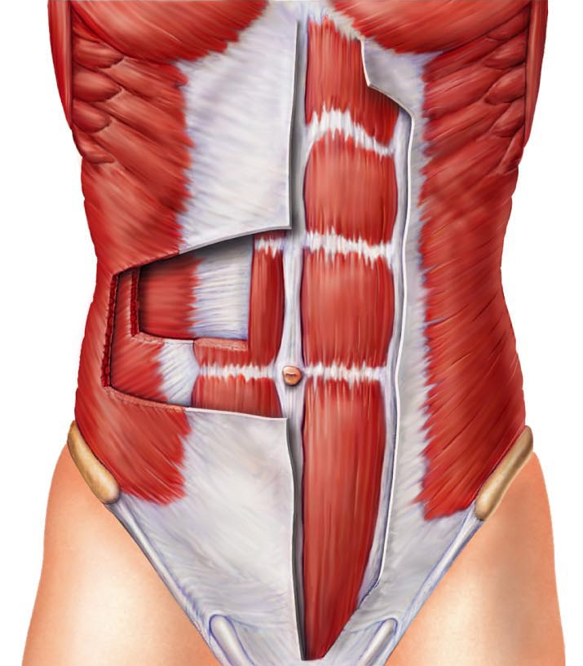
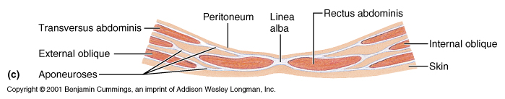
5.7b Muscles of the Abdominal Wall
ʘ rectus abdominis – medial superficial; pubis to rib cage; lumbar rotation, fix & depress ribs, stabilize pelvis during walking
external oblique – largest & most superficial lateral muscle; together ➢ increase ab pressure, flex vertebral column; individual ➢ rotation
internal oblique – deeper, but same actions as ext obliques
ʘ transversus abdominis – deepest; compresses abdominal contents
Linea alba

Slide 20
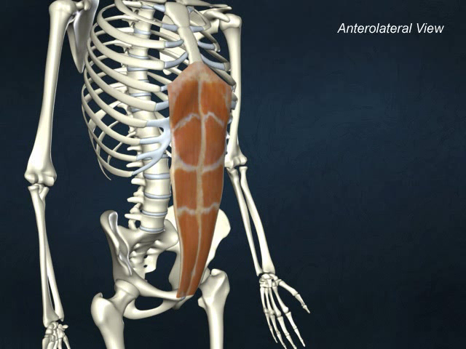
Rectus abdominis

Slide 21
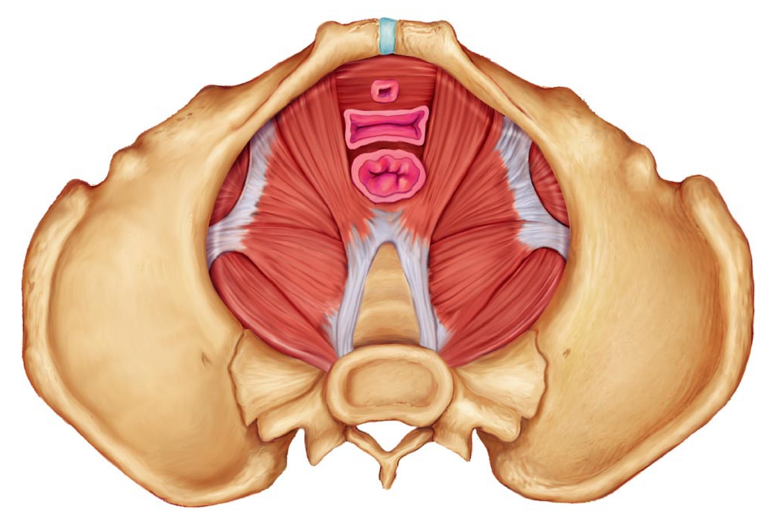
5.8 Muscles of the pelvic floor and perineum
levator ani (pubis to inner coccyx): supports pelvic viscera & forms supportive sling at anorectal junction & vagina; resists increases in intra-abdominal pressure
coccygeus (spine of ischium to sacrum & coccyx): supports pelvic viscera & coccyx
urogenital diaphragm: supports pelvic viscera and constricts urethra

Slide 22
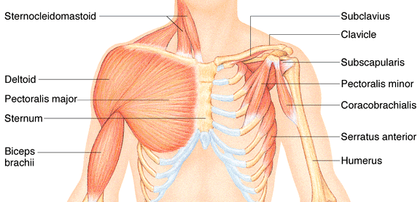
5.10 Superficial Muscles of Thorax:arm movements
ʘ pectoralis major (sternum/rib cartilages to humerus): prime mover of arm flexion; rotates arm medially; adducts arm; climbing, throwing, pushing
ʘ latissimus dorsi (vertebrae to humerus): broad, flat back muscle; prime mover of arm extension, arm adductor, rotates arm at shoulder, rowing, swimming
ʘ deltoid (clavicle/scapula to humerus): thick, rounded, site of IM injection, prime mover of arm abduction (all fibers); also lateral & medial rotations, flexion or extensions if only some fibers used; swinging arm when walking
Fig. 10.14

Slide 23
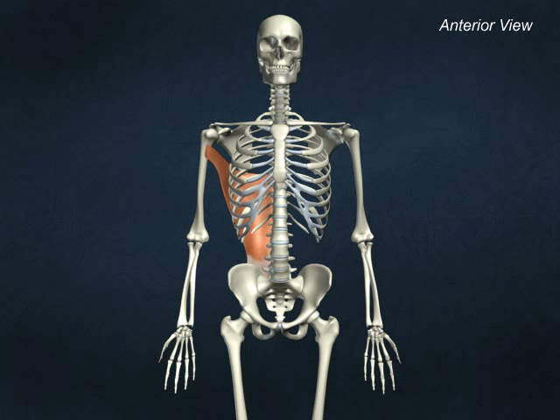
Latissimus dorsi

Slide 24
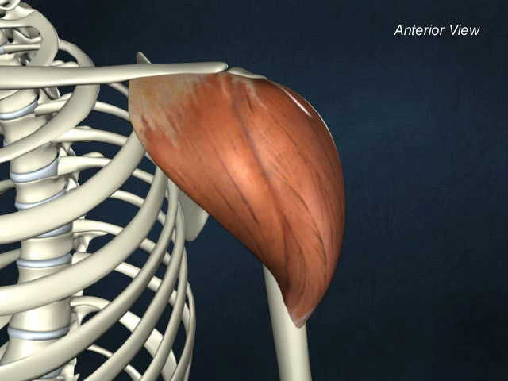
Deltoid

Slide 25
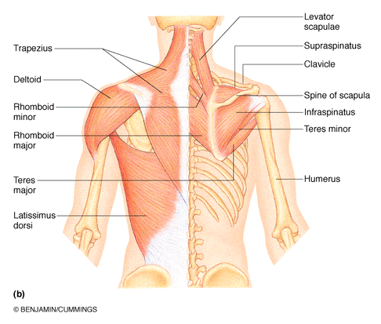

ʘ trapezius (occipital & vertebrae to scapula): superficial, stabilizes, raises, retracts, rotates scapula
rhomboids (vertebrae to scapula): deep to trapezius; aid in scapula movements (eg: squaring shoulders, rotation when lowering arm)
+ subscapularis = rotator cuff muscles
Fig. 10.14

Slide 26
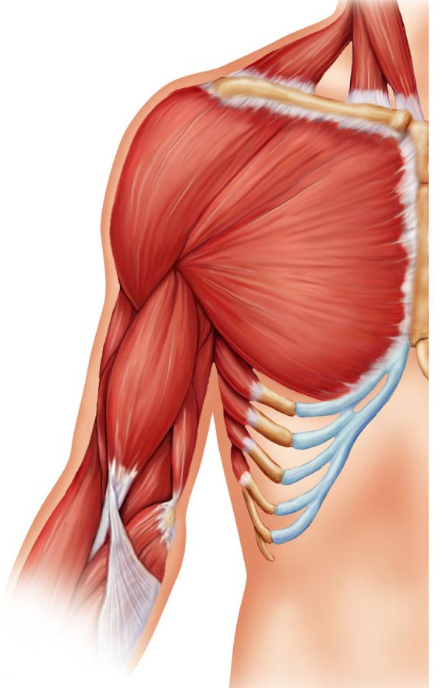
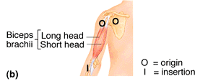
5.10 Muscles Crossing the Shoulder & Elbow Joints
ʘ triceps brachii (scapula/humerus to ulna): only muscle of posterior compartment of arm; powerful forearm extensor, may help stabilize shoulder joint
ʘ biceps brachii (shoulder to radius): anterior, flexes elbow joint & supinates forearm; weak flexor of arm at shoulder
ʘ brachialis (humerus to ulna): immediately deep to biceps brachii; major forearm flexor (strong) – lifts ulna as biceps lifts radius
ʘ brachioradialis (humerus to radius): superficial; from distal humerus to distal forearm; synergist in forearm flexion

Slide 27
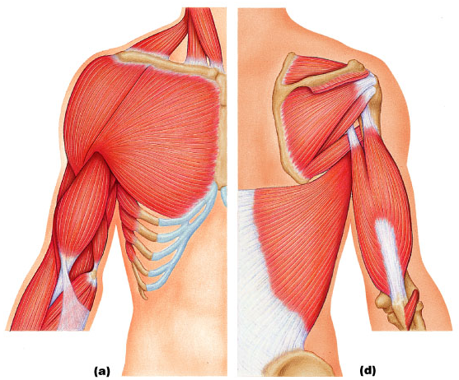
Fig. 10.15
Anterior
Posterior

Slide 28
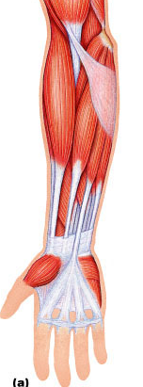
Muscles of the Forearm: Movements of the Wrist, Hand & Fingers
2 functional groups allow for movements of (i) the wrist and of (ii) the fingers and thumb
ʘ pronator teres (humerus/ulna to lateral radius): pronates forearm, weak flexor of elbow
ʘ flexor carpi radialis (humerus to metacarpals): diagonally across forearm, powerful flexor of wrist; abducts hand
ʘ flexor carpi ulnaris (humerus/ulna to metacarpals): powerful flexor of wrist; also adducts hand in concert with extensor carpi ulnaris; stabilizes wrist during finger extension
ʘ flexor digitorum superficialis (humerus/ulna to phalanges): 2-headed, deeper; flexes wrist & middle phalanges of fingers 2-5
flexor retinaculum
Fig 10.16a

Slide 29
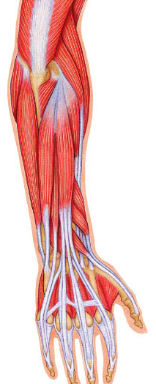

ʘ extensor carpi radialis longus/brevis (humerus to metacarpals): extends & abducts wrist
ʘ extensor digitorum (humerus to phalanges): prime mover of finger extension; extends wrist, can abduct fingers
ʘ supinator (humerus to radius): deep; assists biceps brachii to supinate forearm
10.17a

Slide 30
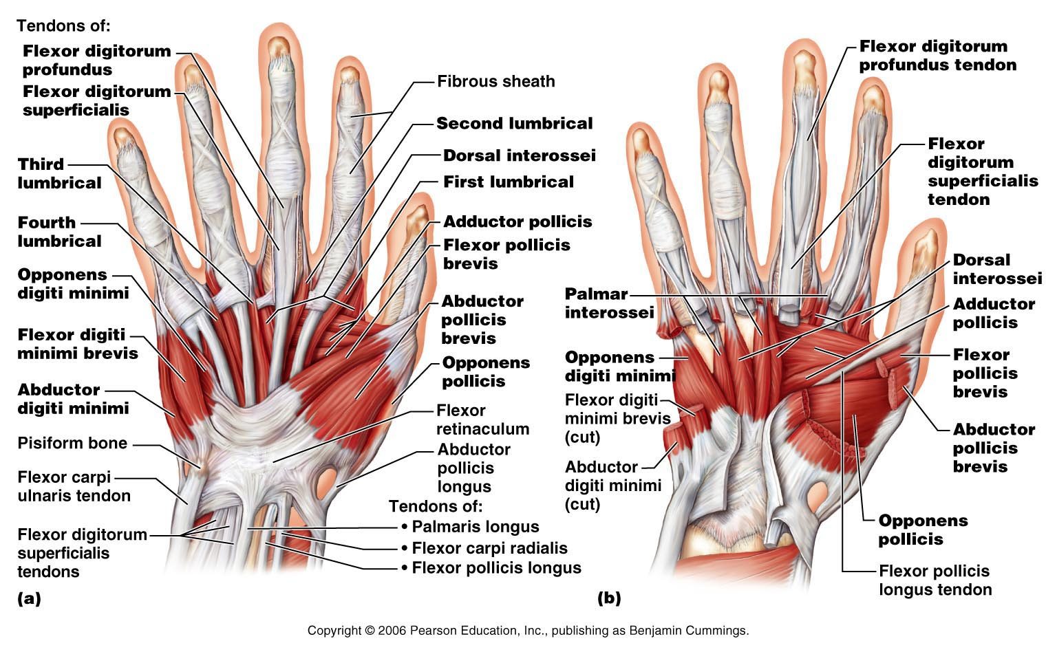
Fig. 10.18: Ventral Views of Right Hand

Slide 31
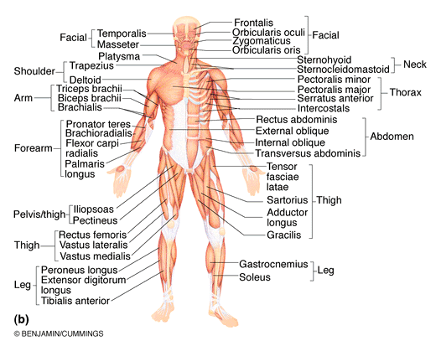

Fig. 10.5
Muscles of Hip, Thigh & Leg
ʘ iliopsoas (iliac crest & lumbar vertebrae to femur): composite of 2 muscles; prime mover of hip flexion
ʘ sartorius (iliac spine to medial tibia): strap-like; longest muscle; flexes & laterally rotates thigh; weak knee flexor
adductors (magnus, longus, brevis) (pubis to femur): all adduct, flex, medially rotate thigh – eg: riding a horse, walking, fixing hip when knee flexed

Slide 32
ʘ pectineus (pubis to femur): adducts, flexes & medially rotates thigh
gracilis (pubis to medial tibia): adducts thigh, medially rotates leg (walking)
ʘ rectus femoris (iliac spine to patella & tibia): extends knee; flexes thigh at hip
ʘ vastus (lateralis, medialis, intermedius): all extend the knee
ʘ tibialis anterior (tibia to tarsals): prime mover of dorsiflexion; inverts foot
ʘ extensor digitorum longus (tibia to phalanges): dorsiflexes foot; prime mover of toe extension

Slide 33
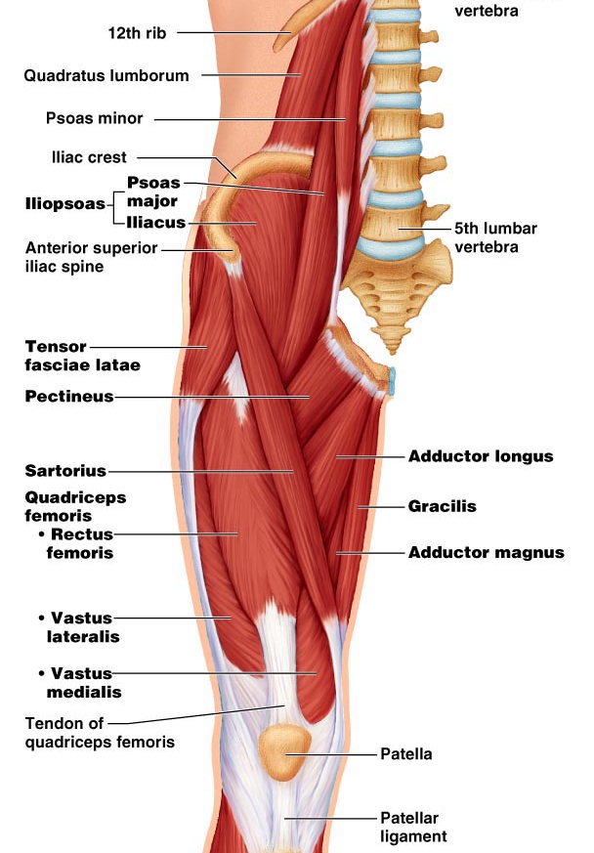
Figs. 10.20

Slide 34
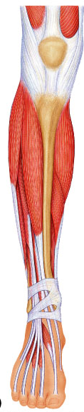
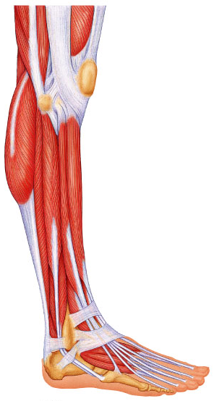
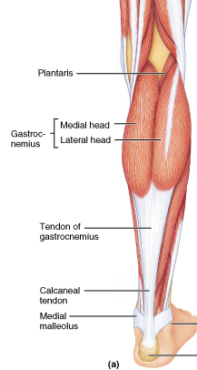
Fig. 10.24
tibialis anterior
extensor digitorum longus
Fig. 10.22
Fig. 10.23

Slide 35
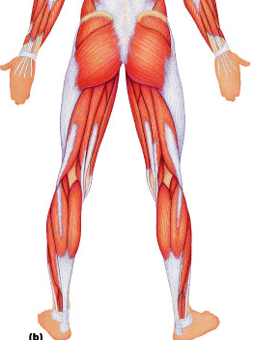
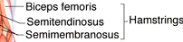
Fig.10.6
ʘ gluteus maximus (ilium/sacrum to femur): largest & most superficial buttock muscle; major thigh extensor - climbing stairs, running (im injection)
ʘ gluteus medius (ilium to femur): abducts & medially rotates thigh; esp. during walking (im injections)
ʘ hamstrings (ischial tuberosity to tibia/fibula): 3 muscles; all extend thigh & flex knee

Slide 36
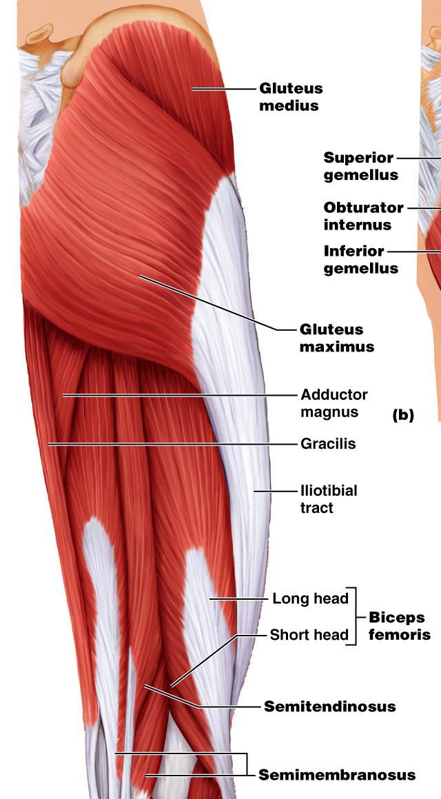
Fig. 10.21

Slide 37
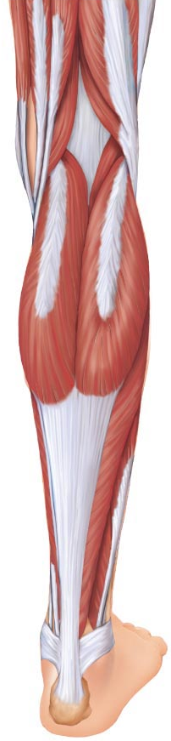
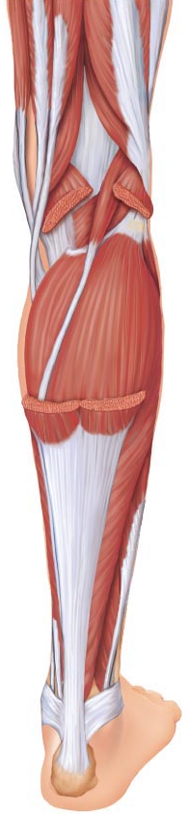
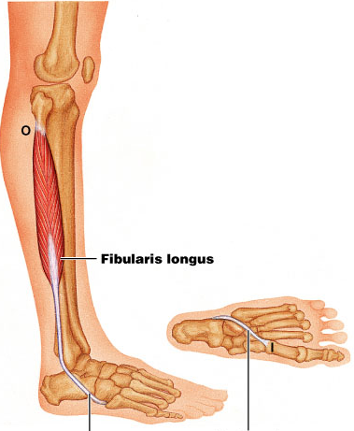
Fig. 10.24
ʘ gastrocnemius (femur to calcaneal tendon): plantar flexes foot when knee extended; flex knee if foot dorsiflexed
ʘ soleus (proximal tibia/fibula to calcaneus): deeper, plantar flexes ankle: walking, running, dancing
ʘ fibularis (peroneus) longus (fibula under foot to 1st metatarsal): plantar flexes & everts foot;helps keep foot flat on ground
calcaneal (Achilles tendon): largest tendon in body (G & S)

Slide 38
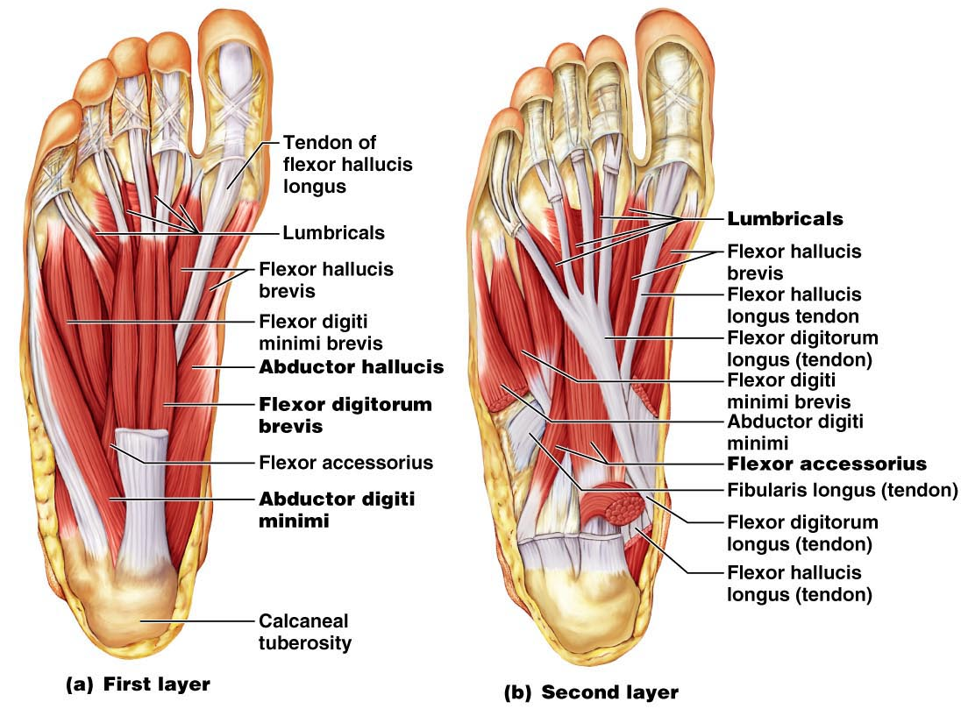
Fig. 10.25
Notes:
Don’t need to know it

