Slide 1
Topic 6 (Part B): ANATOMY OF THE NERVOUS SYSTEM
Chapter 12: pp. 458-473
Chapter 13: pp. 490-510

Slide 2
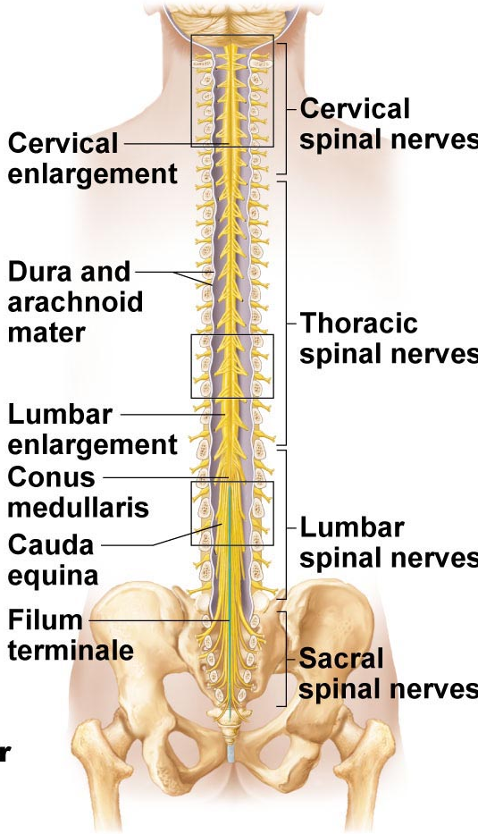
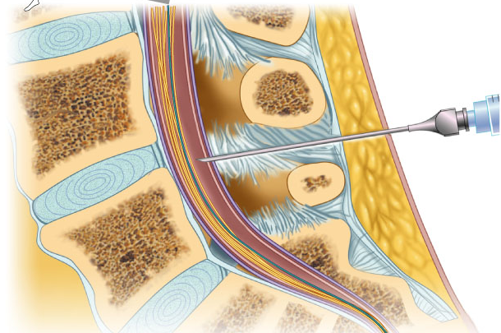
The Spinal Cord
• from foramen magnum to 1st/2nd lumbar vertebra; below this is ideal spot for lumbar puncture
(i) 2-way conduction system
(ii) major reflex centre
(iii) initiates complex patterns of motor activity
  • 31 pairs of spinal nerves exit via foramen between vertebra
• cervical & lumbar enlargements for prevent in damage
• spinal cord held in place by:
(i) denticulate ligaments: PIA matter
(ii) filium terminale: at the bottom, holds in place
What is the cauda equina? Horses tail describes loose arrangement of sinal cord
Fig. 12.26
Notes:
Vertebral column travels faster than the spinal cord therefore it ends earlier

Slide 3
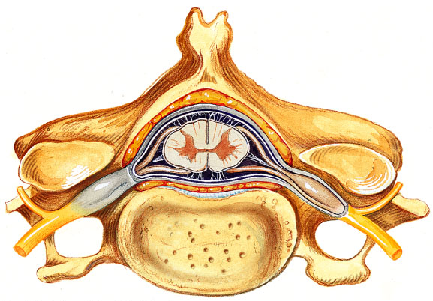
Gray Matter & Spinal Roots
• gray matter as for other regions of CNS – but all neurons multipolar
• organized like butterfly wings: paired anterior (ventral) & posterior (dorsal) horns connected by gray commissure (where is the central canal?)
• small lateral horns associated with thoracic & superior lumbar regions of cord
Fig. 12.28
Notes:
Anterior is bottom
Posterior is incoming
Gray commissure is blue arrow

Slide 4
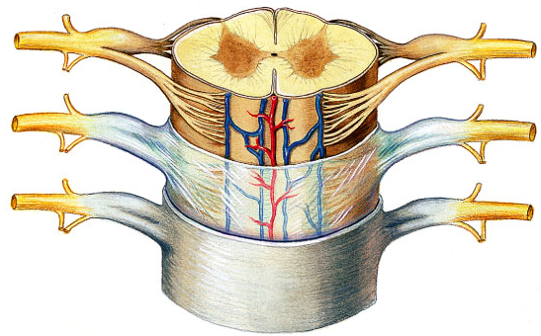
Fig. 12.28
Anterior horns:
• nerve cell bodies of somatic motor neurons – axons exit via ventral roots
• largest at levels of cervical & lumbar enlargements – why??
Lateral horns:
• sympathetic motor neurons to visceral organs; also exit via ventral roots
Notes:
Ventral route is outgoing motor info (blue arrow)

Slide 5
Fig. 12.28
Dorsal root ganglion:
• afferent fibers from peripheral sensory receptors form dorsal roots; dorsal root ganglia house cell bodies of associated sensory neurons – their axons enter cord to:
(i) travel to higher cord/brain centres
(ii) synapse with interneurons in posterior horns at level they enter
• spinal nerve = fused dorsal & ventral roots
What is poliomyelitis??
Notes:
Bump is the dorsal root ganglia (blue arrow)
Star on spinal nerve (two way traffic) these are roots

Slide 6
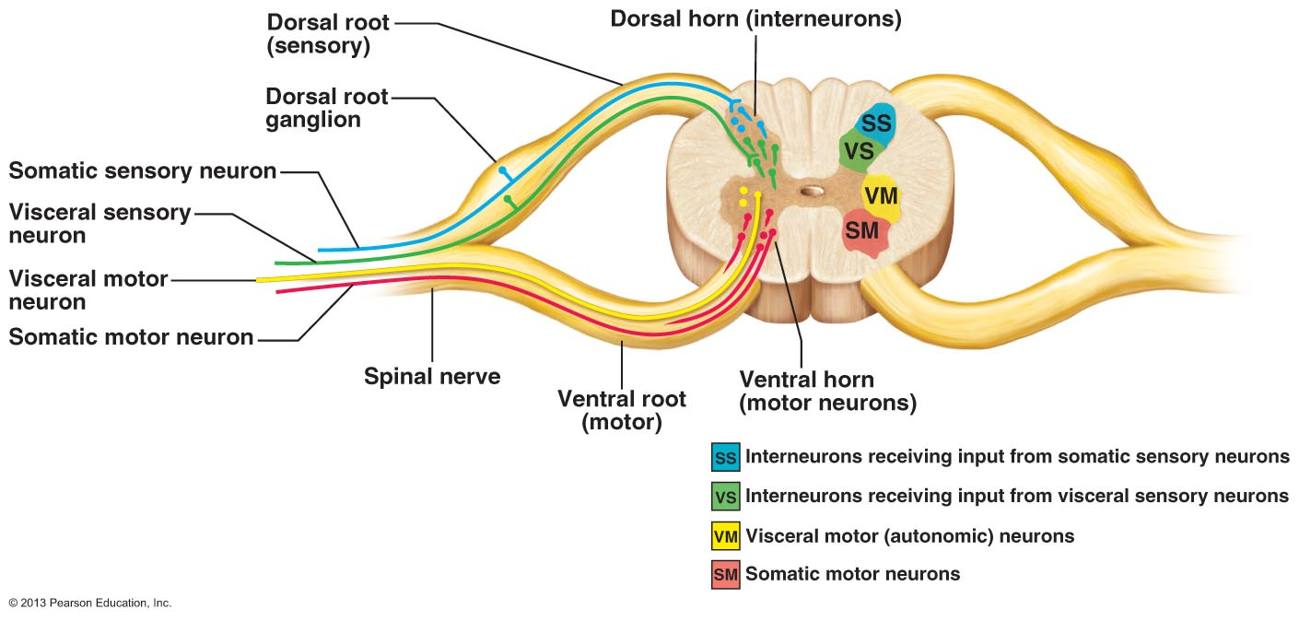
Fig. 12.29: Organization of the Gray Matter of the Spinal Cord
NB: the dorsal and ventral roots are part of the PNS, not the CNS!

Slide 7
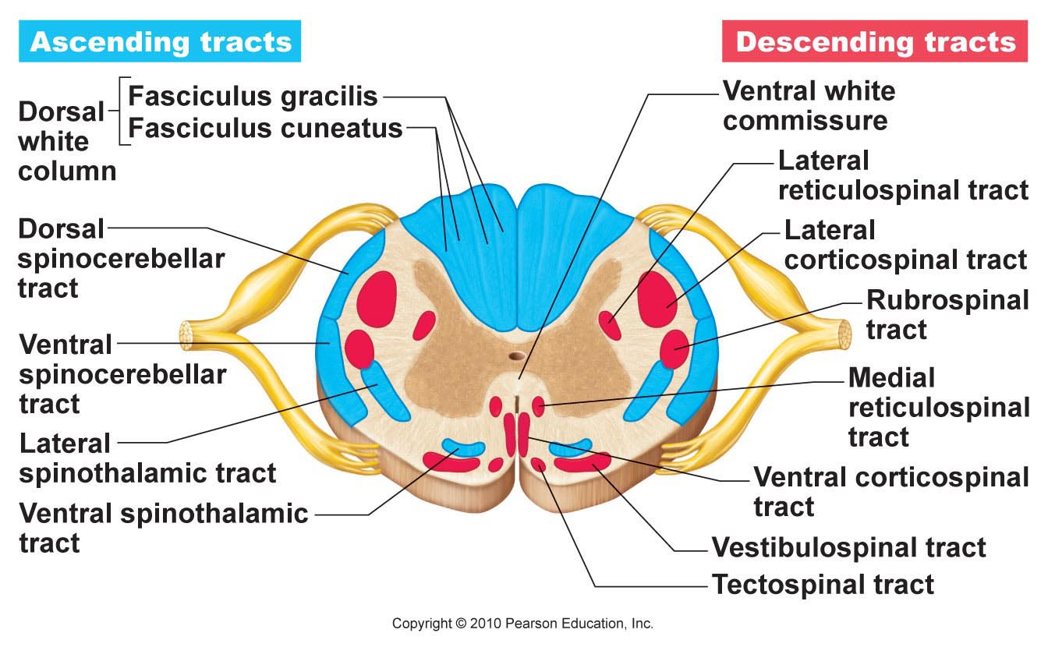
Fig. 12.30
White Matter
• myelinated & unmyelinated fibers – communication between different parts of cord & between cord & brain
• ascending, descending & transverse (commissural) tracts – direction of fibers
Some general properties of spinal tracts:
Most pathways cross over from one side of CNS to other (decussate)
Most consist of a chain of 2 or 3 neurons
Most exhibit somatotopy:
All pathways & tracts are paired – one on each side of spinal cord or brain
Notes:
Descending is motor
Do not need to label

Slide 8
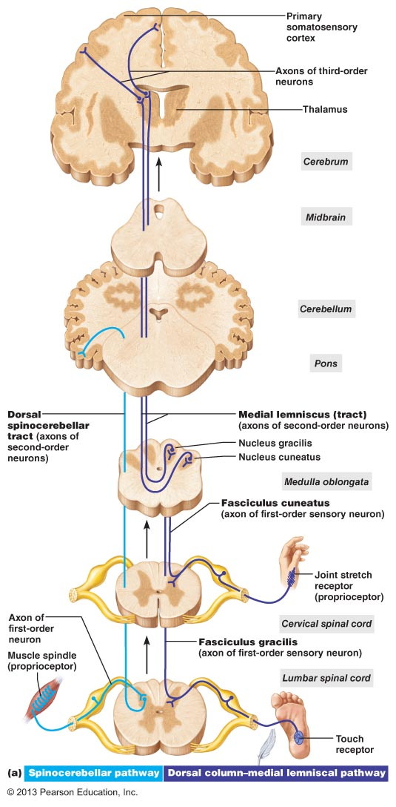
Fig. 12.31a – sample pathway for discriminative touch and conscious proprioception
Notes:
Understand not label
Proprioceptive crosses over going to cortex

Slide 9
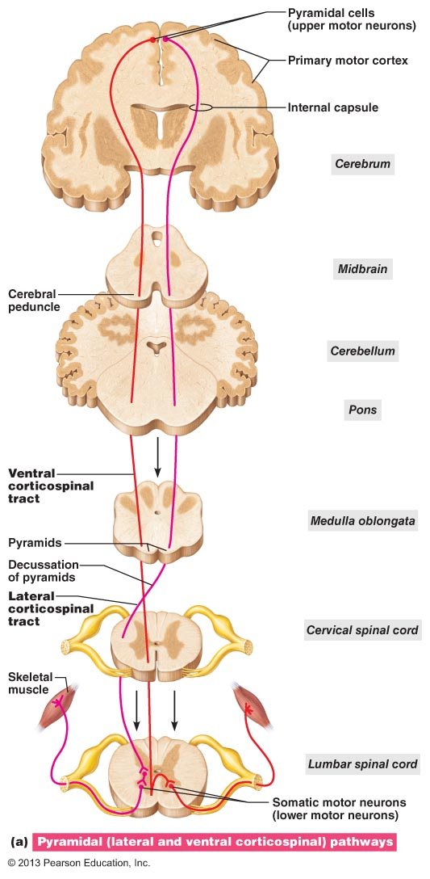
Fig. 12.32a: Direct pyramidal descending tract to skeletal muscle

Slide 10
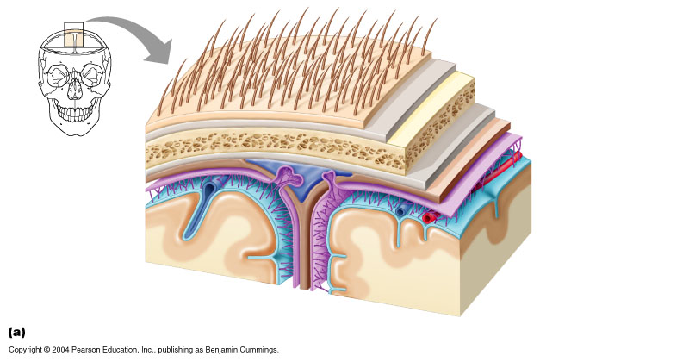
Protection of the CNS
Bones
Meninges
Cerebrospinal fluid
Blood-brain barrier
Meninges (meninx)
• 3 CT membranes that: (a) cover & protect CNS
(b) protect blood vessels & enclose venous sinuses
(c) contain cerebrospinal fluid
(d) form partitions within skull (separate parts)
Dura mater:
• tough; 2 layers around brain: outer periosteal layer & inner meningeal layer-star
• spinal cord has only meningeal layer
• around brain, 2 layers fused except where enclose dural sinuses
• dural septa to partition and anchor: falx cerebri, falx cerebelli, tentorium cerebelli
Fig. 12.22
Notes:
Know this diagram
Miningeal layer sepearates at sinuses
ONLY KNOW FALX CEREBRI

Slide 11
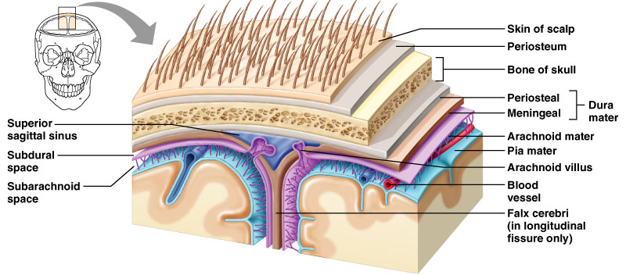
Fig. 12.23
Fig. 12.22
Arachnoid mater:
• loose covering separated from dura mater by subdural space
• subarachnoid space between arachnoid mater & pia mater – filled with CSF & contains largest blood vessels serving brain
• role of arachnoid villi in accumulation of CSF
Pia mater: (see also Fig. 12.22)
• delicate CT + tiny blood vessels – clings tightly to brain, follows convolutions
What is meningitis? What is encephalitis?
Notes:
Aracnoid villus goes into saggital sinus, cerebral spinal fluid gets reabsorbed at level of sinus
Meningitis: inflammation of the membranous coverings of the brain, enters CNS
Encephelitis is inflammation of the neural tissue

Slide 12
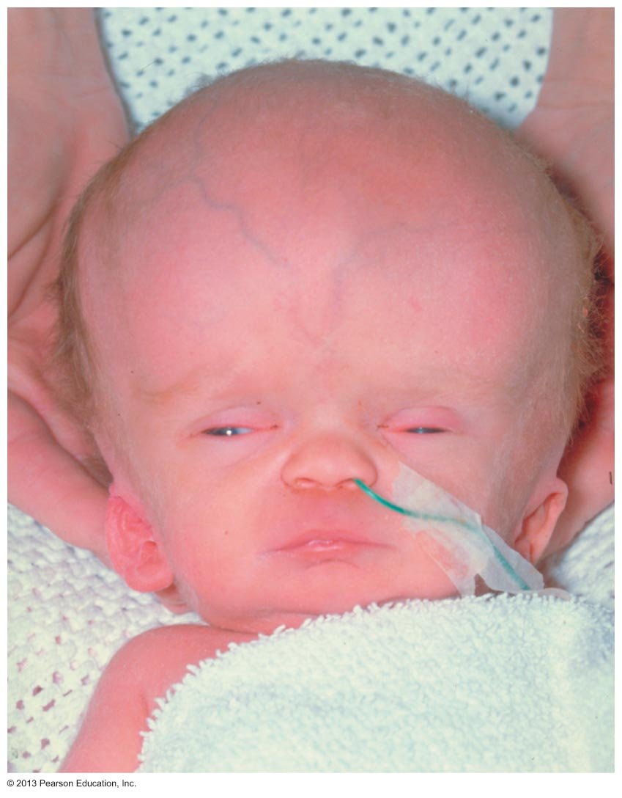
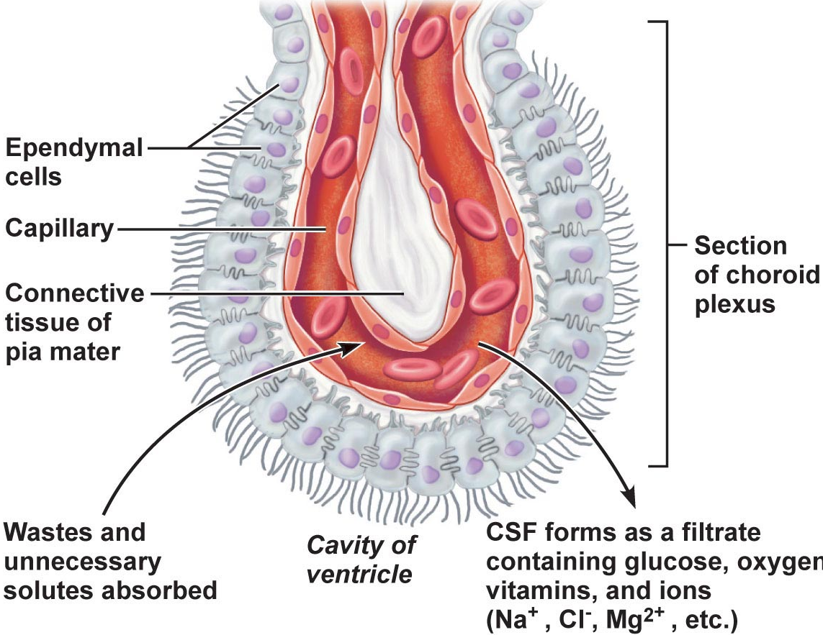
Cerebrospinal Fluid
• liquid cushion to give buoyancy to CNS tissue; also protective, nutritive roles
• similar to plasma but less protein, more vit C, Na⁺, Cl⁻, Mg⁺⁺ & H⁺, less Ca⁺⁺, K⁺
• choroid plexuses in roof of ventricles form CSF: clusters of permeable capillaries enclosed by layer of ependymal cells (role of these cells?)
total CSF = 150 ml; replaced ~ every 8 hours; choroid plexuses also clean CSF
What is hydrocephalus?
Fig. 12.25
Notes:
If you make CSF than you use
Hydrocephalus is when fluid accumulates in the brain in a baby, not as serious

Slide 13
Blood-Brain Barrier
• why?? some hormones also act at NTs; ions can increase rate of neuronal firing (neurons are sensitive to changes and some hormones in blood stream could act as NT in the brain)
composed of 3 layers:
(i) continuous epithelium of capillary wall (sealed by tight junctions) not leaky
(ii) thick basal lamina surrounding external face of capillary
(iii) bulbous feet of astrocytes
• what gets in? glucose, essential amino acids, some electrolytes; also fats, fatty acids, oxygen, carbon dioxide, any other fat-soluble molecules
• not completely uniform:
(i) capillaries of choroid plexuses porous but ependymal cells linked by tight junctions
(ii) very permeable near vomiting centre, hypothalamus; incomplete in newborns

Slide 14
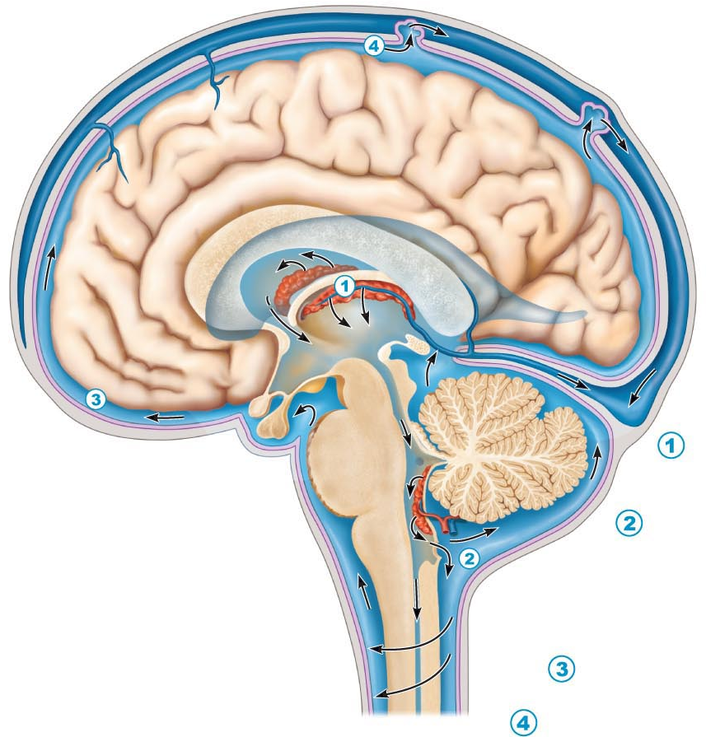
Fig. 12.24: Formation & Circulation of Cerebrospinal Fluid
Notes:
1 is where CSF is arising/made produced in third ventricle then goes down to 2 (fourth ventricle)
Eventually goes to arachnoid villi

Slide 15
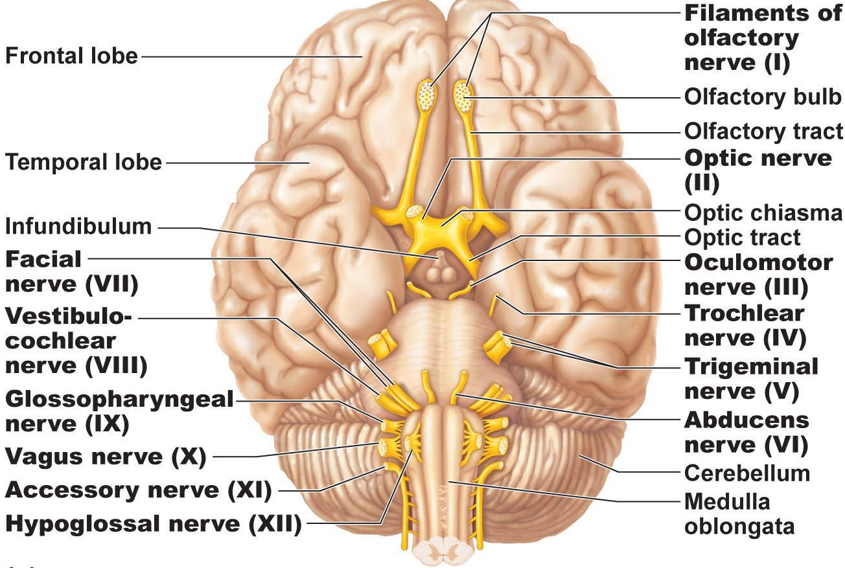
Macroscopic Anatomy of the PNS
• 12 pairs of cranial nerves pass through various foramina of the skull
• first two pairs attach to forebrain; rest originate from brain stem
• all except vagus nerve serve only head & neck structures
• except those for special sense organs, most cranial nerves are mixed nerves
• “On occasion, our trusty truck acts funny – very good vehicle anyhow”
Fig. 13.6 Ventral view
Notes:
Might need this diagram

Slide 16
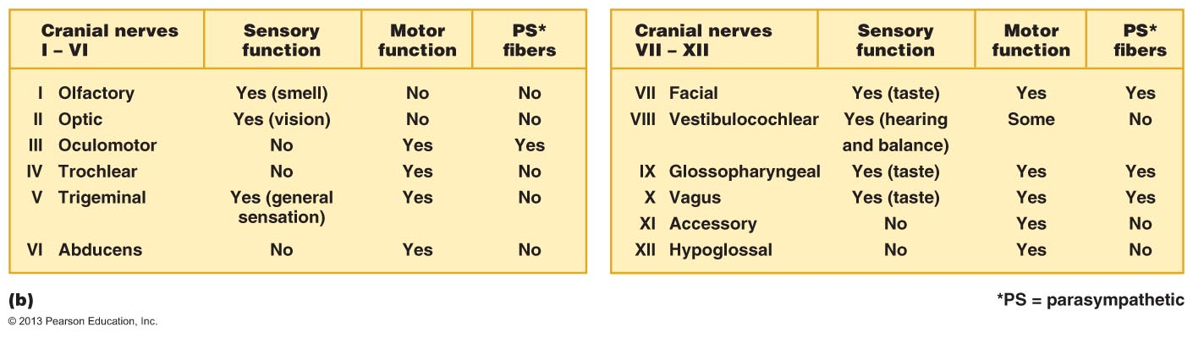
Some say marry money but my brother says (it’s) bad business (to) marry money
Minimal
Fig. 13.6

Slide 17
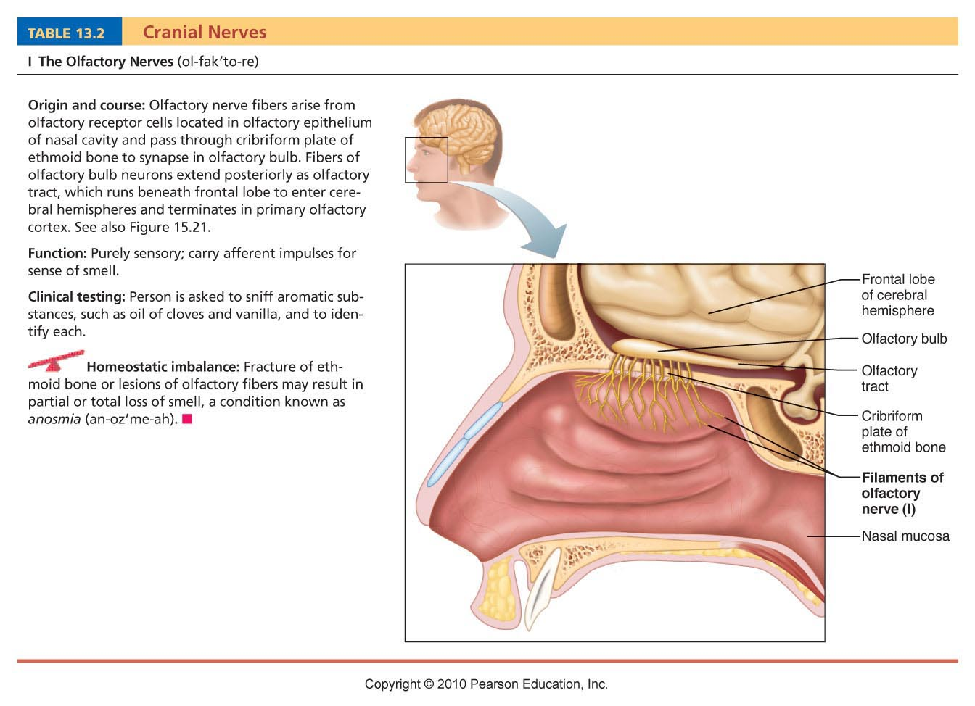
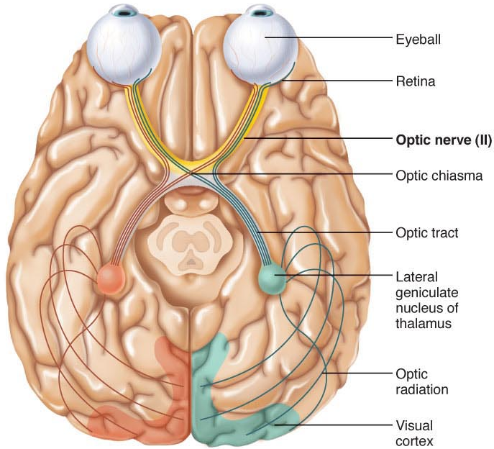
I. Olfactory Nerves:
• from nasal mucosa to olfactory bulbs
• fibers of olfactory bulb neurons extend as olfactory tract to primary olfactory cortex
• afferent sensory fibers for smell
“Some Say”
Optic Nerves:
• fibers from retina form optic nerve which passes through optic foramen of orbit
• optic nerves converge to form optic chiasma (what happens here?); then as optic tracts to thalamus, finally as optical radiation to occipital cortex
• afferent sensory fibers for vision

Slide 18
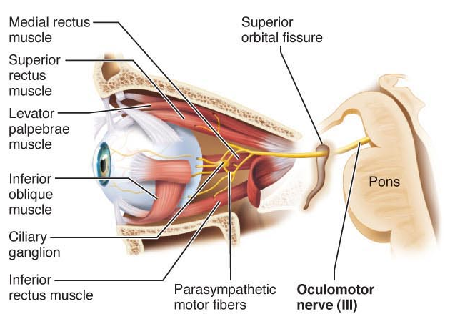
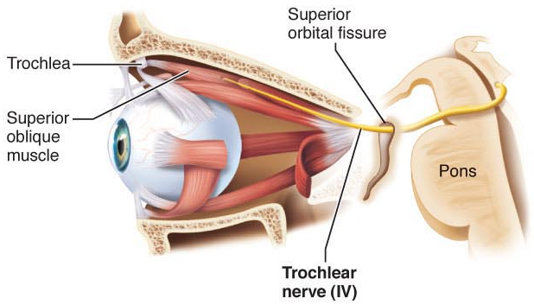
Oculomotor Nerves:
“eye mover”; supplies 4/6 extrinsic muscles of eyeball
fibers from ventral midbrain (near pons) through bony orbit to eye
mixed motor nerves to extrinsic eye muscles, but also paraymp fibers to iris, lens & (sensory afferents from extrinsic eye muscles to midbrain)
“Marry Money”
Trochlear Nerves (pulley):
• innervates ext eye muscle that loops through pulley-shaped ligament in orbit
• motor fibers from dorsal midbrain to superior oblique eye muscle
Notes:
4 REGULATES oblique muscles

Slide 19
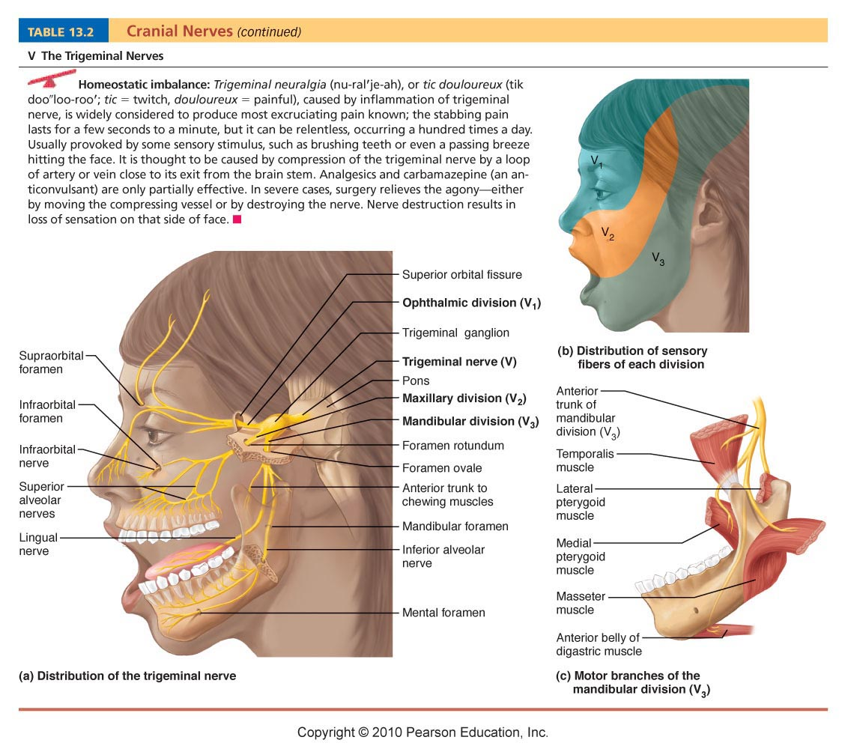
“But”
Trigeminal Nerves:
• largest of cranial nerves; 3 branches: sensory fibers to face & motor fibers for chewing (mandibular division)
1 Opthalmic division
2 Maxillary division
3 Mandibular division
• what nerves useful to dentist?? Mandibular and maxillary (upper and lower)
Notes:
V1 is eye region sensory for touch, temp and pain
V2 sensory with upper jaw and cheek
V3 sensory and motor of lower jaw

Slide 20
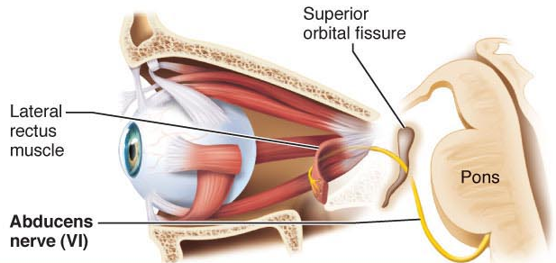
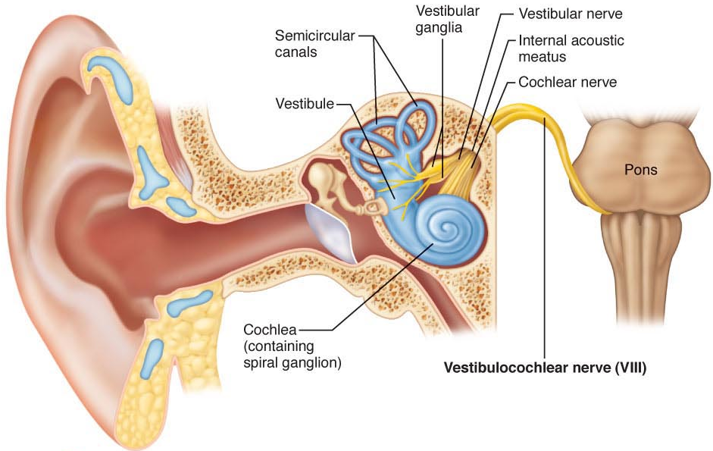
Abducens Nerves:
controls extrinsic eye muscle that abducts eyeball
mixed nerve; primarily motor to lateral rectus muscle
6th eye muscle, towards the side
“My Brother Says”
Vestibulocochlear Nerves:
• sensory nerve for hearing & balance
• cochlear (hearing) & vestibular (balance) branches that fuse

Slide 21
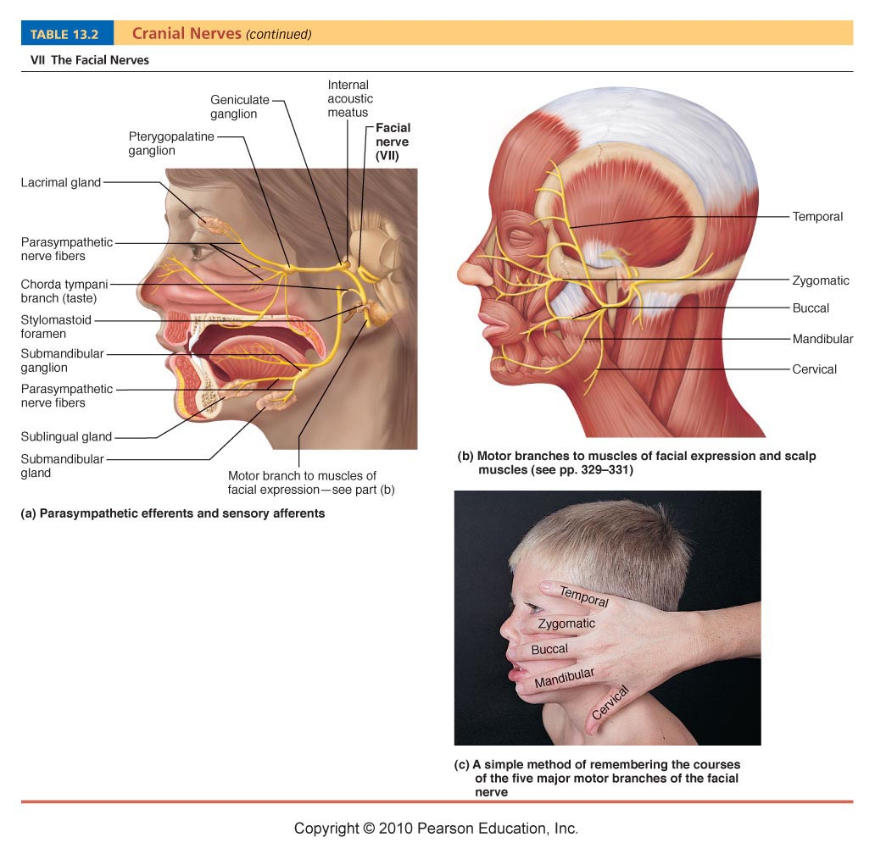
“Brother”
Facial Nerves:
• large nerve; facial expression
• from pons to lateral face
• mixed nerve (primarily motor):
also parasympathetic to lacrimal glands & sensory from anterior 2/3 of tongue
Notes:
Five branches
Temporal, zygomatic, buccal, mandibular, cervical
Motor going out to skin and muscle and sensory for taste

Slide 22
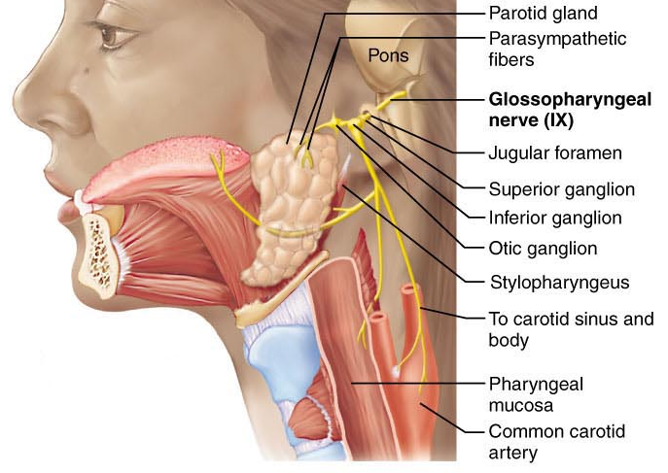
IX. Glossopharyngeal Nerves
• “tongue & pharynx”; mixed nerves to & from medulla
• swallowing & gag reflex; also parasympathetic fibers to parotid glands
• sensory (taste, touch, pressure, pain) from pharynx, posterior tongue
• sensory from carotid sinus (chemo, bp)
“Bad”
Notes:
Associated with swallowing and gag reflex (motor)
Carotid sinus occurs to chemical composition of blood

Slide 23
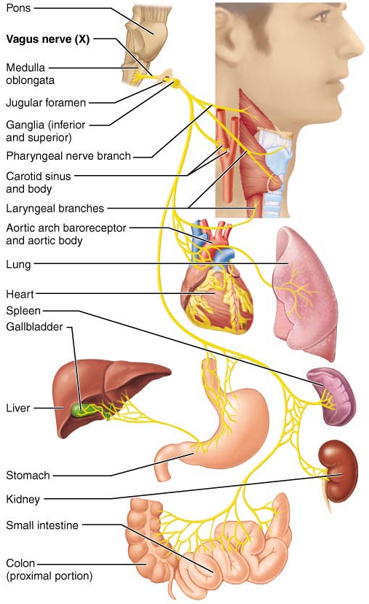
“Business”
Vagus Nerve
• “wanderer”; only cranial nerve to extend beyond head-neck region
• mixed nerves; to & from medulla
• parasympathetic motor to heart, lungs, abdominal viscera; also somatic to pharynx & larynx
• sensory from carotid sinus; also for taste, from proprioceptors in muscles of pharynx, larynx

Slide 24
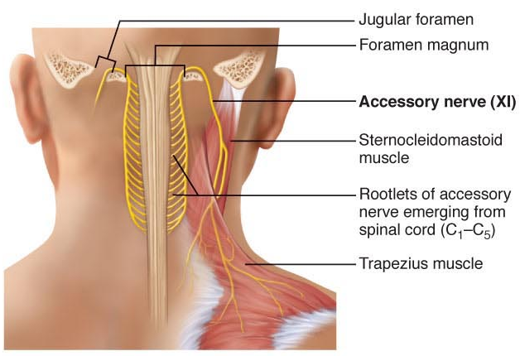
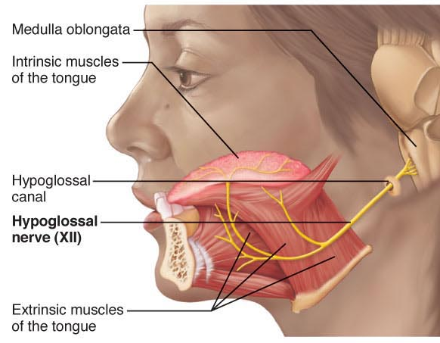
Accessory Nerves:
accessory part of vagus nerve; formed by junction of a cranial root with a spinal root
mixed nerves, but mostly motor to pharynx, larynx, soft palate; spinal root supplies motor fibers to trapezium & sternocleidomastoid muscles (head & neck movement)
“Marry Money”
Hypoglossal Nerves:
• “beneath tongue”; mixed, primarily motor
• to tongue for mixing, swallowing and speech

Slide 25
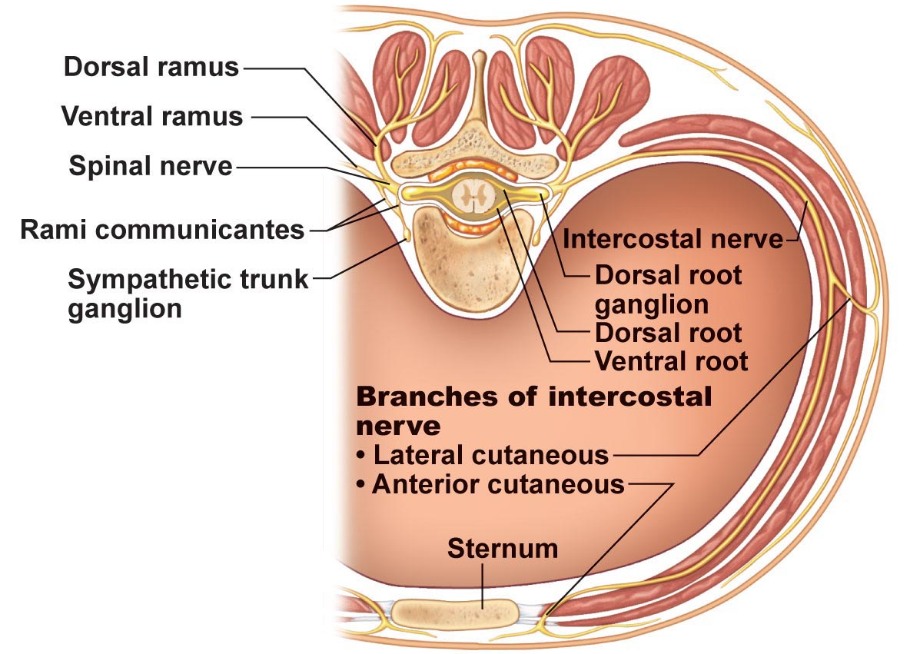
Spinal Nerves
• 31 pairs, all are mixed nerves; named according to point of issue
C₁-C₈; T₁-T₁₂; L₁-L₅; S₁-S₅; C₀
• almost immediately after exit from foramen, each spinal nerve branches into a dorsal ramus & a ventral ramus
• rami carry both sensory & motor fibers
Understand the difference between a root and a ramus!
Fig. 13.8
Notes:
Sensory and motor
Roots dorsal incoming sensory then come together to get a spinal nerve, dorsal ramus goes to muscle at back, ventral ramus goes to front (can be both sensory and motor)

Slide 26
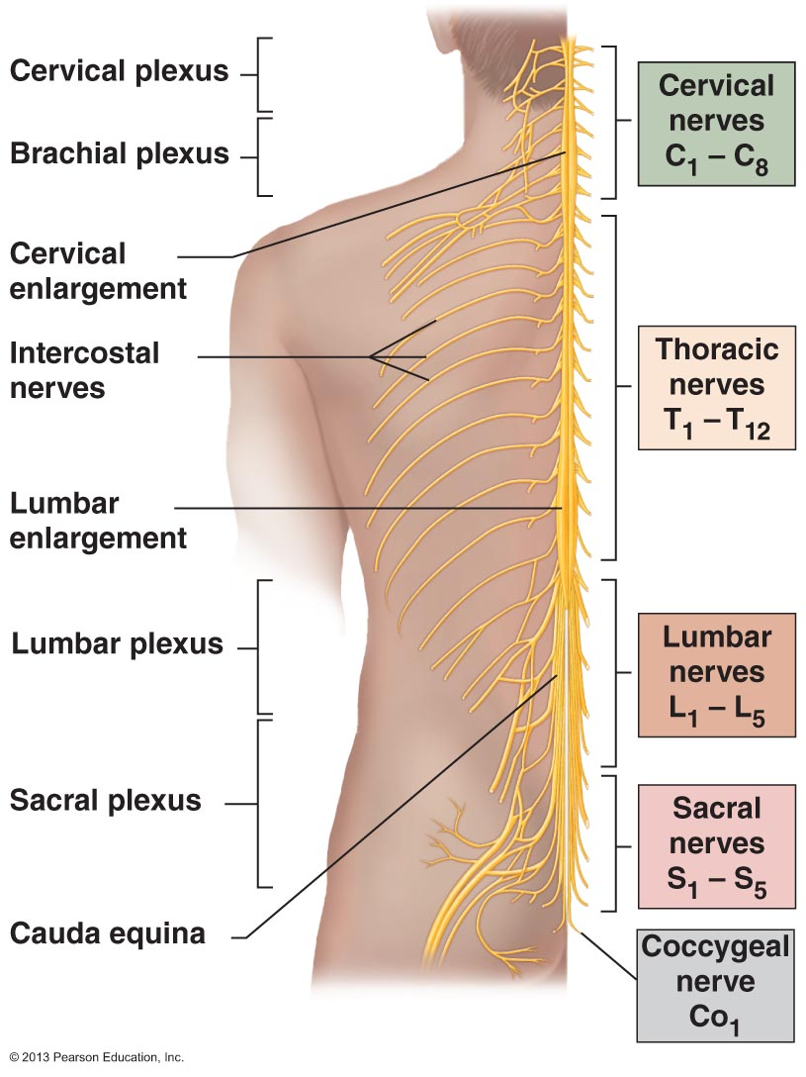
• except for T₂-T₁₂, all ventral rami branch & make lateral connections just outside spinal cord ➢ nerve plexuses
• fibers from different rami criss-cross in plexuses:
Each branch of a plexus contains fibers from several different spinal nerves
Fibers from each ventral ramus travel to body periphery via several different routes
Result: each muscle in a limb receives nerve supply from more than one spinal nerve ➢ damage to one spinal segment or root cannot completely paralyze any limb muscle
Fig. 13.7

Slide 27
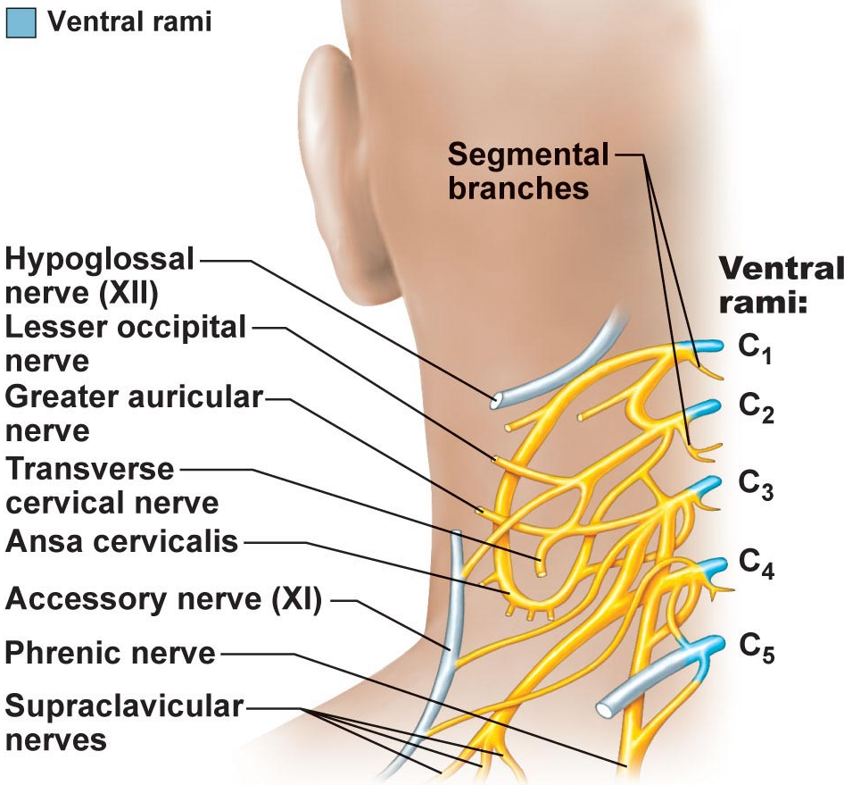
Cervical Plexus & the Neck:
• C₁-C₄; deep in neck under sternocleidomastoid muscle
• most branches are cutaneous nerves (go out to the skin for sensory input)
• single most important nerve is phrenic nerve: both motor & sensory fibers to diaphragm
Fig. 13.9
Notes:
Know how to label the phrenic nerve- goes to diaphragm and stimulates breathing

Slide 28
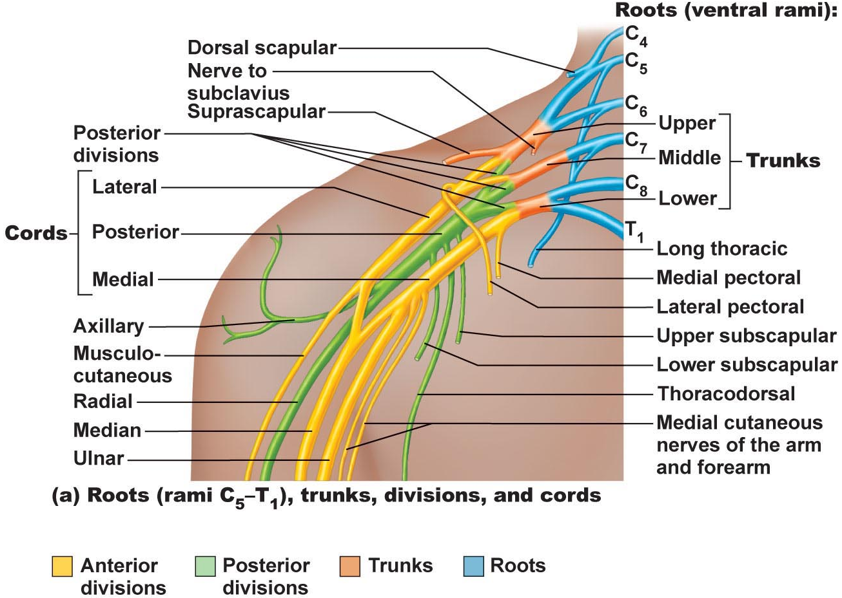
Brachial Plexus & Upper Limb: (first five)
• C₅-C₈ & most of T₁; partly neck, partly axilla – nerves supplying upper limbs
Axillary nerve to shoulder (esp. deltoid muscle)
Musculocutaneous nerve – to biceps brachii & brachialis to flex arm/ elbow joint motor
Median nerve – flexor muscles in anterior forearm & into palm ➢ pronate forearm, flex wrist/fingers, oppose thumb
Fig. 13.10

Slide 29
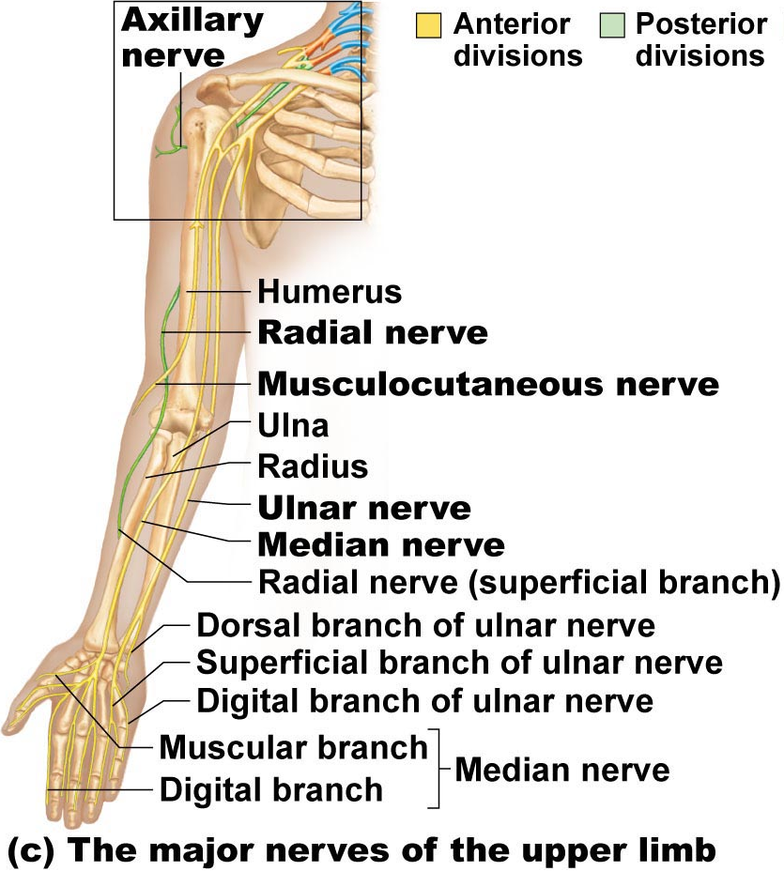
(iv) Ulnar nerve – medial to elbow (“funny bone”) & follows ulna along medial forearm ➢ wrist & finger flexion and adduction & abduction of medial fingers
(v) Radial nerve – largest – to humerus & dorsal part of hand ➢ elbow extension, supination of forearm, extension of wrist & fingers, abduction of thumb
The Back:
• dorsal rami; follows segmented plan
Anterolateral Thorax:
• T₁-T₁₂; simple & segmented as for innervation of back
• intercostal nerves: to intercostal muscles; anterolateral thorax

Slide 30
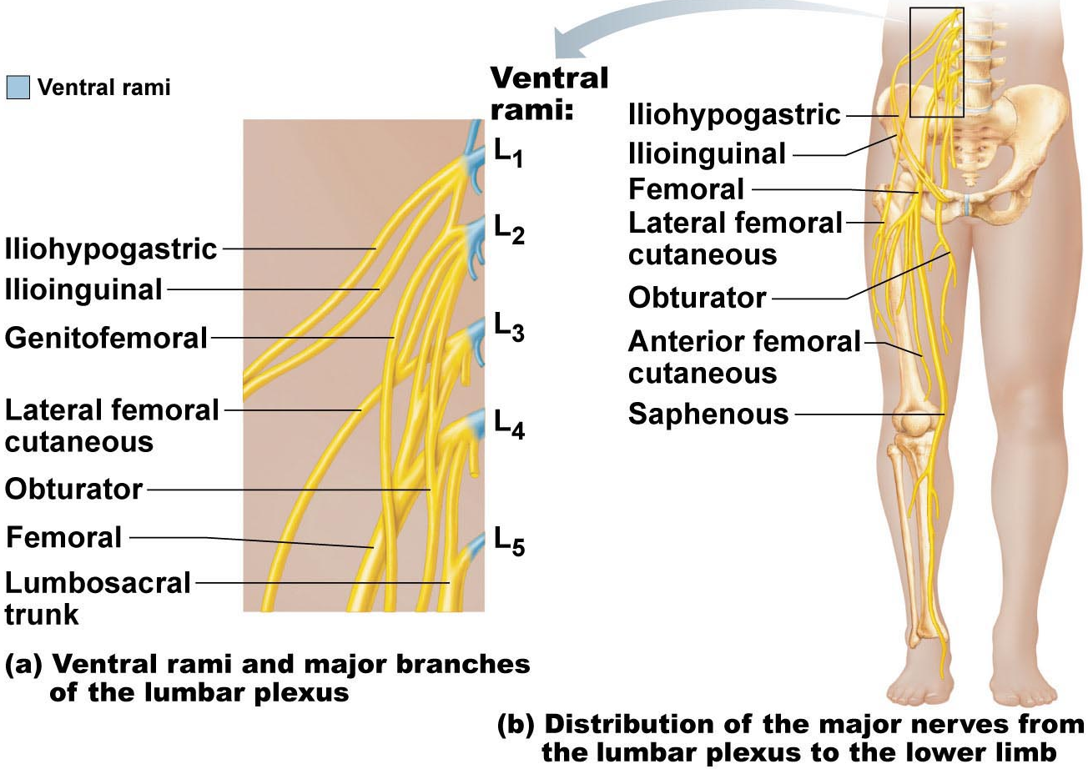
Lumbar Plexus:
• L₁-L₄; branches to abdominal wall muscles, also anterior & medial thigh
Femoral nerve: anterior thigh muscles ➢ thigh flexors & knee extensors
Obturator nerve: medial thigh ➢ adductor muscles
Fig. 13.11

Slide 31
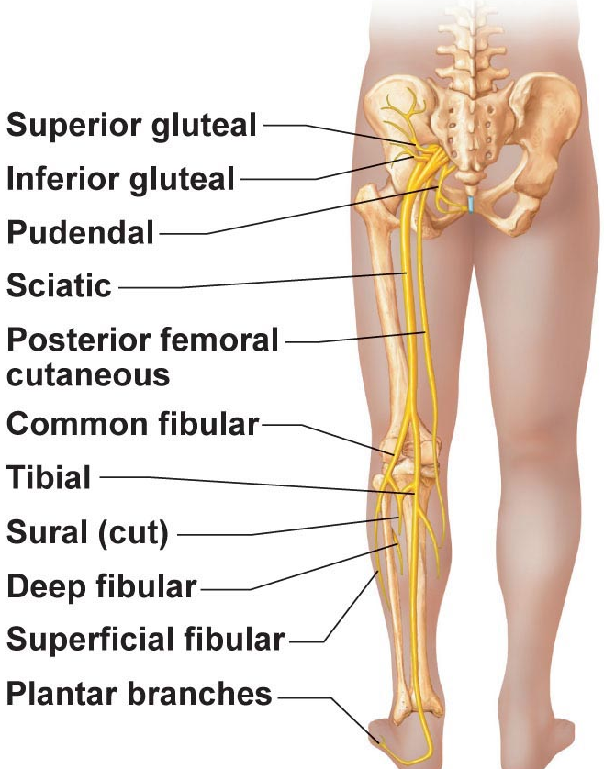
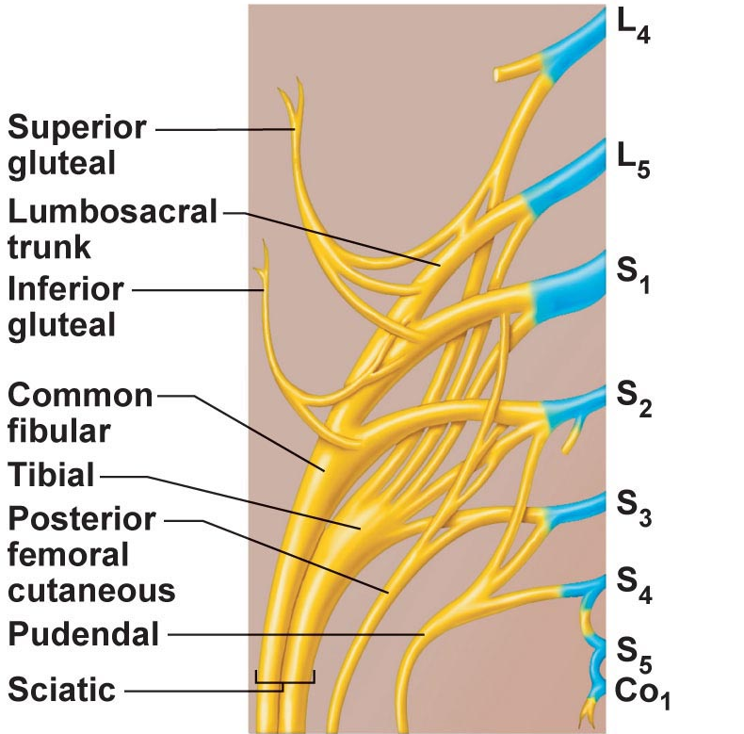
Fig. 13.12
Sacral Plexus:
• L₄-S₄; immediately caudal to lumbar plexus – branches to buttocks, lower limbs, pelvis
Sciatic nerve: posterior thigh – then diverges into (ii) & (iii):
Tibial nerve: behind knee joint to posterior calf & sole of foot
Common fibular nerve: to knee joint, calf (anterolateral) & dorsum of foot
Superior & inferior gluteal nerves: to buttocks
Pudendal nerve: muscles & skin of perineum (e.g. erection, voluntary urination)
Notes:
Sciatic nerve: splits to common fibular and tibial nerve

Slide 32
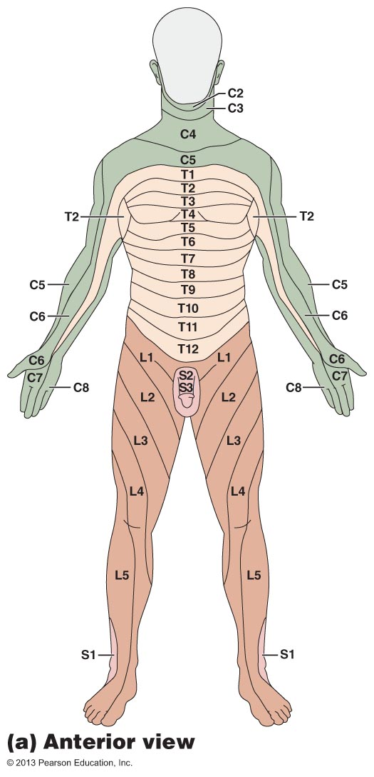
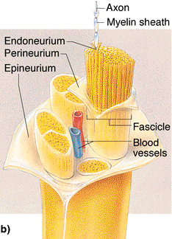
Dermatome: area of skin innervated by cutaneous branches of a single spinal nerve
Fig. 13.13
Endoneurium: loose CT that encloses nerve fiber + associated myelin or neurilemma sheath
Perineurium: coarser CT wrapping around a group of fibers (fascicle)
Epineurium: tough fibrous sheath around all the fascicles to make a nerve
What do I mean when I say that most nerves are mixed nerves? Sensory and motor
Fig. 13.4: Structure of a Nerve
Notes:
Exam: joints muscles neuroanatomy

