Slide 1
Topic 6: ANATOMY OF THE NERVOUS SYSTEM
Part A
CNS (Chapt.11: pp.386-395;Chapt.12:p.430-452)
• connected as a single unit, but anatomically divided into 2 parts:
(i) Central Nervous System: brain + spinal cord; integrating & command centre
(ii) Peripheral Nervous System: cranial & spinal nerves; communication between CNS & all parts of body
A. Sensory division: somatic & visceral fibers; from receptors to CNS
B. Motor division: motor nerve fibers from CNS to effectors (muscles & glands)
B1. Somatic ns: voluntary; from CNS to skeletal muscle
B2. Autonomic ns: involuntary; (visceral motor); from CNS to cardiac muscle, smooth muscle, glands
a) Sympathetic division: “fight or flight”
b) Parasympathetic division: conserve energy at rest

Slide 2
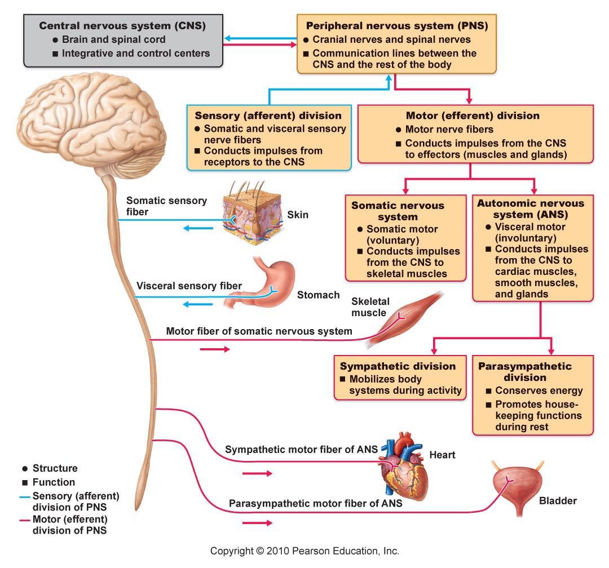
Fig. 11.2: Levels of Organization in the CNS

Slide 3
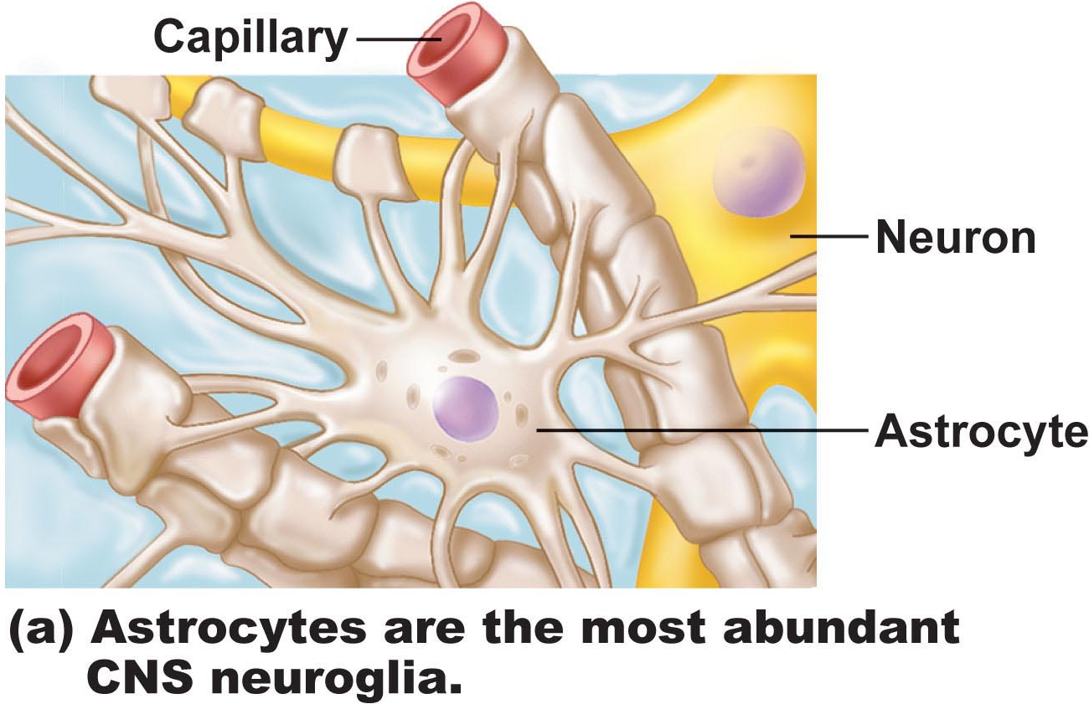
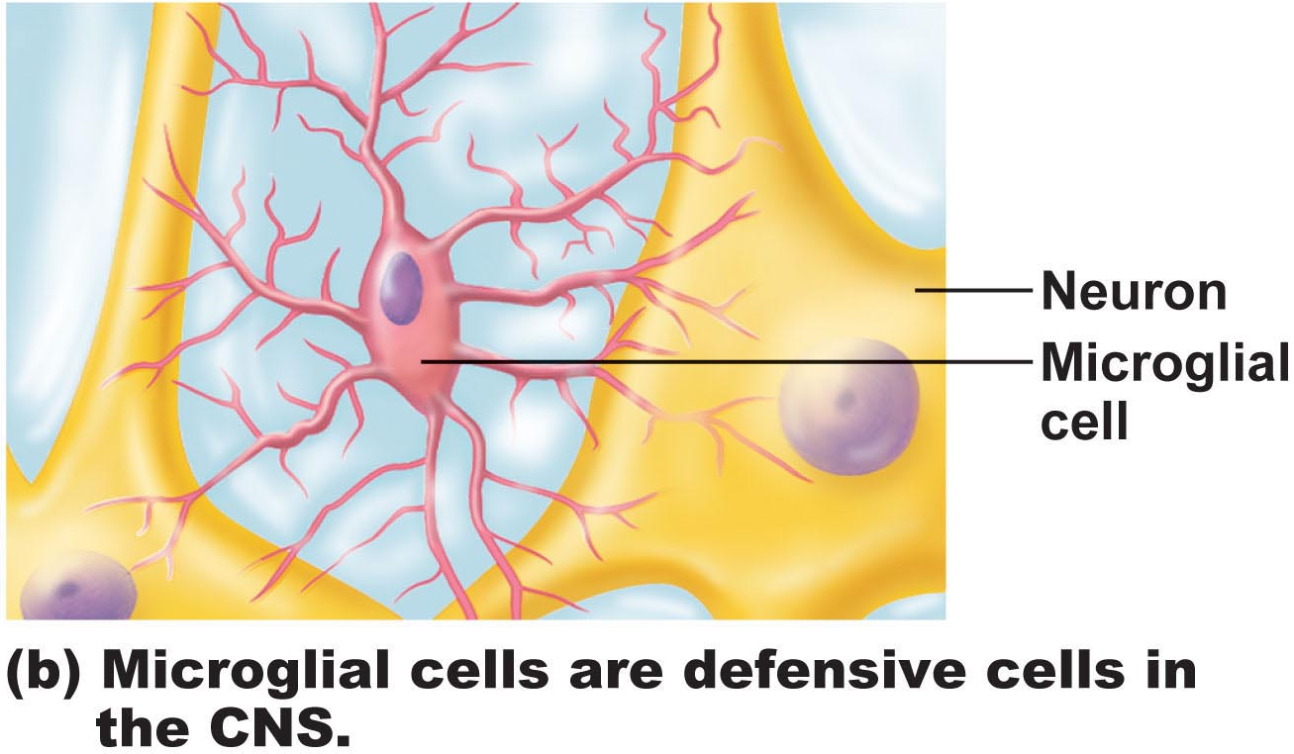
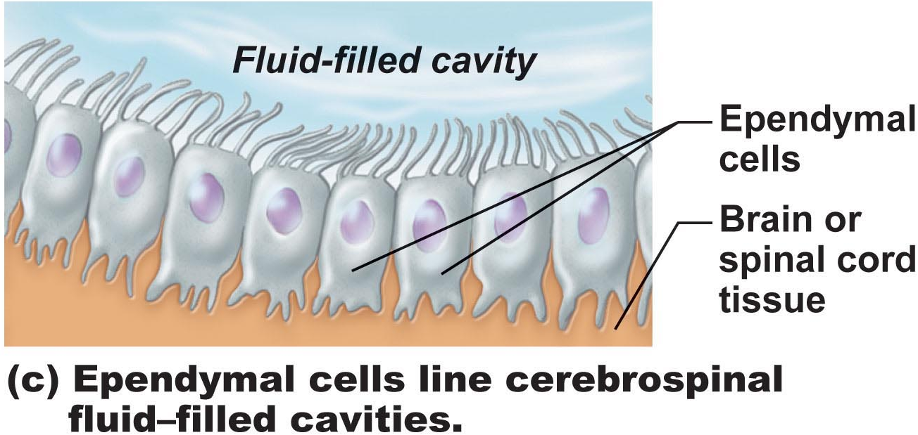
Histology of Nervous Tissue
• very cellular; minimal extracellular matrix
• 2 principal types of cells:
neurons
(ii) supporting cells
Supporting cells: (6 types)
Fig. 11.3
CNS: (4 types – neuroglia)
Astrocytes: star-shaped, most abundant; anchor neurons close to capillaries
• roles in nutrient exchange, antigen presentation, control of environment
Microglia: protective; touch neurons to monitor well-being; can transform into macrophages
Ependymal cells: line cavities of brain & spinal cord as barrier between CSF & fluid bathing cells of CNS; cilia circulate CSF
Oligodendrocytes: “few branches”; provide myelin sheaths to CNS neurons
Notes:
Need more supporting cells since neurons don’t reproduce
Astrocytes help new neurons and guide them to where they need to be, pH stays the same, most common type of cell and most important
Microglia cells check to see how neurons are doing, will clean up debris or damaged neuron, immune cells can’t come in due to blood brain barrier
Ependymal propel cerebral spinal fluid along
Oligodendrocytes provide myelin sheath for short nerves of Central nerve cells, very small and can contribute to several different neurons as the CCNS is so compact

Slide 4
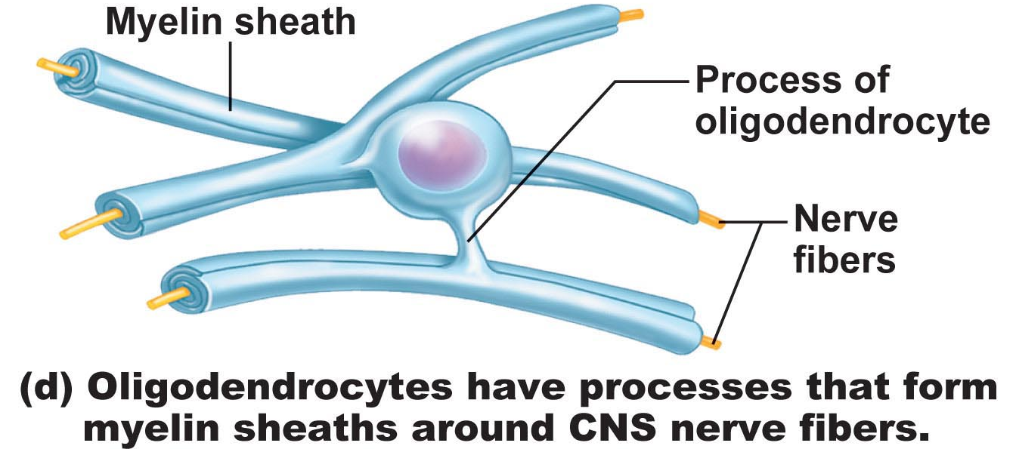
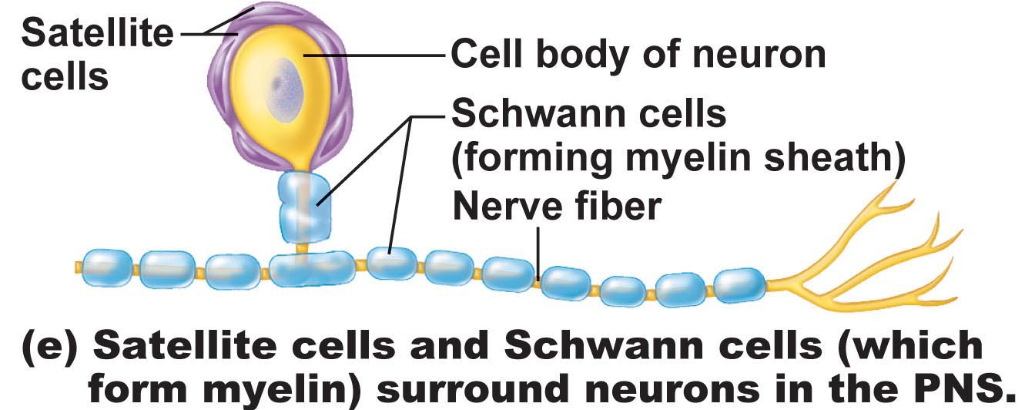
PNS:
Satellite cells: surround neuron cell bodies in ganglia – influence chemical environment of these neurons (?)
Schwann cells: form myelin sheaths around larger neurons in PNS; vital to peripheral nerve cell regeneration
Notes:
Satellite carry about many functions as the astrocyte, protect the environment around them

Slide 5
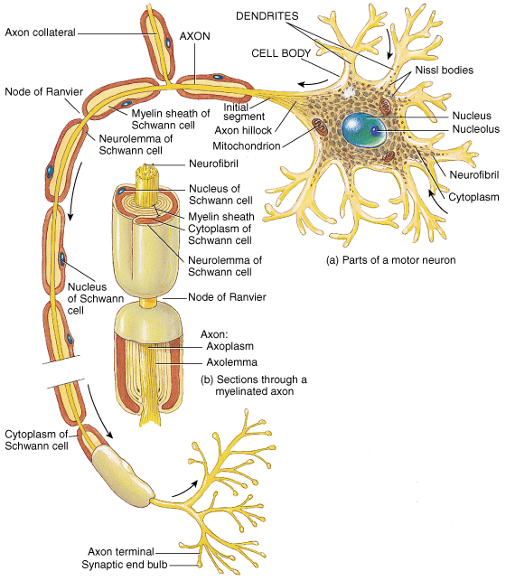
Neurons
• extreme longevity, amitotic, high MR
(metabolic rate)
• cell body = soma = perikaryon
• know: dendrites, axon, axon hillock, myelin sheath, node of Ranvier, telodendria (terminal branches), axonal terminals

Slide 6
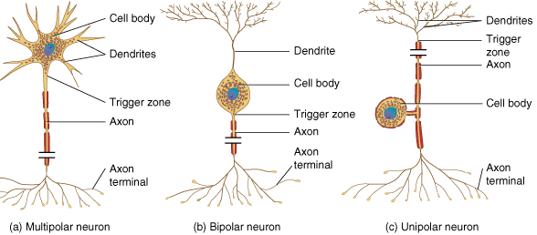
Structural Classification of Neurons
• multipolar vs bipolar vs unipolar
multipolar: 3+ processes – most common type & major type in CNS
bipolar: 2 processes, an axon & a dendrite extend from opposite sides of cell body – only in some special sense organs, eg: retina, olfactory mucosa
unipolar: single process - divides into proximal & distal fibers; usu in ganglia of peripheral NS & function as sensory neurons
T&G
Notes:
Bipolar are not common
Unipolar is sensory neurons

Slide 7
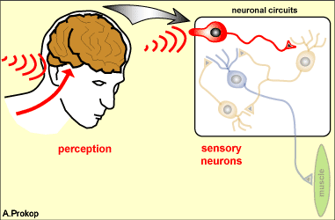
Functional Classification of Neurons
• according to direction nerve impulse travels wrt CNS
• sensory, motor & association neurons
sensory: toward CNS; primary: initial (picks up tactile, visual and scent, original receptor), secondary, tertiary
• except bipolar neurons in some special sense organs, virt all primary sensory neurons are unipolar & cell bodies located in ganglia outside CNS
• higher order sensory neurons all multipolar & reside entirely within CNS – conduction to higher brain centres for interpretation
motor: away from CNS to effector organs like muscle & glands; multipolar; most cell bodies reside in CNS
association (interneurons): between sensory & motor neurons – integration of info; multipolar; most entirely within CNS; 99% of neurons of the body makes connection
http://www.prokop.co.uk/Research/LAYMAN/1-brain-intro.html

Slide 8
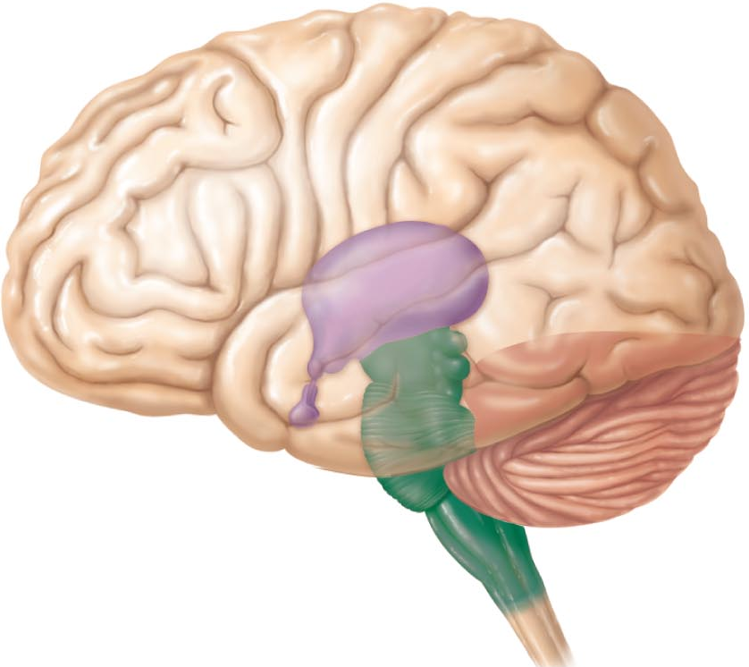
The Brain (jump to chapter 12 here)
• complexity of wiring rather than size is what matters
subdivisions:
cerebral hemispheres
diencephalon (thalamus, hypothalamus,epithalamus)
brain stem (midbrain, pons, medulla)
cerebellum
Fig. 12.2
Notes:
Purple: diencephalon, concentration of CSF is found
Thalamus groups together important information, it also strains through things to see if they need to go to the brain or not

Slide 9
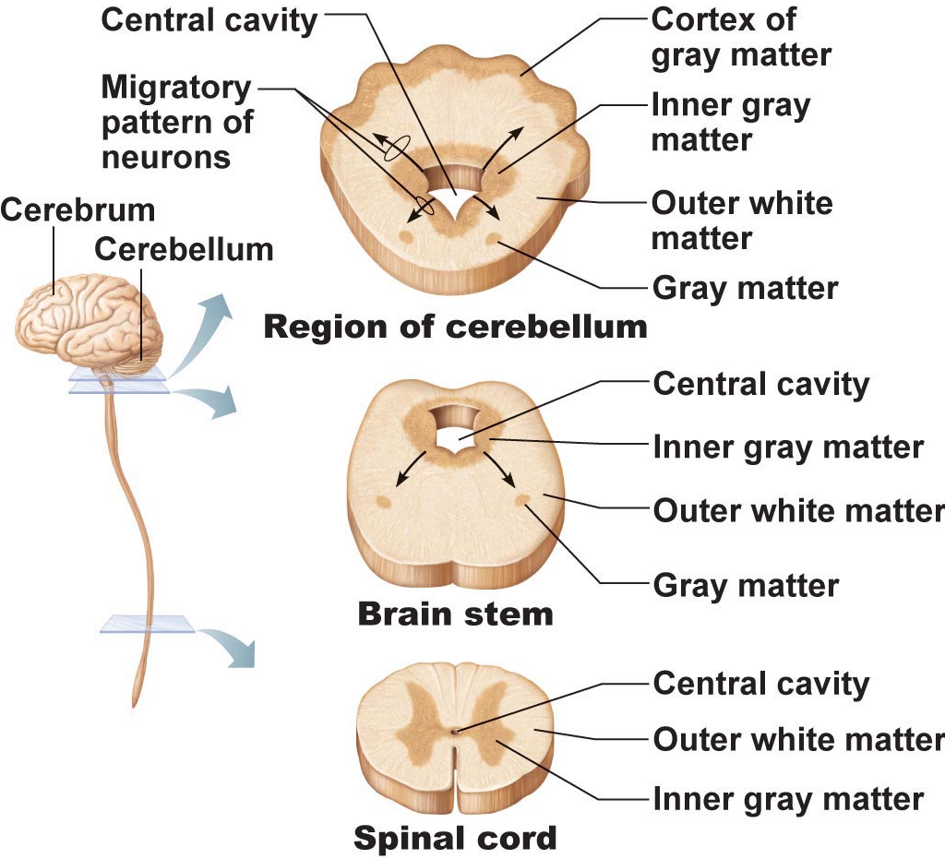
Arrangement of gray & white matter:
Spinal cord has central cavity surrounded by gray matter (cell bodies and dendritic regions) & white matter (fat/myelin sheath and axons)
Brain has same design, but with additional regions of gray matter;
cerebral hemispheres & cerebellum have outer “bark” of gray matter
Ventricles of the Brain:
• continuous with one another and with central cavity of spinal cord
• filled with CSF & lined by ependymal cells
Fig. 12.4 (8th ed.)

Slide 10
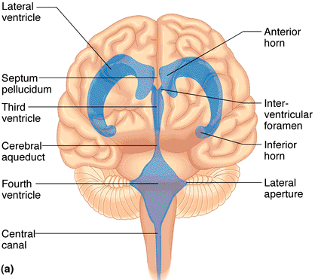
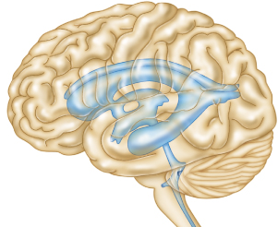
Ventricles (cont):
Paired lateral ventricles separated by narrow septum pellucidum
Each communicates with narrow 3rd ventricle in diencephalon via interventricular foramen
3rd ventricle continuous with 4th ventricle (dorsal to pons) via cerebral aqueduct
4th ventricle continuous with central canal
3 apertures (paired lateral apertures & median aperture) connect ventricles to subarachnoid space (surrounds brain)
Left lateral view
Fig. 12.3
Anterior view

Slide 11
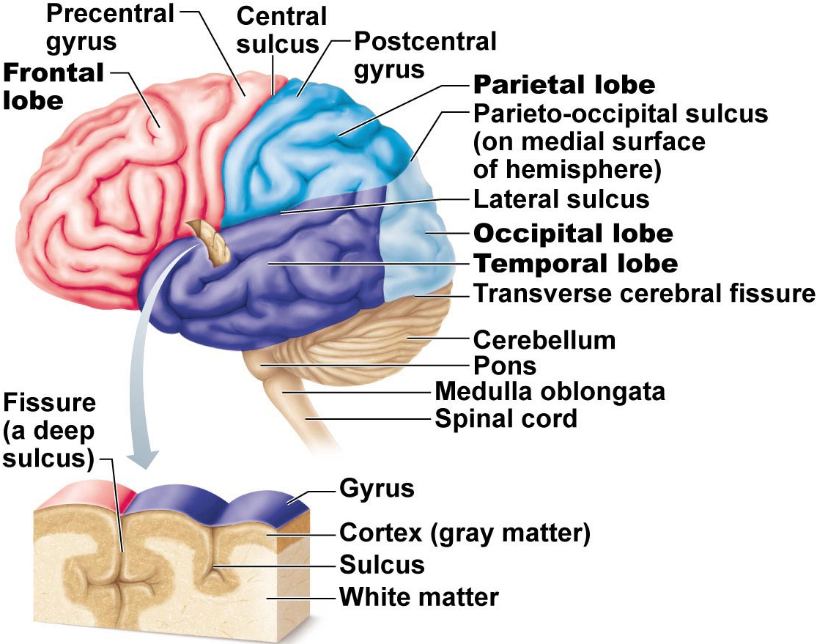
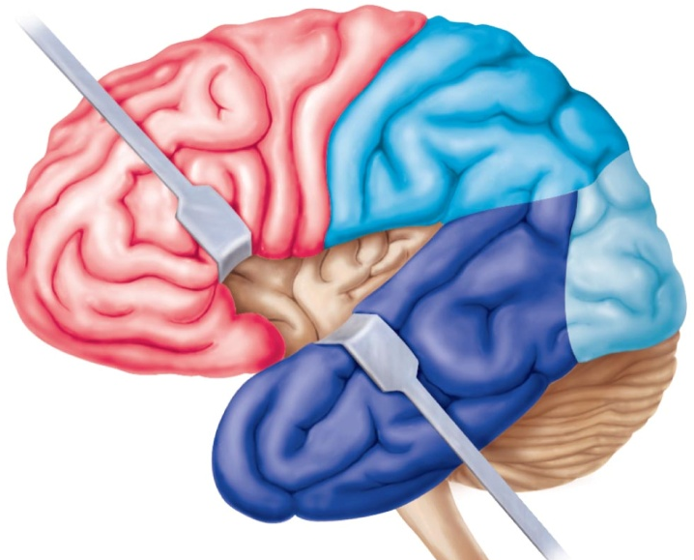
A1. The Cerebral Hemispheres
superior; ~83% of brain mass
gyri separated by sulci; anatomical landmarks
longitudinal fissure; transverse cerebral fissure
Lobes: frontal, parietal, occipital, temporal, insular
central sulcus: precentral/postcentral gyrus
parieto-occipital sulcus, lateral sulcus
Fig. 12.4c
Notes:
Gyrus is hill sulci is valley and fissure is a deep sulcus

Slide 12
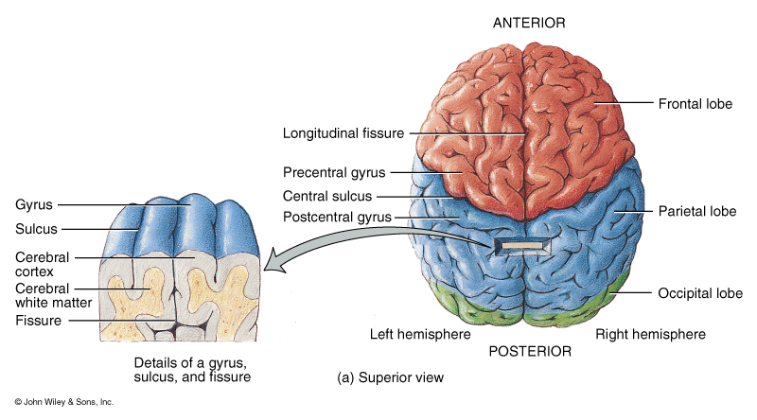
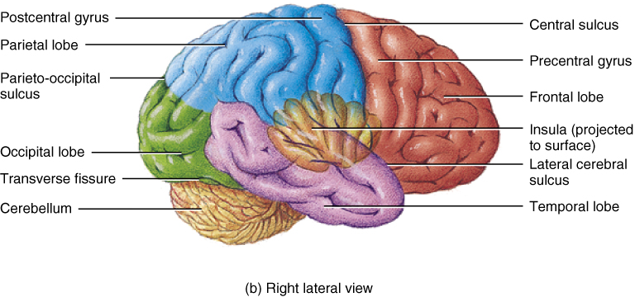
Fig. 14.11 (T&G)

Slide 13
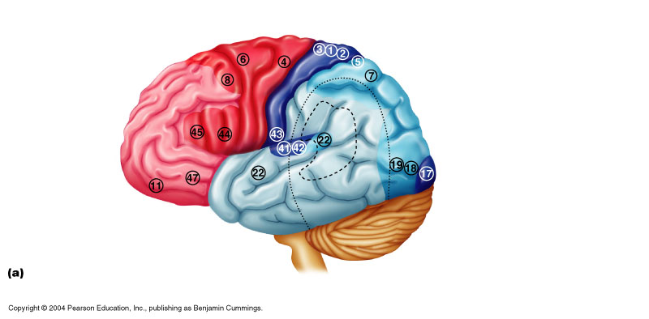
Cerebral cortex:
• allows us to perceive, communicate, remember, understand, appreciate, initiate voluntary movements -- conscious behaviour (Association)
• cell bodies, dendrites & unmyelinated axons; only 2-4 mm thick, but many convolutions triple surface area
• Brodmann areas: numbered according to subtle differences in thickness, structure of contained neurons; some areas link with particular functions; other functions (memory & language) have overlapping domains; more diffusely organized
(i) 3 functional areas: motor, sensory & association
each hemisphere handles sensory & motor functions of opposite side of body
largely symmetrical, but not 100% equal in function (lateralization)
no functional area of cortex acts alone; all conscious behaviour involves entire cortex in some way
Fig. 12.8a (7th ed.)

Slide 14
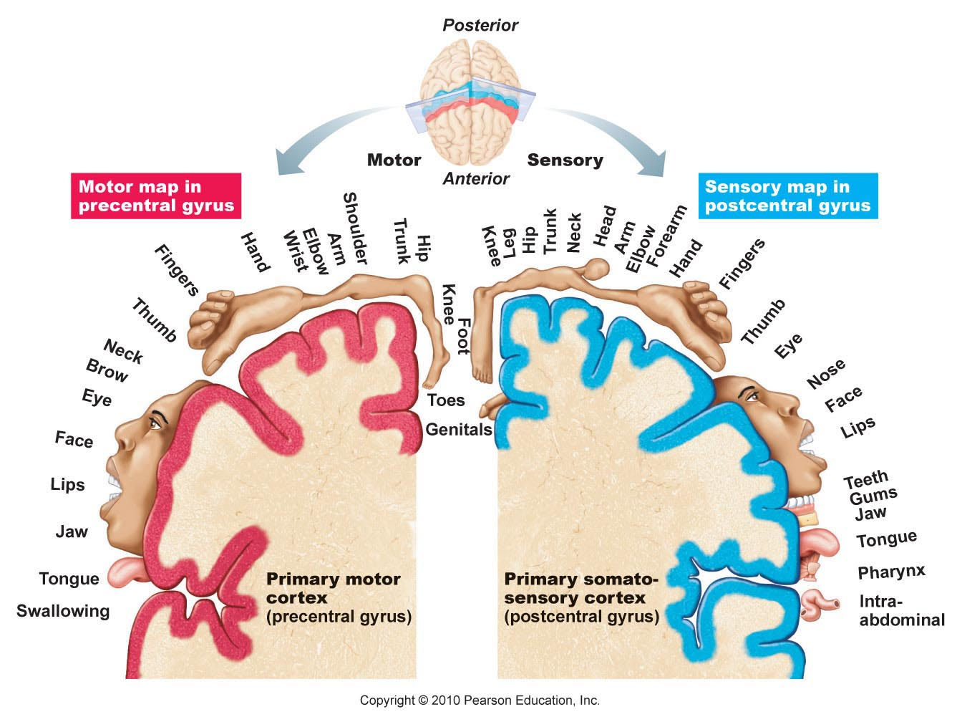
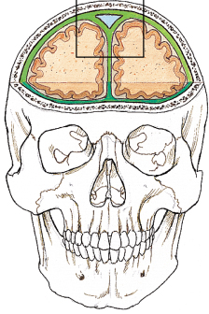
Motor Areas:
• posterior part of frontal lobes: primary motor cortex, premotor cortex, Broca’s area & frontal eye field
1) Primary motor cortex: - precentral gyrus of frontal lobe of each hemisphere; pyramidal cells allow control of skeletal muscles; axons project to spinal cord as pyramidal/corticospinal tracts
• entire body represented spatially in primary motor cortex of each hemisphere – somatotopy
• which areas require most precise motor control?
• motor innervation is contralateral
Fig. 12.7

Slide 15
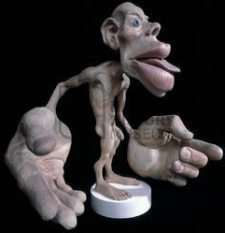
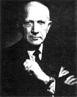
Penfield Homunculus
Wilder Penfield
control not as simple as in diagram – some neurons send impulses to more than one muscle – think about coordinated movement of arm
no overlap between muscles involved in unrelated movements
stroke: damage to area of right hemisphere paralyzes body muscles on left – only voluntary movement lost; reflex contraction still possible

Slide 16
Premotor cortex: 6
• anterior to precentral gyrus
• learned motor skills that are repetitious/patterned
• coordinates movement of several muscle groups
simultaneously/sequentially by activating motor cortex
What if there is damage to the area of premotor cortex regulating keyboarding?
Broca’s area:
• overlaps Brodmann areas 44 & 45
• originally thought to be on one side only (usu left) & a motor speech area
• newer studies: Broca’s area & corresponding region on other side are active when we prepare to speak and plan voluntary activities other than speech
4. Frontal eye field:
• Brodmann area 8; controls voluntary movements of the eyes

Slide 17
Sensory Areas
Primary somatosensory cortex:
• in postcentral gyrus of parietal lobe (Brodmann areas 1-3) incoming (touch pain, proprio-recepters
• receives info from somatic sensory receptors (skin) & proprioreceptors (skeletal muscle)
• spatial discrimination (aware of sensory and
Somatosensory association area:
• posterior to PSC - many connections with it
• integrate/analyze somatic inputs (temp, pressure, ..) – interpret wrt size, texture, relationship of parts based on prior experience

Slide 18
Fig. 12.7

Slide 19
Visual areas:
primary visual cortex ➢ posterior tip occipital lobe
• largest cortical area; contains map of visual space on retina (opposite sides)
visual association area ➢ surrounds PVC
• interprets visual image based on prior experience – eg: recognition of a face, letter (also movement!)
What is the result of damage to the primary visual cortex? To the visual association area?

Slide 20
Auditory areas:
primary auditory cortex sound evaluated wrt pitch, rhythm, loudness
auditory association area interpretation based on memory – speech, words, music, thunder, etc.
5. Vestibular (equilibrium) cortex:
awareness of balance – posterior part of insula & adjacent parietal cortex
6. Olfactory cortex:
• medial aspects of temporal lobes = uncus
• small in humans; most of surrounding tissue now forms limbic system (emotions, memory)
conscious awareness of different odors
7. Gustatory cortex:
• insula; anterior to area #43
8. Visceral sensory area:
posterior to gustatory cortex
what sort of information?

Slide 21
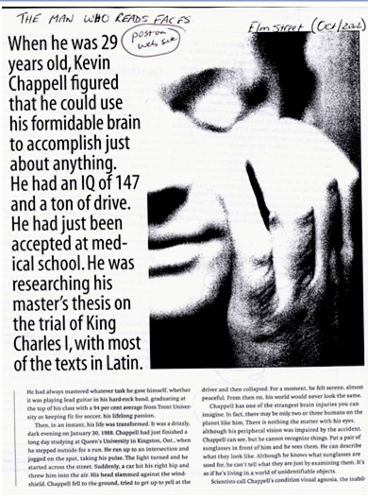
Visual Agnosia – the inability to recognize/understand things that you see

Slide 22
Multimodal Association Areas:
any cortical area that is not “primary”
some communicate with 1⁰ sensory & motor areas & with other sensory association areas to analyze, recognize, act on sensory inputs - multiple inputs & outputs
Anterior Association Area (Prefrontal Cortex):
intellect, complex learning (cognition) & personality (working memory is here)
• abstract ideas, judgment, reasoning, persistence, planning, concern, conscience
• matures slowly; dependent on feedback from social environment
• closely linked to limbic system; involved in mood

Slide 23
2. Posterior Association area: parts of temporal, parietal & occipital lobes
• input from all sensory association areas – storage of complex memories linked to sensation – put info together to understand what see, feel etc
recognition of patterns, faces
• some parts for understanding written & spoken language (Wernicke’s area)
Limbic Association area:
provides emotional impact – e.g. be aware of the danger associated with a particular situation, etc.

Slide 24
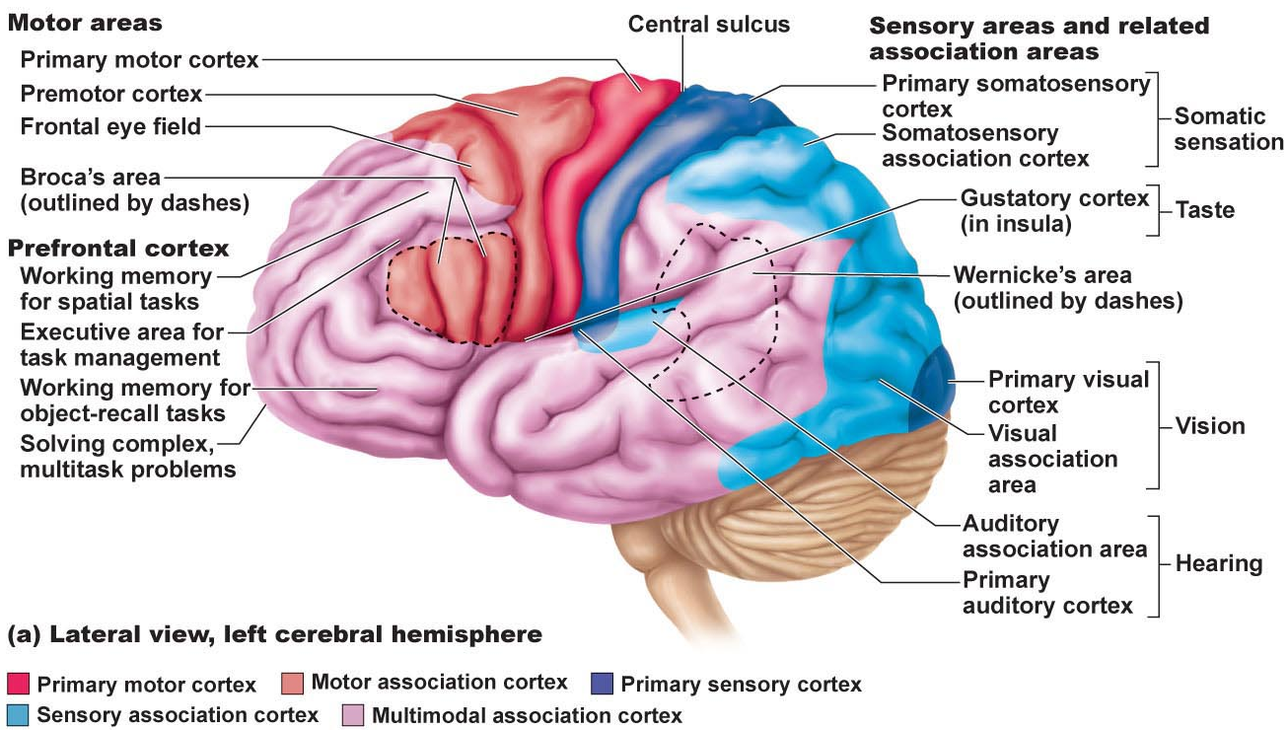
Fig. 12.6a: Lateral view – left cerebral hemisphere

Slide 25
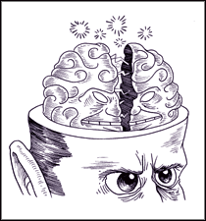
Lateralization of Cortical Functioning
each cerebral hemisphere has abilities not completely shared by other hemisphere
cerebral dominance = hemisphere that is dominant for language
• 90% of people: left hemisphere dominant for language, math, logic
• other hemisphere dominates for visual-spatial skills, intuition, emotion, appreciation of art & music – creative side, better at recognizing faces
• most individuals with left cerebral dominance are right-handed
• in remaining 10%, roles reversed or shared equally

Slide 26
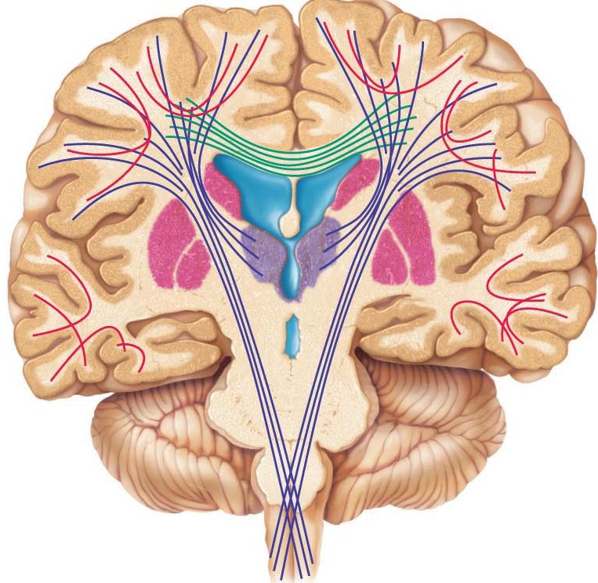
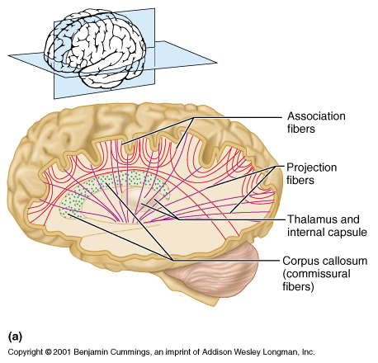
A3. Cerebral White Matter
communication between cerebral areas, between cortex & lower CNS centres
commissural fibers: connect corresponding areas between the 2 hemispheres – largest is corpus callosum
Frontal section
association fibers: connections within a hemisphere (connect gyri, lobes)
projection fibers: to or from cortex and rest of nervous system; these ones run vertically
Fig. 12.8
Midsagittal section

Slide 27
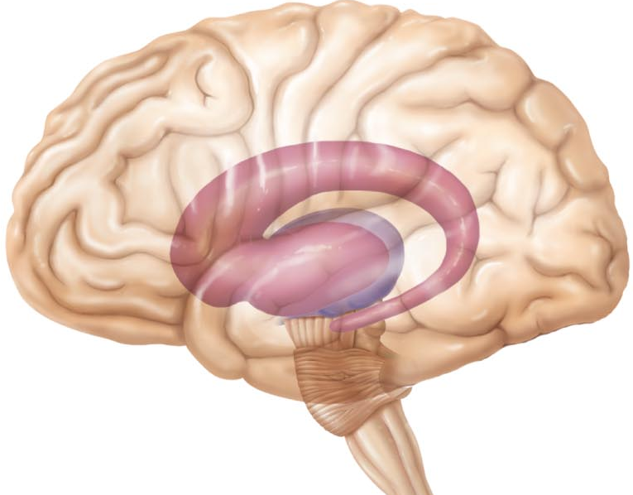
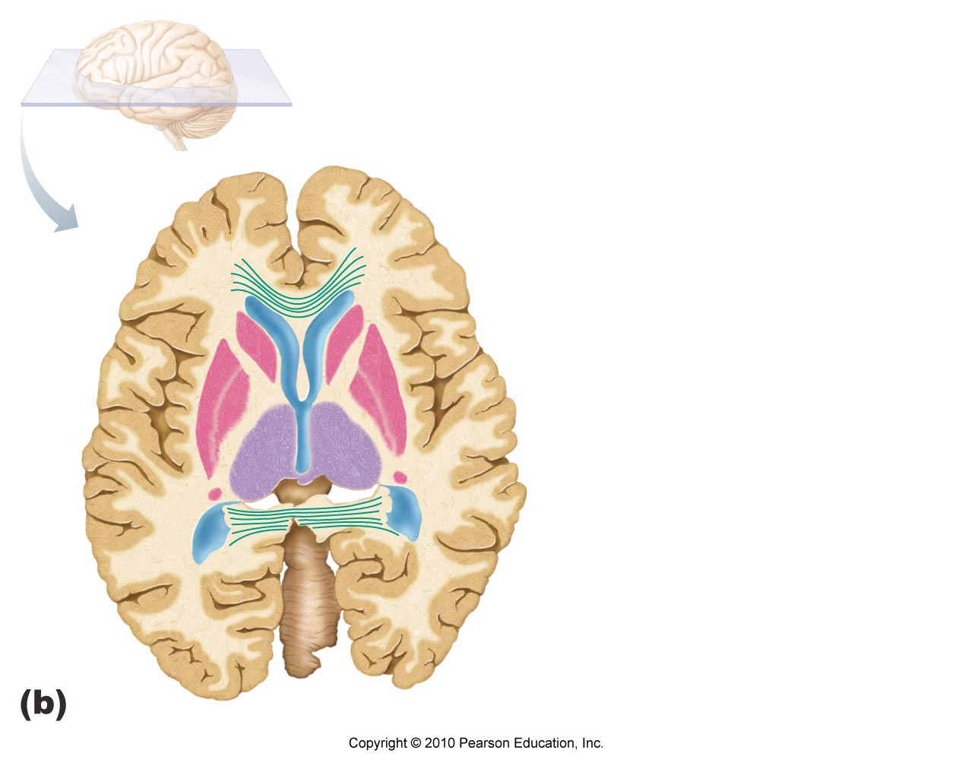
Basal Nuclei
• caudate nucleus +[putamen & globus pallidus = lentiform nucleus]
• inputs from entire cerebral cortex, other subcortical nuclei & each other
• project to premotor & prefrontal cortices to influence muscle movements directed by primary motor cortex – have no direct access to motor pathways
• precise role(s) difficult to determine – roles in starting, stopping, monitoring movements executed by cortex, esp if slow, sustained, stereotyped
• also influence movement intensity, inhibit antagonistic/unnecessary actions
• disorders can result in too much movement (e.g. Huntington’s disease) or too little movement (Parkinson’s disease)
Fig. 12.9
Posterior view

Slide 28
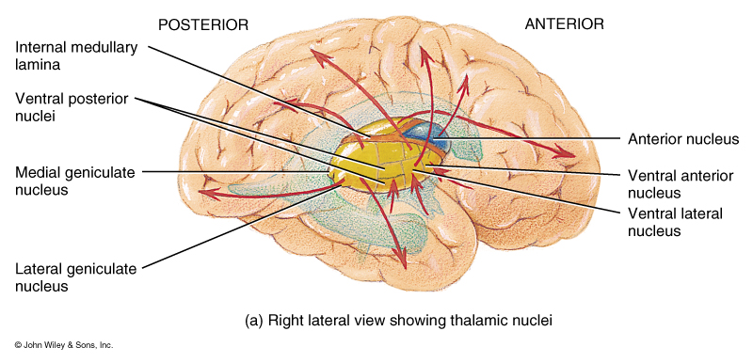
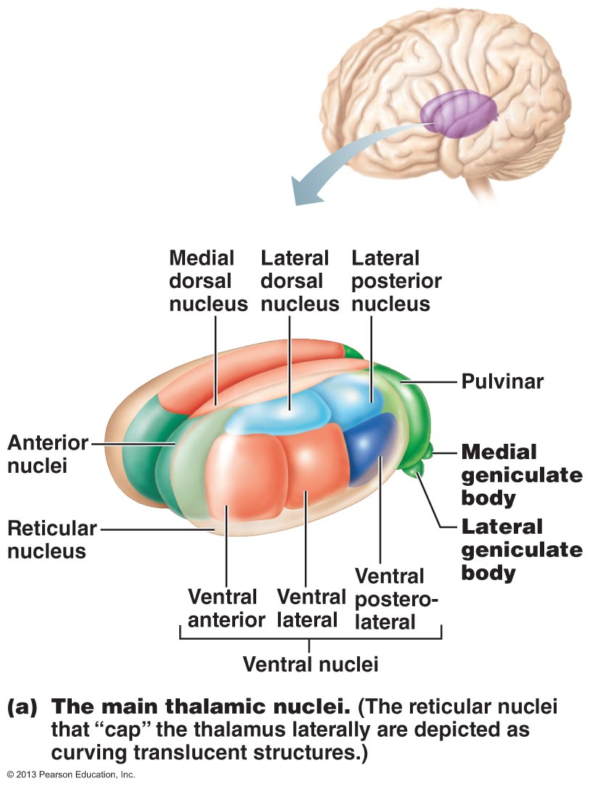
The Diencephalon (see Fig. 12.12)
• thalamus, hypothalamus, epithalamus – enclose the 3rd ventricle
Thalamus: 80%; bilateral masses of gray matter held together by midline commissure called the intermediate mass
• consists of many different nuclei, named for their position in thalamus – afferent impulses from all senses & all parts of body converge on thalamus
• sorting & editing of information; group like impulses to send to appropriate region of cortex – crude awareness of sensation at level of thalamus
• also input pertaining to emotions & viscera from hypothalamus
• key roles in mediating sensation, motor activities, cortical arousal, learning, memory = “gateway to cerebral cortex”
Fig. 12.11a

Slide 29
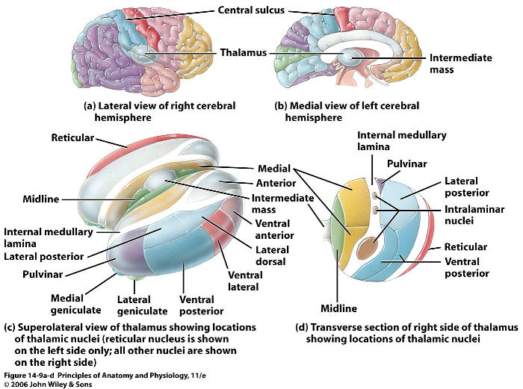
Fig. 14.9(T&G)

Slide 30
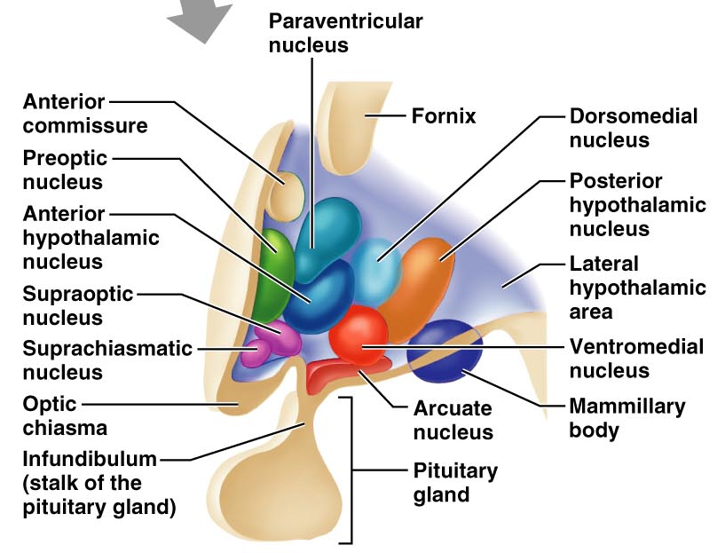
Hypothalamus: “below” thalamus
Autonomic control centre: centres for bp, heart, GI, respiration, etc
Centre for emotional response & behaviour: heart of limbic system
Body temperature regulation:
Regulation of food intake: hunger, satiety
Regulation of water balance & thirst: release of ADH; thirst centre
Regulation of sleep-awake cycles: suprachiasmatic nucleus
Control of endocrine system: releasing factors plus 2 nuclei (supraoptic & paraventricular) produce ADH & oxytocin
Hypothalamic disturbances:
cause disorders in body homeostasis such as body wasting, obesity, sleep disturbances, dehydration, emotional imbalances

Slide 31
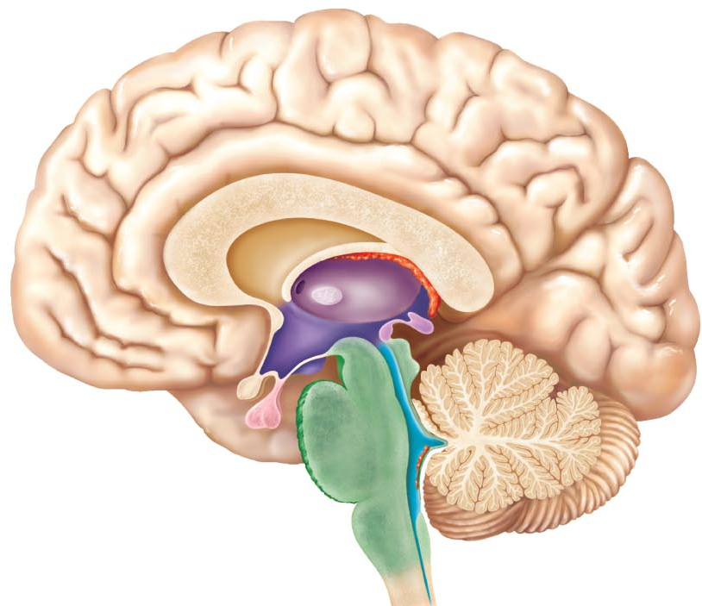
Epithalamus: most dorsal part of diencephalon & forms roof of 3rd ventricle; pineal gland (melatonin) extends from its dorsal border
• choroid plexus (CSF-forming structure) also part of epithalamus
Optic
chiasma
Fig. 12.10: Midsagittal section

Slide 32
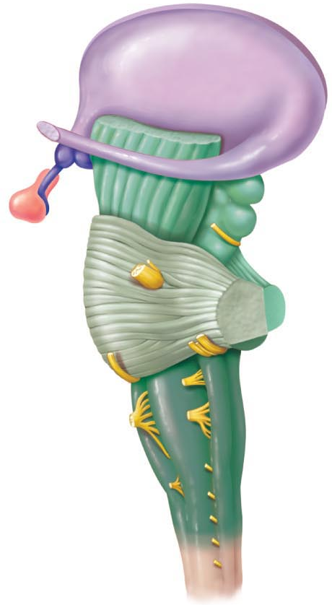
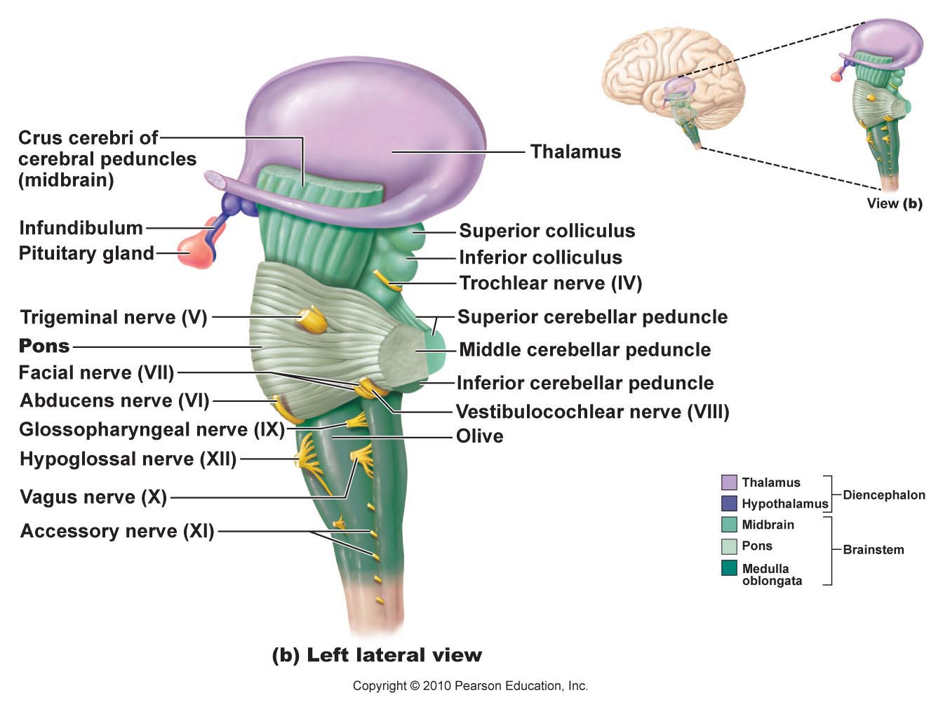
The Brain Stem: consists of midbrain, pons, medulla oblongata
(i) rigidly programmed, automatic behaviours necessary to survival
(ii) pathway between higher & lower neural centres
(iii) associated with 10 pairs of cranial nerves
Fig. 12.13b: Lateral view of brain stem

Slide 33
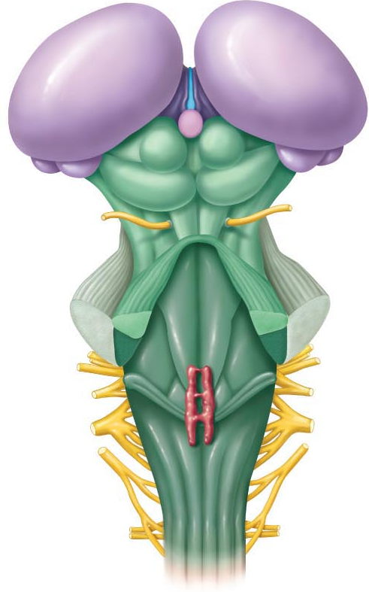
Midbrain:
2 cerebral peduncles that contain large pyramidal (corticospinal) motor tracts
hollow cerebral aqueduct runs through midbrain
periaqueductal gray matter involved in pain suppression
Corpora quadrigemina: superior colliculi are visual reflex centres; inferior colliculi are part of auditory relay (also startle reflex)
Lateral view
Fig. 12.13c: relationship of brain stem to diencephalon; dorsal view

Slide 34
Fig. 12.10: Midsagittal section of brain

Slide 35
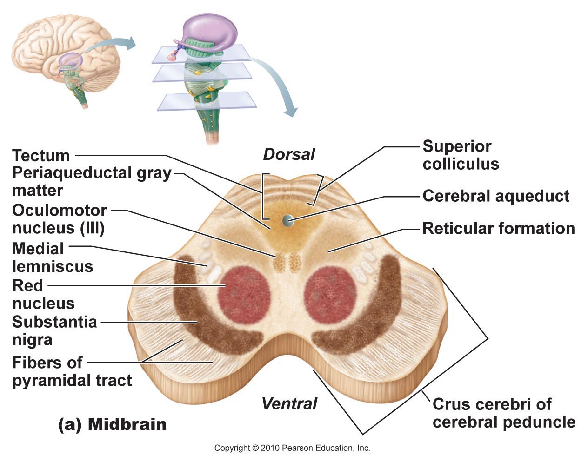
Midbrain (cont):
• substantia nigra: band-like nucleus; high melanin content (precursor ➢ dopamine); linked to basal nuclei of cerebral hemispheres (Parkinson’s disease)
• red nucleus: rich vascular supply, iron pigment in neuron cell bodies; relay nuclei for descending pathways influencing limb flexion
• also some nuclei associated with reticular formation
Fig. 12.14a

Slide 36
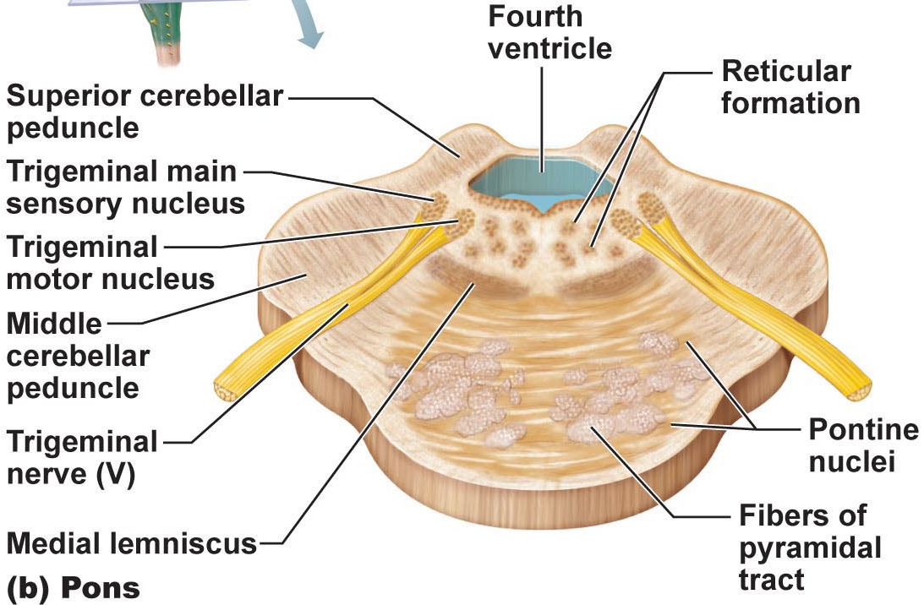
Pons: dorsally, forms part of anterior wall of 4th ventricle
• primarily conduction tracts (“bridge”); some run longitudinally; others oriented transversely to communicate with cerebellum
• cranial nerves V (trigeminal), VI (abducens) & VII facial; other pons nuclei are part of reticular formation and others are involved in respiration)

Slide 37
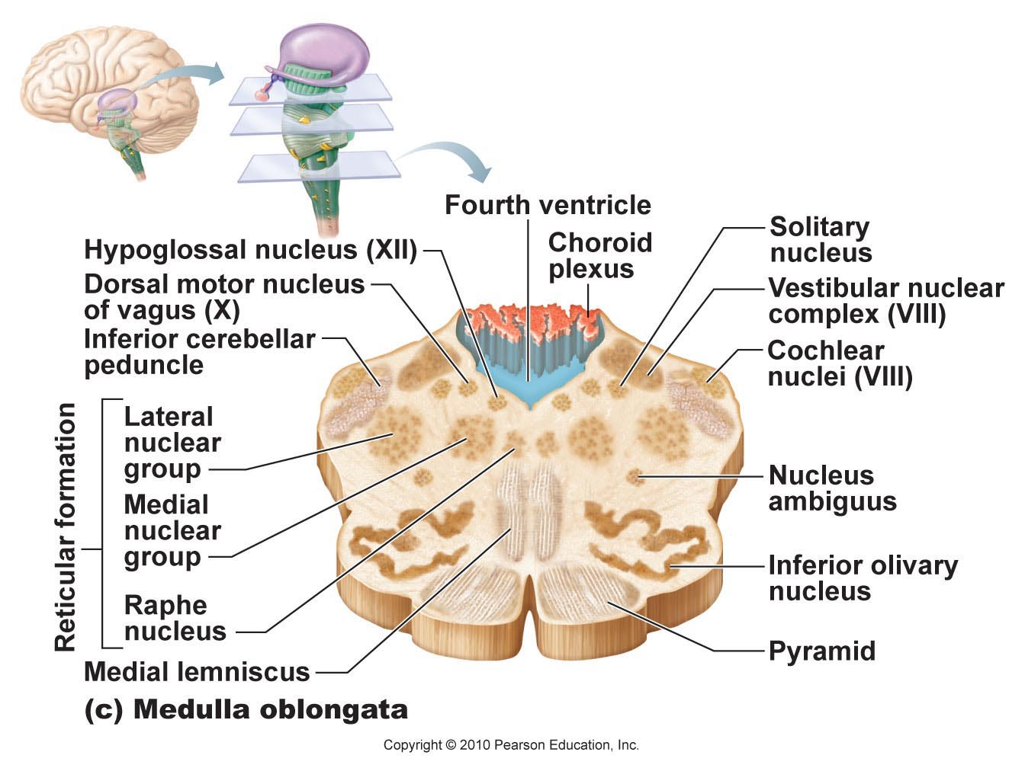
Fig. 12.14c
Medulla oblongata: from pons to spinal cord
• pyramids, decussation (significance of this?)
inferior olivary nuclei: relay sensory info re muscles & joints to cerebellum
cranial nerves XII (hypoglossal), IX (glossopharyngeal), X (vagus), XI (accessory)
vestibulocochlear nerve fibers (VIII) synapse with cochlear nuclei (functions?)

Slide 38
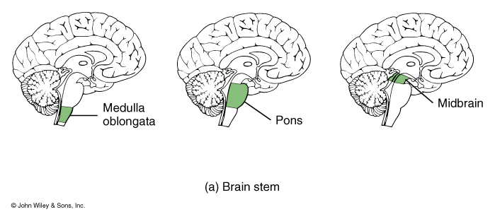
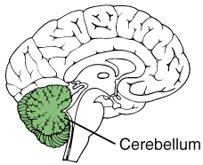
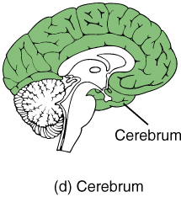
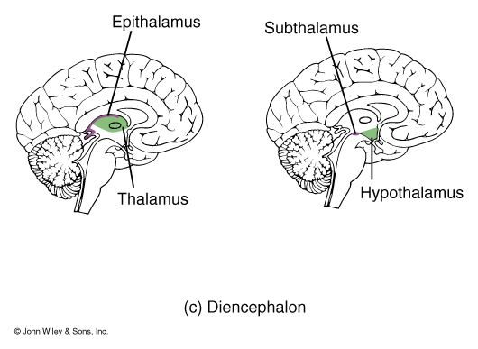
See also Table 12.1
Table 14.1 (T&G)
Medulla oblongata: crucial role as autonomic reflex centre for homeostasis
Cardiovascular centre: cardiac & vasomotor centres
Respiratory centres: rate & depth of breathing
Other centres: eg: vomiting, hiccupping, swallowing coughing, sneezing
• overlap with hypothalamus: hypothalamus controls most visceral functions by relaying instructions through medullary centres which carry them out

Slide 39
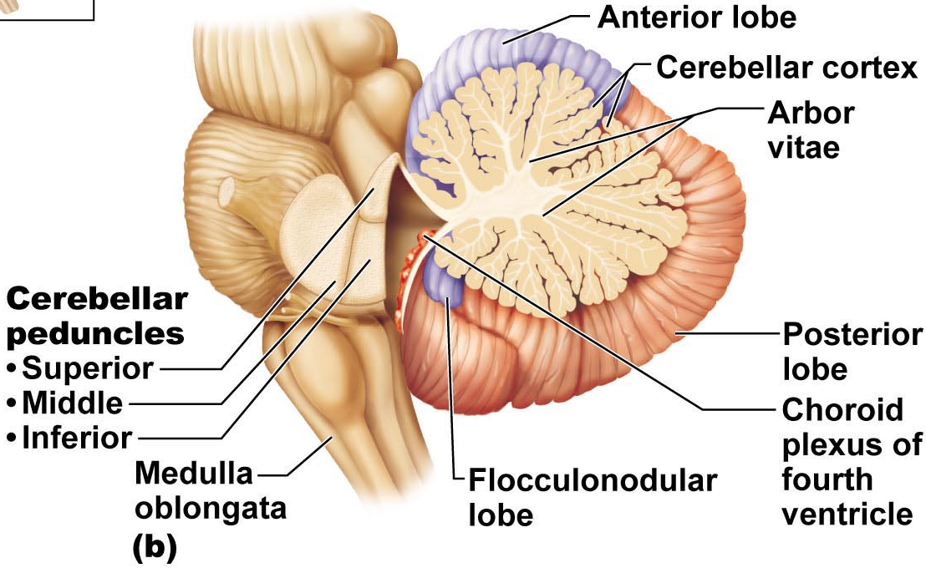
The Cerebellum:
• processes inputs from cerebral motor cortex, brainstem nuclei & sensory receptors ➢ timing & patterns of skeletal muscle contraction for smooth, daily movements – eg: driving, typing, playing a musical instrument, etc (not under conscious control)
• bilaterally symmetrical; connected by vermis; fine transverse fissures called folia; each hemisphere divided into 3 lobes: anterior, posterior, flocculonodular
Fig. 12.15
Notes:
Corrects movement, refines and readjusts
Do not need to label

Slide 40
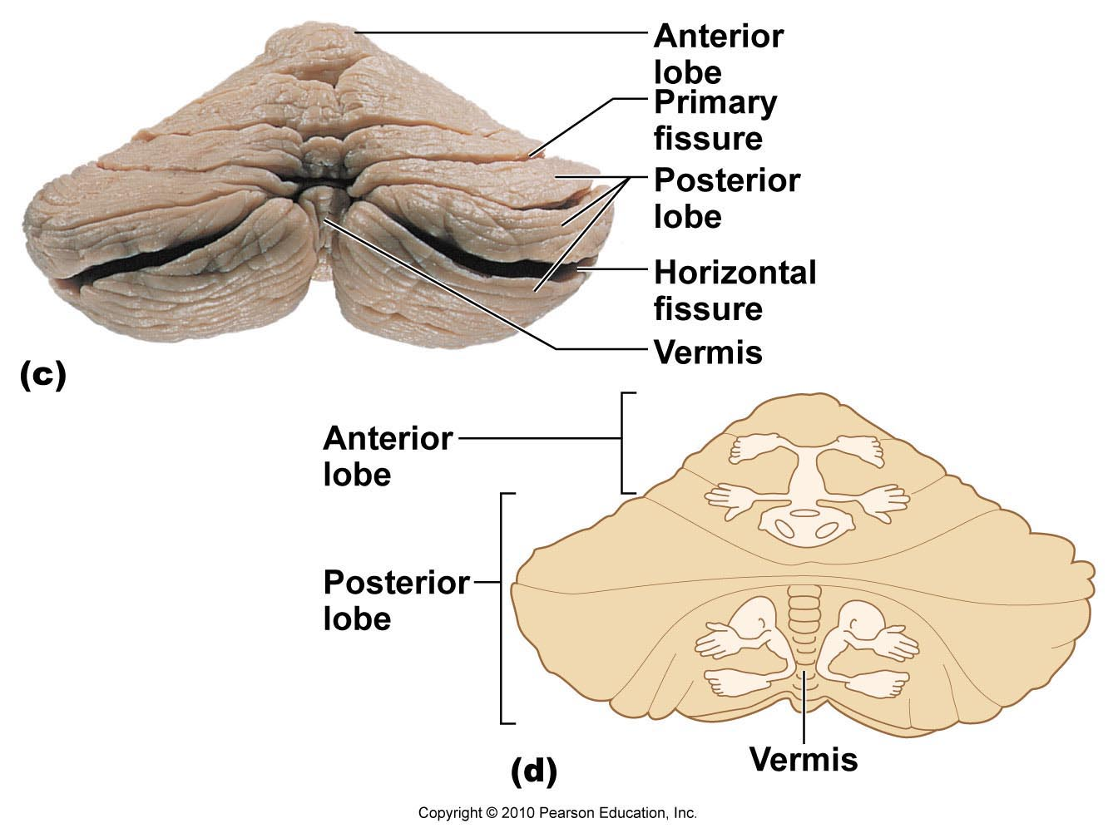
The Cerebellum (cont):
• anterior & posterior lobes have overlapping sensory & motor maps of body
medial: trunk & girdle
intermediate: distal limbs, skilled movements
lateral: input from association areas of cortex (esp. planning movements)
• flocculonodular lobes – input from equilibrium sensors: balance, some eye movements (one on either side
Fig. 12.15

Slide 41
Cerebellar Peduncles
• connect cerebellum to brain stem
• virtually all fibers entering & leaving cerebellum are ipsilateral (unlike cerebral cortex)
Superior: connect cerebellum & midbrain; fibers originate from neurons in deep cerebellar nuclei & project to cerebral motor cortex via thalamus (outgoing)
Middle: connect pons & cerebellum; one-way communication from pons to cerebellar neurons (informs cerebellum of voluntary motor activities initiated by motor cortex) incoming info
Inferior: connect cerebellum & medulla; afferent tracts - sensory info to cerebellum from muscle proprioceptors & vestibular nuclei of brain stem (equilibrium & balance) incoming
Fig. 12.13c
Notes:
Communicating track, no crossing over (ipsilateral)
Does not go directly to motor neurons, starts at thalamus

Slide 42
Cerebellar processing:
Cortex frontal motor association area indicates intent to initiate action & sends collaterals to cerebellum to notify
⇓
Cerebellum also receives proprioceptive info & info from visual & equilibrium pathways: Where is body & where going? How well are these movements being carried out?
⇓
Cerebellar cortex receives this info & determines best way to coordinate force, direction extent of muscle contraction
⇓
Via superior peduncles, cerebellum dispatches blueprint for coordination to cortex; output also to brain stem nuclei (eg: red nucleus) which project to motor neurons of spinal cord

Slide 43
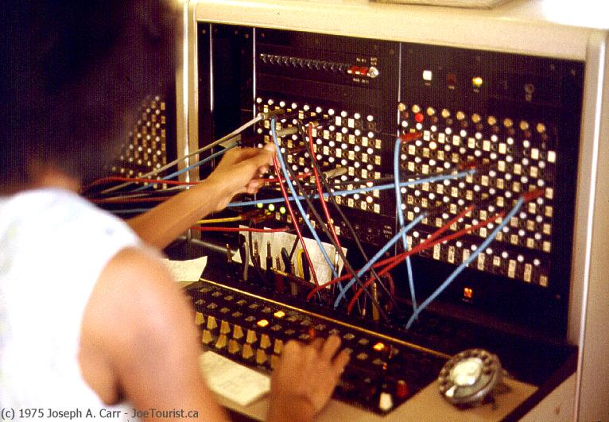
Functional Brain Systems:
• networks of neurons that work together but span large distances within brain
Notes:
Do not need to label cerebellum, understand function and peduncles diagram is fair game

Slide 44
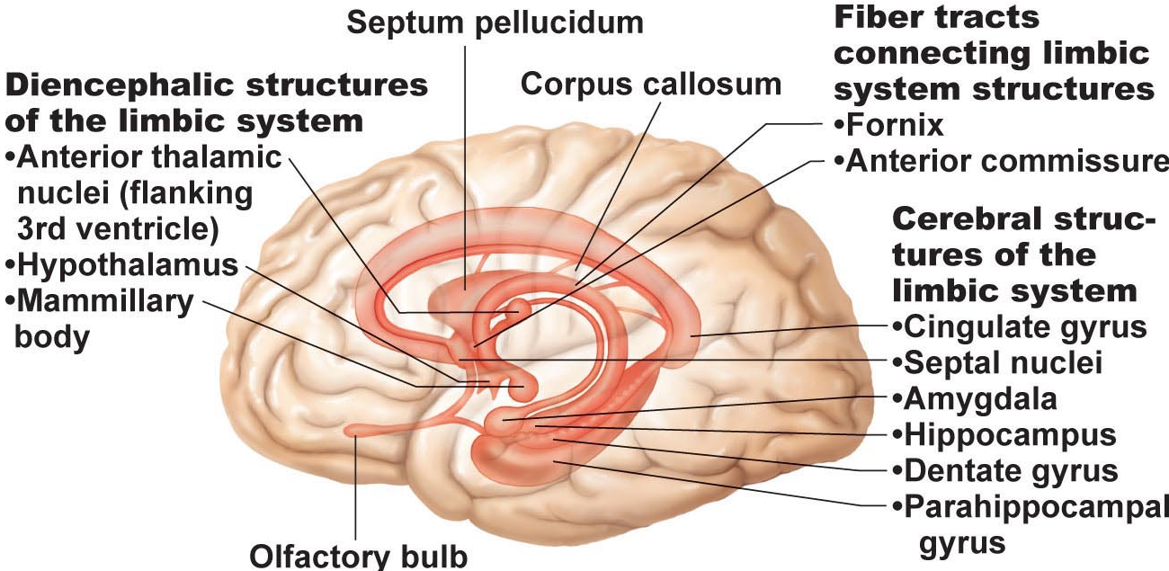
Limbic system: (limbus = ring)
• medial aspect of each cerebral hemisphere & diencephalon; cerebral structures encircle upper brain stem
• emotional-visceral brain – esp: amygdala (anger, fear, assess danger) & anterior cingulate gyrus (gestures, resolve conflicts when frustrated)
• link between odours, memories & emotions
• link for psychosomatic illnesses: stress & effects on bp, GI tract, heart
• links with cortex:(i) aware of emotions, (ii) react emotionally if consciously understand; also: emotions can override logic; reason can stop us from expressing emotions
Fig. 12.16
Notes:
Limbis means ring know how to label amygdala (allows us to put an emotional value on an experience)
Cingulate gyrus is the most superior thing
Limbic is close to smell and is pathway that communicates to the hypothalamus
Connects to the cortex so we are aware of emotuins

Slide 45
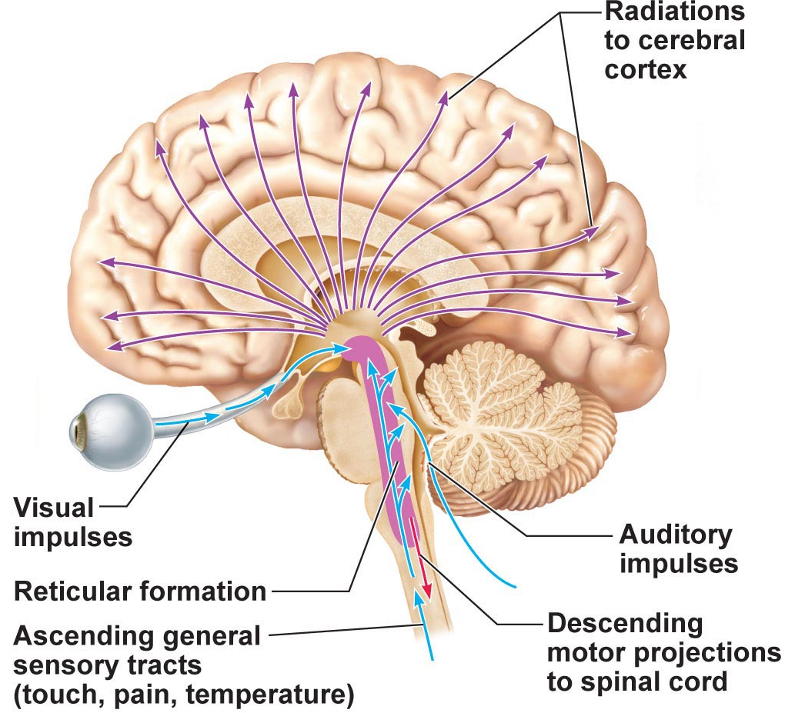
Reticular formation:
• central core of medulla oblongata, pons, midbrain; neurons project to hypothalamus, thalamus, cortex, cerebellum, spinal cord
• reticular activating system (RAS):
(i) maintains arousal of brain; to stay conscious
(ii) filter for incoming signals (RAS & cerebral cortex disregard ~99% of all sensory stimuli)
Fig. 12.17
Notes:
Varies

