Slide 1
Welcome to the Wonderful World of Microeconomics
Class # 1

Slide 2
A. Introduction
It’s All About Me *not really*
The course outline
Blackboard & Lyryx

Slide 3
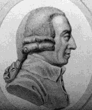
A. I Love Economics
One Of Two Things Happens:
  you either love it or you absolutely hate it
  there is some math in this class
It’s Not The Dismal Science
  economics is about maximizing everything especially our welfare
    unfortunately we have limited resources

Slide 4
B. Definitions
economics:
  unlimited wants and limited resources
  study of scarcity and choice
  Constrained maximization problems
  Ancient Greek - oikos (“house”) and nomos (“custom” or “law”)

Slide 5
B. Macro vs Micro
Microeconomics: The study of the choices that individuals and businesses make, the way these choices interact, and the influence that governments exert on these choices.
Macroeconomics: The study of the aggregate (or total) effects on the national economy and the global economy of the choices that individuals, businesses, and governments make.
Analogies…..

Slide 6
B. Cont
Macro
    inflation / prices
    money supply & demand
    unemployment
    GDP
    interest rates
    exports / imports
    government spending / taxation
    investment

Slide 7
B. Cont.
Micro
  things we rarely hear about
    utility
    profit maximization
    monopoly / monopsony power
    oligopolies
    the marginal principle
Other Sub Disciplines
Notes:
Monopsony power is one buyer

Slide 8
C. A Quick Economics History Lesson
The Scottish Enlightenment - late 1700s
  birth of classical economics
  Adam Smith - The Wealth of Nations
    Specialization
    “The Invisible Hand”
    Rational self interest
  David Hume
    private property, inflation, and foreign trade

Slide 9
C. Cont.
So what really is the point to this history lesson?
classical economics failed to explain the Great Depression
  wages and prices failed to drop

Slide 10
C. Cont.
Keynes “The General Theory of Employment, Interest and Money”
  foundation of macroeconomics
  focus on government spending and taxation to regulate the economy
Stagflation (high unemployment and high inflation) occurred in 1970s
  Keynes suggested increased spending to combat unemployment and decreased spending to fight inflation

Slide 11
C. Cont.
2 major schools of thought:
  New Keynesian
  New Classical (Monetarists)
This is microeconomics…..

Slide 12
D. Normative vs Positive
  Positive statements – claims that attempt to describe the world as it is
    We can confirm or refute a statements validity by examining the evidence
  Normative statements – claims that attempt to prescribe how the world should be
    We can not judge the validity solely on data since values or morals play an important role
Notes:
Positive Statements – to be able to validate it
Normative Statements – are the way the world should be

Slide 13
D. Examples
Canada ought to undertake policies to reduce their unemployment rates
College education should be free to all Canadians
The price of oil rose by over 10 per cent last year
LVMH is the largest luxury brand company in the world

Slide 14
E. Economic Thinking
1. Everything has a cost
  No free lunches
  Russian proverb – the only place you find free cheese is in a mousetrap
2. Things always change
  Ceteris paribus
3. Metaphorical time bombs don’t explode
  Ie. population bomb
Notes:
Ceteris paribus – meaning everything else is constant

Slide 15
E. Cont.
4. Prices make the best incentives
  Issue of govt. control
  Moral hazard
5. Supply and demand work
  As close to a law of nature as we are going to get
6. There’s no easy profit
  Always someone who seeks the opportunity

Slide 16
E. Cont.
7. People do what they want
  Even when it doesn’t make sense (intrinsic value) ie. housing in a certain area because of schools
8. Always look up the evidence
9. Where common sense and economics conflict -- common sense is wrong
10. Economics is about happiness

Slide 17
F. Economics Applies to Everything
Sex
Drugs
Rock and Roll
The weather and why economists care about the sex life of pigs
Can you teach a monkey economics?
http://www.youtube.com/watch?v=J8449HgS3FM

Slide 18
G. What, How and For Whom
What - C + I + G + X
How -Factors of Production
  Labor (wages)
  Capital (interest)
  Land (rent)
  Entrepreneurship (profits)
For Whom -- who ever has the money
Notes:
C- consumption
I – Investment (asset like a table)
G – Government
X - Export

Slide 19
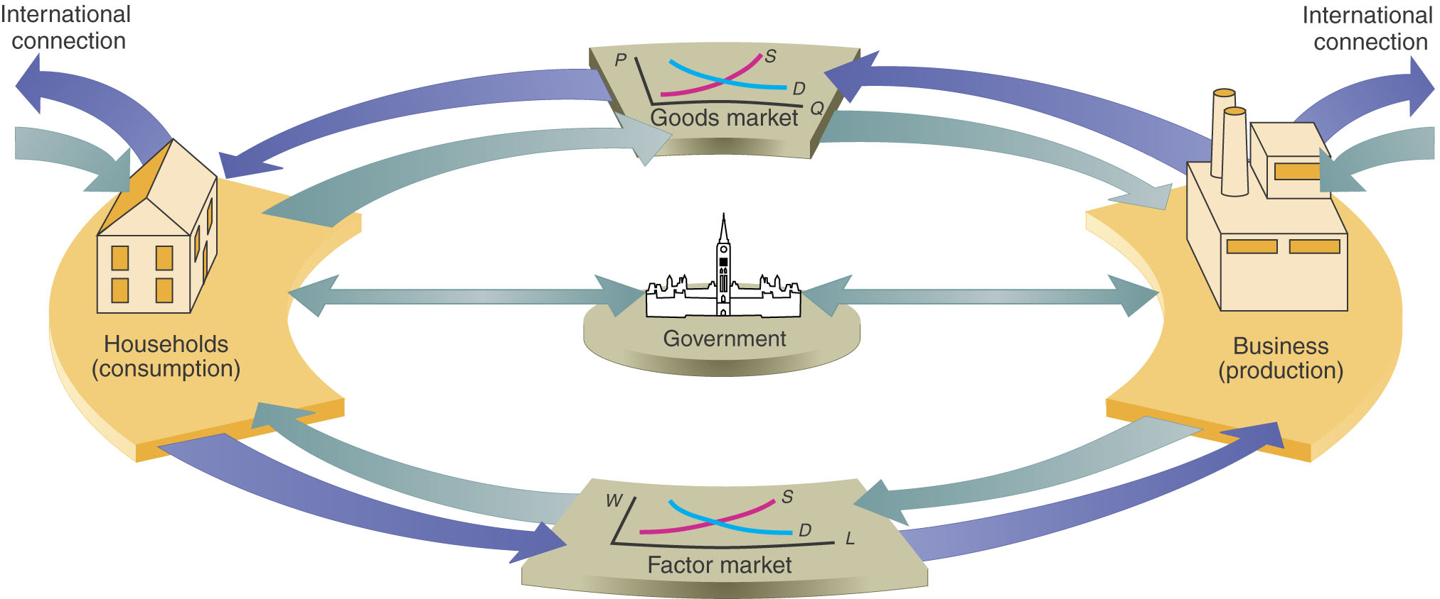
G. Circular Flow

Slide 20
H. Production Possibilities Frontier
The boundary between the combinations of goods and services that can be produced and the combinations that cannot be produced, given the available factors of production and the state of technology.
The PPF is a valuable tool for illustrating the effects of scarcity and its consequences.

Slide 21
H. Production Possibilities Model
Assume 2 products and a set amount of resources and technology
Possibility:
  A. 0 chia pets and 100 pez dispensers
  B. 50 chia pets and 75 pez dispensers
  C. 150 chia pets and 25 pez dispensers
  D. 200 chia pets and 0 pez dispensers

Slide 22
H. Cont.
Efficiency: maximizing output with available resources --- point on PP curve
Inefficiency: under utilization of resources --- any point below PP
Unattainable: anything not achievable -- above PP
Opportunity Cost: movement along the PP curve
We can become more efficient

Slide 23
I. Production Possibilities
Another Example:
Prada Shoes
LV Handbags
A.
0
15
B.
10
10
C.
20
5
D.
30
0

Slide 24
I. Opportunity Cost
Opportunity cost – the basis of cost/benefit economic reasoning; it is a cost of the activity you have chosen measured by the benefit foregone of the next-best alternative
Opportunity Cost = Give Up / Get
  What is the opportunity cost of 1 pair of Prada shoes?
  What is the opportunity cost of 1 LV handbag?

Slide 25
J. The Opportunity Cost of Going to School!
Tuition:
Books:
Entertainment:
What did you give up?
Divided by 400(10 courses * 40 hrs) =

Slide 26
K. The Difference Between Accounting and Economics
You open a lemonade stand and make $30, 000 in profit
However you could have been working on Bay Street making $100,000
What is the accounting profit (loss) of your lemonade stand?
What is the economic profit (loss) of your lemonade stand?

Slide 27
L. Absolute / Comparative Advantage
a country has absolute advantage if it can produce all goods using less inputs than another country
a country has a comparative advantage in the production of the good for which it has the lowest opportunity cost
  both countries gain by specializing in the production of goods in which they have a comparative advantage and trading for other goods => consume outside PPF
Notes:
Comparative advantage is doing what relatively they are good at (If one country is better at both).

Slide 28
L. Practice Problem
Production Possibilities in the United States and China
  Suppose the United States and China produce only satellites and sports shoes. Further, assume that the U.S. opportunity cost of producing 1 satellite is 10 million pairs of shoes and the Chinese opportunity cost of producing 1 satellite is 50 million pairs of shoes.

Slide 29
L. Cont.
No Trade
  With no trade, we assume the United States produces 5 satellites and 50 million shoes and China produces no shoes and 2 satellites.
Comparative Advantage
  The United States has a comparative advantage in satellites because its opportunity cost is lower than China’s opportunity cost. China has a comparative advantage in producing shoes.

Slide 30
L. Cont.
Achieving the Gains from Trade
The United States and China can achieve the gains from trade if the United States specializes in producing satellites, China specializes in producing shoes, and the two countries trade. In this way, both countries can gain because both countries can have more satellites and more shoes.
Notes:
If you specialize you can produce more outside of the PPF

Slide 31
L. Cont.
Dynamic comparative advantage is comparative advantage that arises from learning by-doing.
Notes:
From Practicing

Slide 32
M. A Couple of Other Points
Fallacy of Composition
    If you all study harder, you can all be the top student in the class
    The best action for a business during a time of recessions might be to lay off staff and reduce production. A response that is good for a particular business might be bad for the economy, if all businesses take the same action.
Causation
Unintended Consequences
Notes:
Causation – one thing leads to another
Unintended Consequences – if you get a bonus for being good to students, it will make things worse, marks going up. Did not intend to happen.

Slide 33
For Next Week!
You have a Lyryx assignment so start it (its due in 2 weeks)!!
Look over chapters 1& 2 and we are going to talk about chapter # 3

