Slide 1
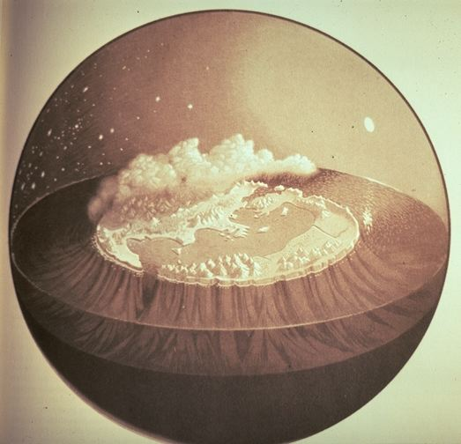
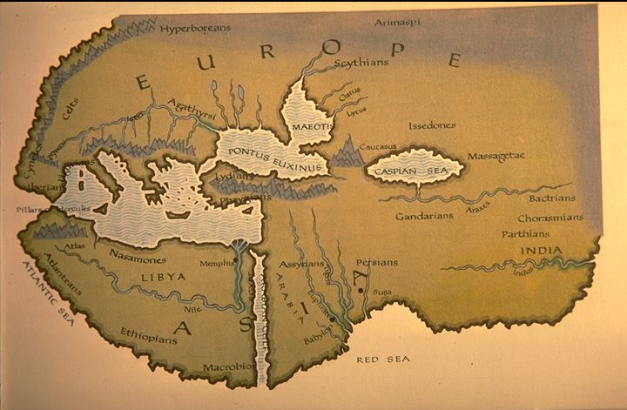
CREATION MYTHS
Ancient Greek Concepts about the world
Hyperboreans
Ethipeans (Illiad 1:423
Notes:
-earth was believed to be a flat floating circle on river okeanos and surrouded by water
River oceanis (okeanos)= fresh water
Geocentric (earth) concept instead of heliocentric (sun)concept– everything revolves around the earth , sun goes around the earth and at night falls into water, same with stars
-heaven (dieties) – talk about top of mount olympus
-earth (humans and dieties )- middle layer
-underworld
a)Hades (dead mortals and dieties)--- name of king of underworld and also place of underworld– everybody dies goes there
b)Tartaros for sinners and dark forces—second level of underworld– for great sinners against gods and dark forces
Second image:
(6th BC)—supernorthern and supersouthern border have contact with god –have good life and when had enough they commit suicide

Slide 2
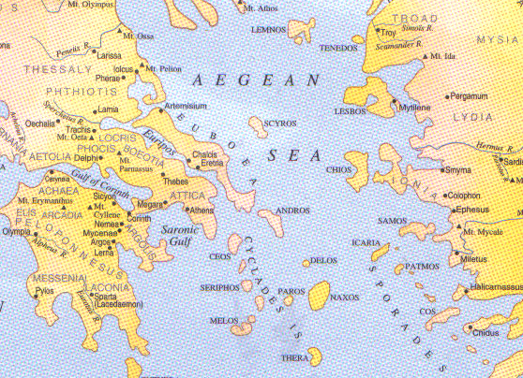
Hesiod (around 700BC)
Theogony
An account of: the origins of the universe (cosmogony) and
the birth and descendants of gods (theogony= birth of gods)
Works and Days
A poem addressed to his brother
Notes:
2 works of poems- Theogony and Works and Days from Hesoid ( this will tell us about the times)
-stories used to be recited and performed
Theogony : account from beginning to when Zeus took power
Works and Days: Hesiod composed this for his brother – disppointed of his brother bc he stole his inheritace – hesoid wanted to teach him the right way to live his life– refers to different stories of creation

Slide 3
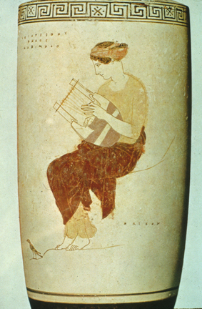
Hesiod’s Theogony
The call to the Muses
Theogony: 1-33
        Excerpt: …So spoke the trustworthy daughters of mighty Zeus and gave me a leafy branch of laurel to pluck for a staff . Then into me breathed the inspired art of the poet to sing of things of the past and those that are yet to be…
The Muse(s): The source of poetic inspiration
(inspriation) Spirit >
(from latin spiro :to breath)
Notes:
**
9 muses – protect art (ex. Muse of poetry, dance, astronomy, history etc) and inspiration behind arts
She gives to the poet memory to memorize and to recite welll
Inspiration comes from the word “spirit” –
Excerpt: this muse gave him a branch (speakers, messengers, poets have staff made of wood for speaking) – the laurel gave him to know things of the past and of things to come

Slide 4
The first elements
CHAOS was born first and after it came the
GAIA (Earth) and …
TARTAROS … and
EROS (Love)

Slide 5
CHAOS (a chasm, an opening, ΧΑΟΣ)
TARTAROS (a dark place, roots of the Earth)
EROS ( The force of Creation)
Notes:
Chaos is an opening, a chasm → refers to the Big Bang
Tartaros: darkest place
EROS: was the intial force (attractoin and brough elements together)

Slide 6
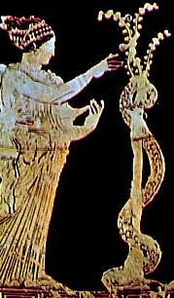
Earth (Gaia, Ge) : the source of all knowledge, the source of life and death.
Symbols of Earth:
The tree and the snake
(the cycle of life, fertility, regeneration and knowledge)
Notes:
-central divinity
--imagined as the ground (place of powers of fertility and dead) and as a female Goddess
--The goddess was believed to have all the wisdom
--The tree: roots underground – 3 levels: ground to sky
---snake: lives in underground and on ground– sheds skin--- regenerative
--tree and snake : regenerative

Slide 7
Offspring of Earth without a consort
Earth
(Gaia)
Sky
(Uranus)
Mountains
(Ore)
Sea
(Pontus)
+
OURANOS
Notes:
Earth creates a cover (sky- Uranus), mountains (ore) and sea (pontus)
-- this cannot go on forever so she mates with sky

Slide 8
Offspring of
Earth and Sky
3
Hecatoncheires
3
Cyclopes
12
Titans
The youngest: Kronos
Notes:
3 hecatoncheires: 3 creatures with hundred hands each
3 cylops: huge eyes
12 Titans- monstrous

Slide 9
Offspring of Earth and Sky
3 Hecatoncheires:100 hands creatures
3 Cyclopes: the divine smiths
Kottos, Gyes, Briareus
Brontes,(lightning) ,
Steropes, (Thunder),
Arges, (Brightness)
The Cyclopes in Theogony vs.
the Cyclopes in the Odyssey
Notes:
Hecaton=100, cheires= hands
Cyclops (circular eye)– Thunder, lighting, and brightness
--they are divine smiths-construct weapons for gods (ex. Bolt for Zeus)
Cyclops in theogony is what we are talking about

Slide 10
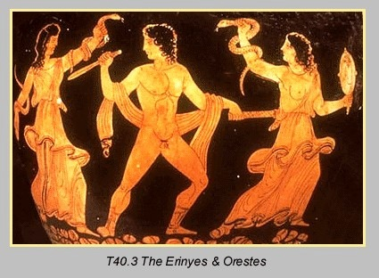
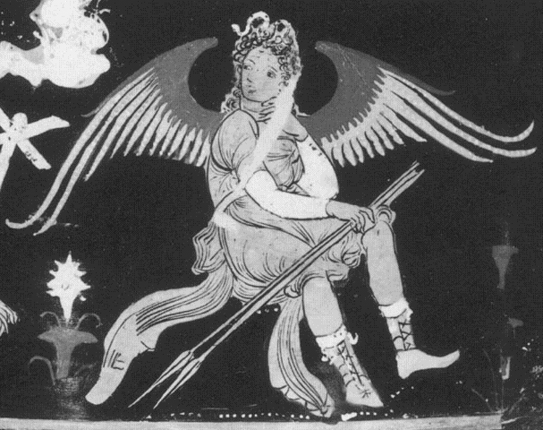
The story of Ouranos’ castration
Story 1
Furies
Giants
Creation after Castration (from blood drops)
Melian Nymphs
1
Notes:
Ouranos (the sky/father) kept the newborn childrne in Gaia’s body
Gaia devised a plan and a weapon: a sickle from adamant( hardest rock-diamond)
She said to her children they need to castrate their father.
Kronos(the youngest) castrated his father and threw the genitals behind him into the sea
Ouranos ceased to exist
Creatiion after castration from blood drops → Furies, Giants, and Melian nymphs

Slide 11
Creation after the castration from the blood drops:
The Furies (Erinyes)- created from the blood of castrated member
Ferocious female spirits
They avenge wrong, especially those who shed kindred blood
Notes:
If someone kills another of same blood, the Furies follow you around and make your life miserable
-described as horrible looking
-hard to appease
Ex. Eumenides: the furies torment orestes- agamemnon’s son, who killed his mother Clytemnestra

Slide 12
Creation after the castration from the blood drops:
The Giants: the sons of Ge/Gaia
Natural forces from the depths of earth responsible for earthquakes and eruptions
Notes:
- don’t’ know much about the 3rd- melian nymphs but they are related to death

Slide 13
Creation after the castration: from the genitals and the sea
Aphrodite
“arose from the sea foam”
Goddess of sexual desire, beauty, love, marriage
A central theme in Greek myth: the destructiveness of sexual attraction
-Eros( attraction or love)/Eris (opposite of attraction) occuring
in homer, Aphrodite is the daughter of Zeus instead
Notes:
The birth of Aphrodite – born form sea /shell based on which story versions

Slide 14
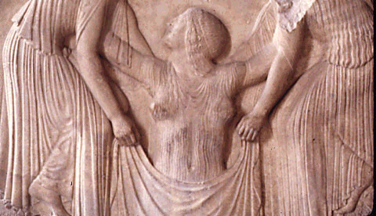
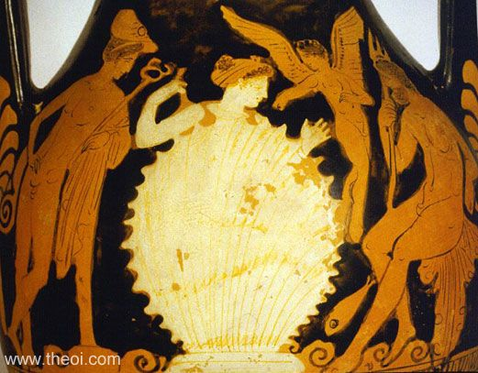
The story of Ouranos’ castration
Story 1
Creation after Castration (from the genitals and the Sea)
Aphrodite
2

Slide 15
SOME COMMON MOTIFS
Creation from a divine part …. …when it touches the earth/ water : FERTILITY
Looking taboo: It is prohibited to see a divinity or a divine action
The separation of the Earth from the Sky
Notes:
Nothing falls in vain– something divine (blood, semen, etc) falls in water leads to fertility
Looking taboo: reflects that human eyes are not able to tolerate a performance of divine action unless the divine allows it – have to avert eyes for divine action---Kronos throws divine thing behind him
Ex. Sodom city becomes destructed by God – tells Lot to leave city of sodom—Lot’s wife seees this divine act and turns to salt?
3. The seperation the earth and sky
-as the divine elements separate, a more ordered cosmos comes into being

Slide 16
Succession of power
Ouranos and Gaia
Kronos and Rhea
Zeus and Hera
Titans
Olympians

Slide 17
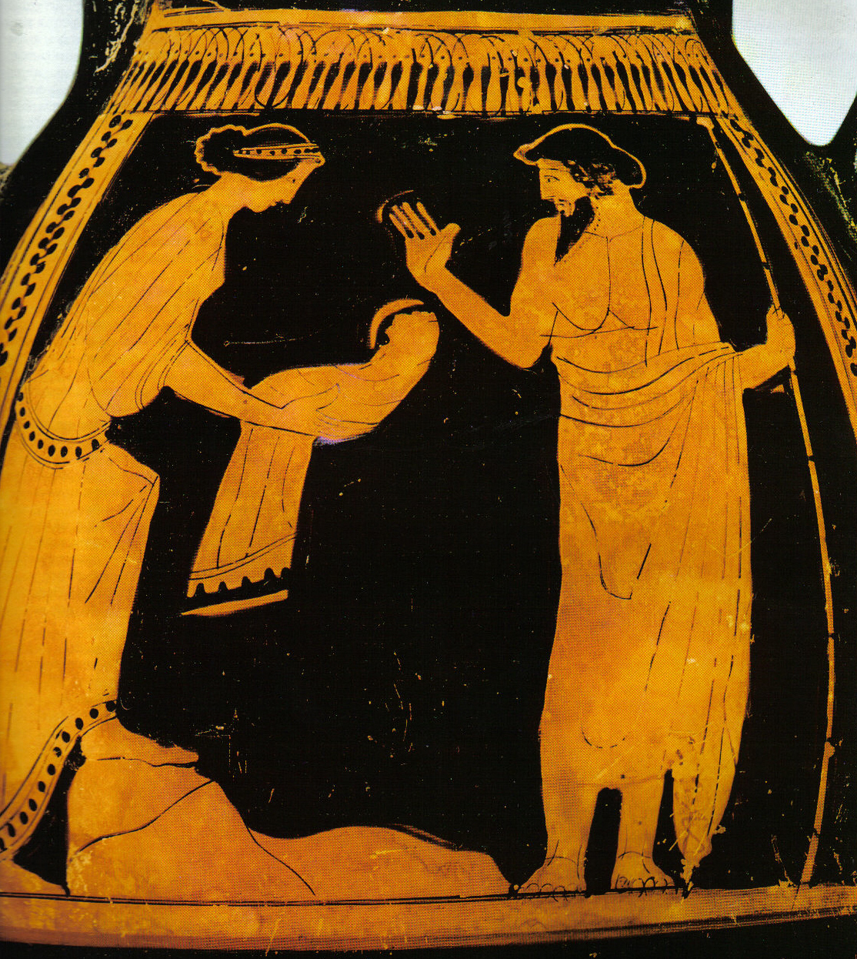
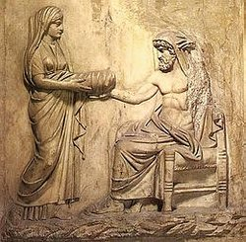
The child swallowing
Story 2
Earth’s prophecy: Kronos will be overpowered by a son. Therefore
Kronos swallowed his children by Rhea as soon as they were born
Rhea's trick
Hestia
Demeter
Hera
Hades
Poseidon
Rock (for Zeus)
Notes:
He suppresss his children like his father instead
All were swallowed except Zeus
Rhea” trick” – Rhea secretly gives birth to Zeus in Crete, Rhea gives Kronos a stone wrapped up in baby’s clothes and…Kronos swallows it.

Slide 18
Similar structure of the 2 myths in Theogony
Uranus and Gaia
U keeps children in G’s body
G devises a crafty plan to trick U
K uses a sickle to castrate U
K dethrones U and becomes the leader
Kronos and Rhea
K swallows children and keeps them in his body
R asks G for advice and tricks K
R gives a stone to K to swallow
Zeus dethrones K and becomes the leader
Notes:
2 similar objects – sickle and stone
Hiding, trick and resolution are all similarities

Slide 19
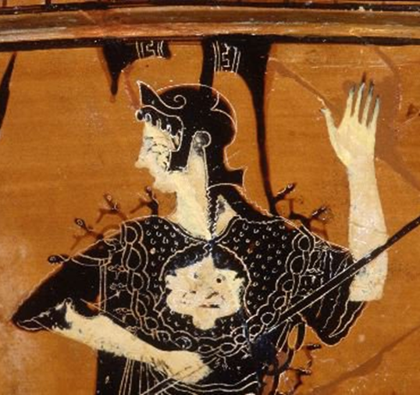
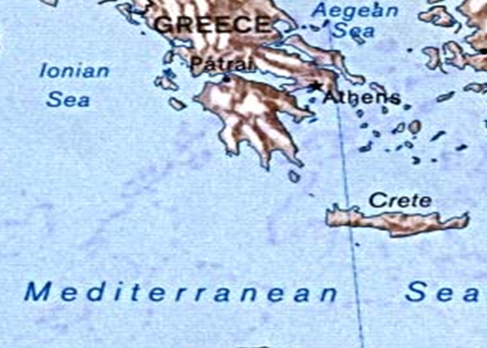
ZEUS
Birth and childhood in Crete
Zeus was entrusted to the nymphs
The goat Amaltheia
The horn of plenty (cornucopia)
The aegis and Capricorn
Notes:
Zeus was born in Crete (this version)
Crete has lots of caves in mountains – places of objects and offerings to gods
Mount Dicti and Dictian cave
--he was fed honey and milk (goat called Amaltheia)
Amaltheia wanted to play and Zeus snaps one horns by accident bc of his streght, when he grows he wants to honour goat so gives the horn of plenty and when she dies he places her in sky (Capricorn symbol)
--Athena (daughter of Zues) wears the aegis ( skin of the goat ) – protective cape
Athena wore the aegis for protection
Zeus created safety (aegis) and abundance (horn of plenty )

Slide 20
Birth and childhood in Crete
Zeus and Kouretes (young men –demigods)
Reflection of an initiation ritual and a cult in Crete
But…
When Zeus grows up, dethrones his father
Zeus gives Kronos and emetic potion and he releases his swallowed children(from youngest-oldest—starting from poseidon to hestia)
Zeus becomes leader of universe (OLYMpian)
Notes:
The Kouretes used to make noise so his father would not hear Zeus’ cries
--ancient socity would have a ritual –young men clang shields dancing to intitate youg boys ---this ritual is reflected in myth

Slide 21
The succession of power type of motif
Motifs:
The fear of losing power by a son (through a prophecy)
Unsuccessful attempts to bypass the prophecy by getting rid of the baby
The son(an outcast) will obtain revenge as an adult and establish his power

Slide 22
Freud’s psychonalaytical theory
The crime of Cronus, symbolizes the suppressed desire of the son for sexual freedom through the elimation of the father-rival
This is how the Odeipus story made

Slide 23
The struggles of Zeus to establish his power
Vs. the Titans
Vs. the Giants
Vs. the monster Typhoeus
Bypassing the prophecy by swallowing Metis
Vs. Prometheus
Revolt of gods of Olympos
Notes:
Zeus always struggles to hold his power
www.youthube.com/watch?v=QdXRbR6AtJg

Slide 24
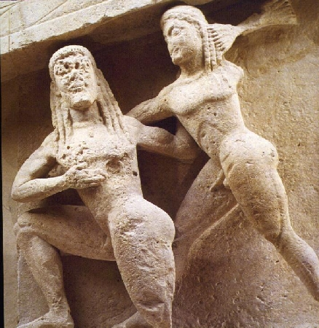
The Titanomachy= battle with titans
From Mount Orthrys
From Mount Olympos
ZEUS
Olympian Gods and Goddesses
Cyclopes
Hekatoncheires
The Oceanid Styx and her children
TITANS
Notes:
Titans- many vs Zeus and his allies
Zeus freed his siblings (gods/goddess)
The titnas were vanquished.. Hurled beneath the earth, deep down into tartaros

Slide 25
The Styx (daughter of Okeanos)
The oath of the gods
Her children:
Victory (Nike)
Zeal (Zelos)
Power (Kratos)
Force (Bia)
The power of water
Notes:
Styx – refered as lake/river under the earth
--after helping Zeus to achieve victory with her children –she provided Zeus with victory, zeal, power, force
-in order to honour her he made her the divinity to which the gods swear oaths (if gods break oaths, they will be punished severly)
-(water is considered very sacred)
Ex. Thetis dipping Achilles in the waters of Styx

Slide 26
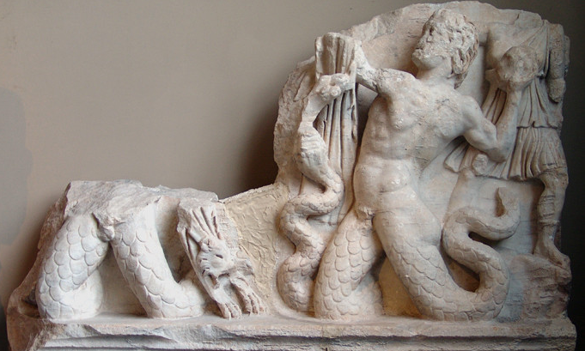
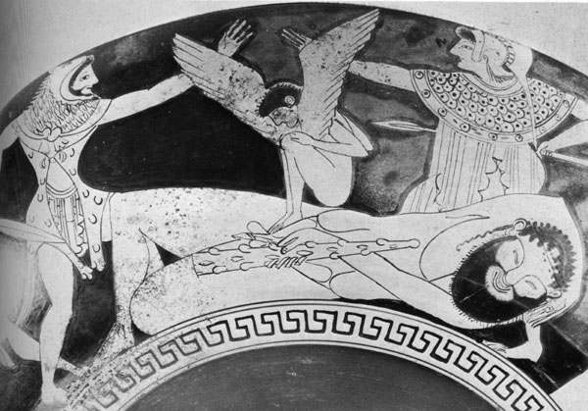
The Gigantomachy
Olympians against the Giants
The role of Herakles
Notes:
Earth was upset that her children the titans were in Tartoaros, she envoked the Giants to fight Zeus
-humans participate (prophecy says that unles a superhuman helps, won’t win battle)—specificlaly herculeus
Herculeus particpates and helps win the battle
--herculeus protrayed with snake legs
-second picture: Giant surrounded by Hercuelues and Athena , small figure is Sleep the twin brother of Death—Sleep makes the Giant fall asleep

Slide 27
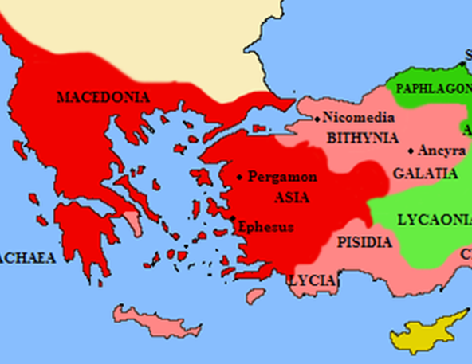
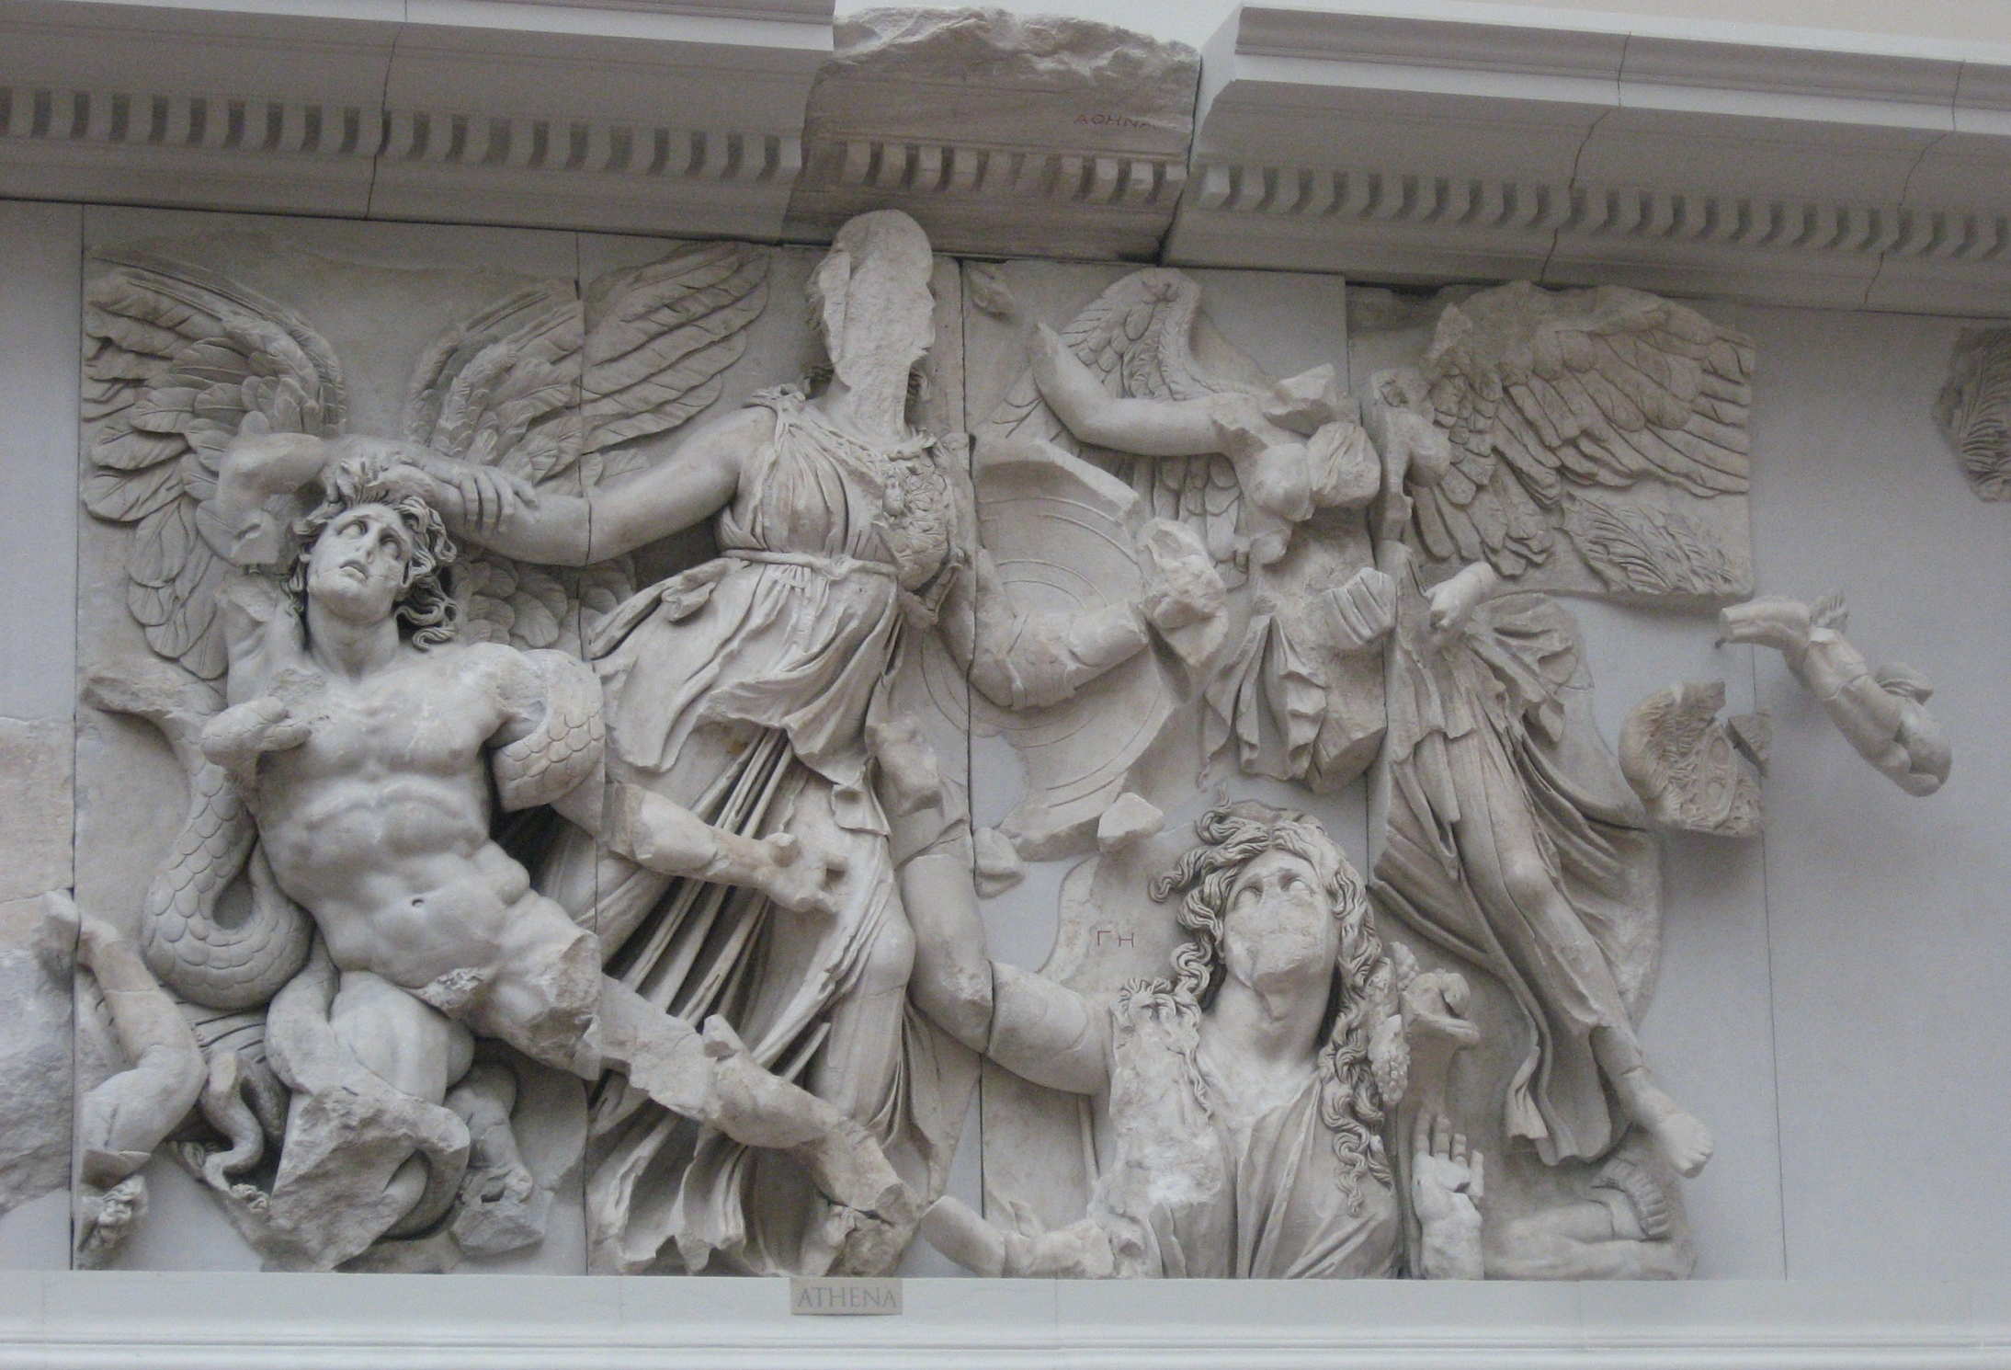
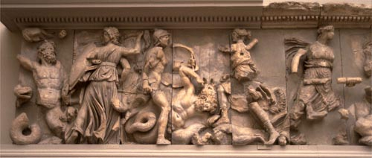
The Gigantomachy from the Great Altar of Pergamon
Notes:
-battle of giants is commonly used on buildings
--Map– the city of Pergamon had an altar before being taken by the Germans→ the altar with figures showing the battle of the giants
Greeks-good, barbarians= bad
--signifies the greeks vs the perians symbolized as olympian gods vs the barbarian giants
→ The giants lost battle and vanquished and went under the ground—why you have earthquakes

Slide 28
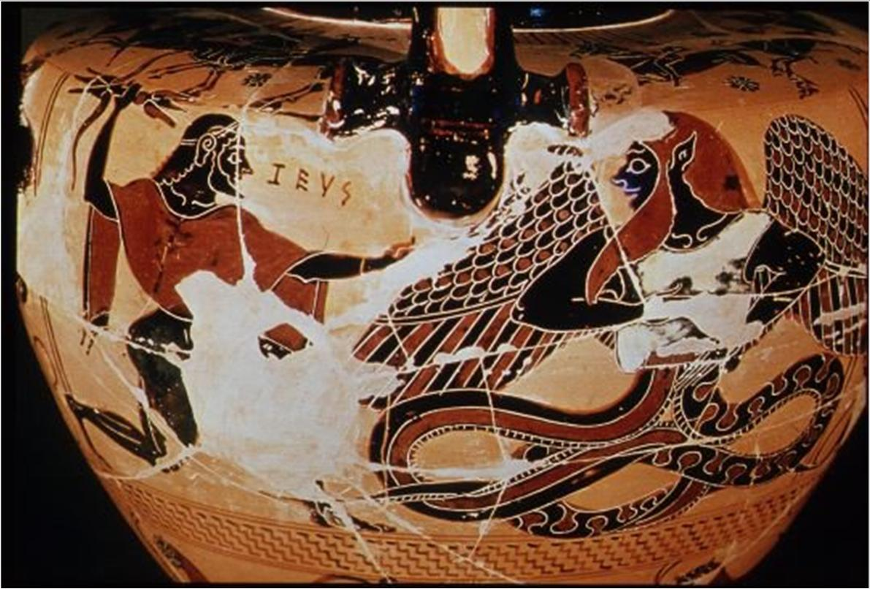
Zeus against Typhoeus
Earth + Tartarus= Typhoeus / Typhoon
Notes:
Earth is still mad so she mates with Tartarus – creating typhoon
Typhoon was defeated by Zeus–ends with a huge battle and blast
-typhoon trapped under the earth
--huge winds /hurricane represented by typhoon

Slide 29
Zeus and Metis
Metis, an Oceanid (the daughter of Okeanos)
Metis: Wisdom, cunningness
The “Succession of Power” type of myth:
  Prophecy
  The fear of being overpowered
  Bypassing the prophecy by swallowing Metis
  …and this time successfully
Notes:
Zeus faces what his father and grandfather faced
Zeus had 6 or 7 wives bf Hera
Metis was his first wife and tells him the prophecy that he will be dethroned by his son, deafeated by son
--he swallows his wife Metis

Slide 30
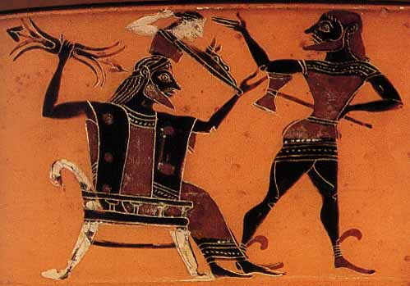
The birth of Athena
Notes:
The baby that Metis(=wisdom) makes comes from the head of Zeus →the birth of Athena
Zeus gave birth to Athena and somehow stopped he prophecy—also gained wisdom
Zeus also gave birth through his knee to Dionysos

Slide 31
Similar structure of the 2 myths in Theogony
Kronos and Rhea
K swallows children and keeps them in his body
R asks G for advice and tricks K
R gives a stone to K to swallow
Zeus dethrones K and becomes the leader
Zeus and Metis
Z swallows M and keeps her in his body
Z is the trickster who gets eternal advice from M
Z remains the leader
Notes:
Zeus breaks the prophecy and remains the leader

Slide 32
Zeus’ marriage to:
Themis (Justice)
Mnemosyne (Memory)
Eurynome
Children
Seasons and Fates
Muses
Graces
Zeus represents the leader of a more orderly universe, where natural forces are settled and where light, justice and wisdom prevail
Notes:
Zeus also marries themis and aquires justice, mnemosyne and acquires widom, and eurynome
Zeus represents more ordrely universe

Slide 33
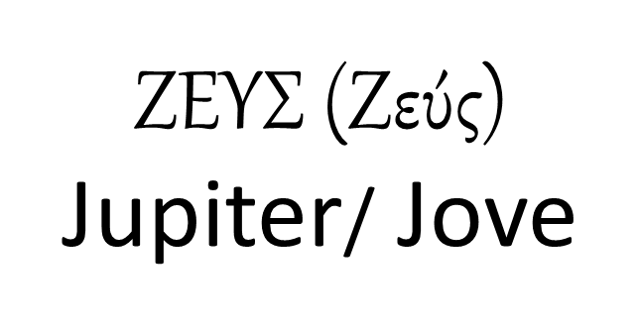
: Powers on Nature
A supreme sky god associated with weather phenomena, especially rain
  Humidity: the vital element of life
Zeus’ titles: The Cloud gatherer, the Lord of Lightning, the Lord of Rain
The Thunderbolt and the Eagle
Symbols of regal and punitive power
Notes:
Zeus: the storm god
Thunderbolt and eagle are his symbols—eagle has great speed and strike fast

Slide 34
Powers on human society
Protector of the family
  ( Father, Protector, Saviour)
Guardian of Law and Order, Giver of Authority and Justice.
  the Counselor, the Law Giver, the Oath protector
Protector of guests and suppliants: A special relationship between the host and the guest. Hospitality is a sacred bond (Xenios Zeus)
XENIA
Notes:
Protector of the family
Protector of guests and suppliants– someone looking for refuge
Xenia- relationship sacred between host and guest →become friends forever

Slide 35
Descendants of Chaos, the children of Night
Chaos Earth Tartarus Eros
|
Night + Darkness (Erebus)
|
Day and Aether (Upper sky, brightness)
Notes:
Chaos gave birth to night and day
--night represents time of night and darkness
--night gave birth to day

Slide 36
Descendants of Chaos, the children of Night
Notes:
Night and darkness composed of all in box including guardians that punish evil (fates, nemesis, hesperides)

Slide 37
The descendents of Night
Nemesis: the goddess of retribution, the punisher of hubris
Punishes excess inappropiate behavior
Notes:
Hesperides (the nymphs of the West), guard the sacred tree and bc they are in the west

Slide 38
FATES in Hesiod
The daughters of Night (Th.211) and the daughters of Zeus (Th.901)
Fates ( Moerae)
Portrayed as 3 weavers
Clotho (The spinner)
Lachesis (The Allocator)
Atropos ( Irreversible)
Notes:
Life is imagined as a thread, clotho spins the thread, lachesis allocated the quality, and atropos cuts the thread

Slide 39
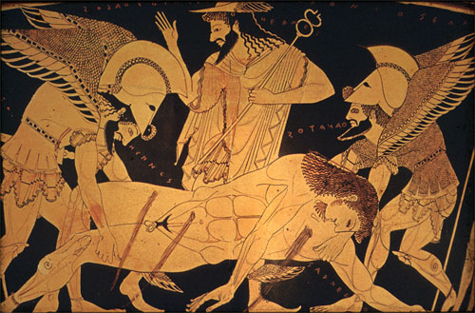
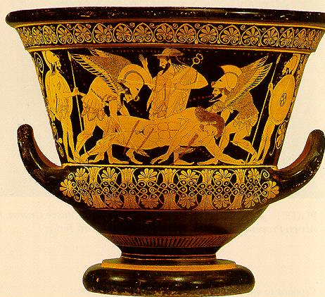
Limitations to his power (Fates)
Notes:
Image- Book 16: on the power of Fate and the death of Sarpedon (son of Zeus)
Sarpedon particpaes in trojan war, the fates tells Zeus he will die, Zues does not want this and so says he will save him, his wife Hera tells him to let the fates be bc you will upset, and Sarpedon dies
--Sarpedon is being carred by Death and Sleep bc Zues respects orders of the fates

Slide 40
(Jan 23) The succession of power motif Near East influences
Battles of the gods- the younger (3rd generation0 prevails (usually the storm god)
Enuma Elish, the Babylonian myth poem of the 2nd mil BC
Apsu (fresh water) + Tiamat (salty)
Anu (sky)- Ea (Earth)
Marduk (a storm and city god)
Kingship in Heaven, the Hittite-hurrian poem of the 14th/13th cen BC
Anu (Sky)
Kumarbi (bites off Anu’s gential and begets
Teshub (storm god)

