Slide 1

Lecture Week 3
The Marketing Environment, Ethics, and Social Responsibility
Copyright © 2013 by Nelson Education Limited

Slide 2
Environmental Scanning and Environmental Management
0
Environmental scanning – Collecting external marketing environment information to identify and interpret potential trends
Environmental management – Attainment of organizational objectives by predicting and influencing the external environments
Strategic alliance – Partnership when companies combine resources to create competitive advantages

Slide 3
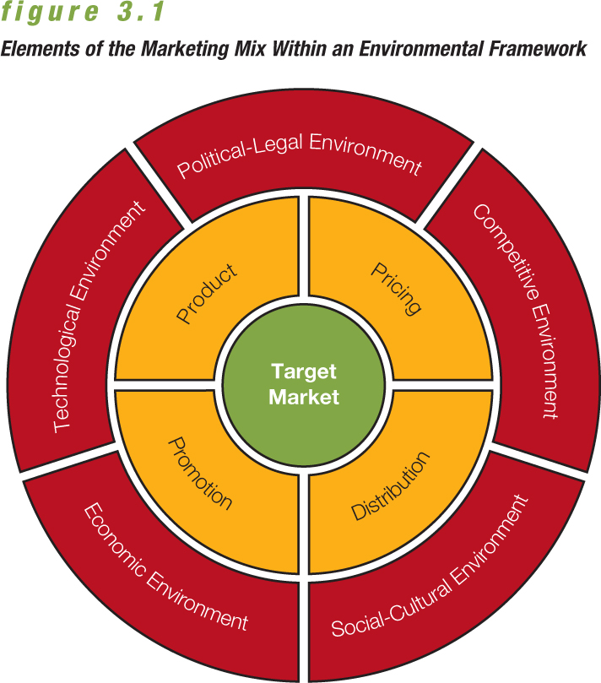
Elements of the Marketing Mix Within an Environmental Framework
0

Slide 4
Competitive Environment
0
Competition
  Monopoly
  Oligopoly
Distinguish between
  Direct competition
  Indirect competition
Time-based competition – Strategy of developing and distributing goods more quickly than competitors

Slide 5
Political-Legal Environment
0
Competition Act – Comprehensive legislation administered by Industry Canada and designed to help both consumers and businesses by promoting a healthy competitive environment
Laws roughly categorized in three marketing areas:
  Pricing
  Promotion
  Distribution

Slide 6
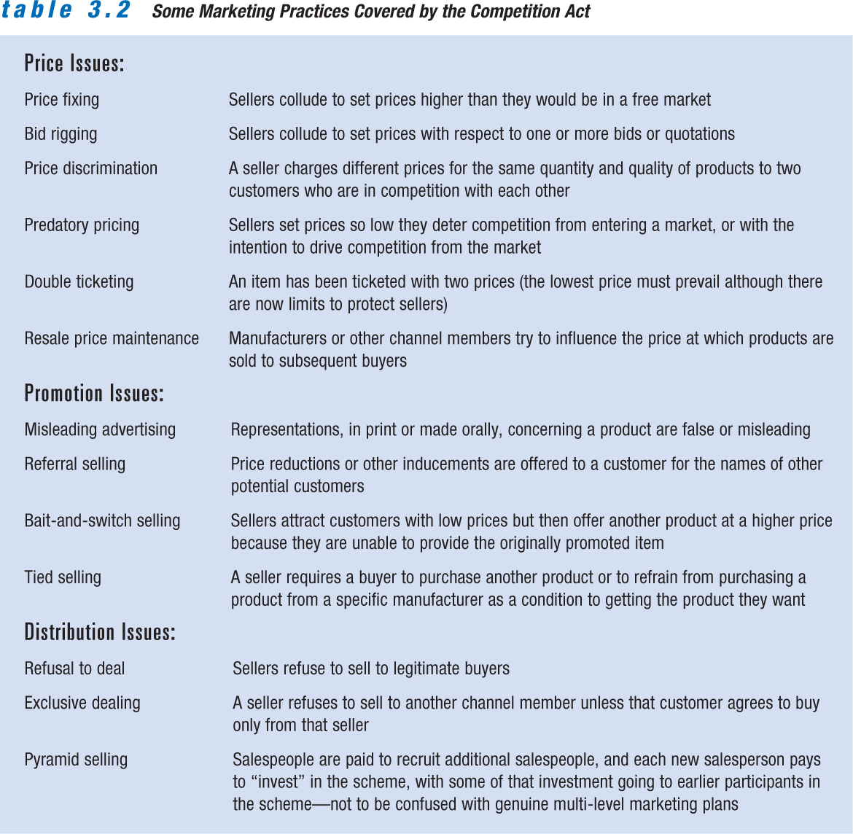
Some Marketing Practices Covered by the Competition Act
0

Slide 7
Government Regulation
0
Provincial laws generally focused on protection of buyers and sellers with respect to direct sales contracts; commonly called Consumer Protection Act or Direct Seller’s Act
Government Regulatory Agencies
Canadian Radio-television and Telecommunications Commission (CRTC)
National Energy Board

Slide 8
Other Regulatory Forces
0
Consumer interest organizations; e.g., People for the Ethical Treatment of Animals
Other groups attempt to advance the rights of minorities, senior citizens, and other causes; e.g., Mothers Against Drunk Driving
Self-regulatory groups set guidelines for responsible business conduct; e.g., Advertising Standards Canada

Slide 9
The Economic Environment
0
Gross domestic product (GDP) – Sum of all goods and services produced by a nation in a year
Economic environment – Factors that influence consumer buying power and marketing strategies
Business cycle – Pattern of stages in the level of economic activity (Prosperity, Recession, Depression, Recovery)

Slide 10
The Economic Environment
0
Terms to know:
  Inflation
  Deflation
  Unemployment
  Discretionary income
  Demarketing

Slide 11
The Technological Environment
0
Application of knowledge based on discoveries in science, inventions, and innovations to marketing
Technology leads to
  New products.
  Improvements in existing products.
  Better customer service.
  Reduced prices.

Slide 12
The Social-Cultural Environment
0
The relationship between the marketer, society, and culture
Marketers must be sensitive to demographic shifts and changing values.
Increasing importance of cultural diversity

Slide 13
Consumerism
0
Consumerism – Social force within the environment that aids and protects the consumer by exerting legal, moral, and economic pressures on business and government
Consumer rights
  The right to choose freely
  The right to be informed
  The right to be heard
  The right to be safe

Slide 14
Ethical Issues in Marketing
0
Marketing ethics – Marketers’ standards of conduct and moral values
Many companies create ethics programs to train employees to act ethically
Employees’ personal values sometimes conflict with employers’ ethical standards

Slide 15
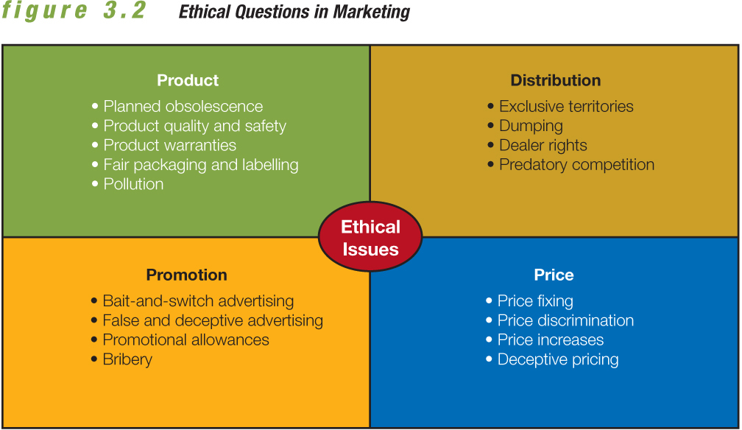
Ethical Issues in Marketing
0

Slide 16
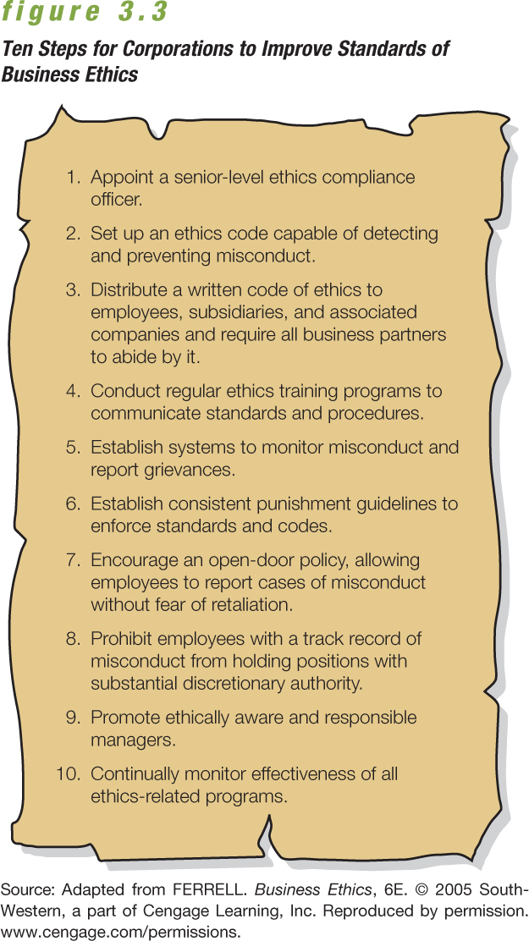
Ethical Issues in Marketing
0

Slide 17
Ethics in Marketing Research
0
Consumers are concerned about privacy.
  Proliferation of databases
  Selling of address lists
  Ease with which consumer information can be gathered
Several agencies offer assistance to Internet consumers.
Canada has a National Do-Not-Call List to help prevent unwanted telemarketing.

Slide 18
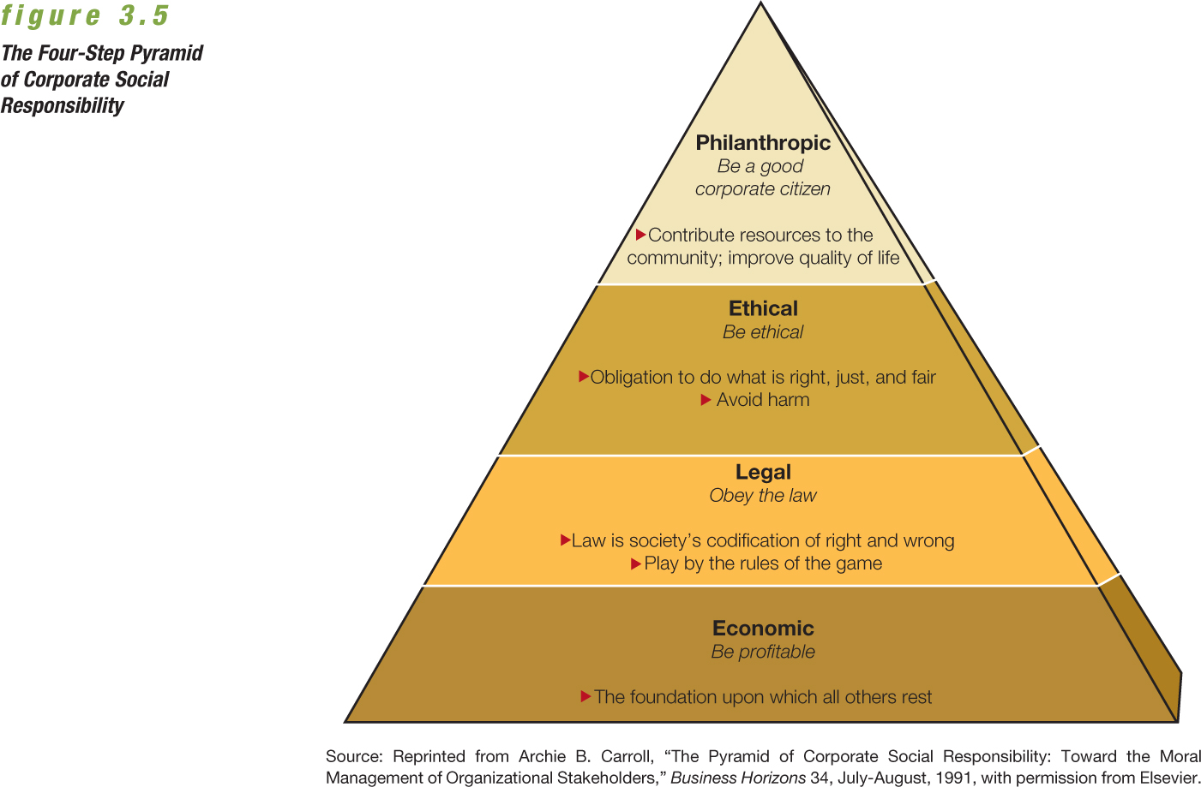
Ethics and Social Responsibility
0

Slide 19
Marketing and Ecology
0
Ecology – Relationship between organisms and their natural environments
Environmental issues influence all areas of marketing decision making.
Green marketing – Production, promotion, and reclamation of environmentally sensitive products

