Slide 1

Lecture Week 2
Strategic Planning in
Contemporary Marketing
Copyright © 2013 by Nelson Education Limited

Slide 2
Marketing Planning: The Basis for Strategy and Tactics
0
Marketing planning – Implementing planning activities devoted to achieving marketing objectives
Strategic Planning
Determines primary objectives
Adopting courses of action to achieve these objectives
Long-term focus
Tactical Planning
Implements activities specified in the strategic plan
Shorter-term focus

Slide 3
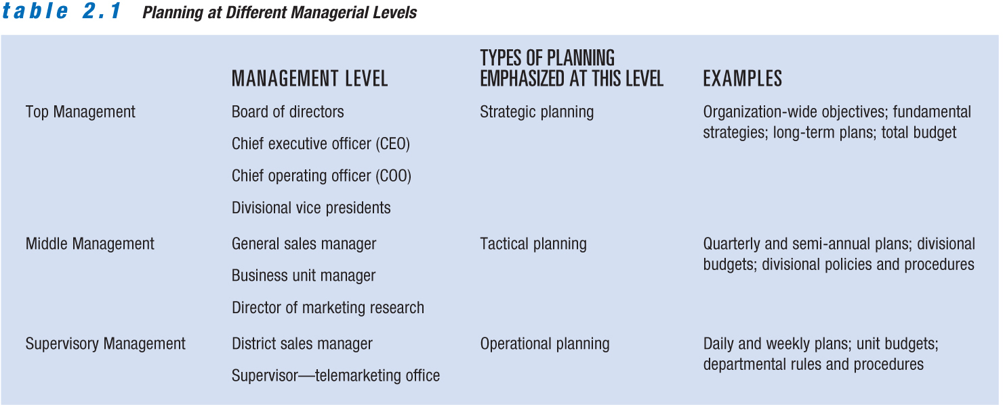
Planning at Different Managerial Levels
0

Slide 4
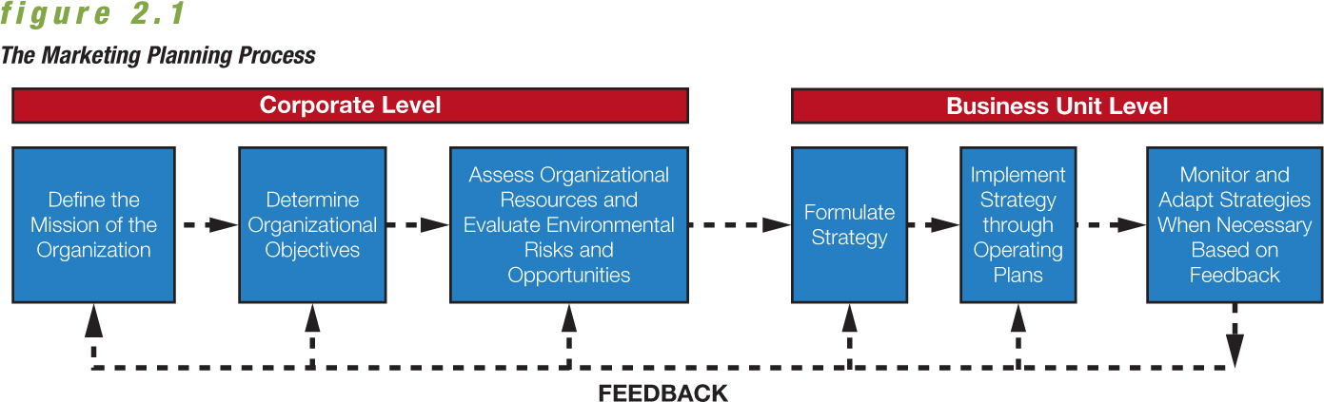
Steps in the Marketing
Planning Process
0

Slide 5
Organization Mission and Objectives
0
  Mission – Essential purpose that differentiates one company from another
    Sephora: “The beauty authority”
    Tim Hortons: “Always Fresh. Always.”
Objectives – Guide the development of marketing objectives and plans
      Add 15 new outlets within the next year.
      Reduce waste by 20 percent.

Slide 6
Assessing Organizational Resources and Evaluating Environmental Risks and Opportunities
Resources
  Production
  Marketing
  Finance
  Technology
  Employees
Strengths help planners:
  set objectives.
  develop plans.
  take advantage of marketing opportunities.
Copyright © 2013 by Nelson Education Limited

Slide 7
Formulating, Implementing, and
Monitoring a Marketing Strategy
0
Marketing strategy – Selecting and satisfying target consumers through the marketing mix elements
The final steps of the planning process:
  Put the marketing strategy into action.
  Monitor performance to ensure that objectives are achieved.

Slide 8
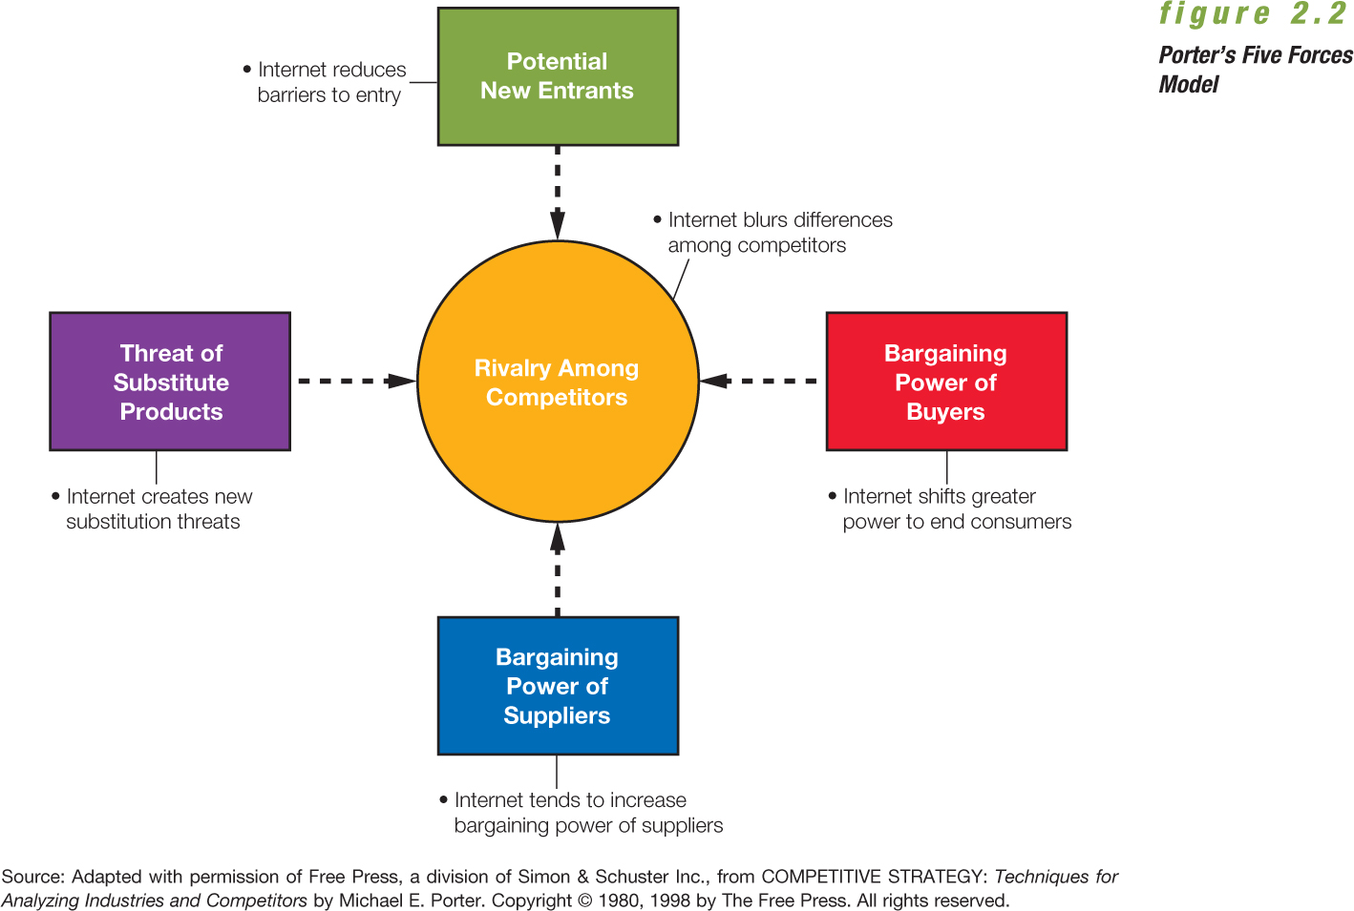
0
Porter’s Five Forces Model

Slide 9
0
First Mover and Second Mover Strategies
First mover strategy – The company first to offer a product in a marketplace will be the long-term market winner.
Second mover strategy – Observing the innovations of first movers and then improving on them to gain advantage in the marketplace

Slide 10
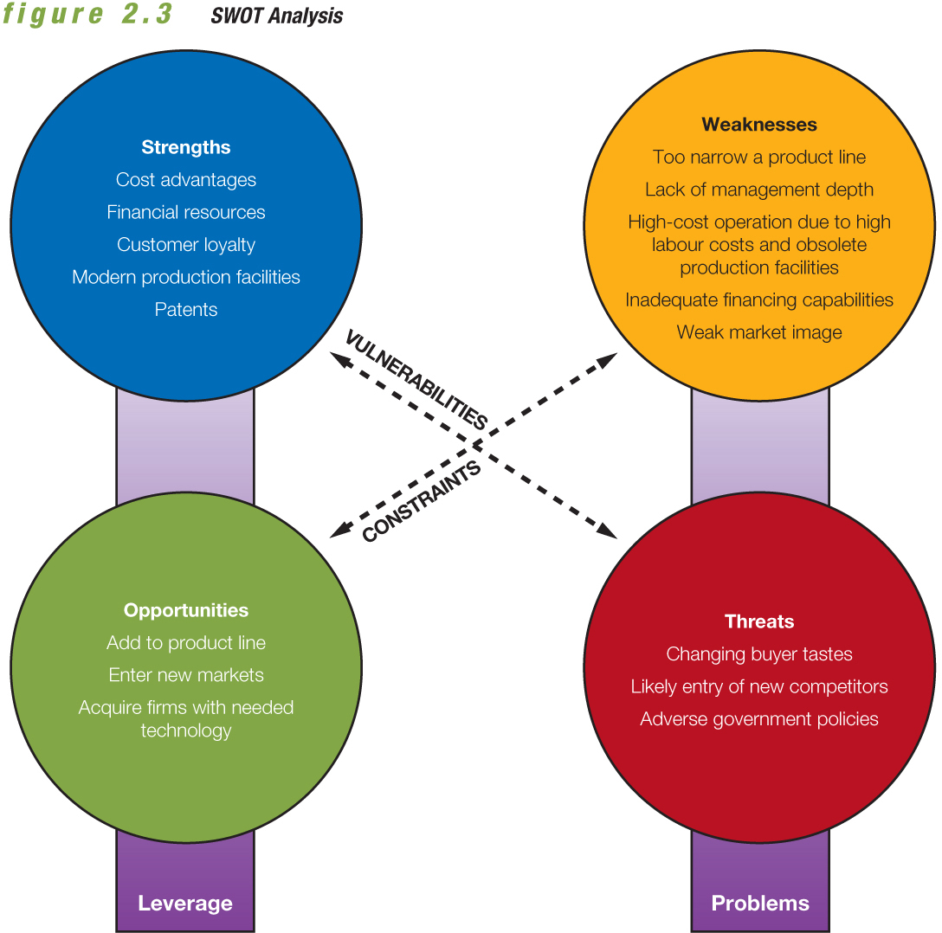
SWOT Analysis
0

Slide 11
The Strategic Window
0
Limited periods when key requirements of a market and a firm’s particular competencies best fit together
Requires a thorough analysis of
  Current and projected external environmental conditions
  Current and projected internal company capabilities
  How, whether, and when the firm can reconcile environmental conditions and company capabilities

Slide 12
Elements of a Marketing Strategy
0
Target market – Group of people toward whom the firm directs its marketing efforts and merchandise
Marketing mix variables – Blending of four strategy elements:
  Product
  Distribution
  Promotion
  Pricing

Slide 13
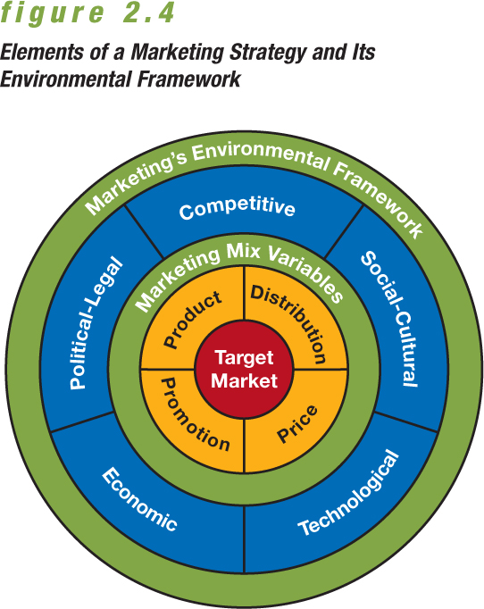
Elements of a Marketing Strategy
0

Slide 14
The Marketing Environment
0
Five external dimensions that affect the marketing mix variables:
  Competitive
  Political-legal
  Economic
  Technological
  Social-cultural

Slide 15
Methods for Marketing Planning:
Business Portfolio Analysis
0
Strategic business units – Key business units within diversified firms
  Each has its own managers, resources, objectives, and competitors.
  Each pursues its own distinct mission and develops its own marketing plans.

Slide 16
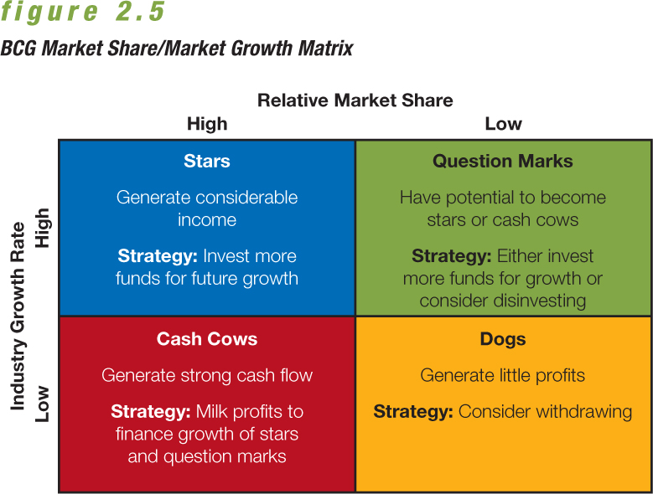
BCG Market Share/Market Growth Matrix
0

Slide 17
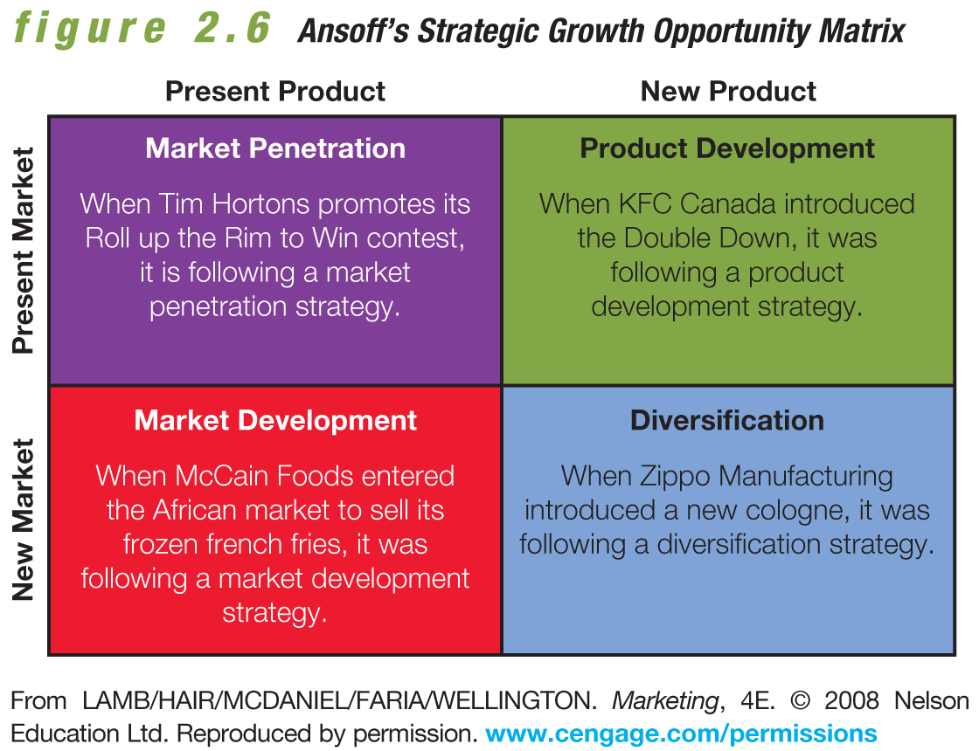
Strategic Growth Opportunity Matrix
0

Slide 18

Appendix B: Relationship Marketing and Customer Relationship Management (CRM)
Notes:
Marketing revolves around relationships with customers and with all the business processes involved in satisfying them. One of the most influential trends in marketing today is the shift from transaction-based marketing (which focuses on short-term or one-time exchanges) to customer-focused relationship marketing (which focuses on long-term arrangements that build solid loyalty).
Relationship marketing has become one of the watchwords in the 21st century because just identifying and attracting new customers isn’t enough to thrive in today’s marketplace. To survive, mutually beneficial relationships need to be built. And retaining customers costs much less than acquiring new ones. Relationship marketing emphasizes cooperation rather than conflict between all the parties involved. This appendix talks about this ongoing collaborative exchange, which creates value for both parties and builds customer loyalty.
The appendix then explains how customer relationship management goes a step further—integrating the customer’s needs into all aspects of the firm’s operations and its relationships with suppliers, distributors, and strategic partners. It combines people, processes, and technology with the long-term goal of maximizing customer value through mutually satisfying interactions and transactions.
The appendix then examines the reasons organizations are moving toward relationship marketing and customer relationship management, explores the impact this move has on producers of goods and services and their customers, and looks at ways to evaluate customer relationship programs.

Slide 19
Transaction-Based Marketing
Buyer and seller exchanges characterized by limited communications and little or no ongoing relationship between the parties
  Focuses on short-term, one-time exchanges
Notes:
Characteristics of transaction-based marketing:
Buyer-seller exchanges are sporadic.
Communication is limited.
Relationships are rare or nonexistent.
The goal is simple and quick—buy something, now.
Conflicts between buyer and seller often disrupt the exchange.
Some marketing exchanges still remain largely transaction-based (such as real estate sales and automobile purchases).

Slide 20
Relationship Marketing
Development, growth, and maintenance of long-term, cost-effective relationships with individual customers, suppliers, employees, and other partners for mutual benefit
Notes:
Relationship marketing: Focuses on developing and maintaining long-term, cost-effective relationships with individual customers, suppliers, employees, and other partners for mutual benefit
It benefits the bottom line because it costs less to retain current customers than find new ones.
It is based on promises—of low prices, high quality, prompt delivery, and superior service.
A network of promises determines whether a relationship will grow.
Characteristics of relationship marketing:
Customers are treated as equal partners in buyer-seller transactions, motivated to make repeat purchases or buy multiple brands from the firm.
The firm is able to obtain a clearer understanding of customer needs over time.
Improved products or customer service often result, paying off in higher sales and lower marketing costs.
Cooperation is emphasized rather than conflict.

Slide 21
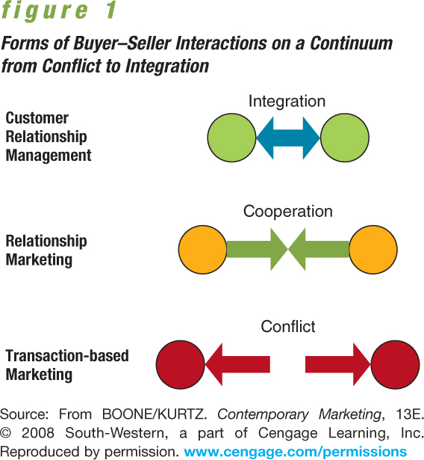
0
Transaction-Based Marketing
Notes:
Figure 1 Forms of Buyer-Seller Interactions from Conflict to Integration. Think of a common product, then imagine possible communications and relationships related to it within each of these three philosophies.

Slide 22
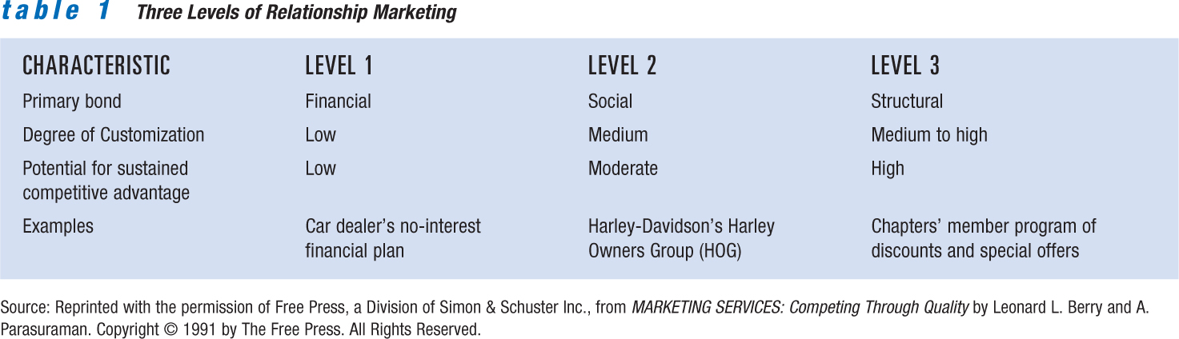
0
The Relationship Marketing Continuum
Notes:
The relationship marketing continuum
As relationships move from lower to higher levels on a continuum, strength of commitment and likelihood of continuation grows also.
First level—focus on price
Interactions are the most superficial and the least likely to lead to a long-term relationship.
Relationship marketing efforts rely on pricing and other financial incentives to motivate customers to enter into buying relationships with a seller.
They’re not customized to the needs of individual buyers and are easily duplicated by competitors.
Second level—social interaction
A social feature is introduced, leading to deeper and less superficial links between buyers and sellers.
Customer service and communication are key factors.
Social interaction can take many forms, from casual chatting to in-store receptions, from personal phone calls to holiday greetings.
Third level—interdependent partnership
Relationships are transformed and their structures change to ensure that buyer and seller are true business partners.
Buyer and seller develop a dependence on one another that continues to grow over time.

Slide 23
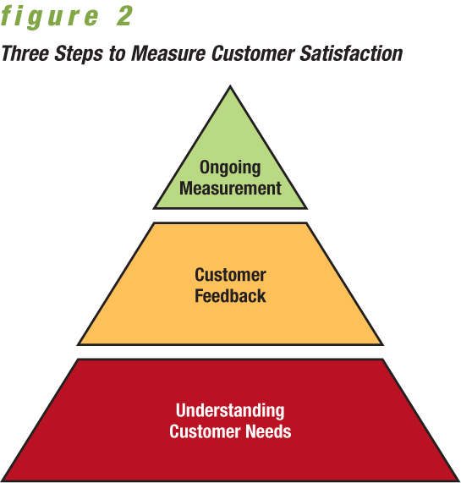
0
Enhancing Customer Satisfaction
Notes:
Enhancing customer satisfaction
Marketers continually monitor customer satisfaction through various methods.
They measure and improve the ways in which they meet customer needs and build relationships.
Three major steps in the process include understanding their needs, getting their feedback, and setting up ongoing programs to ensure customer satisfaction.

Slide 24
How Marketers Keep Customers
Retaining customers is far more profitable than losing them.
It costs five times as much to acquire a new customer as it does to keep a loyal one.
Customer churn, or turnover, is expensive.
Notes:
How marketers keep customers
Retaining customers has a real advantage over finding new ones.
Customer churn, or turnover is an ongoing concern for some industries, (especially banking and telecom industries) and is often expensive.
Customers usually generate more profits for a firm with each additional year in the relationship.

Slide 25
Database Marketing
Use of software to analyze marketing information, identifying and targeting messages toward specific groups of potential customers
Notes:
Database marketing
Database marketing refers to the use of information technology to analyze data about customers and their transactions.
The results lead to new ads or promotions carefully targeted toward certain groups.
It can help build relationships because it allows firms to sort through huge quantities of data and better understand trends in buying habits or preferences.
How database marketing can help companies:
Identifying the most profitable customers
Calculating the lifetime value of each customer’s business
Creating a meaningful dialogue that builds relationships and genuine brand loyalty
Improving customer retention and referral rates
Reducing marketing and promotion costs
Boosting sales volume per customer or targeted customer group

Slide 26
Customers as Advocates
Grassroots marketing — Connecting directly with existing and potential customers through nonmainstream channels
Notes:
Customers as Advocates
Grassroots marketing involves connecting directly with existing and potential customers through nonmainstream channels
Strategies are unconventional, nontraditional, extremely flexible, and not “by the book.”
This approach is often characterized by small budgets and lots of legwork, but the payoff is long-time customers.

Slide 27
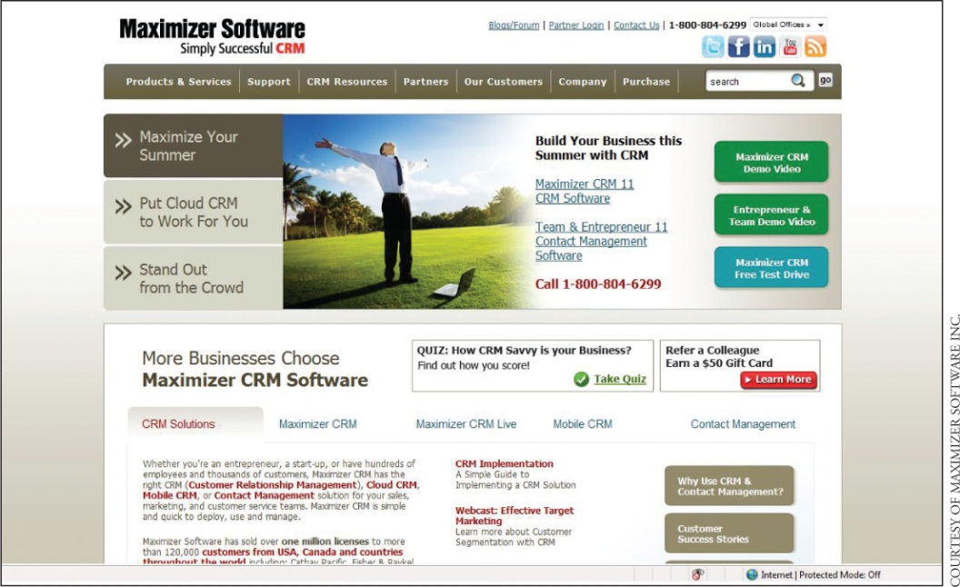
0
Customer Relationship Management
Combination of strategies and tools that drives relationship programs, reorienting the entire organization to a concentrated focus on satisfying customers
Maximizer Software: simplifying CRM systems.
Notes:
Customer relationship management
Emerging from relationship marketing is a more advanced version, customer relationship management (CRM)—the combination of strategies and technologies that empower relationship programs and reorient an entire firm toward customer satisfaction
Its evolution has been made possible by technological advances, particularly computer software systems.
CRM represents a shift in thinking for everyone involved with a firm from the CEO on down, including the firm’s suppliers, dealers, and other partners.
It requires a top commitment on all levels and must permeate every aspect of a firm.
These systems simplify complex business processes while keeping the best interests of customers at heart.
Selecting the type of software system is critical
The software may be used on three levels—individual, server-based, and Internet-based.
A firm can buy a customized system (costs millions and takes months to implement, but offers a better fit and allows for expansion).
It can also rent hosted applications through websites (is relatively cheap and easy to set up, though more limited) .

Slide 28
Retrieving Lost Customers
Customers leave for a variety of reasons:
Boredom with product
Move to a new location
No longer need the product
Prefers a competing product
Notes:
Retrieving lost customers
Customers quit buying a firm’s goods for a number of reasons.
They may find the product boring or unnecessary, or they may try and ultimately prefer a competing item.

Slide 29
0
Buyer-Seller Relationships in
Business-to-Business Marketing
Advantages of buyer-seller relationship can include lower prices, quicker delivery, improved quality and reliability, and others
Notes:
Buyer-seller relationships in business-to-business marketing
Business-to-business marketing
Business-to-business marketing involves a firm’s purchase of goods and services to support operations or production of other products.
Buyer-seller relationships can benefit both parties:
Lower prices for supplies
Quicker delivery of inventory
Improved quality and reliability
Customized product features
More favourable financing terms

Slide 30
Partnership
Affiliation of two or more companies that help each other achieve common goals
  Protect or improve position in existing markets
  Gain access to new domestic or international markets
  Quickly enter new markets
Notes:
Partnerships
Partnerships refer to the affiliation of two or more companies that help each other achieve common goals.
Partnerships form the basis of relationship marketing.
A variety of common goals motivate firms to form partnerships:
To protect or improve positions in existing markets
To gain access to new domestic or international markets
To quickly enter new markets
To expand product lines
To share resources or reduce costs
To ward off threats of future competition
To raise or create barriers to entry
To learn new skills

Slide 31
0
Improving Buyer-Seller Relationships in Business-to-Business Markets
Partnering can lead to enhanced revenues and increased profits.
Notes:
Improving buyer-seller relationships in business-to-business markets
Firms that know how to nurture partner relationships can increase profits.
Partnering often leads to lower prices, better products, and improved distribution, resulting in higher customer satisfaction.
Today, geographic location is of little concern since businesses are establishing relationships using system technology that allows communication anywhere, anytime.
Other ways that buyers and sellers cooperate in business-to-business marketing are through national accounts, databases, EDIs and web services, vendor-managed inventory, supply chains, and alliances.

Slide 32
Business-to-Business Databases
Just as indispensable as in consumer marketing
Notes:
Business-to-business databases
Business-to-business databases are essential in building relationships.
Using information generated from sales reports and scanners, sellers can create databases that guide their own efforts and those of buyers to resell products to final users.

Slide 33
0
Evaluating Customer
Relationship Programs
Lifetime value of a customer — Revenues and intangible benefits that a customer brings to the seller over an average lifetime, less the amount the company must spend to acquire, market to, and service the customer
Notes:
Evaluating customer relationship programs
Lifetime value of a customer refers to the revenues and intangible benefits that a customer brings a seller over an average lifetime, minus the amount the company must spend to acquire and serve the customer.
It is one of the most important measures of relationship marketing programs.
Long-term customers are usually more valuable assets than new ones because they buy more, cost less to serve, refer other customers, and give important feedback.
The “average lifetime” of a customer relationship depends on industry and product characteristics.
It can be calculated by multiplying what an “average” customer spends on each purchase, times number of annual purchases, then subtract its expenses related to that purchase.
Another approach is to calculate the payback from a customer relationship, meaning the length of time it takes to break even on customer acquisition costs.
Other techniques used to evaluate relationship programs include:
Tracking rebate requests, coupon redemptions, credit-card purchases, and product registrations
Monitoring complaints and returned merchandise
Reviewing reply cards, comment forms, and surveys
Monitoring “click-through” behaviour on websites to identify why customers stay and why they leave

