Slide 1
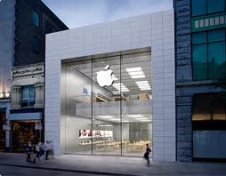
What is Marketing
Lecture Week 1
Marketing: The Art and Science
of Satisfying Customers
Notes:
.

Slide 2


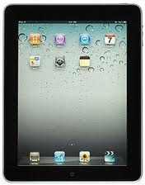
22003.0U Introduction to Marketing
Classroom
No Food – beverages OK
Laptops/Tablets/Cell phones
Class start time 8:30AM
Class end time: 11:30AM

Slide 3
2200 Introduction to Marketing
Course Orientation
Introduction:
  Richard Patterson
  richpat@yorku.ca
  Office: 416.484.6577
  On campus office hours: By appointment

Slide 4
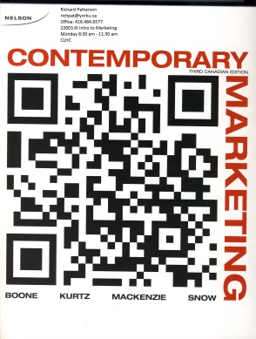
2200 Introduction to Marketing
Course Orientation
Registration – you must be registered in this section to attend this class
Text book:
Please note: Used textbooks will NOT provide the access code for CourseMate a critical technology support for the Video Case Analysis work.
Contemporary Marketing – Third Canadian Edition – Boone Kurtz MacKenzie Snow

Slide 5
2200 Introduction to Marketing
Course Orientation
Course support materials:
Moodle: https://moodle.yorku.ca/
Website 2200 this section U
- Course schedule and Course Policy Guide
Calendar - print-out for time-line management
Text book power-point slides are available on the Moodle course web site.
Video Case –End of Chapter Video Case Question Assignment s–available – on Moodle course section web site

Slide 6
2200 Introduction to Marketing
Course Orientation
Video Case –End of Chapter Video Case Assignment
CourseMate – instructions on the inside of the text book.
You need to register with the below course key and the access code provided in the insert in the front of the text book. www.nelsonbrain.com
        Course Key: CM-CM-9780176647827-0000024

Slide 7
2200 Introduction to Marketing
Course Orientation
Class agenda:
  Administration Updates as required
  Lecture
  Break
  Video Case class discussion
  Group meetings as required/scheduled
  Group Marketing Plan presentations – as per course calendar.

Slide 8
2200 Introduction to Marketing
Course Orientation
Group Marketing Plan
  Two parts:
    1. Environmental and Competitive Analysis:
    All groups meet on a one-on-one with teaching professor immediately following class on:
    January 28th 2014 – random order.
    Part A February 4th 2014 before start of class time.
    2. Final Marketing Plan:
    Due March 25th 2014 before start of class time.

Slide 9
2200 Introduction to Marketing
Course Orientation
Grade Breakdown:
Midterm Exam 30%
Marketing Plan 40%
Group Marketing Plan Presentation 10%
Final Exam 20%
Exams
  Midterm – closed book
  Final – closed book

Slide 10
2200 Introduction to Marketing
Course Orientation
Peer Evaluation
Important to final individual marketing plan grade.
Ensure you read the detailed outline on the course policy guide section of the course web site.
Peer Evaluation Form

Slide 11
2200 Introduction to Marketing
Course Mate – Marketer’s Minutes interview
KEY reading assignment.
Planning a Career in Marketing
Stefan danis, CEO and Chief Talent Officer Mandrake Executive Search
It’s WORTH THE READ

Slide 12
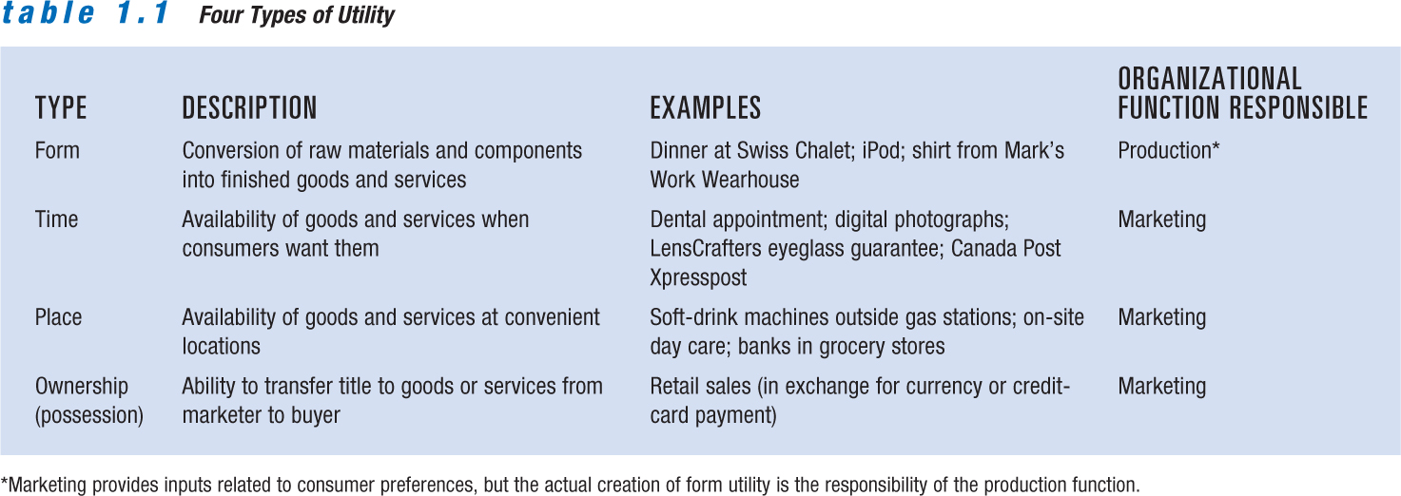
What Is Marketing?
0

Slide 13
What Is Marketing?
0
Organizations must create utility and customers to survive.
Activities marketers perform to create customers:
  Identifying customer needs
  Designing products to meet those needs
  Communicating information

Slide 14
A Definition of Marketing
0
Marketing – An organizational function and a set of processes for:
  Creating, communicating, and delivering value to customers
  Managing customer relationships in ways that benefit the organization and its stakeholders

Slide 15
Today’s Global Marketplace
0
Factors that have extended economic views
  Increase in international trade agreements
  Growth of electronic business
  Interdependence of the world’s economies
Companies seek the most efficient manufacturing sites and most lucrative markets worldwide.
Companies are tailoring their marketing efforts to the needs and preferences of local markets.

Slide 16
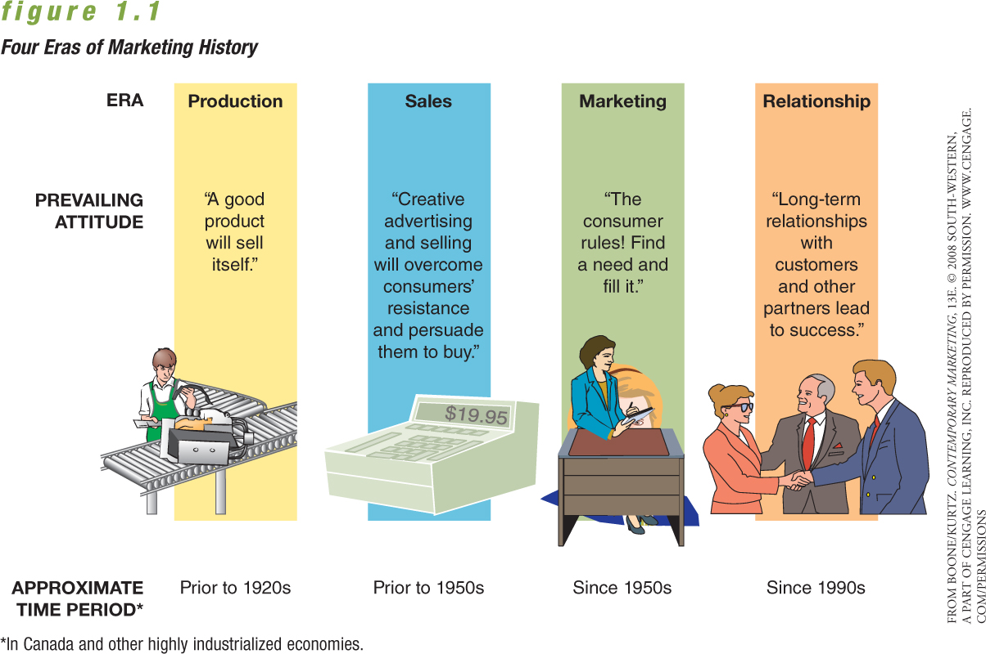
Four Eras in the History of Marketing
0

Slide 17
The Production Era and the Sales Era
0
Production orientation – Stressing efficiency in producing a quality product, with the attitude toward marketing that “a good product will sell itself”; production shortages
Sales orientation – Customers will resist purchasing nonessential items; personal selling and advertising important

Slide 18
The Marketing Era and the
Relationship Era
0
Shift to a buyer’s market creates need for consumer orientation
Emergence of marketing concept – A companywide consumer orientation to achieve long-run success
Relationship marketing – Developing long-term, value-added relationships over time with customers and suppliers; strategic alliances and partnerships

Slide 19
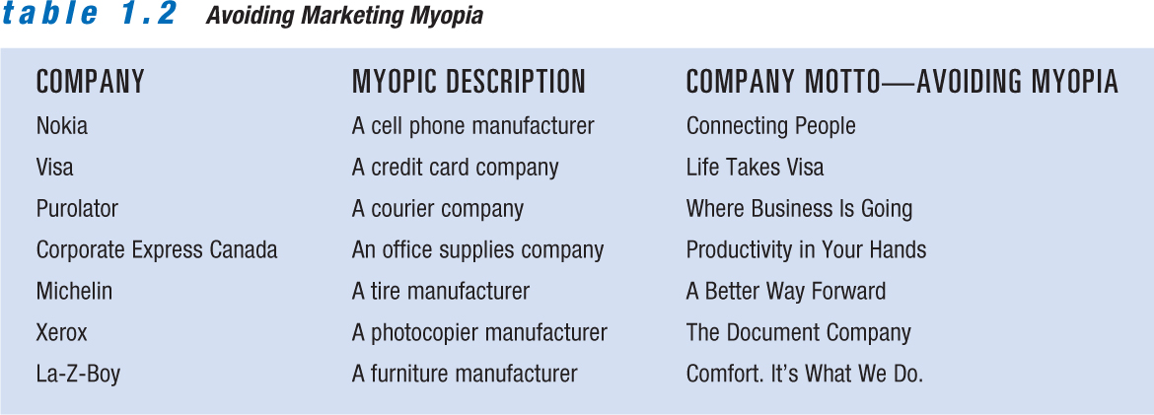
Avoiding Marketing Myopia
0

Slide 20
Marketing in Not-for-Profit Organizations
0
Adopt marketing strategies to meet service objectives
Market to multiple audiences
Form alliances with for-profit firms
Focus is to generate revenue to support cause and not on bottom line
Service users have less control over the firm’s future

Slide 21
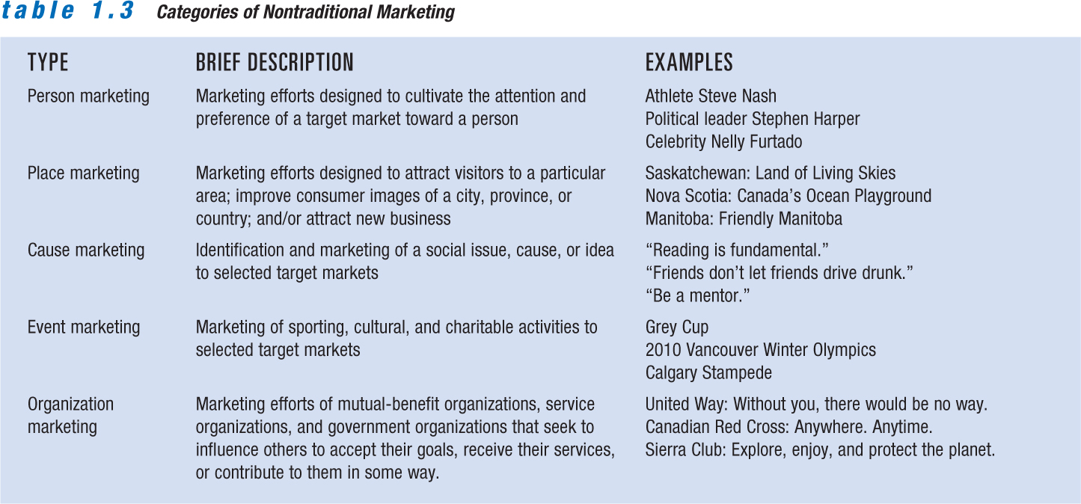
Nontraditional Marketing
0

Slide 22
From Transaction-based Marketing to Relationship Marketing
0
Transaction-based marketing – Buyer and seller exchanges characterized by limited communications and little or no ongoing relationships between the parties
Relationship marketing – Gives a company new opportunities to gain a competitive edge by moving customers up a loyalty ladder

Slide 23
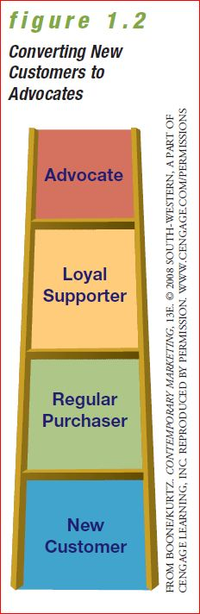
From Transaction-based Marketing to Relationship Marketing
0

Slide 24
Interactive and Social Marketing / Partnerships and Alliances
0
Interactive / social marketing
  Mobile marketing
  Interactive marketing
  Social marketing
  Buzz marketing
Relationship marketing extends to suppliers, distributors, and customers for strategic advantage:
  Strategic alliances

Slide 25
Using Interactive and Social Marketing to Build Relationships
0
Social marketing – The use of online social media as a communications channel for marketing messages
Buzz marketing – Word-of-mouth messages that bridge the gap between a company and its products

Slide 26
Developing Partnerships and
Strategic Alliances
0
Relationship marketing extends to business-to-business relationships with suppliers, distributors, and other partners.
Strategic alliances – Provide firms competitive advantage
Forms of alliances:
  Product development partnerships
  Vertical alliances

Slide 27
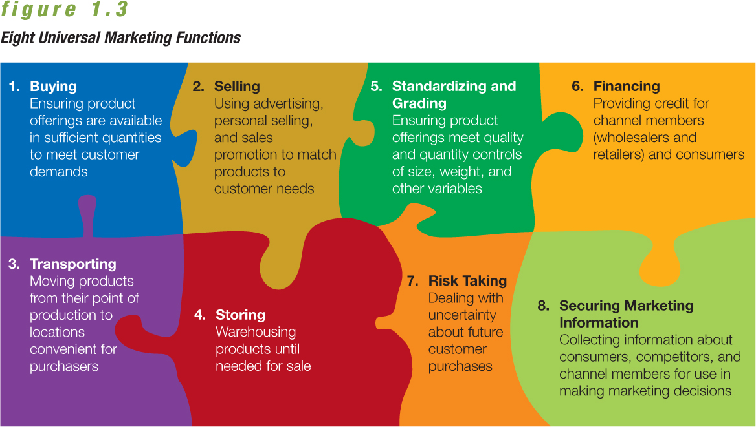
Costs and Functions of Marketing
0

Slide 28
Ethics and Social Responsibility:
Doing Well by Doing Good
0
Ethics – Moral standards of behaviour expected in a society
Social responsibility – Marketing philosophies, policies, procedures, and actions whose primary objective is to enhance society
Sustainable products – Products that can be produced, used, and disposed of with minimal impact on the environment

