Slide 1
5.1 Energy Changes in Chemical and Nuclear Reactions

Slide 2
Thermochemistry
The study of energy changes that accompany the modifications of matter.
Thermochemistry is governed by three laws of thermodynamics.
  First - The Law of Conservation of Energy – the universe has a constant finite amount of energy
  Second – The Law of Enthalpy - High energy flows to lower energy state.
  Third – The Law of Entropy – Systems tend toward disorder. At absolute zero a substance has no energy

Slide 3
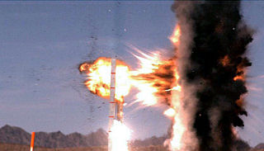
Energy is the ability to do work and uses the SI unit of joules (J)
Work is the amount of energy transferred by a force over a distance and uses the SI unit of joules (J)

Slide 4
Energy: Kinetic or Potential?
Potential Energy arises from the position (physics) or composition (chemistry) of an object
Kinetic energy is the energy of motion
http://www.solpass.org/5s/images/roller.gif

Slide 5
Heat and Energy Changes
Thermal energy (E) is the total quantitiy of kinetic and potential energy in the particles of the substance.
  Unit of measure - Joules
Heat (q or Q) is the transfer of thermal energy between substances.
  Unit of measure - Joules
Temperature (T) the measure of the average kinetic energy of the particles in a substance.
  Unit of measure – K (Kelvin) or ºC (degrees Celsius)

Slide 6
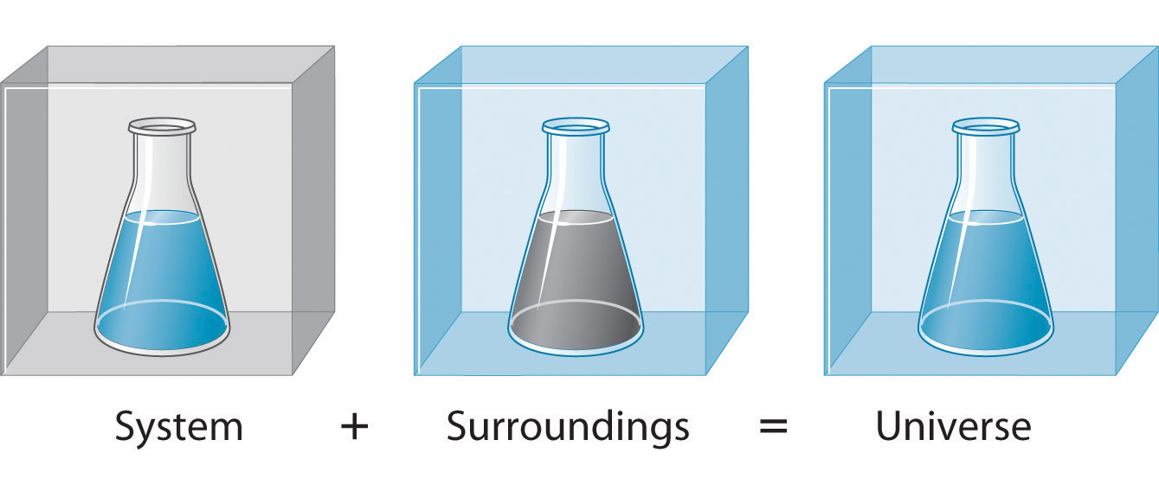
Chemical Systems
Chemical system is the reactants and products being studied
The surroundings is the matter which is not part of the system

Slide 7

Example
BBQ… assume complete combustion ☺
Chemical system: propane, oxygen, carbon dioxide and water
Surroundings: bbq and food

Slide 8
Measuring Energy Changes
The measuring of energy requires one to account for the quantity and motion of energy.
  Open system – a system in which both matter and energy can move in or out.
  Closed system – a system in which energy can move in or out, but matter can not.
  Isolated system – a system in which neither energy of matter can move in or out. … not actually possible ☺

Slide 9
Exothermic & Endothermic Reactions
Exothermic – the surrounding absorb energy from the chemical system.
  (Chemical reaction “gives off energy”.)
  The products have less energy than the reactants.
Endothermic – the chemical system absorbs energy from the surroundings.
  The products have more energy than the reactants.
Isothermic – the energy of the reactants is equal to the products

Slide 10
Exothermic & Endothermic Reactions
Exothermic – the surroundings absorb energy from the chemical system.
  Chemical reaction “gives off energy”.
  The change is thermal energy (Heat, q) is negative for the chemical system.
Energy transfer
Chemical System
Surroundings

Slide 11
Exothermic & Endothermic Reactions
Endothermic – the chemical system absorbs energy from the surroundings.
  Chemical reaction “needs energy” to occur.
  The change is thermal energy (Heat, q) is positive for the chemical system.
Energy transfer
Chemical System
Surroundings

Slide 12
Heat and Energy Changes
Physical, Chemical and Nuclear changes usually result in a change in energy
Physical change - Melting of water (change of state) requires the addition of energy.
  Energy to overcome intermolecular forces.
  Form may change but the molecules remain unchanged.
  Same molecules - different state (form)
  Energy range →1-10² kJ
Notes:
Physical change – a change in a substance’s state → the molecules remain unchanged.
Chemical change – a change in the substance → new molecules are formed.
Nuclear change – a change in an atom’s nucleus →new isotopes are usually formed.

Slide 13
Heat and Energy Changes
Chemical change – The burning of hydrocarbons produces energy.
  Energy associated with the exchange or sharing of valence electrons. Formation or breaking of chemical bonds (intramolecular forces).
  New substances (molecules) with new chemical bonds are created.
  Same atoms – different molecules (bonds)
  Energy Range →10² - 10⁴ kJ

Slide 14
Heat and Energy Changes
Nuclear change – The fission of U-235 produces much energy.
  The energy associated with the alterations to a nucleus. Fission or fusion of nuclei.
  New atoms (isotopes) are formed with different quantities of nucleons (protons, neutrons)
  Different atoms
  Energy Range →10¹⁰ - 10¹² kJ
Notes:
Pg 304 table
Four fundamental forces of nature:
Gravity (weakest)
Electromagnetic – responsible for chemical bonding & intermolecular forces.
Weak nuclear – radiation of particles from nucleus (alpha (⁴ ₂He²+), beta (⁰₀e¹⁻) & gamma radiation)
Strong nuclear – holds the nucleus together (protons repel due to electrostatic forces) → it is the strongest force

