Slide 1
4.6 Quantum Mechanics and Bonding Hybridization
We need next to examine the relationship between:
isolated atoms (with valence e’s in s,p, and d orbitals
of specific shapes, see next slide as review!)
bonded atoms in molecules or ions, in which
bonded regions exhibit significantly different
shapes as described by VSEPR theory

Slide 2
Orbital shapes, Individual (“isolated”) Atoms
Compare (next slide) to molecule, ion bonding shapes

Slide 4
To rationalize how the shapes of atomic orbitals
are transformed into the orbitals occupied in
covalently bonded species, we need the help of
two bonding theories:
Valence Bond (VB) Theory, the theory we will explore,
describes the placement of electrons into bonding
orbitals located around the individual atoms from
which they originated.
Molecular Orbital (MO) Theory places all electrons from
atoms involved into molecular orbitals spread out over
the entire species. This theory works well for excited
species, and molecules like O₂.

Slide 5
COVALENT BOND FORMATION (VB THEORY)
In order for a covalent bond to form between
two atoms, overlap must occur between the orbitals
containing the valence electrons.
The best overlap occurs when two orbitals are allowed
to meet “head on” in a straight line. When this occurs,
the atomic orbitals merge to form a single bonding
orbital and a “single bond” is formed, called a
sigma (σ) bond.

Slide 7
MAXIMIZING BOND FORMATION
In order for “best overlap” to occur, valence electrons
need to be re-oriented and electron clouds reshaped
to allow optimum contact.
To form as many bonds as possible from the available
valence electrons, sometimes separation of electron
pairs must also occur.
We describe the transformation process as “orbital
hybridization” and we focus on the central atom in
the species...

Slide 8
“sp” Hybridization: all 2 Region Species

Slide 9
Hybridization of Be in BeCl₂
Valence e’s
Hybrid sp orbitals:
1 part s, 1 part p
Atomic Be: 1s² 2s²

Slide 10
FORMATION OF BeCl₂:
Each Chlorine atom, 1s²2s²2p⁶3s²3p⁵ , has one
unshared electron in a p orbital. The half filled
p orbital overlaps head-on with a half full hybrid
sp orbital of the beryllium to form a sigma bond.

Slide 12
“sp²” Hybridization: All 3 Region Species

Slide 13
Hybridization of B in BF₃
Hybrid sp² orbitals:
1 part s, 2 parts p
Valence e’s
Atomic B : 1s² 2s² 2p¹

Slide 14
FORMATION OF BF₃:

Slide 16
“sp³” Hybridization: All 4 Region Species

Slide 17
Hybridization of C in CH₄
Valence e’s
Hybrid sp³ orbitals:
1 part s, 3 parts p
Atomic C : 1s² 2s² 2p²

Slide 18
FORMATION OF CH₄:

Slide 20
Unshared Pairs, Double or Triple Bonds
Unshared pairs occupy a hybridized orbital the
same as bonded pairs: See the example of NH₃
that follows.
Double and triple bonds are formed from electrons
left behind and unused in p orbitals. Since all
multiple bonds are formed on top of sigma bonds,
the hybridization of the single (σ) bonds determine
the hybridization and shape of the molecule...

Slide 22
Hybridization of N in NH₃
Valence e’s
Atomic N: 1s² 2s² 2p³

Slide 23
FORMATION OF NH₃:

Slide 25
Double and Triple Bonds
These bonds result from the side to side overlap of p orbitals which results in an electron density above and below the bond axis.

Slide 26
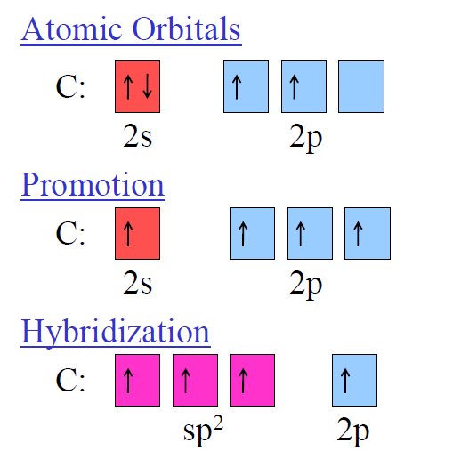
Double bond in Ethene

Slide 27
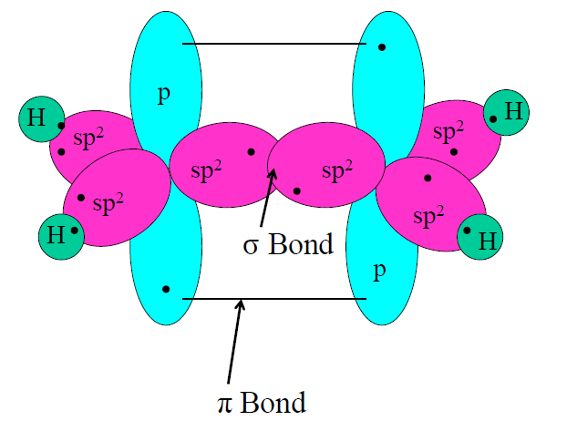

Slide 28
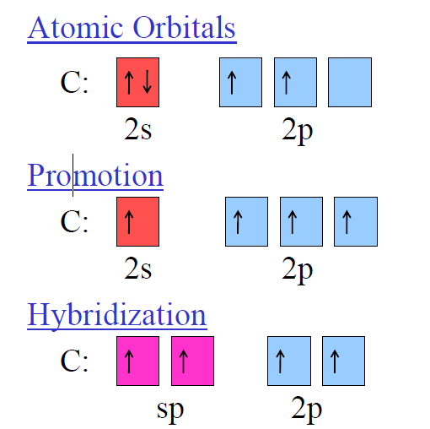
Triple bond in Ethyne

Slide 29
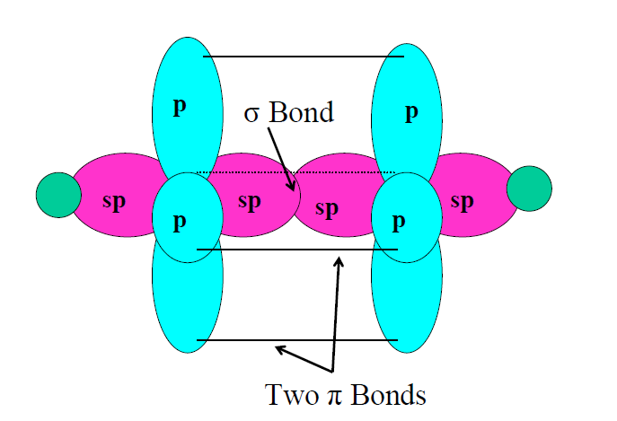

Slide 30
Question
Describe Hybridization of C and shape of following
species:
CO, CO₂, HCN, CH₂O, CO₃²⁻ , CBr₄

Slide 31
“sp³d” Hybridization: All 5 Region Species

Slide 32
Hybridization of P in PF₅
P: 1s² 2s² 2p⁶ 3s² 3p³

Slide 33
FORMATION OF PF₅:

Slide 35
“sp³d²” Hybridization: All 6 Region Species

Slide 36
Hybridization of S in SF₆
S: 1s² 2s² 2p⁶ 3s² 3p⁴

Slide 37
FORMATION OF SF₆:

Slide 39
Question
Describe hybridization of S and shape of species
in SF₂, SO₂, SO₃²⁻ , SF₃⁺, SF₄, SF₅⁻

Slide 40
Summary: Regions, Shapes and Hybridization

