Slide 1
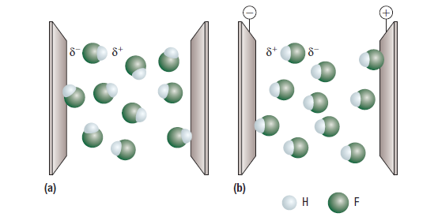
4.3 Electronegativity and Polarity
4.5 Molecular Polarity

Slide 2
Electronegativity and the Polarity of Bonds

Slide 3
Electronegativity: a measure of the tendency of an atom to attract a bonding pair of electrons
The atom that has the greater ability to keep the electrons is said to be more electronegative and is indicated by δ- (Greek lowercase symbol for delta).
The other less electronegative atom is indicated by δ+.
Pauling investigated the different electronegative abilities of elements and assigned most elements an electronegativity value (the Pauling scale).
This value is located under the atomic number on the periodic table in the back of your book.

Slide 4
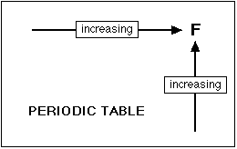
Electronegativity increases from left to right and as you go up a group (family) (Fig. 1).
Fluorine (the most electronegative element) is assigned a value of 4.0, and values range down to cesium and francium, which are the least electronegative at 0.7.
Figure 1. Trends in Electronegativity

Slide 5
What makes a bond polar?

Slide 6
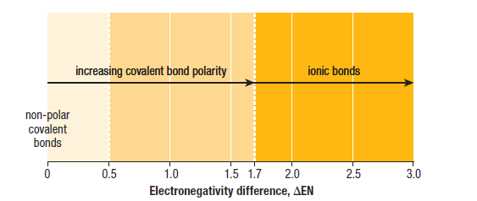
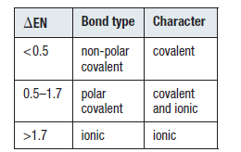
Bonding Continuum

Slide 7
Polar bonds (ionic bonds) have an electronegativity difference that is greater than 1.7.
In polar bonds electrons are not shared equally and as a result one end of the bond to be negative and the other to be positive.

Slide 8
A polar covalent bond has an electronegativity value between 0.5 and 1.7.
Polar covalent bonds share electrons somewhat unequally.
Nonpolar bonds (covalent bonds) have an electronegativity difference between 0 and 0.5.

Slide 9
Polar Molecules

Slide 10
Nonpolar Molecule: a molecule that has either nonpolar bonds or polar bonds whose dipoles cancel to zero
- generally symmetrical molecules

Slide 11
Polar molecule: a molecule that has some polar bonds with dipoles that do not cancel to zero
- generally non-symmetrical molecules
Table 1 on pg. 251- List of polar and nonpolar molecules.

Slide 12
Homework
Pg 221 #1, 3-7, 10
Pg 229 #1-7

