Slide 1

3.5 Atomic Structure and the Periodic Table

Slide 2
Recap
four quantized values that describe an electron in an atom
Quantized means that the values are restricted to certain discrete values
  the values are not on a continuum like distance during a trip
  There are quantum leaps between the values

Slide 3
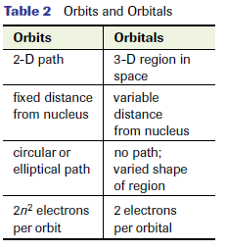
Electron Orbitals
An orbit is like a straight 2D pathway Bohr
orbital defines a region (volume) of space where an electron may be found Modern
Table 2 pg185

Slide 4
The first two quantum numbers (n and l) describe electrons that have different energies under normal circumstances in multi-electron atoms
The last two quantum numbers
(m_{l} ,m_{s}) describe electrons that have different energies only under special conditions,such as the presence of a strong magnetic field
In creating energy level diagrams we will be focusing only on n and l

Slide 5
Shell and Subshell
Shell (n): will keep the Bohr number
  n= 1,2,3…
Subshell (l): we will use a letter symbol

Slide 6
Orbitals and their energies
f
d
p
s

Slide 7
Rules for Energy Level Diagrams
Pauli exclusion principle
  no two electrons in an atom can have the same four quantum numbers; no two electrons in the same atomic orbital can have the same spin; only two electrons with opposite spins can occupy any one orbital

Slide 8
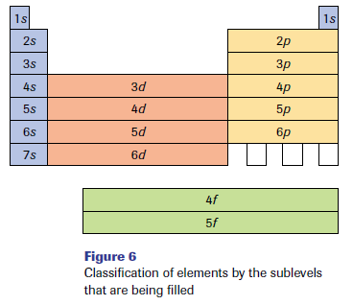
Aufbau principle
  “aufbau” is German for building up; each electron is added to the lowest energy orbital available in an atom or ion

Slide 9
Hund’s rule one electron occupies each of several orbitals at the same energy before a second electron can occupy the same orbital

Slide 10
Draw an energy level diagram for an oxygen atom.

Slide 11
What would a d orbital look like?
What would a f orbital look like?

Slide 12
Creating Energy-Level Diagrams for Anions
same method as for atoms
Except add the extra electrons corresponding to the ion charge to the total number of electrons before proceeding to distribute the electrons into orbitals

Slide 13
Ex. Draw an energy level diagram for N³⁻

Slide 14
Energy Level Diagrams for Cations
draw the energy-level diagram for the corresponding neutral atom first
then remove the number of electrons (corresponding to the ion charge) from the orbitals with the highest principal quantum number, n

Slide 15
The zinc ion, has a two positive charge,
Therefore it has two fewer electrons than the zinc atom.
Remove the two electrons from the orbital with the highest n
the 4s orbital in this example

Slide 16
Draw the energy level diagram for Lithium’s cation.

Slide 17
Electron Configuration
provide the same information as the energy-level diagrams, but in a more concise format
It is a listing of the number and kinds of electrons in order of increasing energy, written in a single line
e.g., Mg: 1s² 2s² 2p⁶ 3s²

Slide 18
Draw electron configurations for the following:
oxygen atom
sulfide ion
iron atom

Slide 19
Write the electron configuration for the tin atom and the tin(II) ion.

Slide 20
Identify the element whose atoms have the following electron configuration:
a) 1s² 2s² 2p⁶ 3s² 3p⁶ 4s² 3d¹⁰4p⁶ 5s² 4d¹⁰ 5p⁶ 6s² 5d¹⁰ 4f¹⁴ 6p⁴
b) 1s² 2s² 2p⁶ 3s² 3p⁶ 4s² 3d¹⁰4p⁵

Slide 21
Shorthand Form of Electron Configurations
There is an internationally accepted shortcut for writing electron configurations
Core electrons of an atom are expressed by using a symbol to represent all of the electrons of the preceding noble gas
the remaining electrons beyond the noble gas are shown in the electron configuration

Slide 22
Previously we did the configuration for tin, now put it in shorthand configuration.
Sn:1s² 2s² 2p⁶ 3s² 3p⁶ 4s² 3d¹⁰4p⁶6 5s² 4d¹⁰ 5p²

Slide 23
Explaining the Periodic Table
s, p, d, and f orbitals corresponds exactly to the number of columns of elements in the s, p, d, and f blocks in the periodic table
noble gas family,Group 18, is a group of gases that are generally nonreactive
  They all have an outer shell with the configuration of ns²np⁶

Slide 24
outer shell or valence electron configurations also apply to most families, in particular, the representative elements (Groups 1-2, 13-18)
transition elements are 10 across because they are formed by electrons filling the d energy sublevel
The lanthanide and actinide series are 14 across as a result of the f orbital being filled with electrons

Slide 25
Explaining Ion Charges
In previous grades you were given no reason as to why elements had certain charges or why the transition metals and the heavier representative elements had multiple charges
Ex. Zn:
[Ar] 4s² 3d¹⁰
another atom would likely take the electrons out of the 4s orbital leaving the 3d filled
Having a full or half full orbital leaves an element relatively stable

Slide 26
Can you try to explain why lead forms 2+ and 4+ ions?
Pb: [Xe] 6s² 4f ¹⁴ 5d¹⁰ 6p²

Slide 27
Explaining Magnetism
Ferromagnetic (strongly magnetic) elements
based on the properties of a collection of atoms, rather than just one atom
Have some unpaired electrons which form “domains” which cause atoms to orient themselves in the same direction leading them to their magnetic potential

Slide 29
Anomalous Electron Configurations
Expected Cr: [Ar] 4s² 3d⁴
Actual Cr: [Ar] 4s¹ 3d⁵
Expected Cu: [Ar] 4s² 3d⁹
Actual Cu: [Ar] 4s¹ 3d¹⁰

Slide 30
evidence suggests that half-filled and filled subshells are more stable (lower energy) than unfilled subshells
appears to be more important for d orbitals compared to s orbitals
Expected Cu: [Ar] 4s² 3d⁹
Actual Cu: [Ar] 4s¹ 3d¹⁰
An s electron is promoted to the d subshell to create a half-filled s subshell and a filled dsubshell

Slide 31
WORK
Try questions pg 166 #1-4
Pg. 170 #1-2
Pg. 172 # 2-10

